Slide 1
PHYS 3313 – Section 001
Lecture #9
Wednesday, Feb. 12, 2014
Dr. Jaehoon Yu
Determination of Electron Charge
Line Spectra
Blackbody Radiation

Slide 2
Announcements
Reminder: Homework #2
  CH3 end of the chapter problems: 2, 19, 27, 36, 41, 47 and 57
  Due Wednesday, Feb. 19
Quiz #2 Wednesday, Feb. 19
  Beginning of the class
  Covers CH1.1 – what we finish Monday, Feb. 17
  BYOF: You may bring a one 8.5x11.5 sheet (front and back) of handwritten formulae and values of constants for the exam
  No derivations or solutions of any problems allowed!
  No additional formulae or values of constants will be provided!
Colloquium today➔ Dr. C. B. Jackson of UTA

Slide 3
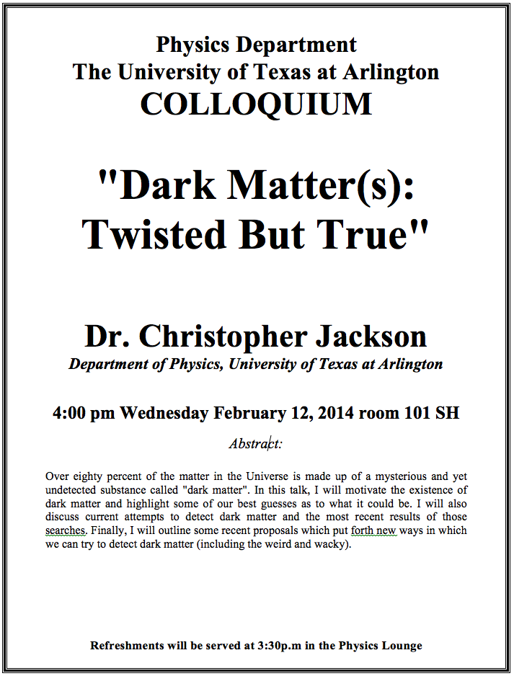

Slide 4
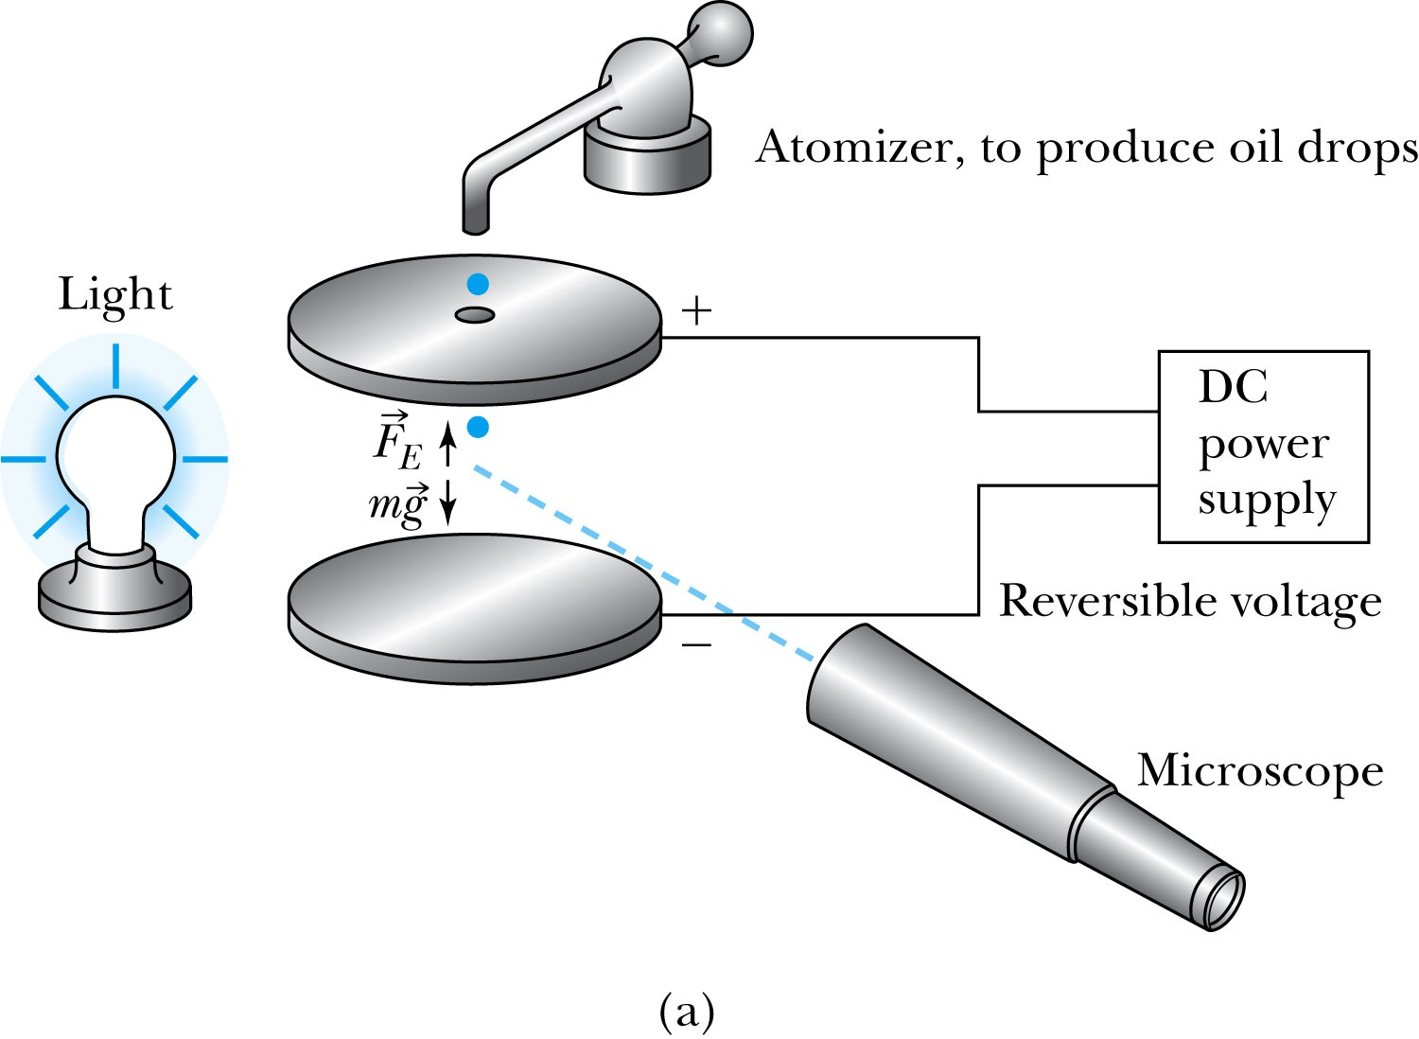
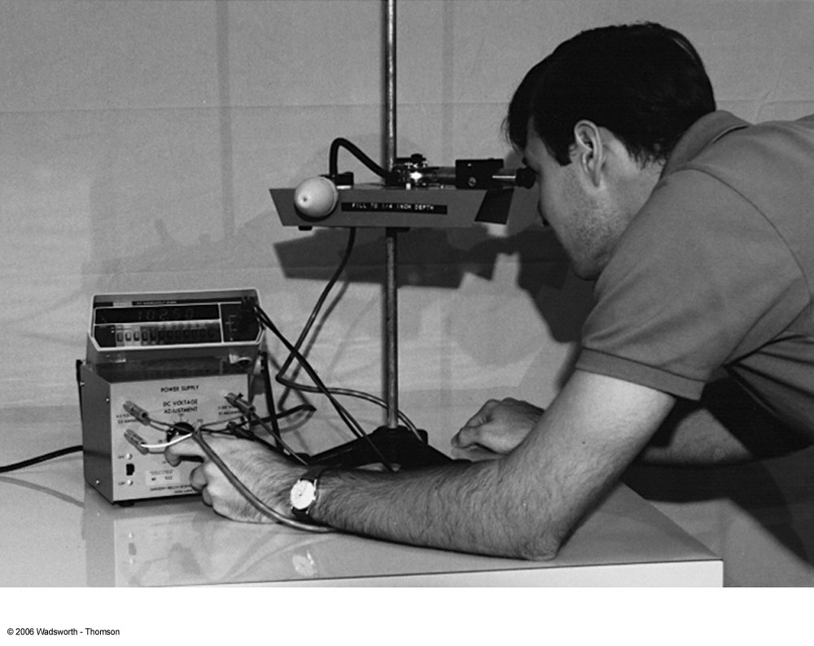
Determination of Electron Charge
Millikan (and Fletcher) in 1909 measured charge of electron and showed that the free electric charge is in multiples of the basic charge of an electron

Slide 5
Calculation of the oil drop charge
Used an electric field and gravity to suspend a charged oil drop
So the magnitude of the charge on the oil drop
Mass is determined from Stokes’ relationship of the terminal velocity to the radius and density
Thousands of experiments showed that there is a basic quantized electron charge

Slide 6
Line Spectra
Chemical elements produce unique wavelengths of light when burned or excited in an electrical discharge.
Collimated light is passed through a diffraction grating with thousands of ruling lines per centimeter.
  The diffracted light is separated at an angle θ according to its wavelength λ by the equation:
where d is the distance between rulings and n is an integer called the order number (n=1 strongest)
Diffraction maxima

Slide 7
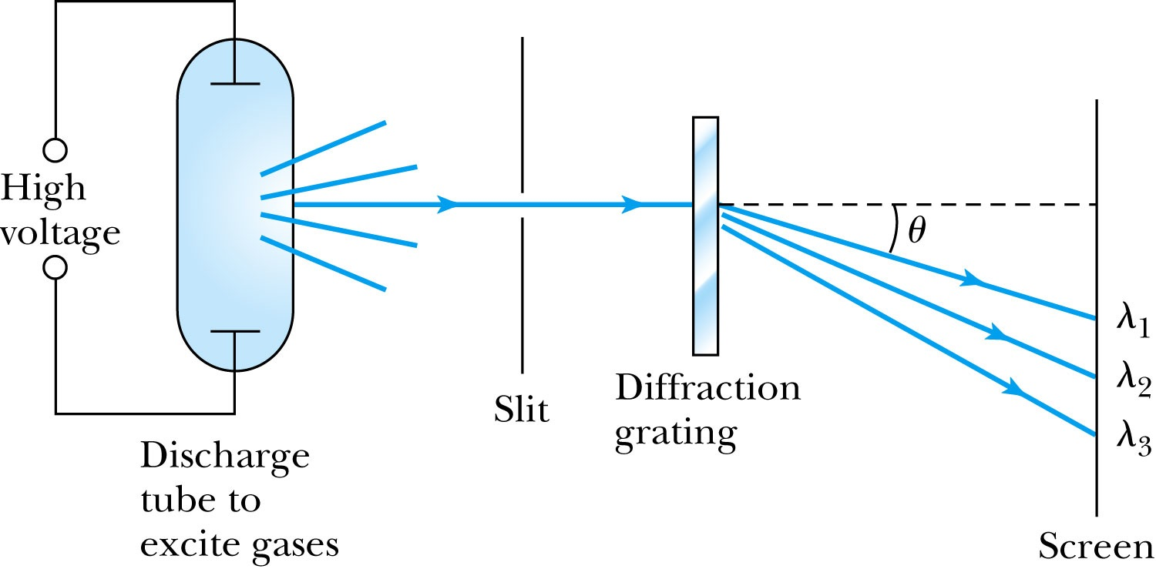
Optical Spectrometer
Diffraction creates a line spectrum pattern of light bands and dark areas on the screen.
Chemical elements and the composition of materials can be identified through the wavelengths of these line spectra

Slide 8
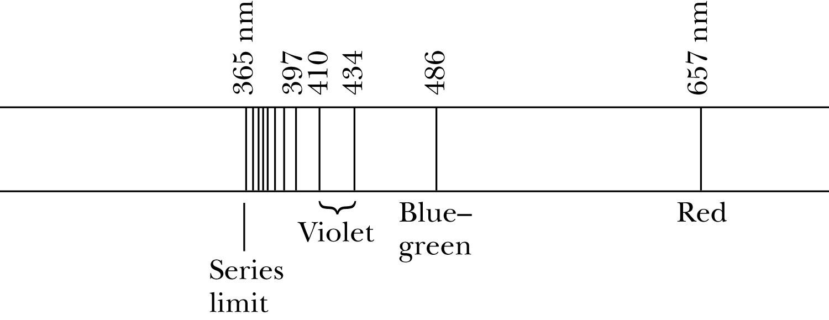
Balmer Series
In 1885, Johann Balmer found an empirical formula for wavelength of the visible hydrogen line spectra in nm:
(where k = 3,4,5… and k > 2)

Slide 9
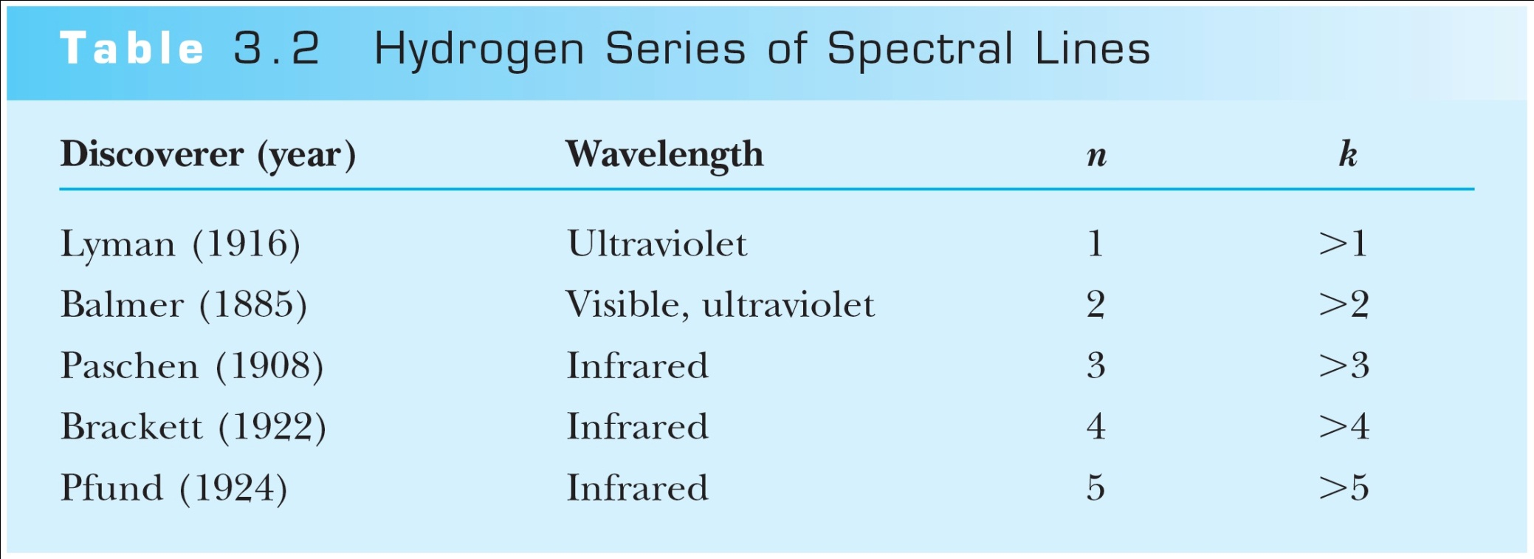
Rydberg Equation
Several more series of hydrogen emission lines at infrared and ultraviolet wavelengths were discovered, the Balmer series equation was extended to the Rydberg equation:
(n = 2, n>K)

Slide 10
Quantization
Current theories predict that charges are quantized in units (quarks) of ±e/3 and ±2e/3, but quarks are not directly observed experimentally.
The charges of particles that have been directly observed are always quantized in units of ±e.
The measured atomic weights are not continuous—they have only discrete values, which are close to integral multiples of a unit mass.

Slide 11
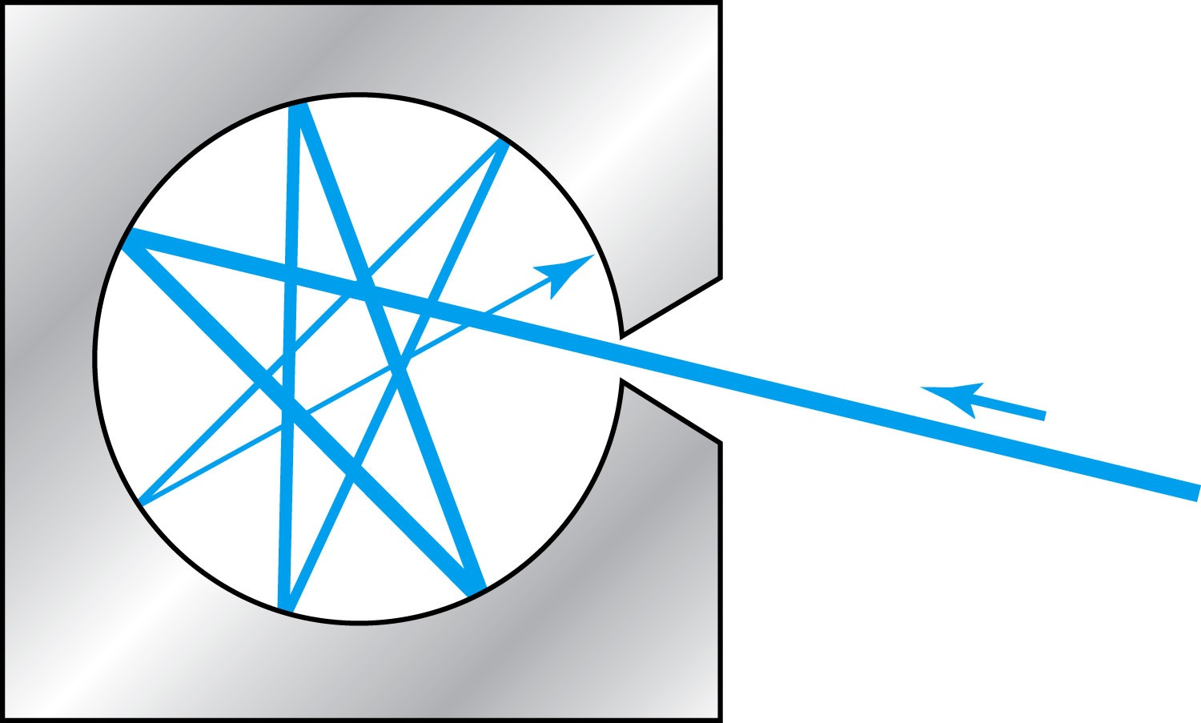
Blackbody Radiation
When matter is heated, it emits radiation.
A blackbody is an ideal object that has 100% absorption and 100% emission without a loss of energy
A cavity in a material that only emits thermal radiation can be considered as a black-body. Incoming radiation is fully absorbed in the cavity.
Blackbody radiation is theoretically interesting because
  Radiation properties are independent of the particular material.
  Properties of intensity versus wavelength at fixed temperatures can be studied

Slide 12
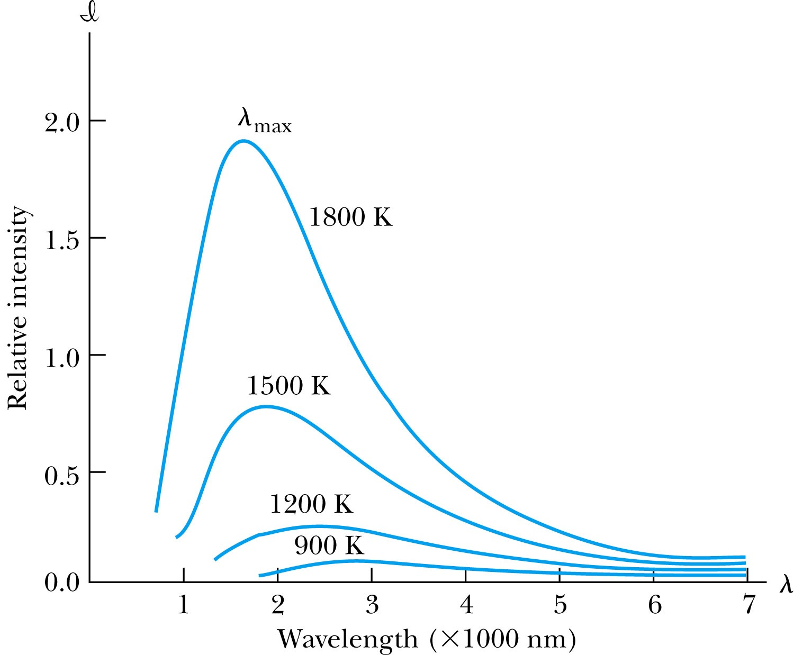
Wien’s Displacement Law
The intensity l(λ, T) is the total power radiated per unit area per unit wavelength at the given temperature.
Wien’s displacement law: The peak of l(λ, T) distribution shifts to smaller wavelengths as the temperature increases.
(where λ_{max} = wavelength of the peak)

Slide 13
Stefan-Boltzmann Law
The total power radiated increases with the temperature:
This is known as the Stefan-Boltzmann law, with the constant σ experimentally measured to be σ =5.6705×10⁻⁸ W / (m² · K⁴).
The emissivity ε (ε = 1 for an idealized blackbody) is the ratio of the emissive power of an object to that of an ideal blackbody and is always less than 1.

Slide 14
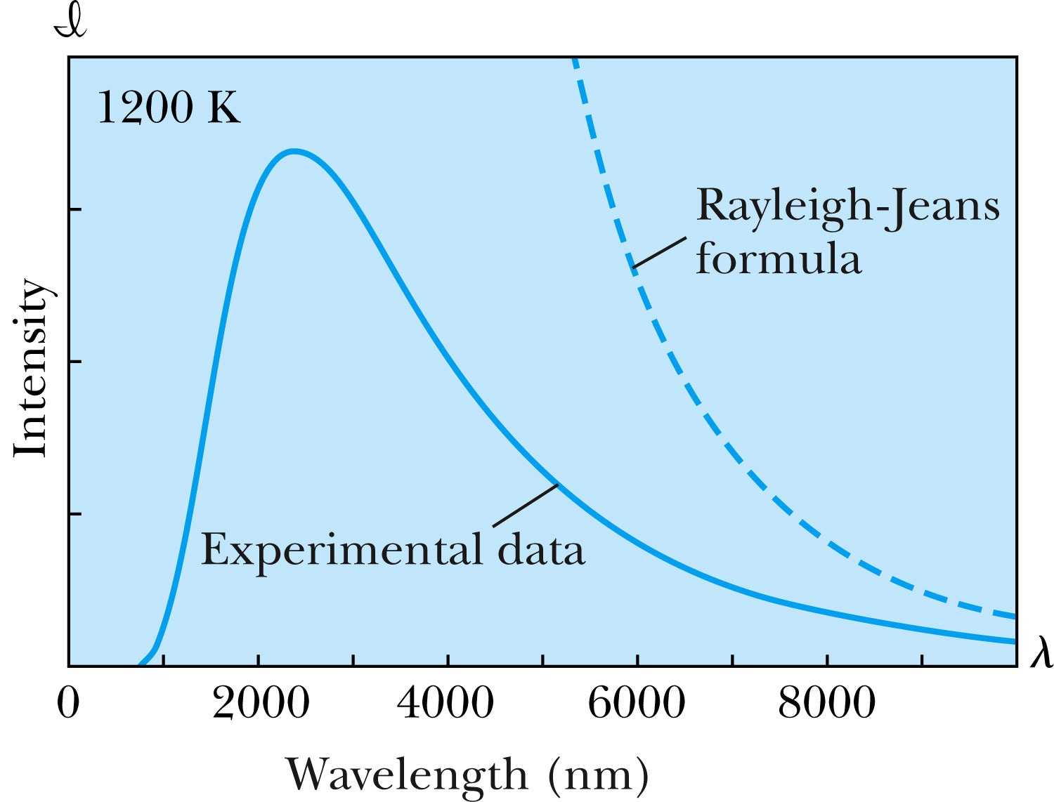
Rayleigh-Jeans Formula
Lord Rayleigh used the classical theories of electromagnetism and thermodynamics to show that the blackbody spectral distribution should be
Worked reasonably well at longer wavelengths but..
it deviates badly at short wavelengths.
➔ “the ultraviolet catastrophe” a serious issue that couldn’t be explained

Slide 15
Planck’s Radiation Law
Planck assumed that the radiation in the cavity was emitted (and absorbed) by some sort of “oscillators” that were contained in the walls. He used Boltzman’s statistical methods to arrive at the following formula that fit the blackbody radiation data.
Planck made two modifications to classical theory:
    The oscillators (of electromagnetic origin) can only have certain discrete energies determined by E_{n} = nhf, where n is an integer, f is the frequency, and h is called Planck’s constant. h = 6.6261 × 10⁻³⁴ J·s.
    The oscillators can absorb or emit energy ONLY in discrete multiples of the fundamental quantum of energy given by
Planck’s radiation law

