Slide 1
PHYS 3313 – Section 001 Lecture #10
Monday, Feb. 17, 2014
Dr. Jaehoon Yu
Photoelectric Effect
Compton Effect
Pair production/Pair annihilation

Slide 2
Announcements
Reminder: Homework #2
CH3 end of the chapter problems: 2, 19, 27, 36, 41, 47 and 57
Due this Wednesday, Feb. 19
Reminder: Quiz #2 Wednesday, Feb. 19
Beginning of the class
Covers CH1.1 – what we finish Monday, Feb. 17
BYOF: You may bring a one 8.5x11.5 sheet (front and back) of handwritten formulae and values of constants for the exam
No derivations or solutions of any problems allowed!
No additional formulae or values of constants will be provided!
Colloquium this Wednesday: Dr.

Slide 3
Special Project #3
A total of N_{i} incident projectile particle of atomic number Z₁ kinetic energy KE scatter on a target of thickness t and atomic number Z₂ and has n atoms per volume. What is the total number of scattered projectile particles at an angle θ? (20 points)
Please be sure to clearly define all the variables used in your derivation! Points will be deducted for missing variable definitions.
This derivation must be done on your own. Please do not copy the book, internet or your friends’.
Due is Wednesday, Feb.26 .

Slide 4
Photoelectric Effect
Definition: Incident electromagnetic radiation shining on a metal transfers energy to the electrons, allowing them to escape the surface of the metal. Ejected electrons are called photoelectrons.
Other methods of electron emission:
Thermionic emission: Application of heat allows electrons to gain enough energy to escape.
Secondary emission: The electron gains enough energy by transfer from another high-speed particle that strikes the material from outside.
Field emission: A strong external electric field pulls the electron out of the material. (an example?)

Slide 5
Classical Interpretation of Photoelectric Effect
Classical theory allows EM radiation to eject photoelectrons from matter
Classical theory predicts the energy of the photoelectrons increase in proportion to the radiation intensity
Thus, KE of the photoelectrons must be proportional to the intensity of light not the current
Time for an experiment!

Slide 6
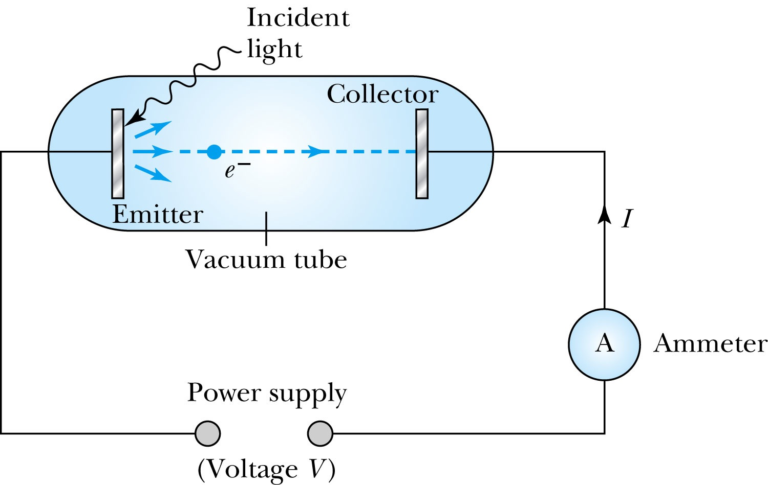
Photoelectric Effect Experimental Setup
Hmm.. Something does not make sense!!
Anode
Photocathode
V increased reverse direction to stop I

Slide 7
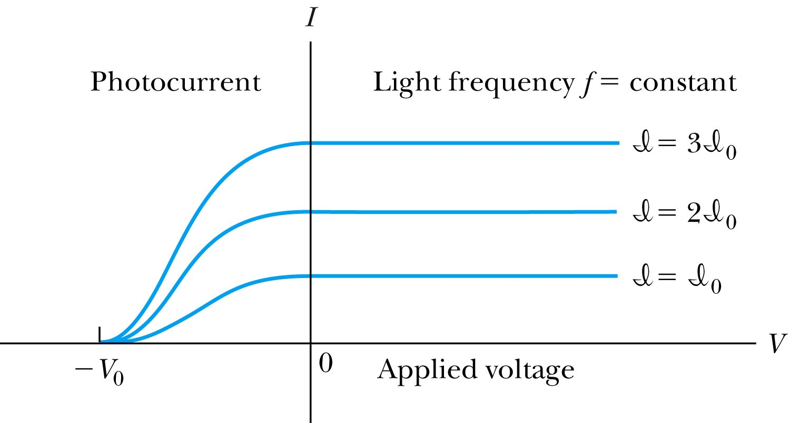
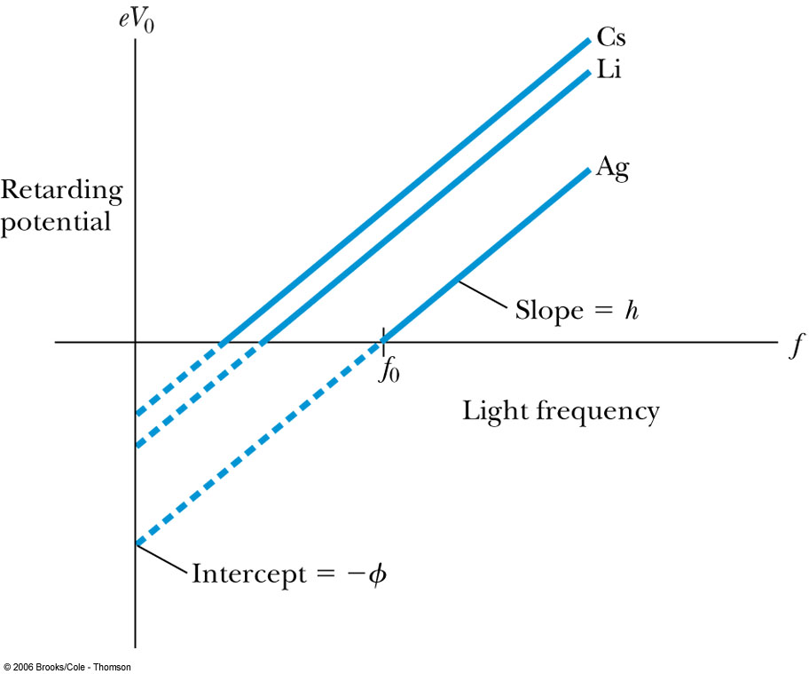
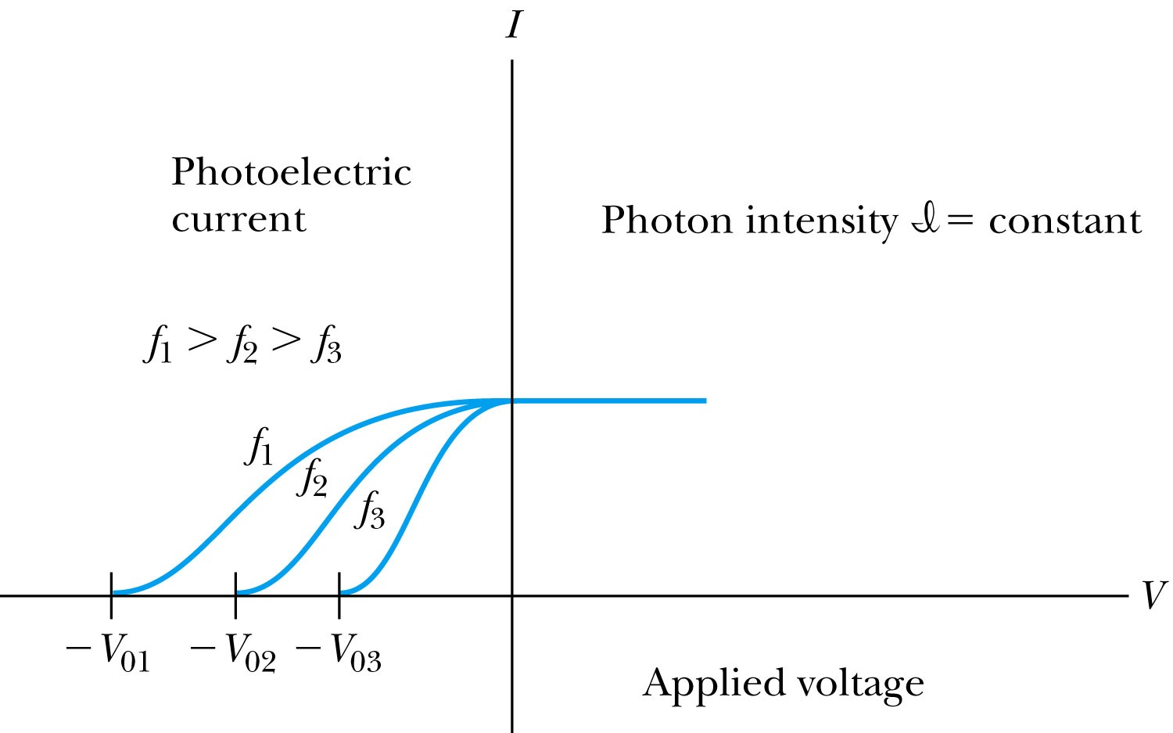
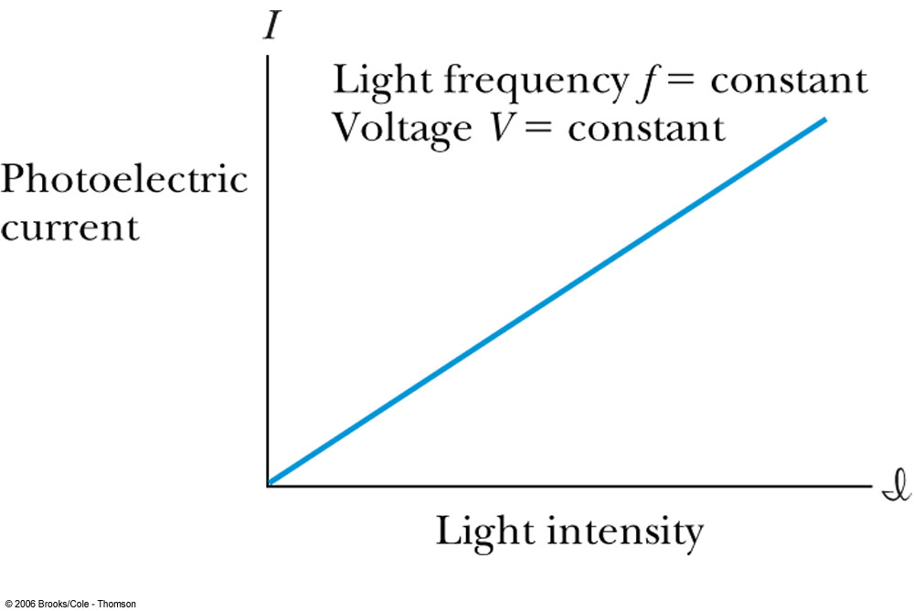
Experimental Observations
KE proportional to frequency!!
The same V₀ but higher current
The same current!!
Number of photoelectrons proportional to light intensity!!

Slide 8
Summary of Experimental Observations
Light intensity does not affect the KE of the photoelectrons
The max KE of the photoelectrons for a given emitter material depends only on the frequency of the light
The smaller the work function φ of the emitter material, the smaller is the threshold frequency of the light that can eject photoelectrons.
When the photoelectrons are produced, their number is proportional to the intensity of light.
The photoelectrons are emitted almost instantly following illumination of the photocathode, independent of the intensity of the light. ➔ Totally unexplained by classical physics

Slide 9
Einstein’s Theory of Photoelectric Effect
Einstein suggested that the electromagnetic radiation field is quantized into particles called photons. Each photon has the energy quantum:
where f is the frequency of the light and h is Planck’s constant.
The photon travels at the speed of light in a vacuum, and its wavelength is given by

Slide 10
Einstein’s Theory
Conservation of energy yields:
where φ is the work function of the metal
The photon energy can then be written
The retarding potentials measured the KE of the most energetic photoelectrons.

Slide 11
Quantum Interpretation
KE of the electron depends only on the light frequency and the work function φ of the material not the light intensity at all
Einstein in 1905 predicted that the stopping potential was linearly proportional to the light frequency, with a slope h, the same constant found by Planck.
From this, Einstein concluded that light is a particle with energy:
Was he already thinking about particle/wave duality?

Slide 12
Ex 3.11: Photoelectric Effect
Light of wavelength 400nm is incident upon lithium (φ=2.93eV). Calculate (a) the photon energy (eV) and (b) the stopping potential V₀.
Since the wavelength is known, we use plank’s formula:
The stopping potential can be obtained using Einstein’s formula for photoelectron energy

Slide 13
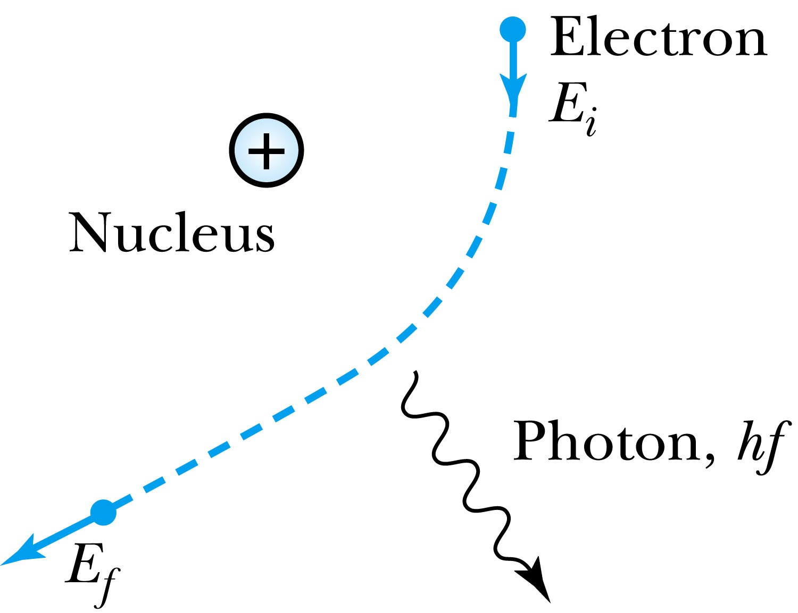
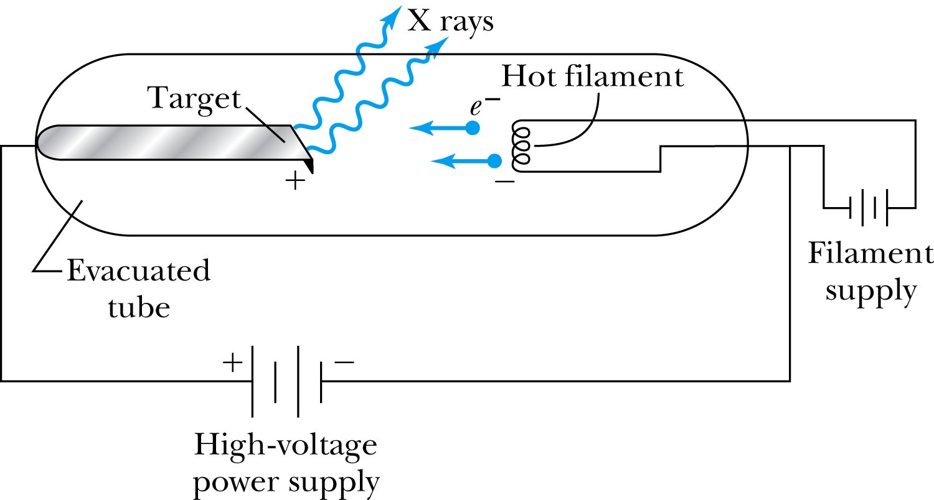
X-Ray Production
Bremsstrahlung (German word for braking radiation): Radiation of a photon from an energetic electron passing through matter due to an acceleration
Since linear momentum must be conserved, the nucleus absorbs very little energy, and it is ignored. The final energy of the electron is determined from the conservation of energy
An electron that loses a large amount of energy will produce an X-ray photon.
Current passing through a filament produces copious numbers of electrons by thermionic emission.
These electrons are focused by the cathode structure into a beam and are accelerated by potential differences of thousands of volts until they impinge on a metal anode surface, producing x rays by bremsstrahlung as they stop in the anode material
X-ray wavelengths range 0.01 – 10nm. What is the minimum energy of an electron to produce X-ray?

Slide 14
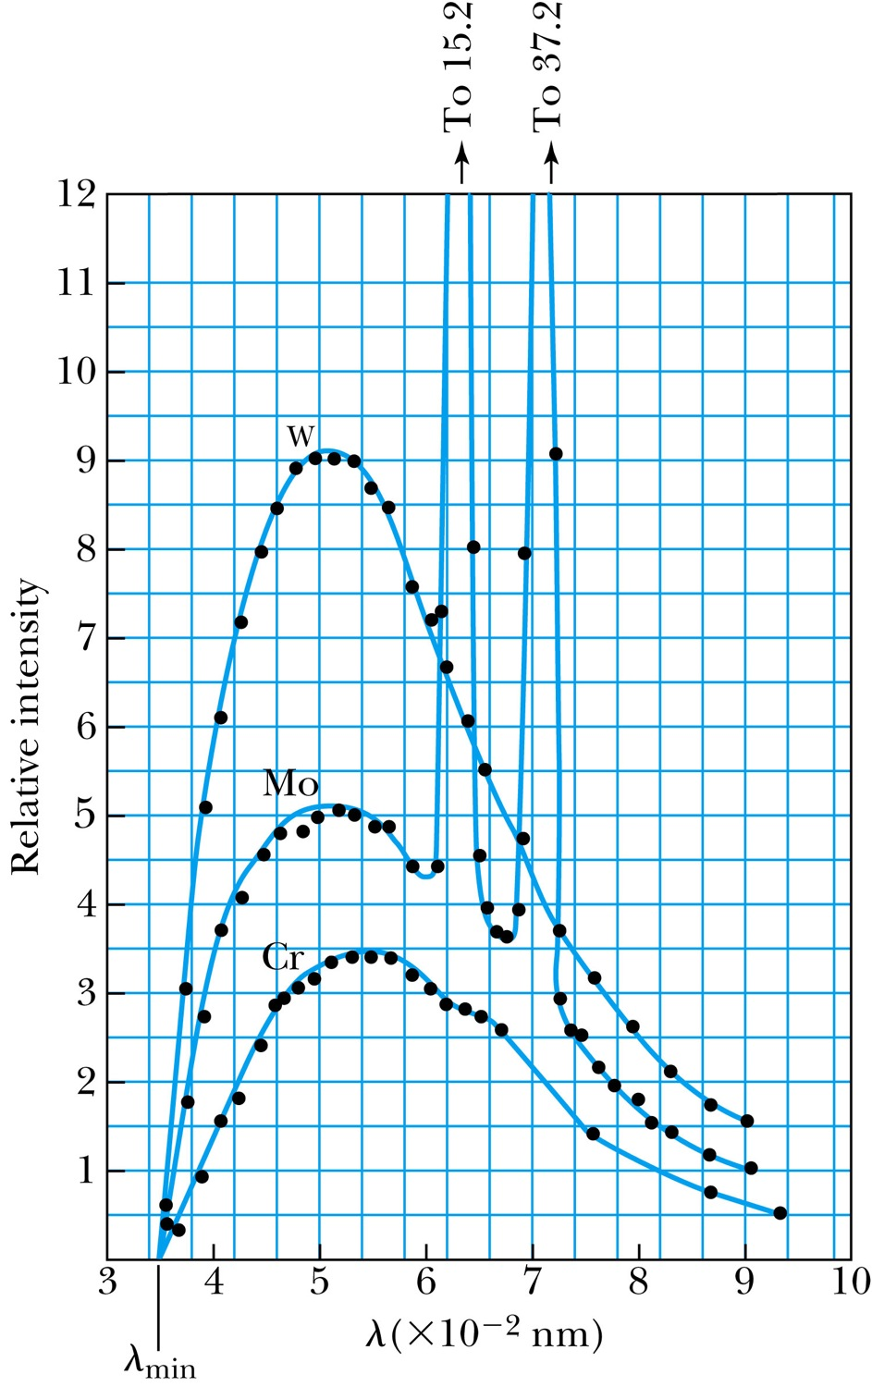
Inverse Photoelectric Effect.
Conservation of energy requires that the electron KE equal the maximum photon energy
Work function neglected since it’s small compared to the potential energy of the electron.
This is the Duane-Hunt limit
The photon wavelength depends only on the accelerating voltage
The same for all targets.

Slide 15
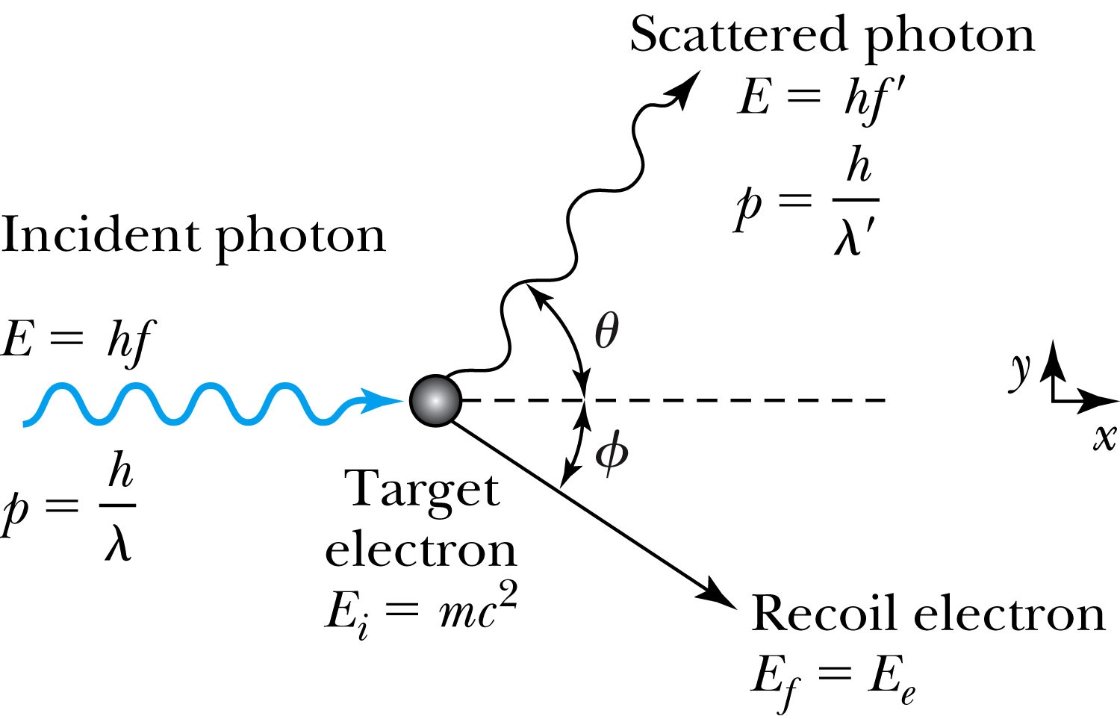
Compton Effect
When a photon enters matter, it is likely to interact with one of the atomic electrons.
The photon is scattered from only one electron.
The laws of conservation of energy and momentum apply as in any elastic collisions between two particles. The momentum of a particle moving at the speed of light is
The electron energy can be written as
Change of the scattered photon wavelength is known as the Compton effect:

