Slide 1
PHYS 3313 – Section 001 Lecture #12
Monday, Feb. 24, 2014
Dr. Jaehoon Yu
Rutherford Scattering Experiment and Rutherford Atomic Model
The Classic Atomic Model
The Bohr Model of the Hydrogen Atom

Slide 2
Announcements
Quiz 2 results
Class average: 26.7/50
Equivalent to 53.4/100
Previous quiz: 30/100
Top score: 50/50
Mid-term exam
In class on Wednesday, Mar. 5
Covers CH1.1 – what we finish on Monday, Mar. 3 + appendices
Mid-term exam constitutes 20% of the total
Please do NOT miss the exam! You will get an F if you miss it.
BYOF: You may bring a one 8.5x11.5 sheet (front and back) of handwritten formulae and values of constants for the exam
No derivations or solutions of any problems allowed!
No additional formulae or values of constants will be provided!

Slide 3
Reminder: Special Project #3
A total of N_{i} incident projectile particle of atomic number Z₁ kinetic energy KE scatter on a target of thickness t and atomic number Z₂ and has n atoms per volume. What is the total number of scattered projectile particles at an angle θ? (20 points)
Please be sure to clearly define all the variables used in your derivation! Points will be deducted for missing variable definitions.
This derivation must be done on your own. Please do not copy the book, internet or your friends’.
Due is this Wednesday, Feb.26 .

Slide 4
Prefixes, expressions and their meanings
deca (da): 10¹
hecto (h): 10²
kilo (k): 10³
mega (M): 10⁶
giga (G): 10⁹
tera (T): 10¹²
peta (P): 10¹⁵
exa (E): 10¹⁸
deci (d): 10⁻¹
centi (c): 10⁻²
milli (m): 10⁻³
micro (μ): 10⁻⁶
nano (n): 10⁻⁹
pico (p): 10⁻¹²
femto (f): 10⁻¹⁵
atto (a): 10⁻¹⁸

Slide 5
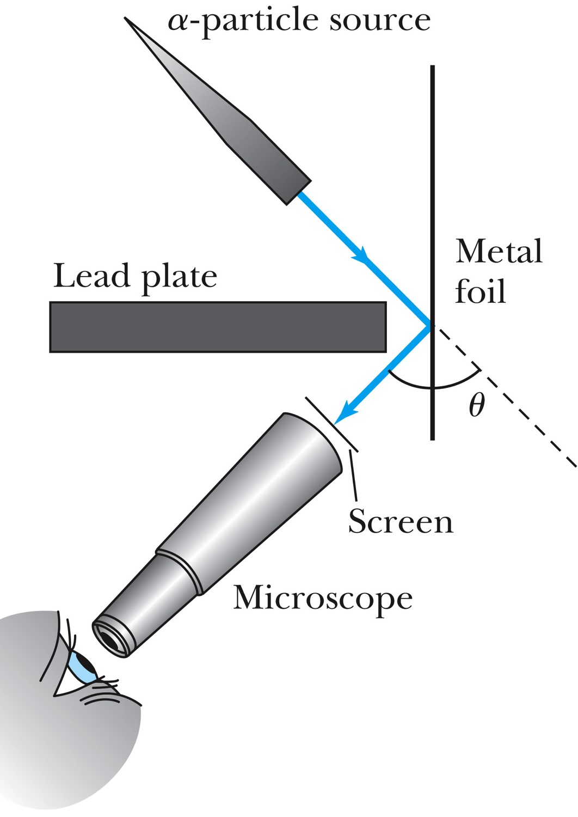
Experiments of Geiger and Marsden
Rutherford, Geiger, and Marsden conceived a new technique for investigating the structure of matter by scattering a particle off atoms.
Geiger showed that many particles were scattered from thin gold-leaf targets at backward angles greater than 90°.
Time to do some calculations!

Slide 6
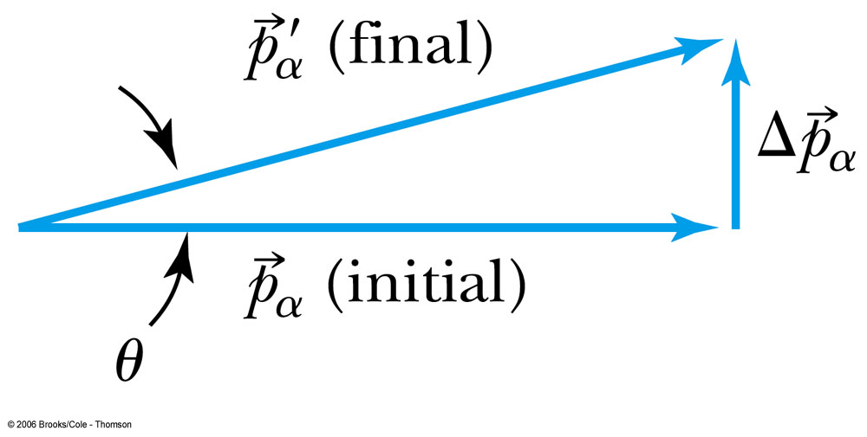
Ex 4.1: Maximum Scattering Angle
Geiger and Marsden (1909) observed backward-scattered (θ>=90º) α particles when a beam of energetic α particles was directed at a piece of gold foil as thin as 6.0x10⁻⁷m. Assuming an α particle scatters from an electron in the foil, what is the maximum scattering angle?
The maximum scattering angle corresponds to the maximum momentum change
Using the momentum conservation and the KE conservation for an elastic collision, the maximum momentum change of the α particle is
Determine θ by letting Δp_{max} be perpendicular to the direction of motion.

Slide 7
Multiple Scattering from Electrons
If an α particle were scattered by many electrons, then N electrons results in <θ>_{total} ~ √Nθ
The number of atoms across the thin gold layer of 6 × 10⁻⁷ m:
Assume the distance between atoms is
and there are
This gives

Slide 8
Rutherford’s Atomic Model
<θ>_{total}~0.8*79=6.8º even if the α particle scattered from all 79 electrons in each atom of gold
The experimental results were inconsistent with Thomson’s atomic model.
Rutherford proposed that an atom has a positively charged core (nucleus) surrounded by the negative electrons.

Slide 9
Assumptions of Rutherford Scattering
The scatterer is so massive that it does not recoil significantly; therefore the initial and final KE of the α particle are practically equal.
The target is so thin that only a single scattering occurs.
The bombarding particle and target scatterer are so small that they may be treated as point masses with electrical charges.
Only the Coulomb force is effective.

Slide 10
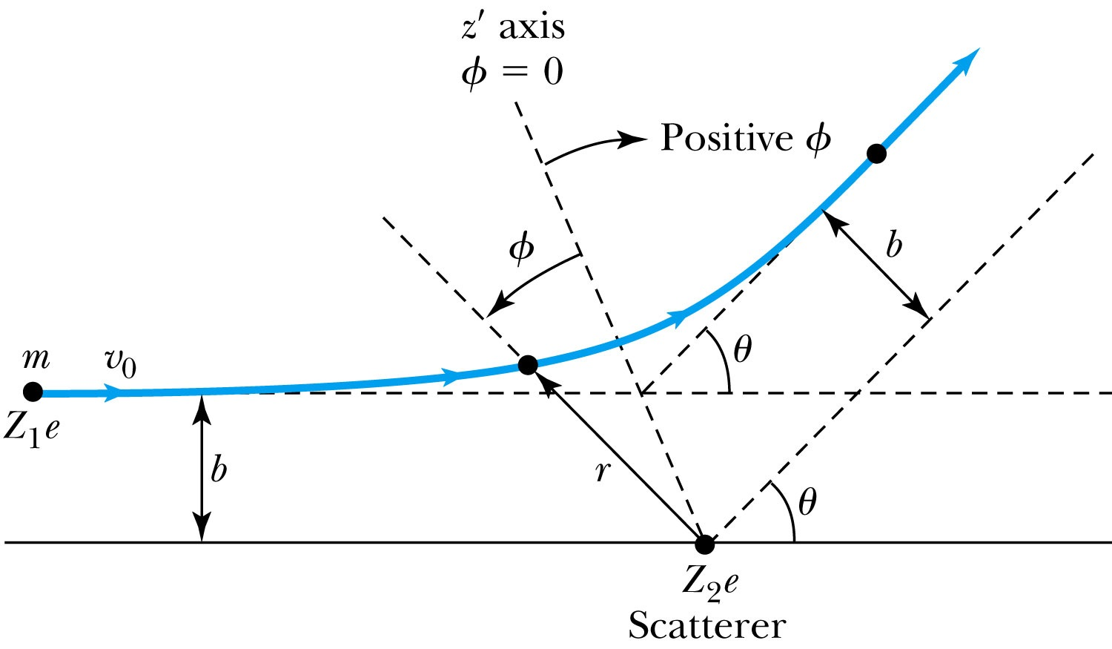
Rutherford Scattering
Scattering experiments help us study matter too small to be observed directly by measuring the angular distributions of the scattered particles
What is the force acting in this scattering?
There is a relationship between the impact parameter b and the scattering angle θ.
When b is small,
r gets small.
Coulomb force gets large.
θ can be large and the particle can be repelled backward.

Slide 11
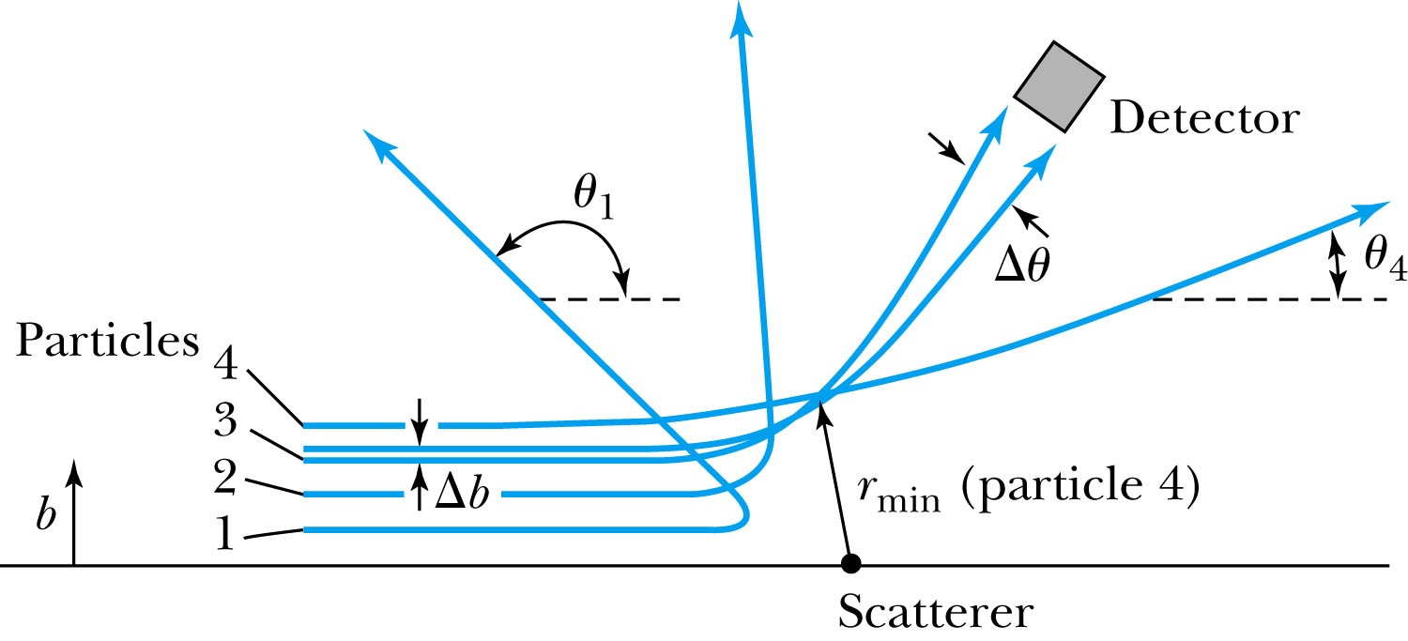
The Relationship Between the Impact Parameter b and the Scattering Angle
The relationship between the impact parameter b and scattering angle θ: Particles with small impact parameters approach the nucleus most closely (r_{min}) and scatter to the largest angles. Particles within a certain range of impact parameters b will be scattered within the window Δθ.

Slide 12
Rutherford Scattering
What are the quantities that can affect the scattering?
What was the force again?
The Coulomb force
The charge of the incoming particle (Z₁e)
The charge of the target particle (Z₂e)
The minimum distance the projectile approaches the target (r)
Using the fact that this is a totally elastic scattering under a central force, we know that
Linear momentum is conserved
KE is conserved
Angular momentum is conserved
From this, impact parameter

Slide 13
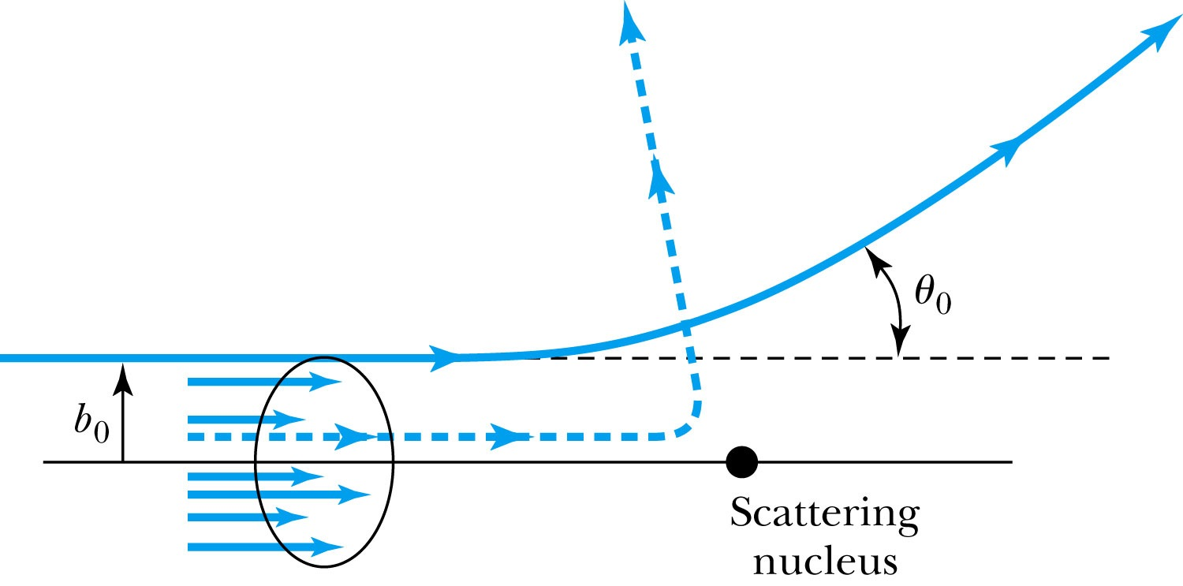
Rutherford Scattering - probability
Any particle inside the circle of area πb₀² will be similarly scattered.
The cross section σ = πb² is related to the probability for a particle being scattered by a nucleus.
The fraction of the incident particles scattered is
The number of scattering nuclei per unit area .
t: target thickness
n: atomic number density

Slide 14
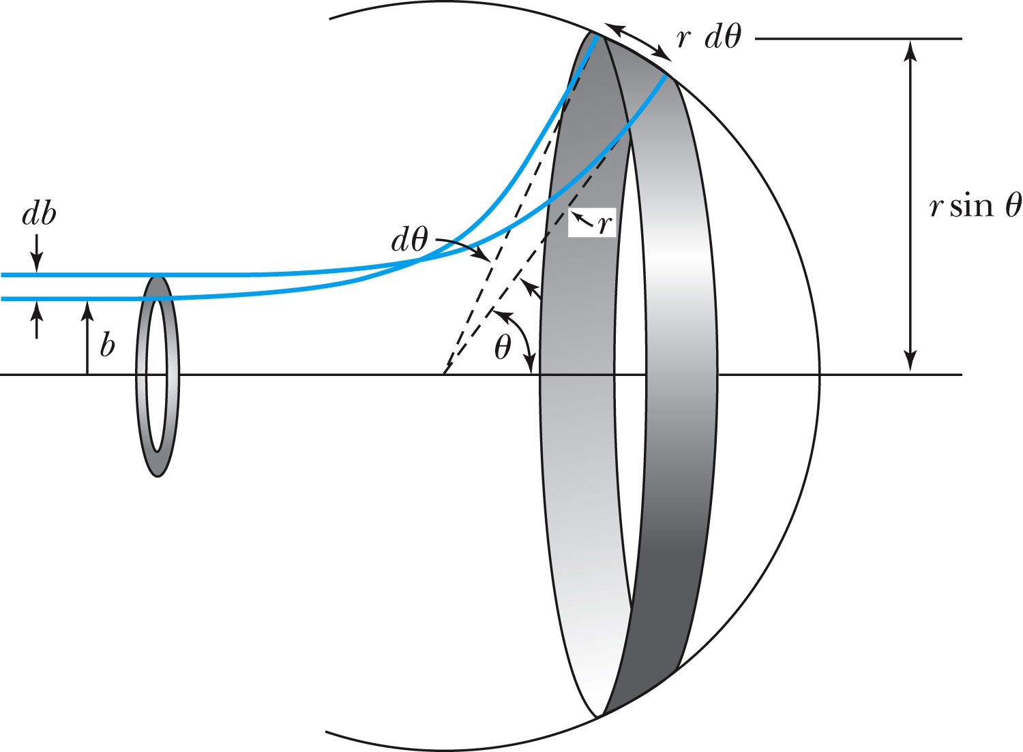
Rutherford Scattering Equation
In an actual experiment, a detector is positioned from θ to θ + dθ that corresponds to incident particles between b and b + db.
The number of particles scattered into the the angular coverage per unit area is

Slide 15
The Important Points
The scattering is proportional to the square of the atomic numbers of both the incident particle (Z₁) and the target scatterer (Z₂).
The number of scattered particles is inversely proportional to the square of the kinetic energy of the incident particle.
For the scattering angle θ, the scattering is proportional to 4th power of sin(θ/2).
The Scattering is proportional to the target thickness for thin targets.

Slide 16
The Classical Atomic Model
As suggested by the Rutherford Model, an atom consisted of a small, massive, positively charged nucleus surrounded by moving electrons. This then suggested consideration of a planetary model of the atom.
Let’s consider atoms as a planetary model.
The force of attraction on the electron by the nucleus and Newton’s 2nd law give
where v is the tangential speed of an electron.
The total energy is

Slide 17
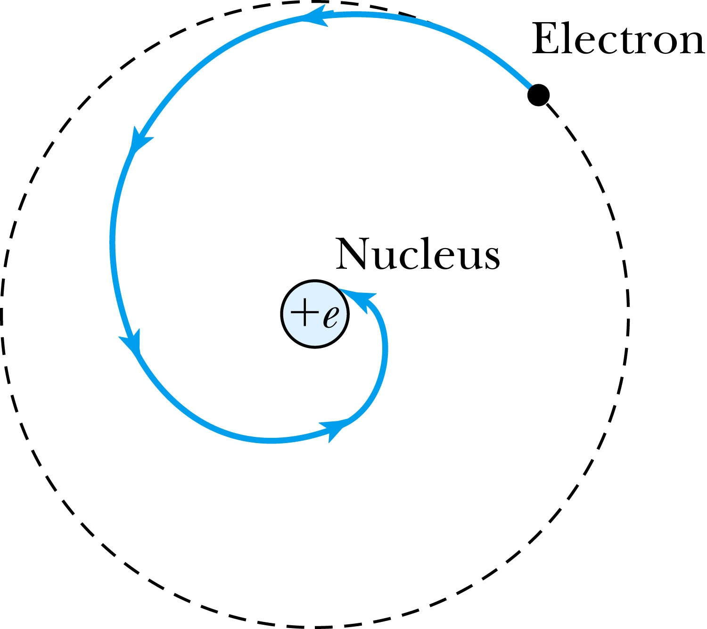
The Planetary Model is Doomed
From classical E&M theory, an accelerated electric charge radiates energy (electromagnetic radiation) which means total energy must decrease. ➔Radius r must decrease!!
Electron crashes into the nucleus!?
Physics had reached a turning point in 1900 with Planck’s hypothesis of the quantum behavior of radiation.

Slide 18
The Bohr Model of the Hydrogen Atom – The assumptions
“Stationary” states or orbits must exist in atoms, i.e., orbiting electrons do not radiate energy in these orbits. These orbits or stationary states are of a fixed definite energy E.
The emission or absorption of electromagnetic radiation can occur only in conjunction with a transition between two stationary states. The frequency, f, of this radiation is proportional to the difference in energy of the two stationary states:
E = E₁ − E₂ = hf
where h is Planck’s Constant
Bohr thought this has to do with fundamental length of order ~10⁻¹⁰m
Classical laws of physics do not apply to transitions between stationary states.
The mean kinetic energy of the electron-nucleus system is quantized as K = nhf_{orb}/2, where f_{orb} is the frequency of rotation. This is equivalent to the angular momentum of a stationary state to be an integral multiple of h/2π

Slide 19
How did Bohr Arrived at the angular momentum quantization?
The mean kinetic energy of the electron-nucleus system is quantized as K = nhf_{orb}/2, where f_{orb} is the frequency of rotation. This is equivalent to the angular momentum of a stationary state to be an integral multiple of h/2π.
Kinetic energy can be written
Angular momentum is defined as
The relationship between linear and angular quantifies
Thus, we can rewrite

Slide 20
Bohr’s Quantized Radius of Hydrogen
The angular momentum is
So the speed of an orbiting e can be written
From the Newton’s law for a circular motion
So from above two equations, we can get

Slide 21
Bohr Radius
The radius of the hydrogen atom for stationary states is
Where the Bohr radius for a given stationary state is:
The smallest diameter of the hydrogen atom is
OMG!! The fundamental length!!
n = 1 gives its lowest energy state (called the “ground” state)

