Slide 1
PHYS 3313 – Section 001 Lecture #13
Wednesday, Feb. 26, 2014
Dr. Jaehoon Yu
Bohr Radius
Bohr’s Hydrogen Model and Its Limitations
Characteristic X-ray Spectra
Hydrogen Spectrum Series
X-ray Scattering
Bragg’s Law

Slide 2
Announcements
Mid-term exam
In class on next Wednesday, Mar. 5
Covers CH1.1 – what we finish on coming Monday, Mar. 3 + appendices
Mid-term exam constitutes 20% of the total
Please do NOT miss the exam! You will get an F if you miss it.
BYOF: You may bring a one 8.5x11.5 sheet (front and back) of handwritten formulae and values of constants for the exam
No derivations or solutions of any problems allowed!
No additional formulae or values of constants will be provided!
Homework #3
End of chapter problems on CH4: 5, 14, 17, 21, 23 and 45
Due: Monday, March 10
Colloquium today at 4pm in SH101
Dr. Billy Quarles of NASA Ames Research Center

Slide 3
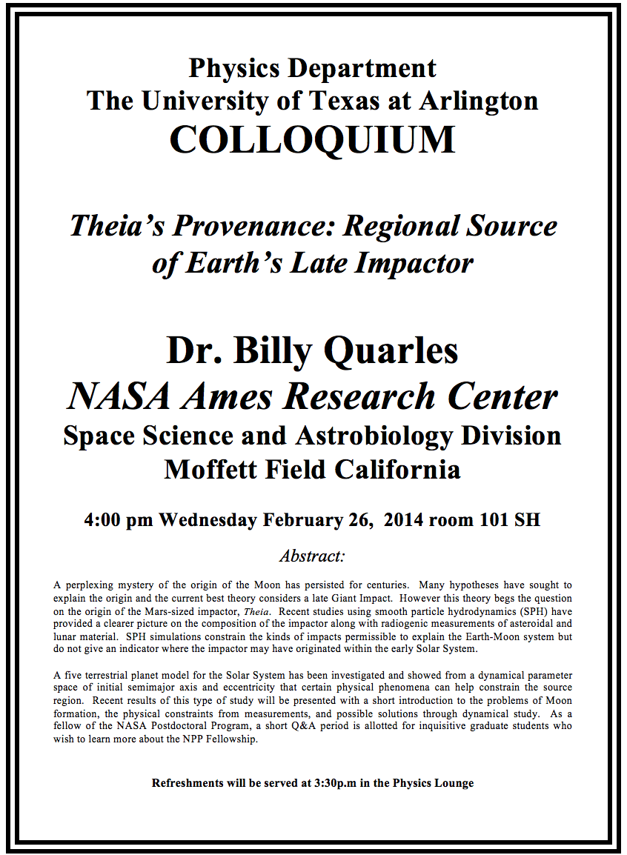

Slide 4
Uncertainties
Statistical Uncertainty: A naturally occurring uncertainty due to the number of measurements
Usually estimated by taking the square root of the number of measurements or samples, √N
Systematic Uncertainty: Uncertainty occurring due to unintended biases or unknown sources
Biases made by personal measurement habits
Some sources that could impact the measurements
In any measurement, the uncertainties provide the significance to the measurement

Slide 5
Bohr’s Quantized Radius of Hydrogen
The angular momentum is
So the speed of an orbiting e can be written
From the Newton’s law for a circular motion
So from above two equations, we can get

Slide 6
Bohr Radius
The radius of the hydrogen atom for stationary states is
Where the Bohr radius for a given stationary state is:
The smallest diameter of the hydrogen atom is
OMG!! The fundamental length!!
n = 1 gives its lowest energy state (called the “ground” state)

Slide 7
Ex. 4.6 Justification for non-relativistic treatment of orbital e
Are we justified for non-relativistic treatment of the orbital electrons?
When do we apply relativistic treatment?
When v/c>0.1
Orbital speed:
Thus

Slide 8
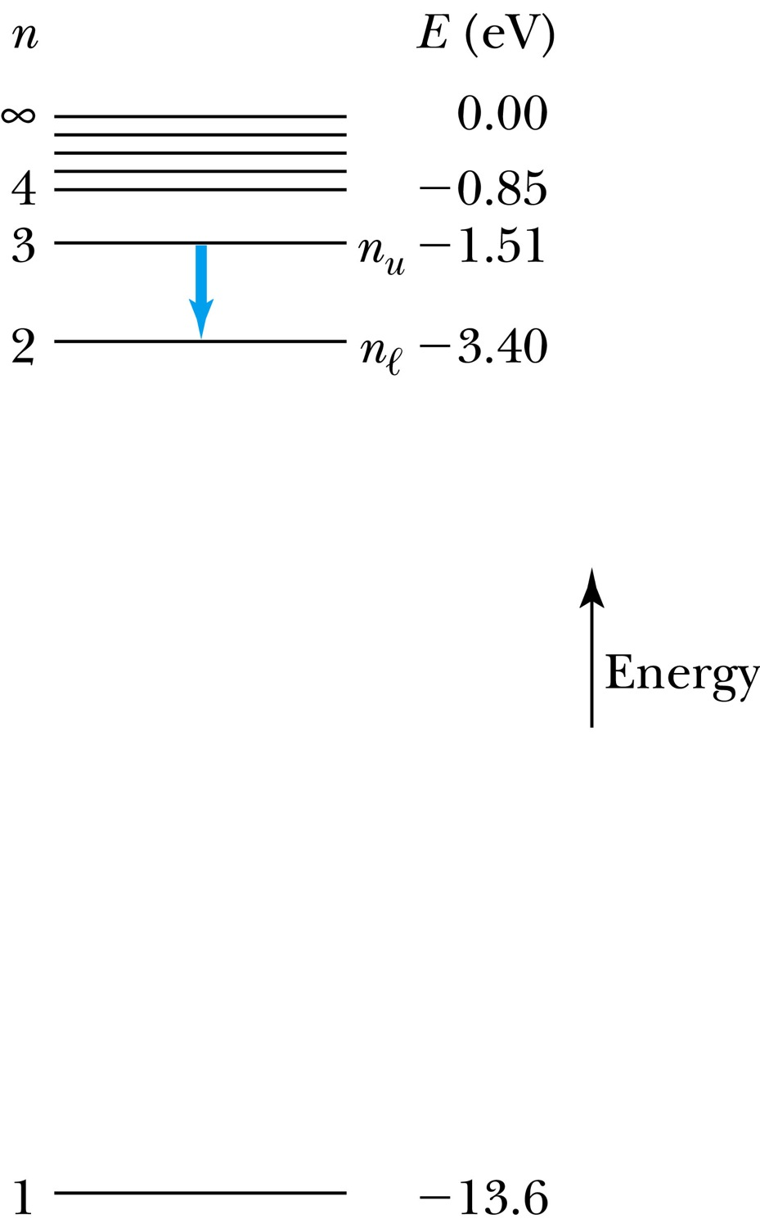
The Hydrogen Atom
The energies of the stationary states
where E₀ is the ground state energy
Emission of light occurs when the atom is in an excited state and decays to a lower energy state (n_{u} → n_{ℓ}).
where f is the frequency of a photon.
R∞ is the Rydberg constant.

Slide 9
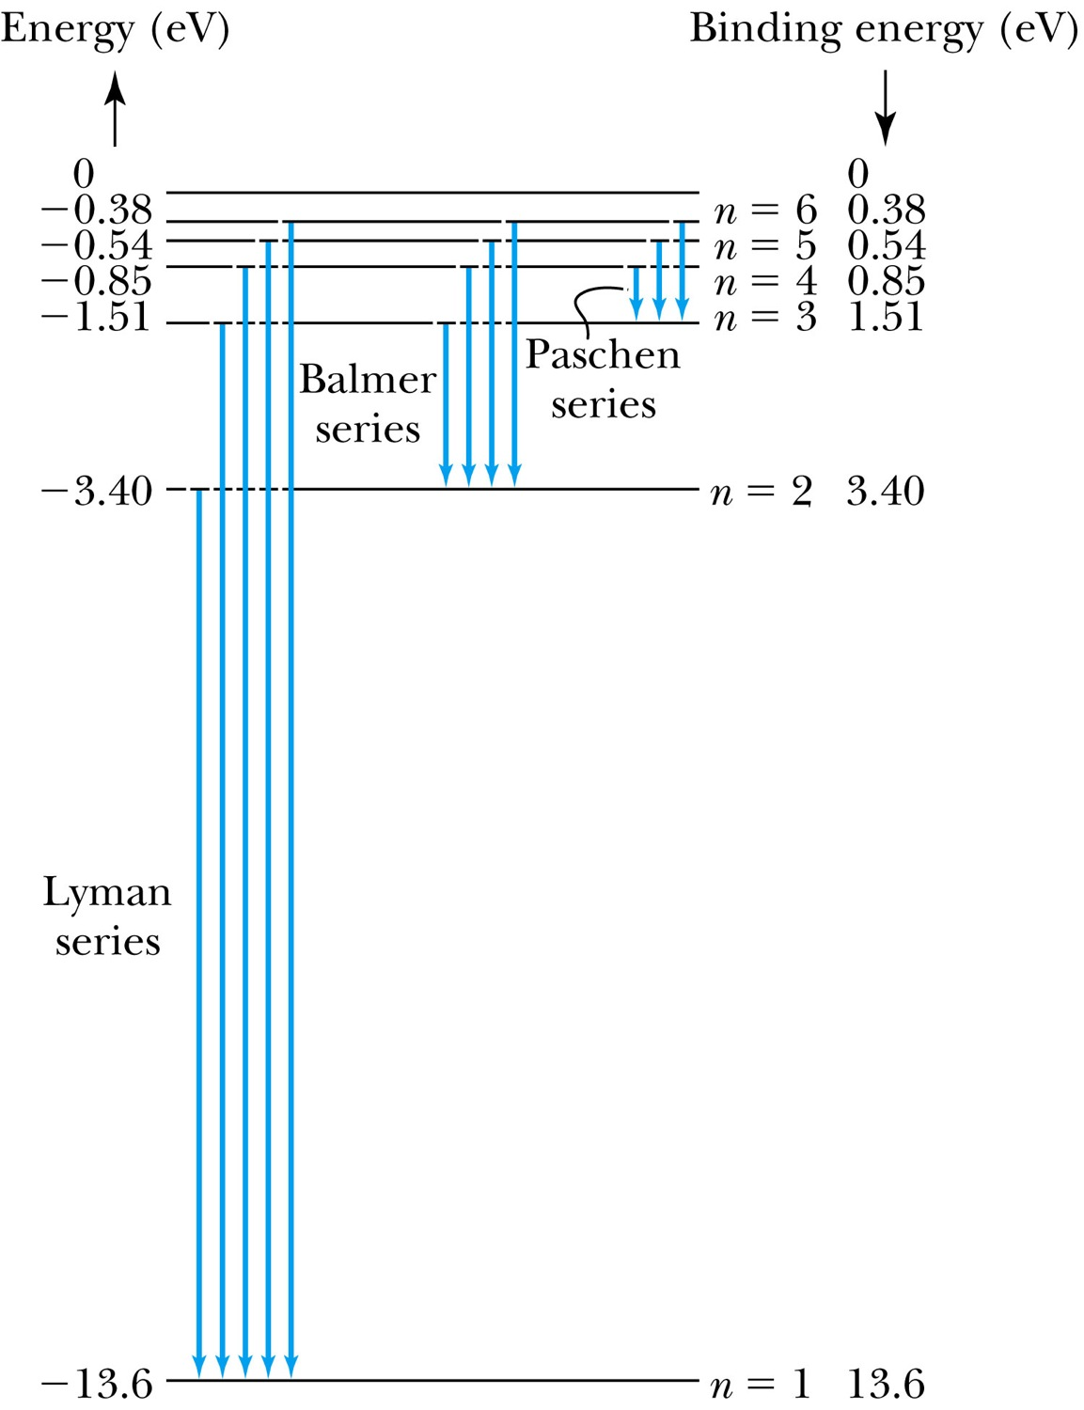
Transitions in the Hydrogen Atom
Lyman series: The atom will remain in the excited state for a short time before emitting a photon and returning to a lower stationary state. All hydrogen atoms exist in n = 1 (invisible).
Balmer series: When sunlight passes through the atmosphere, hydrogen atoms in water vapor absorb the wavelengths (visible).

Slide 10
Fine Structure Constant
The electron’s speed on an orbit in the Bohr model:
On the ground state, v₁ = 2.2 × 10⁶ m/s ~ less than 1% of the speed of light
The ratio of v₁ to c is the fine structure constant, α.

Slide 11
The Correspondence Principle
Classical electrodynamics
Bohr’s atomic model
+
Determine the properties
of radiation
Need a principle to relate the new modern results with classical ones.
Bohr’s correspondence
principle
In the limits where classical and quantum theories should agree, the quantum theory must produce the classical results.

