Slide 1
PHYS 3313 – Section 001 Lecture #14
Monday, Mar. 3, 2014
Dr. Jaehoon Yu
Bohr’s Hydrogen Model and Its Limitations
Characteristic X-ray Spectra
Hydrogen Spectrum Series
X-ray Scattering
Bragg’s Law

Slide 2
Announcements
Mid-term exam
In class on this Wednesday, Mar. 5
Covers CH1.1 – what we finish today (CH4.6)+ appendices
Mid-term exam constitutes 20% of the total
Please do NOT miss the exam! You will get an F if you miss it.
BYOF: You may bring a one 8.5x11.5 sheet (front and back) of handwritten formulae and values of constants for the exam
No derivations or solutions of any problems allowed!
No additional formulae or values of constants will be provided!
Reminder Homework #3
End of chapter problems on CH4: 5, 14, 17, 21, 23 and 45
Due: Monday, March 17
Colloquium this Wednesday at 4pm in SH101
Dr. Xun Jia of UTSW Medical Center

Slide 3
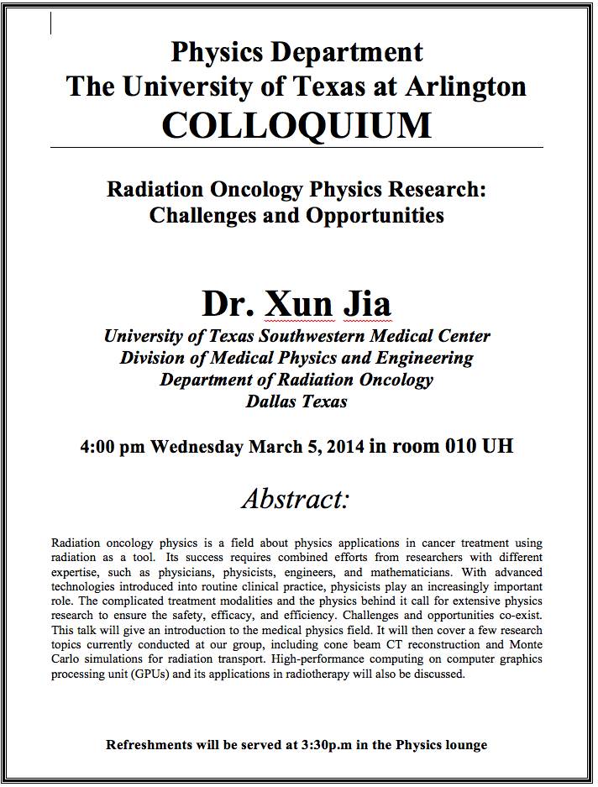

Slide 4
The Correspondence Principle
Classical electrodynamics
Bohr’s atomic model
+
Determine the properties
of radiation
Need a principle to relate the new modern results with classical ones.
Bohr’s correspondence
principle
In the limits where classical and quantum theories should agree, the quantum theory must produce the classical results.

Slide 5
The Correspondence Principle
The frequency of the radiation emitted f_{classical} is equal to the orbital frequency f_{orb} of the electron around the nucleus.
The frequency of photon in the transition from n + 1 to n is
For large n the classical limit,
Substitute E₀:
So the frequency of the radiated E between classical theory and Bohr model agrees in large n case!!

Slide 6
Importance of Bohr’s Model
Demonstrated the need for Plank’s constant in understanding the atomic structure
Assumption of quantized angular momentum which led to quantization of other quantities, r, v and E as follows
Orbital Radius:
Orbital Speed:
Energy levels:

Slide 7
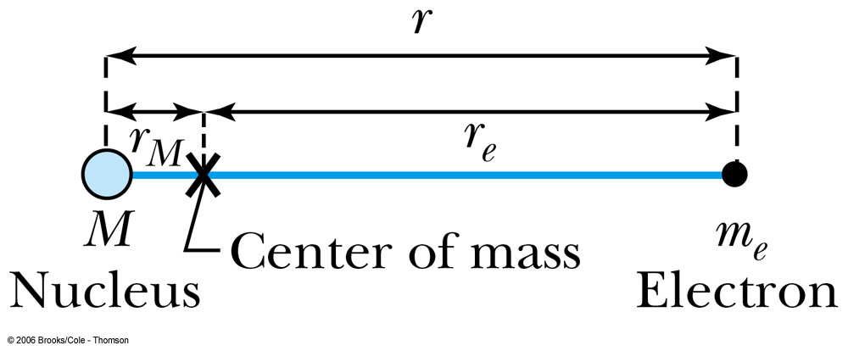
Successes and Failures of the Bohr Model
The electron and hydrogen nucleus actually revolve about their mutual center of mass ➔ reduced mass correction!!
All we need is to replace m_{e} with atom’s reduced mass.
The Rydberg constant for infinite nuclear mass, R∞ is replaced by R.

Slide 8
Limitations of the Bohr Model
The Bohr model was a great step of the new quantum theory, but it had its limitations.
Works only to single-electron atoms
Works even for ions ➔ What would change?
The charge of the nucleus
Could not account for the intensities or the fine structure of the spectral lines
Fine structure is caused by the electron spin
Under a magnetic field, the spectrum splits by the spin
Could not explain the binding of atoms into molecules

Slide 9
Characteristic X-Ray Spectra and Atomic Number
Shells have letter names:
K shell for n = 1
L shell for n = 2
The atom is most stable in its ground state.
When a transition occurs in a heavy atom, the radiation emitted is an x ray.
It has the energy E (x ray) = E_{u} − E_{ℓ}.
An electron from higher shells will fill the inner-shell vacancy at lower energy.

Slide 10
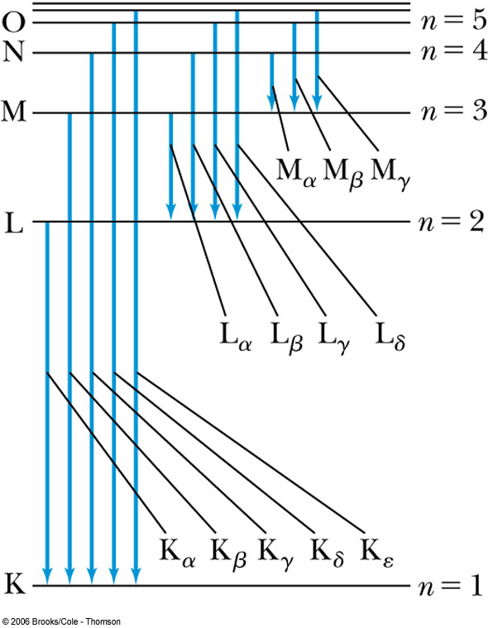
Atomic Number
L shell to K shell K_{α} x ray
M shell to K shell K_{β} x ray
Atomic number Z = number of protons in the nucleus
Moseley found a relationship between the frequencies of the characteristic x ray and Z.
This holds for the K_{α} x ray

Slide 11
Moseley’s Empirical Results
The x ray is produced from n = 2 to n = 1 transition.
In general, the K series of x ray wavelengths are
Moseley’s research clarified the importance of the electron shells for all the elements, not just for hydrogen
Concluded correctly that atomic number Z, rather than the atomic weight, is the determining factor in ordering of the periodic table

