Slide 1
PHYS 3313 – Section 001 Lecture #15
Monday, Mar. 17, 2014
Dr. Jaehoon Yu
Atomic Excitation by Electrons
X-ray Scattering
Bragg’s Law
De Broglie Waves
Bohr’s Quantization
Electron Scattering
Wave Motion

Slide 2
Announcements
Mid-term exam results
Class average: 59/105
Equivalent to 56/100
Top score: 95/105
Mid-term grade discussions
In Dr. Yu’s office, CPB342, Wednesday, Mar. 19
12:45pm – 1:30pm: Last names A – L
1:30pm – 2:20pm: Last names M – Z
Special colloquium on April 2, triple extra credit
Colloquium this Wednesday at 4pm in SH101

Slide 3
Research Projects
Each of the 10 research groups picks one research topic
Study the topic as a group, looking up references
Original theory or Original observation
Experimental proofs or Theoretical predictions + subsequent experimental proofs
Importance and the impact of the theory/experiment
Each member of the group writes a 10 page report, including figures (must not copy!!)
10% of the total grade
Can share the theme and facts but you must write your own!
Due Mon., April 28, 2014
The group presents a 10min power point talk
5% of the total grade
Date and time posted on the web page

Slide 4
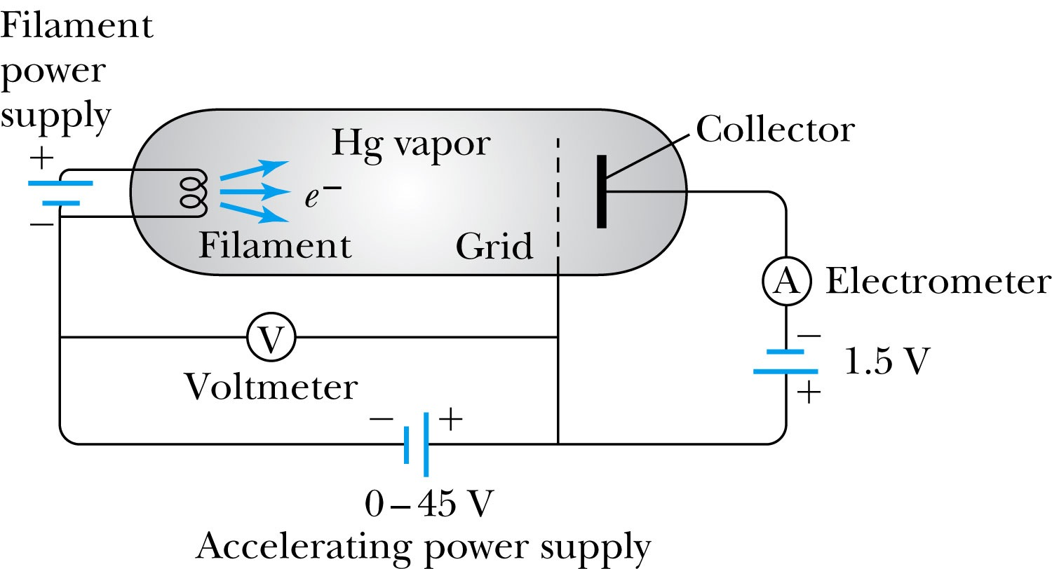
Atomic Excitation by Electrons
Franck and Hertz studied the phenomenon of ionization KE transfer from electrons to atoms.
When the accelerating voltage is below 5 V
electrons did not lose energy going through the mercury vapor
When the accelerating voltage is above 5 V, 10V, etc..
sudden drop in the current
Min. e KE

Slide 5
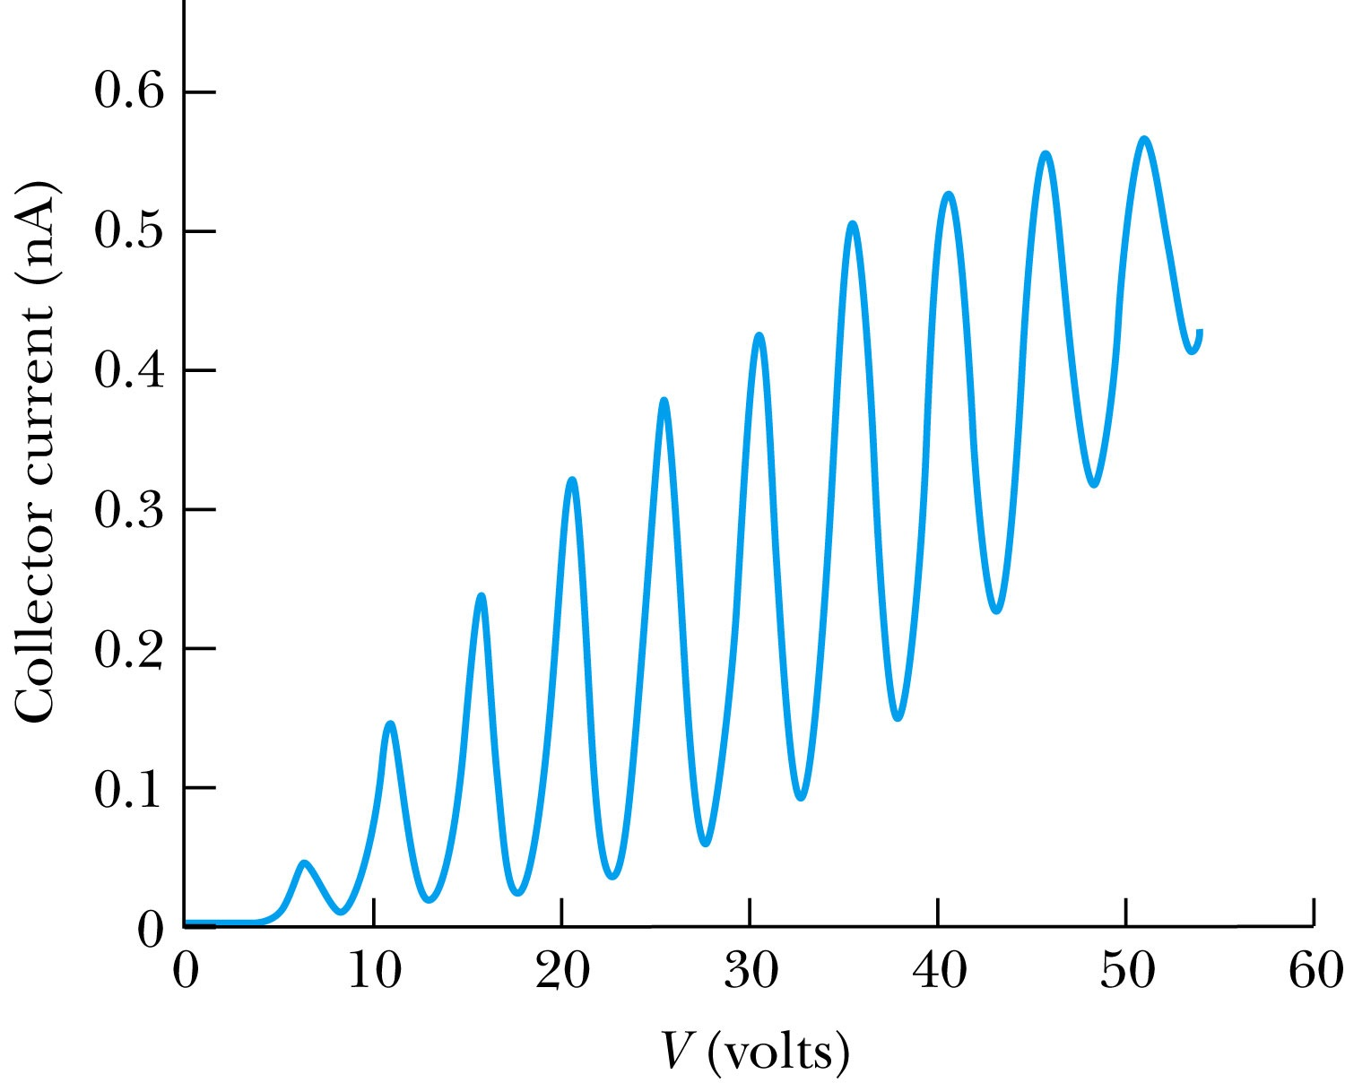
Atomic Excitation by Electrons
Ground state has E₀ to be considered as 0.
First excited state has E₁.
The energy difference E₁ − 0 = E₁ is the excitation energy.
Hg has an excitation energy of 4.88 eV in the first excited state
No energy can be transferred to Hg below 4.88 eV because not enough energy is available to excite an electron to the next energy level
Above 4.88 eV, the current drops because scattered electrons no longer reach the collector until the accelerating voltage reaches 9.76 eV and so on.

Slide 6
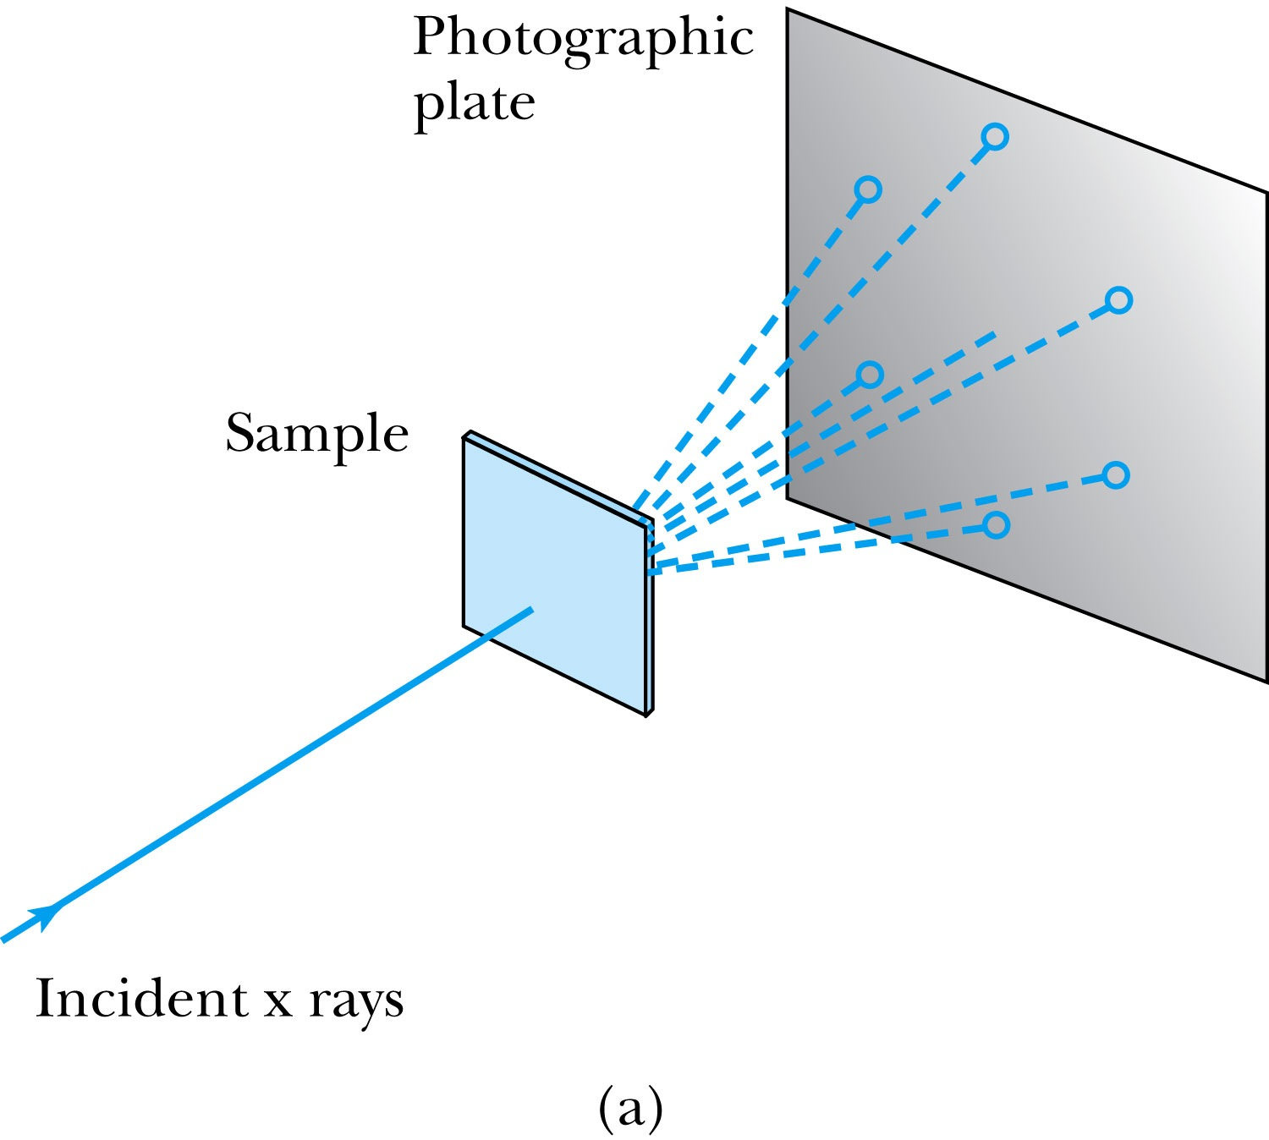
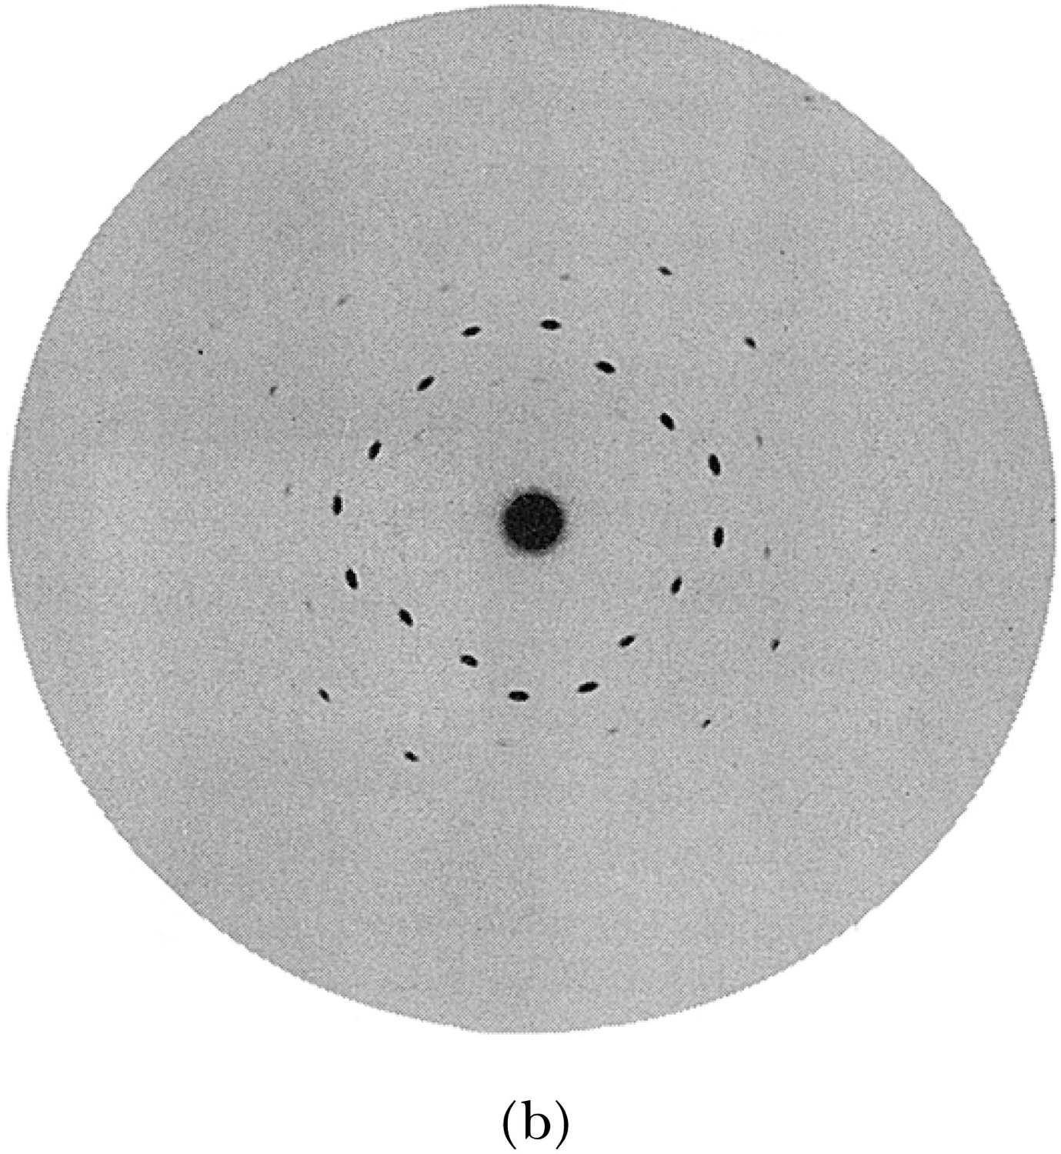
X-Ray Scattering
Max von Laue suggested that if X rays were a form of electromagnetic radiation, interference effects should be observed. (Wave property!!)
Crystals act as three-dimensional gratings, scattering the waves and producing observable interference effects.

Slide 7
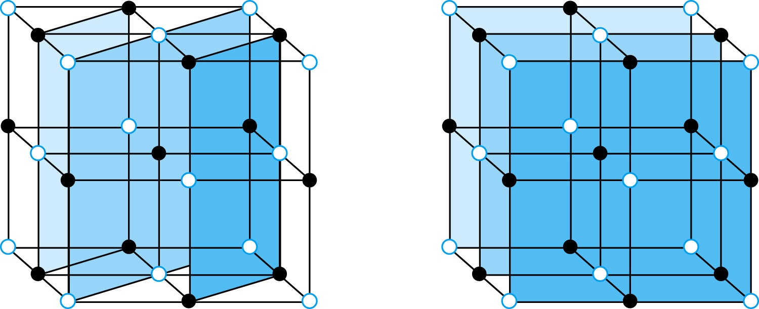
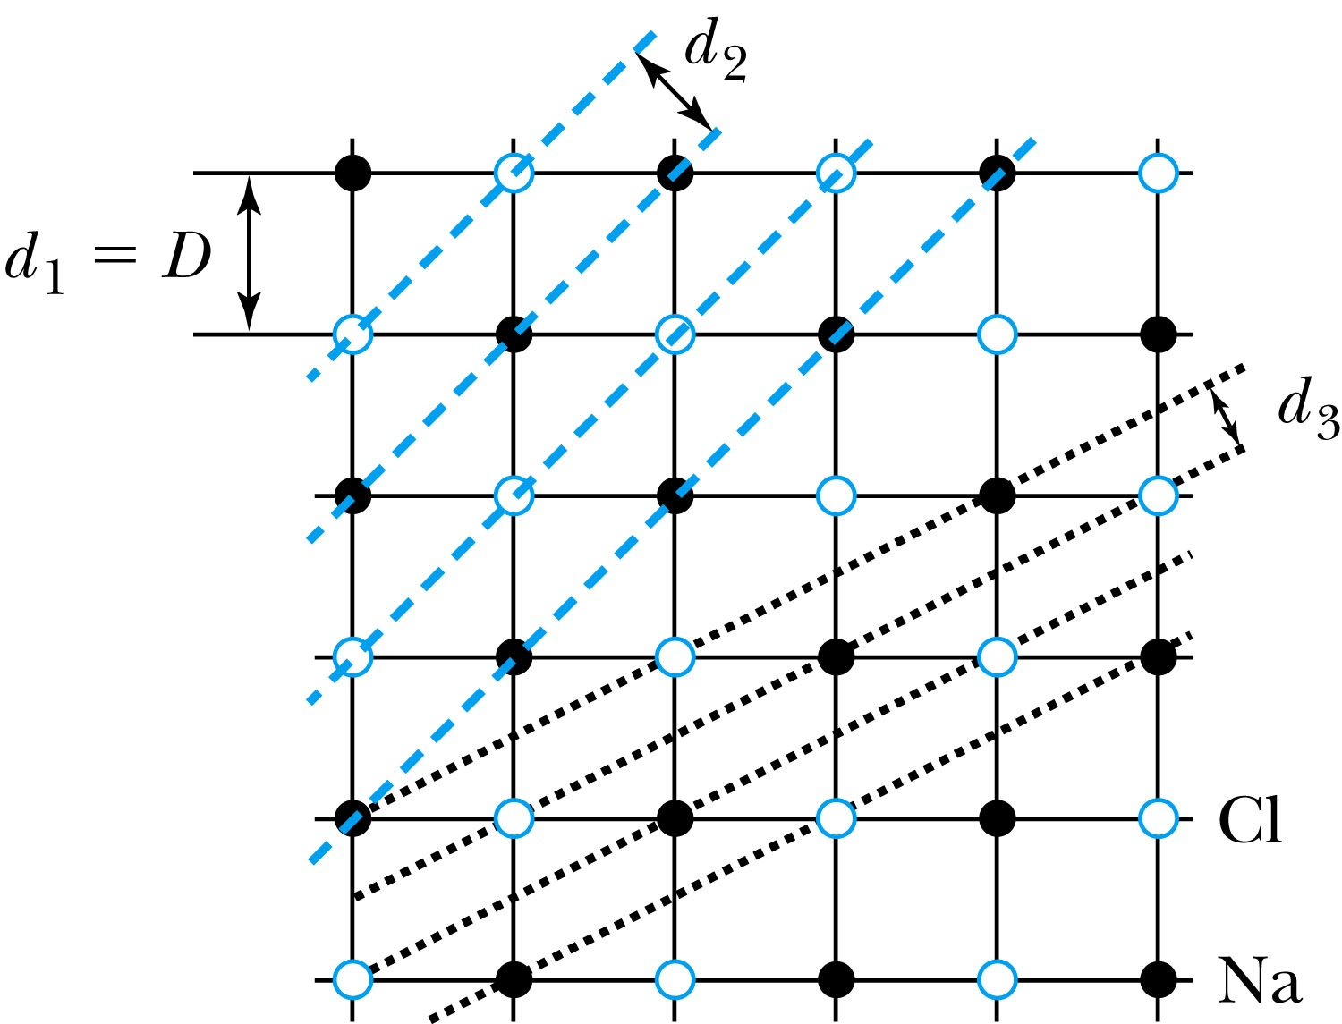
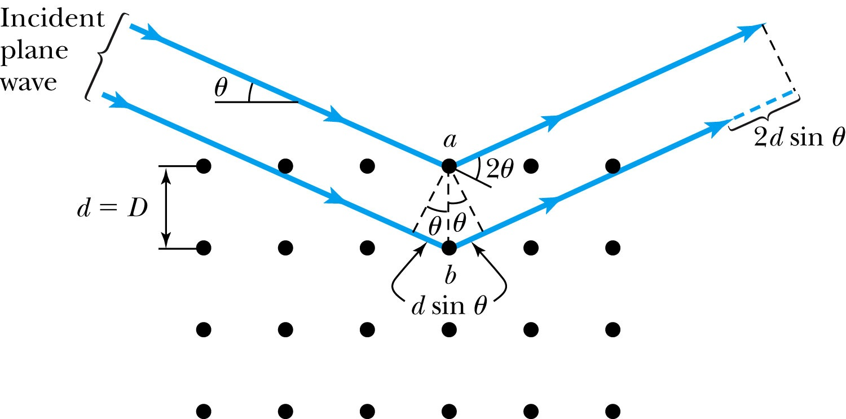
Bragg’s Law
William Lawrence Bragg interpreted the x-ray scattering as the reflection of the incident x-ray beam from a unique set of planes of atoms within the crystal.
There are two conditions for constructive interference of the scattered x rays:
The angle of incidence must equal the angle of reflection of the outgoing wave. (total reflection)
The difference in path lengths between two rays must be an integral number of wavelengths.
Bragg’s Law:
nλ = 2d sin θ
(n = integer)

Slide 8
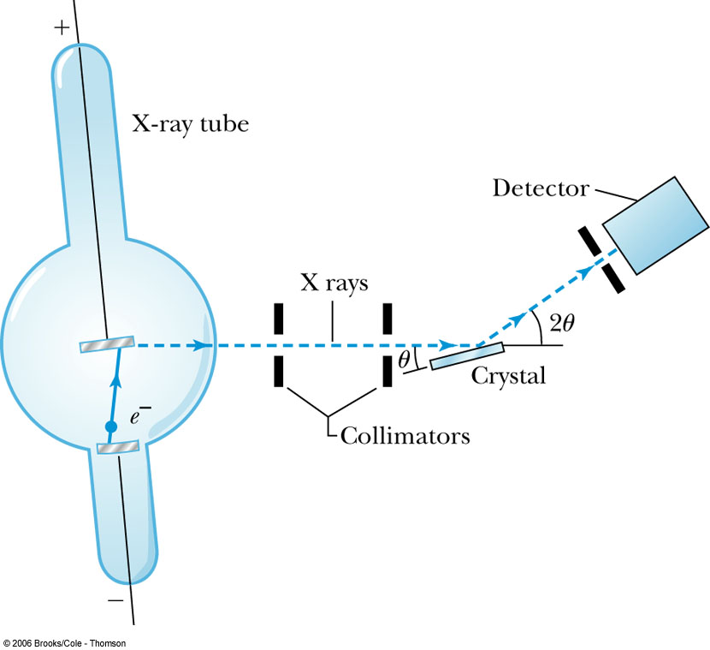
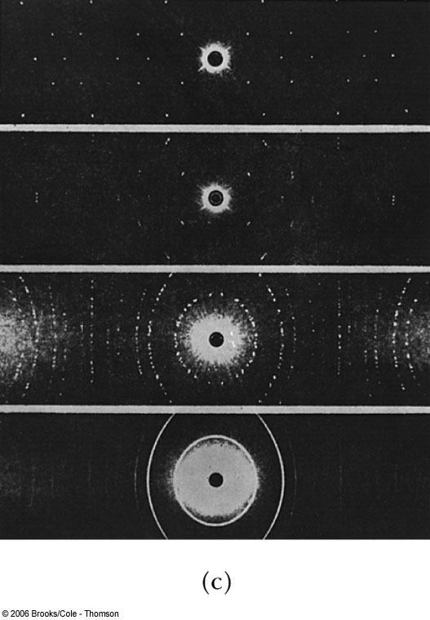
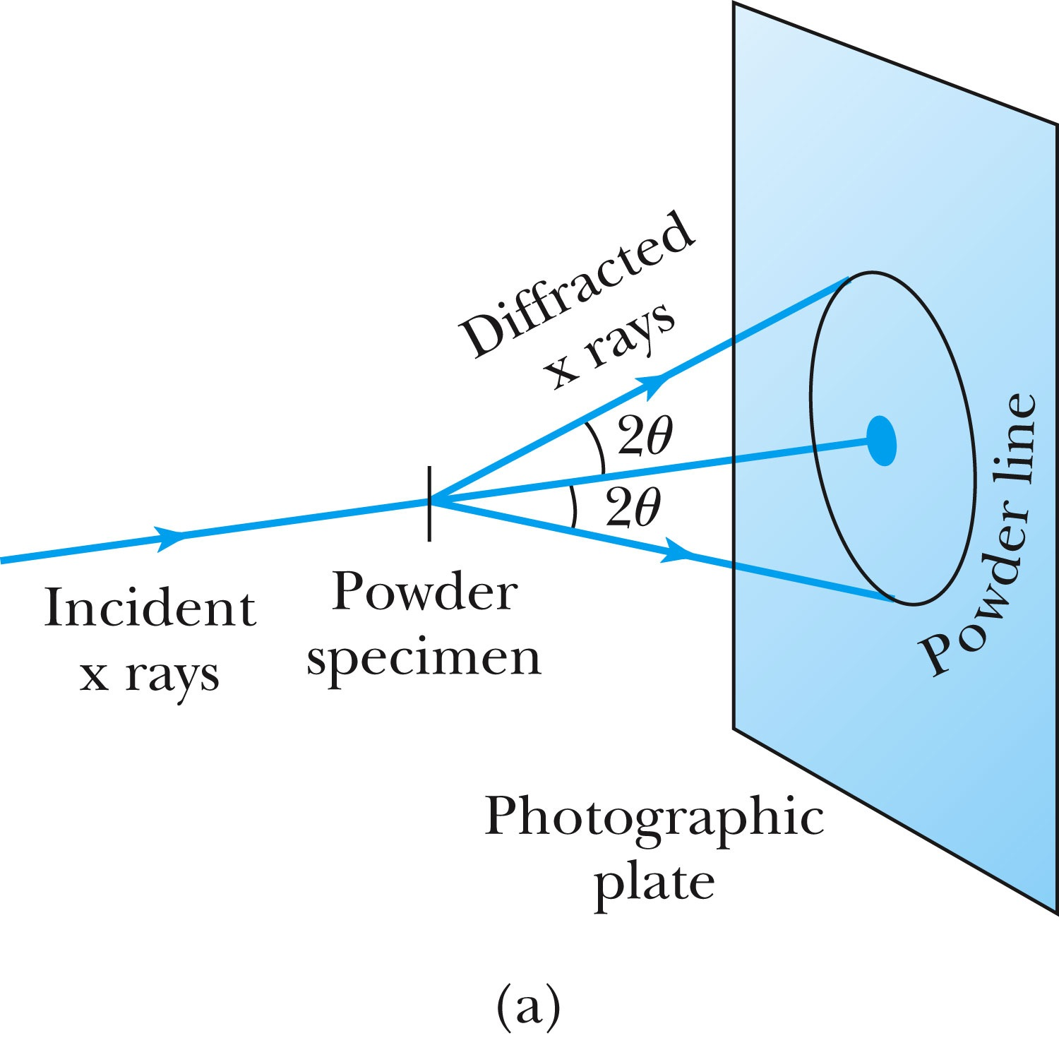
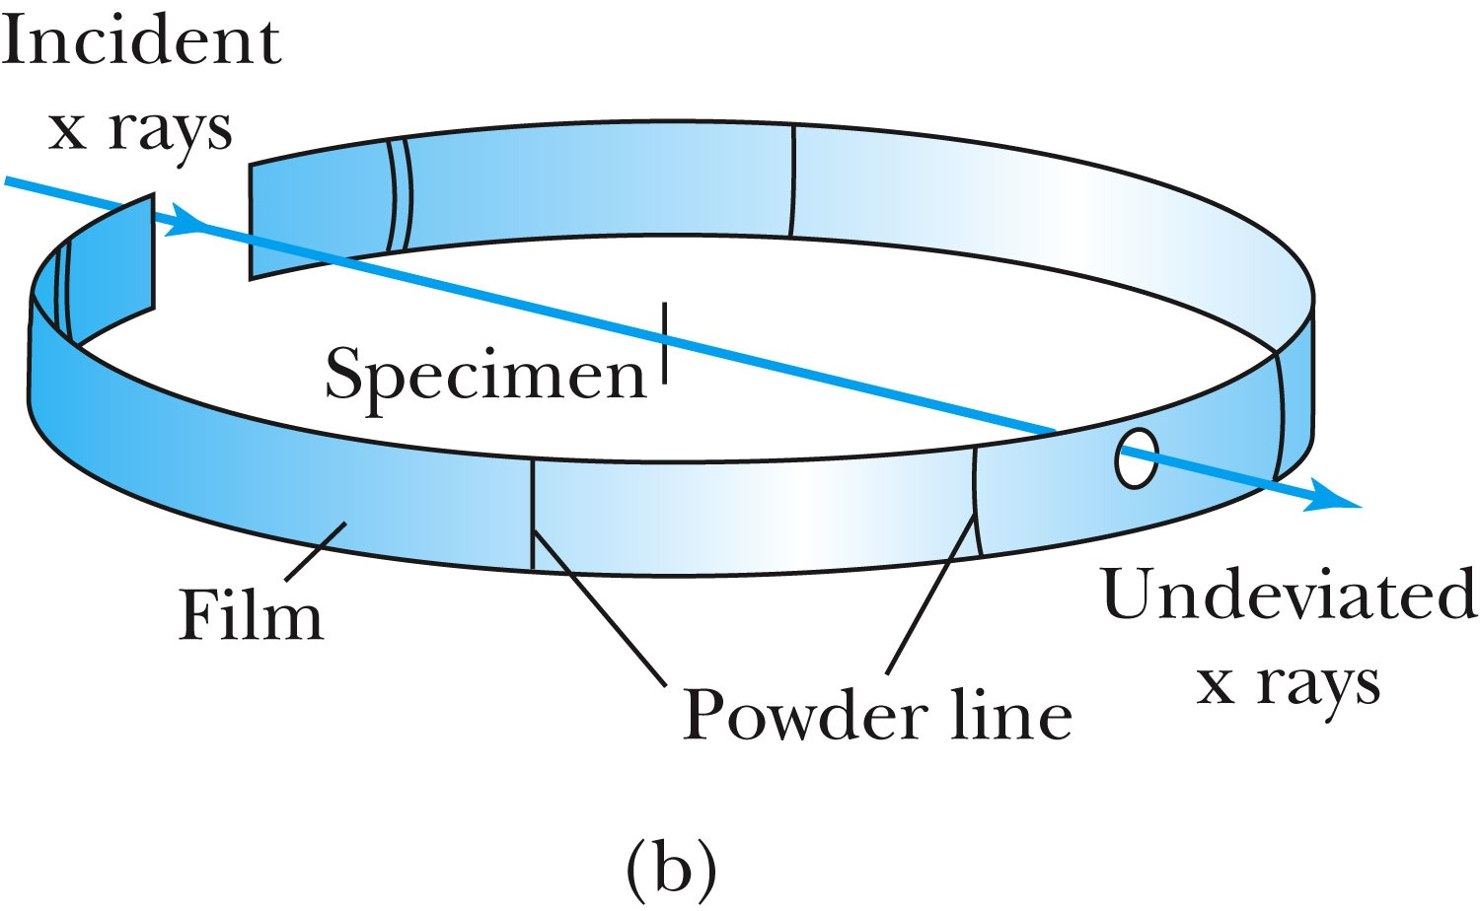
The Bragg Spectrometer
A Bragg spectrometer scatters x rays from several crystals. The intensity of the diffracted beam is determined as a function of scattering angle by rotating the crystal and the detector.
When a beam of x rays passes through the powdered crystal, the dots become a series of rings due to random arrangement.

Slide 9
Ex 5.1: Bragg’s Law
X rays scattered from rock salt (NaCl) are observed to have an intense maximum at an angle of 20º from the incident direction. Assuming n=1 (from the intensity), what must be the wavelength of the incident radiation?
Bragg’s law: nλ = 2d sin θ
What do we need to know to use this? The lattice spacing d!
We know n=1 and 2θ=20º.
We use the density of NaCl to find out what d is.

Slide 10
De Broglie Waves
Prince Louis V. de Broglie suggested that mass particles should have wave properties similar to electromagnetic radiation ➔ many experiments supported this!
Thus the wavelength of a matter wave is called the de Broglie wavelength:
This can be considered as the probing beam length scale
Since for a photon, E = pc and E = hf, the energy can be written as

