Slide 1
PHYS 3313 – Section 001 Lecture #16
Monday, Mar. 24, 2014
Dr. Jaehoon Yu
De Broglie Waves
Bohr’s Quantization Conditions
Electron Scattering
Wave Packets and Packet Envelops
Superposition of Waves
Electron Double Slit Experiment
Wave-Particle Duality

Slide 2
Announcements
Research paper template has been uploaded onto the class web page link to research
Special colloquium on April 2, triple extra credit
Colloquium this Wednesday at 4pm in SH101

Slide 3
De Broglie Waves
Prince Louis V. de Broglie suggested that mass particles should have wave properties similar to electromagnetic radiation ➔ many experiments supported this!
Thus the wavelength of a matter wave is called the de Broglie wavelength:
This can be considered as the probing beam length scale
Since for a photon, E = pc and E = hf, the energy can be written as

Slide 4
Ex 5.2: De Broglie Wavelength
Calculate the De Broglie wavelength of (a) a tennis ball of mass 57g traveling 25m/s (about 56mph) and (b) an electron with kinetic energy 50eV.
What is the formula for De Broglie Wavelength?
(a) for a tennis ball, m=0.057kg.
(b) for electron with 50eV KE, since KE is small, we can use non-relativistic expression of electron momentum!
What are the wavelengths of you running at the speed of 2m/s? What about your car of 2 metric tons at 100mph? How about the proton with 14TeV kinetic energy?
What is the momentum of the photon from a green laser?

Slide 5
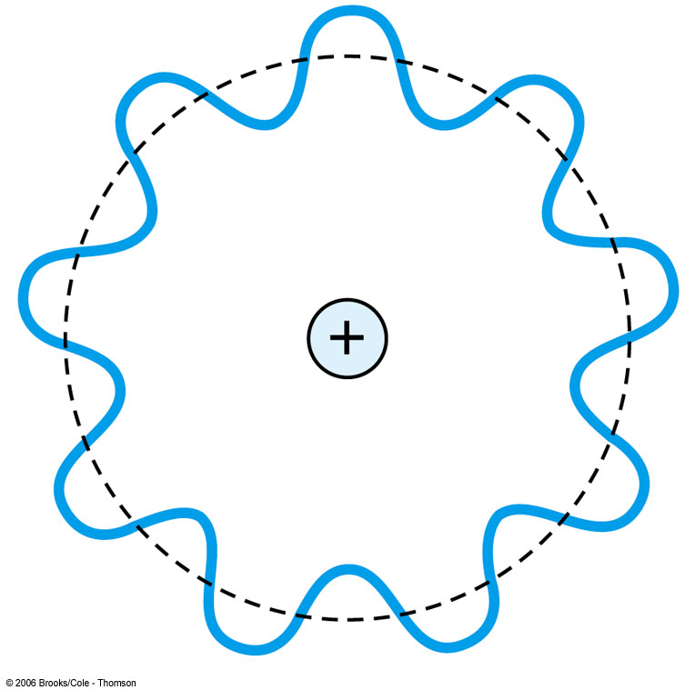
Bohr’s Quantization Condition
One of Bohr’s assumptions concerning his hydrogen atom model was that the angular momentum of the electron-nucleus system in a stationary state is an integral multiple of h/2π.
The electron is a standing wave in an orbit around the proton. This standing wave will have nodes and be an integral number of wavelengths.
The angular momentum becomes:

Slide 6
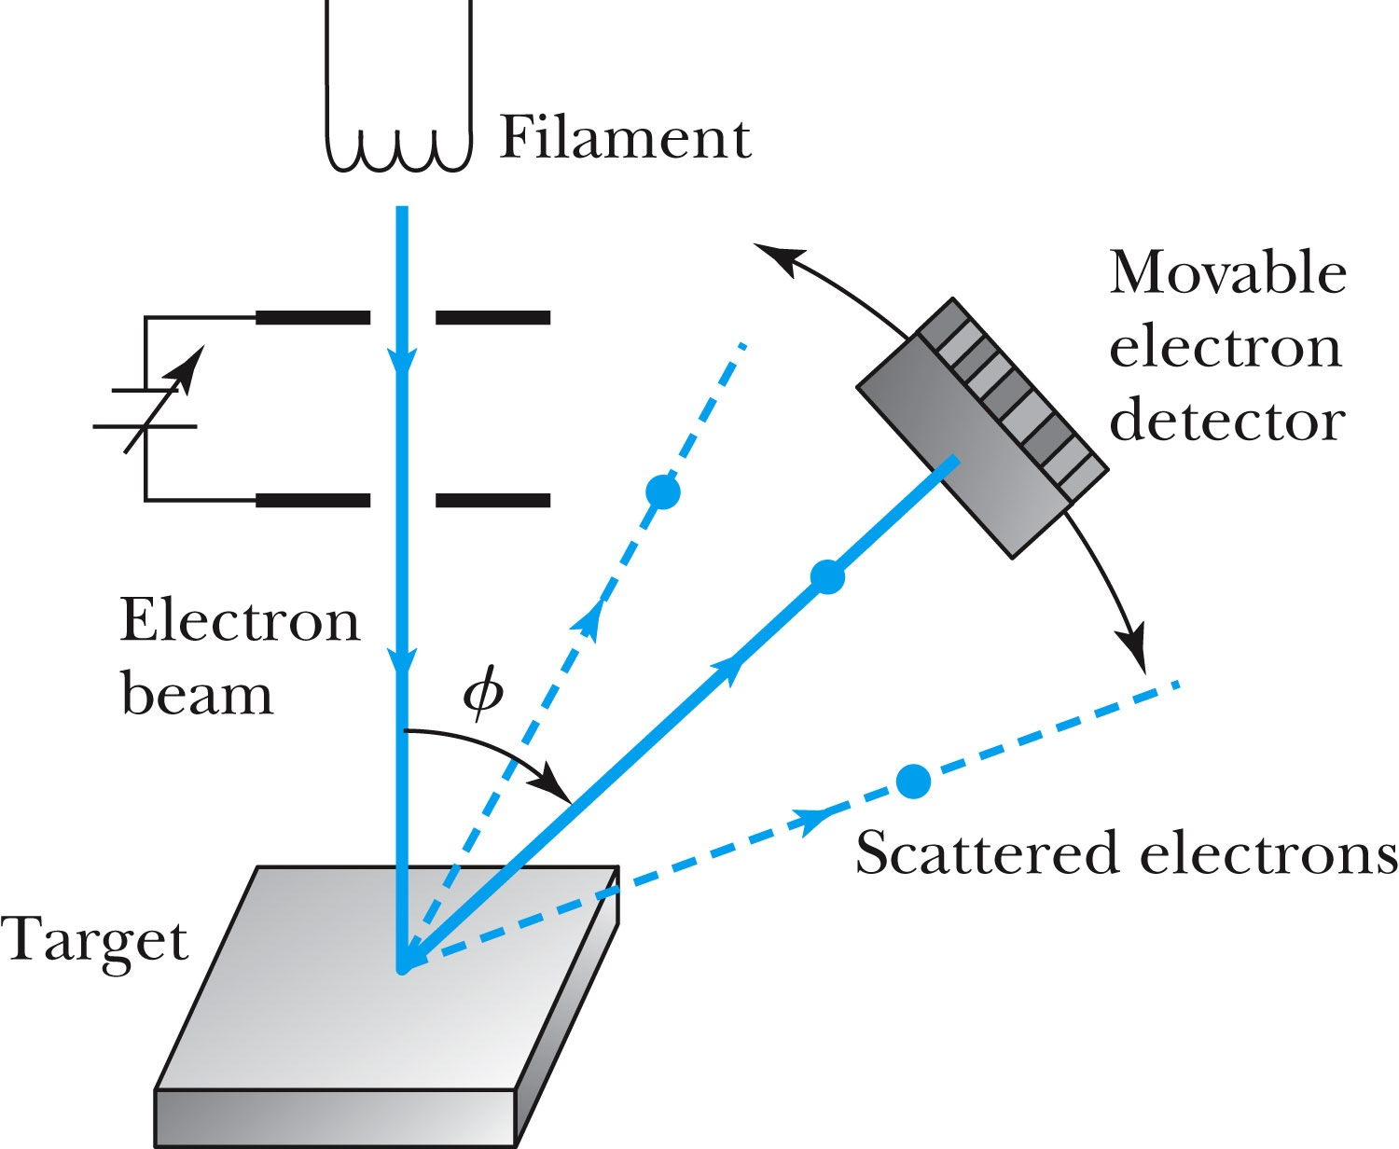
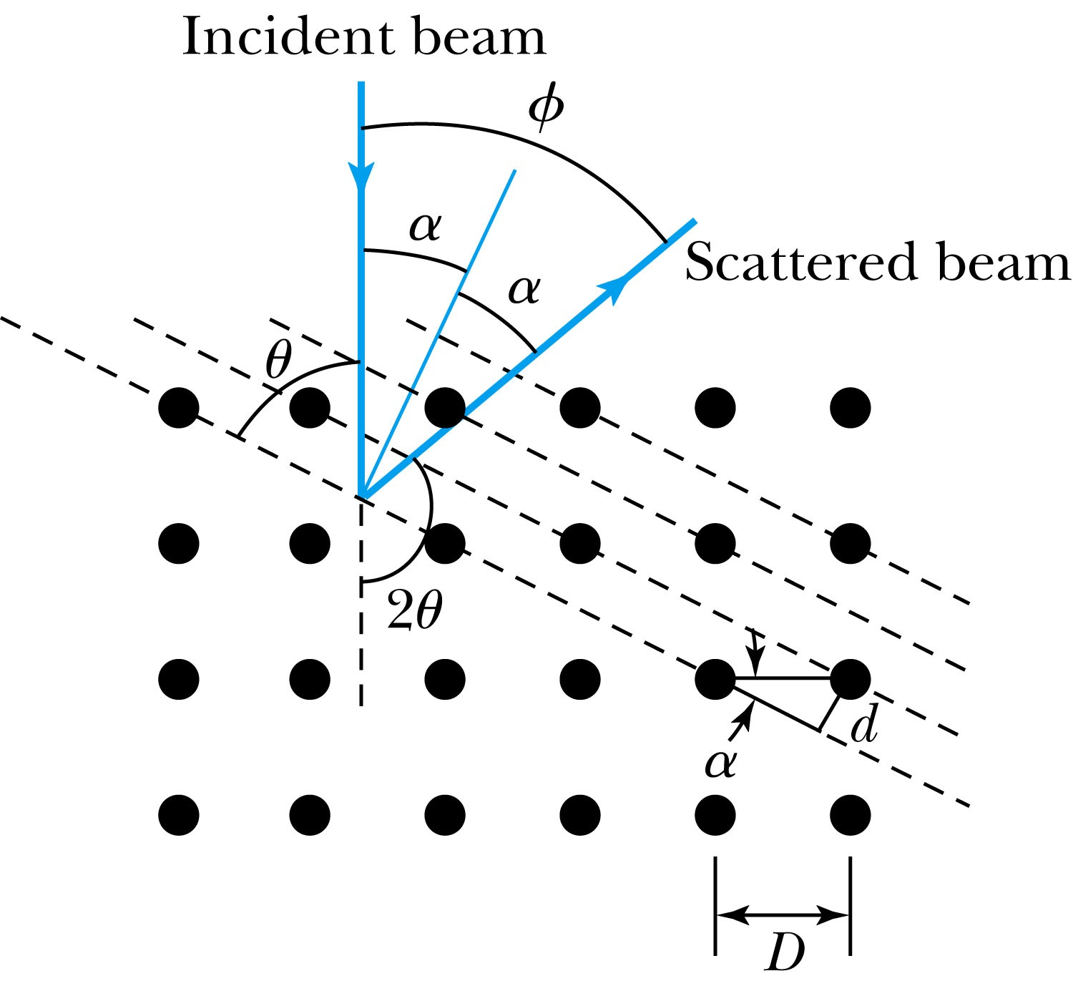
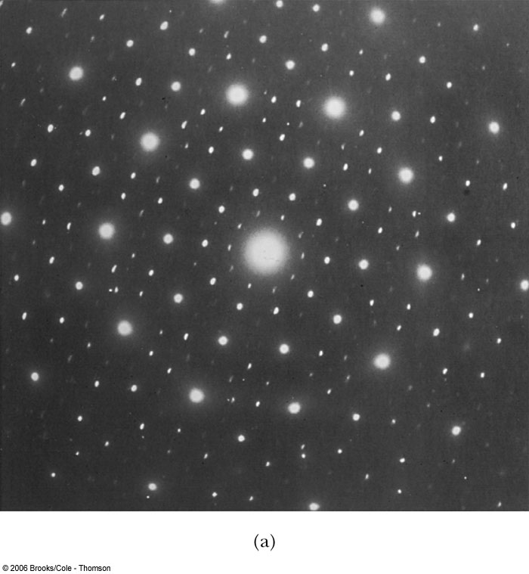
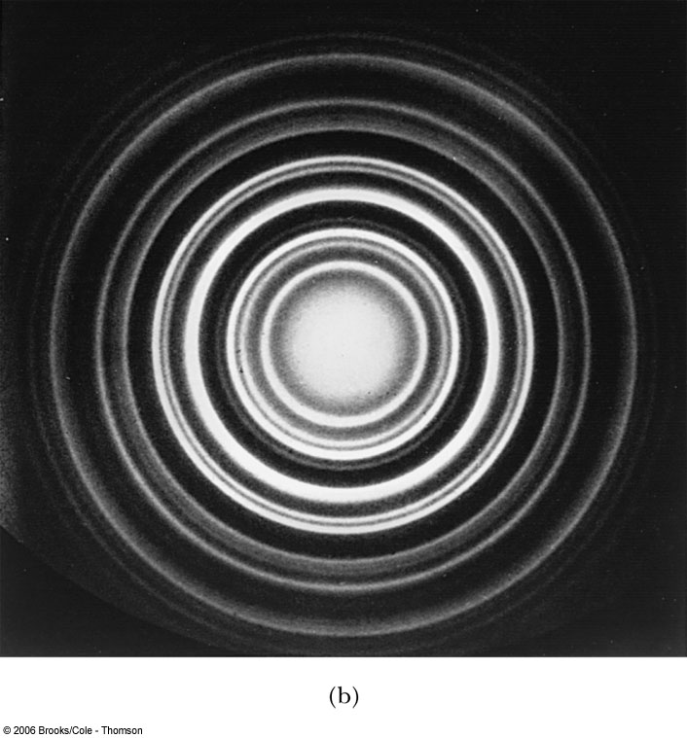
Electron Scattering
Davisson and Germer experimentally observed that electrons were diffracted much like x rays in nickel crystals. ➔ direct proof of De Broglie wave!
George P. Thomson (1892–1975), son of J. J. Thomson, reported seeing the effects of electron diffraction in transmission experiments. The first target was celluloid, and soon after that gold, aluminum, and platinum were used. The randomly oriented polycrystalline sample of SnO₂ produces rings as shown in the figure at right.

Slide 7
Photons, which we thought were waves, act particle like (eg Photoelectric effect or Compton Scattering)
Electrons, which we thought were particles, act particle like (eg electron scattering)
De Broglie: All matter has intrinsic wavelength.
Wave length inversely proportional to momentum
The more massive… the smaller the wavelength… the harder to observe the wavelike properties
So while photons appear mostly wavelike, electrons (next lightest particle!) appear mostly particle like.
How can we reconcile the wave/particle views?

Slide 8
Wave Motion
De Broglie matter waves suggest a further description. The displacement of a wave is
This is a solution to the wave equation
Define the wave number k and the angular frequency ω as:
The wave function is now:

Slide 9
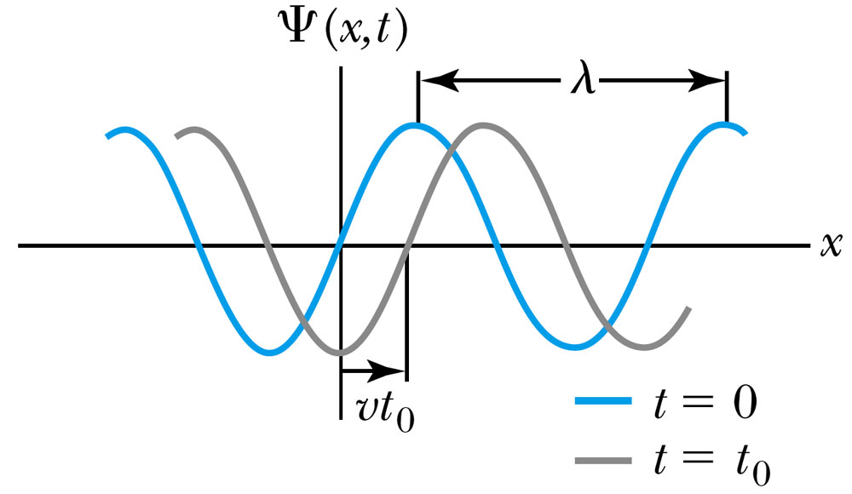
Wave Properties
The phase velocity is the velocity of a point on the wave that has a given phase (for example, the crest) and is given by
A phase constant φ shifts the wave:
.
(When φ=π/2)

Slide 10
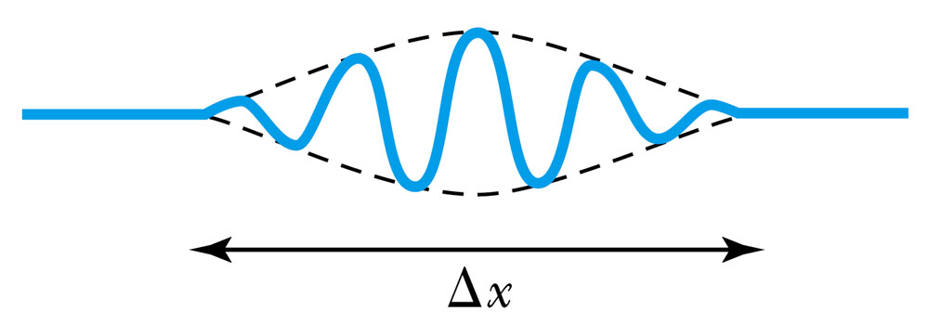
Principle of Superposition
When two or more waves traverse the same region, they act independently of each other.
Combining two waves yields:
The combined wave oscillates within an envelope that denotes the maximum displacement of the combined waves.
When combining many waves with different amplitudes and frequencies, a pulse, or wave packet, can be formed, which can move at a group velocity:

Slide 11
Fourier Series
Adding 2 waves isn’t localized in space… but adding lots of waves can be.
The sum of many waves that form a wave packet is called a Fourier series:
Summing an infinite number of waves yields the Fourier integral:

Slide 12
Wave Packet Envelope
The superposition of two waves yields a wave number and angular frequency of the wave packet envelope.
The range of wave numbers and angular frequencies that produce the wave packet have the following relations:
A Gaussian wave packet has similar relations:
The localization of the wave packet over a small region to describe a particle requires a large range of wave numbers. Conversely, a small range of wave numbers cannot produce a wave packet localized within a small distance.

Slide 13
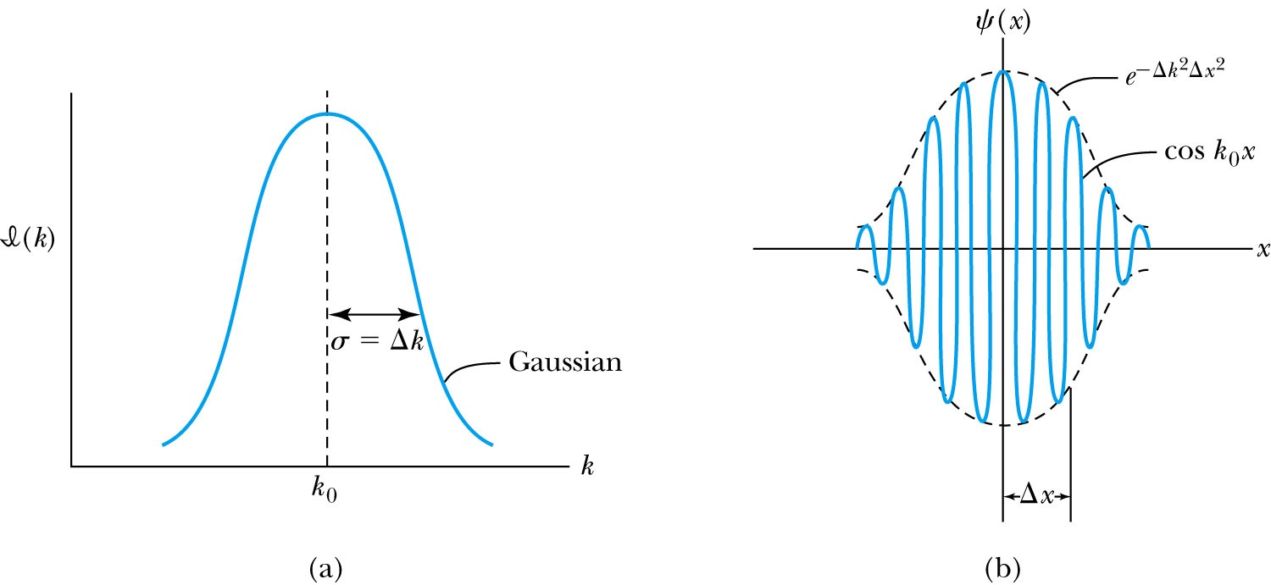
Gaussian Function
A Gaussian wave packet describes the envelope of a pulse wave.
The group velocity is

Slide 14
Dispersion
Considering the group velocity of a de Broglie wave packet yields:
The relationship between the phase velocity and the group velocity is
Hence the group velocity may be greater or less than the phase velocity. A medium is called nondispersive when the phase velocity is the same for all frequencies and equal to the group velocity.

Slide 15
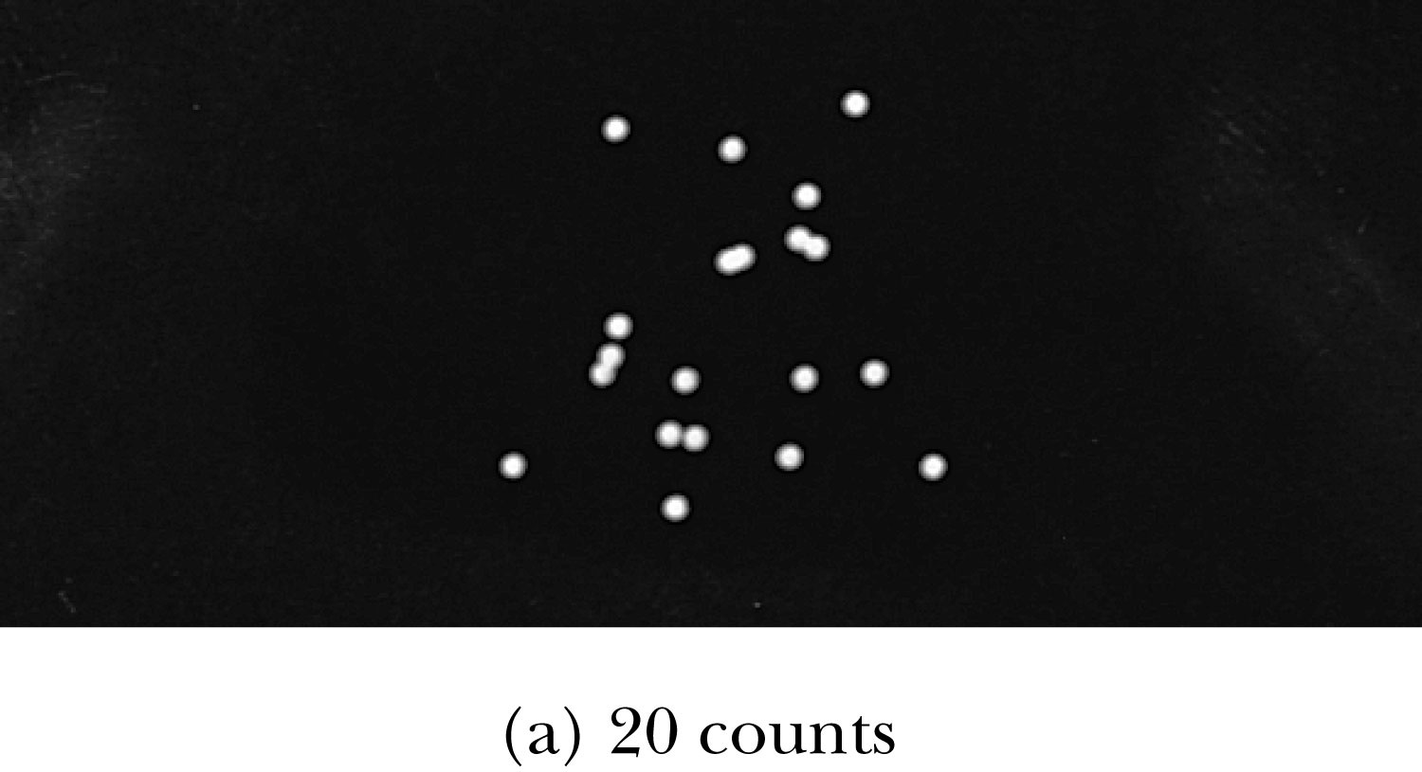
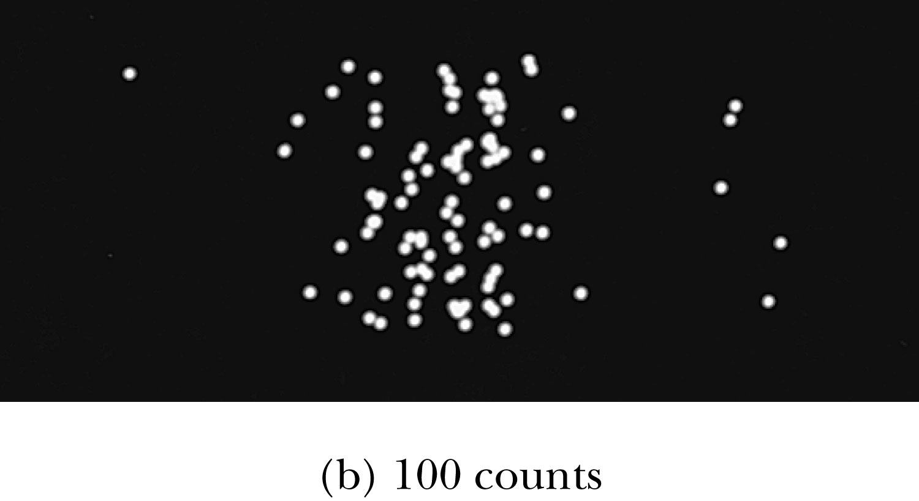
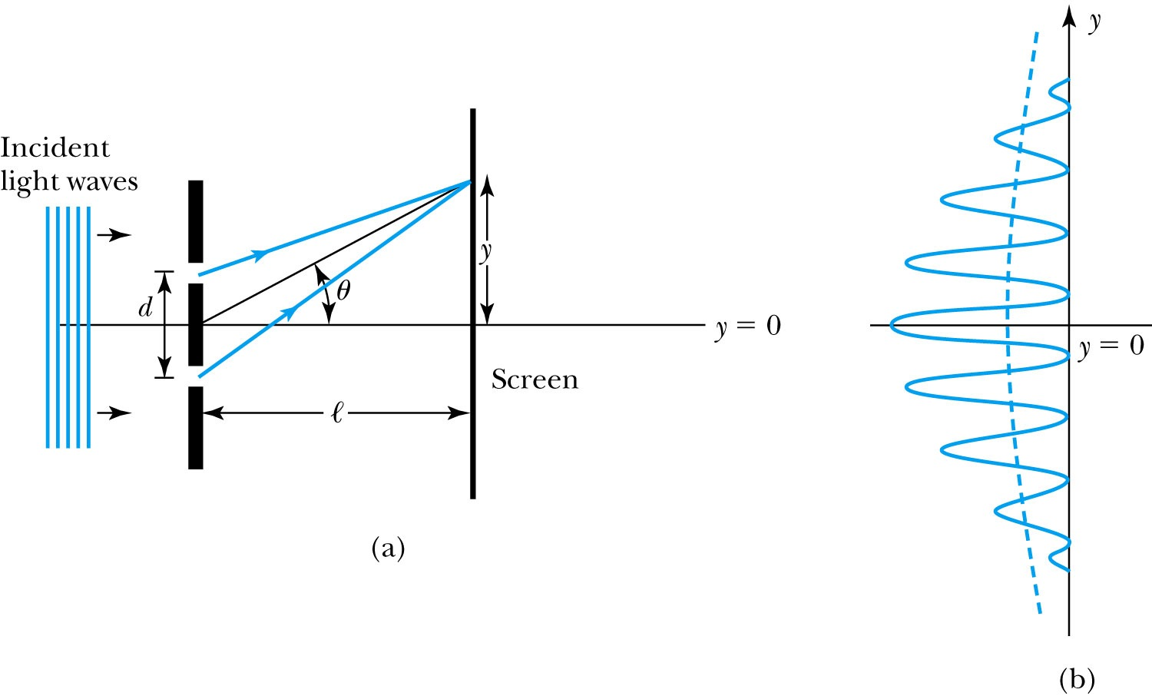
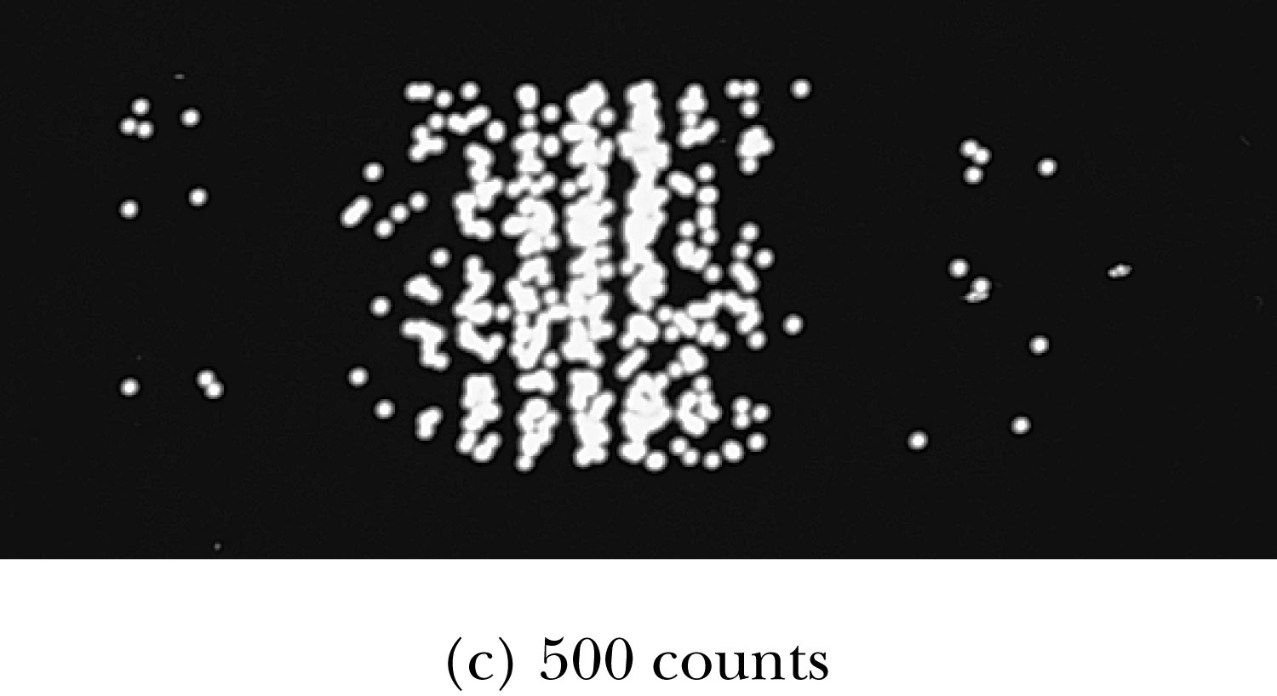
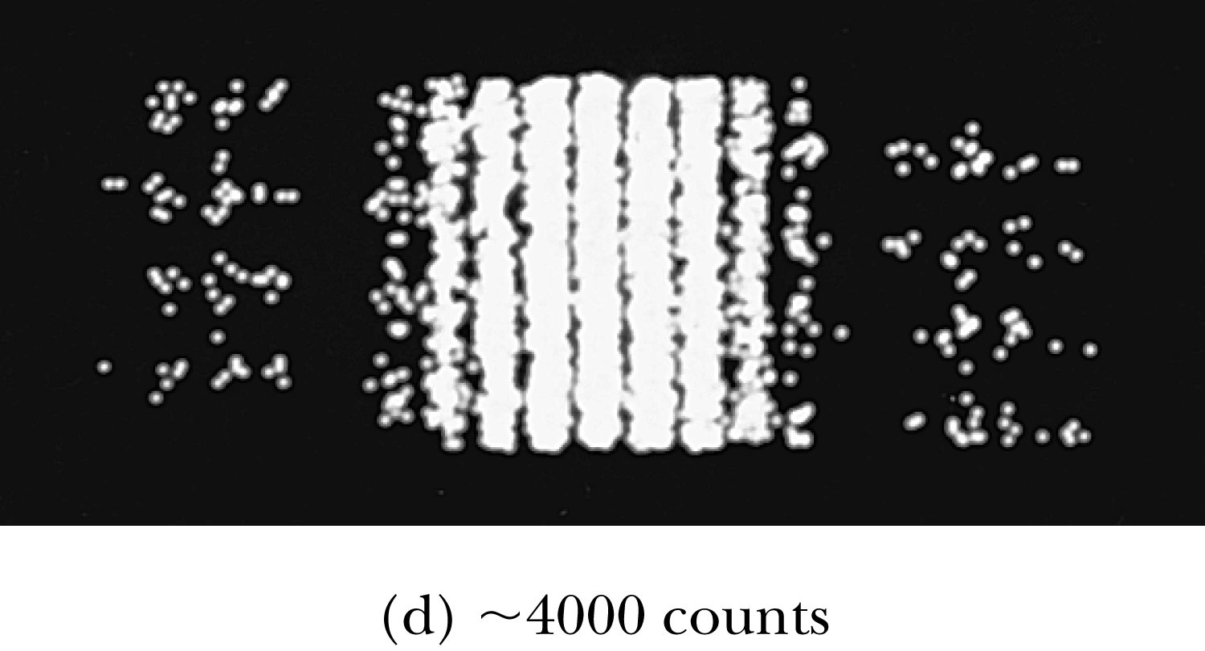
Waves or Particles?
Young’s double-slit diffraction experiment demonstrates the wave property of light.
However, dimming the light results in single flashes on the screen representative of particles.

Slide 16
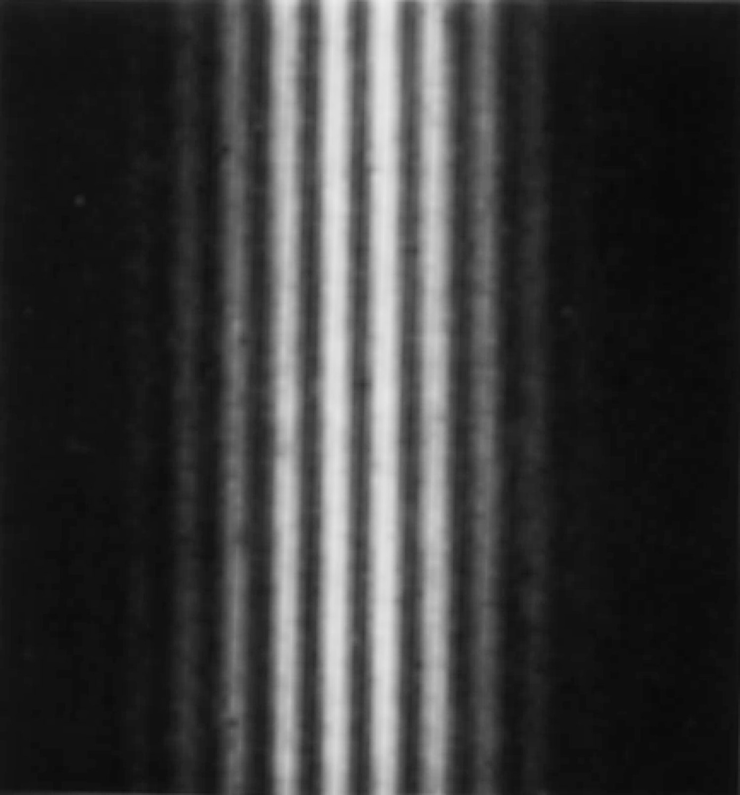
Electron Double-Slit Experiment
C. Jönsson of Tübingen, Germany, succeeded in 1961 in showing double-slit interference effects for electrons by constructing very narrow slits and using relatively large distances between the slits and the observation screen.
This experiment demonstrated that precisely the same behavior occurs for both light (waves) and electrons (particles).

Slide 17
Which slit?
To determine which slit the electron went through: We set up a light shining on the double slit and use a powerful microscope to look at the region. After the electron passes through one of the slits, light bounces off the electron; we observe the reflected light, so we know which slit the electron came through.
Use a subscript “ph” to denote variables for light (photon). Therefore the momentum of the photon is
The momentum of the electrons will be on the order of .
The difficulty is that the momentum of the photons used to determine which slit the electron went through is sufficiently great to strongly modify the momentum of the electron itself, thus changing the direction of the electron! The attempt to identify which slit the electron is passing through will in itself change the interference pattern.

Slide 18
Wave particle duality solution
The solution to the wave particle duality of an event is given by the following principle.
Bohr’s principle of complementarity: It is not possible to describe physical observables simultaneously in terms of both particles and waves.
Physical observables are the quantities such as position, velocity, momentum, and energy that can be experimentally measured. In any given instance we must use either the particle description or the wave description.

Slide 19
Uncertainty Principle
It is impossible to measure simultaneously, with no uncertainty, the precise values of k and x for the same particle. The wave number k may be rewritten as
For the case of a Gaussian wave packet we have
Thus for a single particle we have Heisenberg’s uncertainty principle:

Slide 20
Energy Uncertainty
If we are uncertain as to the exact position of a particle, for example an electron somewhere inside an atom, the particle can’t have zero kinetic energy.
The energy uncertainty of a Gaussian wave packet is
combined with the angular frequency relation
Energy-Time Uncertainty Principle: .

Slide 21
Probability, Wave Functions, and the Copenhagen Interpretation
The wave function determines the likelihood (or probability) of finding a particle at a particular position in space at a given time.
The total probability of finding the electron is 1. Forcing this condition on the wave function is called normalization.

Slide 22
The Copenhagen Interpretation
Bohr’s interpretation of the wave function consisted of 3 principles:
The uncertainty principle of Heisenberg
The complementarity principle of Bohr
The statistical interpretation of Born, based on probabilities determined by the wave function
Together these three concepts form a logical interpretation of the physical meaning of quantum theory. According to the Copenhagen interpretation, physics depends on the outcomes of measurement.

Slide 23
Particle in a Box
A particle of mass m is trapped in a one-dimensional box of width l.
The particle is treated as a wave.
The box puts boundary conditions on the wave. The wave function must be zero at the walls of the box and on the outside.
In order for the probability to vanish at the walls, we must have an integral number of half wavelengths in the box.
The energy of the particle is .
The possible wavelengths are quantized which yields the energy:
The possible energies of the particle are quantized.

