Slide 1
PHYS 3313 – Section 001 Lecture #17
Wednesday, Mar. 26, 2014
Dr. Jaehoon Yu
Probability of Particle
Schrodinger Wave Equation and Solutions
Normalization and Probability
Time Independent Schrodinger Equation
Expectation Values
Momentum Operator

Slide 2
Announcements
Research paper template has been uploaded onto the class web page link to research
Special colloquium on April 2, triple extra credit
Colloquium this Wednesday at 4pm in SH101

Slide 3
Special Project #4
Prove that the wave function Ψ=A[sin(kx-ωt)+icos(kx-ωt)] is a good solution for the time-dependent Schrödinger wave equation. Do NOT use the exponential expression of the wave function. (10 points)
Determine whether or not the wave function Ψ=Ae^{-α|x|} satisfy the time-dependent Schrödinger wave equation. (10 points)
Due for this special project is Monday, Apr. 7.
You MUST have your own answers!

Slide 4
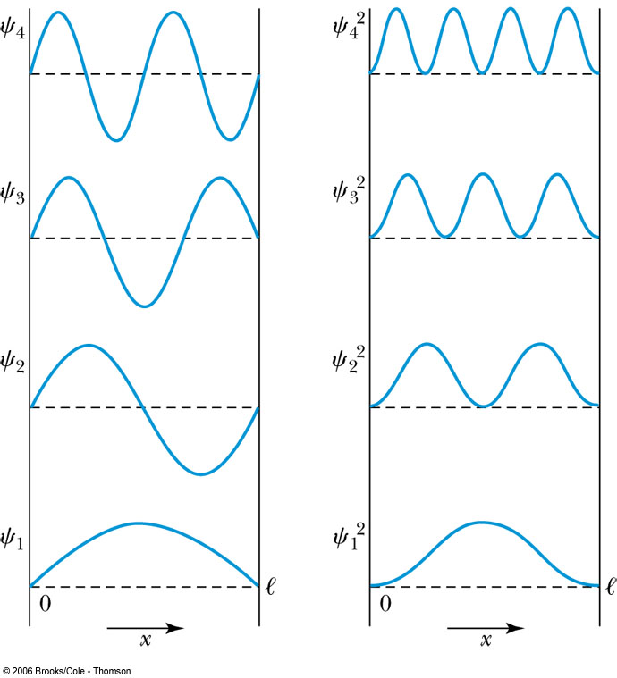
Probability of the Particle
The probability of observing the particle between x and x + dx in each state is
Note that E₀ = 0 is not a possible energy level.
The concept of energy levels, as first discussed in the Bohr model, has surfaced in a natural way by using waves.

Slide 5
The Schrödinger Wave Equation
Erwin Schrödinger and Werner Heinsenberg proposed quantum theory in 1920
The two proposed very different forms of equations
Heinserberg: Matrix based framework
Schrödinger: Wave mechanics, similar to the classical wave equation
Paul Dirac and Schrödinger later on proved that the two give identical results
The probabilistic nature of quantum theory is contradictory to the direct cause and effect seen in classical physics and makes it difficult to grasp!

Slide 6
The Schrödinger Wave Equation
The Schrödinger wave equation in its time-dependent form for a particle of energy E moving in a potential V in one dimension is
The extension into three dimensions is
where is an imaginary number

Slide 7
Ex 6.1: Wave equation and Superposition
The wave equation must be linear so that we can use the superposition principle to. Prove that the wave function in Schrodinger equation is linear by showing that it is satisfied for the wave equation Ψ (ξ,τ)=αΨ₁ (ξ,τ)+βΨ₂ (ξ,τ) where a and b are constants and Ψ₁ (ξ,τ) and Ψ₂ (ξ,τ) describe two waves each satisfying the Schrodinger Eq.
Rearrange terms

Slide 8
General Solution of the Schrödinger Wave Equation
The general form of the solution of the Schrödinger wave equation is given by:
which also describes a wave propagating in the x direction. In general the amplitude may also be complex. This is called the wave function of the particle.
The wave function is also not restricted to being real. Only the physically measurable quantities (or observables) must be real. These include the probability, momentum and energy.

Slide 9
Ex 6.2: Solution for Wave Equation
Show that Ae^{i(kx-ωt)} satisfies the time-dependent Schrodinger wave Eq.
So Ae^{i(kx-ωt)} is a good solution and satisfies Schrodinger Eq.

Slide 10
Ex 6.3: Bad Solution for Wave Equation
Determine Ψ (ξ,τ)=Asin(kx-ωt) is an acceptable solution for the time-dependent Schrodinger wave Eq.
This is not true in all x and t. So Ψ (x,t)=Asin(kx-ωt) is not an acceptable solution for Schrodinger Eq.

Slide 11
Normalization and Probability
The probability P(x) dx of a particle being between x and X + dx was given in the equation
Here Ψ* denotes the complex conjugate of Ψ
The probability of the particle being between x₁ and x₂ is given by
The wave function must also be normalized so that the probability of the particle being somewhere on the x axis is 1.

Slide 12
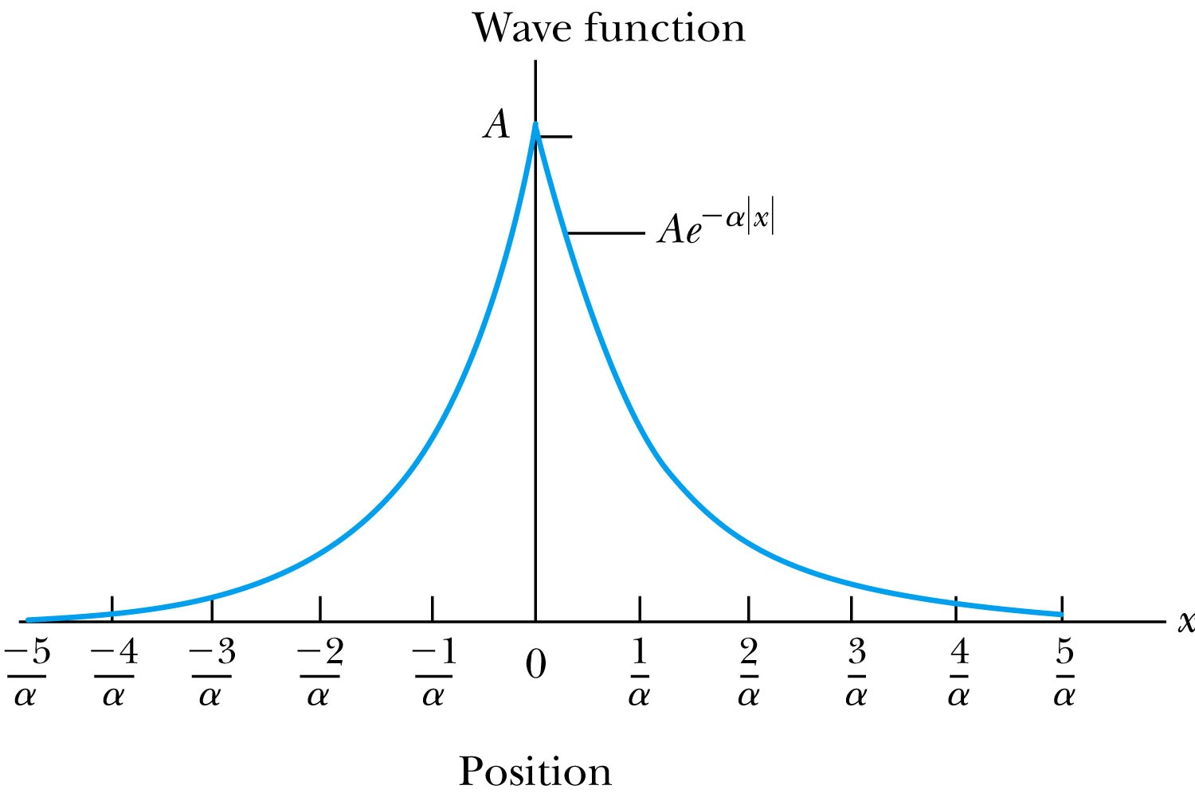
Ex 6.4: Normalization
Consider a wave packet formed by using the wave function that Ae^{-α|ξ|}, where A is a constant to be determined by normalization. Normalize this wave function and find the probabilities of the particle being between 0 and 1/α, and between 1/α and 2/α.
Probability density
Normalized Wave Function

Slide 13
Ex 6.4: Normalization, cont’d
Using the wave function, we can compute the probability for a particle to be with 0 to 1/α and 1/α to 2/α.
For 0 to 1/α:
For 1/α to 2/α:
How about 2/α:to ∞?

Slide 14
Properties of Valid Wave Functions
Boundary conditions
To avoid infinite probabilities, the wave function must be finite everywhere.
To avoid multiple values of the probability, the wave function must be single valued.
For finite potentials, the wave function and its derivatives must be continuous. This is required because the second-order derivative term in the wave equation must be single valued. (There are exceptions to this rule when V is infinite.)
In order to normalize the wave functions, they must approach zero as x approaches infinity.
Solutions that do not satisfy these properties do not generally correspond to physically realizable circumstances.

Slide 15
Time-Independent Schrödinger Wave Equation
The potential in many cases will not depend explicitly on time.
The dependence on time and position can then be separated in the Schrödinger wave equation. Let,
which yields:
Now divide by the wave function:
The left side of this last equation depends only on time, and the right side depends only on spatial coordinates. Hence each side must be equal to a constant. The time dependent side is

Slide 16
Time-Independent Schrödinger Wave Equation(con’t)
We integrate both sides and find:
where C is an integration constant that we may choose to be 0. Therefore
This determines f to be by comparing it to the wave function of a free particle
This is known as the time-independent Schrödinger wave equation, and it is a fundamental equation in quantum mechanics.

Slide 17
Stationary State
Recalling the separation of variables:
and with f(t) = the wave function can be written as:
The probability density becomes:
The probability distributions are constant in time. This is a standing wave phenomena that is called the stationary state.

Slide 18
Comparison of Classical and Quantum Mechanics
Newton’s second law and Schrödinger’s wave equation are both differential equations.
Newton’s second law can be derived from the Schrödinger wave equation, so the latter is the more fundamental.
Classical mechanics only appears to be more precise because it deals with macroscopic phenomena. The underlying uncertainties in macroscopic measurements are just too small to be significant due to the small size of the Planck’s constant

Slide 19
Expectation Values
In quantum mechanics, measurements can only be expressed in terms of average behaviors since precision measurement of each event is impossible (what principle is this?)
The expectation value is the expected result of the average of many measurements of a given quantity. The expectation value of x is denoted by <x>.
Any measurable quantity for which we can calculate the expectation value is called a physical observable. The expectation values of physical observables (for example, position, linear momentum, angular momentum, and energy) must be real, because the experimental results of measurements are real.
The average value of x is

Slide 20
Continuous Expectation Values
We can change from discrete to continuous variables by using the probability P(x,t) of observing the particle at a particular x.
Using the wave function, the expectation value is:
The expectation value of any function g(x) for a normalized wave function:

Slide 21
Momentum Operator
To find the expectation value of p, we first need to represent p in terms of x and t. Consider the derivative of the wave function of a free particle with respect to x:
With k = p / ħ we have
This yields
This suggests we define the momentum operator as .
The expectation value of the momentum is

