Slide 1
PHYS 3313 – Section 001 Lecture #18
Monday, Mar. 31, 2014
Dr. Jaehoon Yu
Valid Wave Functions
Energy and Position Operators
Infinite Square Well Potential
Finite Square Well Potential

Slide 2
Announcements
Research paper template has been uploaded onto the class web page link to research
Special colloquium at 4pm, this Wednesday, April 2, triple extra credit
Quiz #3 at the beginning of the class next Monday, Apr. 7
Covers CH 5.1 through what we finish this Wednesday

Slide 3
Reminder: Special Project #4
Prove that the wave function Ψ=A[sin(kx-ωt)+icos(kx-ωt)] is a good solution for the time-dependent Schrödinger wave equation. Do NOT use the exponential expression of the wave function. (10 points)
Determine whether or not the wave function Ψ=Ae^{-α|x|} satisfy the time-dependent Schrödinger wave equation. (10 points)
Due for this special project is Monday, Apr. 7.
You MUST have your own answers!

Slide 4
Properties of Valid Wave Functions
Boundary conditions
To avoid infinite probabilities, the wave function must be finite everywhere.
To avoid multiple values of the probability, the wave function must be single valued.
For finite potentials, the wave function and its derivatives must be continuous. This is required because the second-order derivative term in the wave equation must be single valued. (There are exceptions to this rule when V is infinite.)
In order to normalize the wave functions, they must approach zero as x approaches infinity.
Solutions that do not satisfy these properties do not generally correspond to physically realizable circumstances.

Slide 5
Expectation Values
In quantum mechanics, measurements can only be expressed in terms of average behaviors since precision measurement of each event is impossible (what principle is this?)
The expectation value is the expected result of the average of many measurements of a given quantity. The expectation value of x is denoted by <x>.
Any measurable quantity for which we can calculate the expectation value is called a physical observable. The expectation values of physical observables (for example, position, linear momentum, angular momentum, and energy) must be real, because the experimental results of measurements are real.
The average value of x is

Slide 6
Continuous Expectation Values
We can change from discrete to continuous variables by using the probability P(x,t) of observing the particle at a particular x.
Using the wave function, the expectation value is:
The expectation value of any function g(x) for a normalized wave function:

Slide 7
Momentum Operator
To find the expectation value of p, we first need to represent p in terms of x and t. Consider the derivative of the wave function of a free particle with respect to x:
With k = p / ħ we have
This yields
This suggests we define the momentum operator as .
The expectation value of the momentum is

Slide 8
Position and Energy Operators
The position x is its own operator as seen above.
The time derivative of the free-particle wave function is
Substituting ω = E / ħ yields
So the energy operator is
The expectation value of the energy is

Slide 9
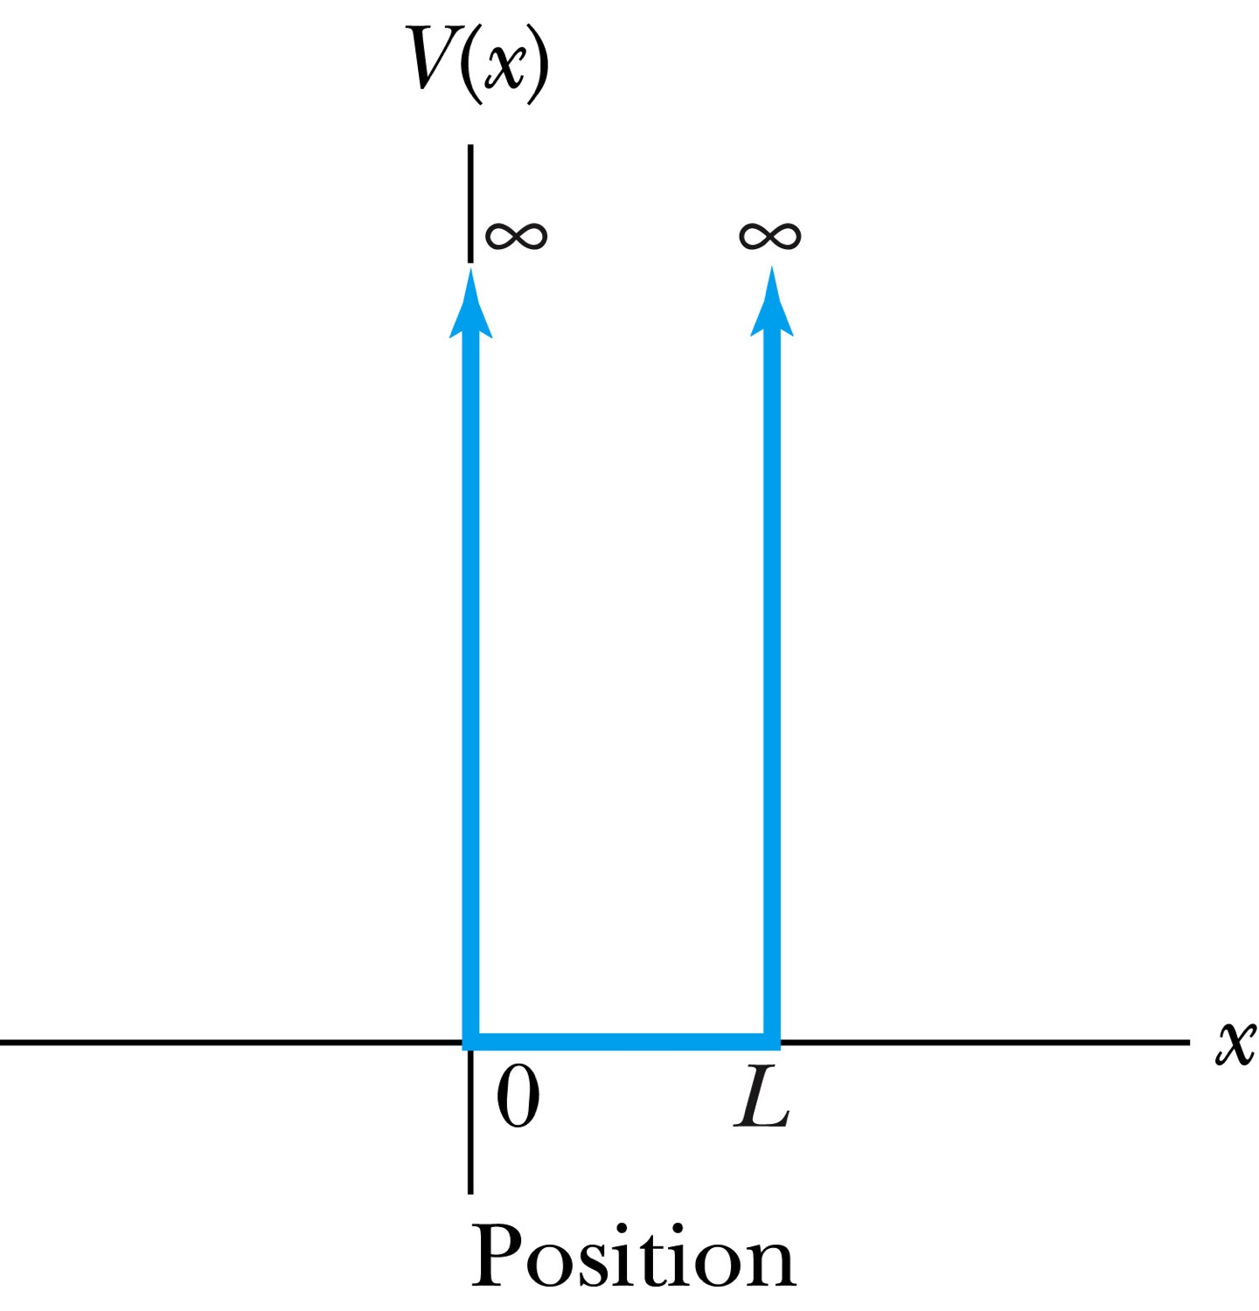
Infinite Square-Well Potential
The simplest such system is that of a particle trapped in a box with infinitely hard walls that the particle cannot penetrate. This potential is called an infinite square well and is given by
The wave function must be zero where the potential is infinite.
Where the potential is zero inside the box, the time independent Schrödinger wave equation becomes where .
The general solution is .

Slide 10
Quantization
Since the wave function must be continuous, the boundary conditions of the potential dictate that the wave function must be zero at x = 0 and x = L. These yield valid solutions for B=0, and for integer values of n such that kL = nπ ➔ k=nπ/L
The wave function is now
We normalize the wave function
The normalized wave function becomes
These functions are identical to those obtained for a vibrating string with fixed ends.

Slide 11
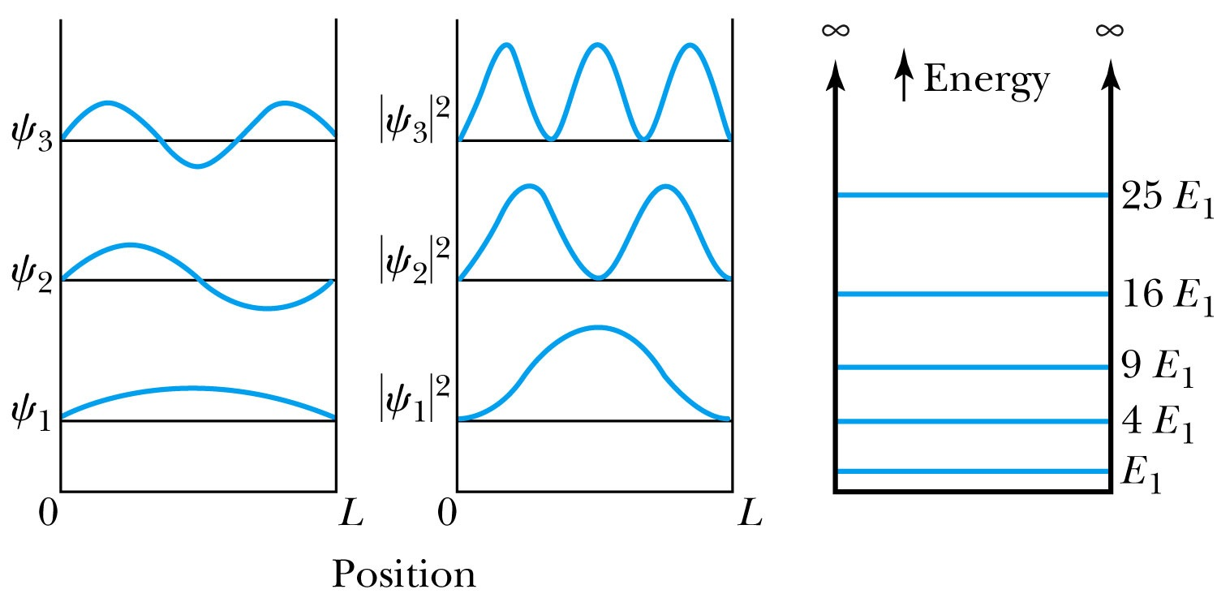
Quantized Energy
The quantized wave number now becomes
Solving for the energy yields
Note that the energy depends on the integer values of n. Hence the energy is quantized and nonzero.
The special case of n = 1 is called the ground state energy.

