Slide 1
PHYS 3313 – Section 001 Lecture #19
Wednesday, Apr. 2, 2014
Dr. Jaehoon Yu
Infinite Square Well Potential
Finite Square Well Potential
Penetration Depth
3D Infinite Potential Well

Slide 2
Announcements
Research paper template has been uploaded onto the class web page link to research
Homework #4
End of chapter problems on CH5: 8, 10, 16, 24, 26, 36 and 47
Due Wednesday, Apr. 9
Quiz #3 at the beginning of the class Monday, Apr. 7
Covers CH 5.1 through CH6.4
Special colloquium at 4pm, today for triple extra credit
Dr. Gerald Blazey of the White House

Slide 3
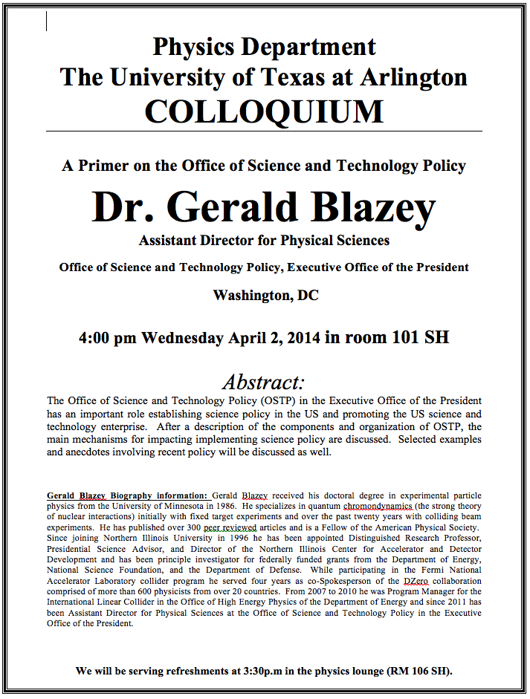

Slide 4
Reminder: Special Project #4
Prove that the wave function Ψ=A[sin(kx-ωt)+icos(kx-ωt)] is a good solution for the time-dependent Schrödinger wave equation. Do NOT use the exponential expression of the wave function. (10 points)
Determine whether or not the wave function Ψ=Ae^{-α|x|} satisfy the time-dependent Schrödinger wave equation. (10 points)
Due for this special project is Monday, Apr. 7.
You MUST have your own answers!

Slide 5
Special project #5
Show that the Schrodinger equation becomes Newton’s second law in the classical limit. (15 points)
Deadline Monday, Apr. 21, 2014
You MUST have your own answers!

Slide 6
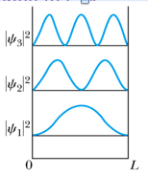
How does this correspond to Classical Mech.?
What is the probability of finding a particle in a box of length L?
Bohr’s correspondence principle says that QM and CM must correspond to each other! When?
When n becomes large, the QM approaches to CM
So when n→∞, the probability of finding a particle in a box of length L is
Which is identical to the CM probability!!
One can also see this from the plot of P!

Slide 7
Details of the computation

Slide 8
Ex 6.8: Expectation values inside a box
Determine the expectation values for x, x², p and p² of a particle in an infinite square well for the first excited state.
What is the wave function of the first excited state?
n=?
2

Slide 9
Ex 6.9: Proton Transition Energy
A typical diameter of a nucleus is about 10⁻¹⁴m. Use the infinite square-well potential to calculate the transition energy from the first excited state to the ground state for a proton confined to the nucleus.
The energy of the state n is
What is n for the ground state?
n=1
What is n for the 1st excited state?
n=2
So the proton transition energy is

Slide 10
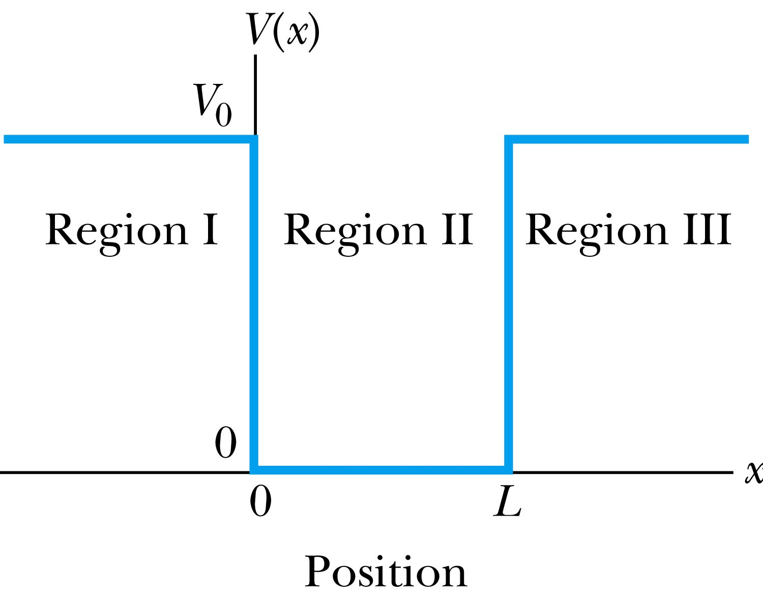
Finite Square-Well Potential
The finite square-well potential is
The Schrödinger equation outside the finite well in regions I and III is
for regions I and III, or using
yields . The solution to this differential has exponentials of the form e^{αx} and e^{-αx}. In the region x > L, we reject the positive exponential and in the region x < 0, we reject the negative exponential. Why?
This is because the wave function should be 0 as x→infinity.

Slide 11
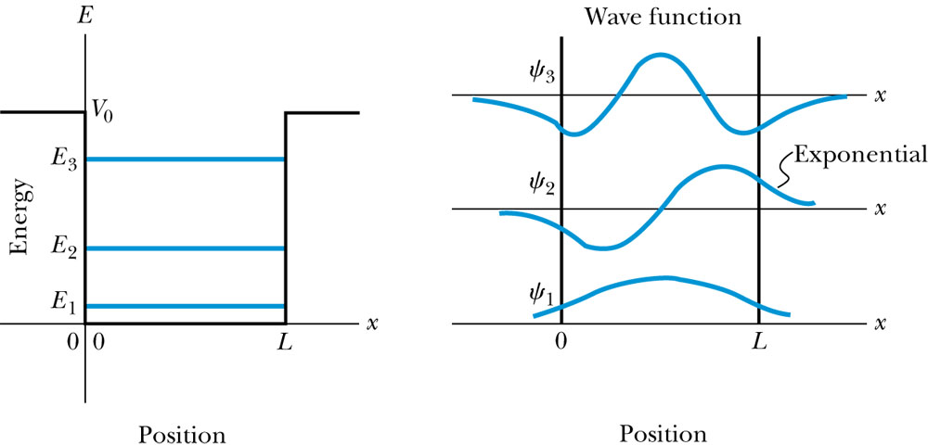
Finite Square-Well Solution
Inside the square well, where the potential V is zero and the particle is free, the wave equation becomes where
Instead of a sinusoidal solution we can write
The boundary conditions require that
and the wave function must be smooth where the regions meet.
Note that the wave function is nonzero outside of the box.
Non-zero at the boundary either..
What would the energy look like?

Slide 12
Penetration Depth
The penetration depth is the distance outside the potential well where the probability significantly decreases. It is given by
It should not be surprising to find that the penetration distance that violates classical physics is proportional to Planck’s constant.

