Slide 1
PHYS 3313 – Section 001 Lecture #20
Monday, Apr. 7, 2014
Dr. Jaehoon Yu
3D Infinite Potential Well
Degeneracy
Simple Harmonic Oscillator
Barriers and Tunneling

Slide 2
Announcements
Research paper deadline is Monday, Apr. 28
Research presentation deadline is Sunday, Apr. 27
Reminder: Homework #4
End of chapter problems on CH5: 8, 10, 16, 24, 26, 36 and 47
Due this Wednesday, Apr. 9
Bring out special project #4 at the end of class

Slide 3
Reminder: Special project #5
Show that the Schrodinger equation becomes Newton’s second law in the classical limit. (15 points)
Deadline Monday, Apr. 21, 2014
You MUST have your own answers!

Slide 4
Three-Dimensional Infinite-Potential Well
The wave function must be a function of all three spatial coordinates.
We begin with the conservation of energy
Multiply this by the wave function to get
Now consider momentum as an operator acting on the wave function. In this case, the operator must act twice on each dimension. Given:
The three dimensional Schrödinger wave equation is
Rewrite

Slide 5
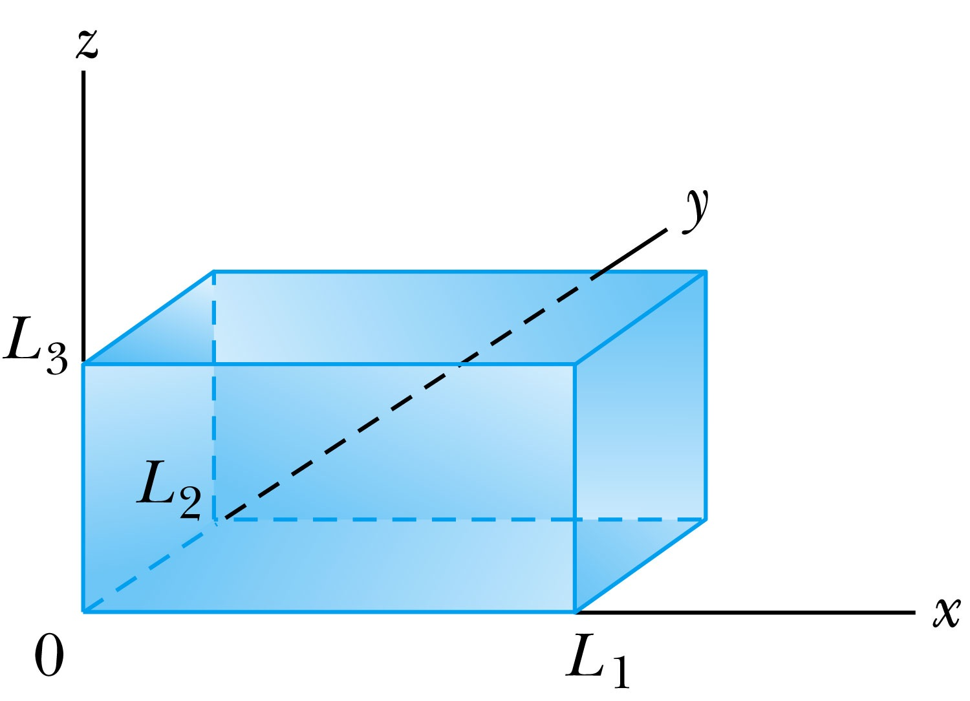
Ex 6.10: Expectation values inside a box
Consider a free particle inside a box with lengths L₁, L₂ and L₃ along the x, y, and z axes, respectively, as shown in the Figure. The particle is constrained to be inside the box. Find the wave functions and energies. Then find the ground energy and wave function and the energy of the first excited state for a cube of sides L.
What are the boundary conditions for this situation?
Particle is free, so x, y and z wave functions are independent from each other!
Each wave function must be 0 at the wall!
Inside the box, potential V is 0.
A reasonable solution is
Using the boundary condition
So the wave numbers are

Slide 6
Ex 6.10: Expectation values inside a box
Consider a free particle inside a box with lengths L₁, L₂ and L₃ along the x, y, and z axes, respectively, as shown in Fire. The particle is constrained to be inside the box. Find the wave functions and energies. Then find the round energy and wave function and the energy of the first excited state for a cube of sides L.
The energy can be obtained through the Schrödinger equation
What is the ground state energy?
E_{1,1,1} when n₁=n₂=n₃=1, how much?
When are the energies the same for different combinations of n_{i}?

Slide 7
Degeneracy*
Analysis of the Schrödinger wave equation in three dimensions introduces three quantum numbers that quantize the energy.
A quantum state is degenerate when there is more than one wave function for a given energy.
Degeneracy results from particular properties of the potential energy function that describes the system. A perturbation of the potential energy, such as the spin under a B field, can remove the degeneracy.
*Mirriam-webster: having two or more states or subdivisions

