Slide 1
PHYS 3313 – Section 001 Lecture #21
Wednesday, Apr. 9, 2014
Dr. Jaehoon Yu
Simple Harmonic Oscillator
Barriers and Tunneling
Alpha Particle Decay
Use of Schrodinger Equation on Hydrogen Atom
Solutions for Schrodinger Equation for Hydrogen Atom

Slide 2
Announcements
Research paper deadline is Monday, Apr. 28
Research presentation deadline is Sunday, Apr. 27
Homework #5
CH6 end of chapter problems: 34, 39, 46, 62 and 65
Due Wednesday, Apr. 16
Reading assignments
CH7.6 and the entire CH8
Bring out homework #4 at the end of class
Quiz results
Class average: 27.7/50
Equivalent to 55.4/100
Previous quizzes: 30.2/100 and 53.4/100
Top score: 50/50
Colloquium today, Dr. Hadavand of UTA

Slide 3
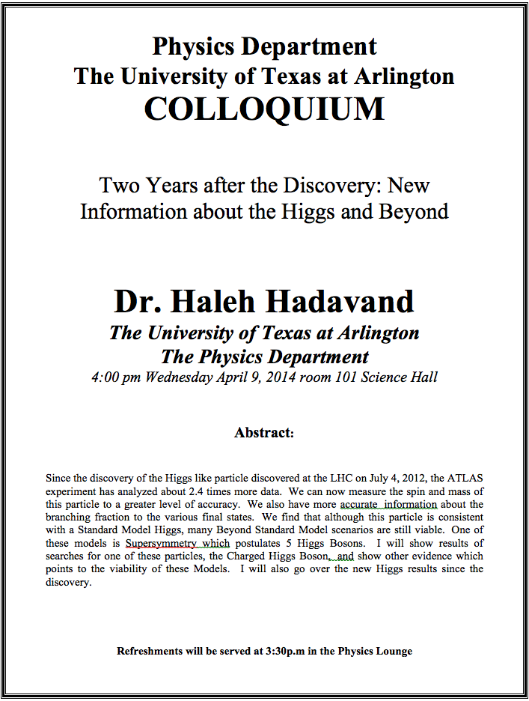

Slide 4
Reminder: Special project #5
Show that the Schrodinger equation becomes Newton’s second law in the classical limit. (15 points)
Deadline Monday, Apr. 21, 2014
You MUST have your own answers!

Slide 5
Reminder: Research Project Report
Must contain the following at the minimum
Original theory or Original observation
Experimental proofs or Theoretical prediction + subsequent experimental proofs
Importance and the impact of the theory/experiment
Conclusions
Each member of the group writes a 10 (max) page report, including figures
10% of the total grade
Can share the theme and facts but you must write your own!
Text of the report must be your original!
Due Mon., Apr. 28, 2014

Slide 6
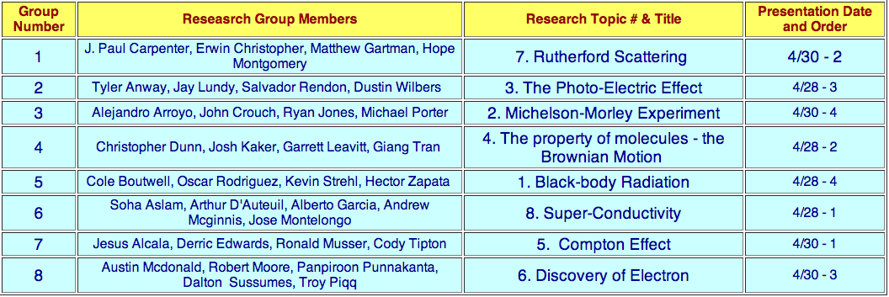

Slide 7
Research Presentations
Each of the 10 research groups makes a 10min presentation
8min presentation + 2min Q&A
All presentations must be in power point
I must receive all final presentation files by 8pm, Sunday, Apr. 27
No changes are allowed afterward
The representative of the group makes the presentation followed by all group members’ participation in the Q&A session
Date and time:
In class Monday, Apr. 28 or in class Wednesday, Apr. 30
Important metrics
Contents of the presentation: 60%
Inclusion of all important points as mentioned in the report
The quality of the research and making the right points
Quality of the presentation itself: 15%
Presentation manner: 10%
Q&A handling: 10%
Staying in the allotted presentation time: 5%
Judging participation and sincerity: 5%

Slide 8
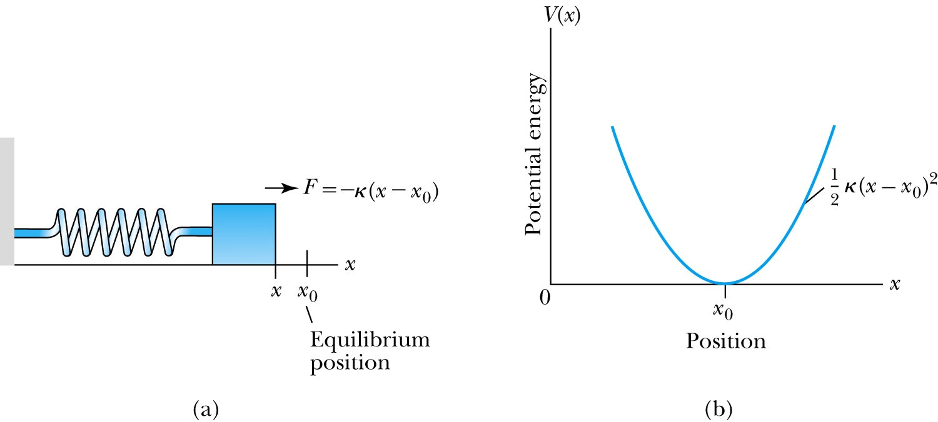
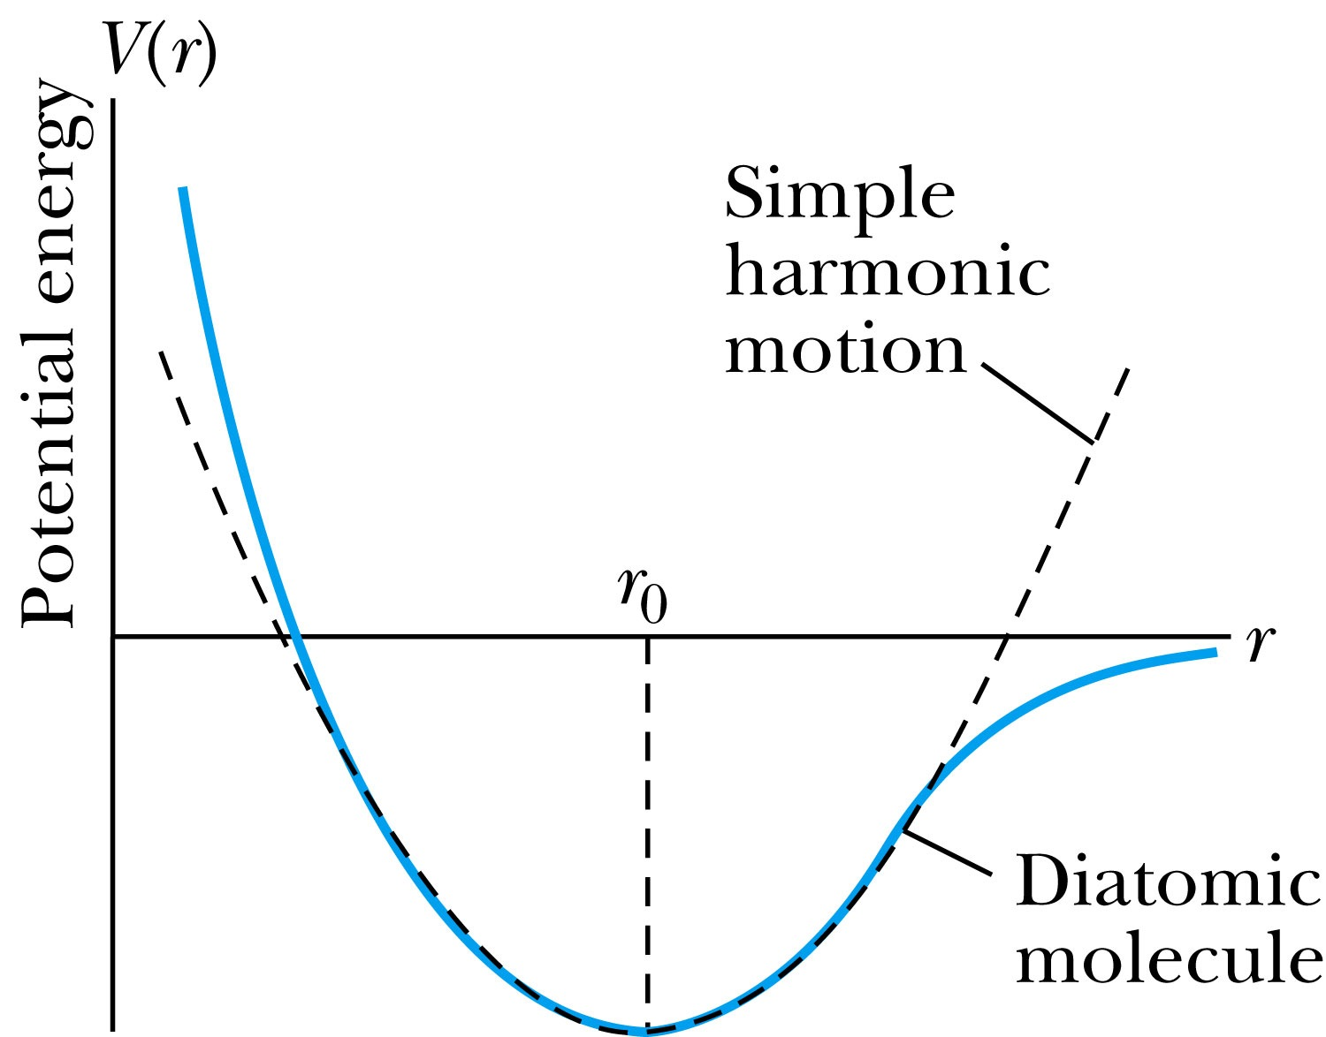
The Simple Harmonic Oscillator
Simple harmonic oscillators describe many physical situations: springs, diatomic molecules and atomic lattices.
Consider the Taylor expansion of a potential function:
The minimum potential at x=x₀, so dV/dx=0 and V₁=0; and the zero potential V₀=0, we have
Substituting this into the wave equation:
Let and which yields .

Slide 9
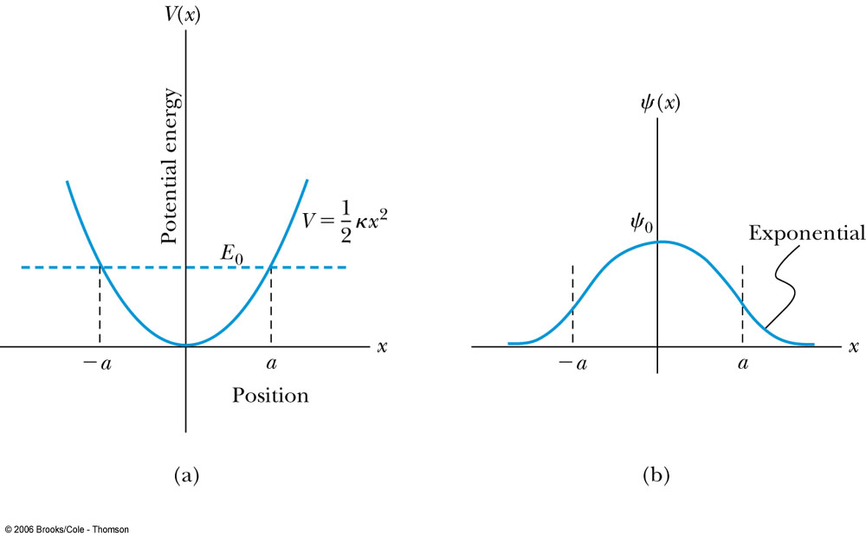
Parabolic Potential Well
If the lowest energy level is zero, this violates the uncertainty principle.
The wave function solutions are where H_{n}(x) are Hermite polynomial function of order n.
In contrast to the particle in a box, where the oscillatory wave function is a sinusoidal curve, in this case the oscillatory behavior is due to the polynomial, which dominates at small x. The exponential tail is provided by the Gaussian function, which dominates at large x.

Slide 10
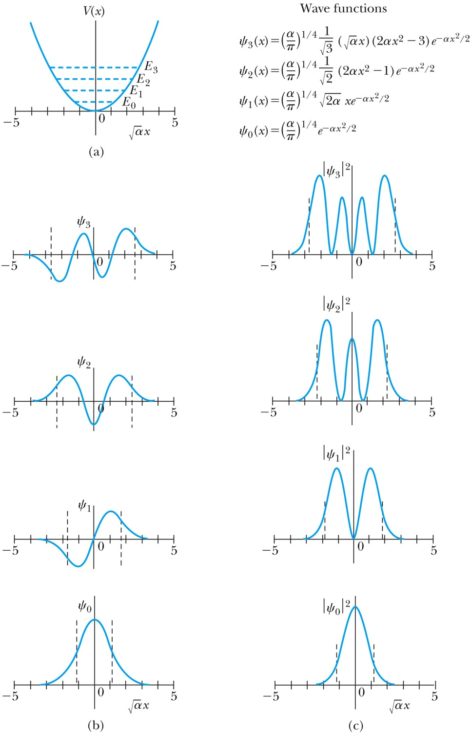
Analysis of the Parabolic Potential Well
The energy levels are given by
The zero point energy is called the Heisenberg limit:
Classically, the probability of finding the mass is greatest at the ends of motion’s range and smallest at the center (that is, proportional to the amount of time the mass spends at each position).
Contrary to the classical one, the largest probability for this lowest energy state is for the particle to be at the center.

Slide 11
Ex. 6.12: Harmonic Oscillator stuff
Normalize the ground state wave function ψ₀ for the simple harmonic oscillator and find the expectation values <x> and <x²>.

Slide 12
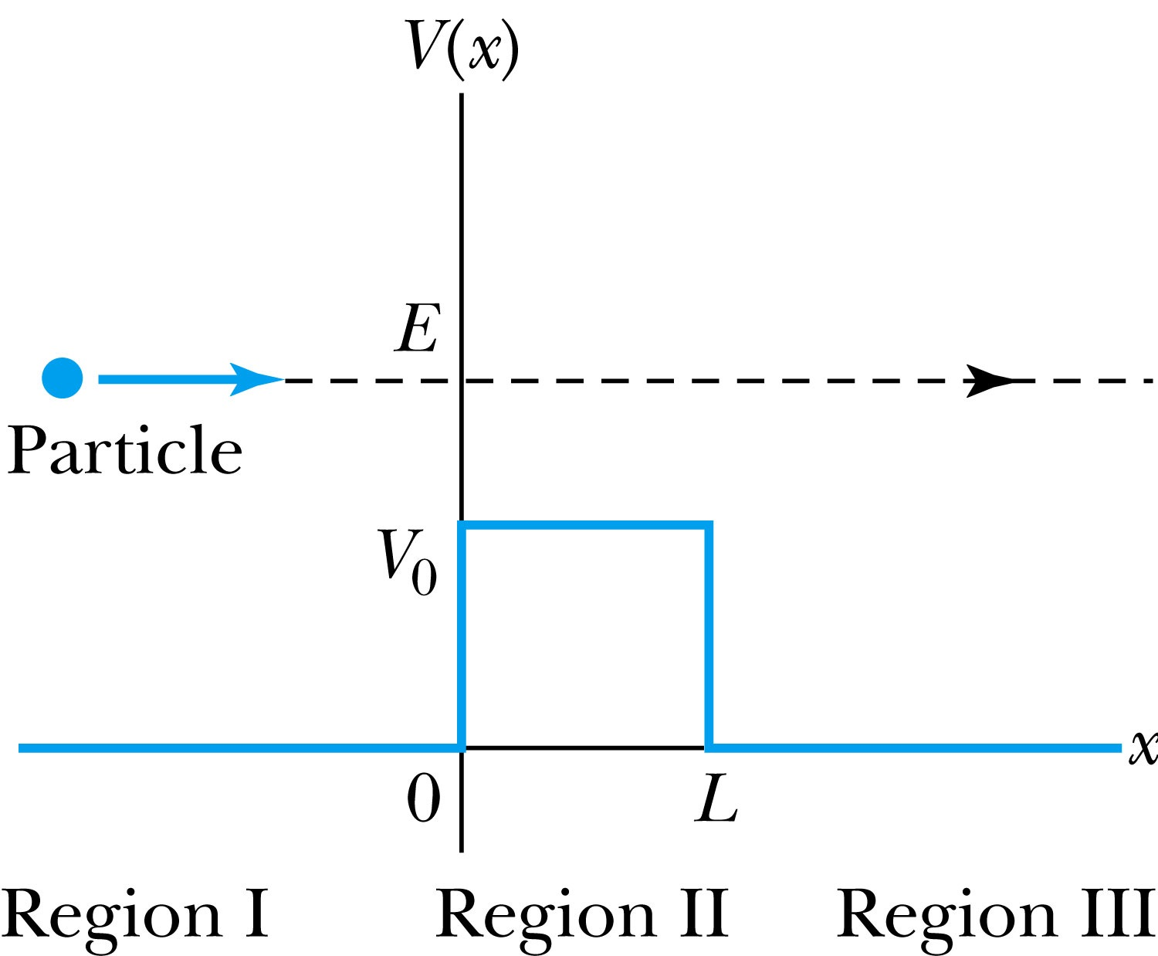
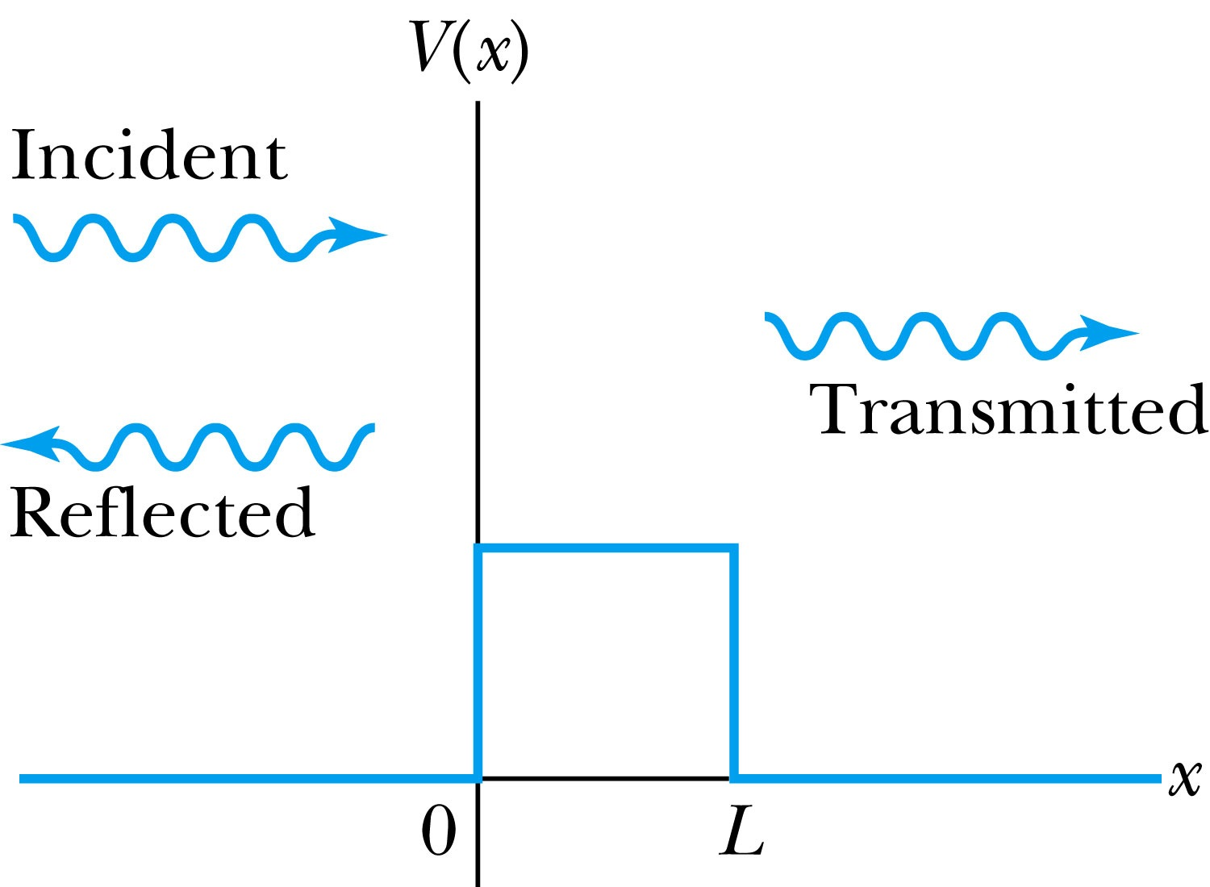
Barriers and Tunneling
Consider a particle of energy E approaching a potential barrier of height V₀ and the potential everywhere else is zero.
We will first consider the case when the energy is greater than the potential barrier.
In regions I and III the wave numbers are:
In the barrier region we have

Slide 13
Reflection and Transmission
The wave function will consist of an incident wave, a reflected wave, and a transmitted wave.
The potentials and the Schrödinger wave equation for the three regions are as follows:
The corresponding solutions are:
As the wave moves from left to right, we can simplify the wave functions to:

Slide 14
Probability of Reflection and Transmission
The probability of the particles being reflected R or transmitted T is:
The maximum kinetic energy of the photoelectrons depends on the value of the light frequency f and not on the intensity.
Because the particles must be either reflected or transmitted we have: R + T = 1
By applying the boundary conditions x → ±∞, x = 0, and x = L, we arrive at the transmission probability:
When does the transmission probability become 1?

