Slide 1
PHYS 3313 – Section 001 Lecture #22
Monday, Apr. 14, 2014
Dr. Jaehoon Yu
Barriers and Tunneling
Alpha Particle Decay
Use of Schrodinger Equation on Hydrogen Atom
Solutions for Schrodinger Equation for Hydrogen Atom

Slide 2
Announcements
Research paper deadline is Monday, Apr. 28
Research presentation file deadline is Sunday, Apr. 27
Reminder: Homework #5
CH6 end of chapter problems: 34, 39, 46, 62 and 65
Due Wednesday, Apr. 16
Homework #6
CH7 end of chapter problems: 7, 8, 9, 12, 17 and 29
Due on Wednesday, Apr. 23, in class
Quiz number 4
At the beginning of the class Wednesday, Apr. 23
Covers up to what we finish Monday, Apr. 21

Slide 3
Reminder: Special project #5
Show that the Schrodinger equation becomes Newton’s second law in the classical limit. (15 points)
Deadline Monday, Apr. 21, 2014
You MUST have your own answers!

Slide 4
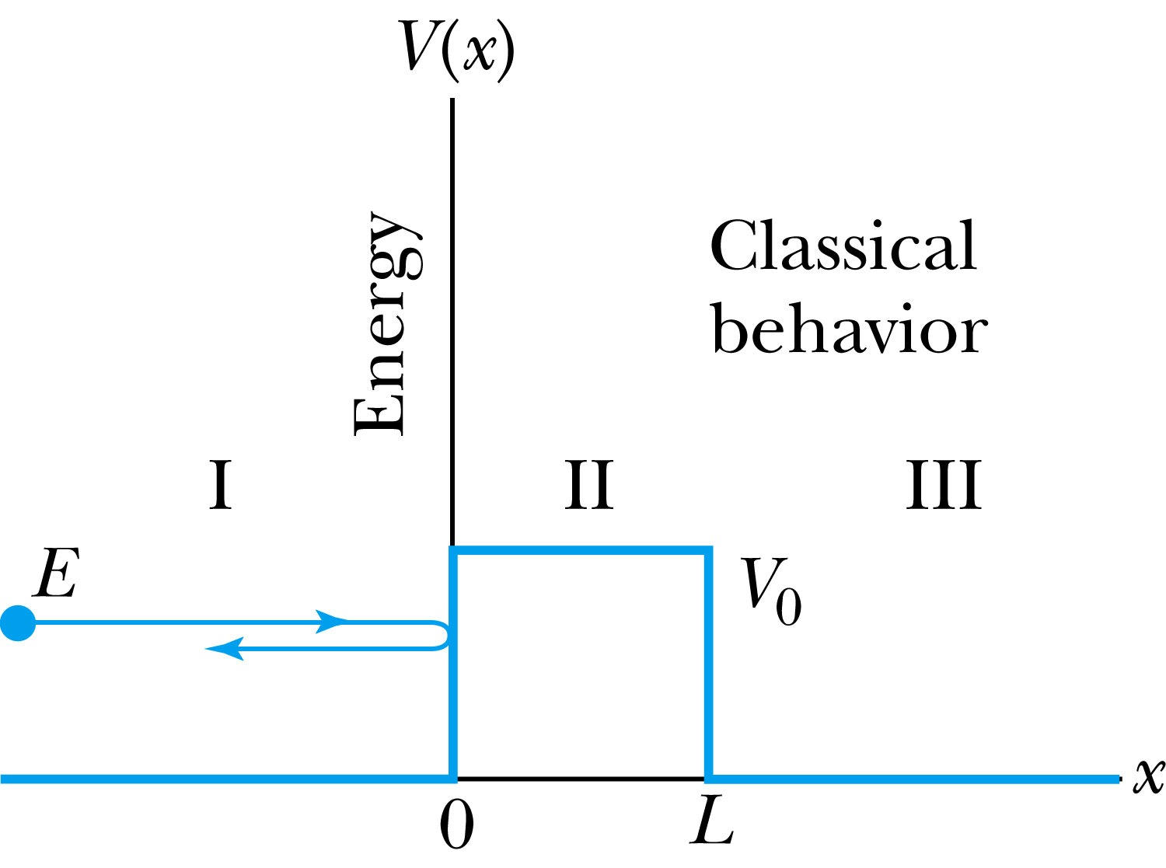
Tunneling
Now we consider the situation where classically the particle does not have enough energy to surmount the potential barrier, E < V₀.
The quantum mechanical result, however, is one of the most remarkable features of modern physics, and there is ample experimental proof of its existence. There is a small, but finite, probability that the particle can penetrate the barrier and even emerge on the other side.
The wave function in region II becomes
The transmission probability that describes the phenomenon of tunneling is

Slide 5
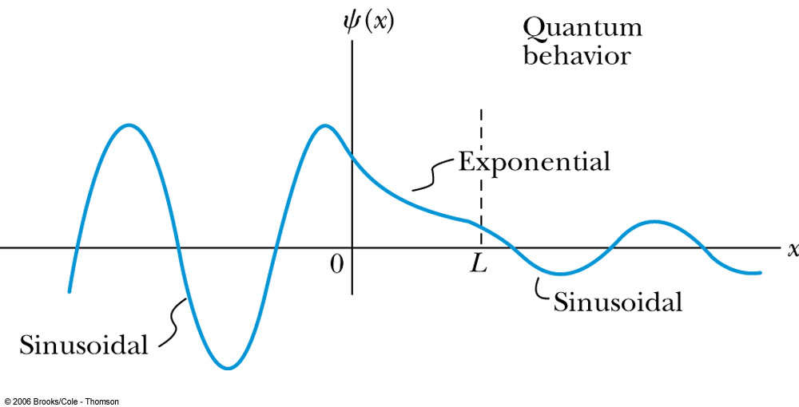
Uncertainty Explanation
Consider when κL >> 1 then the transmission probability becomes:
This violation allowed by the uncertainty principle is equal to the negative kinetic energy required! The particle is allowed by quantum mechanics and the uncertainty principle to penetrate into a classically forbidden region. The minimum such kinetic energy is:

Slide 6
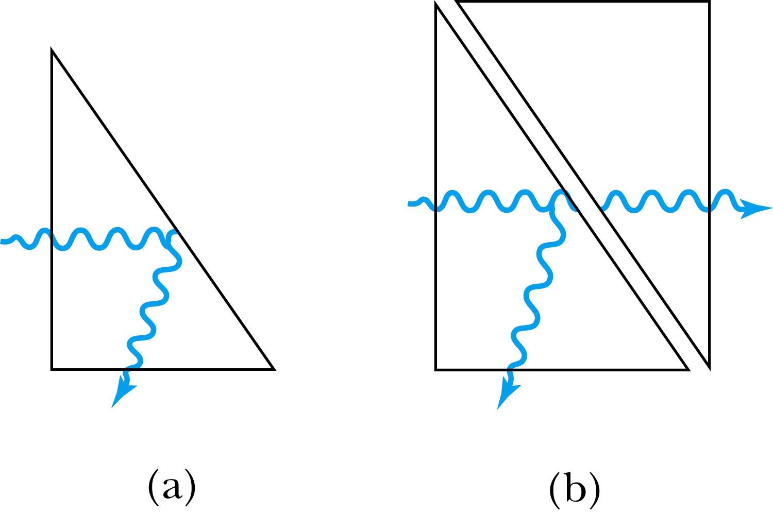
Analogy with Wave Optics
If light passing through a glass prism reflects from an internal surface with an angle greater than the critical angle, total internal reflection occurs. The electromagnetic field, however, is not exactly zero just outside the prism. Thus, if we bring another prism very close to the first one, experiments show that the electromagnetic wave (light) appears in the second prism.
The situation is analogous to the tunneling described here. This effect was observed by Newton and can be demonstrated with two prisms and a laser. The intensity of the second light beam decreases exponentially as the distance between the two prisms increases.

Slide 7
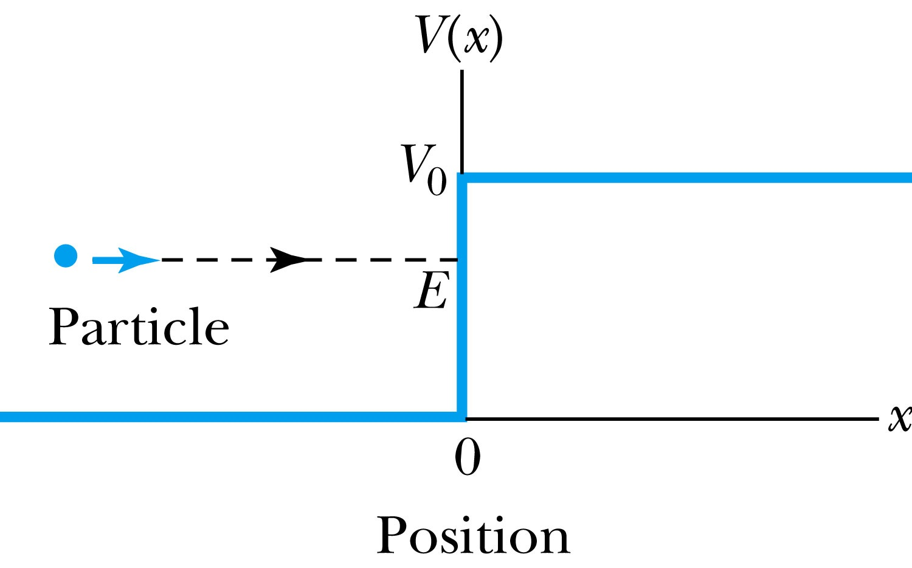
Potential Well
Consider a particle passing through a potential well region rather than through a potential barrier.
Classically, the particle would speed up passing the well region, because K = mv² / 2 = E - V₀.
According to quantum mechanics, reflection and transmission may occur, but the wavelength inside the potential well is shorter than outside. When the width of the potential well is precisely equal to half-integral or integral units of the wavelength, the reflected waves may be out of phase or in phase with the original wave, and cancellations or resonances may occur. The reflection/cancellation effects can lead to almost pure transmission or pure reflection for certain wavelengths. For example, at the second boundary (x = L) for a wave passing to the right, the wave may reflect and be out of phase with the incident wave. The effect would be a cancellation inside the well.

Slide 8
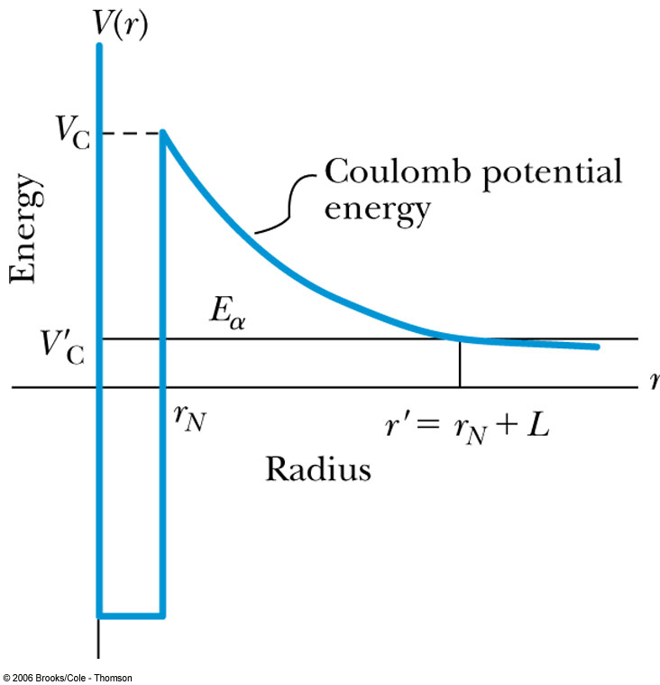
Alpha-Particle Decay
May nuclei heavier than Pb emit alpha particles (nucleus of He). The phenomenon of tunneling explains the alpha-particle decay of heavy, radioactive nuclei.
Inside the nucleus, an alpha particle feels the strong, short-range attractive nuclear force as well as the repulsive Coulomb force.
The nuclear force dominates inside the nuclear radius where the potential is approximately a square well.
The Coulomb force dominates outside the nuclear radius.
The potential barrier at the nuclear radius is several times greater than the energy of an alpha particle (~5MeV).
According to quantum mechanics, however, the alpha particle can “tunnel” through the barrier. Hence this is observed as radioactive decay.

Slide 9
Application of the Schrödinger Equation to the Hydrogen Atom
The approximation of the potential energy of the electron-proton system is the Coulomb potential:
To solve this problem, we use the three-dimensional time-independent Schrödinger Equation:
For Hydrogen-like atoms with one electron (He⁺ or Li⁺⁺)
Replace e² with Ze² (Z is the atomic number)
Use appropriate reduced mass:

Slide 10
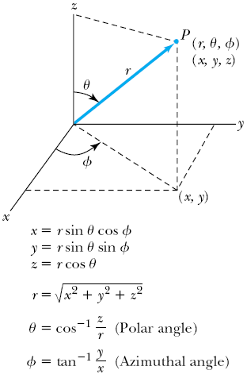
Application of the Schrödinger Equation
The potential (central force) V(r) depends on the distance r between the proton and electron.
Transform to spherical polar coordinates to exploit the radial symmetry.
Insert the Coulomb potential into the transformed Schrödinger equation.

Slide 11
Application of the Schrödinger Equation
The wave function Ψ is a function of r, θ and φ.
The equation is separable into three equations of independent variables
The solution may be a product of three functions
We can separate the Schrodinger equation in polar coordinate into three separate differential equations, each depending only on one coordinate: r, θ, or φ.

Slide 12
Solution of the Schrödinger Equation for Hydrogen
Substitute Ψ into the polar Schrodinger equation and separate the resulting equation into three equations: R(r), f(θ), and g(φ).
Separation of Variables
The derivatives in Schrodinger eq. can be written as
Substituting them into the polar coord. Schrodinger Eq.
Multiply both sides by r² sin² θ / Rfg
Reorganize

Slide 13
Solution of the Schrödinger Equation
Only r and θ appear on the left-hand side and only φ appears on the right-hand side of the equation
The left-hand side of the equation cannot change as φ changes.
The right-hand side cannot change with either r or θ.
Each side needs to be equal to a constant for the equation to be true in all cases. Set the constant −m_{ℓ}² equal to the right-hand side of the reorganized equation
The sign in this equation must be negative for a valid solution
It is convenient to choose a solution to be .
“azimuthal equation”

Slide 14
Solution of the Schrödinger Equation
satisfies the previous equation for any value of m_{ℓ}.
The solution must be single valued in order to have a valid solution for any φ, which requires
m_{ℓ} must be zero or an integer (positive or negative) for this to work
Now, set the remaining equation equal to −m_{ℓ}² and divide both sides by sin²θ and rearrange:
Everything depends on r on the left side and θ on the right side of the equation.

Slide 15
Solution of the Schrödinger Equation
Set each side of the equation equal to constant ℓ(ℓ + 1).
“Radial Equation”
“Angular Equation”
Schrödinger equation has been separated into three ordinary second-order differential equations, each containing only one variable.

Slide 16
Solution of the Radial Equation
The radial equation is called the associated Laguerre equation, and the solutions R that satisfies the appropriate boundary conditions are called associated Laguerre functions.
Assume the ground state has ℓ = 0, and this requires m_{ℓ} = 0.
We obtain
The derivative of yields two terms, and we obtain

Slide 17
Solution of the Radial Equation
Let’s try a solution where A is a normalization constant, and a₀ is a constant with the dimension of length.
Take derivatives of R, we obtain.
To satisfy this equation for any r, each of the two expressions in parentheses must be zero.
Set the second parentheses equal to zero and solve for a₀.
Set the first parentheses equal to zero and solve for E.
Both equal to the Bohr results
Bohr’s radius
Ground state energy of the hydrogen atom

Slide 18
Principal Quantum Number n
The principal quantum number, n, results from the solution of R(r) in the separated Schrodinger Eq. since R(r) includes the potential energy V(r).
The result for this quantized energy is
The negative sign of the energy E indicates that the electron and proton are bound together.

Slide 19
Quantum Numbers
The full solution of the radial equation requires an introduction of a quantum number, n, which is a non-zero positive integer.
The three quantum numbers:
n Principal quantum number
ℓ Orbital angular momentum quantum number
m_{ℓ} Magnetic quantum number
The boundary conditions put restrictions on these
n = 1, 2, 3, 4, . . . (n>0) Integer
ℓ = 0, 1, 2, 3, . . . , n − 1 (ℓ < n) Integer
m_{ℓ} = −ℓ, −ℓ + 1, . . . , 0, 1, . . . , ℓ − 1, ℓ (|m_{ℓ}| ≤ ℓ) Integer
The predicted energy level is

