Slide 1
PHYS 3313 – Section 001 Lecture #23
Tuesday, Apr. 16, 2014
Dr. Jaehoon Yu
Schrodinger Equation for Hydrogen Atom
Quantum Numbers
Solutions to the Angular Equations
Zeeman Effect
Intrinsic Spin

Slide 2
Announcements
Research paper deadline is Monday, Apr. 28
Research presentation file deadline is Sunday, Apr. 27
Reminder: Homework #5
CH6 end of chapter problems: 34, 39, 46, 62 and 65
Due Wednesday, Apr. 16
Homework #6
CH7 end of chapter problems: 7, 8, 9, 12, 17 and 29
Due on Wednesday, Apr. 23, in class
Quiz number 4
At the beginning of the class Wednesday, Apr. 23
Covers up to what we finish Monday, Apr. 21

Slide 3
Reminder: Special project #5
Show that the Schrodinger equation becomes Newton’s second law in the classical limit. (15 points)
Deadline Monday, Apr. 21, 2014
You MUST have your own answers!

Slide 4
Quantum Numbers
The full solution of the radial equation requires an introduction of a quantum number, n, which is a non-zero positive integer.
The three quantum numbers:
n Principal quantum number
ℓ Orbital angular momentum quantum number
m_{ℓ} Magnetic quantum number
The boundary conditions put restrictions on these
n = 1, 2, 3, 4, . . . (n>0) Integer
ℓ = 0, 1, 2, 3, . . . , n − 1 (ℓ < n) Integer
m_{ℓ} = −ℓ, −ℓ + 1, . . . , 0, 1, . . . , ℓ − 1, ℓ (|m_{ℓ}| ≤ ℓ) Integer
The predicted energy level is

Slide 5
Ex 7.3: Quantum Numbers & Degeneracy
What are the possible quantum numbers for the state n=4 in atomic hydrogen? How many degenerate states are there?
n ℓ m_{ℓ}
4 0 0
4 1 -1, 0, +1
4 2 -2, -1, 0, +1, +2
4 3 -3, -2, -1, 0, +1, +2, +3
The energy of a atomic hydrogen state is determined only by the primary quantum number, thus, all these quantum states, 1+3+5+7 = 16, are in the same energy state.
Thus, there are 16 degenerate states for the state n=4.

Slide 6
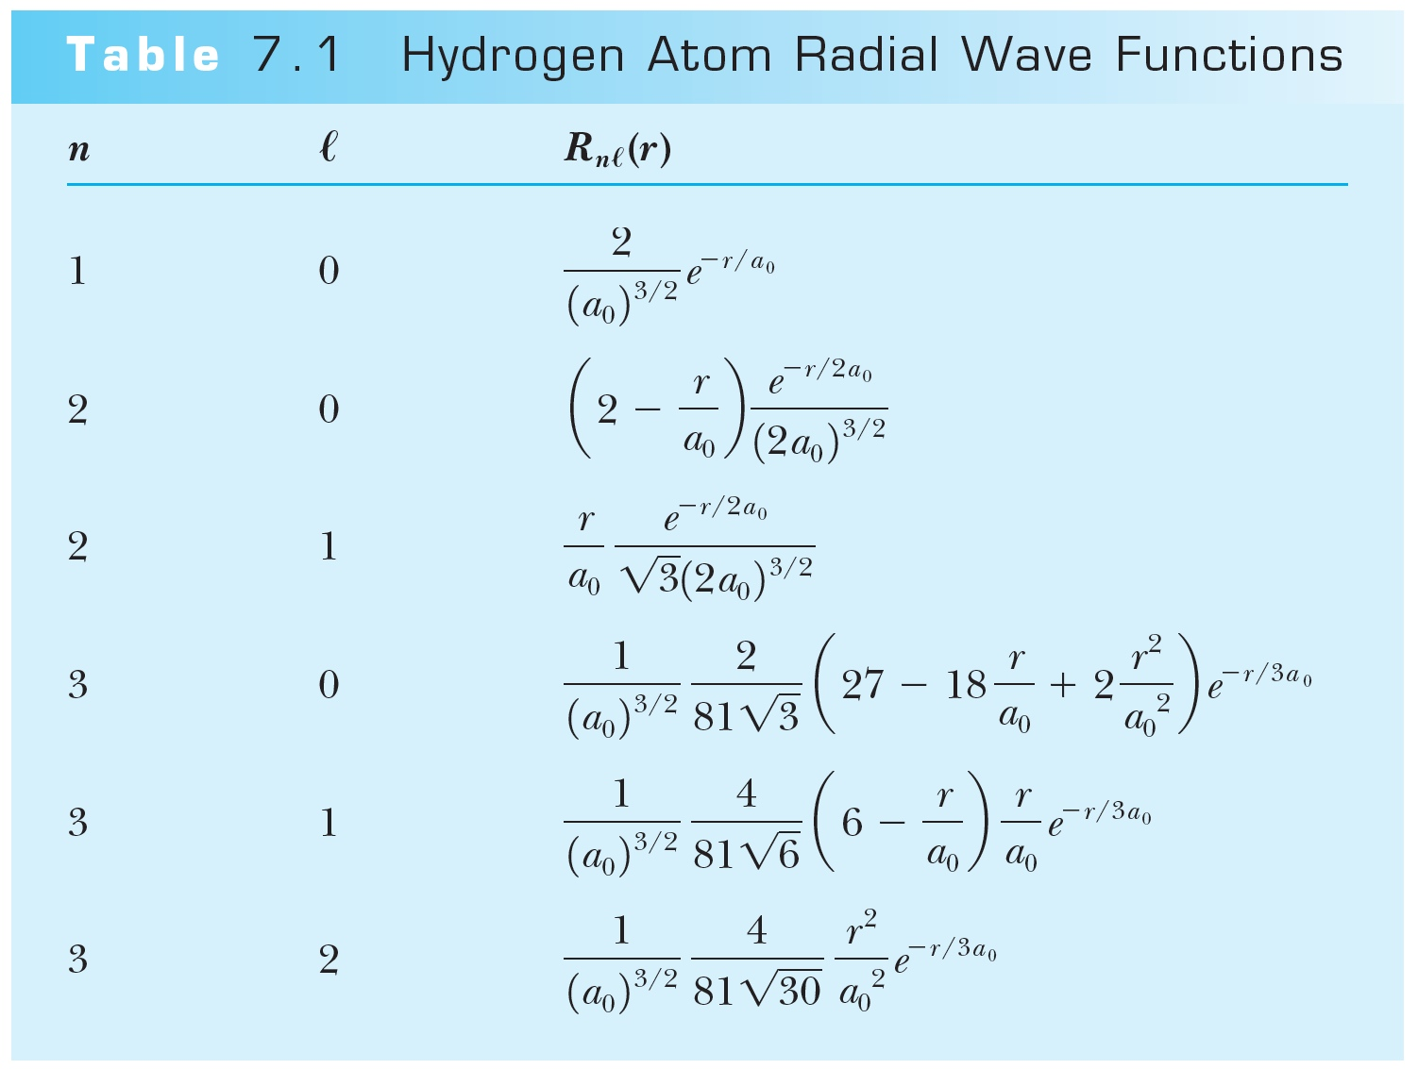
Hydrogen Atom Radial Wave Functions
The radial solution is specified by the values of n and ℓ
First few radial wave functions R_{nℓ}

Slide 7
Solution of the Angular and Azimuthal Equations
Solutions of the azimuthal eq. are or
Solutions to the angular and azimuthal equations are linked because both have m_{ℓ}
Group these solutions together into functions
---- spherical harmonics

Slide 8
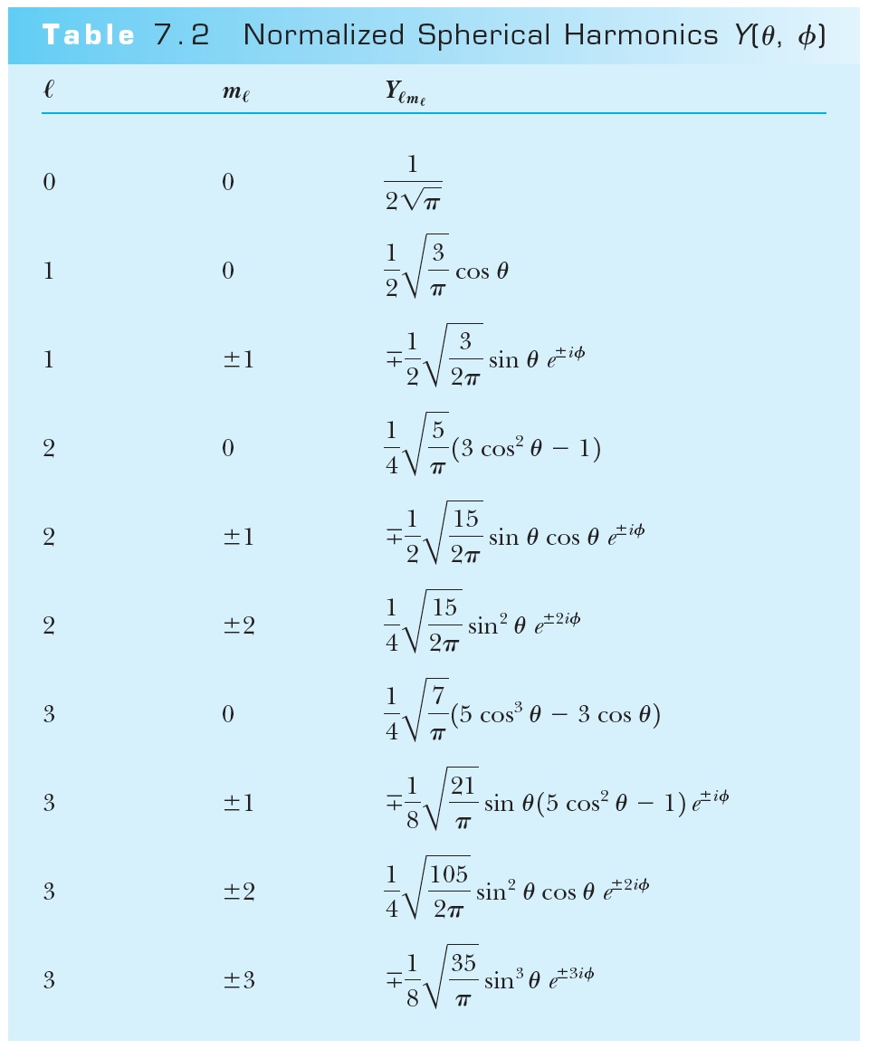
Normalized Spherical Harmonics

Slide 9
Ex 7.1: Spherical Harmonic Function
Show that the spherical harmonic function Y11(θ,φ) satisfies the angular Schrodinger equation.

Slide 10
Solution of the Angular and Azimuthal Equations
The radial wave function R and the spherical harmonics Y determine the probability density for the various quantum states.
Thus the total wave function Ψ(r,θ,φ) depends on n, ℓ, and m_{ℓ}. The wave function can be written as

Slide 11
Orbital Angular Momentum Quantum Number ℓ
It is associated with the R(r) and f(θ) parts of the wave function.
Classically, the orbital angular momentum with L = mv_{orbital}r.
ℓ is related to the magnitude of L by .
In an ℓ = 0 state, .
It disagrees with Bohr’s semi-classical “planetary” model of electrons orbiting a nucleus L = nħ.

Slide 12
Orbital Angular Momentum Quantum Number ℓ
A certain energy level is degenerate with respect to ℓ when the energy is independent of ℓ.
Use letter names for the various ℓ values
ℓ = 0 1 2 3 4 5 . . .
Letter = s p d f g h . . .
Atomic states are referred by their n and ℓ
s=sharp, p=principal, d=diffuse, f =fundamental, then alphabetical
A state with n = 2 and ℓ = 1 is called the 2p state
Is 2d state possible?
The boundary conditions require n > ℓ

Slide 13
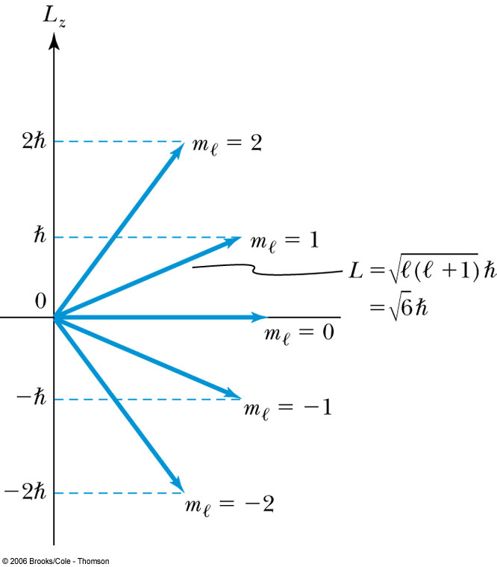
Magnetic Quantum Number m_{ℓ}
The angle φ is a measure of the rotation about the z axis.
The solution for specifies that m_{ℓ} is an integer and related to the z component of L.
The relationship of L, L_{z}, ℓ, and m_{ℓ} for ℓ = 2.
is fixed.
Because L_{z} is quantized, only certain orientations of are possible and this is called space quantization.
m_{ℓ} is called the magnetic moment since z axis is chosen customarily along the direction of magnetic field.

Slide 14
Magnetic Quantum Number m_{ℓ}
Quantum mechanics allows to be quantized along only one direction in space, and because of the relationship L² = L_{x}² + L_{y}² + L_{z}², once a second component is known, the third component will also be known. ➔ violation of uncertainty principle
One of the three components, such as L_{z}, can be known clearly but the other components will not be precisely known
Now, since we know there is no preferred direction,
We expect the average of the angular momentum components squared to be:

Slide 15
Magnetic Effects on Atomic Spectra—The Normal Zeeman Effect
A Dutch physicist Pieter Zeeman showed as early as 1896 that the spectral lines emitted by atoms in a magnetic field split into multiple energy levels. It is called the Zeeman effect.
The Normal Zeeman effect:
A spectral line of an atom is split into three lines.
Consider the atom to behave like a small magnet.
The current loop has a magnetic moment ų = IA and the period T = 2πr / v. If an electron can be considered as orbiting a circular current loop of I = dq / dt around the nucleus, we obtain
where L = mvr is the magnitude of the orbital
angular momentum

Slide 16
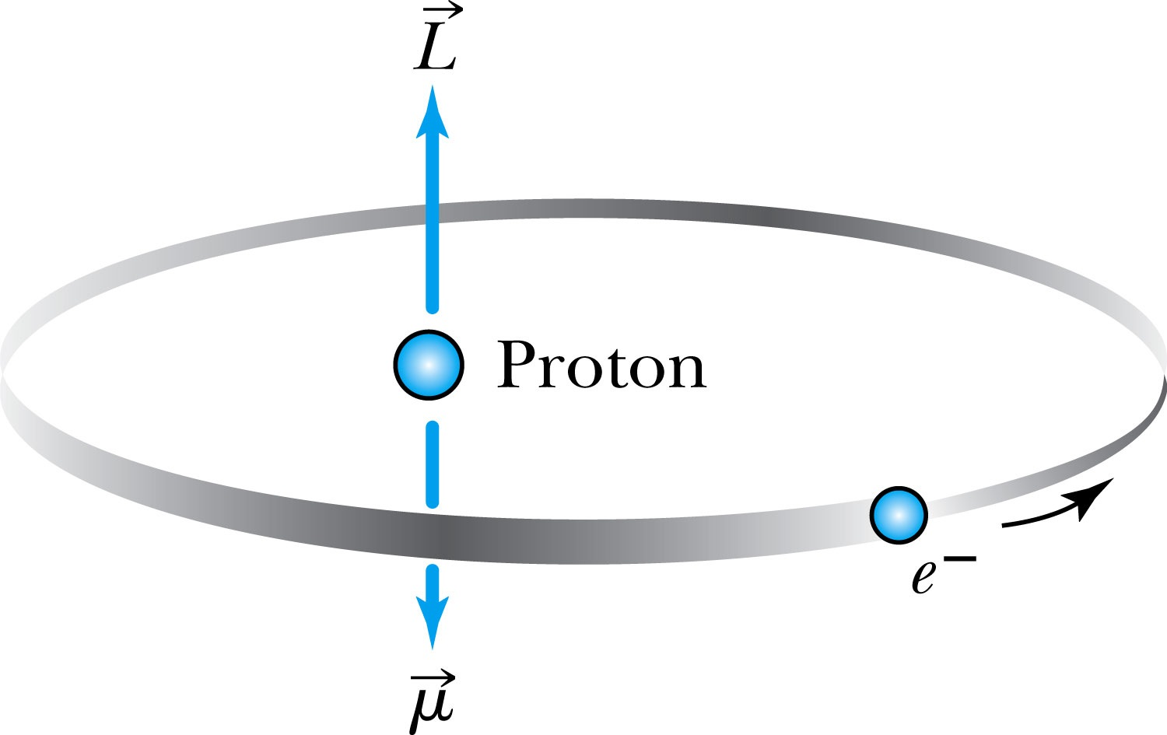
The Normal Zeeman Effect
If there is no magnetic field to align them, points in random directions.
The dipole has a potential energy
The angular momentum is aligned with the magnetic moment, and the torque between and causes a precession of .
Where μ_{B} = eħ / 2m is called the Bohr magneton.
cannot align exactly in the z direction and has only certain allowed quantized orientations.

Slide 17
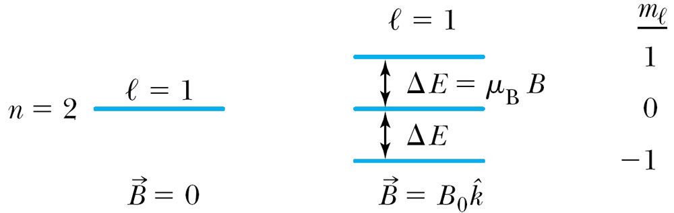
The Normal Zeeman Effect
The potential energy is quantized due to the magnetic quantum number m_{ℓ}.
When a magnetic field is applied, the 2p level of atomic hydrogen is split into three different energy states with the electron energy difference of ΔE = μ_{B}B Δm_{ℓ}.
So split is into a total of 2ℓ+1 energy states
m_{ℓ} | Energy
1 | E₀ + μ_{B}B
0 | E₀
−1 | E₀ − μ_{B}B

Slide 18
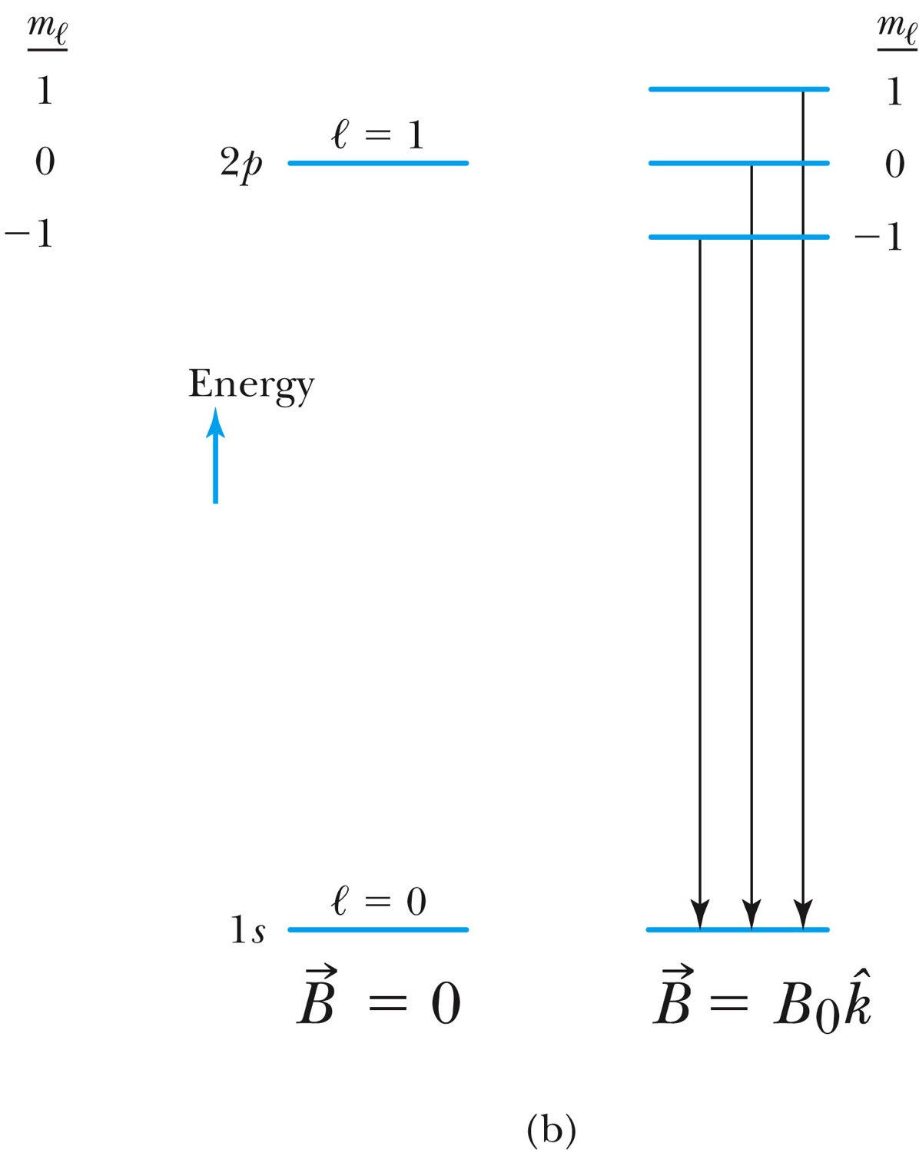
The Normal Zeeman Effect
A transition from 1s to 2p
A transition from 2p to 1s

Slide 19
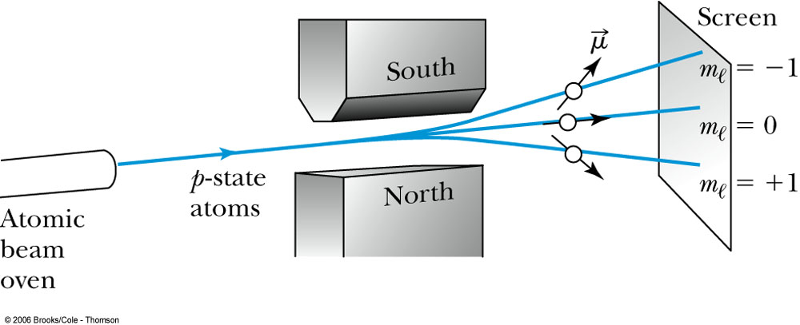
The Normal Zeeman Effect
An atomic beam of particles in the ℓ = 1 state pass through a magnetic field along the z direction. (Stern-Gerlach experiment)
The m_{ℓ} = +1 state will be deflected down, the m_{ℓ} = −1 state up, and the m_{ℓ} = 0 state will be undeflected. ➔ saw only 2 with silver atoms
If the space quantization were due to the magnetic quantum number m_{ℓ}, the number of m_{ℓ} states is always odd at (2ℓ + 1) and should have produced an odd number of lines.

Slide 20
Intrinsic Spin
In 1920, to explain spectral line splitting of Stern-Gerlach experiment, Wolfgang Pauli proposed the forth quantum number assigned to electrons
In 1925, Samuel Goudsmit and George Uhlenbeck in Holland proposed that the electron must have an intrinsic angular momentum and therefore a magnetic moment.
Paul Ehrenfest showed that the surface of the spinning electron should be moving faster than the speed of light to obtain the needed angular momentum!!
In order to explain experimental data, Goudsmit and Uhlenbeck proposed that the electron must have an intrinsic spin quantum number s = ½.

