Slide 1
PHYS 3313 – Section 001
Lecture #2
Monday, Jan. 26, 2015
Dr. Jaehoon Yu
Higgs and Dark Matter
What do you expect to learn in this course?
Classical Physics
Concept of Waves and Particles
Conservation Laws and Fundamental Forces
Atomic Theory of Matter
Unsolved Questions of 1895 and the New Horizon

Slide 2
Announcements
Quiz #1 on appendices 3, 5, 6 and
  Beginning of the class
  Wednesday, Jan. 28
Special colloquium at 4pm tomorrow
  In SH101: Dr. James Siegrist of US Department of Energy
  Special triple extra credit

Slide 3
Special Project #1
Compute the electric force between the two protons separate the farthest in an intact U²³⁸ nucleus. Use the actual size of the U²³⁸ nucleus. (10 points)
Compute the gravitational force between the two protons separate the farthest in an intact U²³⁸ nucleus. (10 points)
Express the electric force in #1 above in terms of the gravitational force in #2. (5 points)
You must look up the mass of the proton, actual size of the U²³⁸ nucleus, etc, and clearly write them on your project report
You MUST have your own, independent answers to the above three questions even if you worked together with others. All those who share the answers will get 0 credit if copied.
Due for the submission is Monday, Feb. 2!

Slide 4
What is the Higgs and What does it do?
When there is perfect symmetry, one cannot tell directions!

Slide 5

What? What’s the symmetry?
Where is the head of the table?
Without a broken symmetry, one cannot tell directional information!!

Slide 6

A broken symmetry

Slide 7
What is the Higgs and What does it do?
When there is perfect symmetry, one cannot tell directions!
Only when symmetry is broken, can one tell directions
Higgs field works to break the perfect symmetry and gives mass to all fundamental particles
Sometimes, this field spontaneously generates a particle, the Higgs particle
So the Higgs particle is the evidence of the existence of the Higgs field!

Slide 8



So how does Higgs Field work again?
Person in space ➔ no symmetry breaking
Person in air ➔ symmetry can be broken
Sometimes, you get
Just like a tornado is a piece of evidence of the existence of air, Higgs particle is a piece of evidence of Higgs mechanism

Slide 9
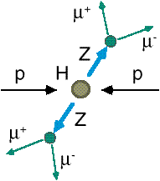
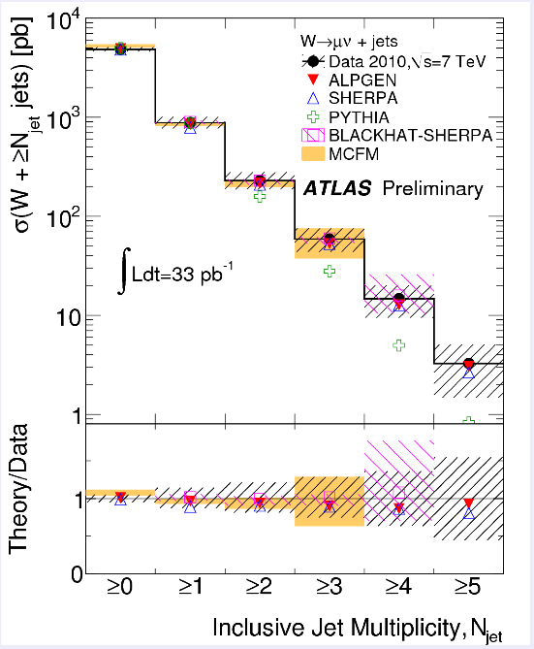
How do we look for the Higgs?
Identify Higgs candidate events
Understand fakes (backgrounds)
Look for a bump!!
  Large amount of data absolutely critical
e⁺ (μ⁺)
e⁻ (μ⁻)
e⁺
e⁻

Slide 10
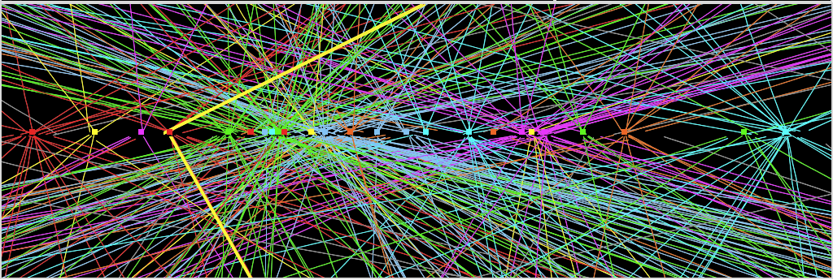
Challenges? No problem!
An interesting collision event with 25 collisions at once!!
Here it is!!

Slide 11
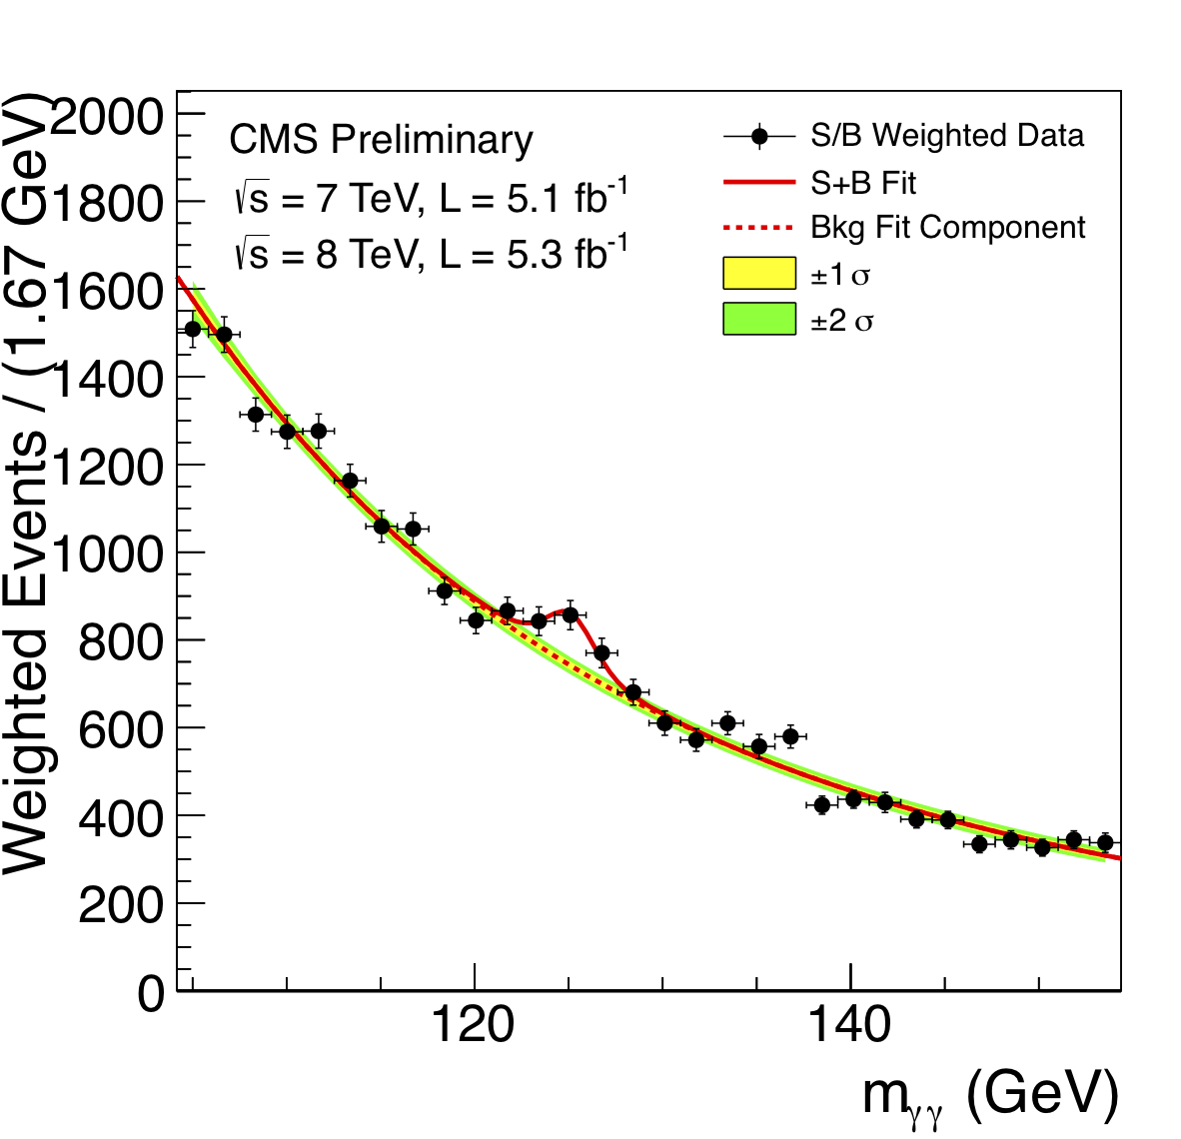
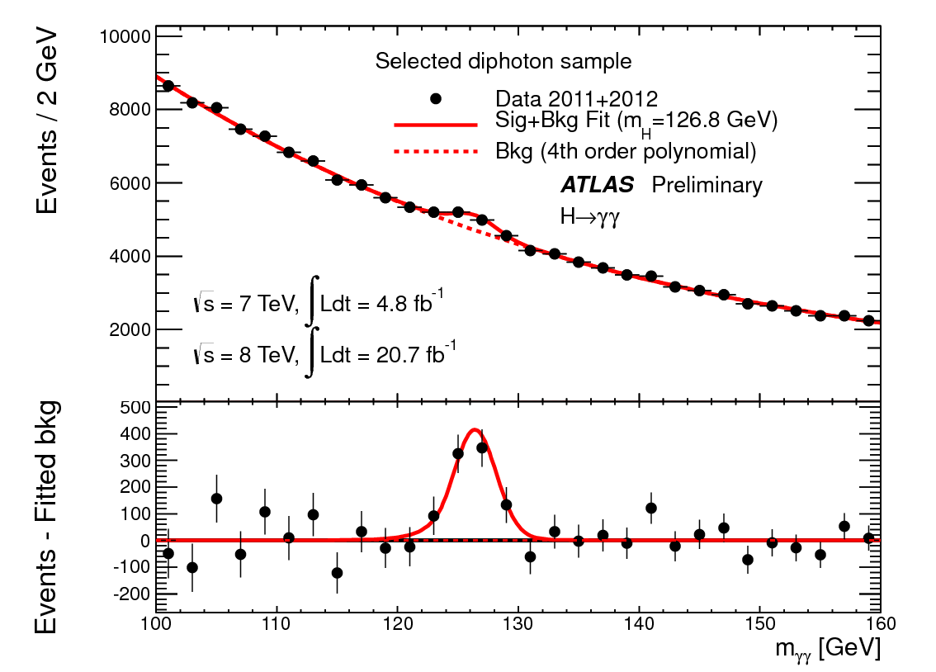
ATLAS and CMS Mass Bump Plots (H→γγ )
ATLAS
CMS
LOOK, Ma! Bumps!!

Slide 12

What did statistics do for Higgs?

Slide 13

How about this?

Slide 14
So have we seen the Higgs particle?
The statistical significance of the finding is way over 7 standard deviations

Slide 15
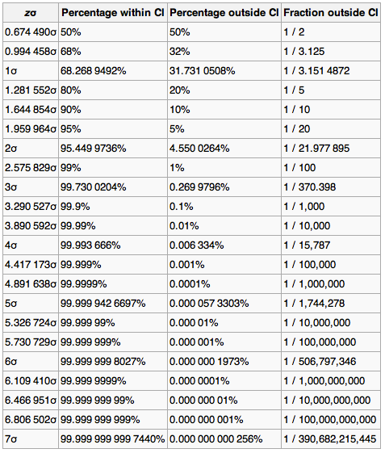
Statistical Significance Table

Slide 16
So have we seen the Higgs particle?
The statistical significance of the finding is much bigger than seven standard deviations
  Level of significance: much better than 99.999 999 999 7% (eleven 9s!!)
  We could be wrong once if we do the same experiment 391,000,000,000 times (will take ~13,000 years even if each experiment takes 1s!!)
So did we find the Higgs particle?
  We have discovered the heaviest new boson we’ve seen thus far
  It has many properties consistent with the Standard Model Higgs particle
    It quacks like a duck and walks like a duck but…
  We do not have enough data to precisely measure all the properties – mass, lifetime, the rate at which this particle decays to certain other particles, etc – to definitively determine its nature
Precision measurements and searches in new channels ongoing

Slide 17
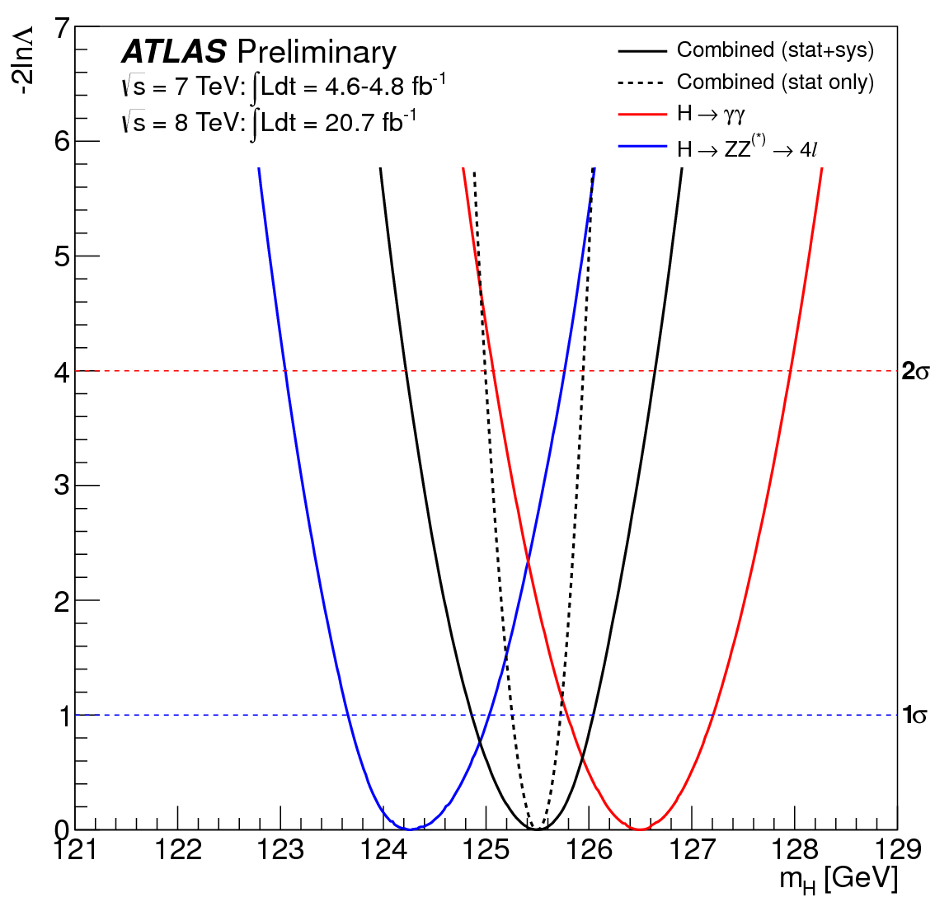
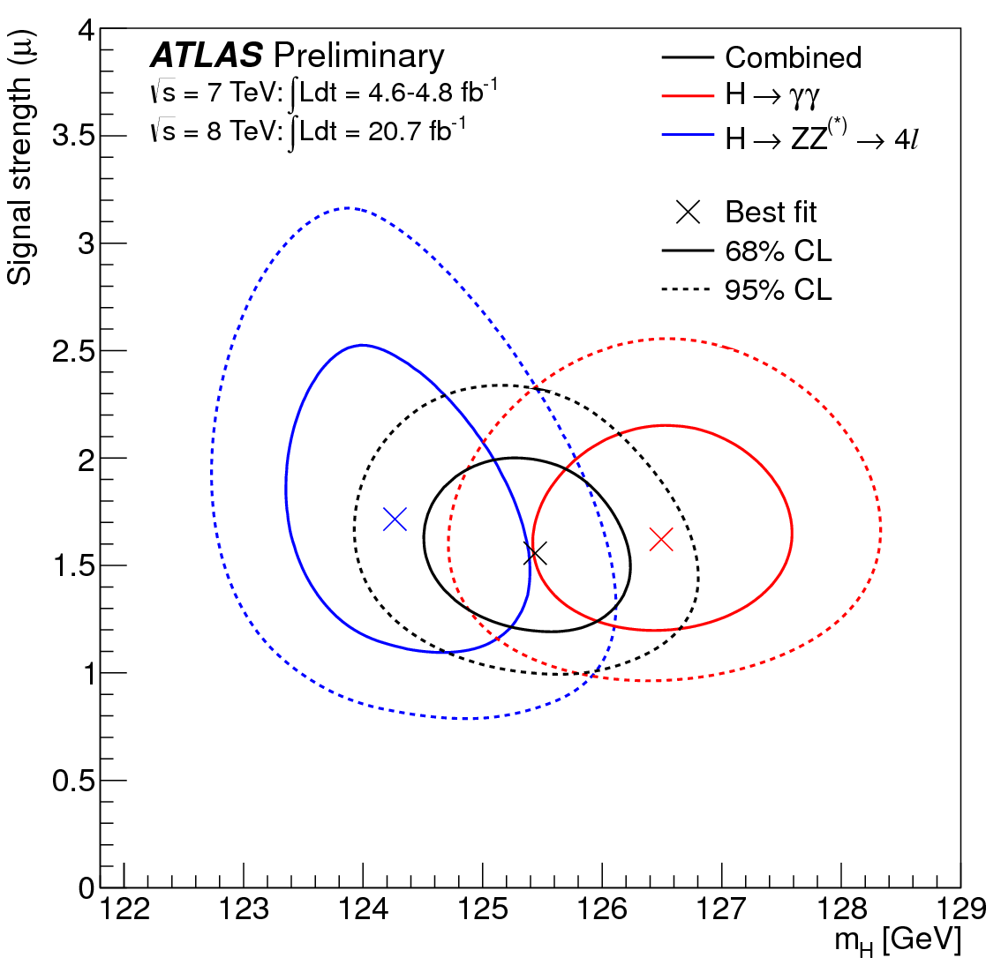
An Interesting Property Measurement
Masses from H→γγ and H→ZZ→4l differ by 2 GeV at about 1.5σ
H→γγ differ from SM by about 2σ and H→ZZ→4l by about 1σ

Slide 18
Long Term LHC Plans
2012 run ended with a total of ~20fb⁻¹
  Combined with 2011 run (5.6fb⁻¹), a total of over 25fb⁻¹
2013 – 2014: shutdown (LS1) ongoing to go to the design energy (13 – 14TeV) at high inst. Luminosity
2015 – 2017: √s=13 – 14TeV, L~10³⁴, ~100fb⁻¹
2018: Shut-down (LS2)
2019 – 2021: √s~=13 – 14TeV, L~2x10³⁴, ~300fb⁻¹
2022 – 2023: Shut-down (LS3)
2023 – 2030(?): √s=13 – 14TeV, L~5x10³⁴ (HL-LHC), ~3000fb⁻¹

Slide 19
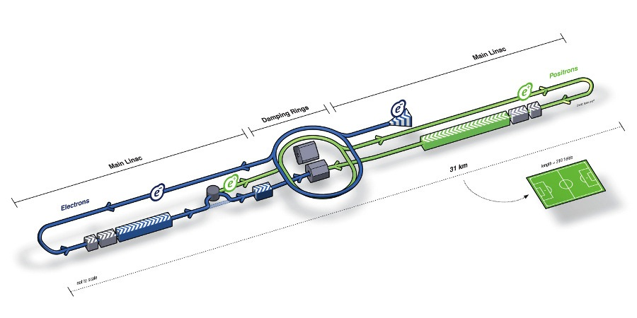
What’s next? Future Linear Collider
Now that we have found a new boson, precision measurement of the particle’s properties becomes important
An electron-positron collider on a straight line for precision measurements
10~15 years from now (In Dec. 2011, Japanese PM announced that they would bid for a LC in Japan and reaffirmed by the new PM in 2013)
  Our Japanese colleagues have declared that they will bid for building ILC
  Japan announced the selection of the site for the ILC in Aug. 2013!!
Takes 10 years to build a detector
Circumference ~6.6km
~300 soccer fields
L~31km (~20 mi)

Slide 20
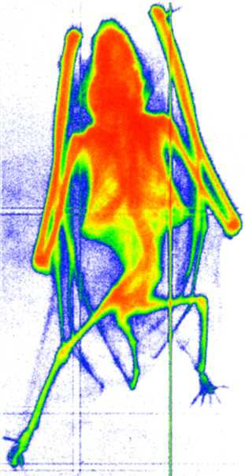
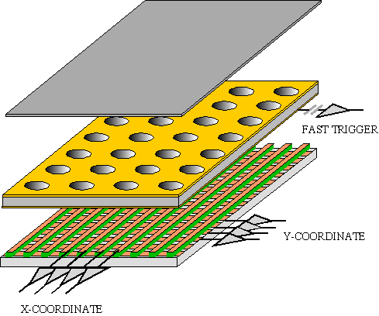
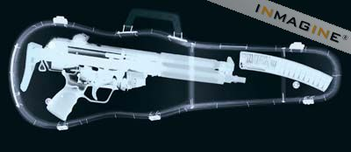
GEM Application Potential
FAST X-RAY IMAGING
Using the lower GEM signal, the readout can be self-triggered with energy discrimination:
9 keV absorption radiography of a small mammal (image size ~ 60 x 30 mm²)
A. Bressan et al,
Nucl. Instr. and Meth. A 425(1999)254
F. Sauli, Nucl. Instr. and Meth.A 461(2001)47

Slide 21
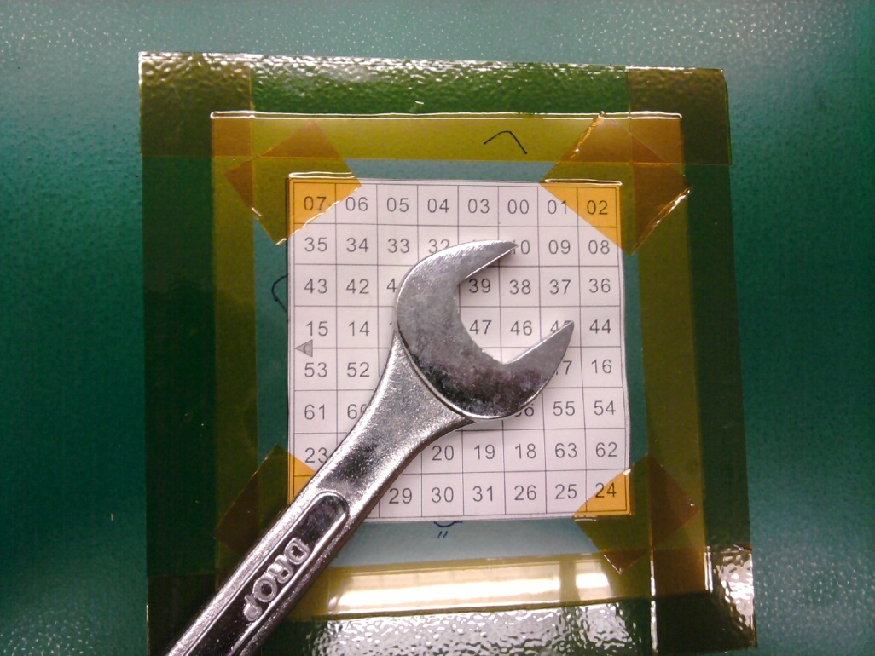
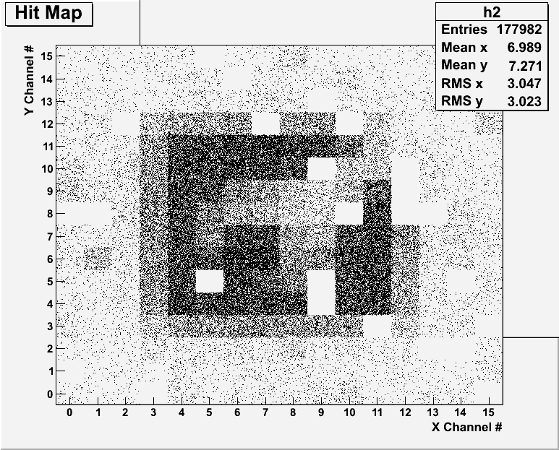
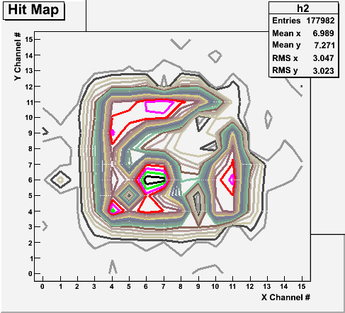
X-ray Image of an object with a prototype
Can you see what the object is?

Slide 22
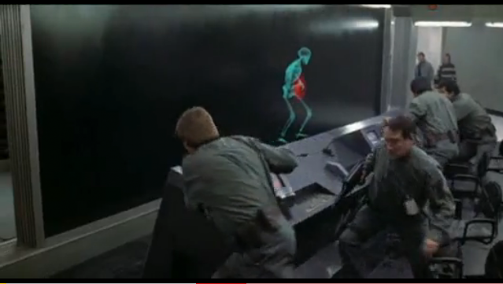
And in not too distant future, we could do …

Slide 23


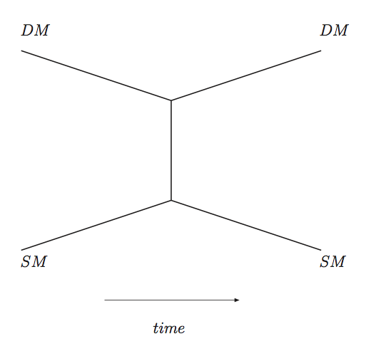
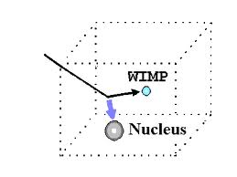
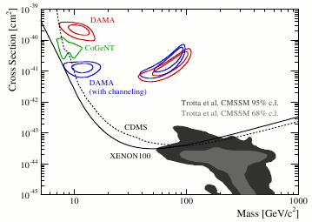
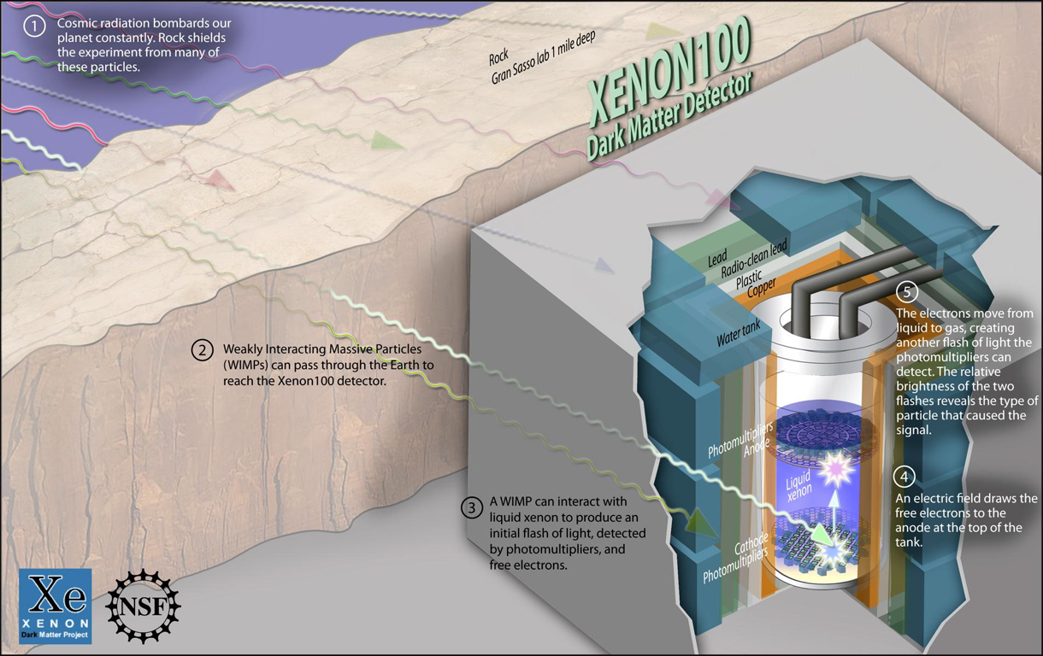

Dark Metter Search Motivation
Now that the Higgs particle, a part of only 5% of the universe, is seen
It is time for us to look into the 95% of the universe!!

Slide 24
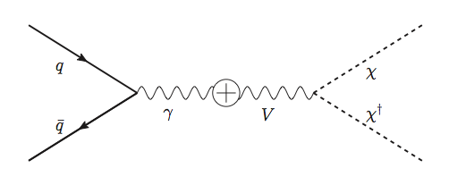
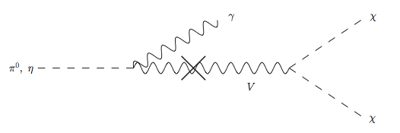
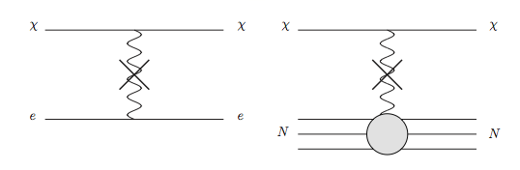
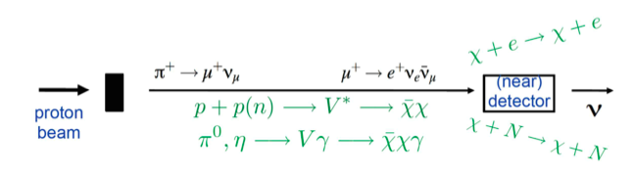
Light DM Production at High Intensity Accelerator
Production of DM:
Detection of DM:
How does a DM event look in an experiment?:
High Intensity Proton Beam

Slide 25
Search for Dark Matter at an Accelerator
Fermi National Accelerator Laboratory is turning into a lab with very high intensity accelerator program

Slide 26
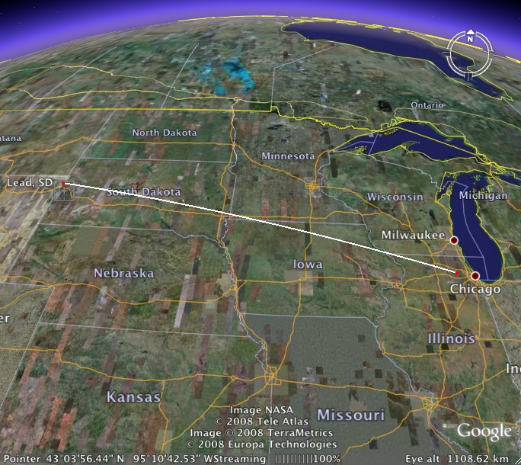
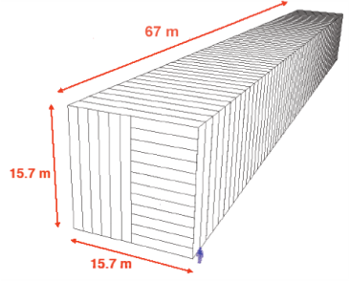
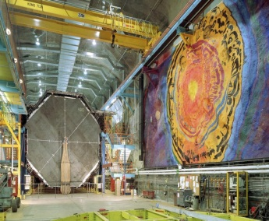
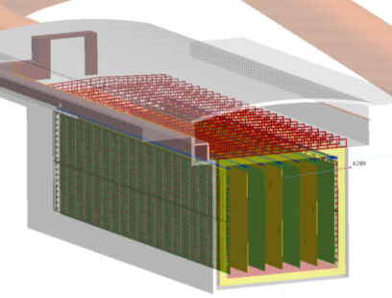
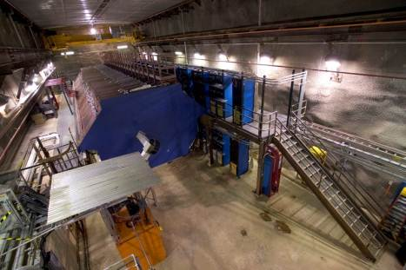
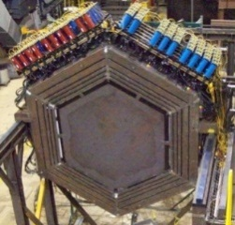

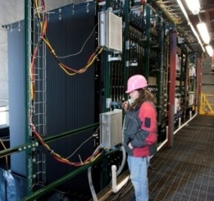
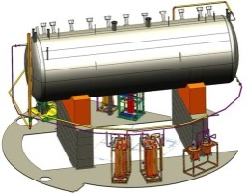
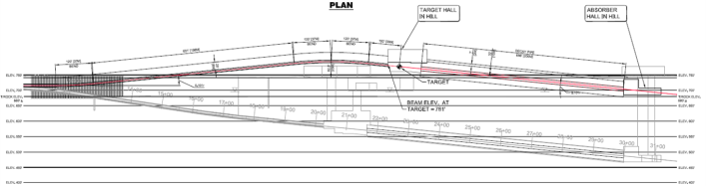
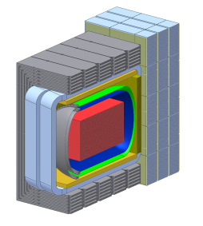
Intensity Frontier at Fermilab: Neutrinos
NOvA (far)
MINOS (far)
Operating
since 2005
(350 kW)
under construction
Online 2014
(700 kW)
Far detector
MINOS (near)
735 km
810 km
MINERvA
LBNE under development
1300 km
Proton decay
Supernovae neutrinos
MiniBooNE
NOvA
(near)
Goal: operating in 2020s
MicroBooNE
Beamline
Near detector

Slide 27
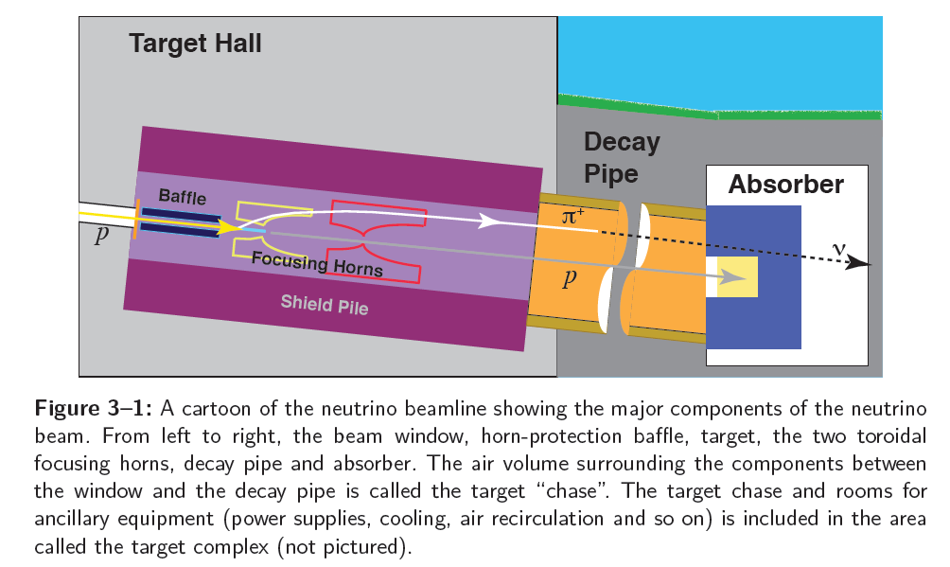
LBNE Neutrino Beam Assembly

Slide 28
Doubly Sign-selected Horn System (DSHS)
Add a dipole after the mesons are fully focused with the 2nd horn
dipole
High Precision Detector
p
p, π⁰, χ
Beam Dump
ν target
π⁺⁽⁻⁾, charged mesons
Focusing
horns
Decay pipe
LBNE detector system

Slide 29
Dark Matter Searches at Fermilab
Fermi National Accelerator Laboratory is turning into a lab with very high intensity accelerator program
UTA group is part of four experiments
  E Long Baseline Neutrino Facility (ELBNF), an $1,3B flagship experiment, with data expected in 2025
    High flux secondary beam and a near detector enables searches for DM
    In addition to precision measurements of key neutrino param..
    UTA playing very significant role in this experiment
A rich physics program for the next 20 – 30 years!!
If we see DM, we could use this to make DM Beam??

Slide 30
So what?
Linear collider and advanced detectors are being developed for future precision measurements of Higgs and other newly discovered particles
The new frontier will give us a change to look for dark matter at an accelerator and other paradigm changing phenomena
Outcome and the bi-product of HEP research improves our daily lives directly and indirectly
  WWW came from HEP
  GEM will make a large screen low dosage X-ray imaging possible
Many technological advances happened through the last 100 years & will happen through the coming 100 yrs
Continued and sufficient investments to forefront scientific endeavor is essential for the future!

Slide 31
What do we want to learn in this class?
The physics that provided fundamentals to the technical progress for us
Learn concepts of quantum theory for microscopic phenomena and relativity for phenomena with high speed
Learn physical principles that we still exploit
Learn skills to express observations and measurements in mathematical language
Learn skills to research literatures and express your research in systematic manner in writing
Build up confidence in your physics abilities and to take on any challenges laid in front of you!!
Most importantly, let us have a lot of FUN!!

Slide 32
In this course, you will learn…
Concepts and derivation of many of the modern physics
  History at the beginning of the new era
  Special relativity
  Quantum theory
  Atomic physics
  Condensed Matter physics
  Nuclear physics
  Particle Physics
Focus on learning about the concepts with less complicated math
  You will learn some Quantum calculations and understand the concept of probabilities
Expectation at the end of the semester: You will be able to understand what fundamental physics provides the bases for the current technology

Slide 33
Why do Physics?
Exp.{
To understand nature through experimental observations and measurements (Research)
Establish limited number of fundamental laws, usually with mathematical expressions
Predict the nature’s course
Theory and Experiment work hand-in-hand
Theory works generally under restricted conditions
Discrepancies between experimental measurements and theory are good for improvements
Improves our everyday lives, even though some laws can take a while till we see them amongst us
Theory {
33

Slide 34
Brief History of Physics
AD 18th century:
  Newton’s Classical Mechanics: A theory of mechanics based on observations and measurements, concepts of many kinematic parameters, including forces
    First unification of forces – planetary forces and forces on the Earth
AD 19th Century:
  Electricity, Magnetism, and Thermodynamics
Late AD 19th and early 20th century (Modern Physics Era, after 1895)
  Physicists thought everything was done and nothing new could be discovered
34

Slide 35
State of Minds in late 19th Century
Albert A. Michelson, 1894
  The more important fundamental laws and facts of physical science have all been discovered, and these are now so firmly established that the possibility of their ever being supplanted in consequence of new discoveries is exceedingly remote. Our future discoveries must be looked for in the sixth place of decimals!
William Thompson (Lord Kelvin), 1900
  There is nothing new to be discovered in physics now. All that remains is more and more precise measurement.

Slide 36
Brief History of Physics
AD 18th century:
  Newton’s Classical Mechanics: A theory of mechanics based on observations and measurements, concepts of many kinematic parameters, including forces
    First unification of forces – planetary forces and forces on the Earth
AD 19th Century:
  Electricity, Magnetism, and Thermodynamics
Late AD 19th and early 20th century (Modern Physics Era, after 1895)
  Physicists thought everything was done and nothing new could be discovered
  Concept of atoms did not quite exist
  There were only handful of problems not well understood late 19th century became the basis for new discoveries in 20th century
  That culminates in understanding of phenomena in microscopic scale and extremely high speed approaching the speed of light (3x10⁸m/s)
  Einstein’s theory of relativity: Generalized theory of space, time, and energy (mechanics)
  Quantum Mechanics: Theory of atomic phenomena
36

