Slide 1
PHYS 3313 – Section 001 Lecture #3
Wednesday, Jan. 28, 2015
Dr. Jaehoon Yu
Classical Physics
Concept of Waves and Particles
Conservation Laws and Fundamental Forces
Atomic Theory of Matter
Unsolved Questions of 1895 and the New Horizon

Slide 2
Reminder: Special Project #1
Compute the electric force between the two protons separate the farthest in an intact U²³⁸ nucleus. Use the actual size of the U²³⁸ nucleus. (10 points)
Compute the gravitational force between the two protons separate the farthest in an intact U²³⁸ nucleus. (10 points)
Express the electric force in #1 above in terms of the gravitational force in #2. (5 points)
You must look up the mass of the proton, actual size of the U²³⁸ nucleus, etc, and clearly write them on your project report
You MUST have your own, independent answers to the above three questions even if you worked together with others. All those who share the answers will get 0 credit if copied.
Due for the submission is Monday, Feb. 2!

Slide 3
MECHANICS
CLASSICAL
PHYSICS
All these in just 200 years!!
ELECTRICITY
AND
MAGNETISM
THERMODYNAMICS
CONSERVATION LAWS

Slide 4
Triumph of Classical Physics: The Conservation Laws
Conservation of energy: The total sum of energy (in all its forms) is conserved in all interactions.
Conservation of linear momentum: In the absence of external forces, linear momentum is conserved in all interactions.
Conservation of angular momentum: In the absence of external torque, angular momentum is conserved in all interactions.
Conservation of charge: Electric charge is conserved in all interactions.

Slide 5
Mechanics
Galileo (1564-1642)
First great experimentalist
Principle of inertia
Established experimental foundations

Slide 6
Isaac Newton (1642-1727)
Three laws describing the relationship between mass and acceleration, concept of forces ➔ First unification of forces!!
Newton’s first law (law of inertia): An object in motion with a constant velocity will continue in motion unless acted upon by some net external force.
Newton’s second law: Introduces force (F) as responsible for the the change in linear momentum (p):
or
Newton’s third law (law of action and reaction): The force exerted by body 1 on body 2 is equal in magnitude and opposite in direction to the force that body 2 exerts on body 1.

Slide 7
Electromagnetism
Contributions made by:
Coulomb (1736-1806)
Oersted (1777-1851)
Young (1773-1829)
Ampère (1775-1836)
Faraday (1791-1867)
Henry (1797-1878)
Maxwell (1831-1879)
Hertz (1857-1894)

Slide 8
Culminates in Maxwell’s Equations
In the absence of dielectric or magnetic materials, the four equations developed by Maxwell are:
Gauss’ Law for electricity
A generalized form of Coulomb’s law relating electric field to its sources, the electric charge
Gauss’ Law for magnetism
A magnetic equivalent of Coulomb’s law relating magnetic field to its sources. This says there are no magnetic monopoles.
Faraday’s Law
An electric field is produced by a changing magnetic field
Generalized Ampére’s Law
A magnetic field is produced by an electric current or by a changing electric field

Slide 9
Thermodynamics
Deals with temperature, heat, work, and the internal energy of systems
Contributions made by:
Benjamin Thompson (1753-1814)
Sadi Carnot (1796-1832)
James Joule (1818-1889)
Rudolf Clausius (1822-1888)
William Thompson (1824-1907)

Slide 10
The Kinetic Theory of Gases
Contributions made by:
Robert Boyle (1627-1691) ➔ PV = constant (fixed T)
Jacques Charles (1746-1823) & Joseph Louis Gay-Lussac (1778-1823) ➔ V/T=constant (fixed P)
Culminates in the ideal gas equation for n moles of a “simple” gas:
(where R is the ideal gas constant, 8.31 J/mol · K)
We now know that gas consists of rapidly moving atoms and molecules, bouncing off each other and the wall!!

Slide 11
Additional Contributions
Amedeo Avogadro (1776-1856) ➔ Hypothesized in 1811 that the equal V of gases at the same T and P contain equal number of molecules (N_{A}=6.023x10²³ molecules/mol)
1 mole of Hydrogen molecule is 2g & 1 mole of carbon is 12g.
John Dalton (1766-1844) opposed due to confusion between his own atomic model and the molecules
Daniel Bernoulli (1700-1782) ➔ Kinetic theory of gases in 1738
By 1895, the kinetic theory of gases are widely accepted
Ludwig Boltzmann (1844-1906), James Clerk Maxwell (1831-1879) & J. Willard Gibbs (1939-1903) made statistical interpretation of thermodynamics bottom half of 19th century

Slide 12
Primary Results of Statistical Interpretation
Average molecular kinetic energy is directly related to the absolute temperature
Internal energy U is directly related to the average molecular kinetic energy
Internal energy is equally distributed among the number of degrees of freedom (f ) of the system
(N_{A} = Avogadro’s Number)
And many others

Slide 13
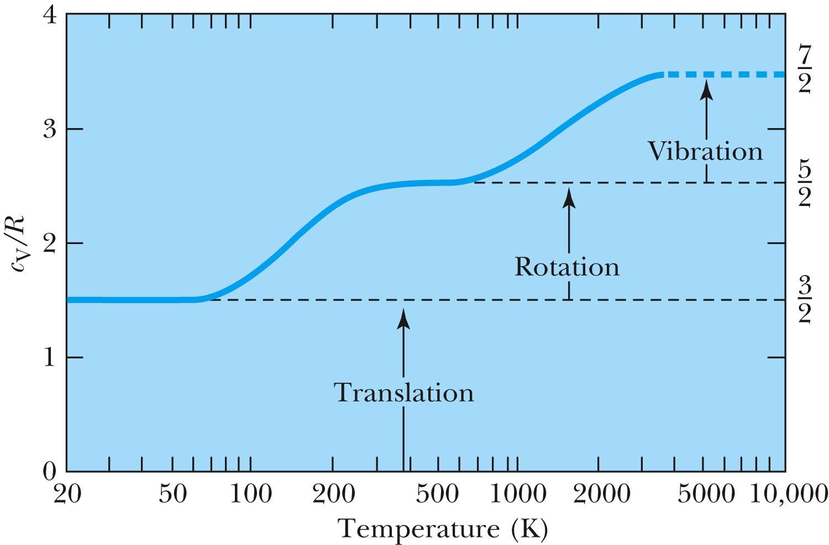
Experimental Demonstration of Equi-partition Principle

Slide 14
Concept of Waves and Particles
Two ways in which energy is transported:
Point mass interaction: transfers of momentum and kinetic energy: particles
Extended regions wherein energy transfers by way of vibrations and rotations are observed: waves

Slide 15
Particles vs. Waves
Two distinct phenomena describing physical interactions
Both required Newtonian mass
Particles in the form of point masses and waves in the form of perturbation in a mass distribution, i.e., a material medium
The distinctions are observationally quite clear
However, not so obvious for the case of visible light
Thus as the 17th century begins the major disagreement arose concerning the nature of light

Slide 16
The Nature of Light
Isaac Newton promoted the corpuscular (particle) theory
Published a book “Optiks” in 1704
Particles of light travel in straight lines or rays
Explained sharp shadows
Explained reflection and refraction
Christian Huygens (1629 -1695) promoted the wave theory
Presented the theory in 1678
Light propagates as a wave of concentric circles from the point of origin
Explained reflection and refraction
Could not explain “sharp” edges of the shadow
Thomas Young (1773 -1829) & Augustin Fresnel (1788 – 1829) ➔ Showed in 1802 and afterward that light clearly behaves as wave through two slit interference and other experiments
In 1850 Foucault showed that light travel slowly in water than air, the final blow to the corpuscular theory in explaining refraction

Slide 17
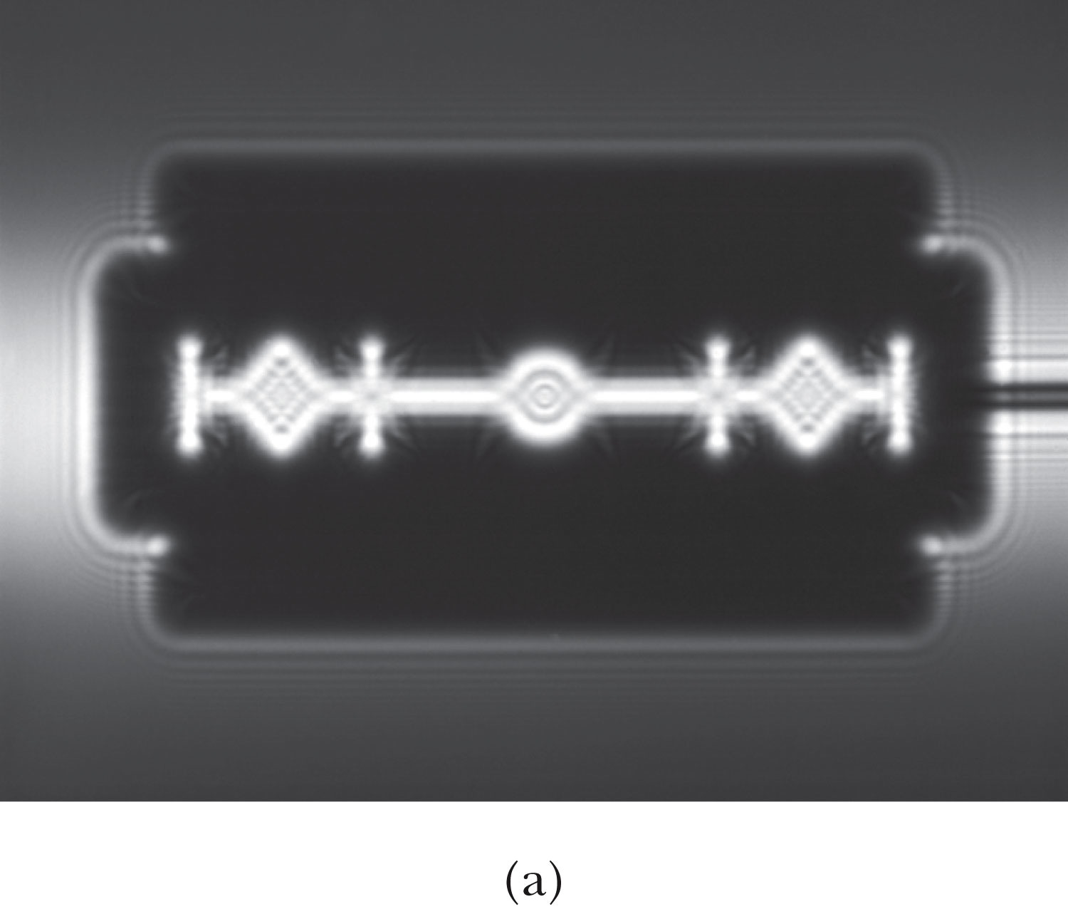
The Wave Theory Advances…
Contributions by Huygens, Young, Fresnel and Maxwell
Double-slit interference patterns
Refraction of light from the vacuum to a medium
Light was an electromagnetic phenomenon
Shadows are not as sharp as once thought with the advancement of experimental precision
Establishes that light propagates as a wave

Slide 18
The Electromagnetic Spectrum
Visible light covers only a small range of the total electromagnetic spectrum
All electromagnetic waves travel in vacuum with the speed c given by:
(where μ₀ and ε₀ are the respective permeability and permittivity of “free” space)

Slide 19
Conservation Laws and Fundamental Forces
Conservations laws are guiding principles of physics
Recall the fundamental conservation laws:
Conservation of energy
Conservation of linear momentum
Conservation of angular momentum
Conservation of electric charge
In addition to the classical conservation laws, two modern results include:
The conservation of baryons and leptons
The fundamental invariance principles for time reversal, distance, and parity

Slide 20
Also in the Modern Context…
The three fundamental forces are introduced
Gravitational:
Responsible for planetary motions, holding things on the ground, etc
Electroweak (unified at high energies)
Weak: Responsible for nuclear beta decay and effective only over distances of ~10⁻¹⁵ m
Electromagnetic: Responsible for all non-gravitational interactions, such as all chemical reactions, friction, tension….
(Coulomb force)
Strong: Responsible for “holding” the nucleus together and effective in the distance less than ~10⁻¹⁵ m

Slide 21
Relative Strength of Fundamental Forces

Slide 22
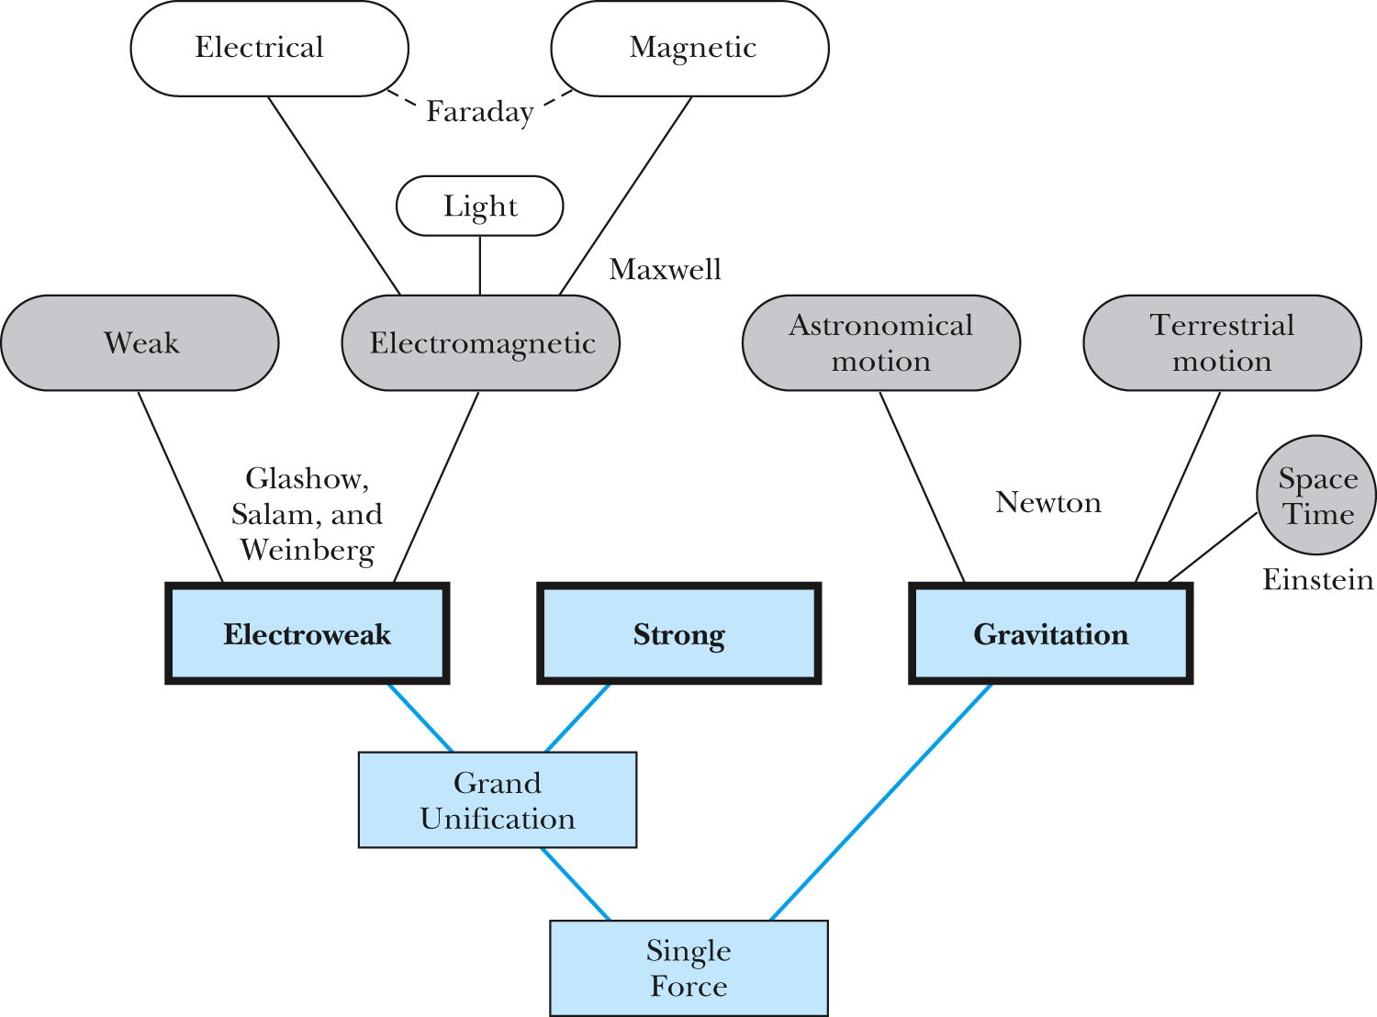
Unification of Forces
GUT, String theory
Not yet experimentally verified: p decays, magnetic monopole

