Slide 1
PHYS 3313 – Section 001 Lecture #4
Monday, Feb. 2, 2015
Dr. Jaehoon Yu
Atomic Theory of Matter
Unsolved Questions of 1895 and New Horizon
Unsolved Questions Today!
Galilean Transformation
Do we need Ether?
Michelson-Morley Experiment
Einstein’s postulates

Slide 2
Announcements
Reading assignments: CH 2.10 (special topic), 2.13 and 2.14
Please go through eq. 2.45 through eq. 2.49 and example 2.9
Homework #1
chapter 2 end of the chapter problems
17, 21, 23, 24, 32, 59, 61, 66, 68, 81 and 96
Due is by the beginning of the class, Monday, Feb. 9
Work in study groups together with other students but PLEASE do write your answer in your own way!
Quiz #1 results
Class average: 17.1/75
Equivalent to 23/100
Top score: 48/75

Slide 3
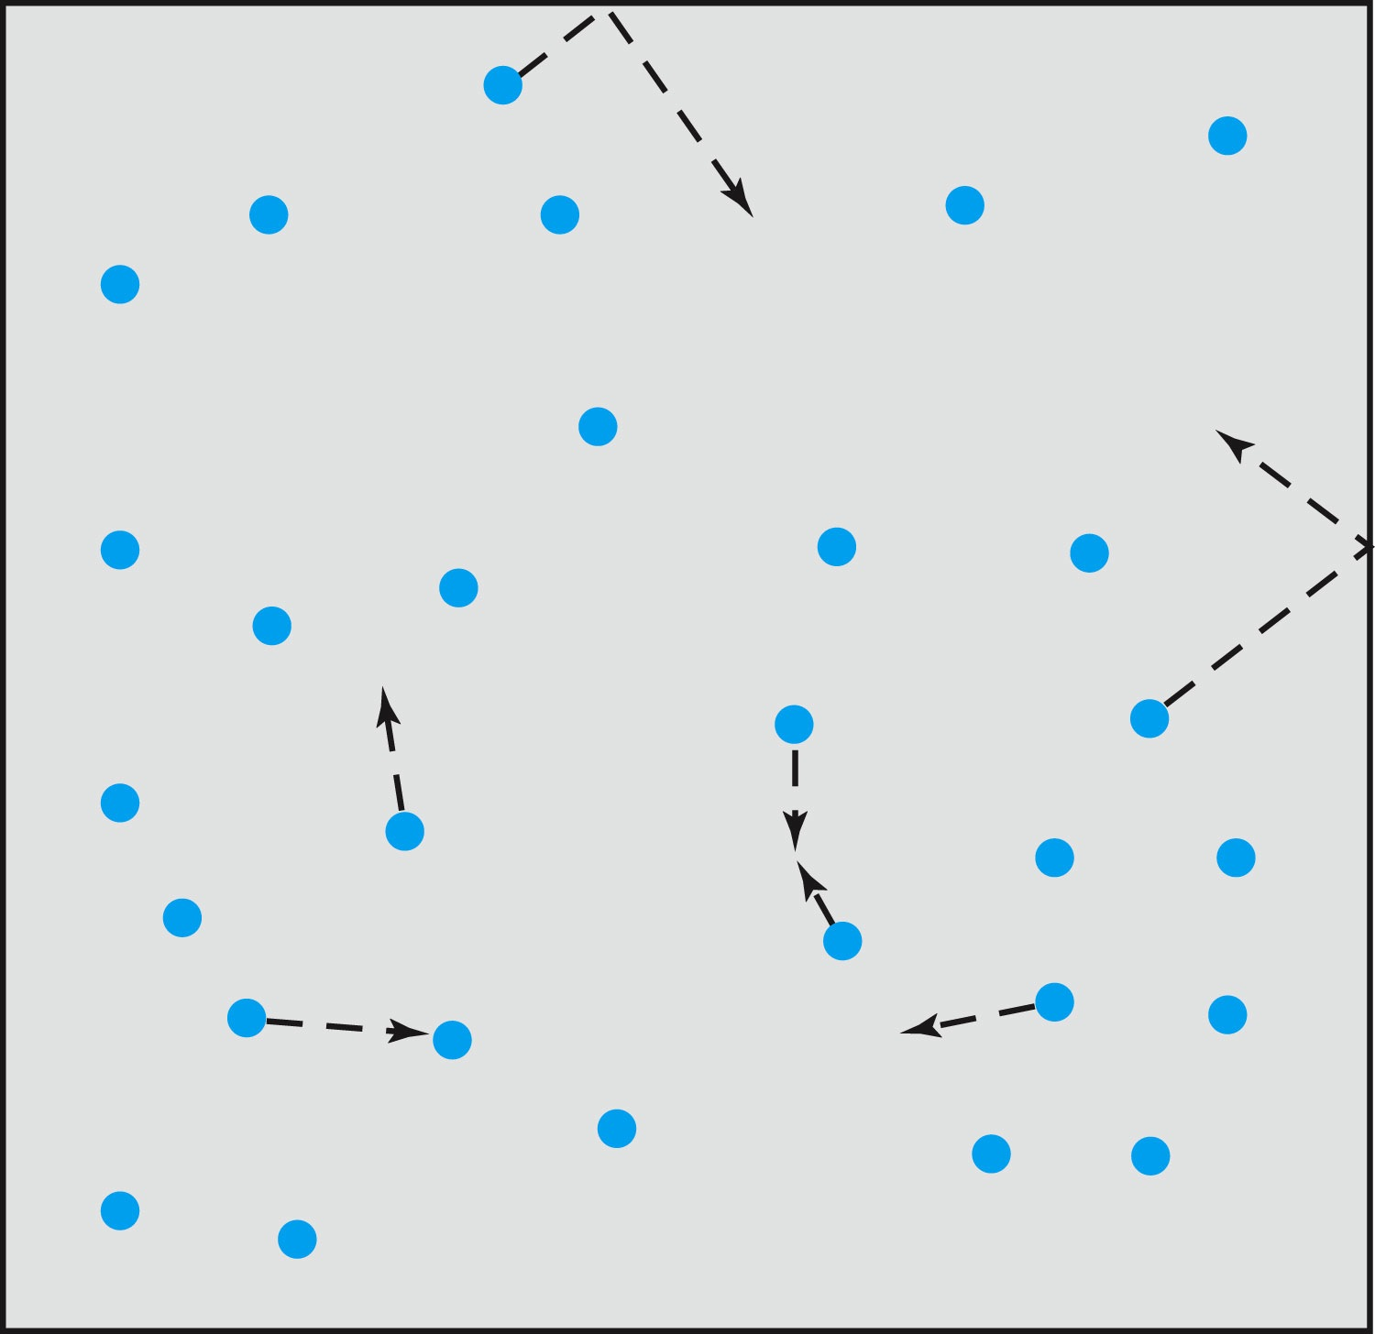
Relevance of Gas Concept to Atoms
The idea of gas (17th century) as a collection of small particles bouncing around with kinetic energy enabled concept of small, unseen objects
This concept formed the bases of existence something small that makes up matter

Slide 4
The Atomic Theory of Matter
Concept initiated by Democritus and Leucippus (~450 B.C.) (first to use the Greek atomos, meaning “indivisible”)
In addition to fundamental contributions by Boyle, Charles, and Gay-Lussac, Proust (1754 – 1826) proposes the law of definite proportions➔ A compound of 2 or more elements, the weight proportion of the elements is always same
Dalton advances the atomic theory of matter to explain the law of definite proportions
Avogadro proposed that all gases at the same temperature, pressure, and volume contain the same number of molecules (atoms); viz. 6.02 × 10²³ atoms
Cannizzaro (1826 – 1910) makes a distinction between atoms and molecules advancing the ideas of Avogadro.

Slide 5
Further Advances in Atomic Theory
Maxwell derives the speed distribution of atoms in a gas
Robert Brown (1753 – 1858), a botanist, observes microscopic “random” motion of suspended grains of pollen in water (Brownian motion)
Einstein in the 20th century explains this random motion using atomic theory

Slide 6
Opposition to the Atomic Theory
Ernst Mach (1838 – 1916) opposes the theory on the basis of logical positivism, i.e., atoms being “unseen” questions their reality
Wilhelm Ostwald (1853 – 1932) supports Mach’s premise and called atoms hypothetical structures for bookkeeping based on experimental results of radioactivity, discrete spectral lines, and the formation of molecular structures

Slide 7
Overwhelming Evidence for Existence of Atoms
Max Planck (1858 – 1947) advances the concept to explain blackbody radiation, using submicroscopic “quanta”
Boltzmann requires existence of atoms for advances in statistical mechanics
Albert Einstein (1879 – 1955) uses molecules to explain Brownian motion and determines the approximate value of their sizes and masses
Jean Perrin (1870 – 1942) experimentally verifies Einstein’s predictions

Slide 8
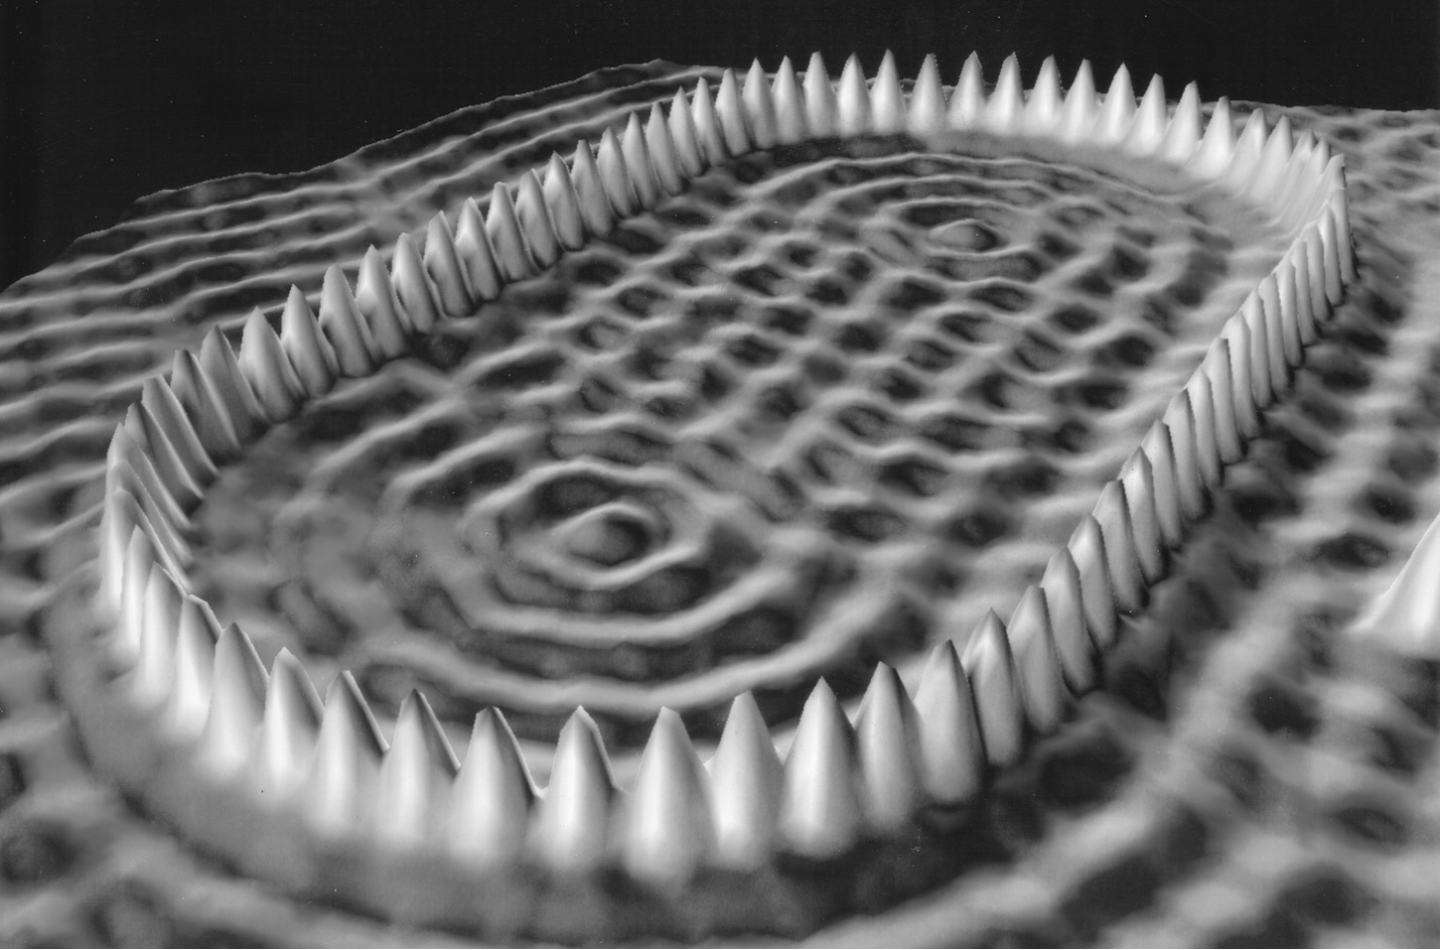
Unresolved Questions and New Horizons
The atomic theory controversy raises fundamental questions
It was not universally accepted
The constituents (if any) of atoms became a significant question
The structure of matter remained unknown with certainty
Experimental precisions were insufficient to discern this level of small scale

Slide 9
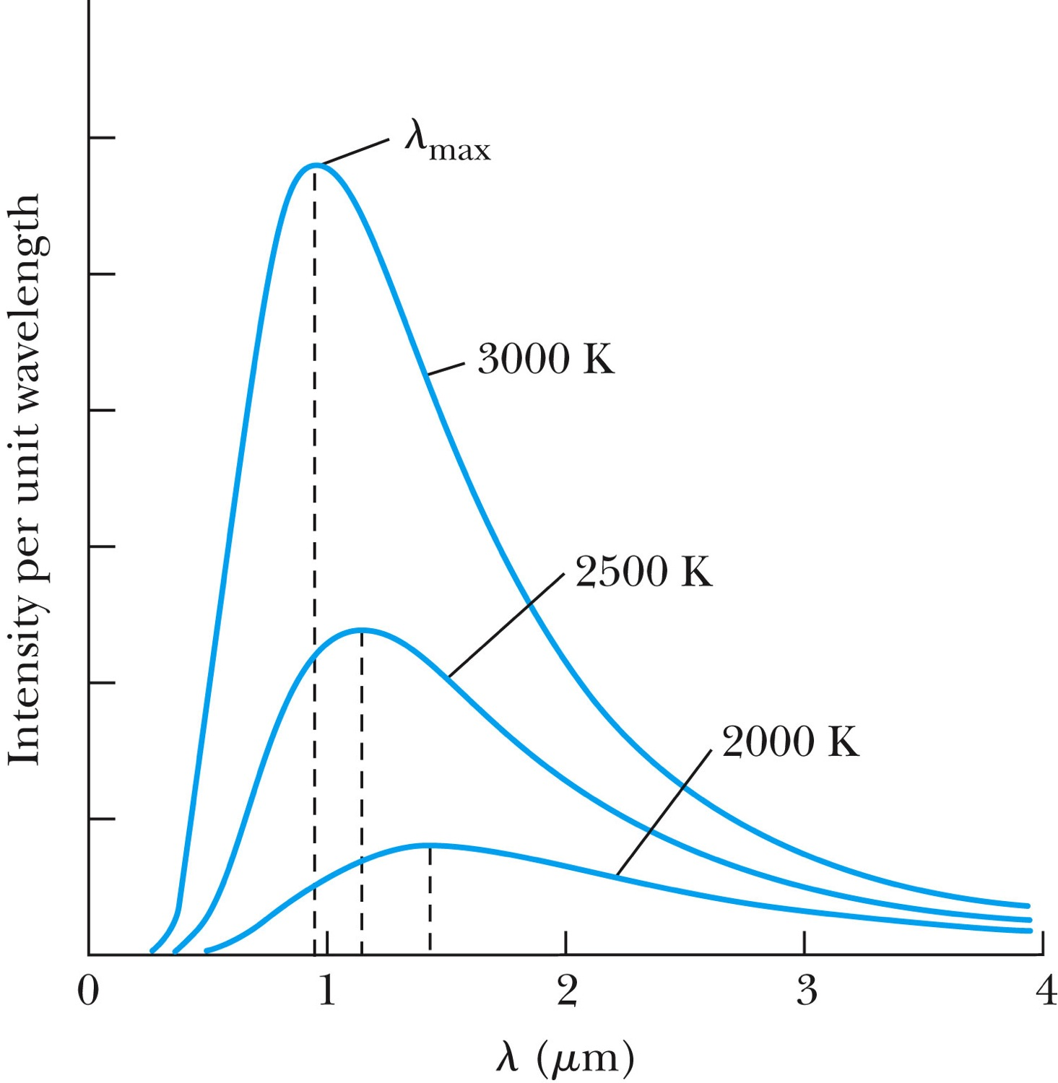
Further Complications
Three fundamental problems:
The (non) existence of a medium that transmits light waves from the sun
The observed differences in the electric and magnetic fields between stationary and moving reference systems
The failure of classical physics to explain blackbody radiation in which characteristic spectra of radiation that cover the entire EM wavelengths were observed depending on temperature not on the body itself

Slide 10
Additional Experimental Discoveries Contribute to the Complications
Discovery of x-rays (1895, Röntgen)
Discovery of radioactivity (1896, Becquerel)
Discovery of the electron (1897, Thompson)
Discovery of the Zeeman effect (1896, Zeeman), the dependence of spectral frequency on magnetic field

Slide 11
The Beginnings of Modern Physics
These new discoveries and the many resulting complications required a revision of the fundamental physical assumptions culminated on the successes of the classical foundations
To this end, the introduction of the modern theory of relativity and quantum mechanics becomes the starting point of this most fascinating revision

Slide 12
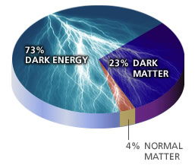
Unsolved Problems Today!
Why are there three families of quarks and leptons?
Why is the mass range so large (0.1m_{p} – 175 m_{p})?
How do matters acquire mass?
Is the new particle we’ve discovered the Higgs particle?
Why is the matter in the universe made only of particles?
What happened to anti-particles? Or anti-matters?
Do neutrinos have mass & what are the mixing parameters?
Why are there only three apparent forces?
Is the picture we present the real thing?
What makes up the 96% of the universe?
How about extra-dimensions?
How is the universe created?
Are there any other theories that describe the universe better?
Many more questions to be answered!!

Slide 13
Newtonian (Classical) Relativity
It is assumed that Newton’s laws of motion must be measured with respect to (relative to) some reference frame.
A reference frame is called an inertial frame if Newton’s laws are valid in that frame.
Such a frame is established when a body, not subjected to a net external force, is observed to move in rectilinear motion at constant velocity
➔ Newtonian Principle of Relativity (Galilean Invariance): If Newton’s laws are valid in one reference frame, then they are also valid in another reference frame moving at a uniform velocity relative to the first system.

Slide 14
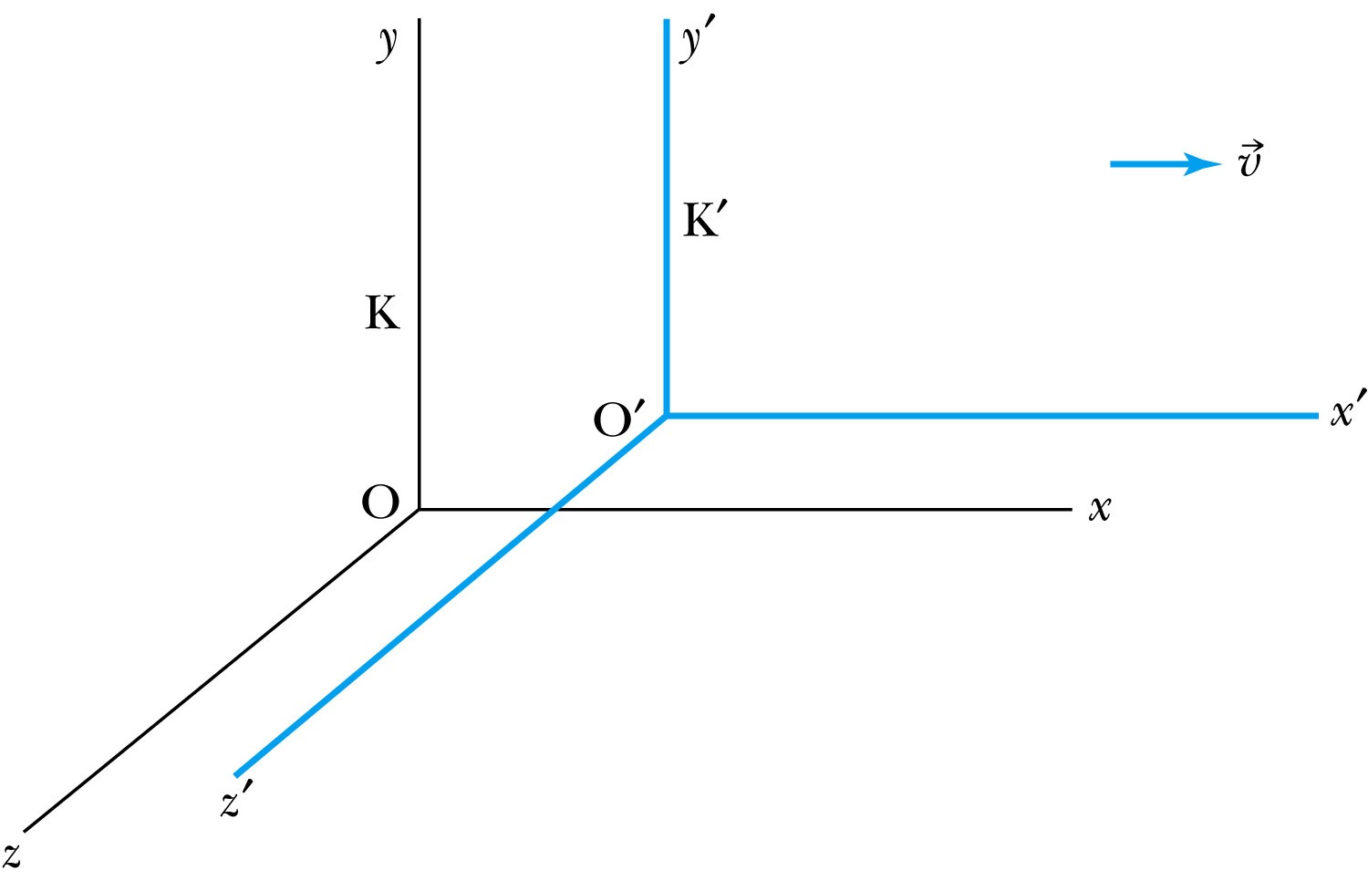
Inertial Frames K and K’
K is at rest and K’ is moving with a constant velocity
Axes are parallel
K and K’ are said to be INERTIAL COORDINATE SYSTEMS

Slide 15
The Galilean Transformation
For a point P
In system K: P = (x, y, z, t)
In system K’: P = (x’, y’, z’, t’)
P
x
K
K’
x’-axis
x-axis

Slide 16
Conditions of the Galilean Transformation
Parallel axes between the two inertial reference frames
K’ has a constant relative velocity in the x-direction with respect to K
Time (t) for all observers is a Fundamental invariant, i.e., the same for all inertial observers
Space and time are separate!!

Slide 17
The Inverse Relations
Step 1. Replace with
Step 2. Replace “primed” quantities with
“unprimed” and “unprimed” with “primed”

Slide 18
The Transition to Modern Relativity
Although Newton’s laws of motion had the same form under the Galilean transformation, Maxwell’s equations did not.
In 1905, Albert Einstein proposed a fundamental connection between space and time and that Newton’s laws are only an approximation.

Slide 19
They Needed Ether!!
The wave nature of light suggested that there existed a propagation medium called the luminiferous ether or just ether.
Provides an inertial reference frame
The properties of ether
Very low density for planets to move through it without loss of energy
Sufficiently high elasticity to support the high velocity of light waves (c=?)

Slide 20
Ether as the Absolute Reference System
In Maxwell’s theory, the speed of light is given by
The velocity of light between the moving systems must be a constant.
Can you see why?
Needed a system of medium that keeps this constant!
Ether proposed as the absolute reference system in which the speed of light is constant and from which other measurements could be made.
The Michelson-Morley experiment was an attempt to show the existence of ether.

Slide 21
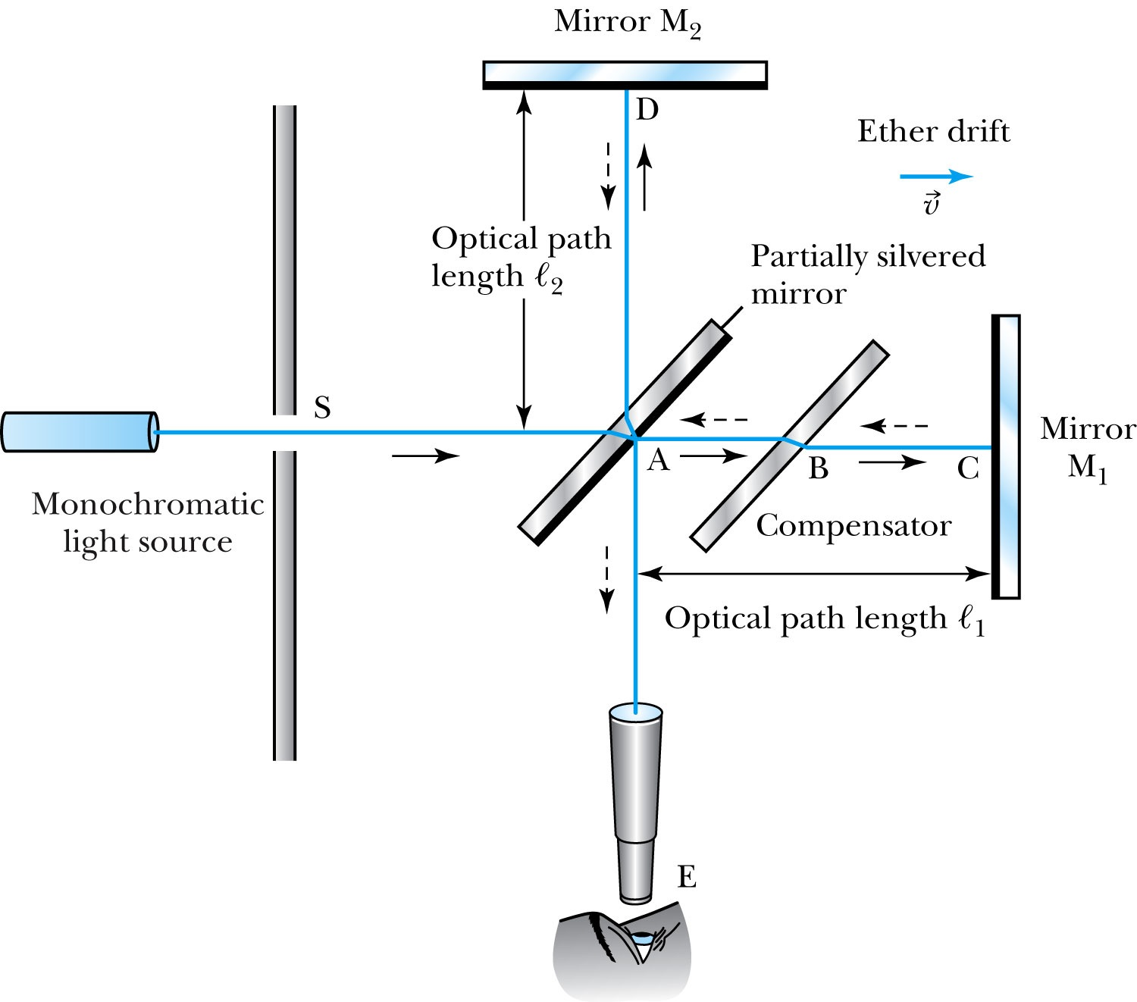
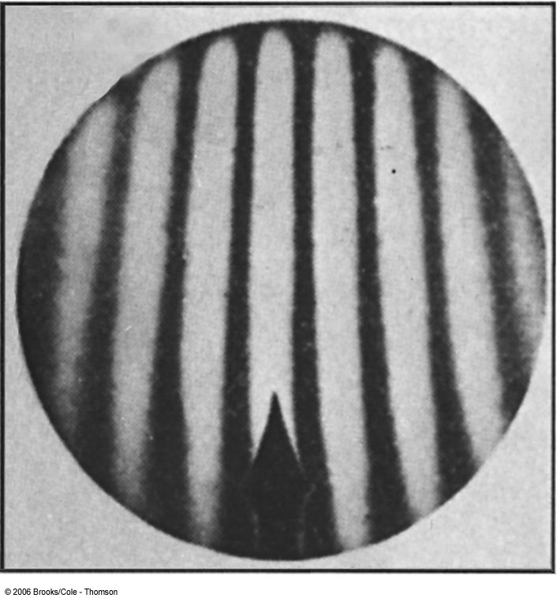
The Michelson-Morley Experiment
Albert Michelson (1852–1931) built an extremely precise device called the interferometer to measure the phase difference between two light waves traveling in orthogonal directions.

Slide 22
How does Michelson Interferometer work?
AC is parallel to the motion of the Earth inducing an “ether wind”
Light from source S is split by mirror A and travels to mirrors C and D in mutually perpendicular directions
After reflection the beams recombine at A slightly out of phase due to the “ether wind” as viewed by telescope E.
Ether

Slide 23
The analysis – Galilean X-formation
Travel time t₁ for a round trip over AC (the ether direction) is
Travel time t₂ for a round trip over AD (perpendicular direction to ether) is
The time difference is

Slide 24
The analysis
After rotating the machine by 90º, the time difference becomes
The difference of the time differences
Since v (the Earth’s speed) is 10⁻⁴ of c, we can do binomial expansion of the above

Slide 25
The Results
Using the Earth’s orbital speed as:
V = 3 × 10⁴ m/s
together with
ℓ₁ ≈ ℓ₂ = 1.2 m
So that the time difference becomes
Δt’ − Δt ≈ v²(ℓ₁ + ℓ₂)/c³ = 8 × 10⁻¹⁷ s
Although a very small number, it was within the experimental range of measurement for light waves.
Later with Morley, they increased the path lengths to 11m and improved precision better than a factor of 10
Yet, Michelson FAILED to “see” the expected interference pattern

Slide 26
Conclusions of Michelson Experiment
Michelson noted that he should be able to detect a phase shift of light due to the time difference between path lengths but found none.
He thus concluded that the hypothesis of the stationary ether must be incorrect.
After several repeats and refinements with assistance from Edward Morley (1893-1923), again a null result.
Thus, ether does not seem to exist!
Many explanations ensued afterward but none worked out!
This experiment shattered the popular belief of light being waves

