Slide 1
PHYS 3313 – Section 001 Lecture #6
Monday, Feb. 9, 2015
Dr. Jaehoon Yu
Relativistic Velocity Addition
The Twin Paradox
Space-time Diagram
The Doppler Effect

Slide 2
Announcements
Bring your homework #1 after the class

Slide 3
Reminder: Special Project #2
Derive the three Lorentz velocity transformation equations, starting from Lorentz coordinate transformation equations. (10 points)
Derive the three reverse Lorentz velocity transformation equations, starting from Lorentz coordinate transformation equations. (10 points)
Prove that the space-time invariant quantity s²=x²-(ct)² is indeed invariant, i.e. s²=s’², in Lorentz Transformation. (5 points)
You must derive each one separately starting from the Lorentz spatial coordinate transformation equations to obtain any credit.
Just simply switching the signs and primes will NOT be sufficient!
Must take the simplest form of the equations, using β and γ.
You MUST have your own, independent answers to the above three questions even if you worked together with others. All those who share the answers will get 0 credit if copied.
Due for the submission is this Monday, Feb. 16!

Slide 4
The Complete Lorentz Transformations

Slide 5
Addition of Velocities
How do we add velocities in a relativistic case?
Taking differentials of the Lorentz transformation, relative velocities may be calculated:

Slide 6
So that…
defining velocities as: v_{x} = dx/dt, v_{y} = dy/dt, v’_{x} = dx’/dt’, etc. it can be shown that:
With similar relations for v_{y} and v_{z:}

Slide 7
The Lorentz Velocity Transformations
In addition to the previous relations, the Lorentz velocity transformations for v’_{x}, v’_{y} , and v’_{z} can be obtained by switching primed and unprimed and changing v to –v.

Slide 8
Velocity Addition Summary
Galilean Velocity addition where and
From inverse Lorentz transform and
So
Thus
What would be the measured speed of light in S frame?
Since we get
Observer in S frame measures c too! Strange but true!

Slide 9
Velocity Addition Example
Yu Darvish is riding his bike at 0.8c relative to observer. He throws a ball at 0.7c in the direction of his motion. What speed does the observer see?
What if he threw it just a bit harder?
Doesn’t help—asymptotically approach c, can’t exceed (it’s not just a postulate it’s the law)

Slide 10
A test of Lorentz velocity addition: π⁰ decay
How can one test experimentally the correctness of the Lorentz velocity transformation vs Galilean one?
In 1964, T. Alvager and company performed a measurements of the arrival time of two photons resulting from the decay of a π⁰ in two detectors separated by 30m.
Each photon has a speed of 0.99975c. What are the speed predicted by Galilean and Lorentz x-mation?
v_{G}=c+0.99975c=1.99975c
How much time does the photon take to arrive at the detector?

Slide 11
Twin Paradox
The Set-up: Twins Mary and Frank at age 30 decide on two career paths: Mary (the Moving twin) decides to become an astronaut and to leave on a trip 8 light-years (ly) from the Earth at a great speed and to return; Frank (the Fixed twin) decides to stay on the Earth.
The Problem: Upon Mary’s return, Frank reasons, that her clocks measuring her age must run slow. As such, she will return younger. However, Mary claims that it is Frank who is moving and consequently his clocks must run slow.
The Paradox: Who is younger upon Mary’s return?

Slide 12
Twin Paradox cont’d
Let’s say, Mary is traveling at the speed of 0.8c
Frank will measure Mary’s total travel time as
T=8ly/0.8c=10yrs
Mary’s clock will run slower due to relativity:
Thus, Frank claims that Mary will be 42 years old while he is 50 years old
Who is correct?

Slide 13
The Resolution
Frank’s clock is in an inertial system during the entire trip; however, Mary’s clock is not. As long as Mary is traveling at constant speed away from Frank, both of them can argue that the other twin is aging less rapidly.
When Mary slows down to turn around, she leaves her original inertial system and eventually returns in a completely different inertial system.
Mary’s claim is no longer valid, because she does not remain in the same inertial system. There is also no doubt as to who is in the inertial system. Frank feels no acceleration during Mary’s entire trip, but Mary does.
So Frank is correct! Mary is younger!

Slide 14
Space-time
When describing events in relativity, it is convenient to represent events on a space-time diagram.
In this diagram one spatial coordinate x specifies the position, and instead of time t, ct is used as the other coordinate so that both coordinates will have the same dimensions of length.
Space-time diagrams were first used by H. Minkowski in 1908 and are often called Minkowski diagrams. Paths in Minkowski space-time are called worldlines.

Slide 15
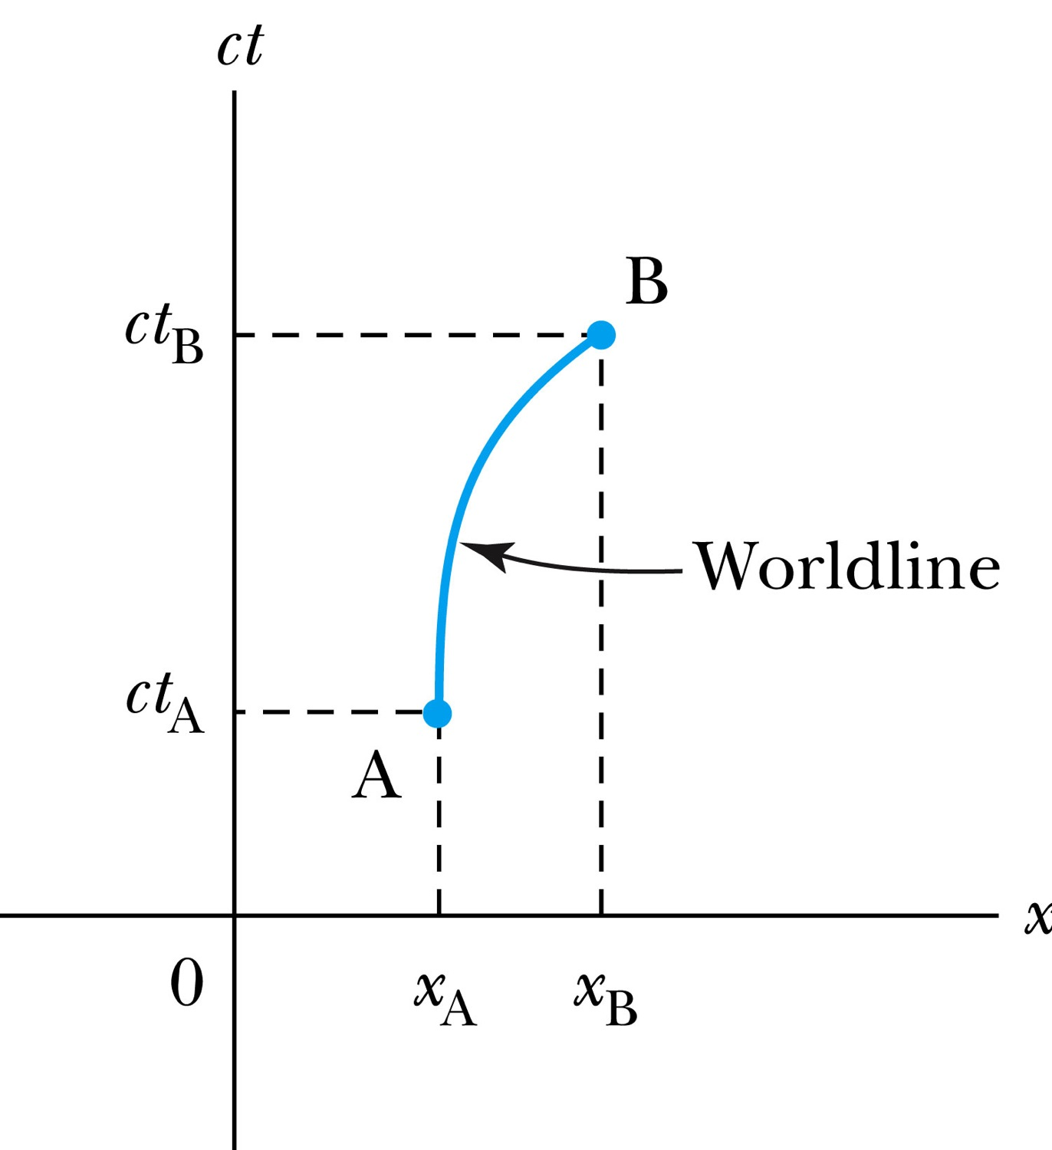
The Space-time Diagram
Notes:
Add the paragraph for Figure 2.21

Slide 16
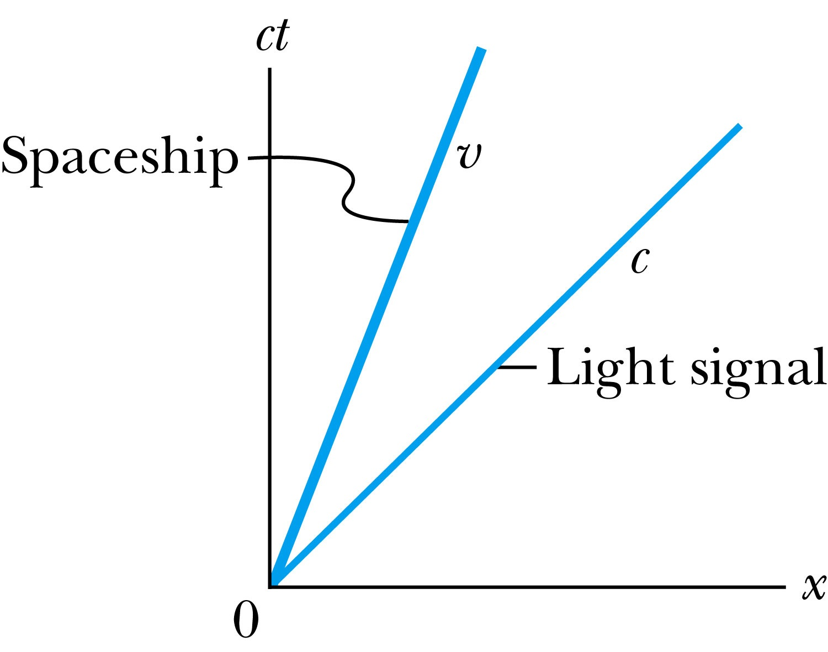
Particular Worldlines
How does the worldline for a spaceship running at the velocity v(<c) look?
How does the worldline for light signal look?
Notes:
Add the paragraph from Fig. 2.22

Slide 17
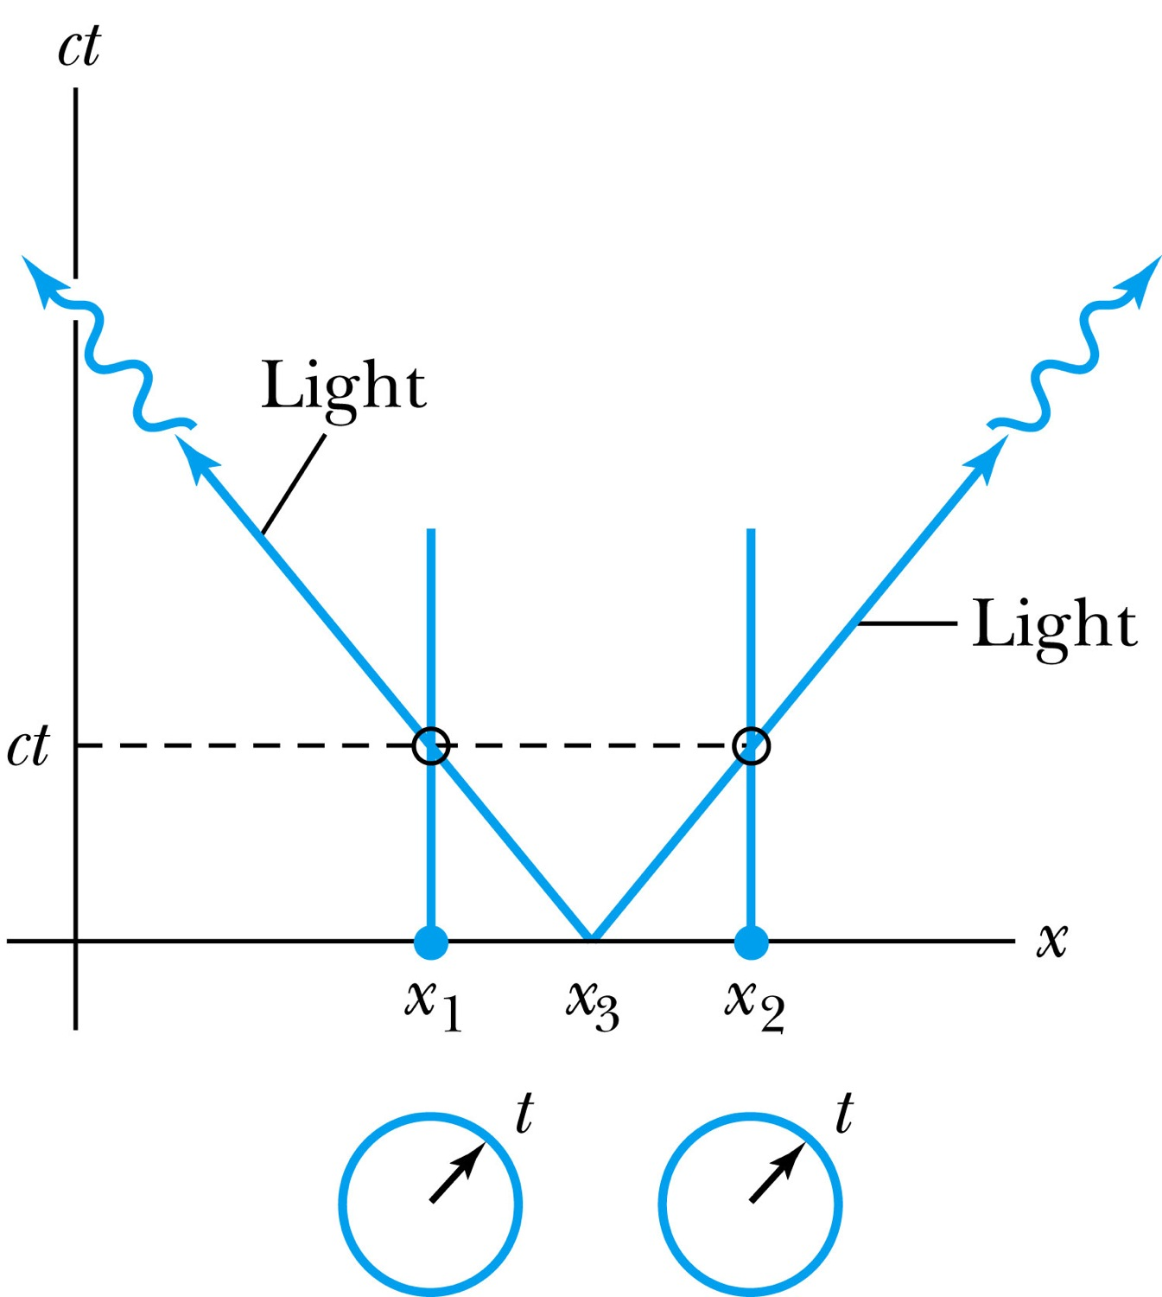
How about the time measured by two stationary clocks?
Notes:
Add paragraph from figure 2.23

Slide 18
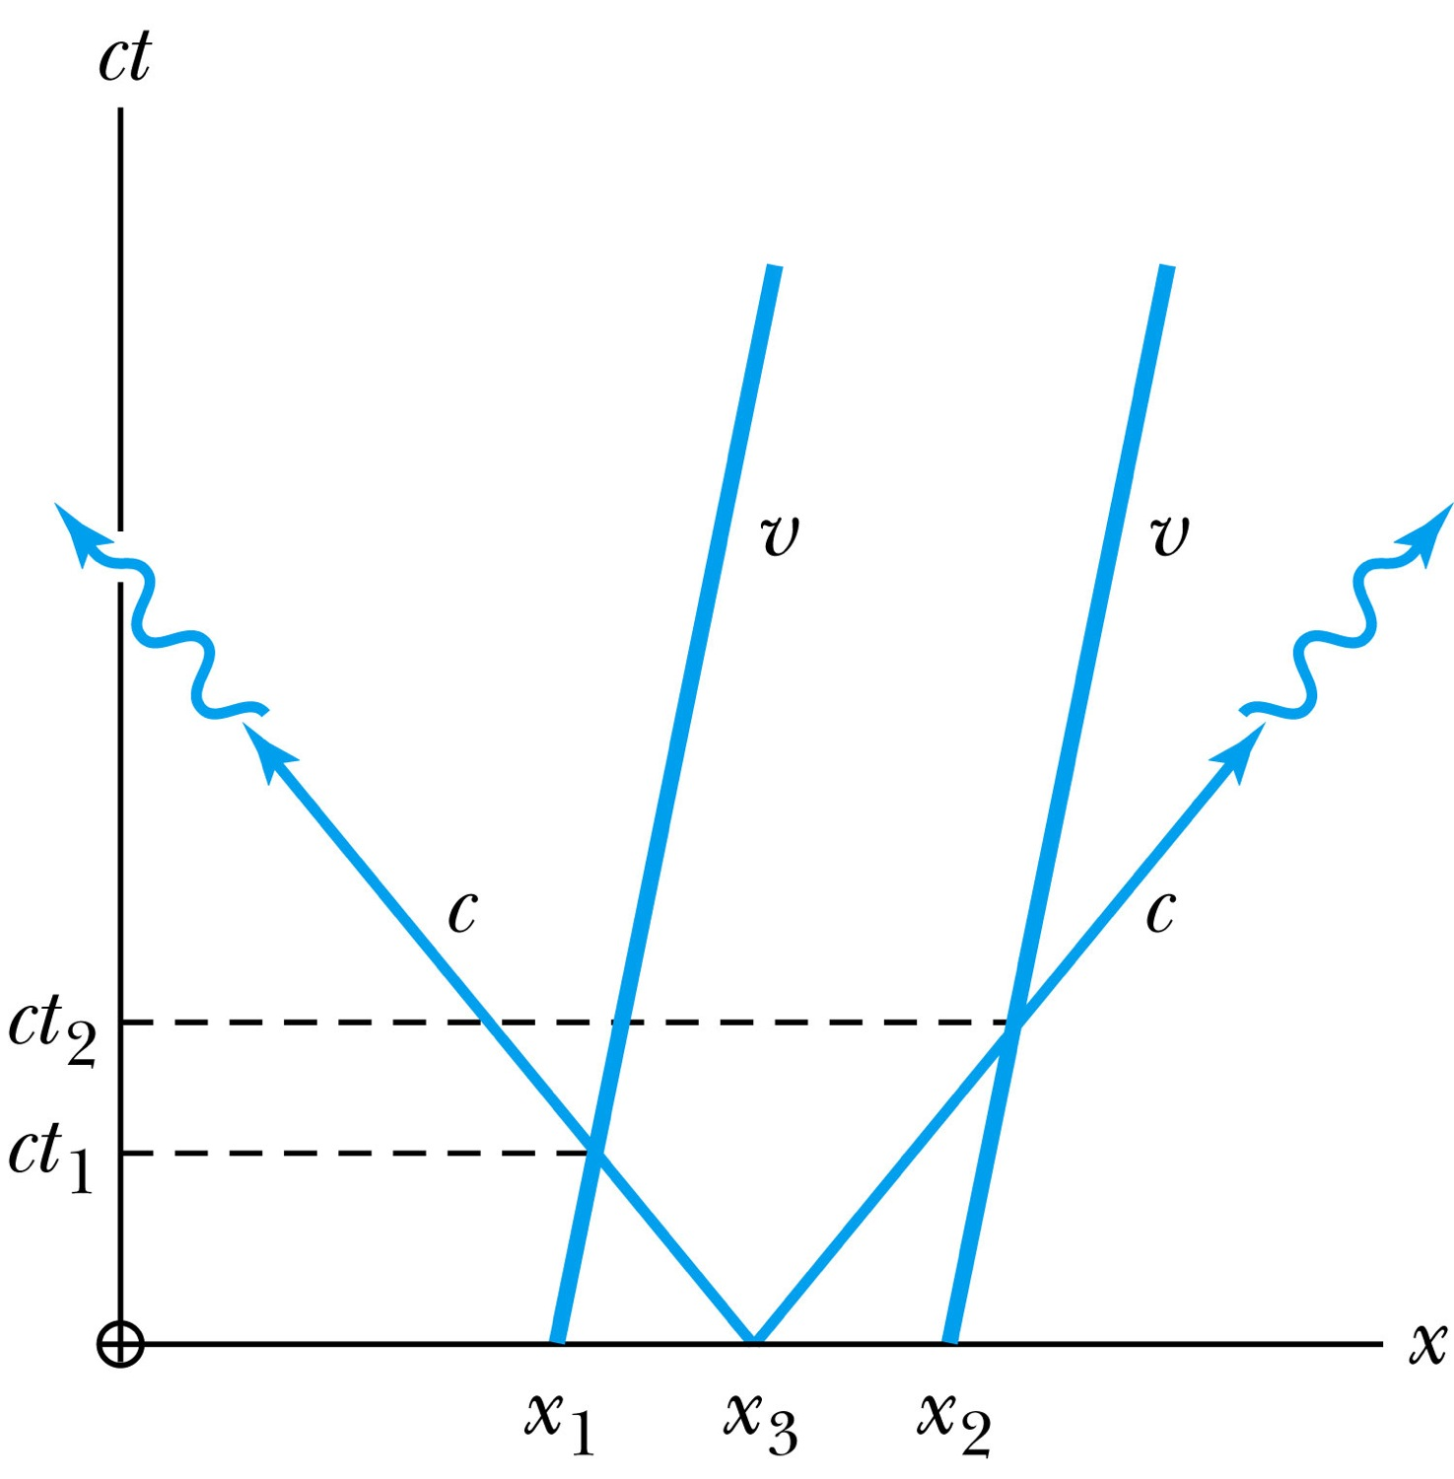
How about the time measured by moving clocks?
Notes:
Add paragraph from figure 2.24

Slide 19
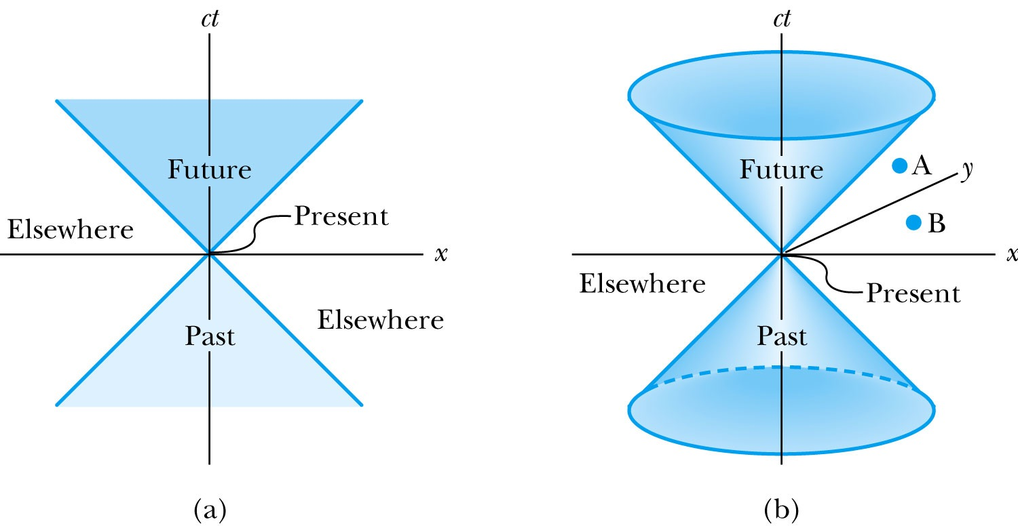
The Light Cone
Notes:
Add paragraph from Figure 2.25

