Slide 1
PHYS 3313 – Section 001 Lecture #7
Wednesday, Feb. 11, 2015
Dr. Jaehoon Yu
Invariant Quantities
The Doppler Effect
Relativistic Momentum and Energy
Relationship Between Relativistic Quantities
Quantization

Slide 2
Announcements
Reading assignments: CH 3.3 (special topic – the discovery of Helium) and CH3.7
Colloquium today Dr. William Newton of TAMU Commerce
Into the Mantle of the Neutron Star: Probing Condensed Nuclear Matter under Extreme Condition
SH101 at 4pm

Slide 3
Reminder: Special Project #2
Derive the three Lorentz velocity transformation equations, starting from Lorentz coordinate transformation equations. (10 points)
Derive the three reverse Lorentz velocity transformation equations, starting from Lorentz coordinate transformation equations. (10 points)
Prove that the space-time invariant quantity s²=x²-(ct)² is indeed invariant, i.e. s²=s’², in Lorentz Transformation. (5 points)
You must derive each one separately starting from the Lorentz spatial coordinate transformation equations to obtain any credit.
Just simply switching the signs and primes will NOT be sufficient!
Must take the simplest form of the equations, using β and γ.
You MUST have your own, independent answers to the above three questions even if you worked together with others. All those who share the answers will get 0 credit if copied.
Due for the submission is this Monday, Feb. 16!

Slide 4
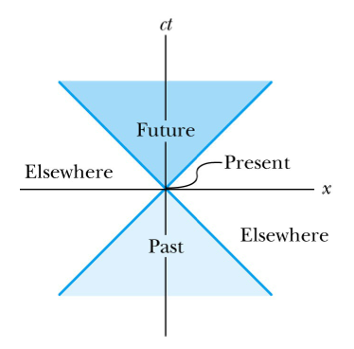
Space-time Invariants
There are three possibilities for the invariant quantity Δs²:
Δs² = 0: Δx² = c² Δt²: light-like separation
Two events can be connected only by a light signal.
Δs² > 0: Δx² > c² Δt²: space-like separation
No signal can travel fast enough to connect the two events. The events are not causally connected!!
Δs² < 0: Δx² < c² Δt²: time-like separation
Two events can be causally connected.
These two events cannot occur simultaneously!
1
3
2

Slide 5
The Doppler Effect
The Doppler effect of sound
Increased frequency of sound as a source approaches a receiver
Decreased frequency as the source recedes.
The same change in sound frequency occurs when the source is fixed and the receiver is moving.
The change in frequency of the sound wave depends on whether the source or the receiver is moving.
Does this violate the principle of relativity?
No
Why not?
Sound wave is in a special frame of media such as air, water, or a steel plate in order to propagate;
Light does not need a medium to propagate!

Slide 6
Recall the Doppler Effect
Notes:
Add paragraph from figure 2.27

Slide 7
The Relativistic Doppler Effect
Consider a source of light (a star) and a receiver (an astronomer) approaching one another with a relative velocity v.
Consider the receiver in system K and the light source in system K’ moving toward the receiver with velocity v.
The source emits n waves during the time interval T.
Because the speed of light is always c and the source is moving with velocity v, the total distance between the front and rear of the wave emitted during the time interval T is:
Length of wave train = cT − vT

Slide 8
The Relativistic Doppler Effect (con’t)
Because there are n waves emitted by the source in time period T, the wavelength measured by the stationary receiver is
And the resulting frequency measured by the receiver is
The number of waves emitted in the moving frame of the source is n=f₀T ‘₀ with the proper time T’₀=T/γ we obtain the measured frequency by the receiver as

Slide 9
Results of Relativistic Doppler Effect
When source/receiver is approaching with β = v/c the resulting frequency is
Higher than the actual source’s frequency, blue shift!!
When source/receiver is receding with β = v/c the resulting frequency is
Lower than the actual source’s frequency, red shift!!
If we use +β for approaching source/receiver and -β for receding source/receiver, relativistic Doppler Effect can be expressed
For more generalized case

Slide 10
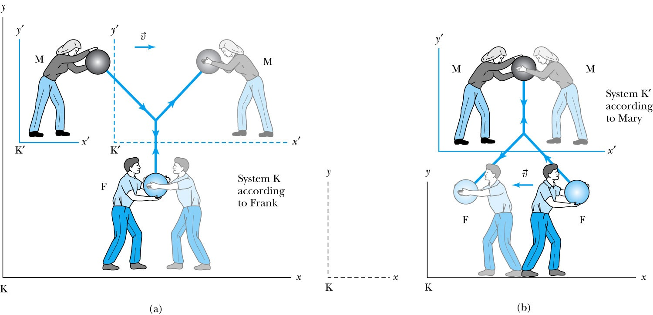
Relativistic Momentum
The most fundamental principle used here is the momentum conservation!
Frank is at rest in system K holding a ball of mass m.
Mary holds a similar ball in system K’ that is moving in the x direction with velocity v with respect to system K.
At one point they threw the ball at each other with exactly the same speed
Notes:
Add paragraph from figure 2.29

Slide 11
Relativistic Momentum
If we use the definition of momentum, the momentum of the ball thrown by Frank is entirely in the y direction
p_{Fy} = mu₀
The change of momentum as observed by Frank is
Δp_{F} = Δp_{Fy} = −2mu₀
Mary measures the initial velocity of her own ball to be
u’_{Mx} = 0 and u’_{My} = −u₀.
In order to determine the velocity of Mary’s ball as measured by Frank we use the velocity transformation equations:

Slide 12
Relativistic Momentum
Before the collision, the momentum of Mary’s ball as measured by Frank (in the Fixed frame) with the Lorentz velocity transformation becomes
For a perfectly elastic collision, the momentum after the collision is
Thus the change in momentum of Mary’s ball according to Frank is
OMG! The linear momentum is not conserved even w/o an external force!!
What do we do?
Redefine the momentum in a fashion
Something has changed. Mass is now, mγ!! The relativistic mass!!
Mass as the fundamental property of matter is called the “rest mass”, m₀!
Notes:
Spaced a bit more evenly

Slide 13
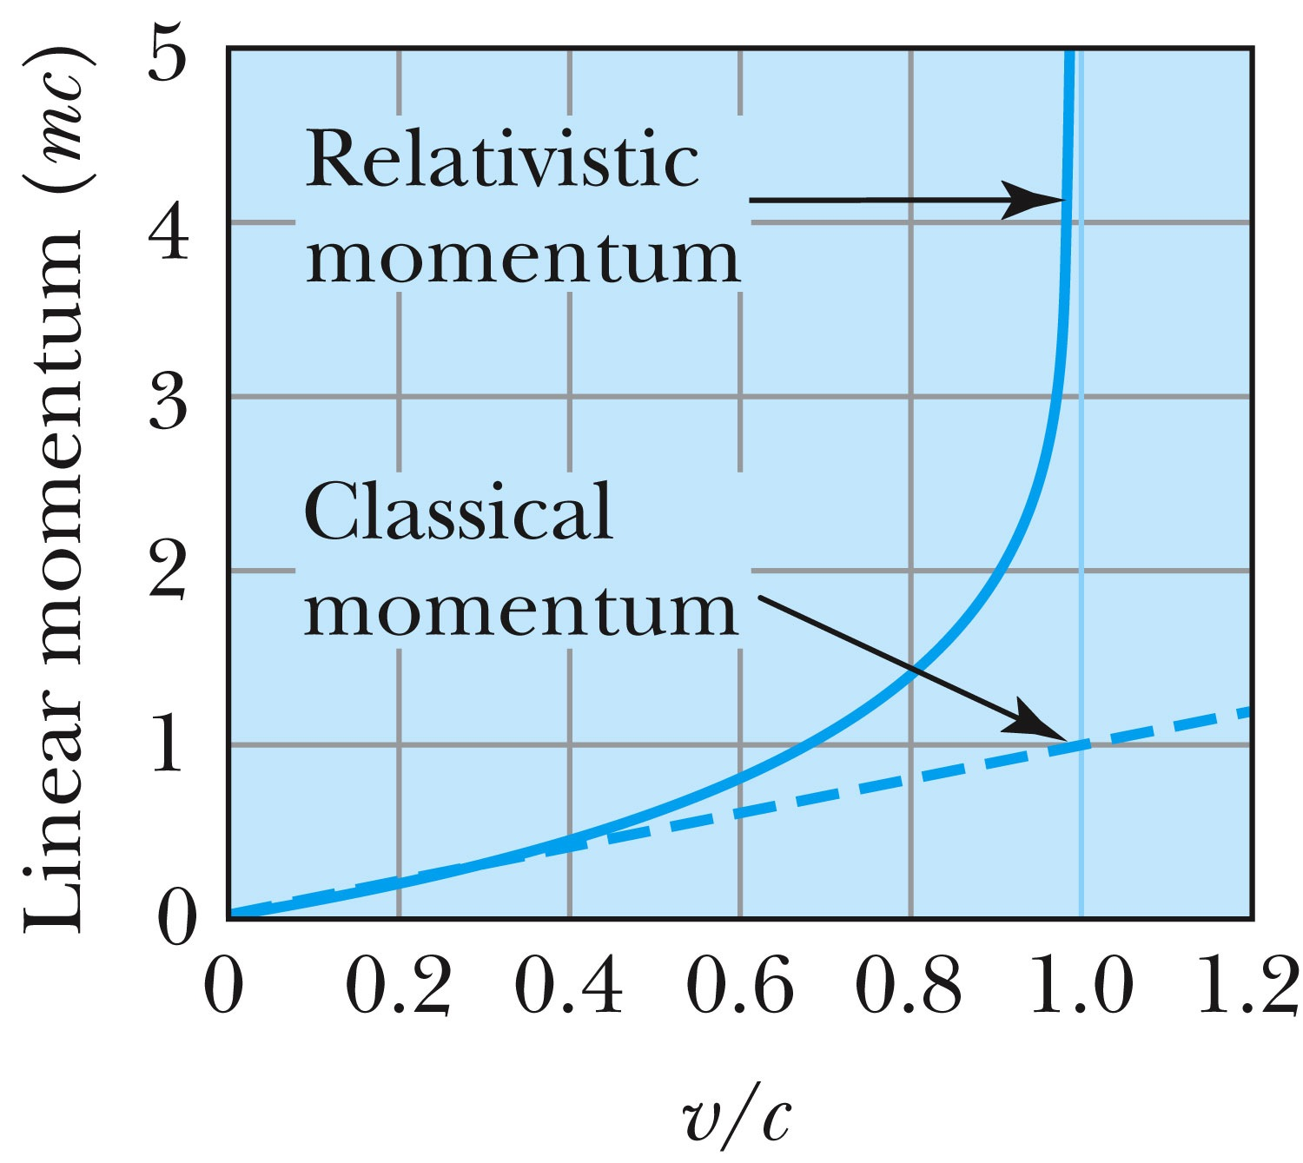
Relativistic and Classical Linear Momentum
Notes:
Add arrow head to the line from “Relativistic” to the graph
Possibly make the line from the “Classical” straight (as in figure 2.310
rather than curved, also add arrow head to this line pointing to the curve.

