Slide 1
PHYS 3313 – Section 001 Lecture #8
Monday, Feb. 16, 2015
Dr. Jaehoon Yu
Relativistic Energy
Relationship Between Relativistic Quantities
Binding Energy
Quantization
Discovery of the X-ray and the Electron

Slide 2
Announcements
Reading assignments: CH3.9
Homework #2
CH3 end of the chapter problems: 2, 19, 27, 36, 41, 47 and 57
Due Wednesday, Feb. 25
Quiz #2 Monday, Feb. 23
Beginning of the class
Covers CH1.1 – what we finish this this Wednesday, Feb. 18

Slide 3
How do we keep momentum conserved in a relativistic case?
Redefine the classical momentum in the form:
This Γ(u) is different than the γ factor since it uses the particle’s speed u
➔ What? How does this make sense?
➔ Well the particle itself is moving at a relativistic speed, thus that must impact the measurements by the observer in the rest frame!!
Now, the agreed form of the momentum in all frames is (τ is the proper time):
Resulting in the new relativistic definition of the momentum:
When u→0, this formula becomes that of the classical.
What can the speed u be to maintain the accuracy of the classical momentum to 1%?
Notes:
Spaced a bit more evenly

Slide 4
Relativistic Energy
Due to the new idea of relativistic mass, we must now redefine the concepts of work and energy.
Modify Newton’s second law to include our new definition of linear momentum, and force becomes:
The work W done by a force F to move a particle from rest to a certain kinetic energy is
Resulting relativistic kinetic energy becomes
Why doesn’t this look anything like the classical KE?

Slide 5
Big note on Relativistic KE
Only is right!
and are wrong!

Slide 6
Total Energy and Rest Energy
Rewriting the relativistic kinetic energy:
The term mc² is called the rest energy and is denoted by E₀.
The sum of the kinetic energy and rest energy is interpreted as the total energy of the particle. (note that u is the speed of the particle)

Slide 7
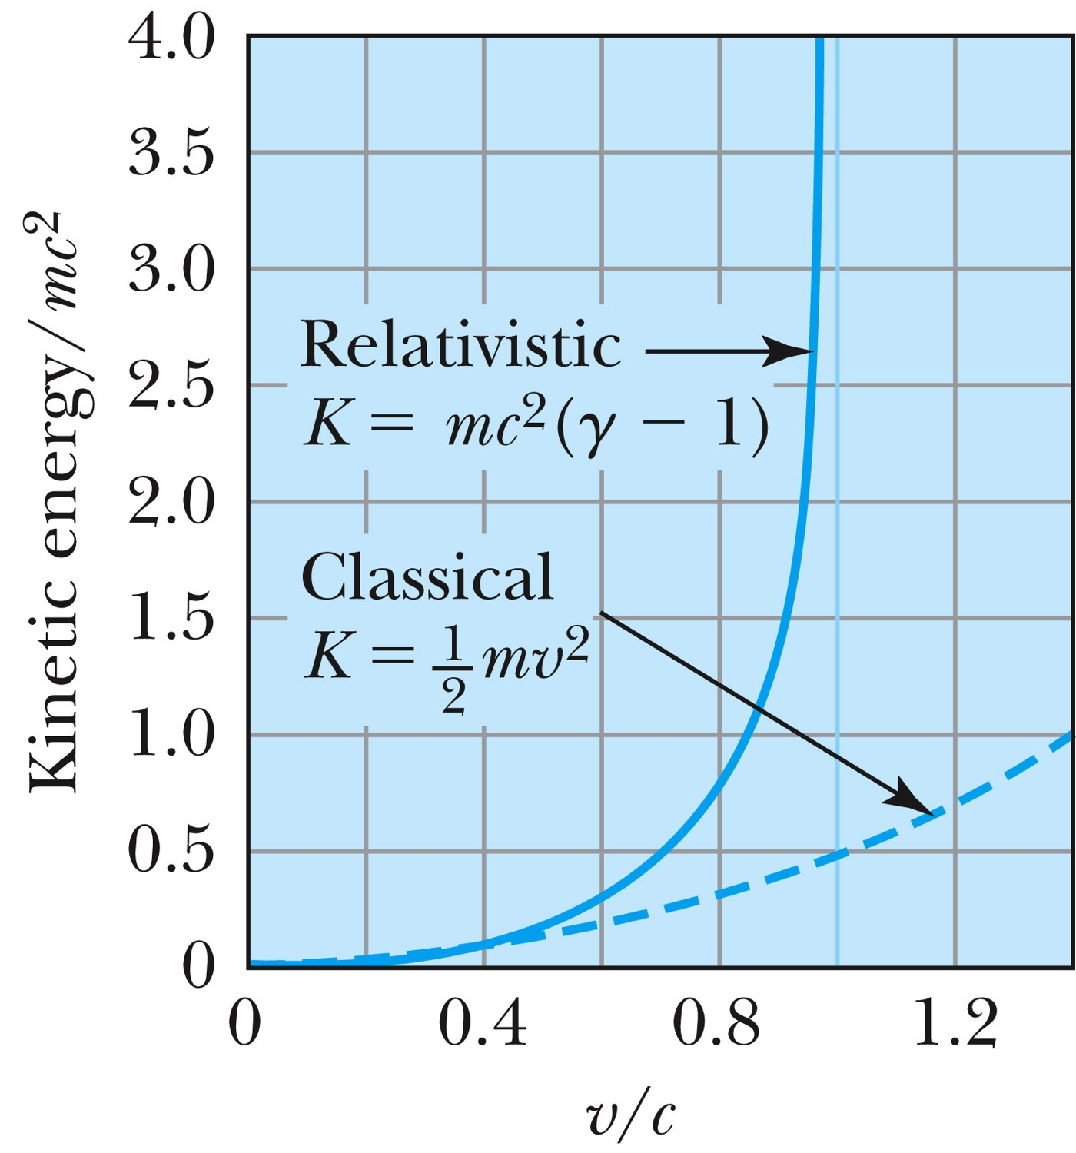
Relativistic and Classical Kinetic Energies
Notes:
Add arrow head to the line from “Relativistic” to the graph
Possibly make the line from the “Classical” straight (as in figure 2.310
rather than curved, also add arrow head to this line pointing to the curve.

Slide 8
Relationship of Energy and Momentum
We square this formula, multiply by c², and rearrange the terms.
Rewrite
Rewrite
Notes:
Title rewritten

Slide 9
Massless Particles have a speed equal to the speed of light c
Recall that a photon has “zero” rest mass and the equation from the last slide reduces to: E = pc and we may conclude that:
Thus the speed, u, of a massless particle must be c since, as 0, and it follows that: u = c.
Notes:
Add this slide

Slide 10
Units of Work, Energy and Mass
The work done in accelerating a charge through a potential difference V is W = qV.
For a proton, with the charge e = 1.602 × 10⁻¹⁹ C being accelerated across a potential difference of 1 V, the work done is
1 eV = 1.602 × 10⁻¹⁹ J
W = (1.602 × 10⁻¹⁹)(1 V) = 1.602 × 10⁻¹⁹ J
eV is also used as a unit of energy.

Slide 11
Other Units
Rest energy of a particle: Example: Rest energy, E₀, of proton
Atomic mass unit (amu): Example: carbon-12
What is 1u in eV?

Slide 12
Binding Energy
The potential energy associated with the force keeping a system together ➔ E_{B}.
The difference between the rest energy of the individual particles and the rest energy of the combined bound system.

Slide 13
Examples 2.13 and 2.15
Ex. 2.13: A proton with 2-GeV kinetic energy hits another proton with 2 GeV KE in a head on collision. (proton rest mass = 938MeV/c²)
Compute v, β, p, K and E for each of the initial protons
What happens to the kinetic energy?
Ex. 2.15: What is the minimum kinetic energy the protons must have in the head-on collision in the reaction p+p→π⁺+d, in order to produce the positively charged pion (139.6MeV/c² ) and a deuteron.(1875.6MeV/c²).

