Slide 1
PHYS 3313 – Section 001 Lecture #9
Wednesday, Feb. 18, 2015
Dr. Jaehoon Yu
Quantization
Discovery of the X-ray and the Electron
Determination of Electron Charge
Line Spectra
Blackbody Radiation
Photoelectric Effect

Slide 2
Announcements
Reminder: Homework #2
CH3 end of the chapter problems: 2, 19, 27, 36, 41, 47 and 57
Due Wednesday, Feb. 25
Reminder: Quiz #2 Monday, Feb. 23
Beginning of the class
Covers CH1.1 – what we finish today
You can bring your calculator but it must not have any relevant formula pre-input
BYOF: You may bring a one 8.5x11.5 sheet (front and back) of handwritten formulae and values of constants for the exam
No derivations, word definitions, or solutions of any problems !
No additional formulae or values of constants will be provided!
Colloquium today on Wind Energy…

Slide 3
What does the word “Quantize” mean?
Dictionary: To restrict to discrete values
To consist of indivisible discrete quantities instead of continuous quantities
Integer is a quantized set with respect to real numbers
Some examples of quantization?
Digital photos
Lego blocks
Electric charge
Photon (a quanta of light) energy
Angular momentum
Etc…

Slide 4
Discovery of the X Ray and the Electron
X rays were discovered by Wilhelm Röntgen in 1895.
Observed X rays emitted by cathode rays bombarding glass
Electrons were discovered by J. J. Thomson.
Observed that cathode rays were charged particles

Slide 5
Cathode Ray Experiments
In the 1890’s scientists and engineers were familiar with cathode rays, generated from one of the metal plates in an evacuated tube across a large electric potential
People thought cathode rays had something to do with atoms.
It was known that cathode rays could penetrate matter and their properties were under intense investigation during the 1890’s.

Slide 6
Observation of x Rays
Wilhelm Röntgen studied the effect of cathode rays passing through various materials.
He noticed that a nearby phosphorescent screen glowed during some of these experiments.
These rays were unaffected by magnetic fields and penetrated materials more than cathode rays.
He called them x rays and deduced that they were produced by the cathode rays bombarding the glass walls of his vacuum tube

Slide 7
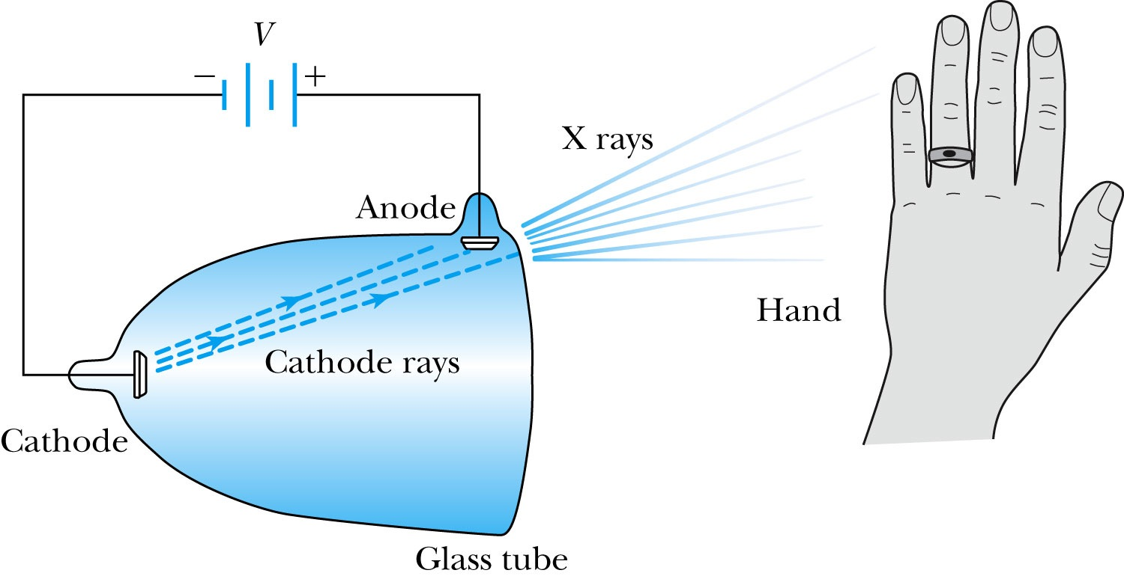
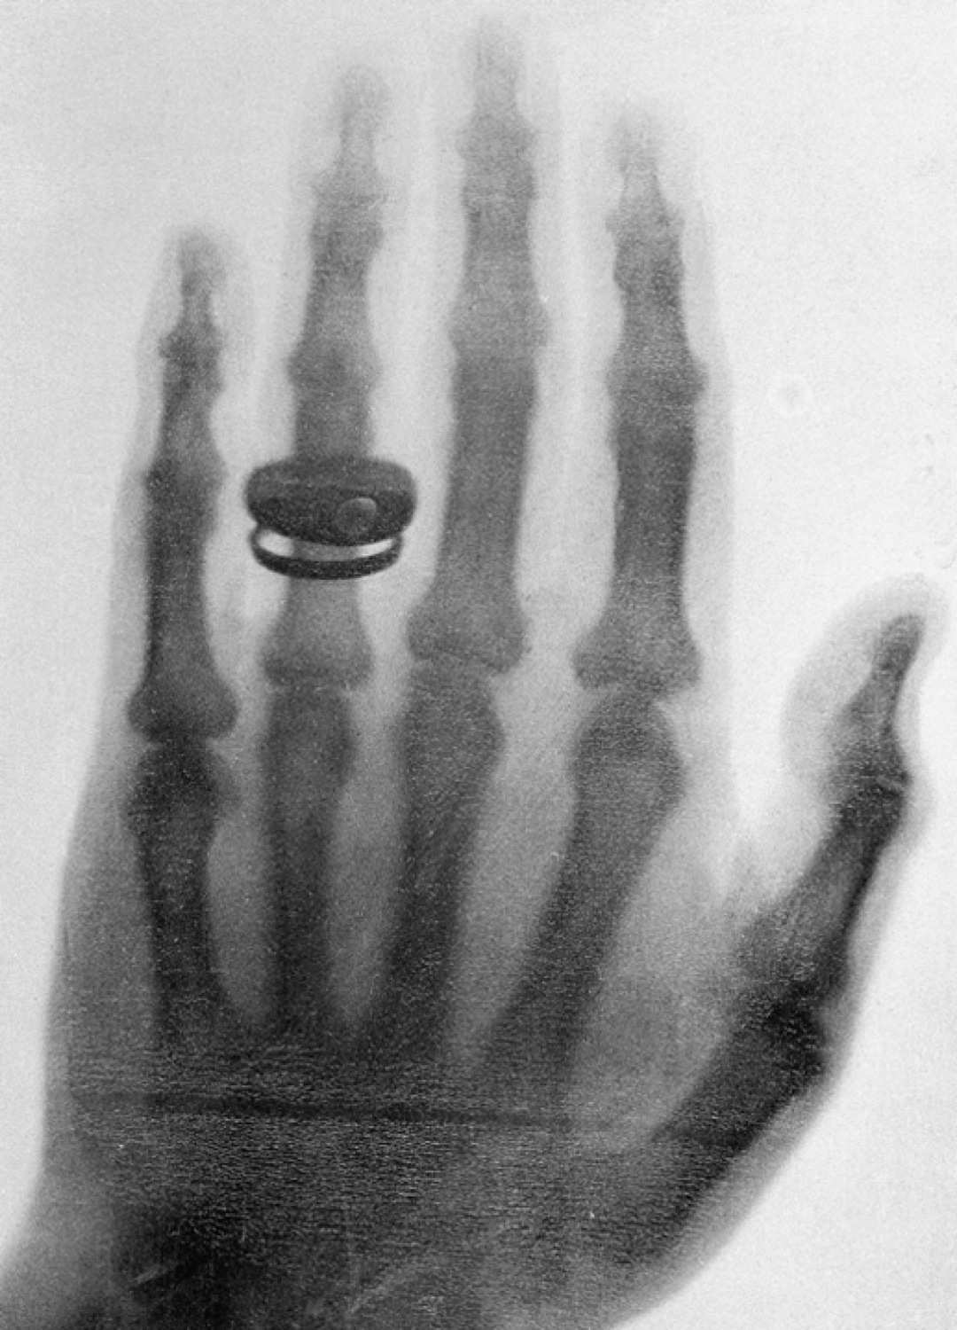
Röntgen’s X Ray Tube
Röntgen produced the X-ray by allowing cathode rays to impact the glass wall of the tube.
Took image the bones of a hand on a phosphorescent screen.
Tremendous contribution to medical imaging, and Röntgen received the 1st Nobel Prize for this!

Slide 8
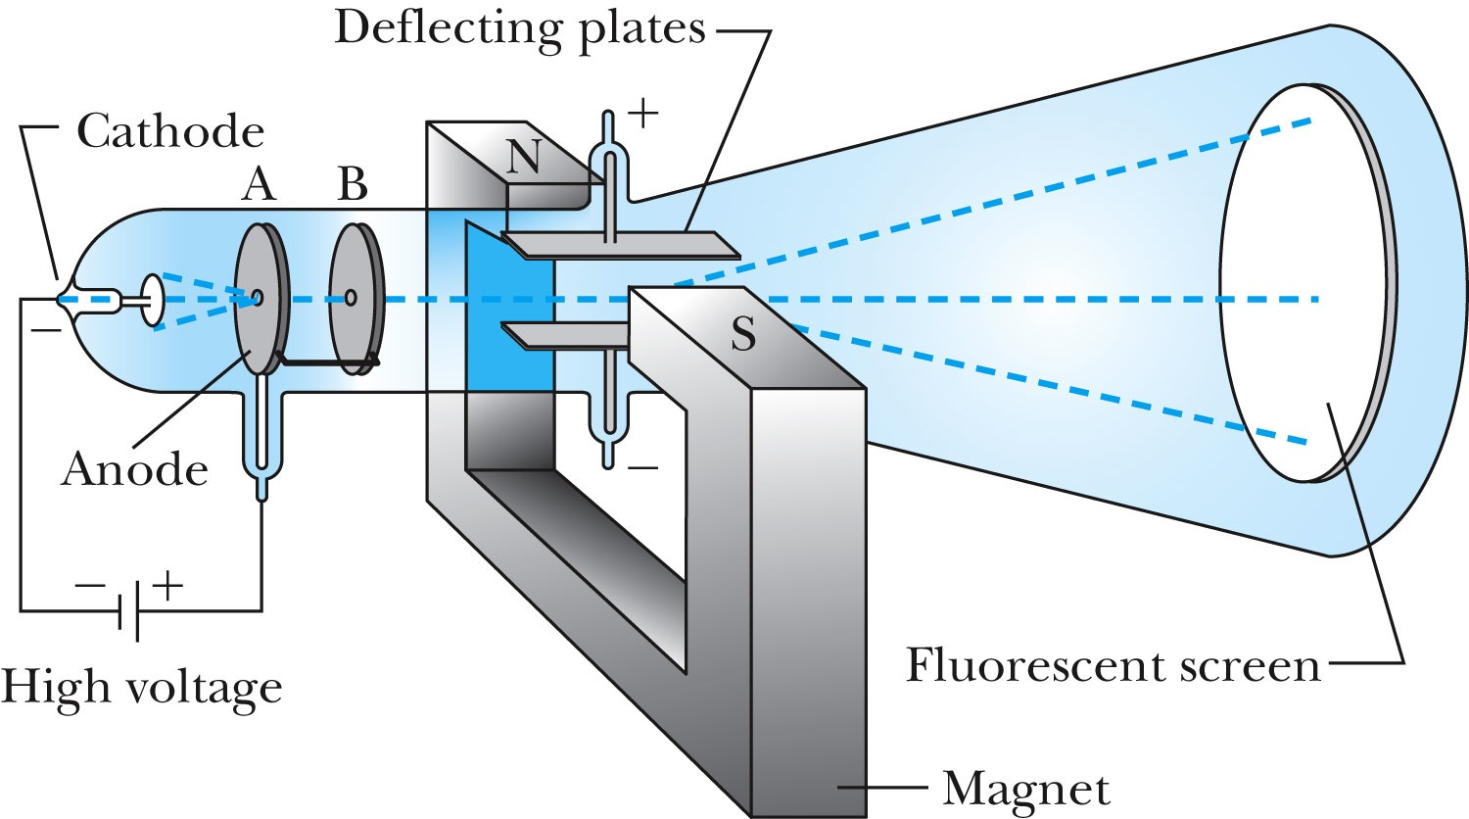
J.J. Thomson’s Cathode-Ray Experiment
Thomson showed that the cathode rays were negatively charged particles (electrons)! How?
By deflecting them in electric and magnetic fields.

Slide 9
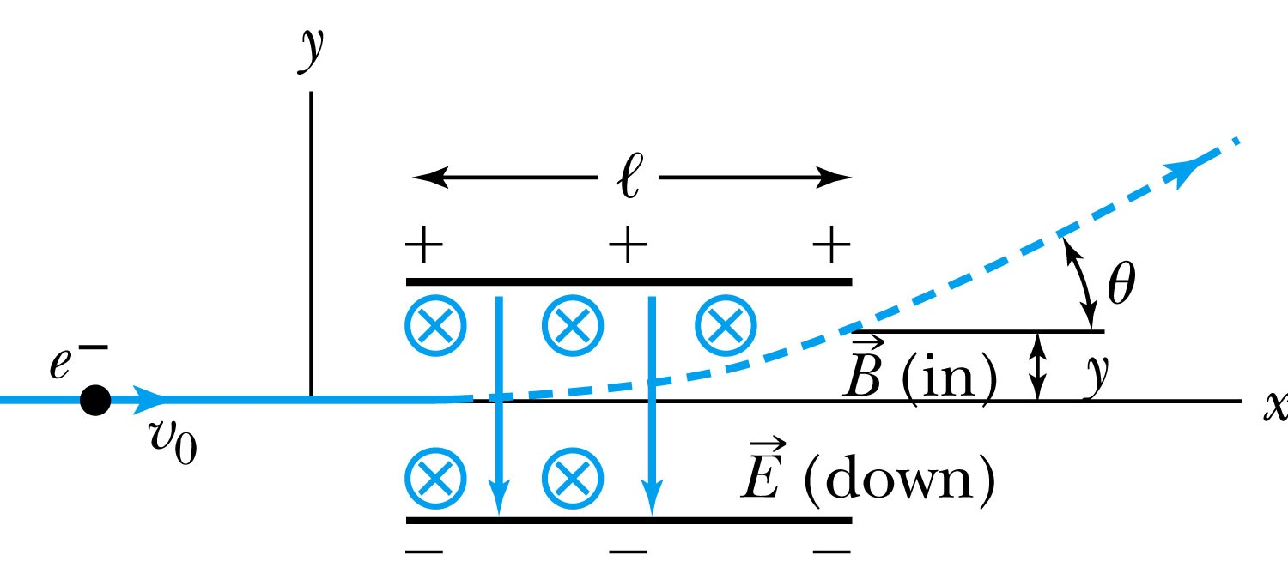
Thomson’s Experiment
Thomson measured the ratio of the electron’s charge to mass by sending electrons through a region containing a magnetic field perpendicular to an electric field.
Measure the deflection angle with only E!
Turn on and adjust B field till no deflection!
What do we know?
l, B, E and θ
What do we not know?
v₀, q and m

Slide 10
Calculation of q/m
An electron moving through the electric field w/o magnetic field is accelerated by the force:
Electron angle of deflection:
Adjust the perpendicular magnetic field until it balances E and keeps electrons from deflecting in y-direction
Charge to mass ratio:

Slide 11
Ex 3.1: Thomson’s experiment
In an experiment similar to Thomson’s, we use deflecting plates 5.0cm in length with an electric field of 1.2x10⁴V/m. Without the magnetic field, we find an angular deflection of 30º, and with a magnetic field of 8.8x10⁻⁴T we find no deflection. What is the initial velocity of the electron and its q/m?
First v₀ using E and B, we obtain:
q/m is then
What is the actual value of q/m using the known quantities?

Slide 12
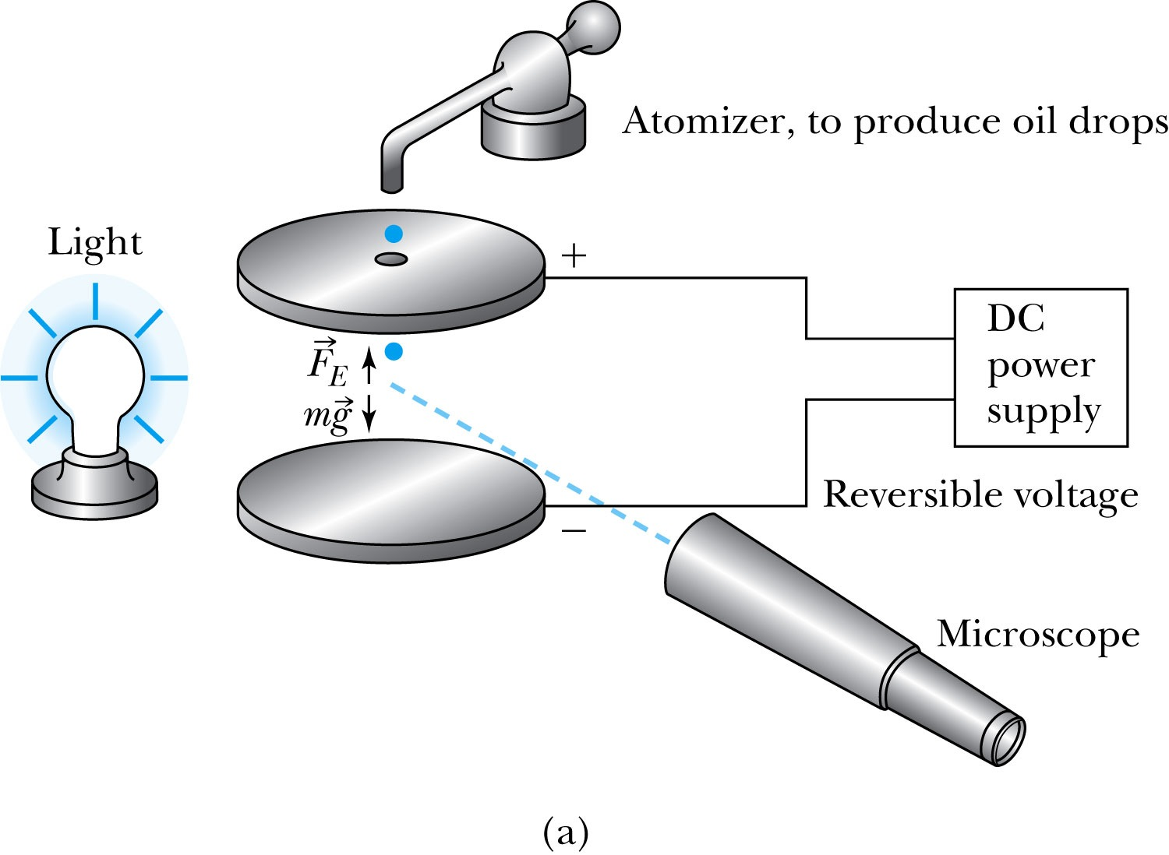
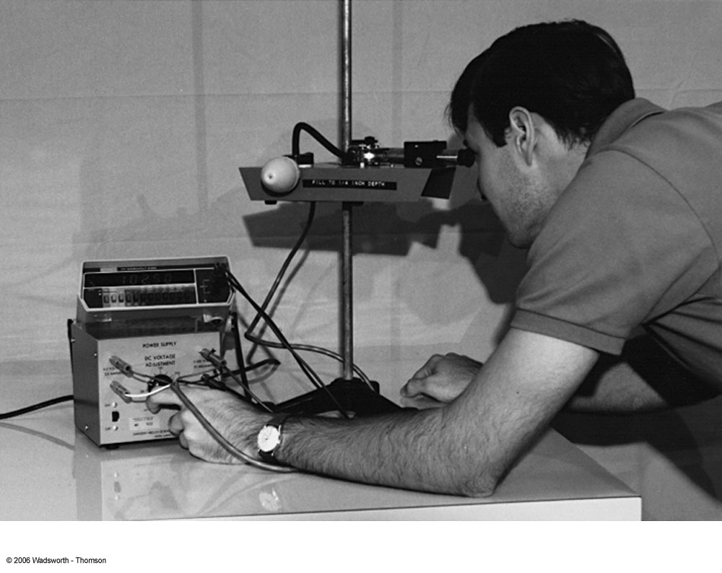
Determination of Electron Charge
Millikan (and Fletcher) in 1909 measured the charge of electron and showed that the free electric charge is in multiples of the basic charge of an electron

Slide 13
Calculation of the oil drop charge
Used an electric field and gravity to suspend a charged oil drop
So the magnitude of the charge on the oil drop
Mass is determined from Stokes’ relationship of the terminal velocity to the radius, medium viscosity and density
Thousands of experiments showed that there is a basic quantized electron charge

Slide 14
Line Spectra
Chemical elements produce unique wavelengths of light when burned or excited in an electrical discharge.
Collimated light is passed through a diffraction grating with thousands of ruling lines per centimeter.
The diffracted light is separated at an angle θ according to its wavelength λ by the equation:
where d is the distance between rulings and n is an integer called the order number (n=1 strongest)
Diffraction maxima

Slide 15
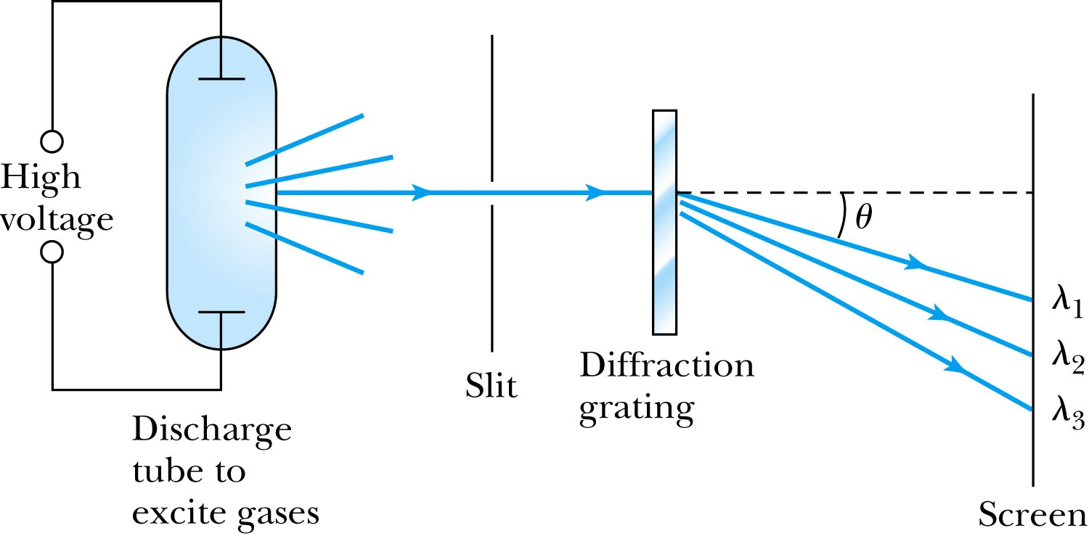
Optical Spectrometer
Diffraction creates a line spectrum pattern of light bands and dark areas on the screen.
Chemical elements and the composition of materials can be identified through the wavelengths of these line spectra

Slide 16
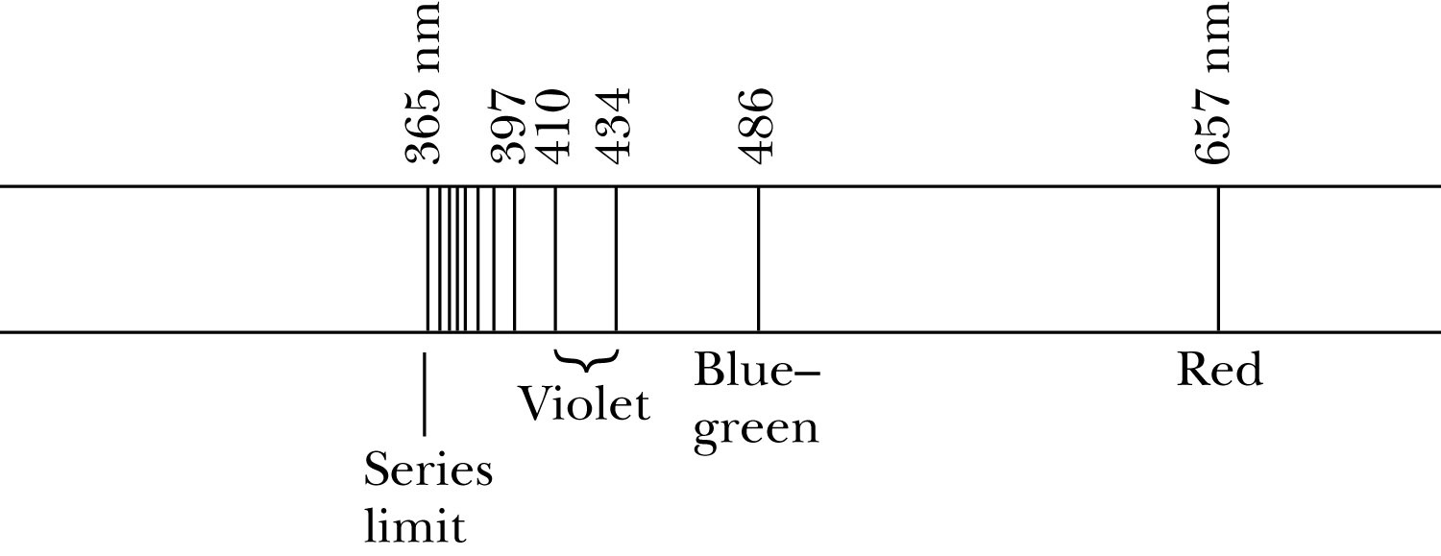
Balmer Series
In 1885, Johann Balmer found an empirical formula for wavelength of the visible hydrogen line spectra in nm:
(where k = 3,4,5… and k > 2)

Slide 17
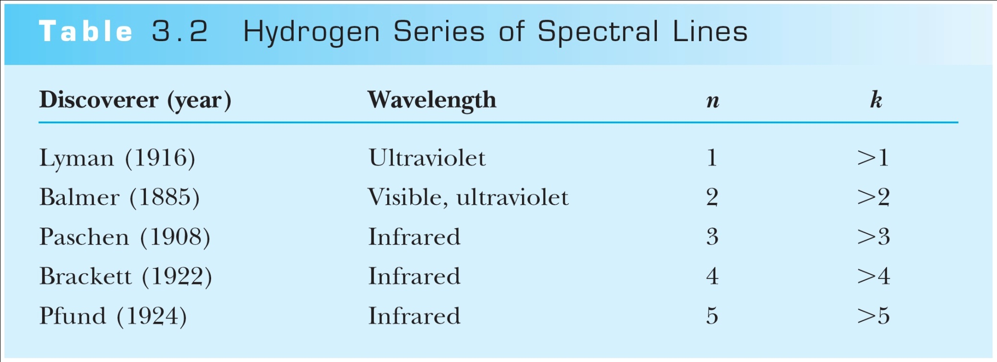
Rydberg Equation
Several more series of hydrogen emission lines at infrared and ultraviolet wavelengths were discovered, the Balmer series equation was extended to the Rydberg equation:
(n = 2, n>K)

Slide 18
Quantization
Current theories predict that charges are quantized in units (quarks) of ±e/3 and ±2e/3, but quarks are not directly observed experimentally.
The charges of particles that have been directly observed are always quantized in units of ±e.
The measured atomic weights are not continuous—they have only discrete values, which are close to integral multiples of a unit mass.

