Slide 1
PHYS 3313 – Section 001 Lecture #10
Wednesday, Feb. 25, 2015
Dr. Jaehoon Yu
Blackbody Radiation
Photoelectric Effect
Compton Effect
Pair production/Pair annihilation

Slide 2
Announcements
Midterm Exam
In class next Wednesday, March. 4
Covers from CH1.1 through what we learn March 2 plus the math refresher in the appendices
Mid-term exam constitutes 20% of the total
Please do NOT miss the exam! You will get an F if you miss it.
BYOF: You may bring a one 8.5x11.5 sheet (front and back) of handwritten formulae and values of constants for the exam
No derivations, word definitions or solutions of any problems !
No additional formulae or values of constants will be provided!
Colloquium at 4pm today in SH101
Dr. Wallace from UTD on 2D devices

Slide 3
Special Project #3
A total of N_{i} incident projectile particle of atomic number Z₁ kinetic energy KE scatter on a target of thickness t and atomic number Z₂ and has n atoms per volume. What is the total number of scattered projectile particles at an angle θ? (20 points)
Please be sure to clearly define all the variables used in your derivation! Points will be deducted for missing variable definitions.
This derivation must be done on your own. Please do not copy the book, internet or your friends’.
Due is Wednesday, March 18

Slide 4
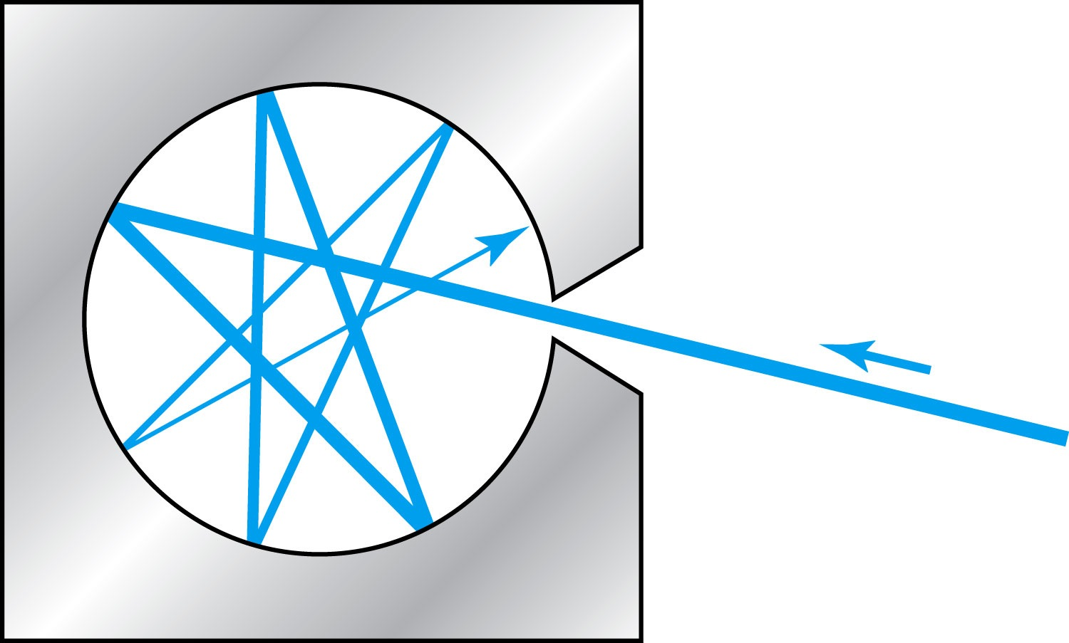
Blackbody Radiation
When matter is heated, it emits radiation.
A blackbody is an ideal object that has 100% absorption and 100% emission without a loss of energy
A cavity in a material that only emits thermal radiation can be considered as a black-body. Incoming radiation is fully absorbed in the cavity.
Blackbody radiation is theoretically interesting because
Radiation properties are independent of the particular material.
Properties of intensity versus wavelength at fixed temperatures can be studied

Slide 5
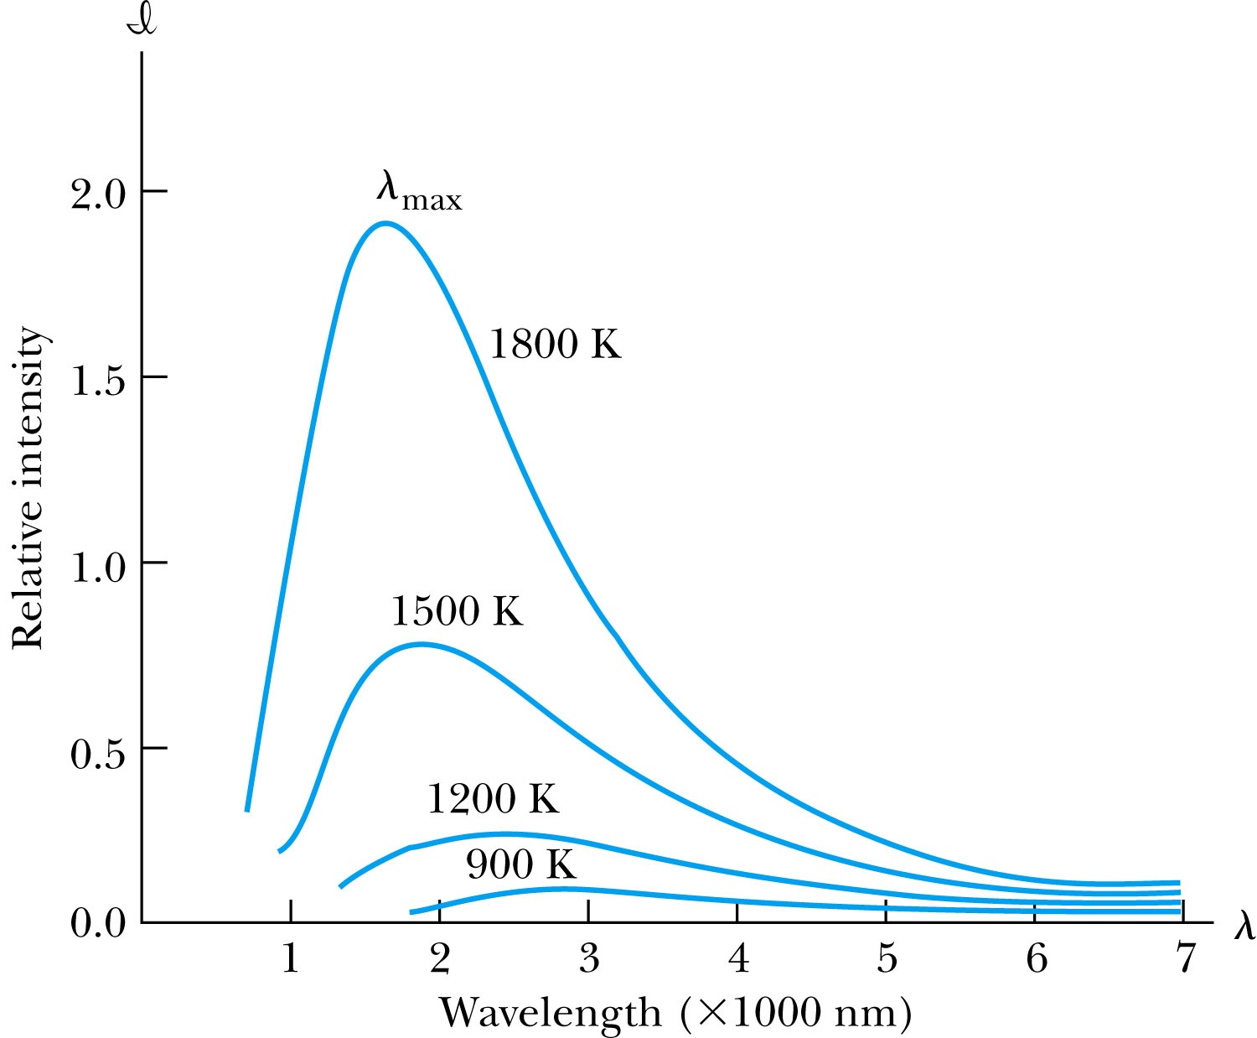
Wien’s Displacement Law
The intensity l(λ, T) is the total power radiated per unit area per unit wavelength at the given temperature.
Wien’s displacement law: The peak of l(λ, T) distribution shifts to smaller wavelengths as the temperature increases.
(where λ_{max} = wavelength of the peak)

Slide 6
Stefan-Boltzmann Law
The total power radiated increases with the temperature:
This is known as the Stefan-Boltzmann law, with the constant σ experimentally measured to be σ =5.6705×10⁻⁸ W / (m² · K⁴).
The emissivity ε (ε = 1 for an idealized blackbody) is the ratio of the emissive power of an object to that of an ideal blackbody and is always less than 1.

Slide 7
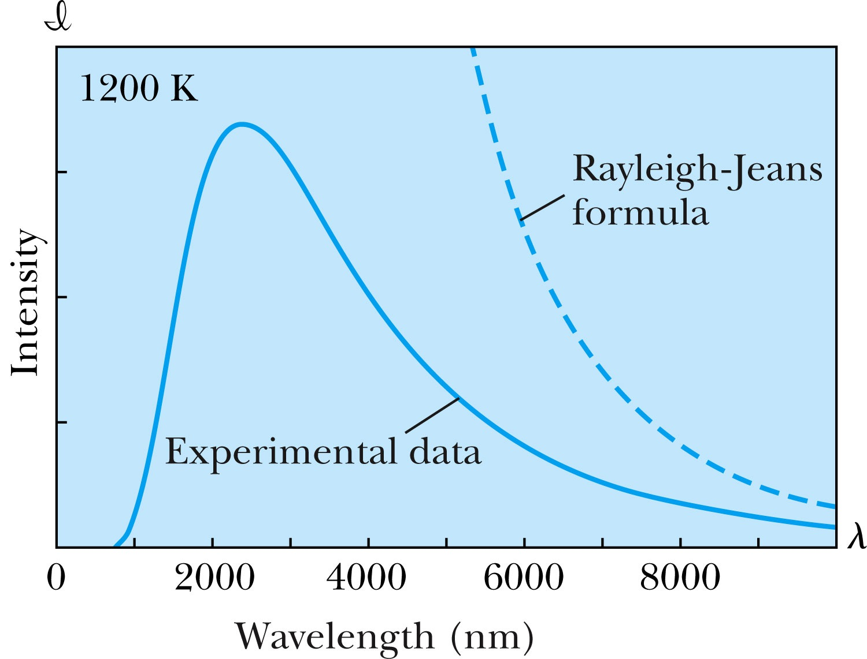
Rayleigh-Jeans Formula
Lord Rayleigh used the classical theories of electromagnetism and thermodynamics to show that the blackbody spectral distribution should be
Worked reasonably well at longer wavelengths but..
it deviates badly at short wavelengths.
➔ “the ultraviolet catastrophe” a serious issue that couldn’t be explained

Slide 8
Planck’s Radiation Law
Planck assumed that the radiation in the cavity was emitted (and absorbed) by some sort of “oscillators” that were contained in the walls. He used Boltzman’s statistical methods to arrive at the following formula that fit the blackbody radiation data.
Planck made two modifications to classical theory:
The oscillators (of electromagnetic origin) can only have certain discrete energies determined by E_{n} = nhf, where n is an integer, f is the frequency, and h is called Planck’s constant. h = 6.6261 × 10⁻³⁴ J·s.
The oscillators can absorb or emit energy ONLY in discrete multiples of the fundamental quantum of energy given by
Planck’s radiation law

Slide 9
Photoelectric Effect
Definition: Incident electromagnetic radiation shining on a metal transfers energy to the electrons, allowing them to escape the surface of the metal. Ejected electrons are called photoelectrons.
Other methods of electron emission:
Thermionic emission: Application of heat allows electrons to gain enough energy to escape.
Secondary emission: The electron gains enough energy by transfer from another high-speed particle that strikes the material from outside.
Field emission: A strong external electric field pulls the electron out of the material. (an example?)

Slide 10
Classical Interpretation of Photoelectric Effect
Classical theory allows EM radiation to eject photoelectrons from matter
Classical theory predicts the energy of the photoelectrons increase in proportion to the radiation intensity
Thus, KE of the photoelectrons must be proportional to the intensity of light not the current
Time for an experiment!

Slide 11
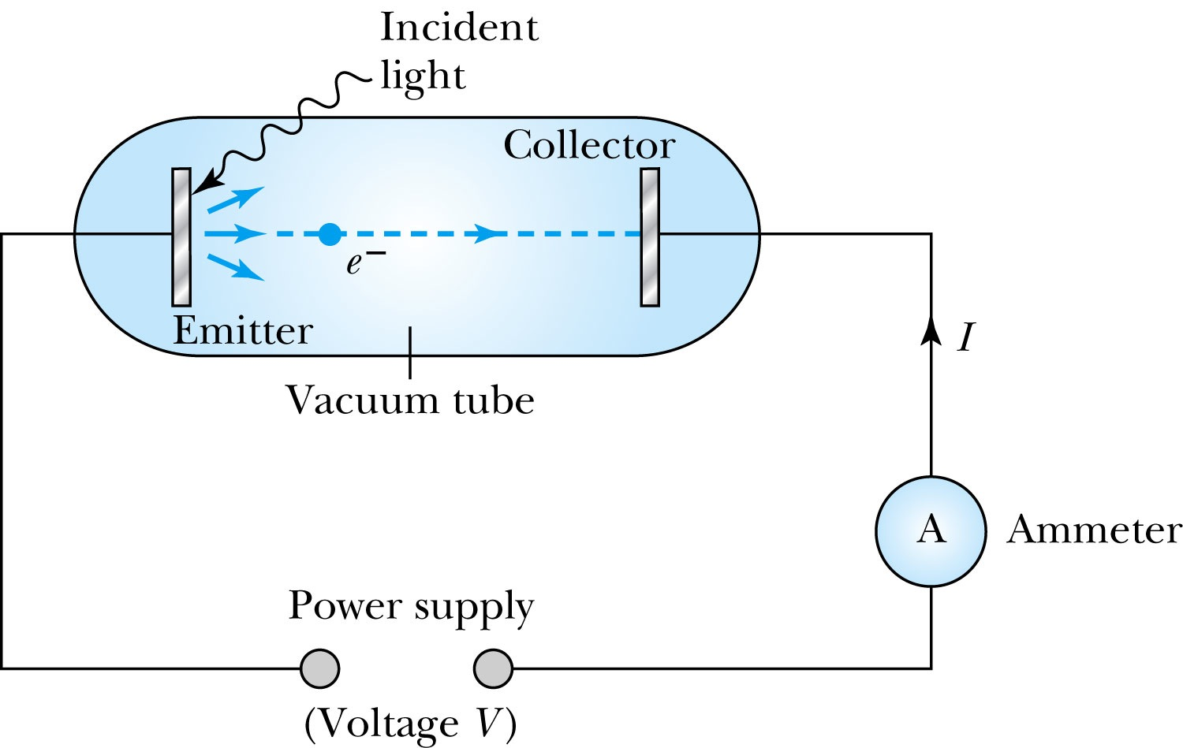
Photoelectric Effect Experimental Setup
Hmm.. Something does not make sense!!
Anode
Photocathode
V increased reverse direction to stop I

Slide 12
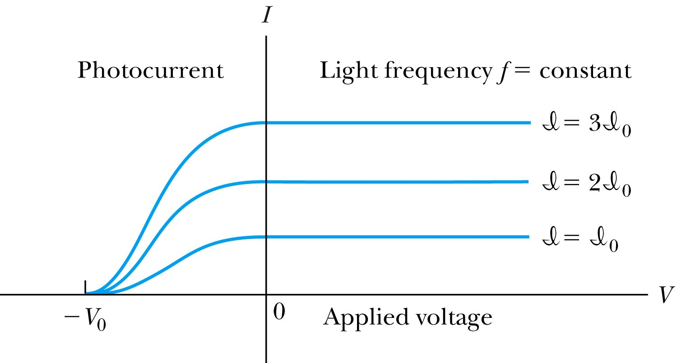
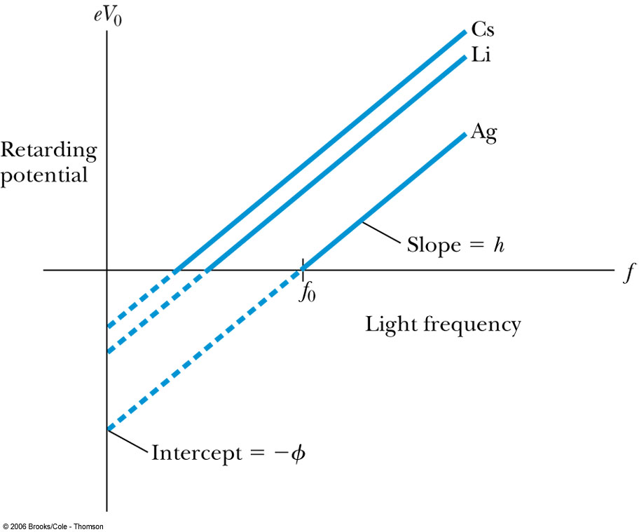
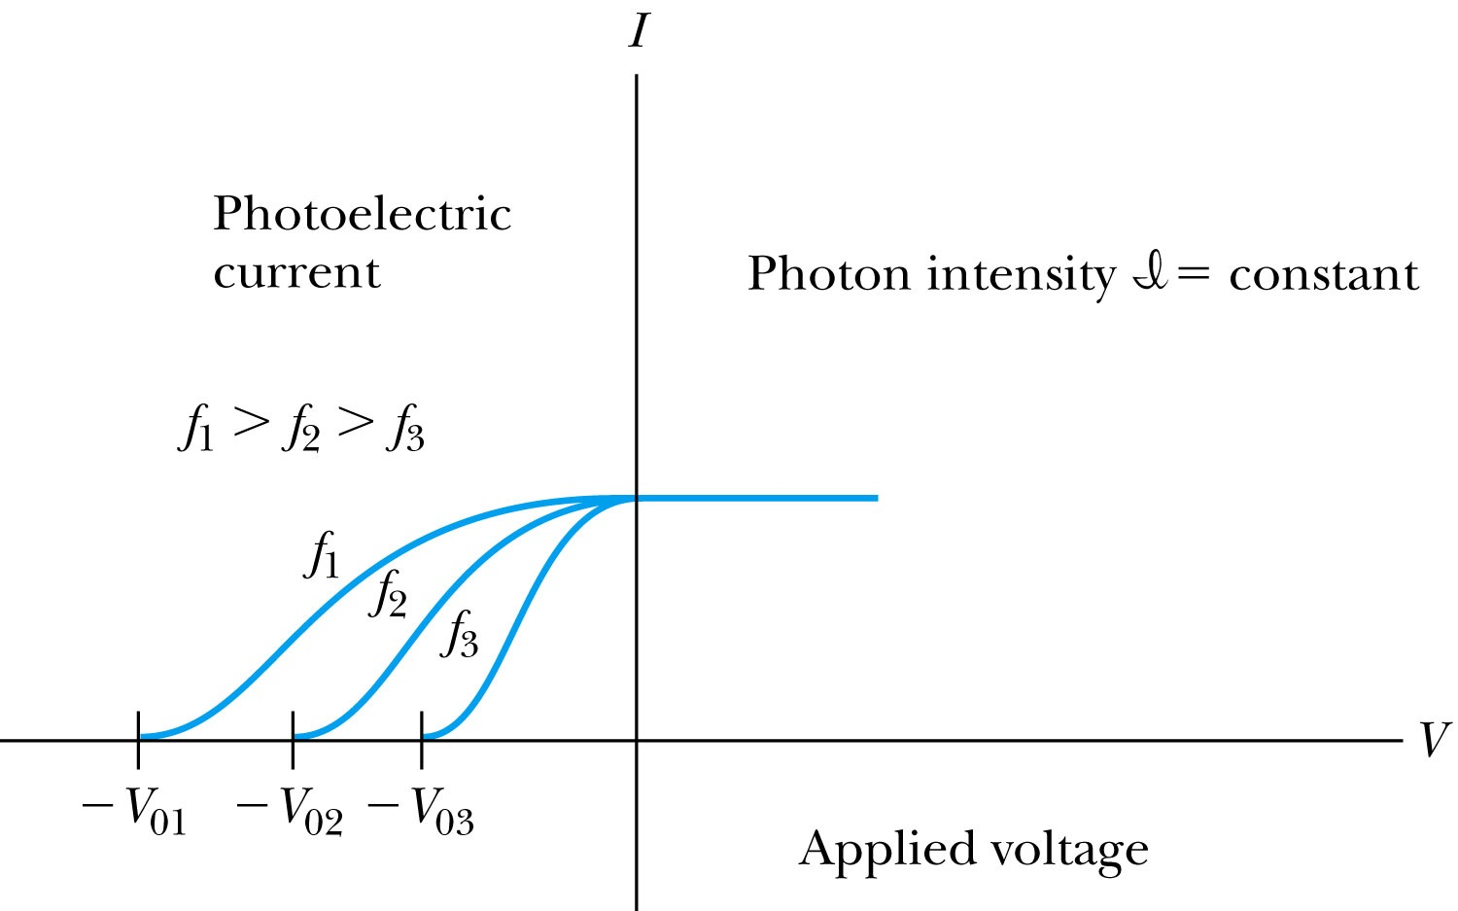
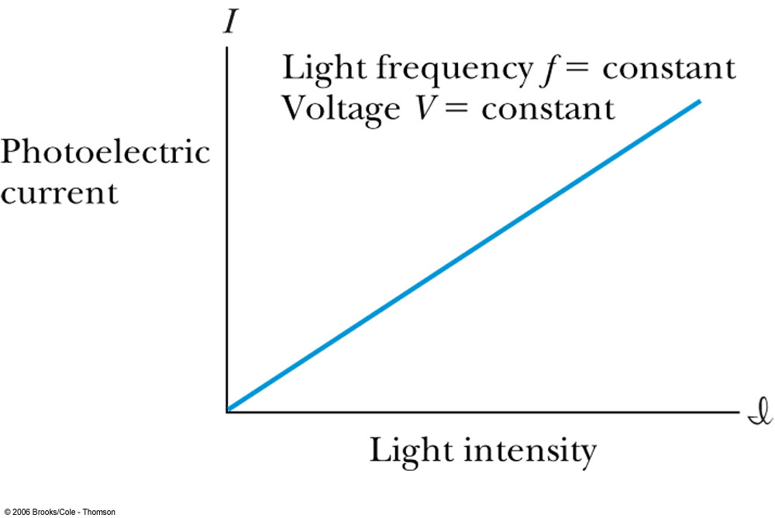
Experimental Observations
KE proportional to frequency!!
The same V₀ but higher current
The same current!!
Number of photoelectrons proportional to light intensity!!

Slide 13
Summary of Experimental Observations
Light intensity does not affect the KE of the photoelectrons
The max KE of the photoelectrons for a given emitter material depends only on the frequency of the light
The smaller the work function φ of the emitter material, the smaller is the threshold frequency of the light that can eject photoelectrons.
When the photoelectrons are produced, their number is proportional to the intensity of light.
The photoelectrons are emitted almost instantly following the illumination of the photocathode, independent of the intensity of the light. ➔ Totally unexplained by classical physics

Slide 14
Einstein’s Theory of Photoelectric Effect
Einstein suggested that the electromagnetic radiation field of the light is quantized into particles called photons. Each photon has the energy quantum:
where f is the frequency of the light and h is Planck’s constant.
The photon travels at the speed of light in a vacuum, and its wavelength is given by

Slide 15
Einstein’s Theory
Conservation of energy yields:
where φ is the work function of the metal
The photon energy can then be written
The retarding potentials measure the KE of the most energetic photoelectrons.

Slide 16
Quantum Interpretation
KE of the electron depends only on the light frequency and the work function φ of the material not the light intensity at all
Einstein in 1905 predicted that the stopping potential was linearly proportional to the light frequency, with a slope h, the same constant found by Planck.
From this, Einstein concluded that light is a particle with energy:
Was he already thinking about particle/wave duality?

Slide 17
Ex 3.11: Photoelectric Effect
Light of wavelength 400nm is incident upon lithium (φ=2.93eV). Calculate (a) the photon energy (eV) and (b) the stopping potential V₀.
Since the wavelength is known, we use plank’s formula:
The stopping potential can be obtained using Einstein’s formula for photoelectron energy

