Slide 1
PHYS 3313 – Section 001 Lecture #11
Monday, March 2, 2015
Dr. Jaehoon Yu
Compton Effect
Pair production/Pair annihilation
Rutherford Scattering Experiment and Rutherford Atomic Model
The Classic Atomic Model
The Bohr Model of the Hydrogen Atom

Slide 2
Announcements
Midterm Exam
In class this Wednesday, March. 4
Covers from CH1.1 through what we learn today (CH4.1) plus the math refresher in the appendices
Mid-term exam constitutes 20% of the total
Please do NOT miss the exam! You will get an F if you miss it.
BYOF: You may bring a one 8.5x11.5 sheet (front and back) of handwritten formulae and values of constants for the exam
No derivations, word definitions or solutions of any problems !
No additional formulae or values of constants will be provided!
Colloquium at 4pm Wednesday in SH101
Dr. Jinyi Qi from UC Davis on Ultra Llow does PET imaging

Slide 3
Reminder: Special Project #3
A total of N_{i} incident projectile particle of atomic number Z₁ kinetic energy KE scatter on a target of thickness t and atomic number Z₂ and has n atoms per volume. What is the total number of scattered projectile particles at an angle θ? (20 points)
Please be sure to clearly define all the variables used in your derivation! Points will be deducted for missing variable definitions.
This derivation must be done on your own. Please do not copy the book, internet or your friends’.
Due is Wednesday, March 18

Slide 4
Prefixes, expressions and their meanings
deca (da): 10¹
hecto (h): 10²
kilo (k): 10³
mega (M): 10⁶
giga (G): 10⁹
tera (T): 10¹²
peta (P): 10¹⁵
exa (E): 10¹⁸
deci (d): 10⁻¹
centi (c): 10⁻²
milli (m): 10⁻³
micro (μ): 10⁻⁶
nano (n): 10⁻⁹
pico (p): 10⁻¹²
femto (f): 10⁻¹⁵
atto (a): 10⁻¹⁸

Slide 5
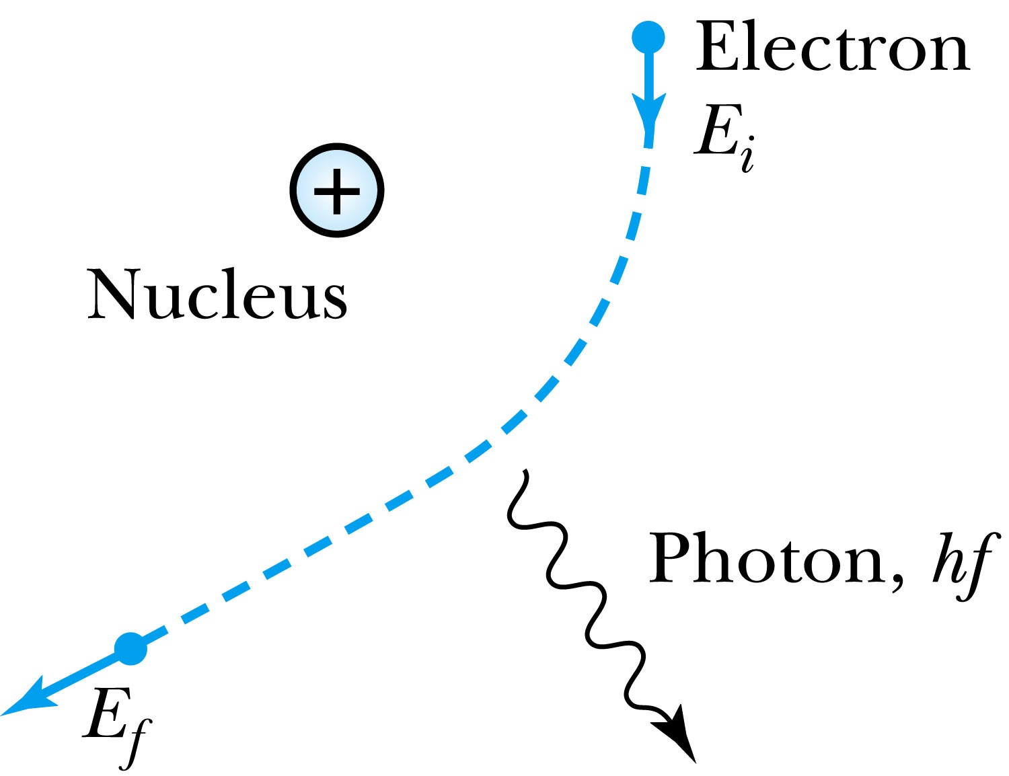
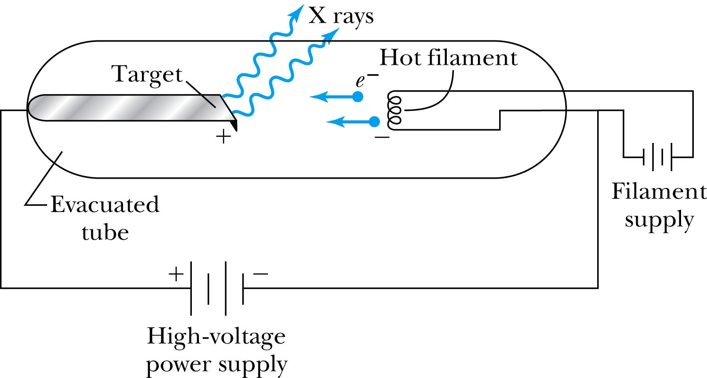
X-Ray Production
Bremsstrahlung (German word for braking radiation): Radiation of a photon from an energetic electron passing through matter due to an acceleration
Since linear momentum must be conserved, the nucleus absorbs very little energy, and it is ignored. The final energy of the electron is determined from the conservation of energy
An electron that loses a large amount of energy will produce an X-ray photon.
Current passing through a filament produces copious numbers of electrons by thermionic emission.
These electrons are focused by the cathode structure into a beam and are accelerated by potential differences of thousands of volts until they impinge on a metal anode surface, producing x rays by bremsstrahlung as they stop in the anode material
X-ray wavelengths range 0.01 – 10nm. What is the minimum energy of an electron to produce X-ray?

Slide 6
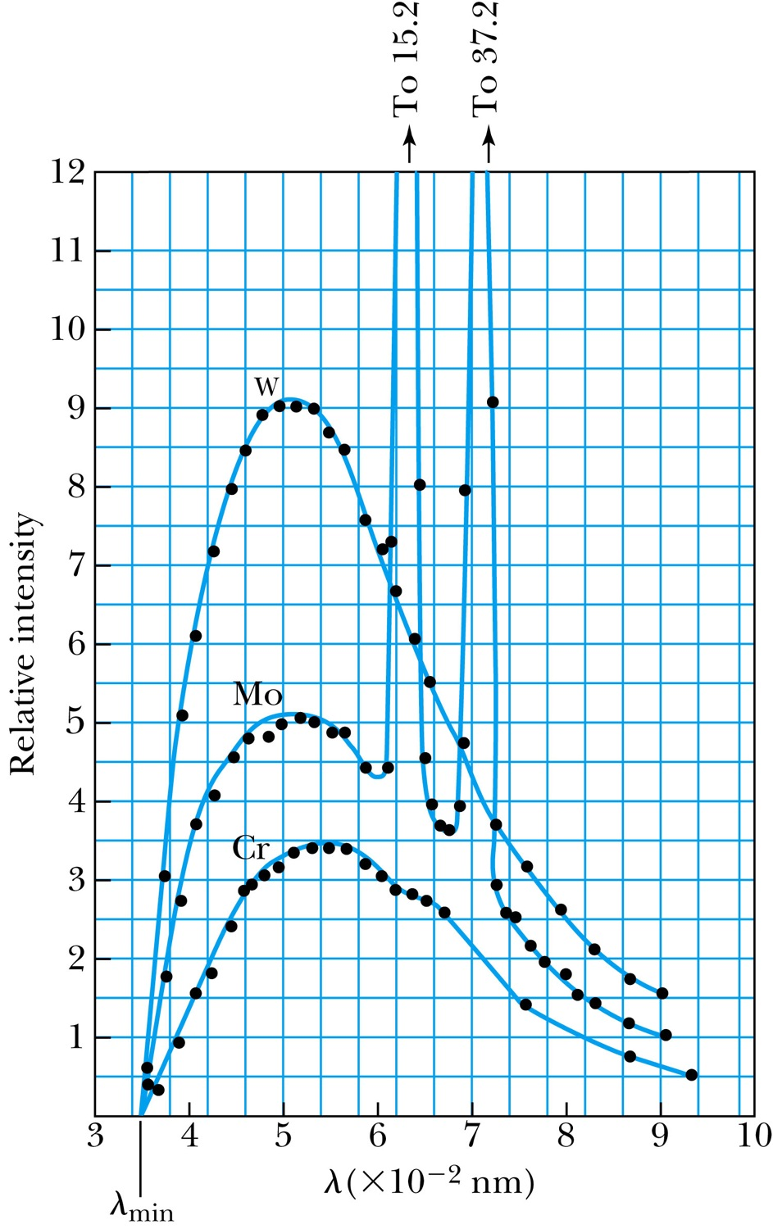
Inverse Photoelectric Effect.
Conservation of energy requires that the electron KE equals the maximum photon energy
Work function neglected since it’s small compared to the potential energy of the electron.
This is the Duane-Hunt limit
The photon wavelength depends only on the accelerating voltage
The same for all targets.

Slide 7
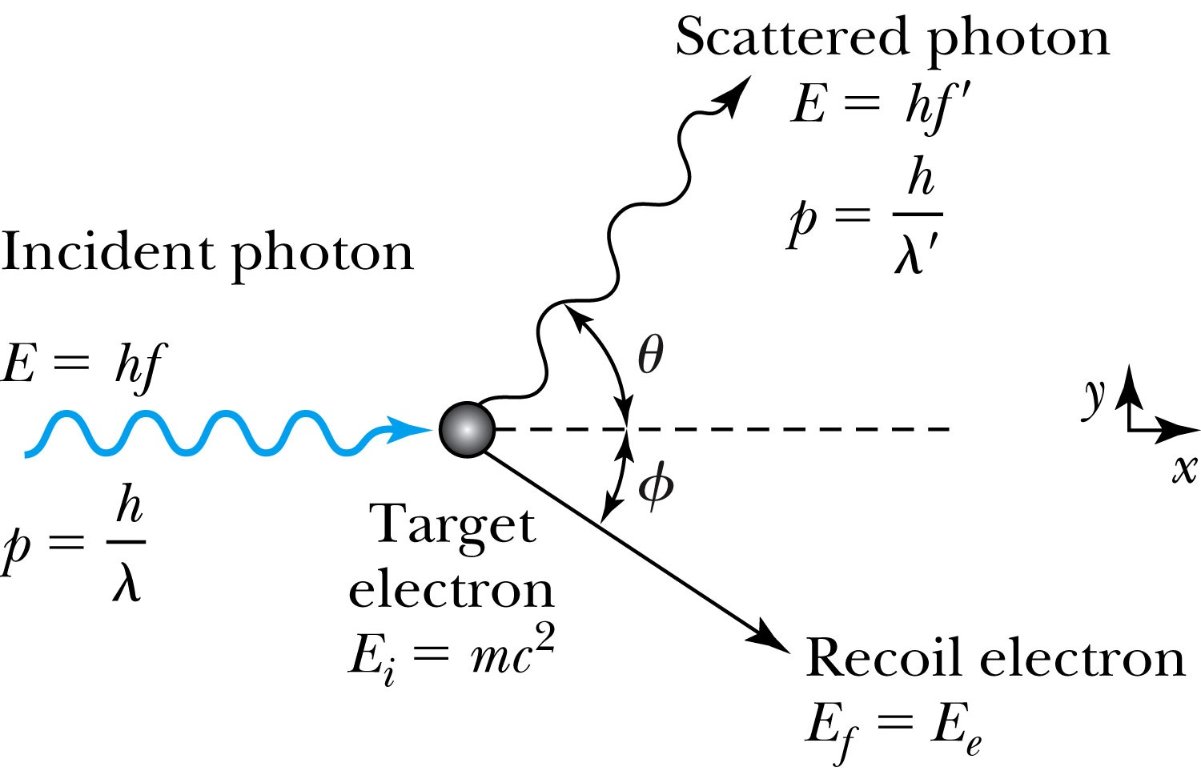
Compton Effect
When a photon enters matter, it is likely to interact with one of the atomic electrons.
The photon is scattered from only one electron
The laws of conservation of energy and momentum apply as in any elastic collision between two particles. The momentum of a particle moving at the speed of light is
The electron energy can be written as
Change of the scattered photon wavelength is known as the Compton effect:

Slide 8
Pair Production and Annihilation
If a photon can create an electron, it must also create a positive charge to balance charge conservation.
In 1932, C. D. Anderson observed a positively charged electron (e⁺) in cosmic radiation. This particle, called the positron, had been predicted to exist several years earlier by P. A. M. Dirac.
A photon’s energy can be converted entirely into an electron and a positron in a process called the pair production.
Can only happen inside a material
How much energy do you think is needed?

Slide 9
Pair Production in Empty Space?
Energy conservation for pair production in empty space
Momentum conservation yields
Thus max momentum exchange
Recall that the total energy for a particle can be written as
However this yields a contradiction:
Hence the conversion of energy in empty space is impossible and thus pair production cannot happen in empty space

Slide 10
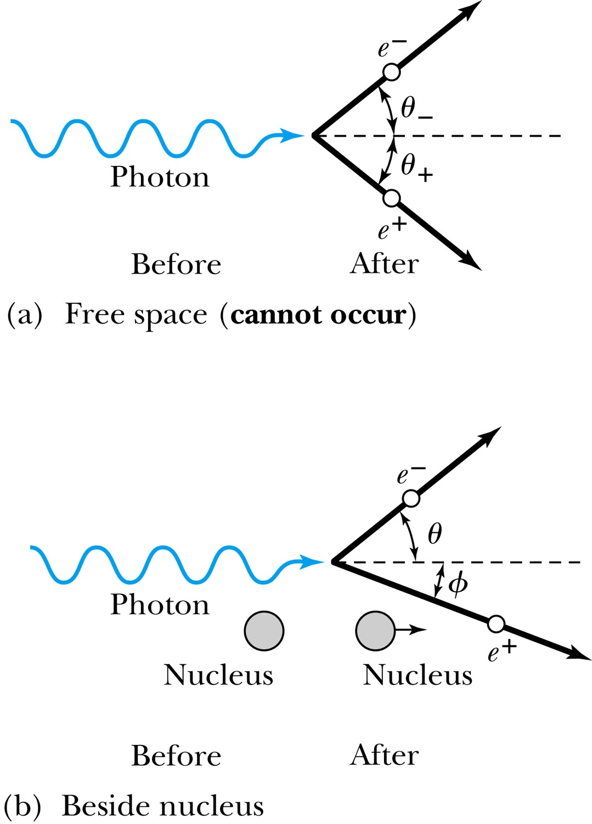
Pair Production in Matter
Since the relations and contradict each other, a photon can not produce an electron and a positron in empty space.
In the presence of matter, however, the nucleus absorbs some energy and momentum.
The photon energy required for pair production in the presence of matter is

Slide 11
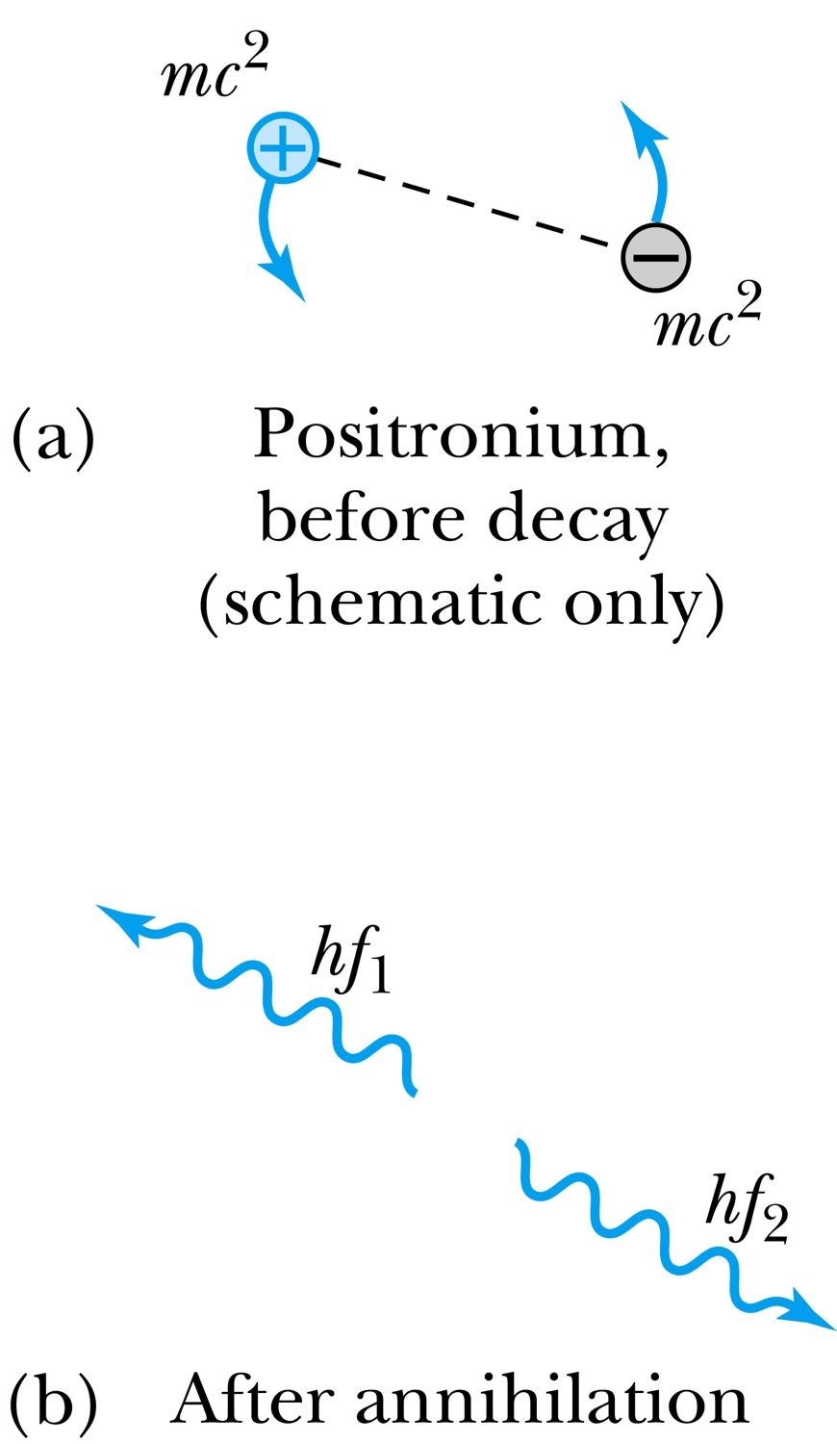
Pair Annihilation
A positron going through matter will likely annihilate with an electron.
A positron is drawn to an electron and form an atom-like configuration called positronium.
Pair annihilation in empty space will produce two photons to conserve momentum. Annihilation near a nucleus can result in a single photon.
Conservation of energy:
Conservation of momentum:
The two photons will be almost identical, so that
The two photons from a positronium annihilation will move in the opposite directions with an energy of:

Slide 12
The Atomic Models of Thomson and Rutherford
Without seeing it, 19th century scientists believed atoms have structure.
Pieces of evidence that scientists had in 1900 to indicate that the atom was not a fundamental unit
There are simply too many kinds of atoms (~70 known at that time), belonging to a distinct chemical element
Too many to be fundamental!!
Atoms and electromagnetic phenomena seem to be intimately related
The issue of valence ➔ Why certain elements combine with some elements but not with others?
Is there a characteristic internal atomic structure?
The discoveries of radioactivity, x rays, and the electron

Slide 13
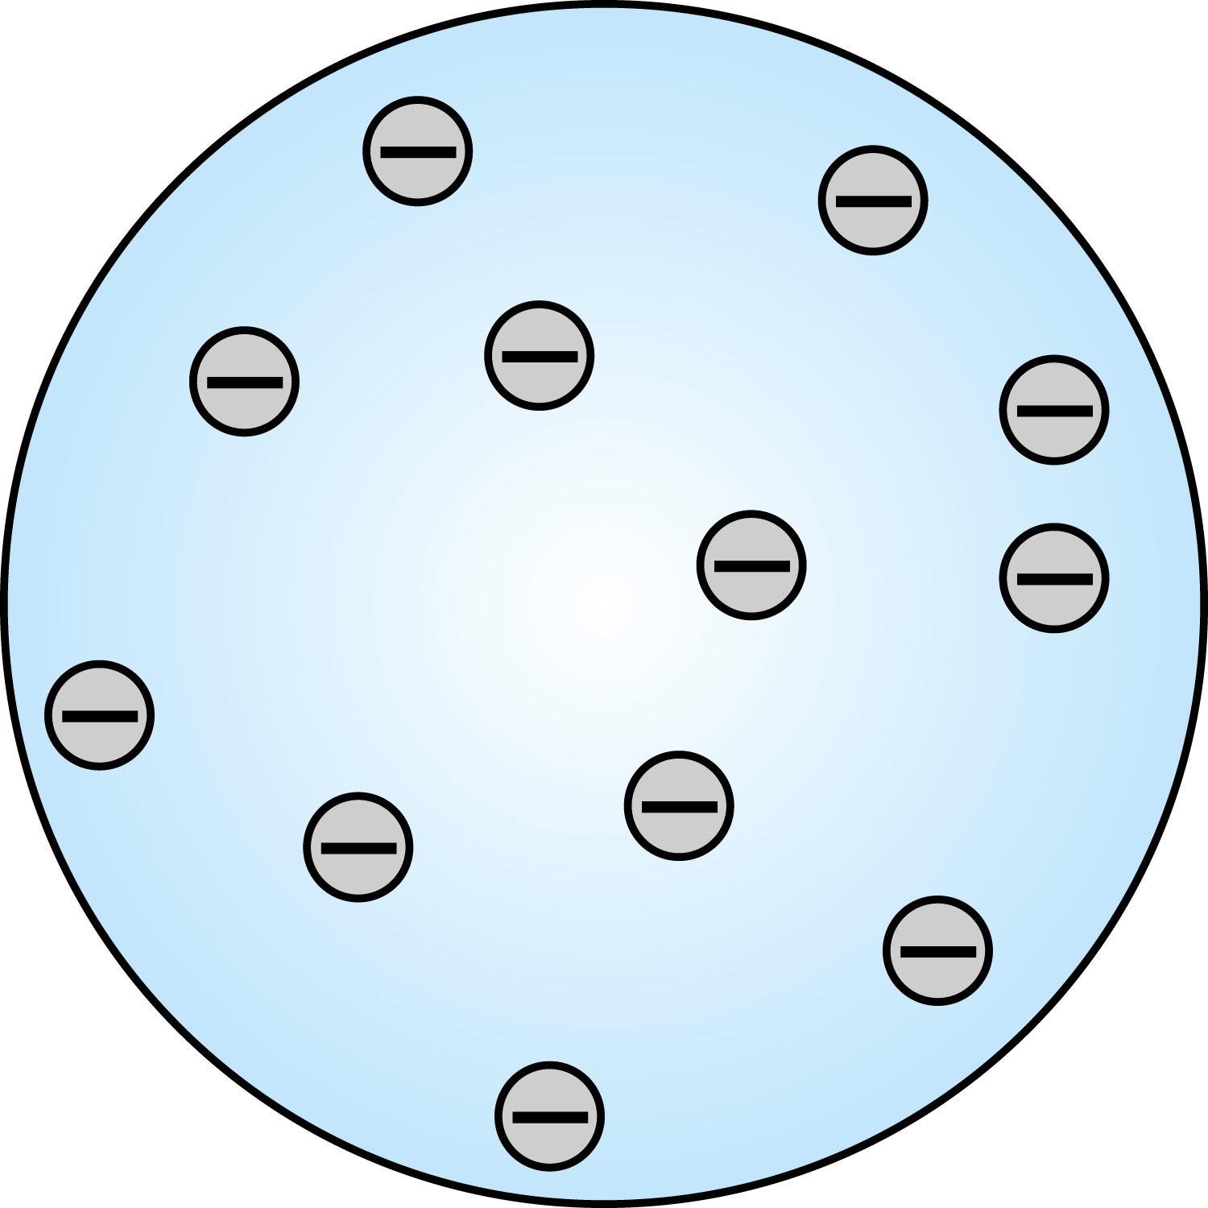
Thomson’s Atomic Model
Thomson’s “plum-pudding” model
Atoms are electrically neutral and have electrons in them
Atoms must have an equal amount of positive charges in it to balance electron negative charges
So how about positive charges spread uniformly throughout a sphere the size of the atom with the newly discovered “negative” electrons embedded in a uniform background.
Thomson thought when the atom was heated the electrons could vibrate about their equilibrium positions and thus produce electromagnetic radiation.

Slide 14
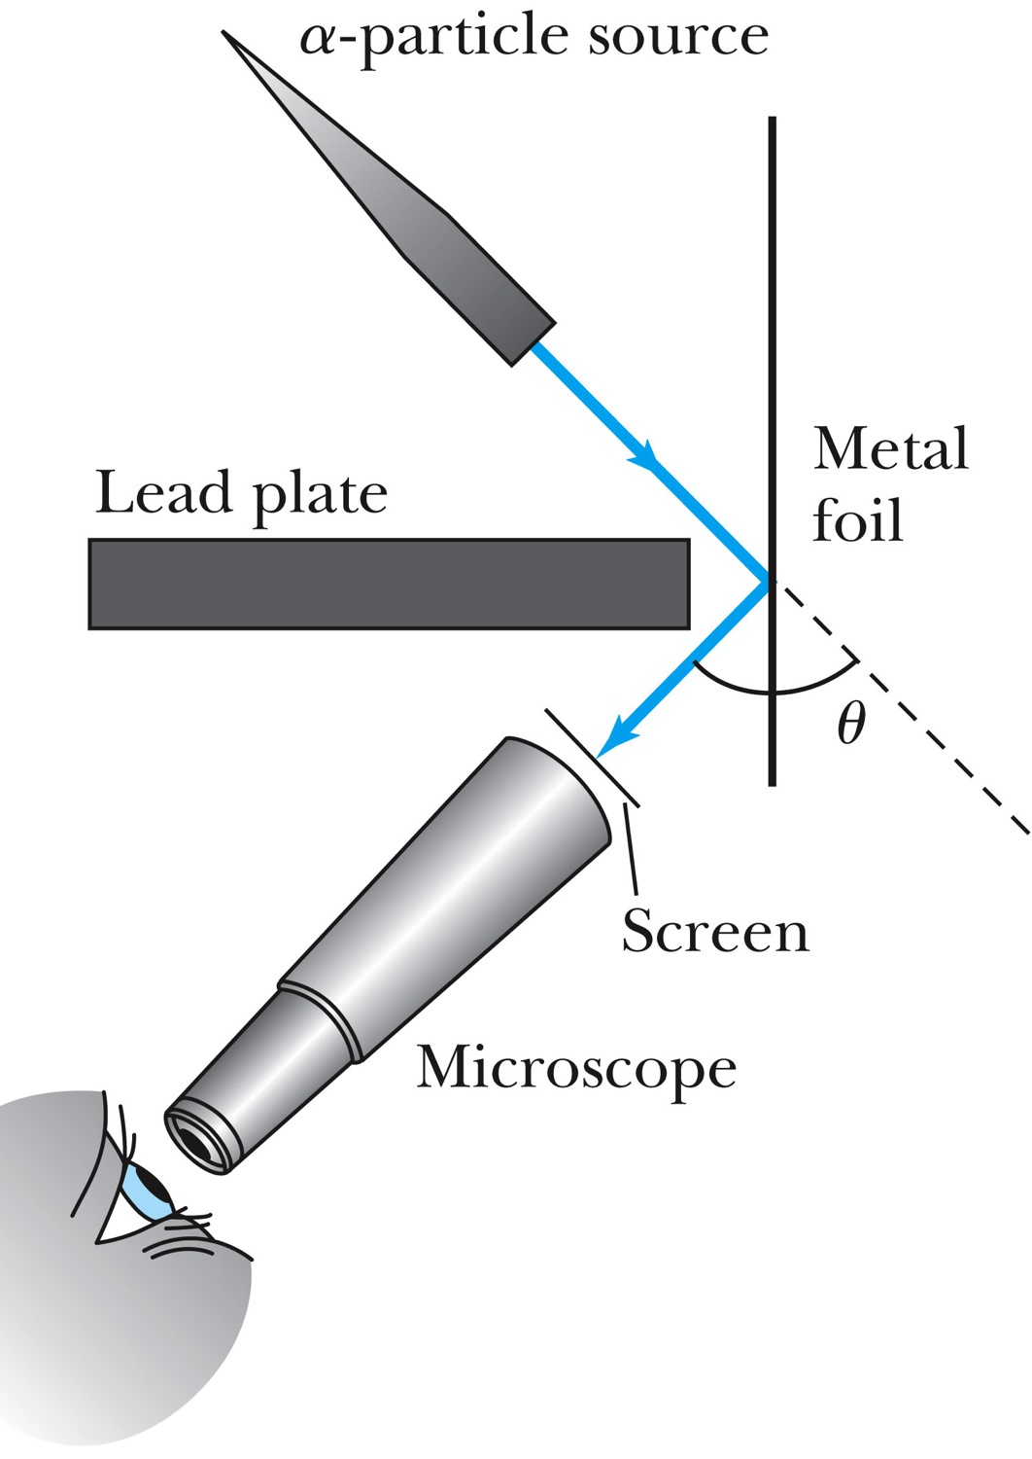
Experiments of Geiger and Marsden
Rutherford, Geiger, and Marsden conceived a new technique for investigating the structure of matter by scattering a particle off atoms.
Geiger showed that many particles were scattered from thin gold-leaf targets at backward angles greater than 90°.
Time to do some calculations!

Slide 15
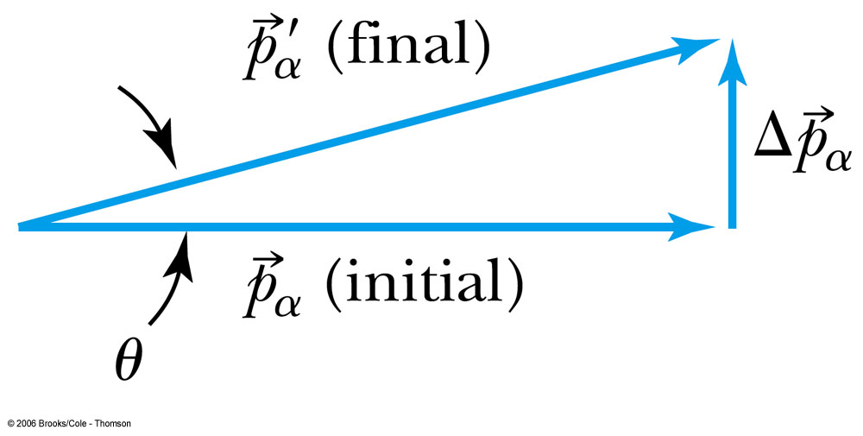
Ex 4.1: Maximum Scattering Angle
Geiger and Marsden (1909) observed backward-scattered (θ>=90º) α particles when a beam of energetic α particles was directed at a piece of gold foil as thin as 6.0x10⁻⁷m. Assuming an α particle scatters from an electron in the foil, what is the maximum scattering angle?
The maximum scattering angle corresponds to the maximum momentum change
Using the momentum conservation and the KE conservation for an elastic collision, the maximum momentum change of the α particle is in a head-on collision
Determine θ by letting Δp_{max} be perpendicular to the direction of motion.

Slide 16
Multiple Scattering from Electrons
If an α particle were scattered by many electrons, then N electrons results in <θ>_{total} ~ √N*θ
The number of atoms across a thin gold layer of 6 × 10⁻⁷ m:
Assume the distance between atoms is
and there are
This gives

Slide 17
Rutherford’s Atomic Model
<θ>_{total}~0.8*79=6.8º even if the α particle scattered from all 79 electrons in each atom of gold
The experimental results were inconsistent with Thomson’s atomic model.
Rutherford proposed that an atom has a positively charged core (nucleus) surrounded by the negative electrons.

