Slide 1
PHYS 3313 – Section 001
Lecture #12
Monday, March 16, 2015
Dr. Jaehoon Yu
Rutherford Scattering Experiment and Rutherford Atomic Model
The Classic Atomic Model
Bohr Radius
Bohr’s Hydrogen Model and Its Limitations
Characteristic X-ray Spectra

Slide 2
Announcements
Midterm Exam Results
  Class average: 58.5/102
    Equivalent to 57.5/100
  Top score: 90
Mid-term grade discussions
  1 – 2:30pm this Wednesday, March 18 in my office, CPB342
  Extremely important for you to come and talk to me about the prospect of your grade
  Bring the special project #3 at that time
Colloquium at 4pm this Wednesday, in SH101
  Dr. Doug Drob from NRL on “Understanding the Response of the Ionosphere to Atmospheric Waves Generated by Tsunamis and Other Geophysical Disturbances”

Slide 3
Reminder: Special Project #3
A total of N_{i} incident projectile particle of atomic number Z₁ kinetic energy KE scatter on a target of thickness t and atomic number Z₂ and has n atoms per volume. What is the total number of scattered projectile particles at an angle θ? (20 points)
Please be sure to clearly define all the variables used in your derivation! Points will be deducted for missing variable definitions.
This derivation must be done on your own. Please do not copy the book, internet or your friends’.
Due is this Wednesday, March 18

Slide 4

Research Topics and Groups

Slide 5
Research Project Report
Must contain the following at the minimum
  Original theory or Original observation and ref to the original paper published (not the web link!)
  Experimental proofs or Theoretical prediction + subsequent experimental proofs
  Importance and the impact of the theory/experiment
  Conclusions
Each member of the group writes a 10 (max) page report, including figures
  10% of the total grade
  Can share the theme and facts but you must write your own!
  Text of the report must be your original!
    Template available on class web site under research groups and topics
  Due Mon., May 4, 2015
Each group prepares a presentation

Slide 6

Rutherford’s Atomic Model
<θ>_{total}~0.8*79=6.8º even if the α particle scattered from all 79 electrons in each atom of gold
The experimental results were inconsistent with Thomson’s atomic model.
Rutherford proposed that an atom has a positively charged core (nucleus) surrounded by negatively charged electrons.

Slide 7
Assumptions of Rutherford Scattering
The scatterer is so massive that it does not recoil significantly; therefore the initial and final KE of the α particle are practically equal.
The target is so thin that only a single scattering occurs.
The bombarding particle and target scatterer are so small that they may be treated as point masses with electrical charges.
Only the Coulomb force is effective.

Slide 8
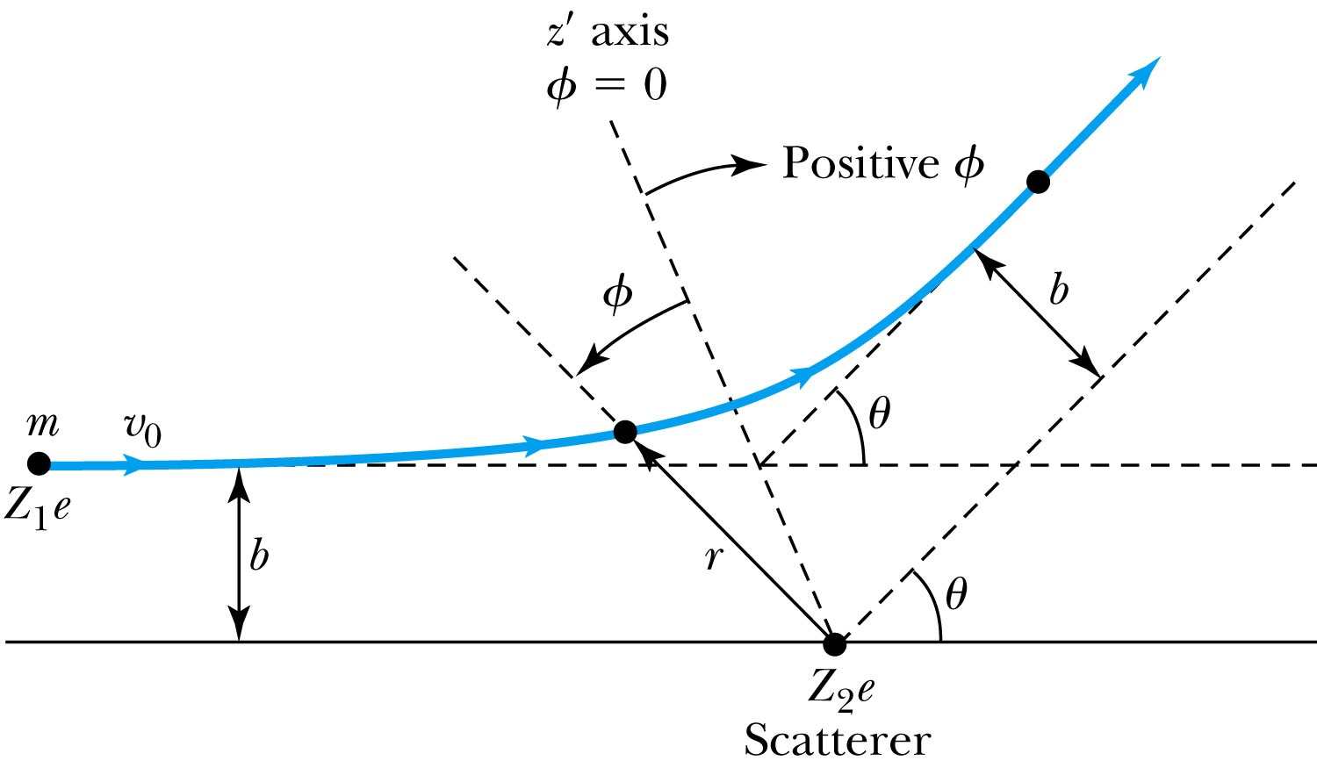
Rutherford Scattering
Scattering experiments help us study matter too small to be observed directly by measuring the angular distributions of the scattered particles
  What is the force acting in this scattering?
There is a relationship between the impact parameter b and the scattering angle θ.
When b is small,
r gets small.
Coulomb force gets large.
θ can be large and the particle can be repelled backward.

Slide 9
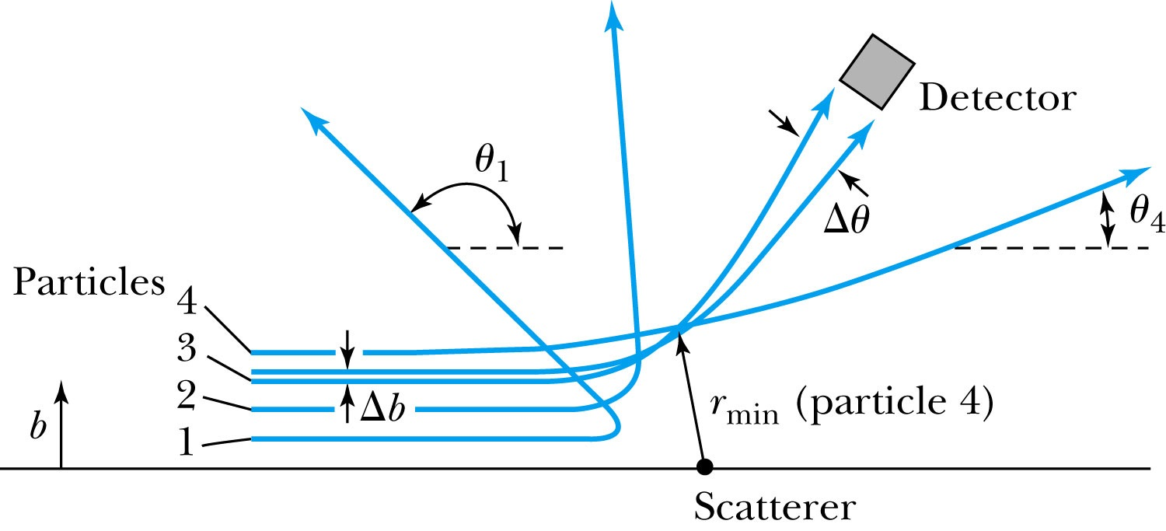
The Relationship Between the Impact Parameter b and the Scattering Angle
The relationship between the impact parameter b and scattering angle θ: Particles with small impact parameters approach the nucleus most closely (r_{min}) and scatter to the largest angles. Particles within a certain range of impact parameters b will be scattered within the window Δθ.

Slide 10
Rutherford Scattering
What are the quantities that can affect the scattering?
  What was the force again?
    The Coulomb force
  The charge of the incoming particle (Z₁e)
  The charge of the target particle (Z₂e)
  The minimum distance the projectile approaches the target (r)
Using the fact that this is a totally elastic scattering under a central force, we know that
  Linear momentum is conserved
  KE is conserved
  Angular momentum is conserved
From this, impact parameter

Slide 11
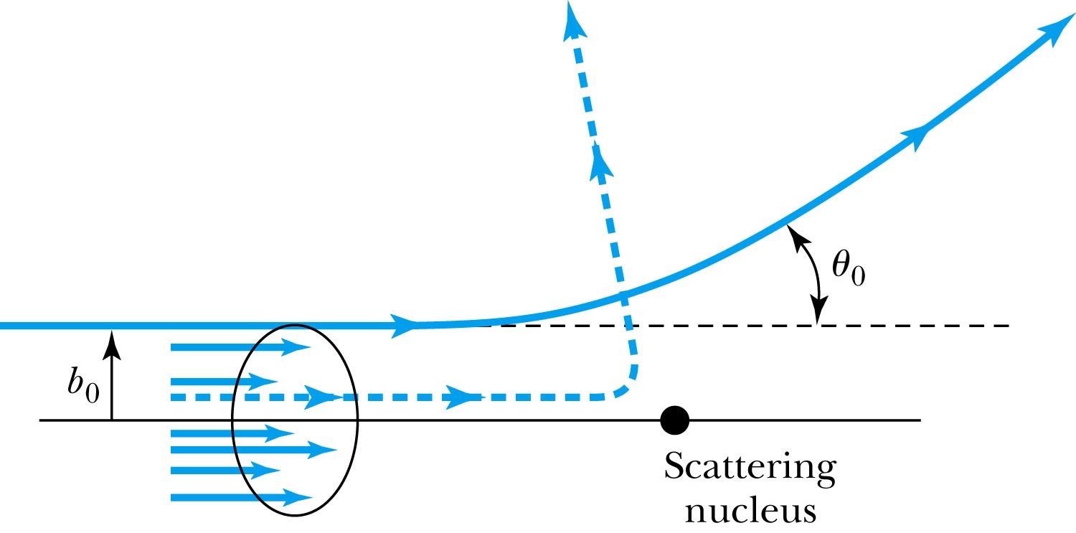
Rutherford Scattering - probability
Any particle inside the circle of area πb₀² will be similarly scattered.
The cross section σ = πb² is related to the probability for a particle being scattered by a nucleus.
The fraction of the incident particles scattered is
The number of scattering nuclei per unit area .
t: target thickness
n: atomic number density

Slide 12
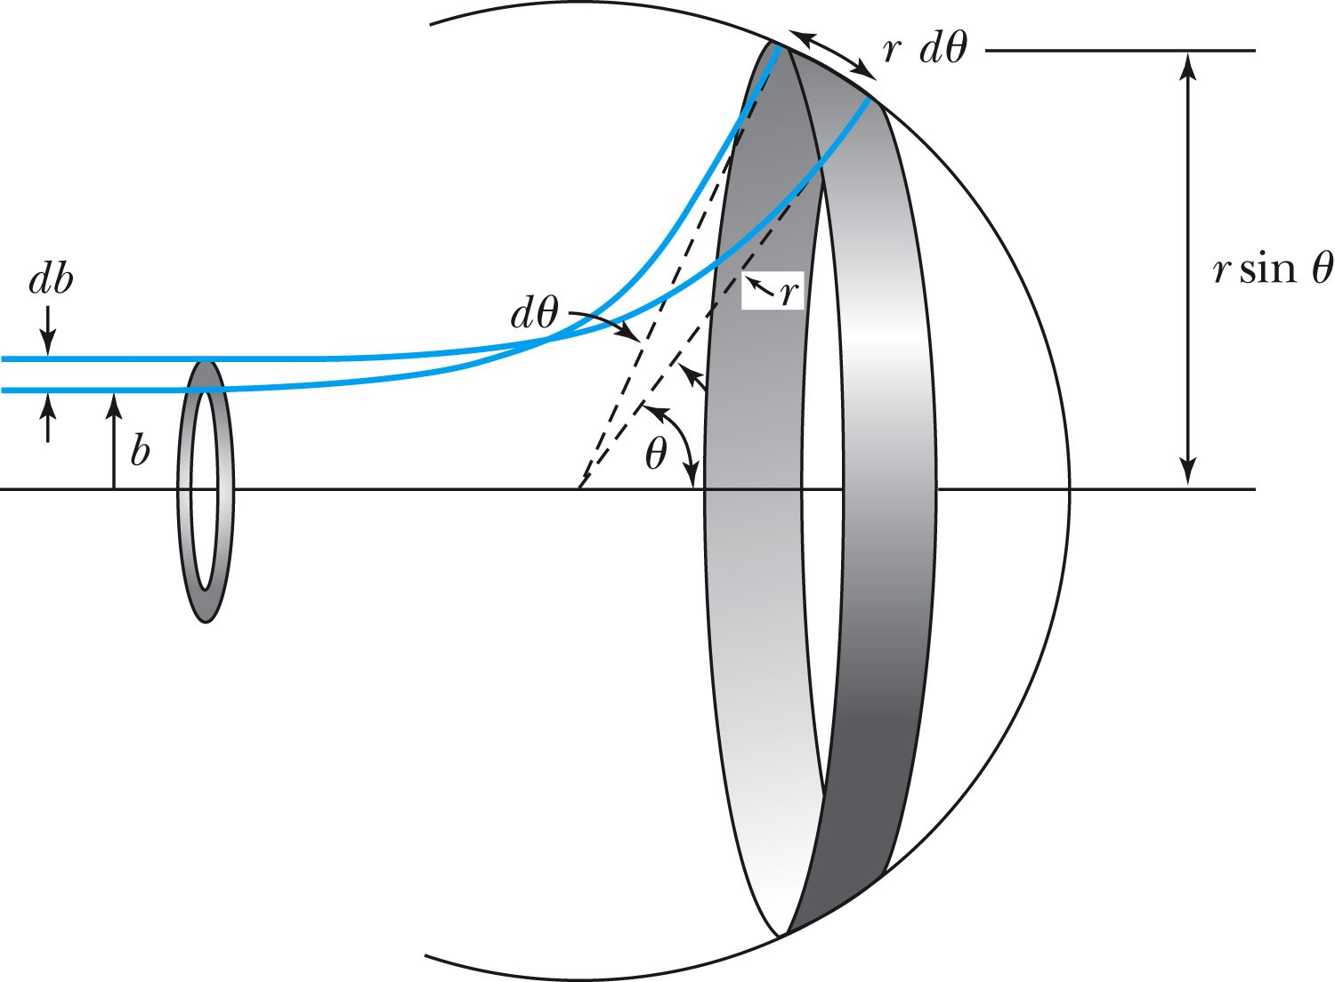
Rutherford Scattering Equation
In an actual experiment, a detector is positioned from θ to θ + dθ that corresponds to incident particles between b and b + db.
The number of particles scattered into the the angular coverage per unit area is

Slide 13
The Important Points
The scattering is proportional to the square of the atomic numbers of both the incident particle (Z₁) and the target scatterer (Z₂).
The number of scattered particles is inversely proportional to the square of the kinetic energy of the incident particle.
For the scattering angle θ, the scattering is proportional to 4th power of sin(θ/2).
The Scattering is proportional to the target thickness for thin targets.

Slide 14
The Classical Atomic Model
As suggested by the Rutherford Model, an atom consisted of a small, massive, positively charged nucleus surrounded by moving electrons. This then suggested consideration of a planetary model of the atom.
Let’s consider atoms in a planetary model.
The force of attraction on the electron by the nucleus and Newton’s 2nd law give
where v is the tangential speed of an electron.
The total energy is

Slide 15
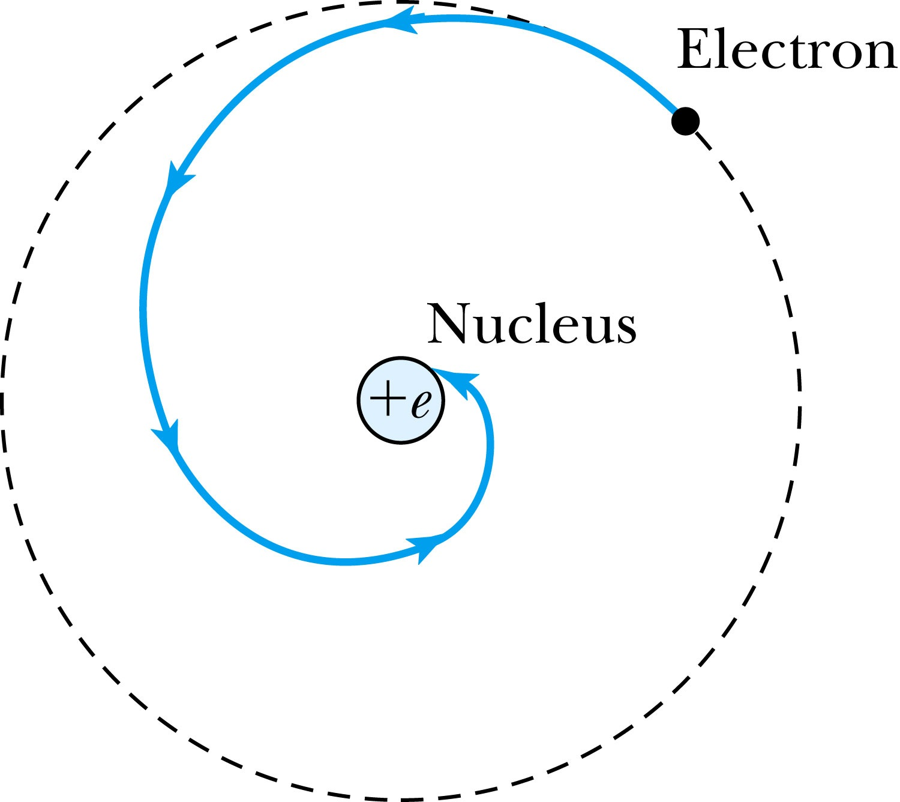
The Planetary Model is Doomed
From classical E&M theory, an accelerated electric charge radiates energy (electromagnetic radiation) which means total energy must decrease. ➔Radius r must decrease!!
Electron crashes into the nucleus!?
Physics had reached a turning point in 1900 with Planck’s hypothesis of the quantum behavior of radiation.

Slide 16
The Bohr Model of the Hydrogen Atom – The assumptions
“Stationary” states or orbits must exist in atoms, i.e., orbiting electrons do not radiate energy in these orbits. These orbits or stationary states are of a fixed definite energy E.
The emission or absorption of electromagnetic radiation can occur only in conjunction with a transition between two stationary states. The frequency, f, of this radiation is proportional to the difference in energy of the two stationary states:
E = E₁ − E₂ = hf
where h is Planck’s Constant
  Bohr thought this has to do with fundamental length of order ~10⁻¹⁰m
Classical laws of physics do not apply to transitions between stationary states.
The mean kinetic energy of the electron-nucleus system is quantized as
K = nhf_{orb}/2, where f_{orb} is the frequency of rotation. This is equivalent to the angular momentum of a stationary state to be an integral multiple of h/2π

Slide 17
How did Bohr Arrived at the angular momentum quantization?
The mean kinetic energy of the electron-nucleus system is quantized as
K = nhf_{orb}/2, where f_{orb} is the frequency of rotation. This is equivalent to the angular momentum of a stationary state to be an integral multiple of h/2π.
Kinetic energy can be written
Angular momentum is defined as
The relationship between linear and angular quantifies
Thus, we can rewrite

