Slide 1
PHYS 3313 – Section 001 Lecture #13
Monday, March 23, 2015
Dr. Jaehoon Yu
Bohr Radius
Bohr’s Hydrogen Model and Its Limitations
Characteristic X-ray Spectra

Slide 2
Announcements
Homework #3
End of chapter problems on CH4: 5, 14, 17, 21, 23 and 45
Due: Monday, March 30
Quiz Wednesday, April 1
At the beginning of the class
Covers CH4.1 through what we finish Monday, March 30
BYOF with the same rule as before
Colloquium at 4pm this Wednesday, in SH101

Slide 3
Uncertainties
Statistical Uncertainty: A naturally occurring uncertainty due to the number of measurements
Usually estimated by taking the square root of the number of measurements or samples, √N
Systematic Uncertainty: Uncertainty occurring due to unintended biases or unknown sources
Biases made by personal measurement habits
Some sources that could impact the measurements
In any measurement, the uncertainties provide the significance to the measurement

Slide 4
Bohr’s Quantized Radius of Hydrogen
The angular momentum is
So the speed of an orbiting e can be written
From the Newton’s law for a circular motion
So from above two equations, we can get

Slide 5
Bohr Radius
The radius of the hydrogen atom for the n^{th} stationary state is
Where the Bohr radius for a given stationary state is:
The smallest diameter of the hydrogen atom is
OMG!! The fundamental length!!
n = 1 gives its lowest energy state (called the “ground” state)

Slide 6
Ex. 4.6 Justification for non-relativistic treatment of orbital e
Are we justified for the non-relativistic treatment of the orbital electrons?
When do we apply relativistic treatment?
When v/c>0.1
Orbital speed:
Thus

Slide 7
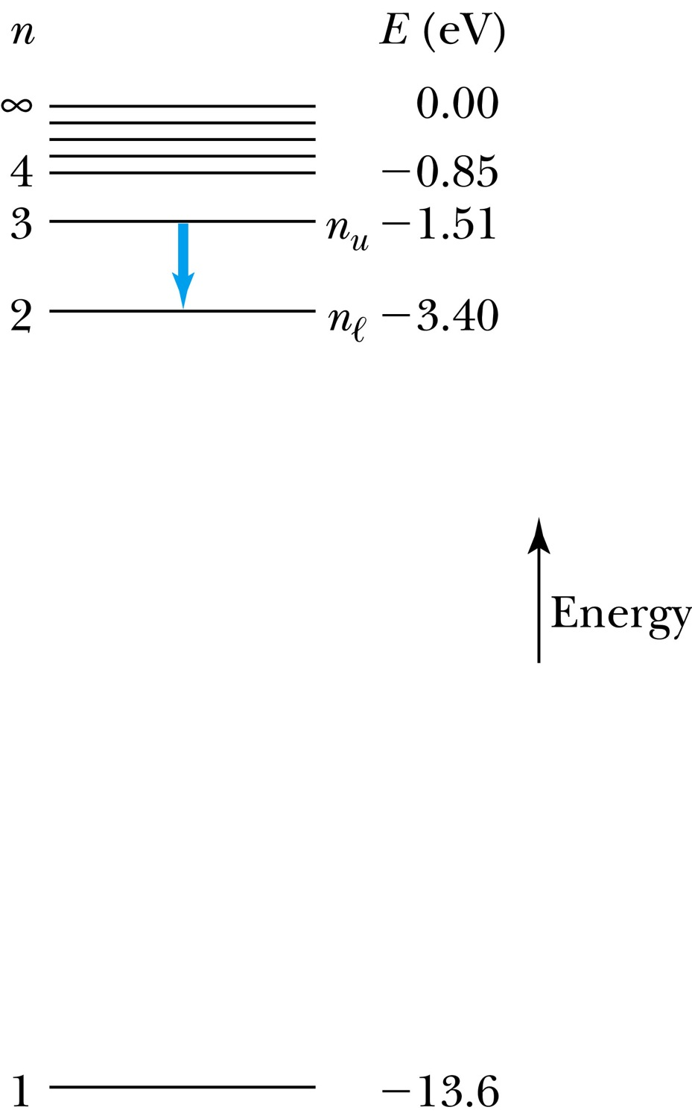
The Hydrogen Atom
Recalling the total E of an e in an atom, the n^{th} stationary states En
where E₀ is the ground state energy
Emission of light occurs when the atom is in an excited state and decays to a lower energy state (n_{u} → n_{ℓ}).
where f is the frequency of a photon.
R∞ is the Rydberg constant.

Slide 8
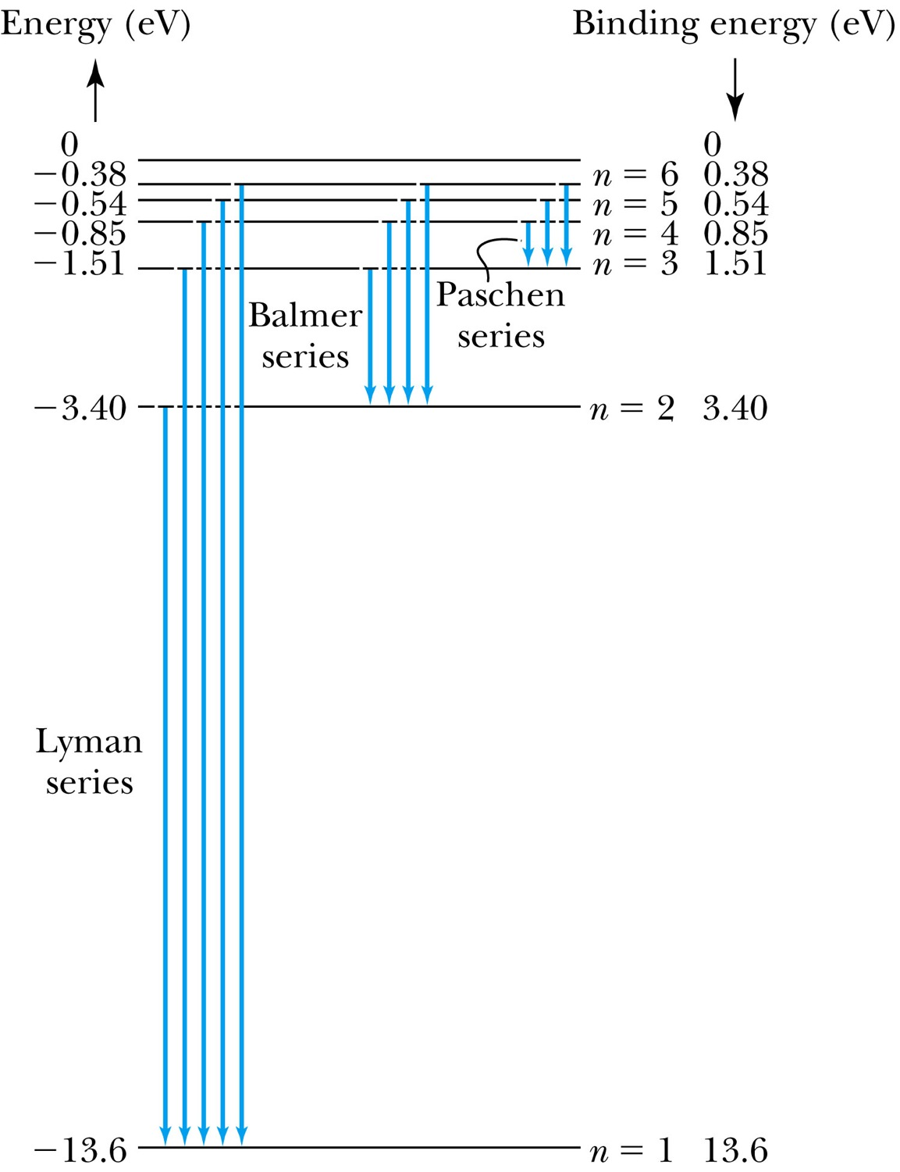
Transitions in the Hydrogen Atom
Lyman series: The atom will remain in the excited state for a short time before emitting a photon and returning to a lower stationary state. All hydrogen atoms exist in n = 1 (invisible).
Balmer series: When sunlight passes through the atmosphere, hydrogen atoms in water vapor absorb the wavelengths (visible).

Slide 9
Fine Structure Constant
The electron’s speed on an orbit in the Bohr model:
On the ground state, v₁ = 2.2 × 10⁶ m/s ~ less than 1% of the speed of light
The ratio of v₁ to c is the fine structure constant, α.

Slide 10
The Correspondence Principle
Classical electrodynamics
Bohr’s atomic model
+
Determine the properties
of radiation
Need a principle to relate the new modern results with classical ones.
Bohr’s correspondence
principle
In the limits where classical and quantum theories should agree, the quantum theory must produce the classical results.

Slide 11
The Correspondence Principle
The frequency of the radiation emitted f_{classical} is equal to the orbital frequency f_{orb} of the electron around the nucleus.
The frequency of the photon in the transition from n + 1 to n is
For large n the classical limit,
Substitute E₀:
So the frequency of the radiated E between classical theory and Bohr model agrees in large n case!!

Slide 12
Importance of Bohr’s Model
Demonstrated the need for Plank’s constant in understanding the atomic structure
Assumption of quantized angular momentum which led to quantization of other quantities, r, v and E as follows
Orbital Radius:
Orbital Speed:
Energy levels:

Slide 13
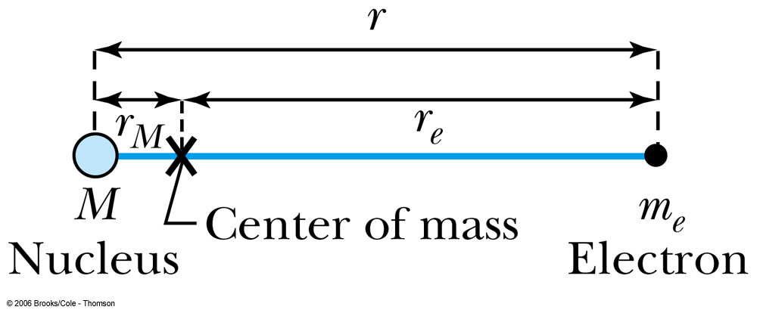
Successes and Failures of the Bohr Model
The electron and hydrogen nucleus actually revolve about their mutual center of mass ➔ reduced mass correction!!
All we need is to replace m_{e} with atom’s reduced mass.
The Rydberg constant for infinite nuclear mass, R∞ is replaced by R.

Slide 14
Limitations of the Bohr Model
The Bohr model was a great step of the new quantum theory, but it had its limitations.
Works only to single-electron atoms
Works even for ions ➔ What would change?
The charge of the nucleus
Could not account for the intensities or the fine structure of the spectral lines
Fine structure is caused by the electron spin
Under a magnetic field, the spectrum splits by the spin
Could not explain the binding of atoms into molecules

