Slide 1
PHYS 3313 – Section 001 Lecture #14
Wednesday, March 25, 2015
Dr. Jaehoon Yu
Characteristic X-ray Spectra
Hydrogen Spectrum Series
X-ray Scattering
Bragg’s Law
de Broglie Waves
Bohr’s Quantization Conditions
Electron Scattering

Slide 2
Announcements
Reminder: Homework #3
End of chapter problems on CH4: 5, 14, 17, 21, 23 and 45
Due: Monday, March 30
Quiz Wednesday, April 1
At the beginning of the class
Covers CH4.1 through what we finish Monday, March 30
BYOF with the same rule as before
Colloquium at 4pm today in SH101

Slide 3
Characteristic X-Ray Spectra and Atomic Number
Shells have letter names:
K shell for n = 1
L shell for n = 2
The atom is most stable in its ground state.
When a transition occurs in a heavy atom, the radiation emitted is an x ray. (λ=0.01 – 10nm)
It has the energy E (x ray) = E_{u} − E_{ℓ}.
An electron from higher shells will fill the inner-shell vacancy at lower energy.

Slide 4
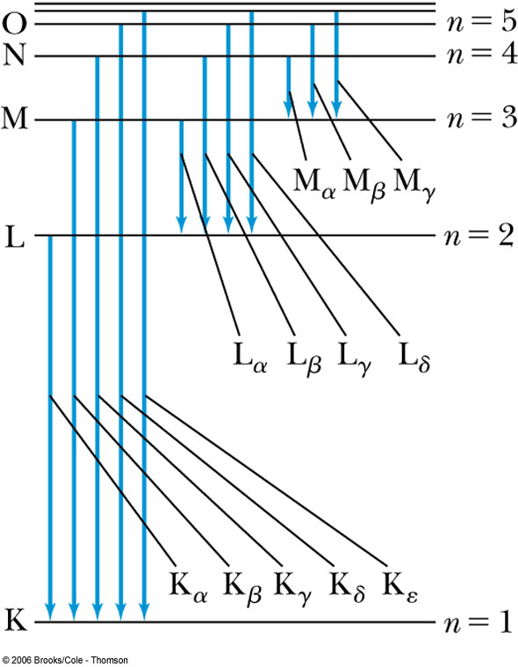
Atomic Number
L shell to K shell K_{α} X ray
M shell to K shell K_{β} X ray
Atomic number Z = number of protons in the nucleus
Moseley found a relationship between the frequencies of the characteristic X ray and Z.
This holds for the K_{α} X ray

Slide 5
Moseley’s Empirical Results
The X ray is produced from n = 2 to n = 1 transition.
In general, the K series of X ray wavelengths are
Moseley’s research clarified the importance of the electron shells for all the elements, not just for hydrogen
Concluded correctly that atomic number Z, rather than the atomic weight, is the determining factor in ordering of the periodic table

Slide 6
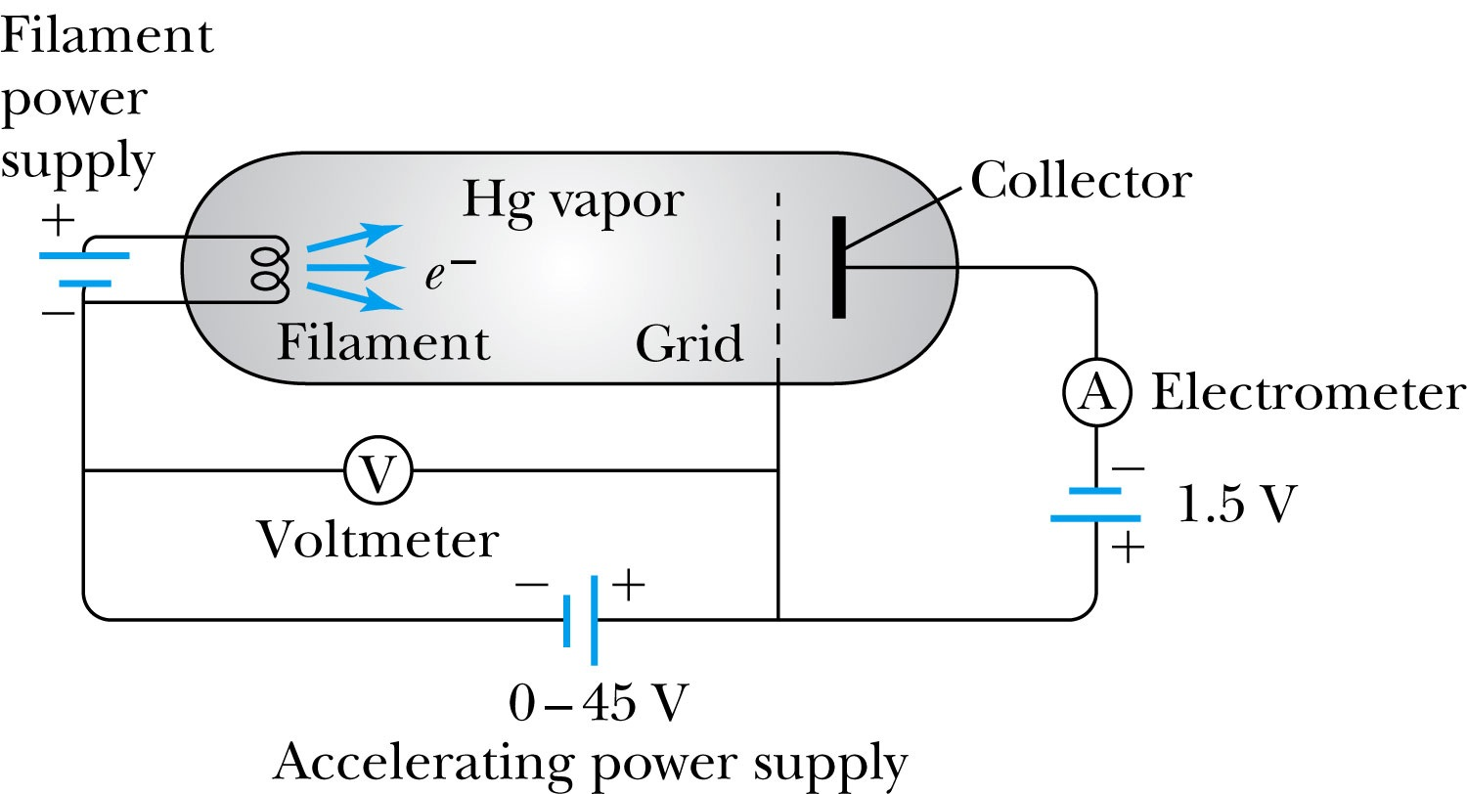
Atomic Excitation by Electrons
Franck and Hertz studied the phenomenon of ionization KE transfer from electrons to atoms.
When the accelerating voltage is below 5 V
electrons did not lose energy going through the mercury vapor
When the accelerating voltage is above 5 V, 10V, etc..
sudden drop in the current
Min. e KE

Slide 7
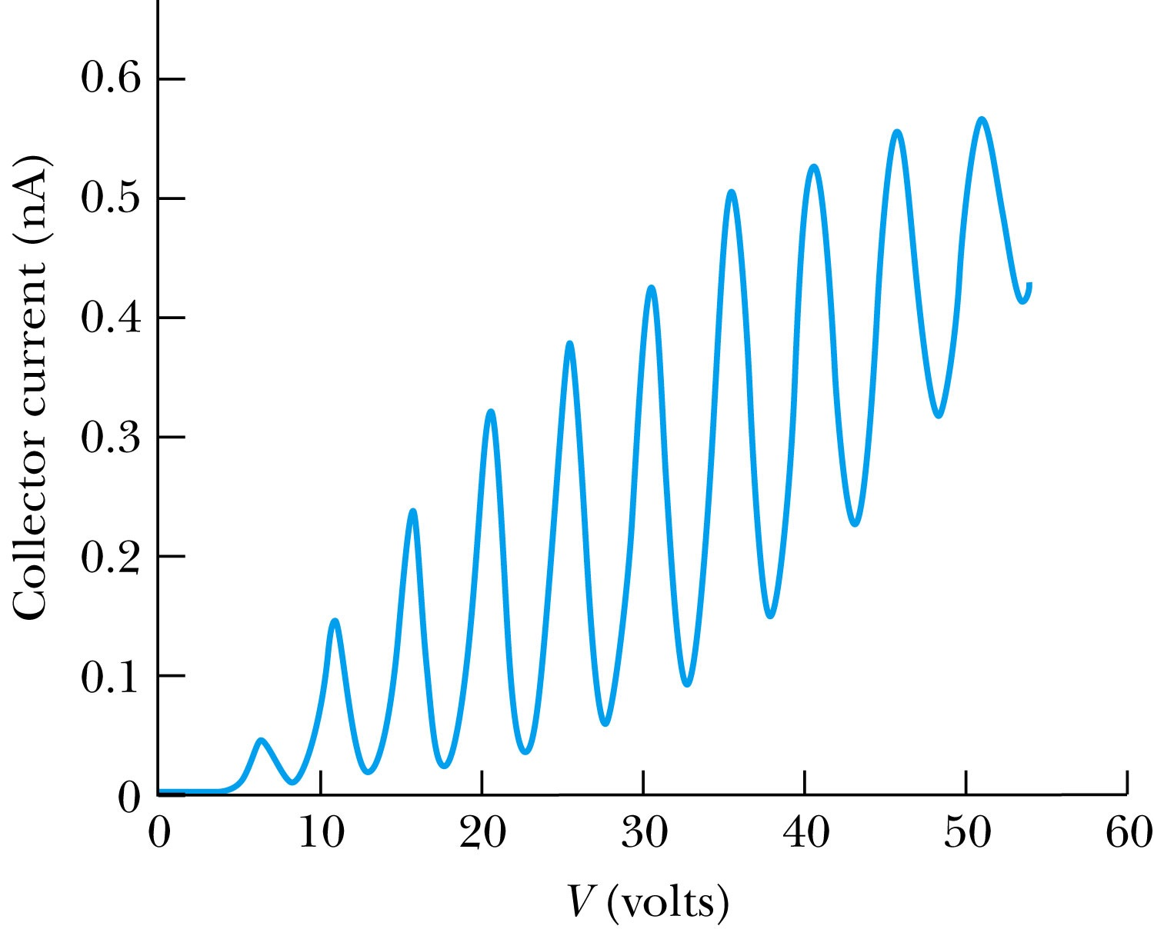
Atomic Excitation by Electrons
Ground state has E₀ which can be considered as 0.
First excited state has E₁.
The energy difference E₁ − 0 = E₁ is the excitation energy.
Hg (mercury) has an excitation energy of 4.88 eV in the first excited state
No energy can be transferred to Hg below 4.88 eV because not enough energy is available to excite an electron to the next energy level
Above 4.88 eV, the current drops because scattered electrons no longer reach the collector until the accelerating voltage reaches 9.76 eV and so on.

Slide 8
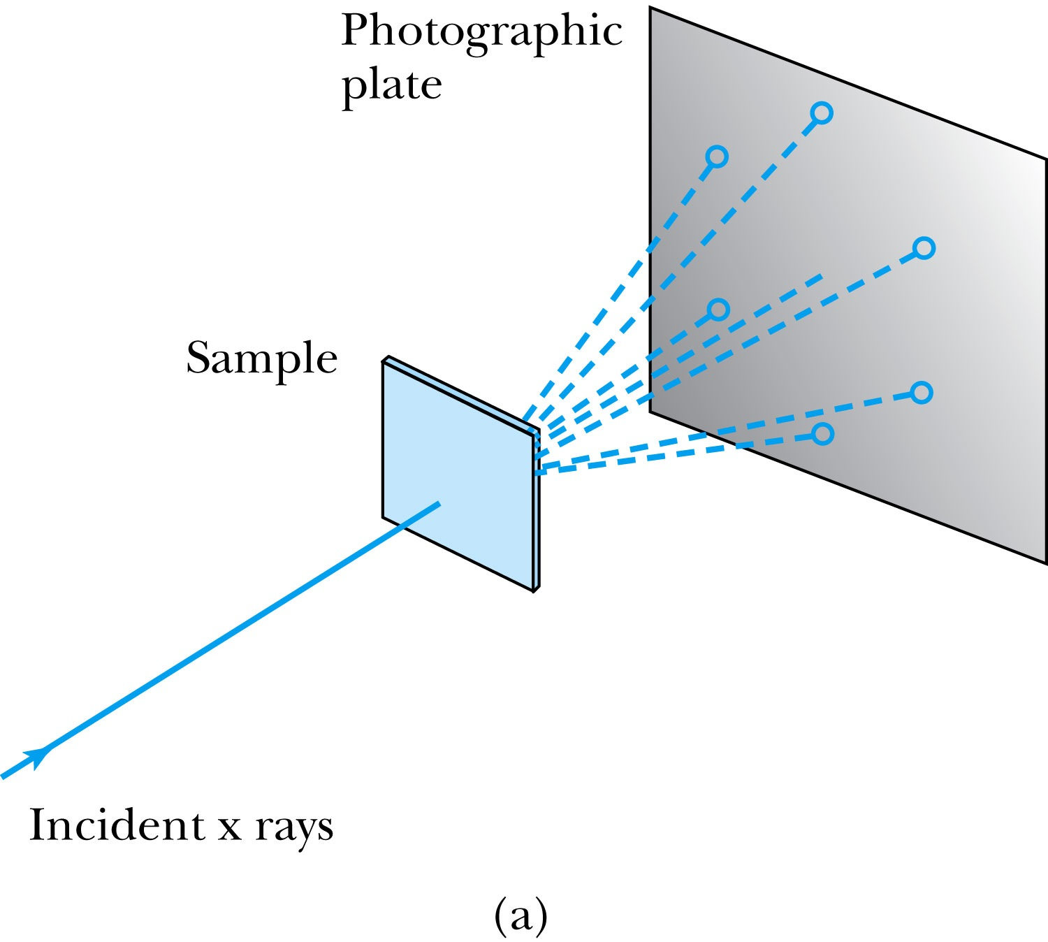
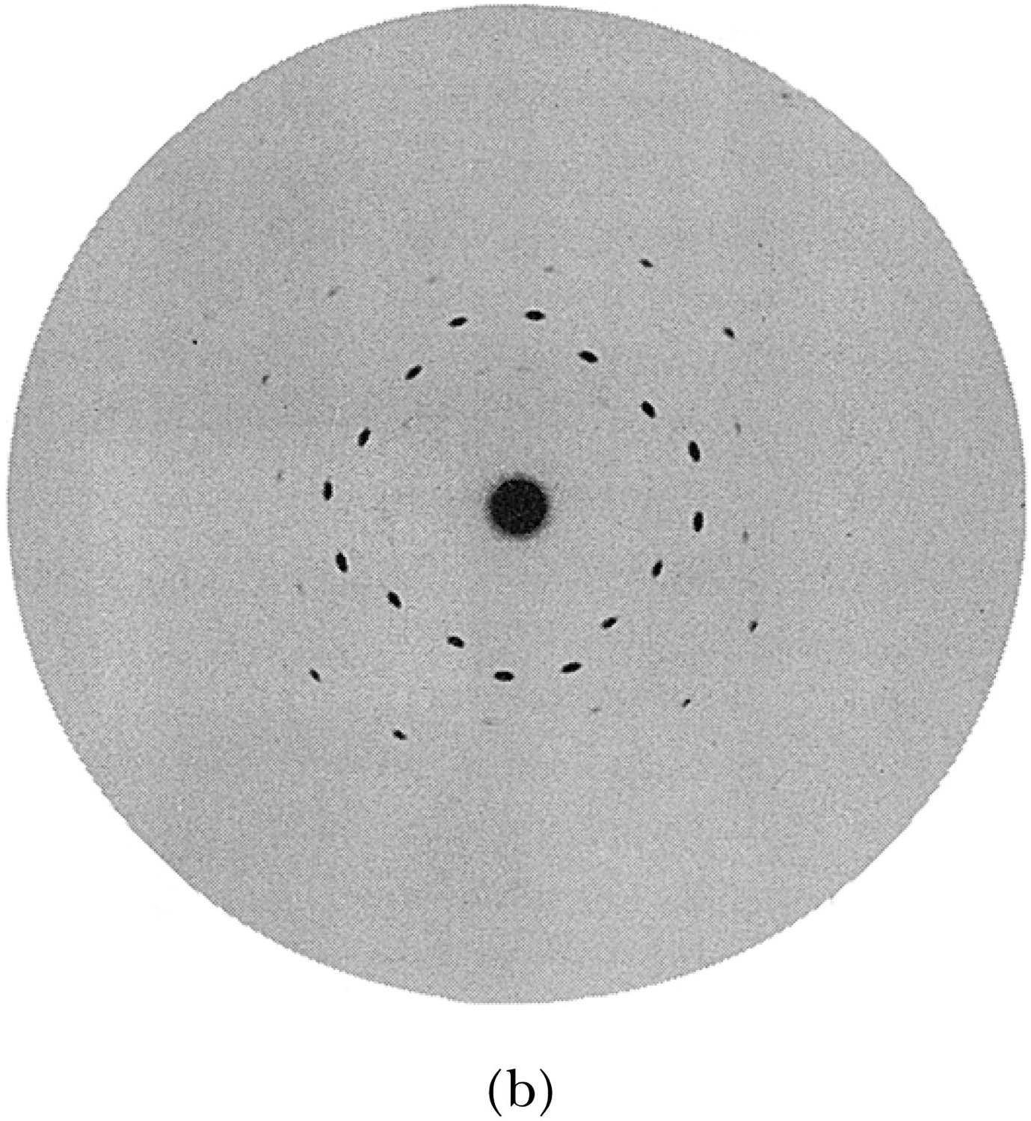
X-Ray Scattering
Max von Laue suggested that if X rays were a form of electromagnetic radiation, interference effects should be observed. (Wave property!!)
Crystals act as three-dimensional gratings, scattering the waves and producing observable interference effects.

Slide 9
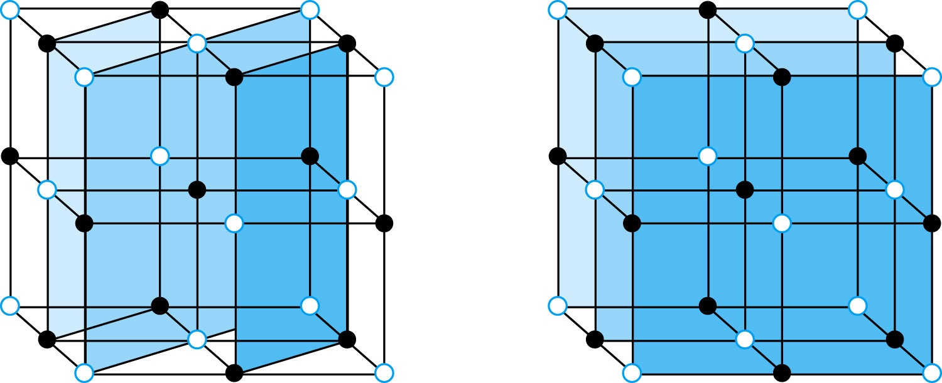
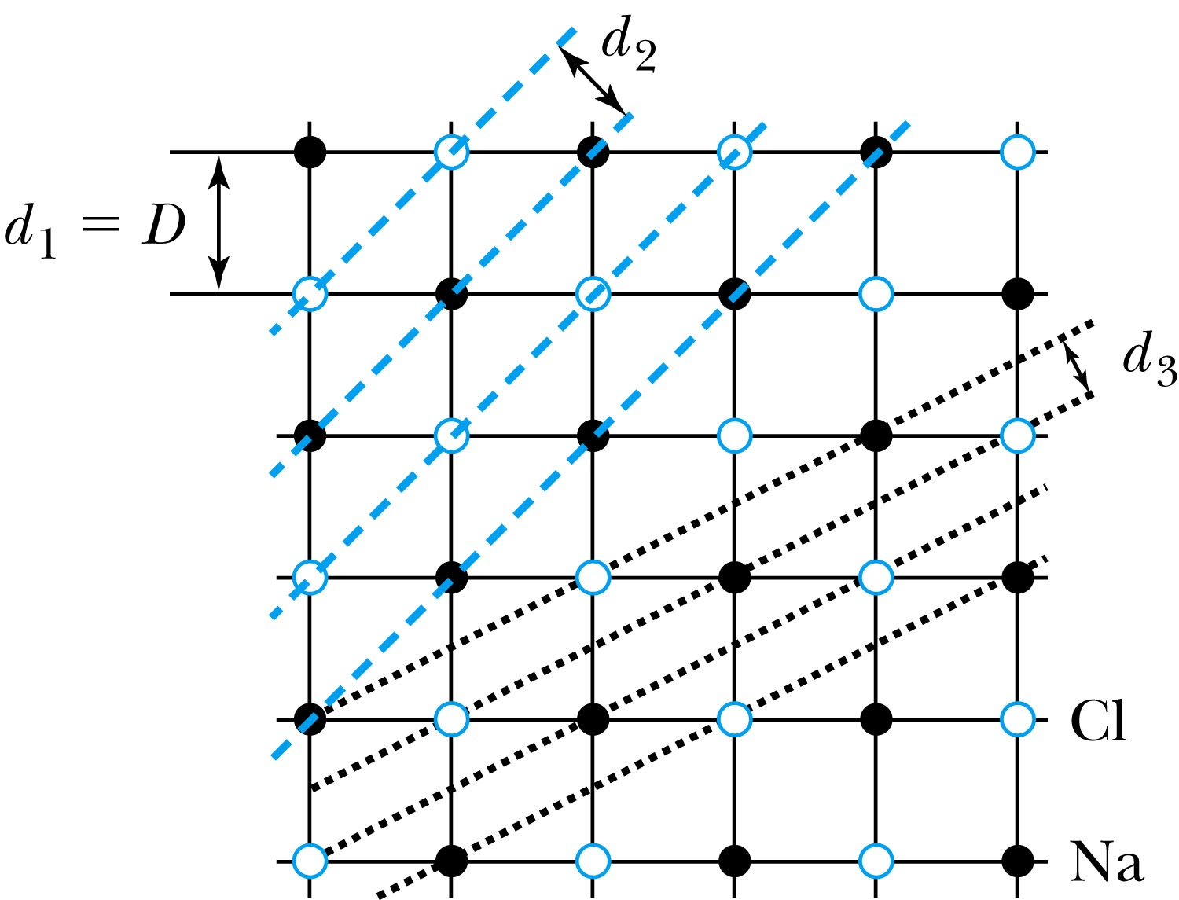
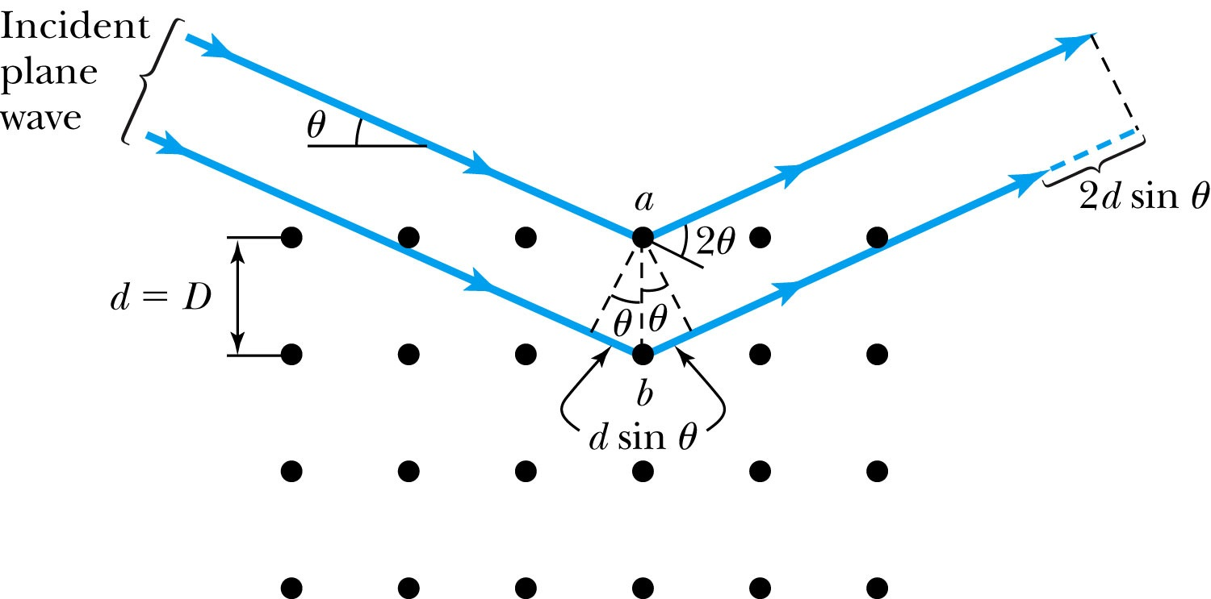
Bragg’s Law
William Lawrence Bragg interpreted the x-ray scattering as the reflection of the incident X-ray beam from a unique set of planes of atoms within the crystal.
There are two conditions for constructive interference of the scattered X rays:
The angle of incidence must equal the angle of reflection of the outgoing wave. (total reflection)
The difference in path lengths between two rays must be an integral number of wavelengths.
Bragg’s Law:
nλ = 2d sin θ
(n = integer)

Slide 10
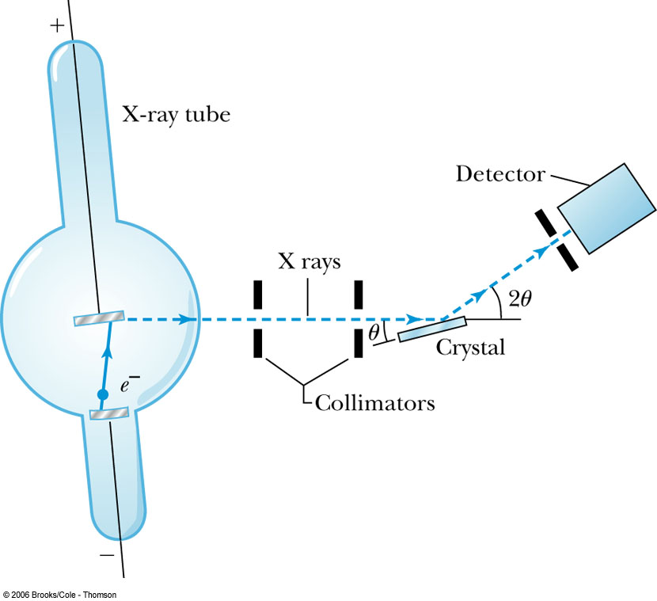
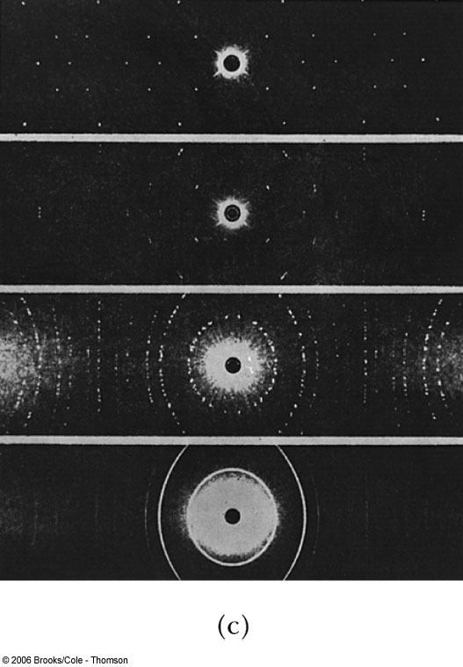
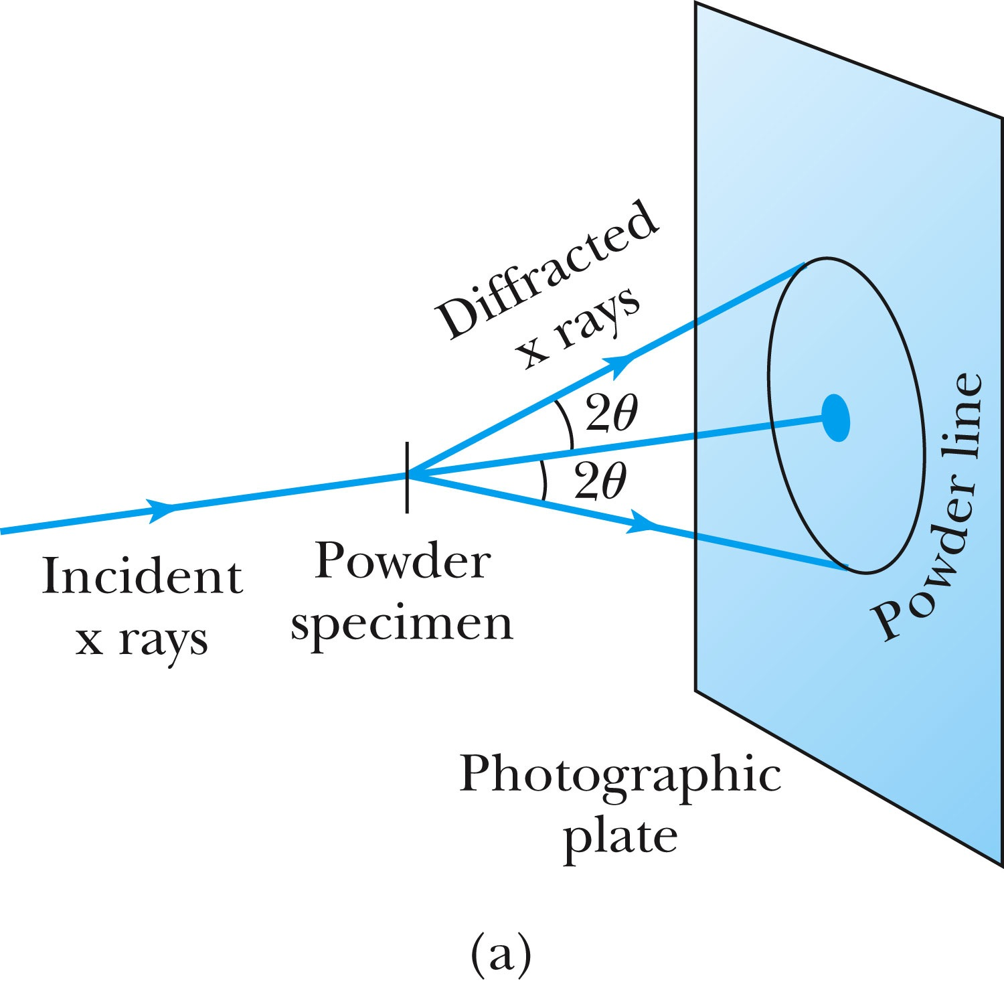
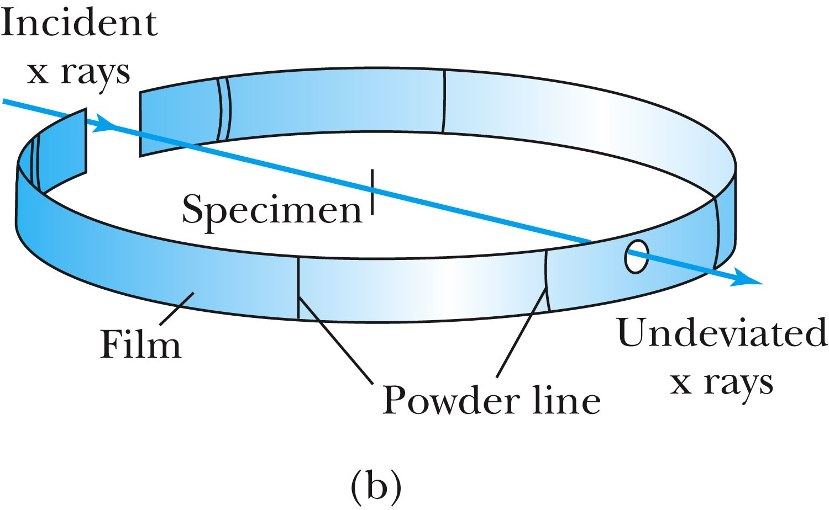
The Bragg Spectrometer
A Bragg spectrometer scatters X rays from several crystals. The intensity of the diffracted beam is determined as a function of scattering angle by rotating the crystal and the detector.
When a beam of X rays passes through the powdered crystal, the dots become a series of rings due to random arrangement.

Slide 11
Ex 5.1: Bragg’s Law
X rays scattered from rock salt (NaCl) are observed to have an intense maximum at an angle of 20º from the incident direction. Assuming n=1 (from the intensity), what must be the wavelength of the incident radiation?
Bragg’s law: nλ = 2d sin θ
What do we need to know to use this? The lattice spacing d!
We know n=1 and 2θ=20º.
We use the density of NaCl to find out what d is.

Slide 12
De Broglie Waves
Louis V. de Broglie suggested that mass particles should have wave properties similar to electromagnetic radiation ➔ many experiments supported this!
Thus the wavelength of a matter wave is called the de Broglie wavelength:
This can be considered as the probing beam length scale
Since for a photon, E = pc and E = hf, the energy can be written as

Slide 13
Ex 5.2: De Broglie Wavelength
Calculate the De Broglie wavelength of (a) a tennis ball of mass 57g traveling 25m/s (about 56mph) and (b) an electron with kinetic energy 50eV.
What is the formula for De Broglie Wavelength?
(a) for a tennis ball, m=0.057kg.
(b) for electron with 50eV KE, since KE is small, we can use non-relativistic expression of electron momentum!
What are the wavelengths of you running at the speed of 2m/s? What about your car of 2 metric tons at 100mph? How about the proton with 14TeV kinetic energy?
What is the momentum of the photon from a green laser (λ=532nm)?

Slide 14
Bohr’s Quantization Condition
One of Bohr’s assumptions concerning his hydrogen atom model was that the angular momentum of the electron-nucleus system in a stationary state is an integral multiple of h/2π.
The electron is a standing wave in an orbit around the proton. This standing wave will have nodes and be an integral number of wavelengths.
The angular momentum becomes:

Slide 15
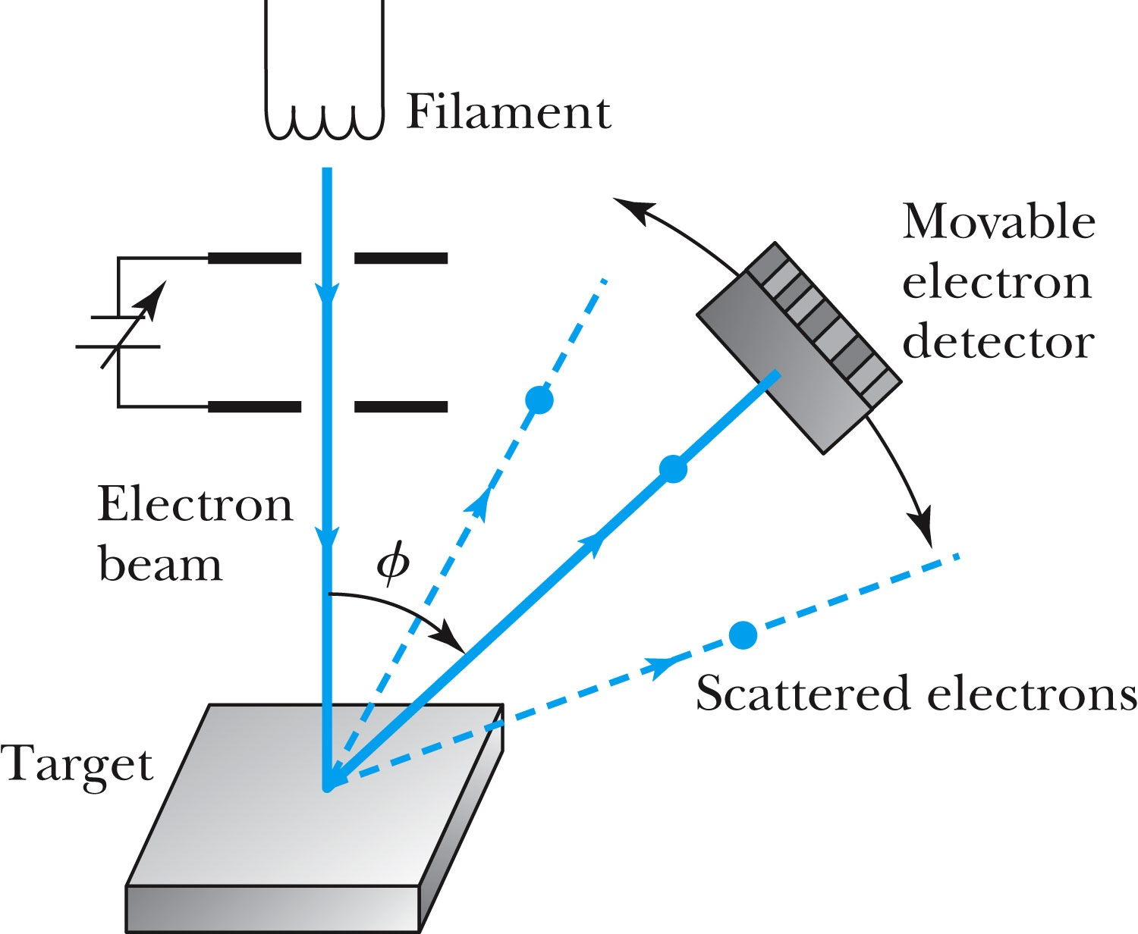
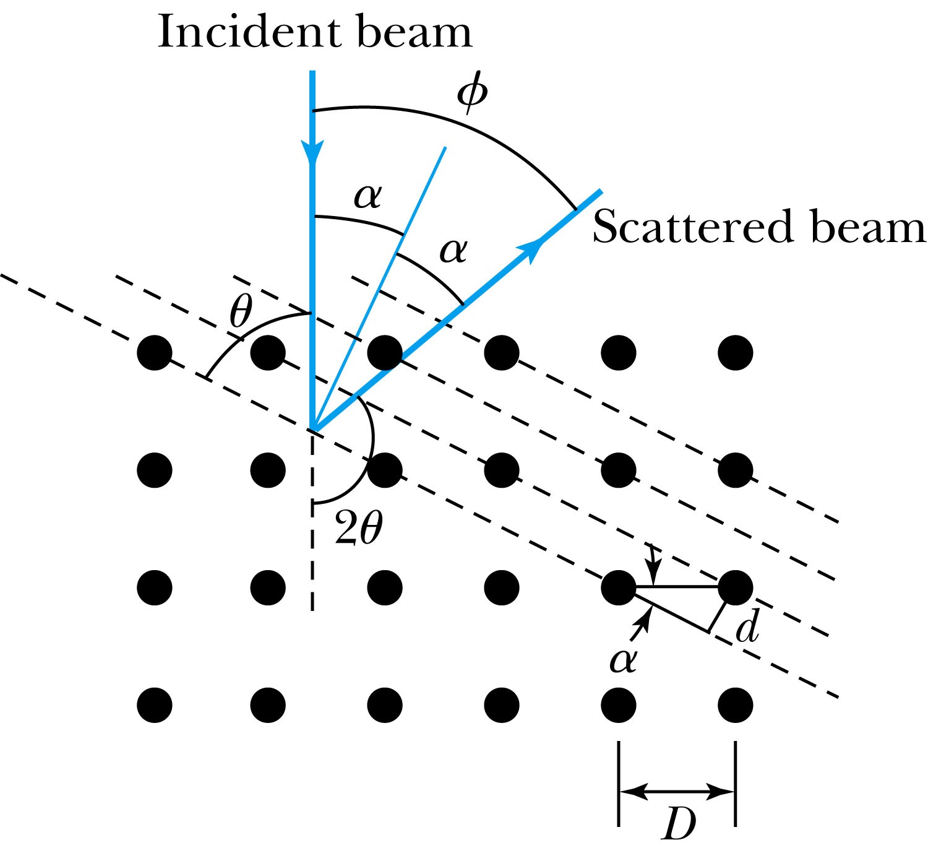
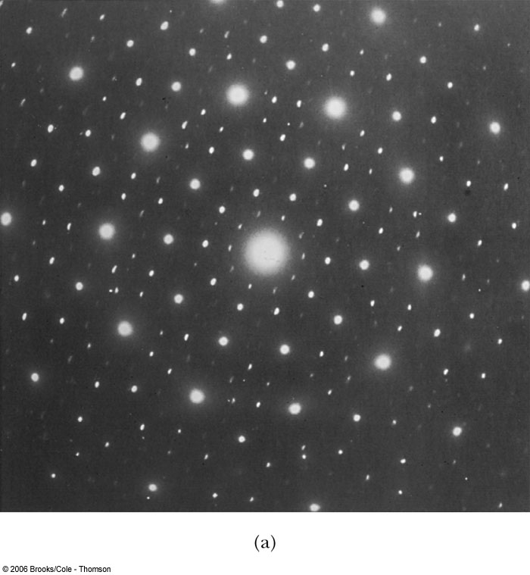
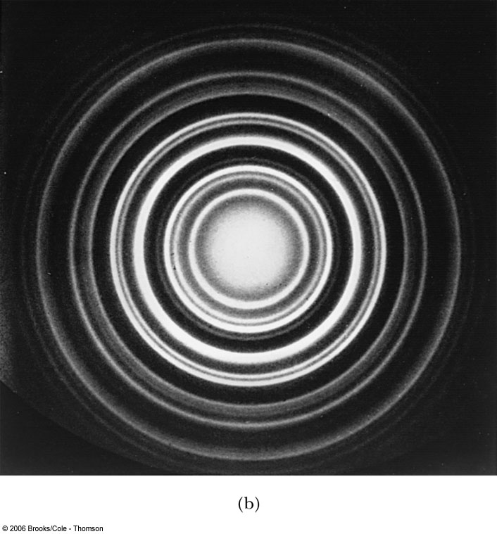
Electron Scattering
Davisson and Germer experimentally observed that electrons were diffracted much like X rays in nickel crystals. ➔ direct proof of de Broglie wave!
George P. Thomson (1892–1975), son of J. J. Thomson, reported seeing the effects of electron diffraction in transmission experiments. The first target was celluloid, and soon after that gold, aluminum, and platinum were used. The randomly oriented polycrystalline sample of SnO₂ produces rings as shown in the figure at right.

Slide 16
Photons, which we thought were waves, act particle like (eg Photoelectric effect or Compton Scattering)
Electrons, which we thought were particles, act wave particle like (eg electron scattering)
de Broglie: All matter has intrinsic wavelength.
Wavelength is inversely proportional to momentum
The more massive… the smaller the wavelength… the harder to observe the wavelike properties
So while photons appear mostly wavelike, electrons (next lightest particle!) appear mostly particle like.
How can we reconcile the wave/particle views?

