Slide 1
PHYS 3313 – Section 001 Lecture #15
Monday, March 30, 2015
Dr. Jaehoon Yu
Wave Motion and Properties
Wave Packets and Packet Envelops
Superposition of Waves
Electron Double Slit Experiment
Wave-Particle Duality
The Uncertainty Principle
The Schrodinger Wave Equation

Slide 2
Announcements
Quiz this Wednesday, April 1
At the beginning of the class
Covers CH4.1 through what we finish Monday, March 30
BYOF with the same rule as before
Colloquium at 4pm Wednesday, in SH101

Slide 3
Wave Motion
de Broglie matter waves suggest a further description. The displacement of a traveling wave is
This is a solution to the wave equation
Define the wave number k and the angular frequency ω as:
The wave function can be rewritten:

Slide 4
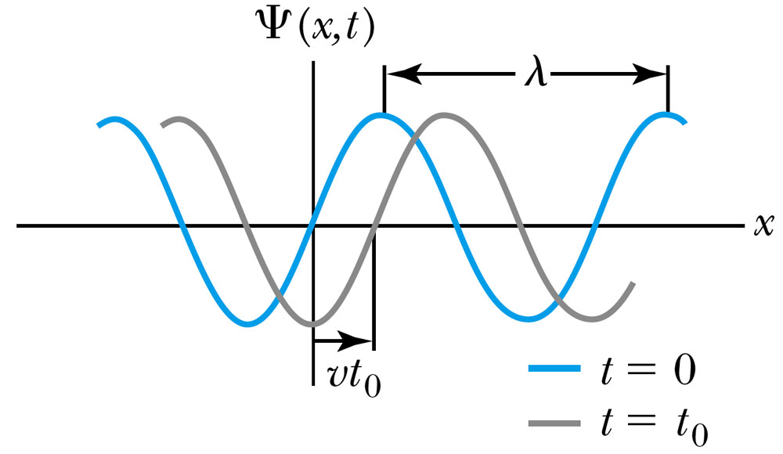
Wave Properties
The phase velocity is the velocity of a point on the wave that has a given phase (for example, the crest) and is given by
The phase constant φ shifts the wave:
.
(When φ=π/2)

Slide 5
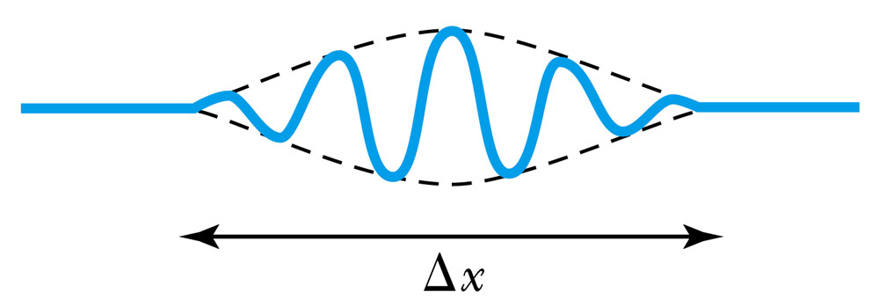
Principle of Superposition
When two or more waves traverse the same region, they act independently of each other.
Combining two waves of the same amplitude yields:
The combined wave oscillates within an envelope that denotes the maximum displacement of the combined waves.
When combining many waves with different amplitudes and frequencies, a pulse, or wave packet, can be formed, which can move at a group velocity:

Slide 6
Fourier Series
The sum of many waves that form a wave packet is called a Fourier series:
Summing an infinite number of waves yields the Fourier integral:

Slide 7
Wave Packet Envelope
The superposition of two waves yields a wave number and angular frequency of the wave packet envelope.
The range of wave numbers and angular frequencies that produce the wave packet have the following relations:
A Gaussian wave packet has similar relations:
The localization of the wave packet over a small region to describe a particle requires a large range of wave numbers. Conversely, a small range of wave numbers cannot produce a wave packet localized within a small distance.

Slide 8
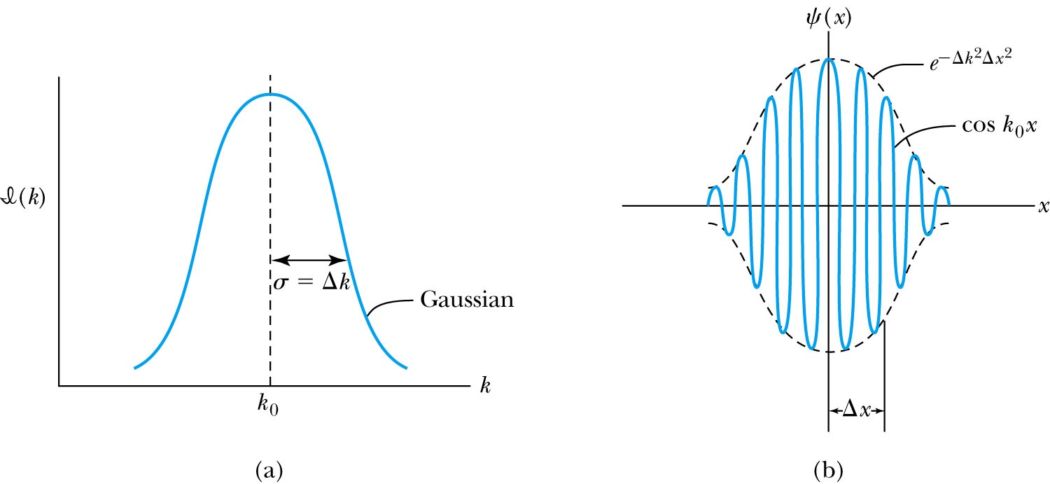
Gaussian Function
A Gaussian wave packet describes the envelope of a pulse wave.
The group velocity is

Slide 9
Dispersion
Considering the group velocity of a de Broglie wave packet yields:
The relationship between the phase velocity and the group velocity is
Hence the group velocity may be greater or less than the phase velocity. A medium is called nondispersive when the phase velocity is the same for all frequencies and equal to the group velocity.

Slide 10
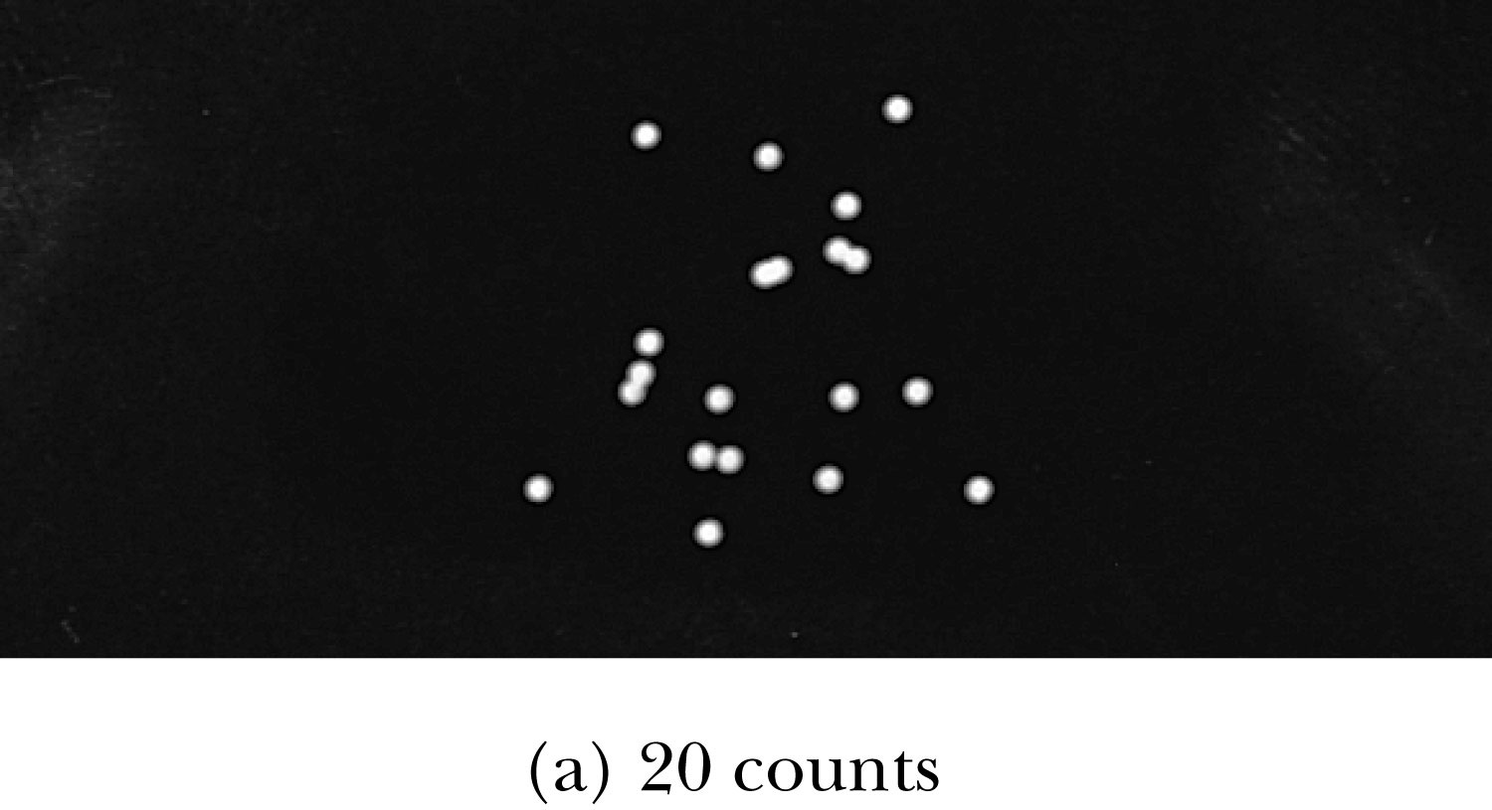
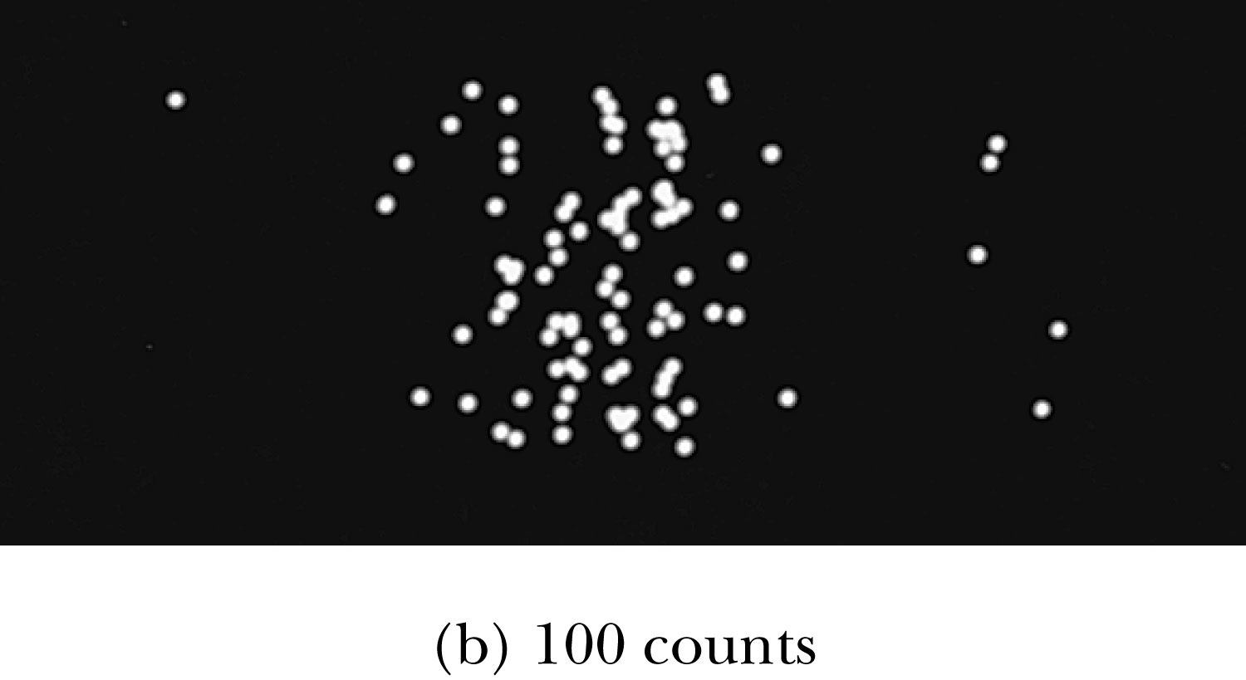
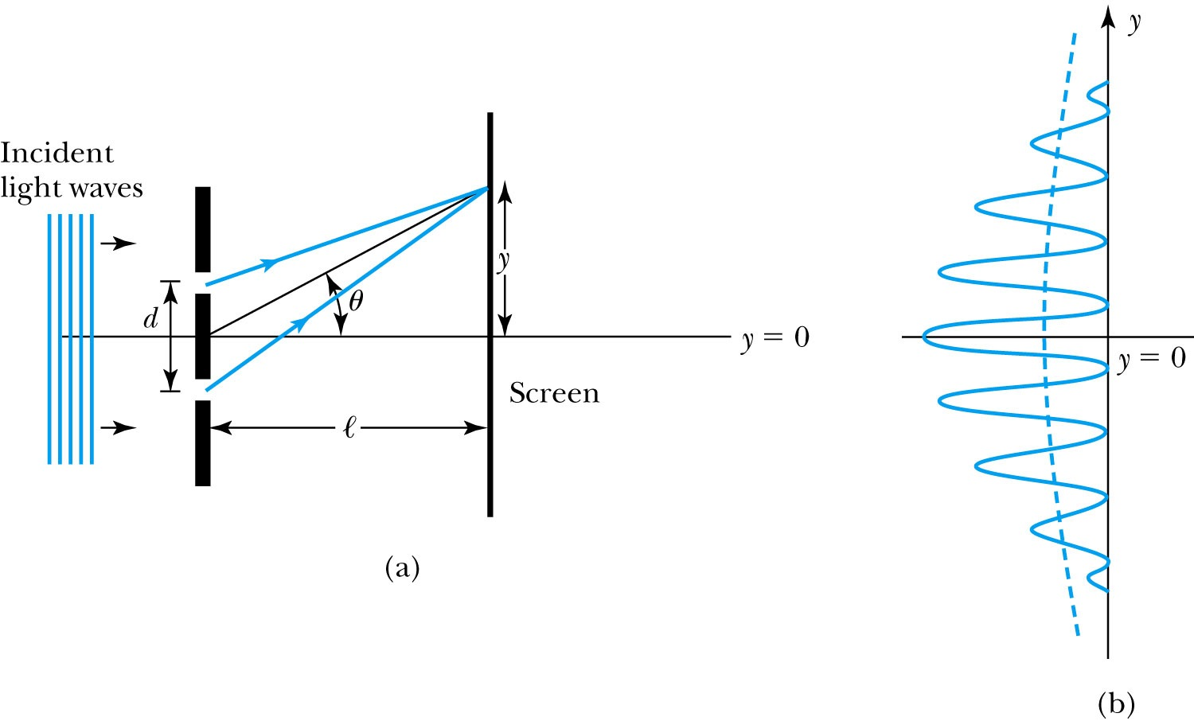
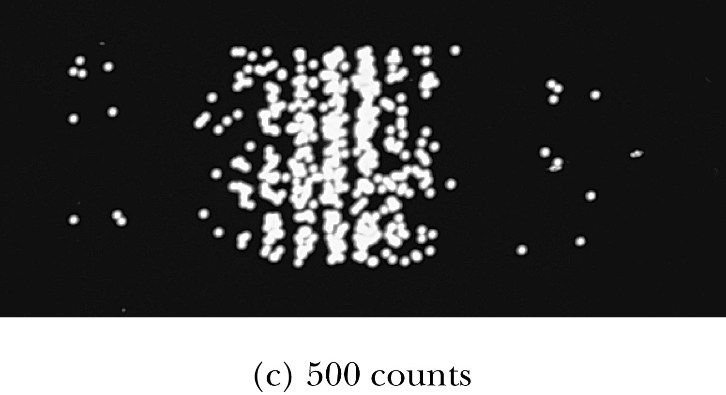
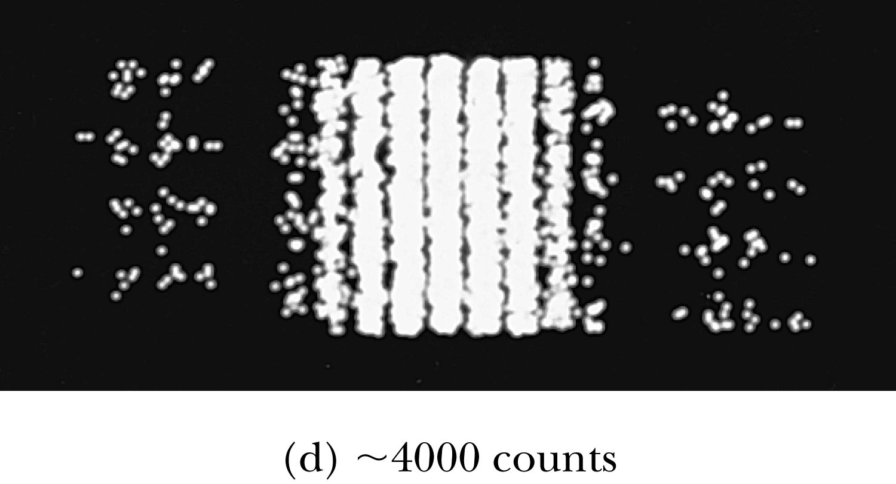
Waves or Particles?
Young’s double-slit diffraction experiment demonstrates the wave property of light.
However, dimming the light results in single flashes on the screen representative of particles.

Slide 11
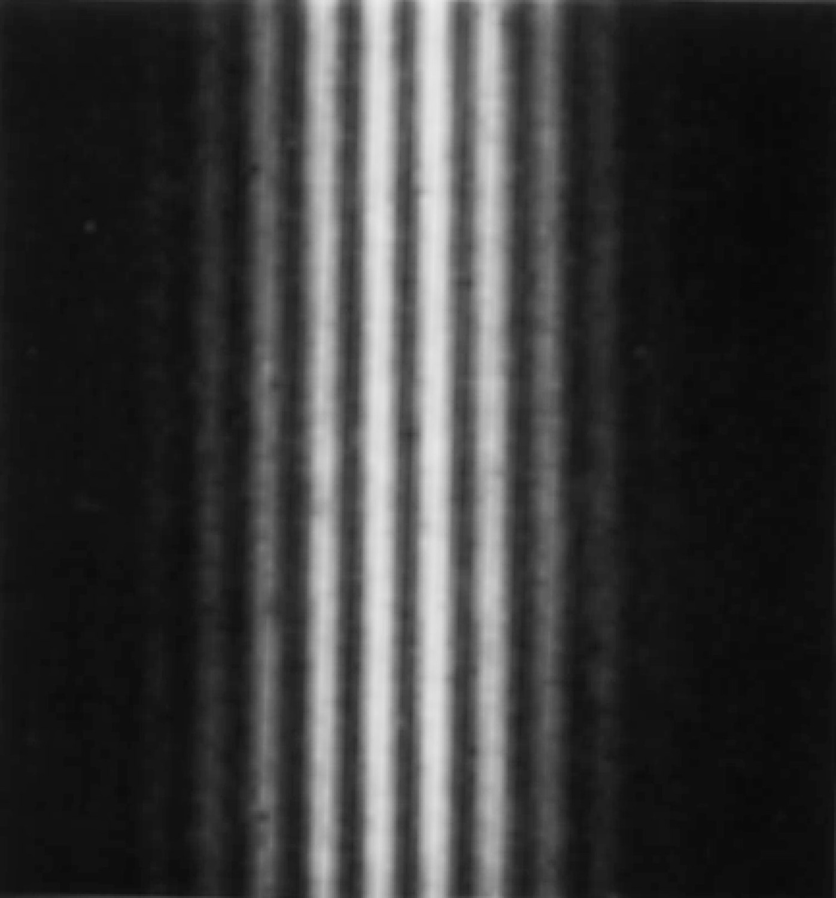
Electron Double-Slit Experiment
C. Jönsson of Tübingen, Germany, succeeded in 1961 in showing double-slit interference effects for electrons by constructing very narrow slits and using relatively large distances between the slits and the observation screen.
This experiment demonstrated that precisely the same behavior occurs for both light (waves) and electrons (particles).

Slide 12
Wave particle duality solution
The solution to the wave particle duality of an event is given by the following principle.
Bohr’s principle of complementarity: It is not possible to describe physical observables simultaneously in terms of both particles and waves.
Physical observables are the quantities such as position, velocity, momentum, and energy that can be experimentally measured. In any given instance we must use either the particle description or the wave description.

Slide 13
Uncertainty Principles
It is impossible to measure simultaneously, with no uncertainty, the precise values of k and x for the same particle. The wave number k may be rewritten as
For the case of a Gaussian wave packet we have
Thus for a single particle, we have Heisenberg’s uncertainty principle:
Momentum-position
Energy- time

Slide 14
Probability, Wave Functions, and the Copenhagen Interpretation
The wave function determines the likelihood (or probability) of finding a particle at a particular position in space at a given time.
The total probability of finding the particle is 1. Forcing this condition on the wave function is called normalization.

Slide 15
The Copenhagen Interpretation
Bohr’s interpretation of the wave function consisted of 3 principles:
The uncertainty principle of Heisenberg
The complementarity principle of Bohr
The statistical interpretation of Born, based on probabilities determined by the wave function
Together these three concepts form a logical interpretation of the physical meaning of quantum theory. According to the Copenhagen interpretation, physics depends on the outcomes of measurement.

Slide 16
Particle in a Box
A particle of mass m is trapped in a one-dimensional box of width l.
The particle is treated as a wave.
The box puts boundary conditions on the wave. The wave function must be zero at the walls of the box and on the outside.
In order for the probability to vanish at the walls, we must have an integral number of half wavelengths in the box.
or
The energy of the particle is .
The possible wavelengths are quantized which yields the energy:
The possible energies of the particle are quantized.

Slide 17
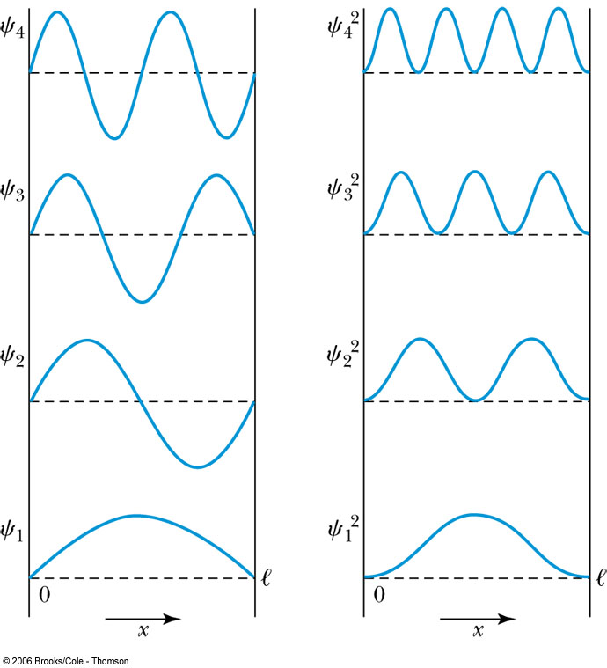
Probability of the Particle
The probability of observing the particle between x and x + dx in each state is
Note that E₀ = 0 is not a possible energy level.
The concept of energy levels, as first discussed in the Bohr model, has surfaced in a natural way by using waves.

Slide 18
The Schrödinger Wave Equation
The Schrödinger wave equation in its time-dependent form for a particle of energy E moving in a potential V in one dimension is
The extension into three dimensions is
where is an imaginary number

Slide 19
General Solution of the Schrödinger Wave Equation
The general form of the solution of the Schrödinger wave equation is given by:
which also describes a wave moving in the x direction. In general the amplitude may also be complex. This is called the wave function of the particle.
The wave function is also not restricted to being real. Notice that the sine term has an imaginary number. Only the physically measurable quantities must be real. These include the probability, momentum and energy.

Slide 20
Normalization and Probability
The probability P(x) dx of a particle being between x and X + dx was given in the equation
Here Ψ* denotes the complex conjugate of Ψ
The probability of the particle being between x₁ and x₂ is given by
The wave function must also be normalized so that the probability of the particle being somewhere on the x axis is 1.

