Slide 1
PHYS 3313 – Section 001 Lecture #17
Monday, April 6, 2015
Dr. Jaehoon Yu
Normalization and Probability
Time Independent Schrodinger Equation

Slide 2
Announcements
Research paper template has been placed onto the class web page link to research
Homework #4
End of chapter problems on CH5: 8, 10, 16, 24, 26, 36 and 47
Due Monday, Apr. 13
Quiz #4 at the beginning of the class Monday, Apr. 13
Covers CH 5.4 through what we finish this Wednesday
Colloquium this Wed.

Slide 3
Reminder: Special Project #4
Prove that the wave function Ψ=A[sin(kx-ωt)+icos(kx-ωt)] is a good solution for the time-dependent Schrödinger wave equation. Do NOT use the exponential expression of the wave function. (10 points)
Determine whether or not the wave function Ψ=Ae^{-α|x|} satisfy the time-dependent Schrödinger wave equation. (10 points)
Due for this special project is Wednesday, Apr. 8.
You MUST have your own answers!

Slide 4
Normalization and Probability
The probability P(x) dx of a particle being between x and X + dx was given by the equation
Here Ψ* denotes the complex conjugate of Ψ
The probability of the particle being between x₁ and x₂ is given by
The wave function must also be normalized so that the probability of the particle being somewhere on the x axis is 1.

Slide 5
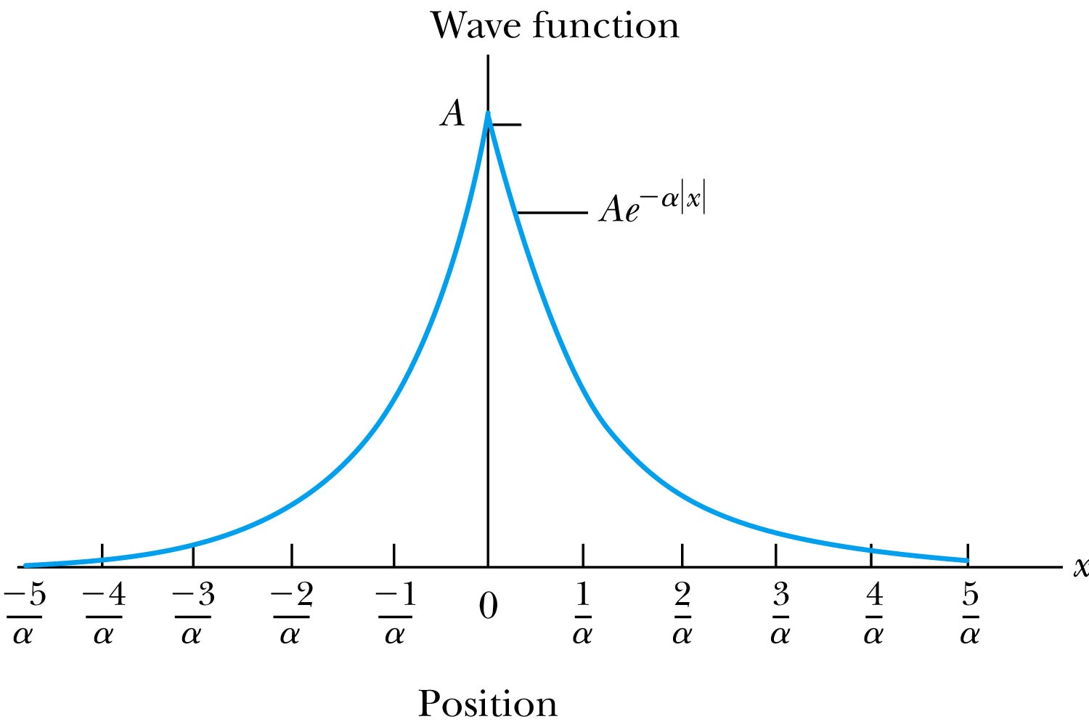
Ex 6.4: Normalization
Consider a wave packet formed by using the wave function that Ae^{-α|ξ|}, where A is a constant to be determined by normalization. Normalize this wave function and find the probabilities of the particle being between 0 and 1/α, and between 1/α and 2/α.
Probability density
Normalized Wave Function

Slide 6
Ex 6.4: Normalization, cont’d
Using the wave function, we can compute the probability for a particle to be with 0 to 1/α and 1/α to 2/α.
For 0 to 1/α:
For 1/α to 2/α:
How about 2/α:to ∞?

Slide 7
Properties of Valid Wave Functions
Boundary conditions
To avoid infinite probabilities, the wave function must be finite everywhere.
To avoid multiple values of the probability, the wave function must be single valued.
For finite potentials, the wave function and its derivatives must be continuous. This is required because the second-order derivative term in the wave equation must be single valued. (There are exceptions to this rule when V is infinite.)
In order to normalize the wave functions, they must approach zero as x approaches infinity.
Solutions that do not satisfy these properties do not generally correspond to physically realizable circumstances.

Slide 8
Time-Independent Schrödinger Wave Equation
The potential in many cases will not depend explicitly on time.
The dependence on time and position can then be separated in the Schrödinger wave equation. Let,
which yields:
Now divide by the wave function:
The left side of this last equation depends only on time, and the right side depends only on spatial coordinates. Hence each side must be equal to a constant. The time dependent side is

Slide 9
Time-Independent Schrödinger Wave Equation(con’t)
We integrate both sides and find:
where C is an integration constant that we may choose to be 0. Therefore
This determines f to be . Comparing this to the time dependent portion of the free particle wave function
This is known as the time-independent Schrödinger wave equation, and it is a fundamental equation in quantum mechanics.

Slide 10
Stationary State
Recalling the separation of variables:
and with the wave function can be written as:
The probability density becomes:
The probability distributions are constant in time. This is a standing wave phenomena that is called the stationary state.

Slide 11
Comparison of Classical and Quantum Mechanics
Newton’s second law and Schrödinger’s wave equation are both differential equations.
Newton’s second law can be derived from the Schrödinger wave equation, so the latter is the more fundamental.
Classical mechanics only appears to be more precise because it deals with macroscopic phenomena. The underlying uncertainties in macroscopic measurements are just too small to be significant.

