Slide 1
PHYS 3313 – Section 001
Lecture #18
Wednesday, April 8, 2015
Dr. Jaehoon Yu
Expectation Values
Momentum Operator
Position and Energy Operators
Infinite Square-well Potential

Slide 2
Announcements
Quiz 3 results
  Class average: 28.5/60
    Equivalent to: 47.5/100
    Previous quizzes: 23.5/100 and 46.5/100
  Top score: 56/60
Reminder: Homework #4
  End of chapter problems on CH5: 8, 10, 16, 24, 26, 36 and 47
  Due Monday, Apr. 13
Quiz #4 at the beginning of the class Monday, Apr. 13
  Covers CH 5.4 through what we finish today
Colloquium 4pm tomorrow, Thursday, SH101
  Professor Francis Halzen of U. of Wisconsin, Madison
    Don’t miss the refreshment at 3:30pm in physics lounge

Slide 3
Special project #5
Show that the Schrodinger equation becomes Newton’s second law in the classical limit. (15 points)
Deadline Wednesday, Apr. 15, 2015
You MUST have your own answers!

Slide 4
Reminder: Research Project Report
Must contain the following at the minimum
  Original theory or Original observation
  Experimental proofs or Theoretical prediction + subsequent experimental proofs
  Importance and the impact of the theory/experiment
  Conclusions
  The reference to the original paper must be included!
  Bibliography referring to web site must be minimized (<20%)
Each member of the group writes a 10 (max) page report, including figures
  10% of the total grade
  Can share the theme and facts but you must write your own!
  Text of the report must be your original!
  Due Mon., May 4, 2015

Slide 5
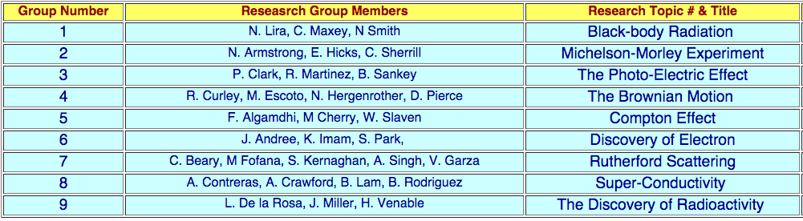
Research Topic and Group Assignments
X
X

Slide 6
Research Presentations
Each of the 9 research groups makes a 10min presentation
  10min presentation + 5min Q&A
  All presentations must be in power point
  I must receive all final presentation files by 8pm, Sunday, May 4, 2015
    No changes are allowed afterward
  The representative of the group makes the presentation followed by all group members’ participation in the Q&A session
Date and time:
  In class Monday, May 4 or Wednesday, May 6
Important metrics
  Contents of the presentation: 60%
    Inclusion of all important points as mentioned in the report
    The quality of the research and making the right points
  Quality of the presentation itself: 15%
  Presentation manner: 10%
  Q&A handling: 10%
  Staying in the allotted presentation time: 5%
  Judging participation and sincerity: 5%

Slide 7
Expectation Values
The expectation value is the expected result of the average of many measurements of a given quantity. The expectation value of x is denoted by <x>.
Any measurable quantity for which we can calculate the expectation value is called the physical observable. The expectation values of physical observables (for example, position, linear momentum, angular momentum, and energy) must be real, because the experimental results of measurements are real.
The average value of x is

Slide 8
Continuous Expectation Values
We can change from discrete to continuous variables by using the probability P(x,t) of observing the particle at the particular x.
Using the wave function, the expectation value is:
The expectation value of any function g(x) for a normalized wave function:

Slide 9
Momentum Operator
To find the expectation value of p, we first need to represent p in terms of x and t. Consider the derivative of the wave function of a free particle with respect to x:
With k = p / ħ we have
This yields
This suggests we define the momentum operator as .
The expectation value of the momentum is

Slide 10
Position and Energy Operators
The position x is its own operator as seen above.
The time derivative of the free-particle wave function is
Substituting ω = E / ħ yields
So the energy operator is
The expectation value of the energy is

Slide 11
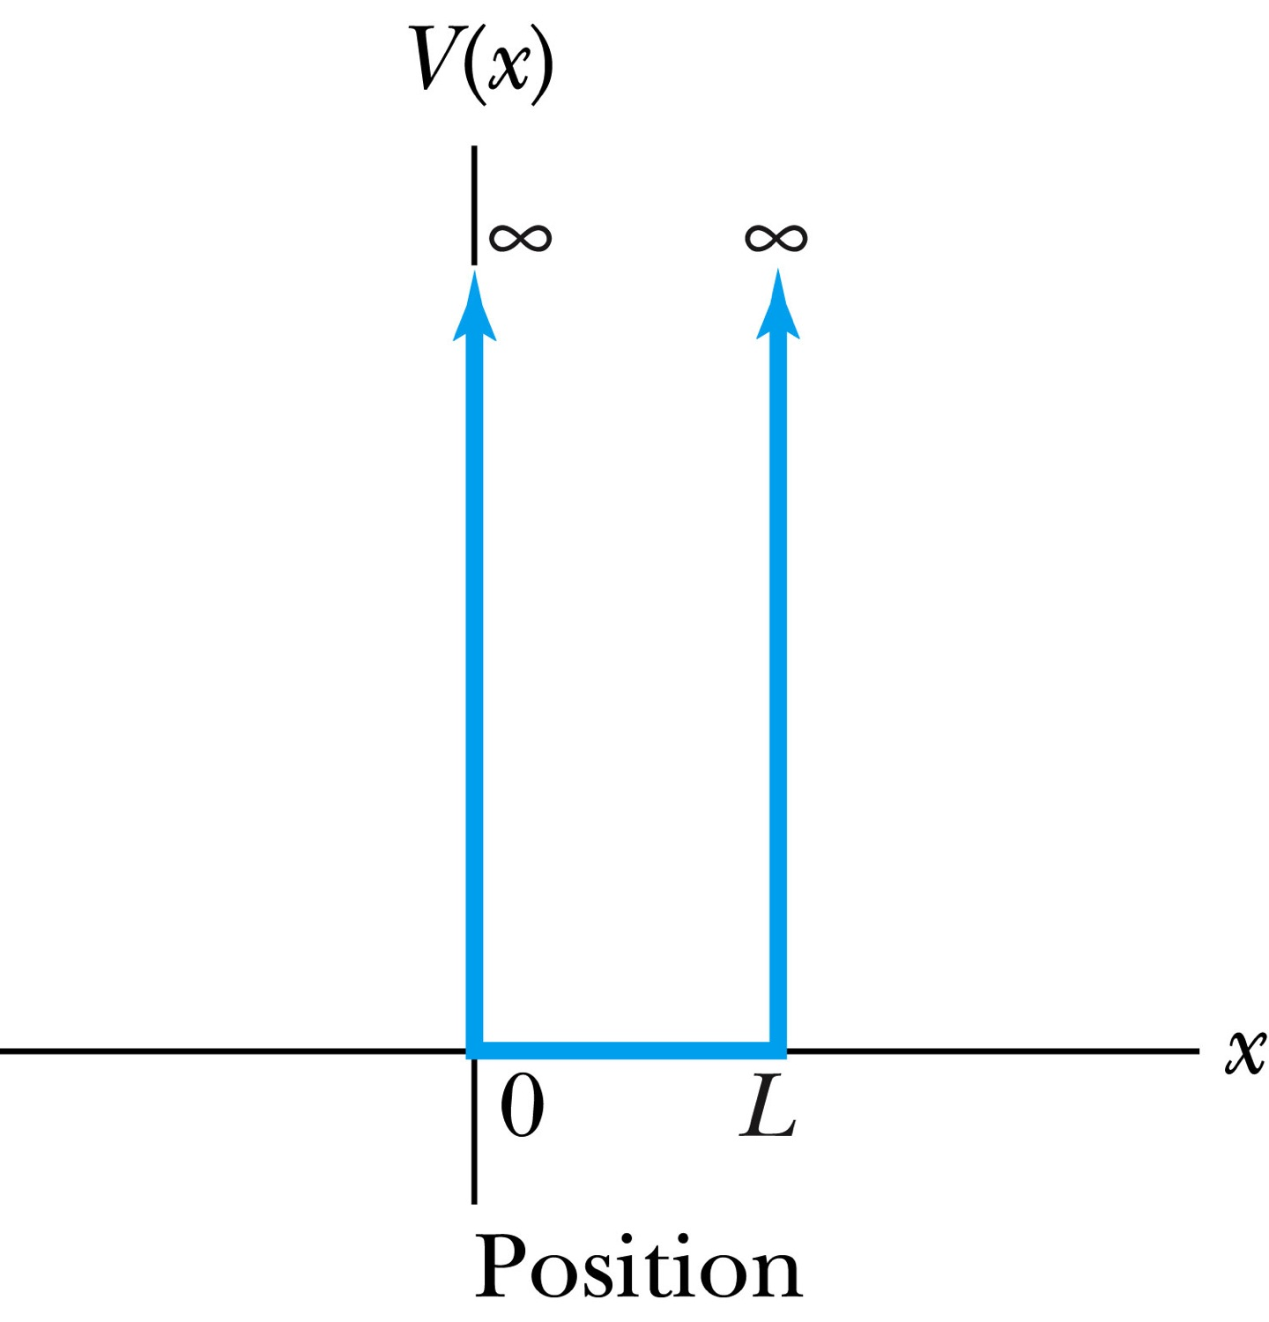
Infinite Square-Well Potential
The simplest such system is that of a particle trapped in a box with infinitely hard walls that the particle cannot penetrate. This potential is called an infinite square well and is given by
The wave function must be zero where the potential is infinite.
Where the potential is zero inside the box, the time independent Schrödinger wave equation becomes where .
The general solution is .

Slide 12
Quantization
Since the wave function must be continuous, the boundary conditions of the potential dictate that the wave function must be zero at x = 0 and x = L. These yield valid solutions for B=0, and for integer values of n such that kL = nπ ➔ k=nπ/L
The wave function is now
We normalize the wave function
The normalized wave function becomes
These functions are identical to those obtained for a vibrating string with fixed ends.

