Slide 1
PHYS 3313 – Section 001 Lecture # 19
Monday, April 13, 2015
Dr. Jaehoon Yu
Refresher: Infinite Square-well Potential
Energy quantization
Expectation value computations
Finite Square Well Potential
Penetration Depth

Slide 2
Announcements
Quiz #4 at the beginning of the class this Wednesday, Apr. 15
The class web site was down so I will give you an extension..
Covers CH 5.4 through what we finish today
BFOF
Colloquium 4pm Wednesday, SH101

Slide 3
Reminder: Special project #5
Show that the Schrodinger equation becomes Newton’s second law in the classical limit. (15 points)
Deadline this Wednesday, Apr. 15, 2015
You MUST have your own answers!

Slide 4
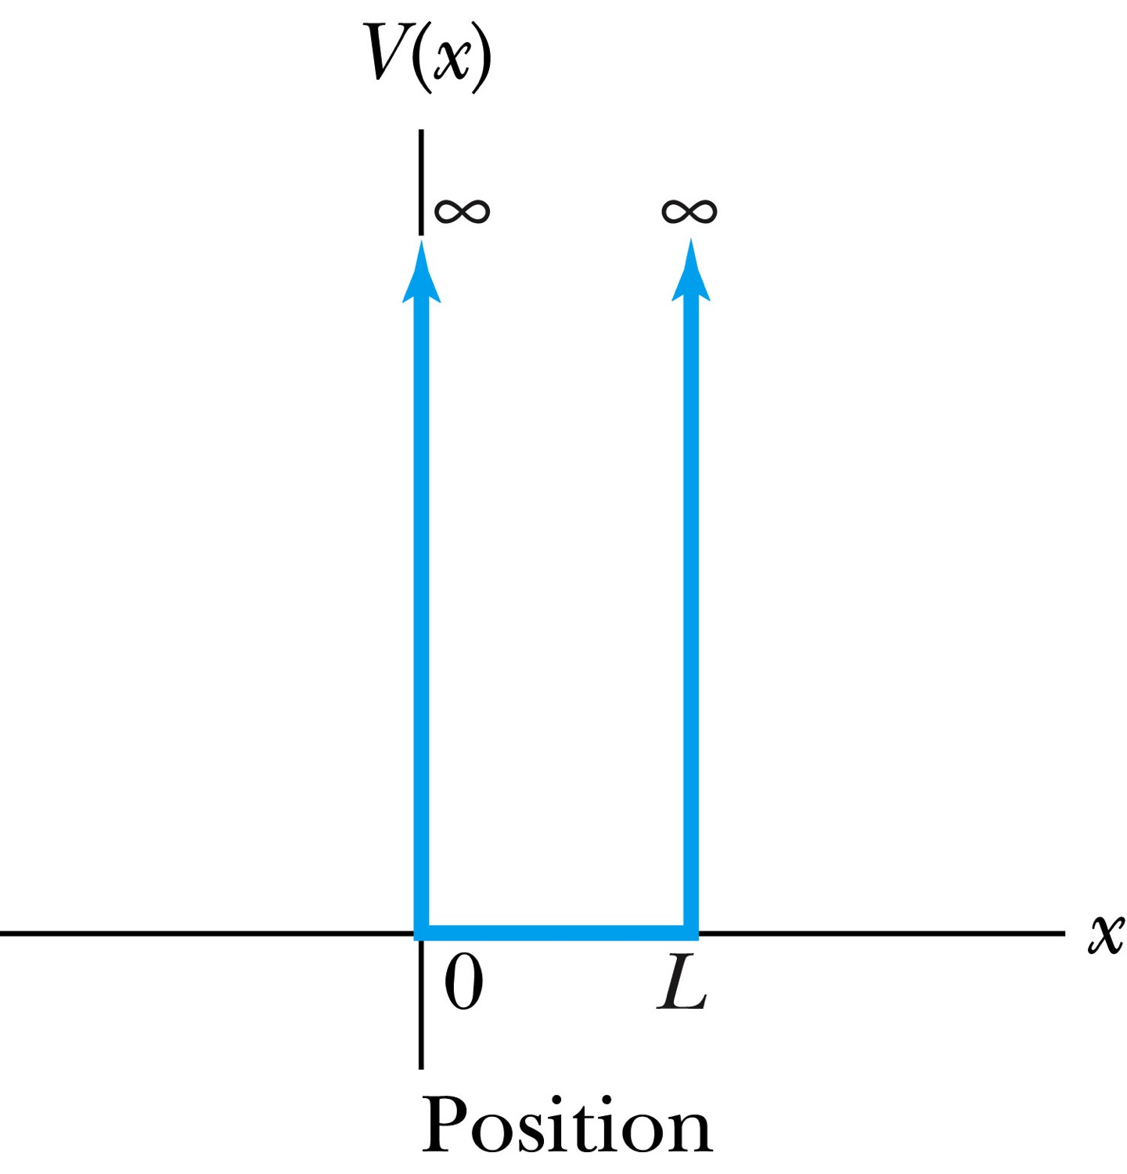
Infinite Square-Well Potential
The simplest such system is that of a particle trapped in a box with infinitely hard walls that the particle cannot penetrate. This potential is called an infinite square well and is given by
The wave function must be zero where the potential is infinite.
Where the potential is zero inside the box, the time independent Schrödinger wave equation becomes where .
The general solution is .

Slide 5
Quantization
Since the wave function must be continuous, the boundary conditions of the potential dictate that the wave function must be zero at x = 0 and x = L. These yield valid solutions for B=0, and for integer values of n such that kL = nπ ➔ k=nπ/L
The wave function is now
We normalize the wave function
The normalized wave function becomes
These functions are identical to those obtained for a vibrating string with fixed ends.

Slide 6
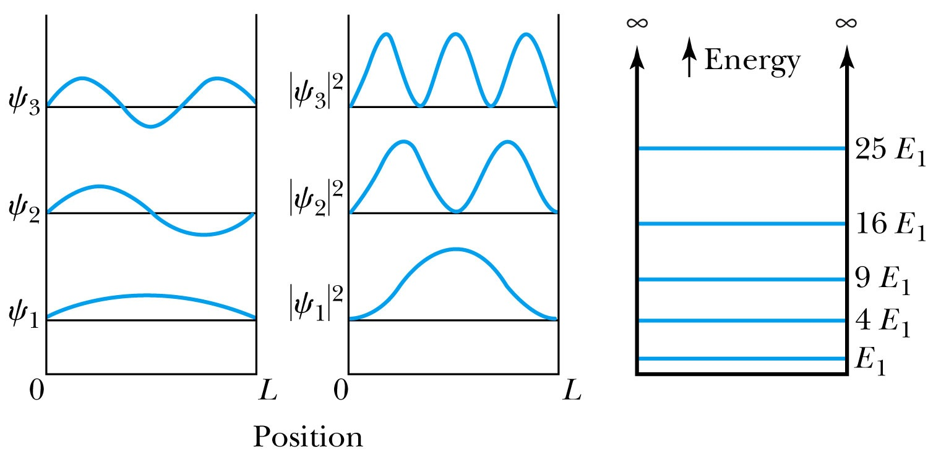
Quantized Energy
The quantized wave number now becomes
Solving for the energy yields
Note that the energy depends on the integer values of n. Hence the energy is quantized and nonzero.
The special case of n = 1 is called the ground state energy.

Slide 7
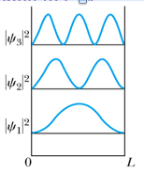
How does this correspond to Classical Mech.?
What is the probability of finding a particle in a box of length L?
Bohr’s correspondence principle says that QM and CM must correspond to each other! When?
When n becomes large, the QM approaches to CM
So when n→∞, the probability of finding a particle in a box of length L is
Which is identical to the CM probability!!
One can also see this from the plot of P!

Slide 8
Expectation Value & Operators
Expectation value for any function g(x)
Position operator is the same as itself, x
Momentum Operator
Energy Operator

Slide 9
Ex 6.8: Expectation values inside a box
Determine the expectation values for x, x², p and p² of a particle in an infinite square well for the first excited state.
What is the wave function of the first excited state?
n=?
2

Slide 10
Ex 6.9: Proton Transition Energy
A typical diameter of a nucleus is about 10⁻¹⁴m. Use the infinite square-well potential to calculate the transition energy from the first excited state to the ground state for a proton confined to the nucleus.
The energy of the state n is
What is n for the ground state?
n=1
What is n for the 1st excited state?
n=2
So the proton transition energy is

