Slide 1
PHYS 3313 – Section 001
Lecture # 20
Wednesday, April 15, 2015
Dr. Jaehoon Yu
Finite Square Well Potential
Penetration Depth
Degeneracy
Simple Harmonic Oscillator
Barriers and Tunneling
Alpha Particle Decay

Slide 2
Announcements
Research paper deadline is Monday, May 4
Research presentation deadline is Sunday, May 3
Homework #5
  CH6 end of chapter problems: 34, 39, 46, 62 and 65
  Due Wednesday, Apr. 22
Reading assignments
  CH7.6 and the entire CH8
Bring out the special project #5
No Colloquium today

Slide 3
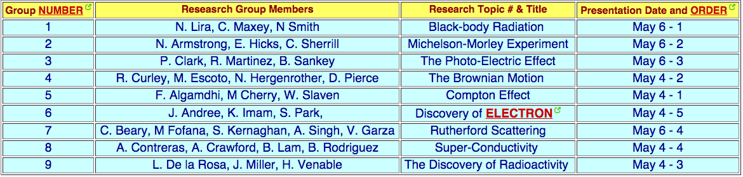

Slide 4
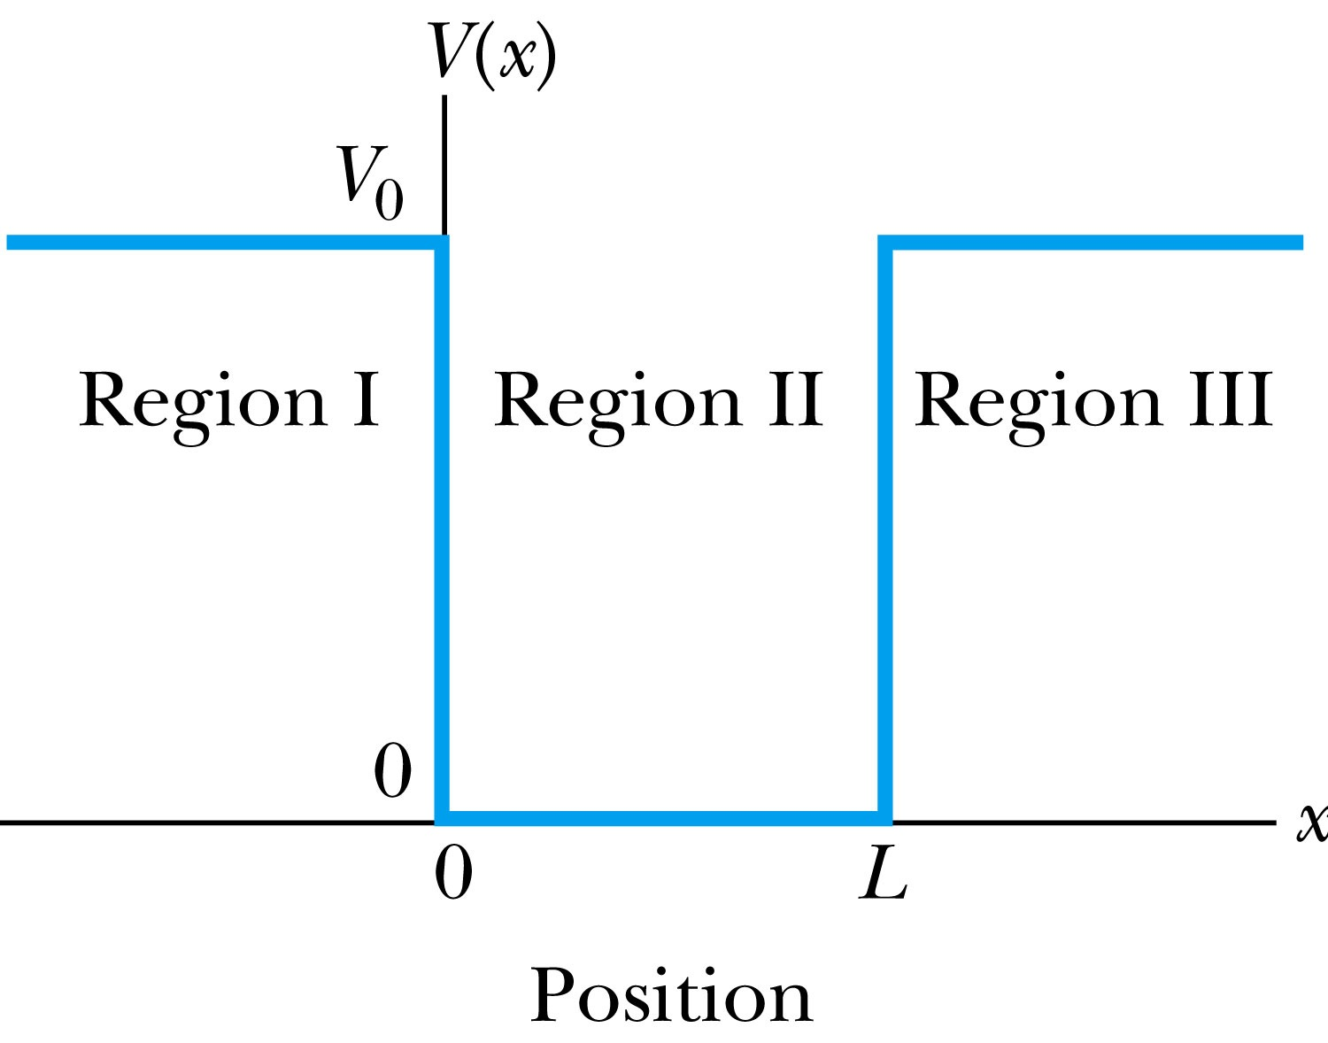
Finite Square-Well Potential
The finite square-well potential is
The Schrödinger equation outside the finite well in regions I and III is
for regions I and III, or using
yields . The solution to this differential has exponentials of the form e^{αx} and e^{-αx}. In the region x > L, we reject the positive exponential and in the region x < 0, we reject the negative exponential. Why?
This is because the wave function should be 0 as x→±infinity.

Slide 5
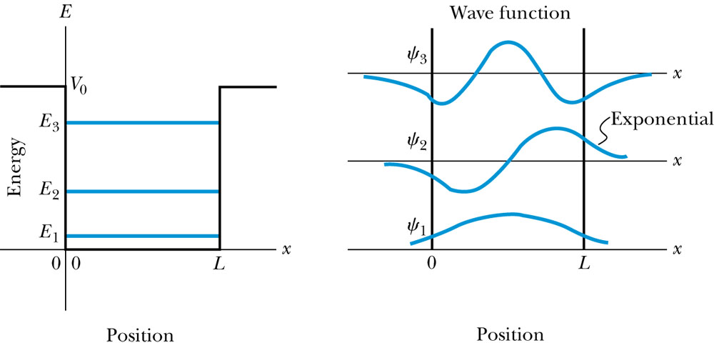
Finite Square-Well Solution
Inside the square well, where the potential V is zero and the particle is free, the wave equation becomes where
Instead of a sinusoidal solution we can write
The boundary conditions require that
and the wave function must be smooth where the regions meet.
Note that the
wave function is
nonzero outside
of the box.
Non-zero at the
boundary either..
What would the
energy look like?

Slide 6
Penetration Depth
The penetration depth is the distance outside the potential well where the probability significantly decreases. It is given by
It should not be surprising to find that the penetration distance that violates classical physics is proportional to Planck’s constant.

Slide 7
Three-Dimensional Infinite-Potential Well
The wave function must be a function of all three spatial coordinates.
We begin with the conservation of energy
Multiply this by the wave function to get
Now consider momentum as an operator acting on the wave function. In this case, the operator must act twice on each dimension. Given:
The three dimensional Schrödinger wave equation is
Rewrite

Slide 8
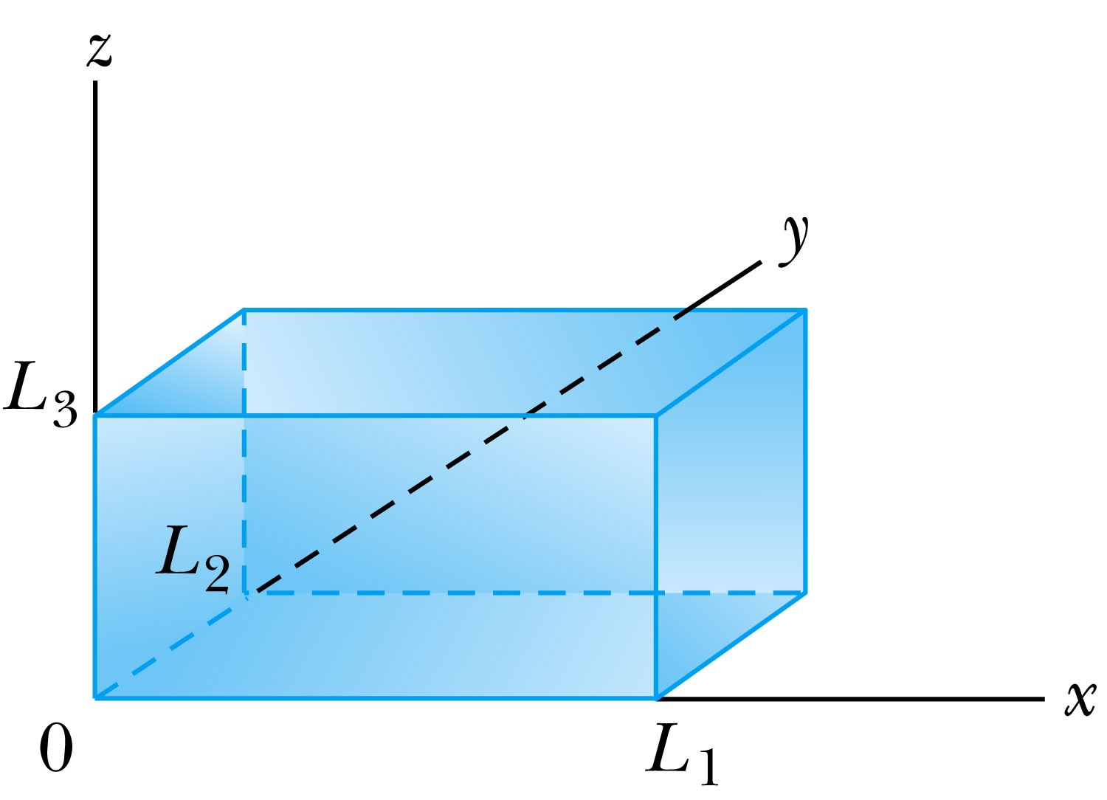
Ex 6.10: Expectation values inside a box
Consider a free particle inside a box with lengths L₁, L₂ and L₃ along the x, y, and z axes, respectively, as shown in the figure. The particle is constrained to be inside the box. Find the wave functions and energies. Then find the ground energy and wave function and the energy of the first excited state for a cube of sides L.
What are the boundary conditions for this situation?
Particle is free, so x, y and z wave functions are independent from each other!
Each wave function must be 0 at the wall!
Inside the box, potential V is 0.
A reasonable solution is
Using the boundary condition
So the wave numbers are

Slide 9
Ex 6.10: Expectation values inside a box
Consider a free particle inside a box with lengths L₁, L₂ and L₃ along the x, y, and z axes, respectively, as shown in figure. The particle is constrained to be inside the box. Find the wave functions and energies. Then find the round energy and wave function and the energy of the first excited state for a cube of sides L.
The energy can be obtained through the Schrödinger equation
What is the ground state energy?
E_{1,1,1} when n₁=n₂=n₃=1, how much?
When are the energies the same for different combinations of n_{i}?

Slide 10
Degeneracy*
Analysis of the Schrödinger wave equation in three dimensions introduces three quantum numbers that quantize the energy.
A quantum state is degenerate when there is more than one wave function for a given energy.
Degeneracy results from particular properties of the potential energy function that describes the system. A perturbation of the potential energy, such as the spin under a B field, can remove the degeneracy.
*Mirriam-webster: having two or more states or subdivisions

