Slide 1
PHYS 3313 – Section 001
Lecture # 21
From the Discovery of the Higgs to Search for Dark Matter
Monday, April 20, 2015
Dr. Jaehoon Yu
  Outline
Introduction
What is the Higgs Particle?
Did we discover the Higgs? What’s next?
Search for the Dark Matter at an Accelerator!
Conclusions

Slide 2
Announcements
Research paper deadline is Monday, May 4
Research presentation deadline is Sunday, May 3
Reminder: Homework #5
  CH6 end of chapter problems: 34, 39, 46, 62 and 65
  Due Wednesday, Apr. 22
Homework #6
  CH7 end of chapter problems: 7, 8, 9, 12, 17 and 29
  Due on Wednesday, Apr. 29, in class
Reading assignments
  CH7.6 and the entire CH8
Quiz number 5
  At the beginning of the class Wednesday, Apr. 29
  Covers up to what we finish Monday, Apr. 27
Quiz 4 results
  Class average: 25.6/50
    Equivalent to: 51.2/100
    Previous records: 26.5, 46.5 and 47.5
  Top score: 50/50

Slide 3


We always wonder…
What makes up the universe?
How does the universe work?
What holds the universe together?
How can we live in the universe well?
Where do we all come from?

Slide 4
High Energy Physics
Definition: A field of physics that pursues understanding the fundamental constituents of matter and basic principles of interactions between them.
Known interactions (forces):
  Gravitational Force
  Electromagnetic Force
  Weak Nuclear Force
  Strong Nuclear Force
Current theory: The Standard Model of Particle Physics (SU3xSU2XU1)

Slide 5
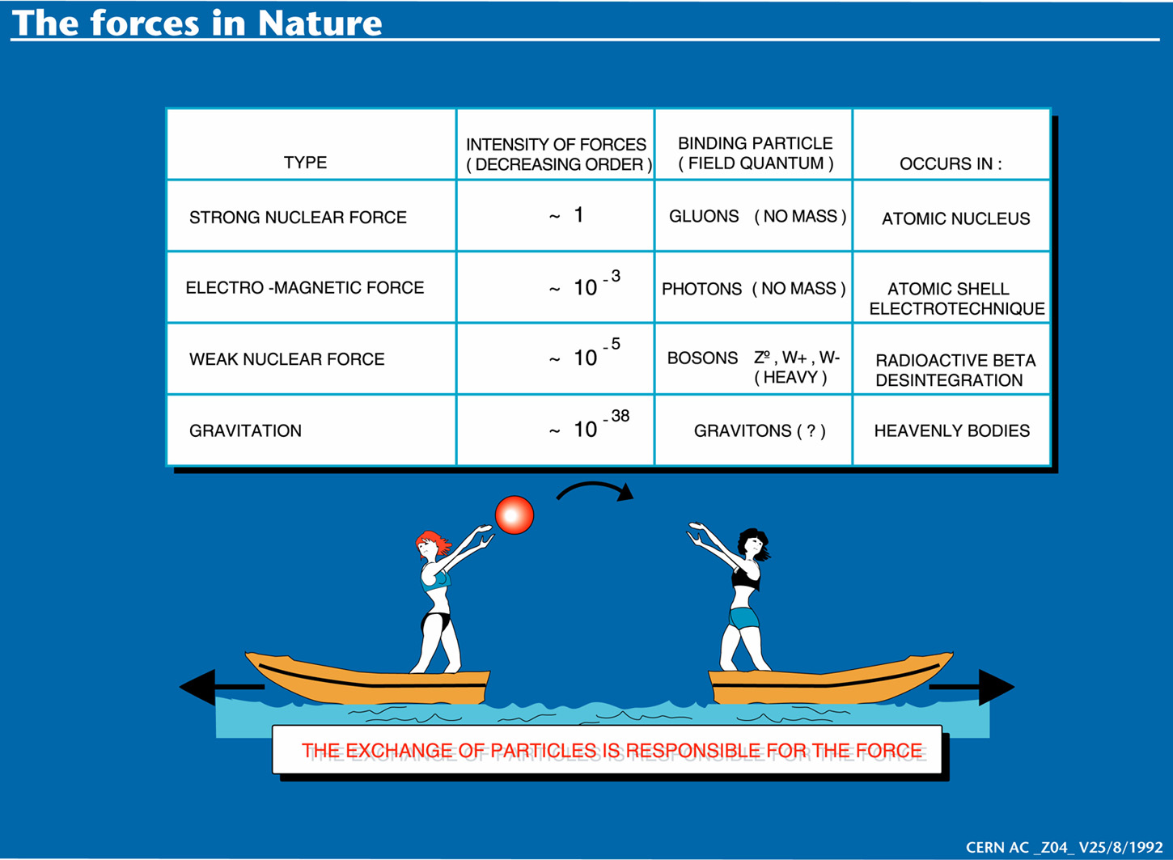

Slide 6
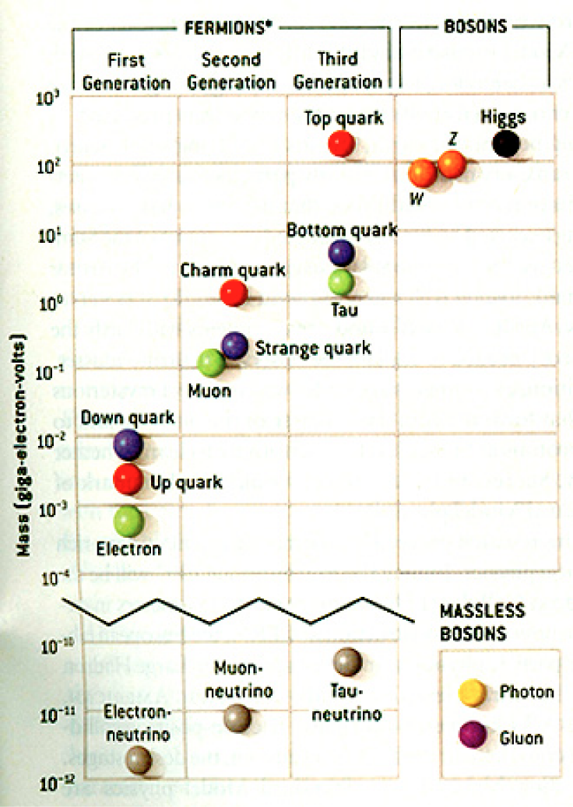
HEP and the Standard Model
Discovered in 1995, ~175m_{p}
Make up most ordinary matters ~0.1m_{p}
Total of 16 particles (12+4 force mediators) make up all the visible matter in the universe! ➔ Simple and elegant!!!
Tested to a precision of 1 part per million!

Slide 7
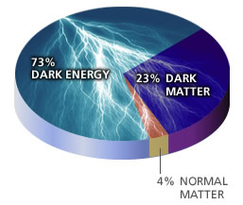
So what’s the problem?
Why is the mass range so large (0.1m_{p} – 175 m_{p})?
How do matters acquire mass?
  Higgs mechanism but where is the Higgs?
Why is the matter in the universe made only of particles?
Neutrinos have mass!! What are the mixing parameters, particle-anti particle asymmetry and mass ordering?
Why are there only three apparent forces?
Is the picture we present the real thing?
  What makes up the ~95% of the universe?
Are there any other theories that describe the universe better?
  Does the super-symmetry exist?
Where do we all come from?
How can we live well in the universe as an integral partner?
  - Higgs mechanism, did we find the Higgs?
Notes:
----- Meeting Notes (2/12/14 10:16) -----

Slide 8
Accelerators are Powerful Microscopes.
They make high energy particle beams
that allow us to see small things.
seen by
low energy beam
(poorer resolution)
seen by
high energy beam
(better resolution)

Slide 9
Accelerators are also Time Machines.
They make particles last seen
in the earliest moments of the universe.
Energy
particle beam
energy
anti-particle beam
energy
Particle and anti-particle annihilate.
E = mc²

Slide 10
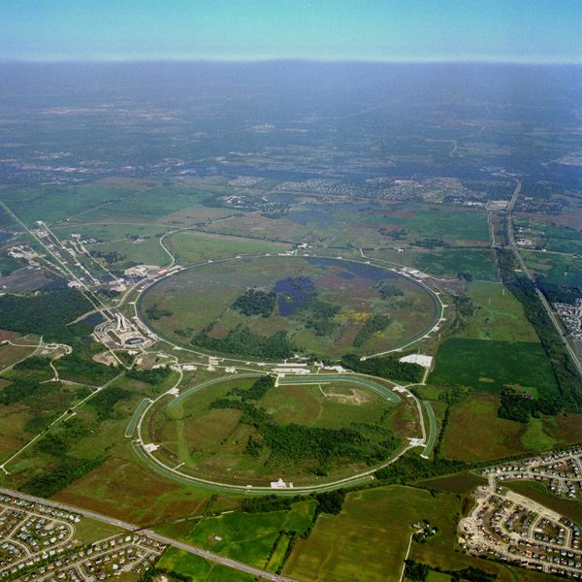
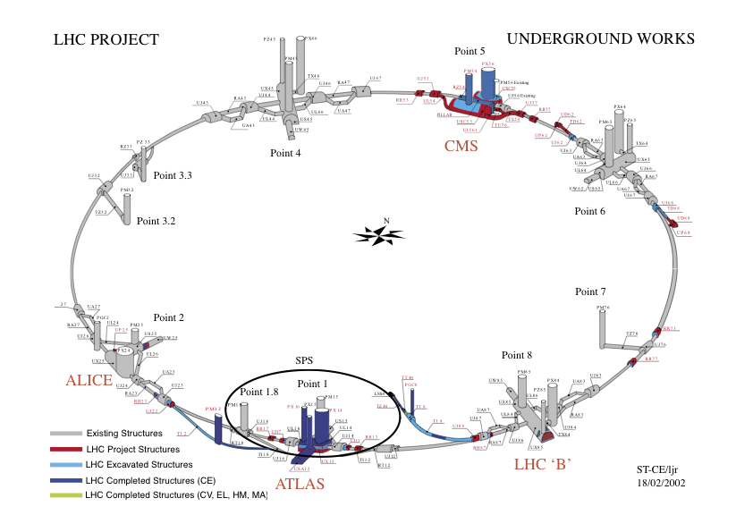
Fermilab Tevatron and LHC at CERN
World’s Highest Energy proton-anti-proton collider
  4km (2.5mi) circumference
  E_{cm}=1.96 TeV (=6.3x10⁻⁷J/p➔ 13M Joules on the area smaller than 10⁻⁴m²)
  Equivalent to the kinetic energy of a 20t truck at the speed 81mi/hr
    ~100,000 times the energy density at the ground 0 of the Hiroshima atom bomb
  Tevatron was shut down in 2011
  Vibrant other programs running, including the search for dark matter with beams!!
World’s Highest Energy p-p collider
  27km (17mi) circumference, 100m (300ft) underground
  Design E_{cm}=14 TeV (=44x10⁻⁷J/p➔ 362M Joules on the area smaller than 10⁻⁴m²)
  Equivalent to the kinetic energy of a B727 (80tons) at the speed 193mi/hr
    ~3M times the energy density at the ground 0 of the Hiroshima atom bomb
Large amount of data accumulated in 2010 – 2013
Bream circulating at 7.5TeV each at present
Chicago
CDF
p
DØ
Tevatron
p

Slide 11
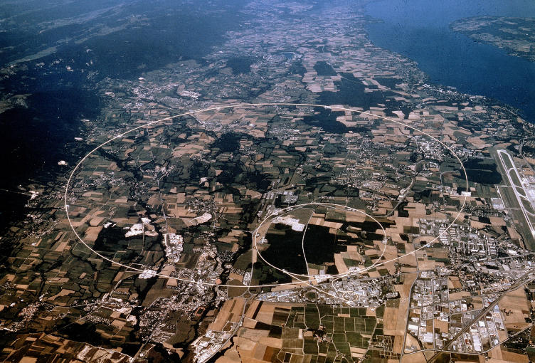
LHC @ CERN Aerial View
CMS
France
Geneva Airport
ATLAS
Swizerland

Slide 12
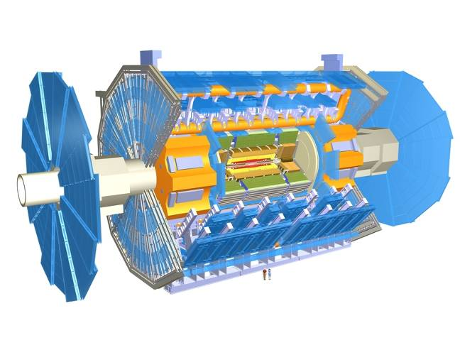
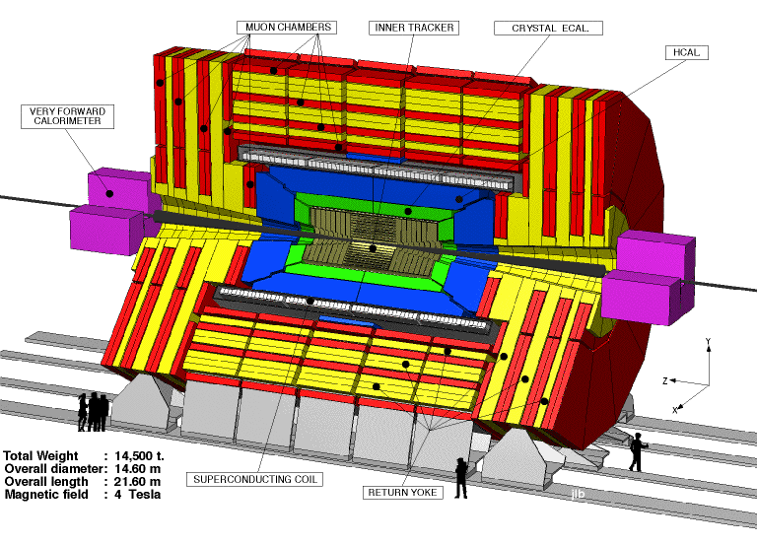

The ATLAS and CMS Detectors
Weighs 7000 tons and ~10 story tall
Records 200 – 400 collisions/second (out of 50million)
Records approximately 350 MB/second
Records ~2 PB per year ➔ 200*Printed material of the US Lib. of Congress
200x

Slide 13
What is the Higgs and What does it do?
When there is perfect symmetry, one cannot tell directions!

Slide 14

What? What’s the symmetry?
Where is the head of the table?
Without a broken symmetry, one cannot tell directional information!!

Slide 15

A broken symmetry

Slide 16
What is the Higgs and What does it do?
When there is perfect symmetry, one cannot tell directions!
Only when symmetry is broken, can one tell directions
Higgs field works to break the perfect symmetry and gives mass to all fundamental particles
Sometimes, this field spontaneously generates a particle, the Higgs particle
So the Higgs particle is the evidence of the existence of the Higgs field!

Slide 17



So how does Higgs Field work again?
Person in space ➔ no symmetry breaking
Person in air ➔ symmetry can be broken
Sometimes, you get
Just like a tornado is a piece of evidence of the existence of air, Higgs particle is a piece of evidence of Higgs mechanism

Slide 18
Higgs Production X-sec and BR
Higgs mass is not given in the theory!!

Slide 19
How do we look for the Higgs?
Higgs particle is so heavy they decay into other lighter particles instantaneously
When one searches for new particles, one looks for the easiest way to get at them
Of many signatures of the Higgs, some are much easier to find, if it were the Standard Model Higgs
  H→ γγ
  H → ZZ* → 4e, 4μ, 2e2μ, 2e2ν and 2μ2ν
  H→ WW*→2e2ν and 2μ2ν
  And many more complicated signatures

Slide 20
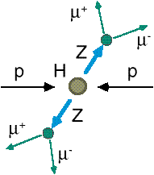
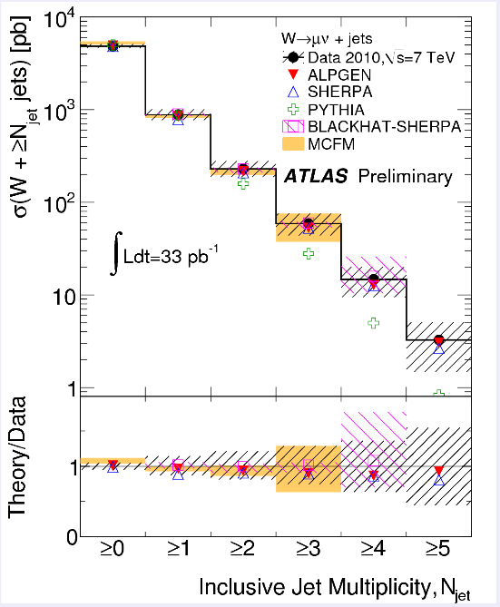
How do we look for the Higgs?
Identify Higgs candidate events
Understand fakes (backgrounds)
Look for a bump!!
  Large amount of data absolutely critical
e⁺ (μ⁺)
e⁻ (μ⁻)
e⁺
e⁻

Slide 21
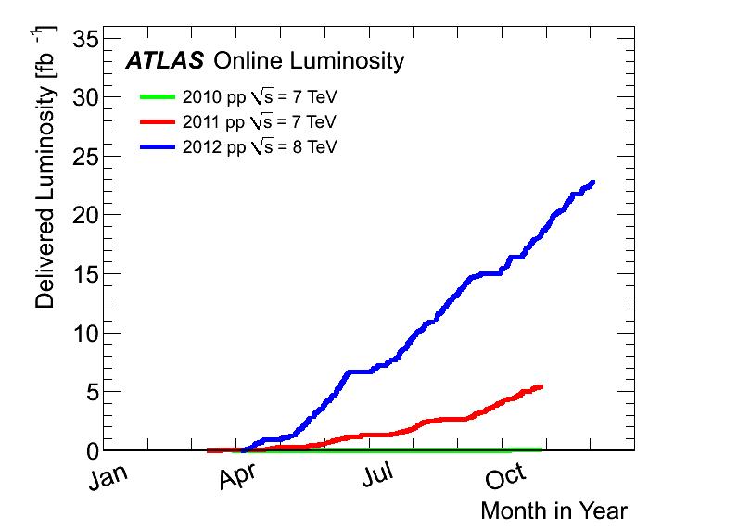
Amount of LHC Data
2012:21.2fb⁻¹
Total at 7 and 8 TeV ~1fb⁻¹/week
Max inst. luminosity:
~ 7.7 x10³³ cm⁻² s⁻¹
Superb performance!!
The discovery announcement
2011
5.6 fb⁻¹
at 7 TeV
2010
0.05 fb⁻¹
at 7 TeV

Slide 22
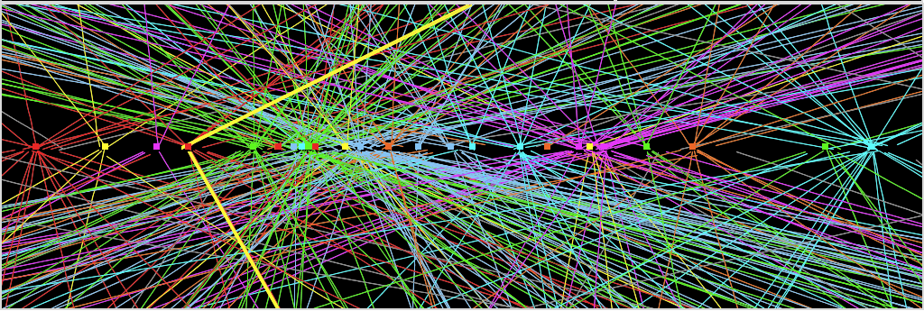
Challenges? No problem!
An interesting collision event with 25 collisions at once!!
Here it is!!

Slide 23
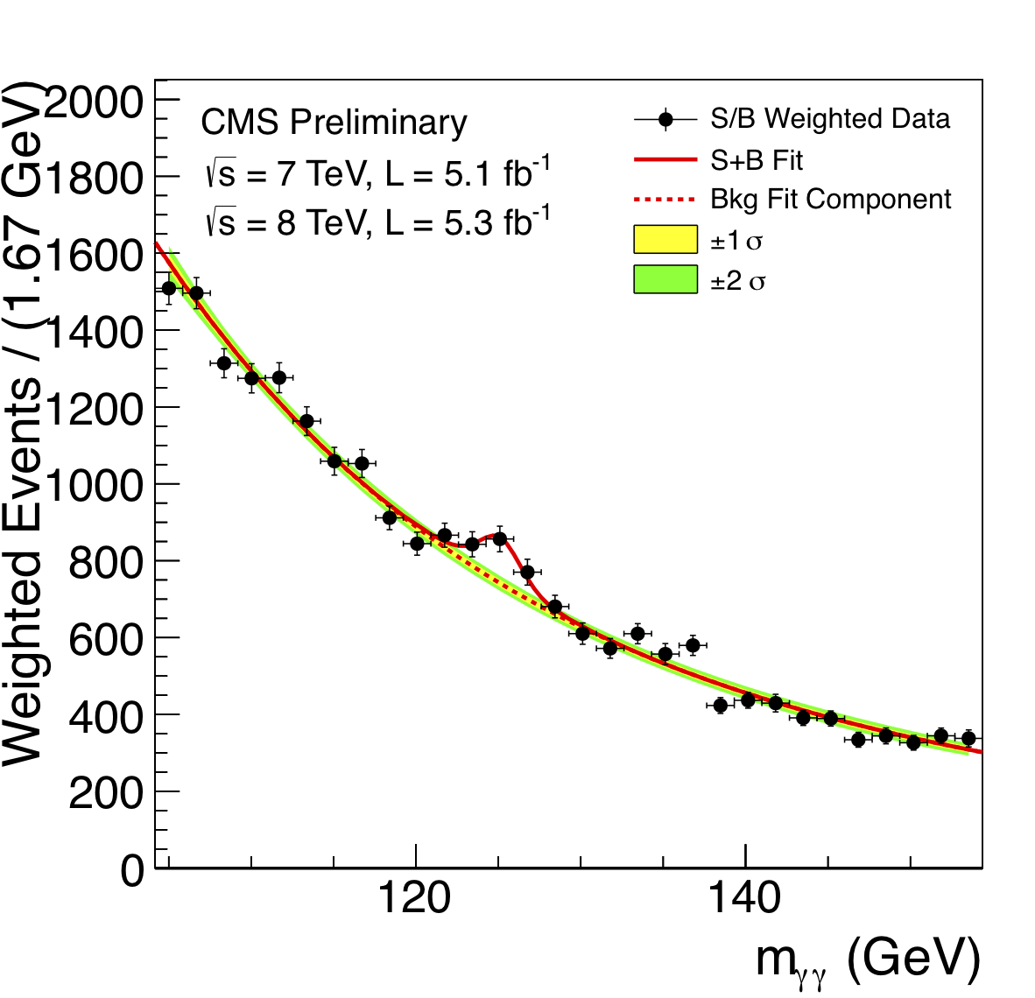
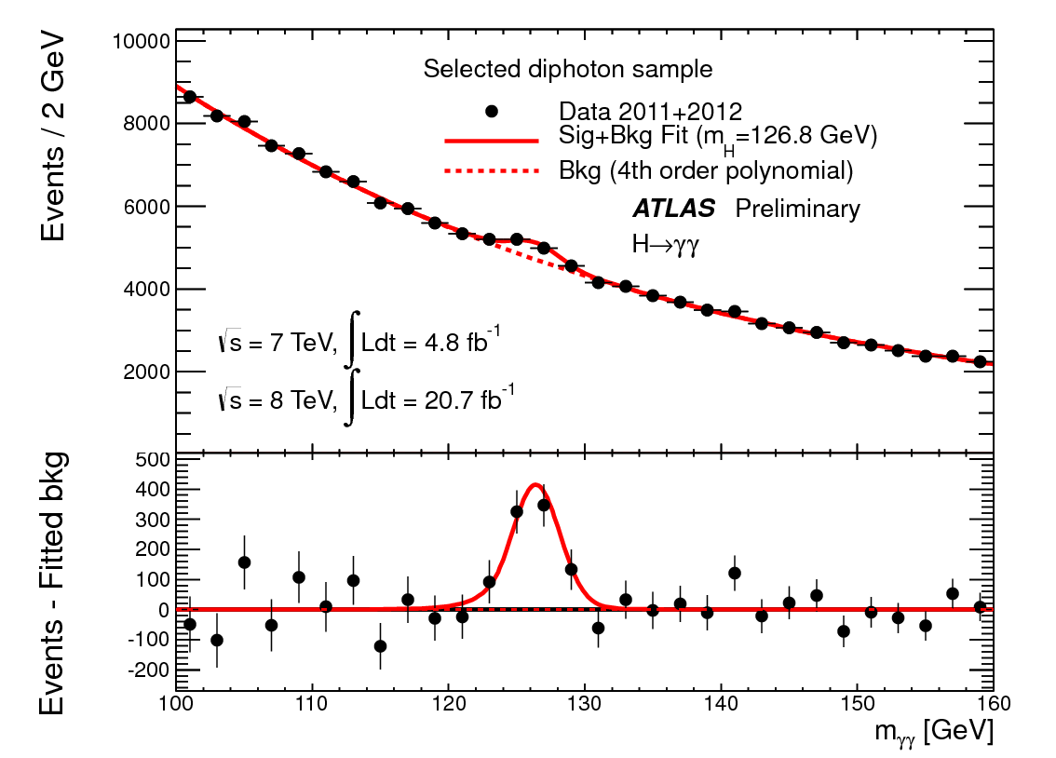
ATLAS and CMS Mass Bump Plots (H→γγ )
ATLAS
CMS
LOOK, Ma! Bumps!!

Slide 24
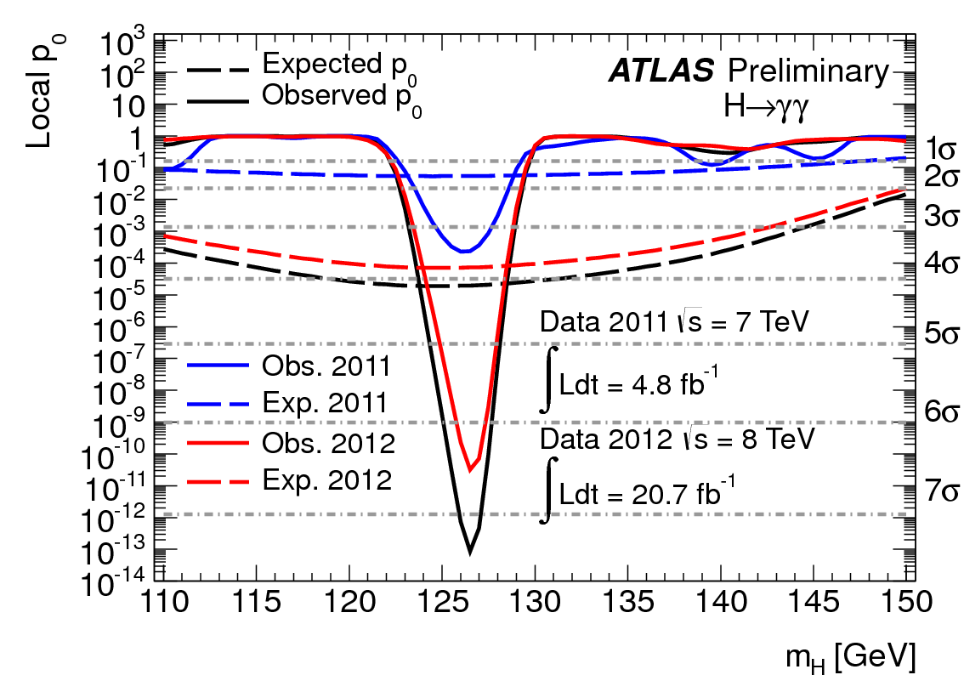
H→γγ Significance
Excess of 7.4 σ at M_{H}=126.5GeV

Slide 25
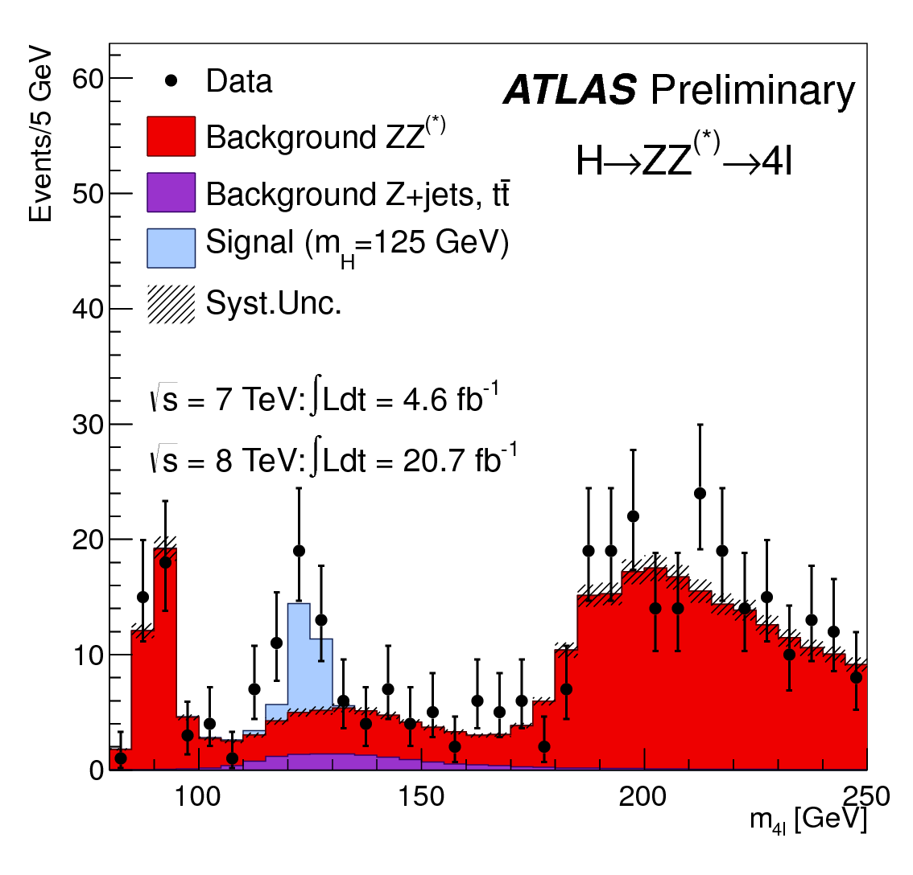
ATLAS Mass Bump Plot (H→4λ )?
LOOK, Pa! A Bump!!

Slide 26
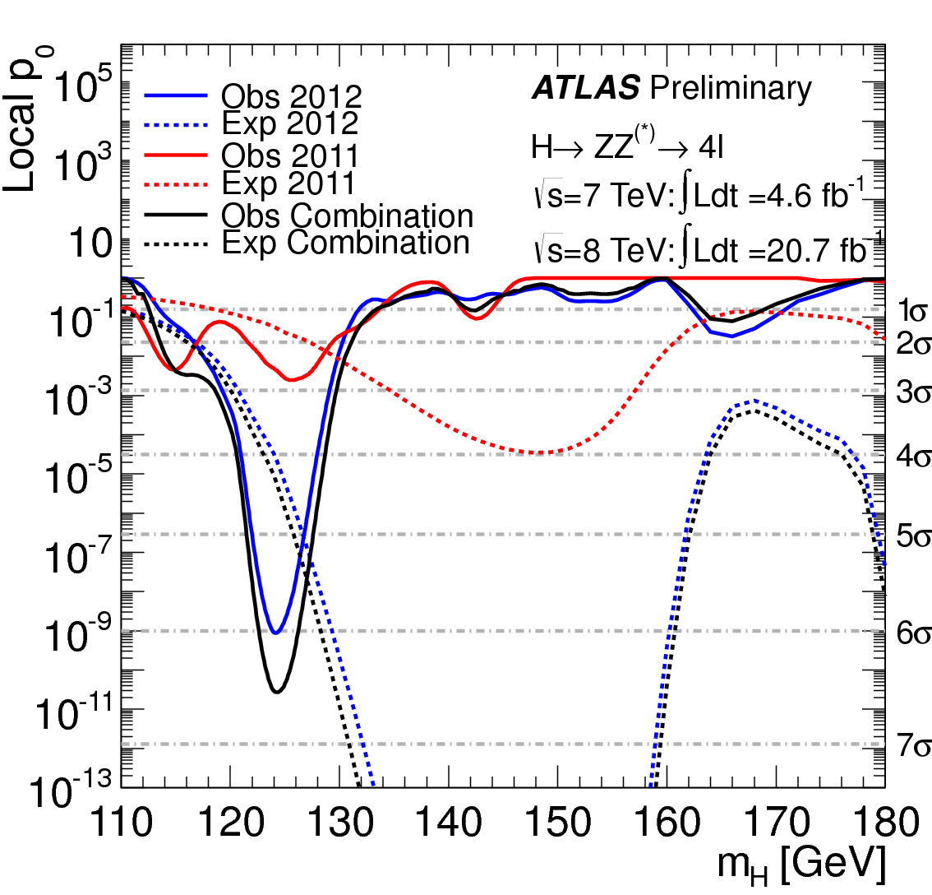
H→ZZ→4l Channel Significance
6.5σ Εξχεσσ!!

Slide 27

What did statistics do for Higgs?

Slide 28

How about this?

Slide 29
So have we seen the Higgs particle?
The statistical significance of the finding is over 7 standard deviations

Slide 30
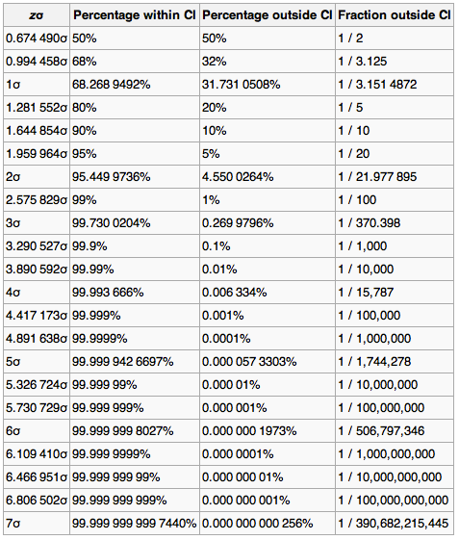
Statistical Significance Table

Slide 31
So have we seen the Higgs particle?
The statistical significance of the finding is much bigger than seven standard deviations
  Level of significance: much better than 99.999 999 999 7% (eleven 9s!!)
  We could be wrong once if we do the same experiment 391,000,000,000 times (will take ~13,000 years even if each experiment takes 1s!!)
So did we find the Higgs particle?
  We have discovered the heaviest new boson we’ve seen thus far
  It has many properties consistent with the Standard Model Higgs particle
    It quacks like a duck and walks like a duck but…
  We do not have enough data to precisely measure all the properties – mass, lifetime, the rate at which this particle decays to certain other particles, etc – to definitively determine its nature
Precision measurements and searches in new channels ongoing

Slide 32
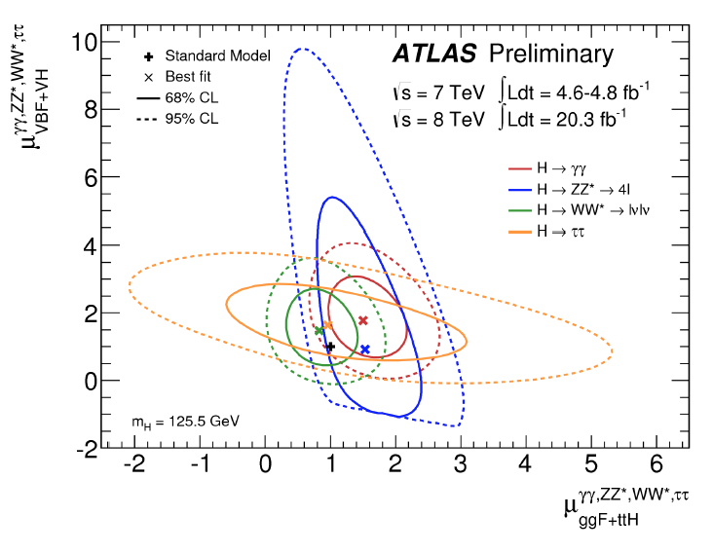
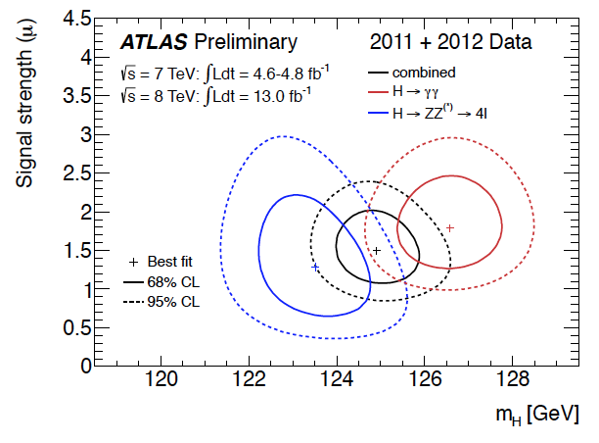
Precision Measurements of Higgs
Higgs coupling to various final states show close to SM predictions
ATLAS H→γγ and H→ZZ→4l mass difference still persists at 2.3σ.

Slide 33
Long Term LHC Plans
2015 – 2017: √s= 13TeV→ 14TeV, L~10³⁴, 2 times the energy and 4 times the data we have now
2018: Shut-down (LS2) for detector upgrades
2019 – 2021: √s~=13 – 14TeV, L~2x10³⁴, 3 times the data in 2015 – 2017
2022 – 2023: Shut-down (LS3)
2023 – 2030(?): √s=13 – 14TeV, L~5x10³⁴ (HL-LHC), 10 times the data in 2019 – 2021

Slide 34
What does this discovery mean?
This is the giant first in completing the Standard Model
Will help understand the origin of mass and the mechanism at which mass is acquired
Will help understand the origin and the structure of the universe and the inter-relations of the forces
Will help us make our lives better
Generate excitements and interests on science and train the next generation
  UTA Had a Nobel laureate visit for a public lecture in 2012
    1200 people attended the lecture!!

Slide 35
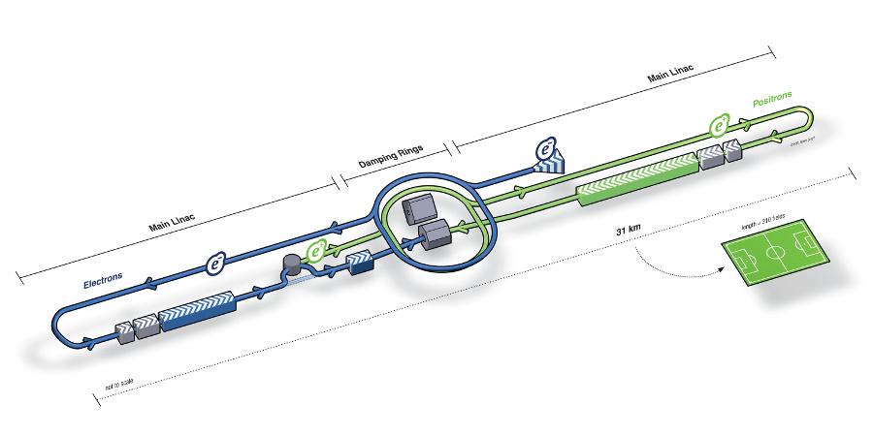
What’s next? Future Linear Collider
Now that we have found a new boson, precision measurement of the particle’s properties becomes important
An electron-positron collider on a straight line for precision measurements
10~15 years from now (In Dec. 2011, Japanese PM announced that they would bid for a LC in Japan and reaffirmed by the new PM in 2013)
  Our Japanese colleagues have declared that they will bid for building ILC
  Japan announced the selection of the site for the ILC in Aug. 2013!!
Takes 10 years to build a detector
Circumference ~6.6km
~300 soccer fields
L~31km (~20 mi)

Slide 36
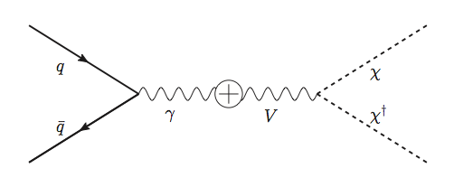
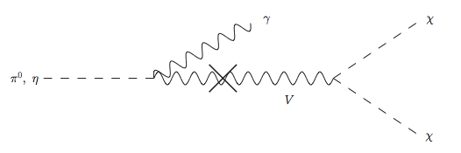
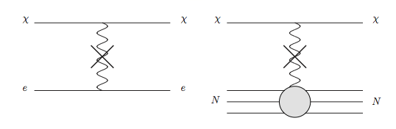
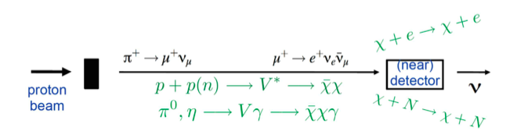
Light DM Production at High Intensity Accelerator
Now the Higgs particle, a part of only 5% of the universe, may’ve been seen
It is time for us to look into the 95% of the universe!!
Detection of DM:
How does a DM event look in an experiment?:
Higher E_{P} @ DUNE
Lower E_{P} @ MiniBooNE
High Intensity Proton Beam

Slide 37
Search for Dark Matter at an Accelerator
Fermi National Accelerator Laboratory is turning into a lab with very high intensity accelerator program

Slide 38
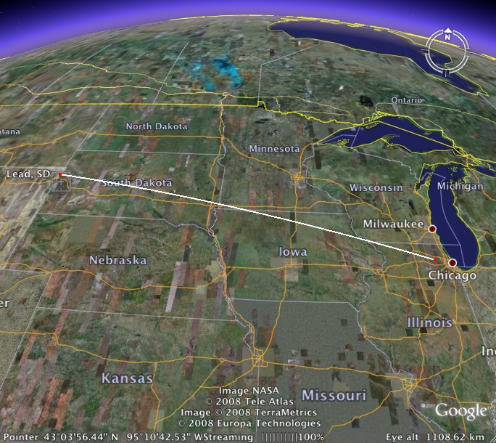
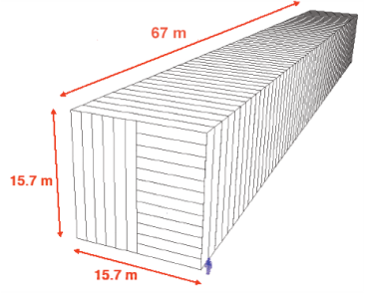
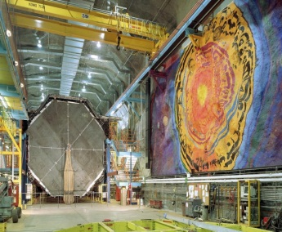
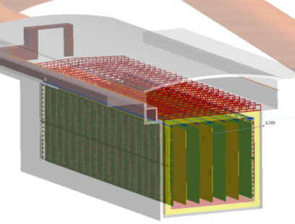
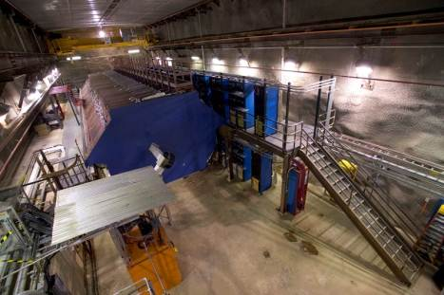
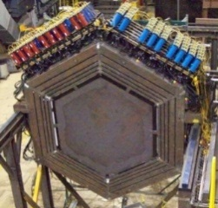

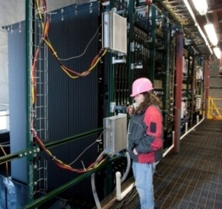
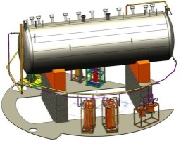
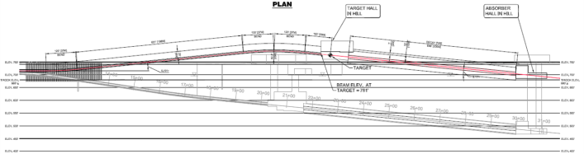
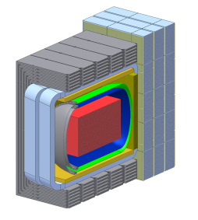
Intensity Frontier at Fermilab
NOvA (far)
MINOS (far)
Operating
since 2005
(350 kW)
under construction
Online 2013
(700 kW)
Far detector
MINOS (near)
735 km
810 km
MINERvA
LBNE under development
1300 km (800miles)
Proton decay
Supernovae neutrinos
MiniBooNE
NOvA
(near)
Goal: operating in 2020s
MicroBooNE
Beamline
Near detector

Slide 39
Some thoughts on DM searches in ν experiments at IF
High flux P beams ideal for DM stats
High Energy P beams good for distinguishing sub-GeV DM from ν for boosted DM
  Can take advantage of kinematic quantities
  Need high precision – position, angular, time and energy resolutions – near detector
But we’ve still got significant background from neutrinos due to sheer numbers
  How do we eliminate them and still co-exist with neutrino experiments?

Slide 40
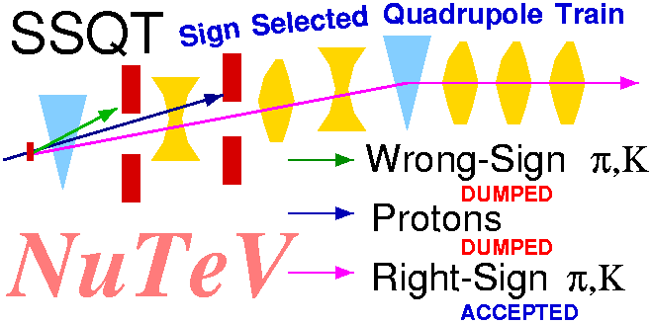
Sign Selected Beam Idea for DM Searches
The biggest background is neutrinos in the beam
  Neutrinos are primarily produced from charged meson decays
  WIMPS have no electrical charges and are produced in the primary target
We can have a beamline that separates neutrinos and anti-neutrinos from DM’s

Slide 41
Dark Matter Searches at Fermilab
Fermi National Accelerator Laboratory is turning into a lab with very high intensity accelerator program
UTA group is part of three experiments at Fermilab
  Deep Underground Neutrino Experiment (DUNE), a $2B flagship experiment, with data expected in 2025
    High flux secondary beam and a near detector enables searches for DM
    In addition to precision measurements of key neutrino param..
    UTA playing very significant role in this experiment
A rich physics program for the next 20 – 30 years!!
If we see DM, we could use this to make DM Beam??

Slide 42
Conclusions!
The LHC opened up a whole new world!!
Discovered one new charge neutral particle that couples to vector force carriers and whose measured mass is 125 times the proton mass
  The discovery is no longer a matter of significance
Properties of the discovered particle being intensely studied
  Confirmed that some properties are like the Standard Model Higgs Particle ➔ Walks like the Higgs and Quacks like the Higgs
  Still not enough though…
Linear collider and advanced detectors are being developed for future precision measurements of Higgs and other newly discovered particles

Slide 43
Conclusions, cnt’d
The new frontier at Fermilab will give us a chance to look for dark matter at an accelerator and possibly making DM beams, Yeah!!
Outcome and the bi-product of HEP research improves our daily lives directly and indirectly
  WWW came from HEP
  GEM will make a large screen low dosage X-ray imaging possible
Many technological advances happened through the last 100 years & will happen through the coming 100 yrs
UTA is a big contributor in this endeavor!
Continued and sufficient investments to forefront scientific endeavor is essential for the future!

Slide 44
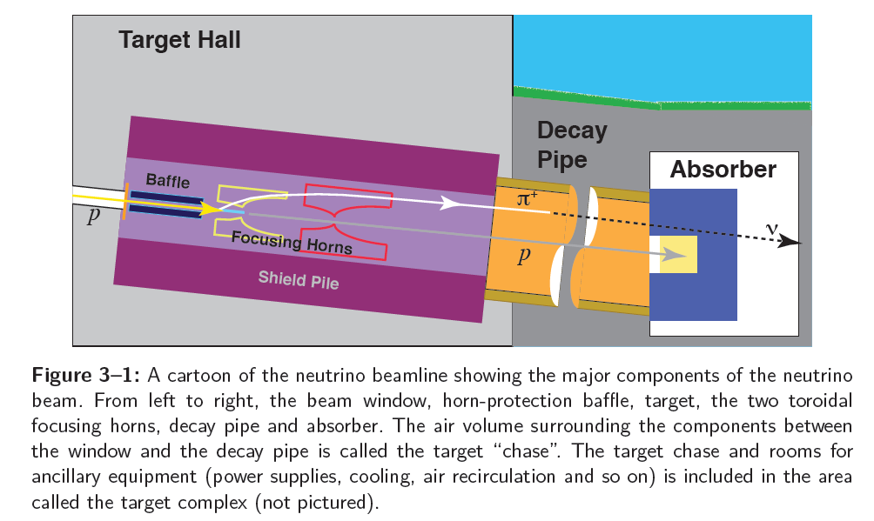
DUNE Neutrino Beam Assembly

Slide 45
Doubly Sign-selected Horn System (DSHS)
Add a dipole after the mesons are fully focused with the 2nd horn
dipole
High Precision Detector
p
p, π⁰, χ
Beam Dump
ν target
π⁺⁽⁻⁾, charged mesons
Focusing
horns
Decay pipe
DUNE detector system

