Slide 1
PHYS 3313 – Section 001 Lecture # 22
Wednesday, April 22, 2015
Dr. Barry Spurlock
Simple Harmonic Oscillator
Barriers and Tunneling
Alpha Particle Decay
Schrodinger Equation on Hydrogen Atom
Solutions for Schrodinger Equation for Hydrogen Atom

Slide 2
Announcements
Research paper deadline is Monday, May 4
Research presentation deadline is Sunday, May 3
Bring out Homework #5
Reminder Homework #6
CH7 end of chapter problems: 7, 8, 9, 12, 17 and 29
Due on Wednesday, Apr. 29, in class
Reading assignments
CH7.6 and the entire CH8
Quiz number 5
At the beginning of the class Wednesday, Apr. 29
Covers up to what we finish Monday, Apr. 27

Slide 3
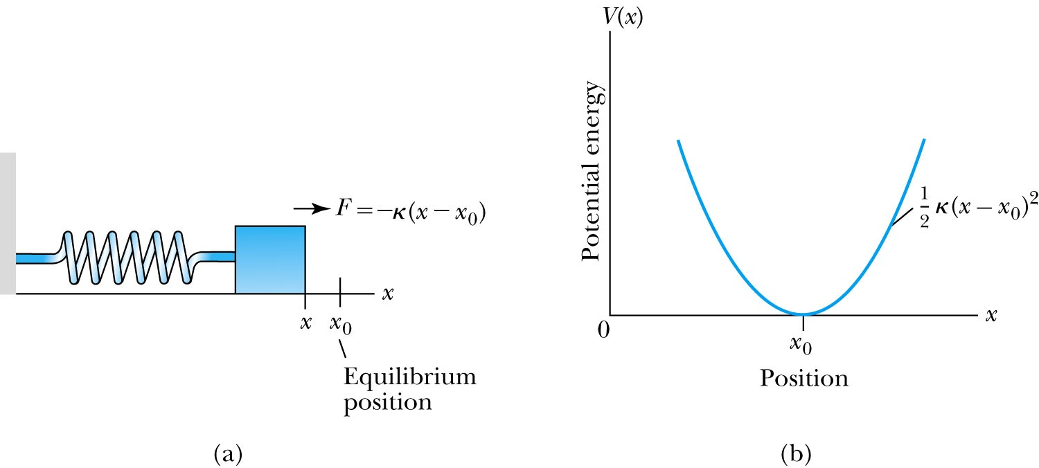
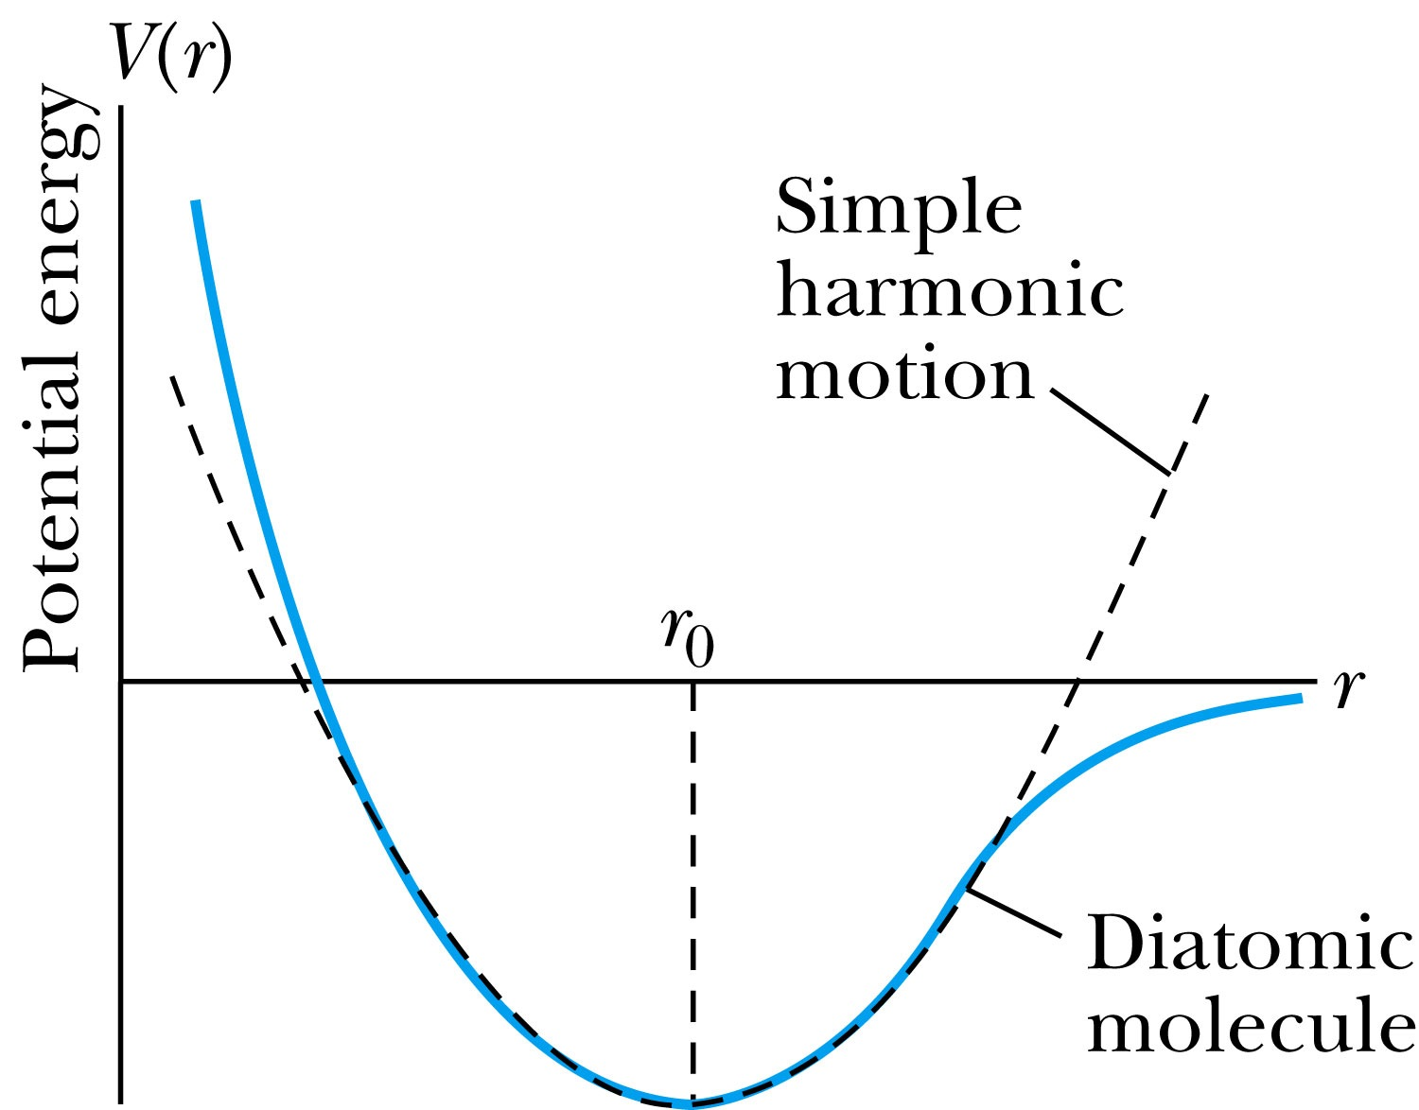
The Simple Harmonic Oscillator
Simple harmonic oscillators describe many physical situations: springs, diatomic molecules and atomic lattices.
Consider the Taylor expansion of a potential function:
The minimum potential at x=x₀, so dV/dx=0 and V₁=0; and the zero potential V₀=0, we have
Substituting this into the wave equation:
Let and which yields .

Slide 4
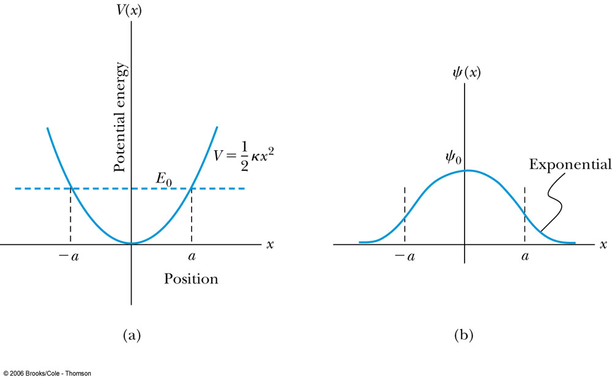
Parabolic Potential Well
If the lowest energy level is zero, this violates the uncertainty principle.
The wave function solutions are where H_{n}(x) are Hermite polynomial function of order n.
In contrast to the particle in a box, where the oscillatory wave function is a sinusoidal curve, in this case the oscillatory behavior is due to the polynomial, which dominates at small x. The exponential tail is provided by the Gaussian function, which dominates at large x.

Slide 5
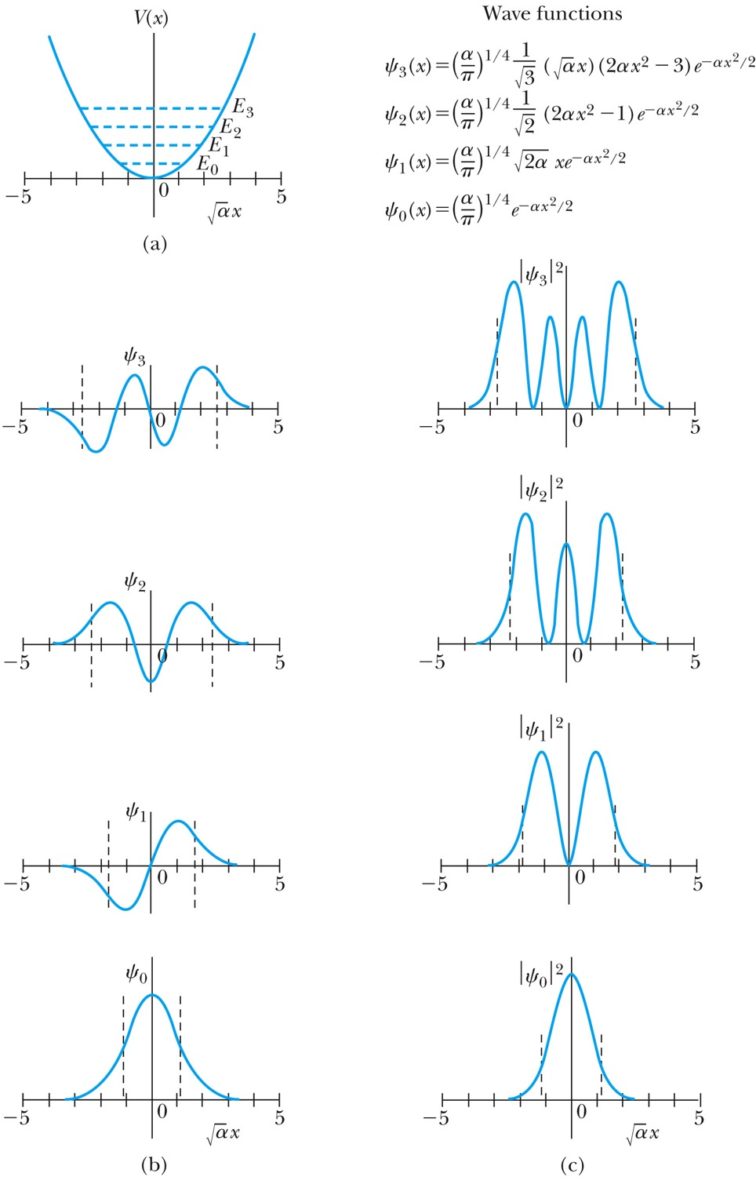
Analysis of the Parabolic Potential Well
The energy levels are given by
The zero point energy is called the Heisenberg limit:
Classically, the probability of finding the mass is greatest at the ends of motion’s range and smallest at the center (that is, proportional to the amount of time the mass spends at each position).
Contrary to the classical one, the largest probability for this lowest energy state is for the particle to be at the center.

Slide 6
Ex. 6.12: Harmonic Oscillator stuff
Normalize the ground state wave function ψ₀ for the simple harmonic oscillator and find the expectation values <x> and <x²>.

Slide 7
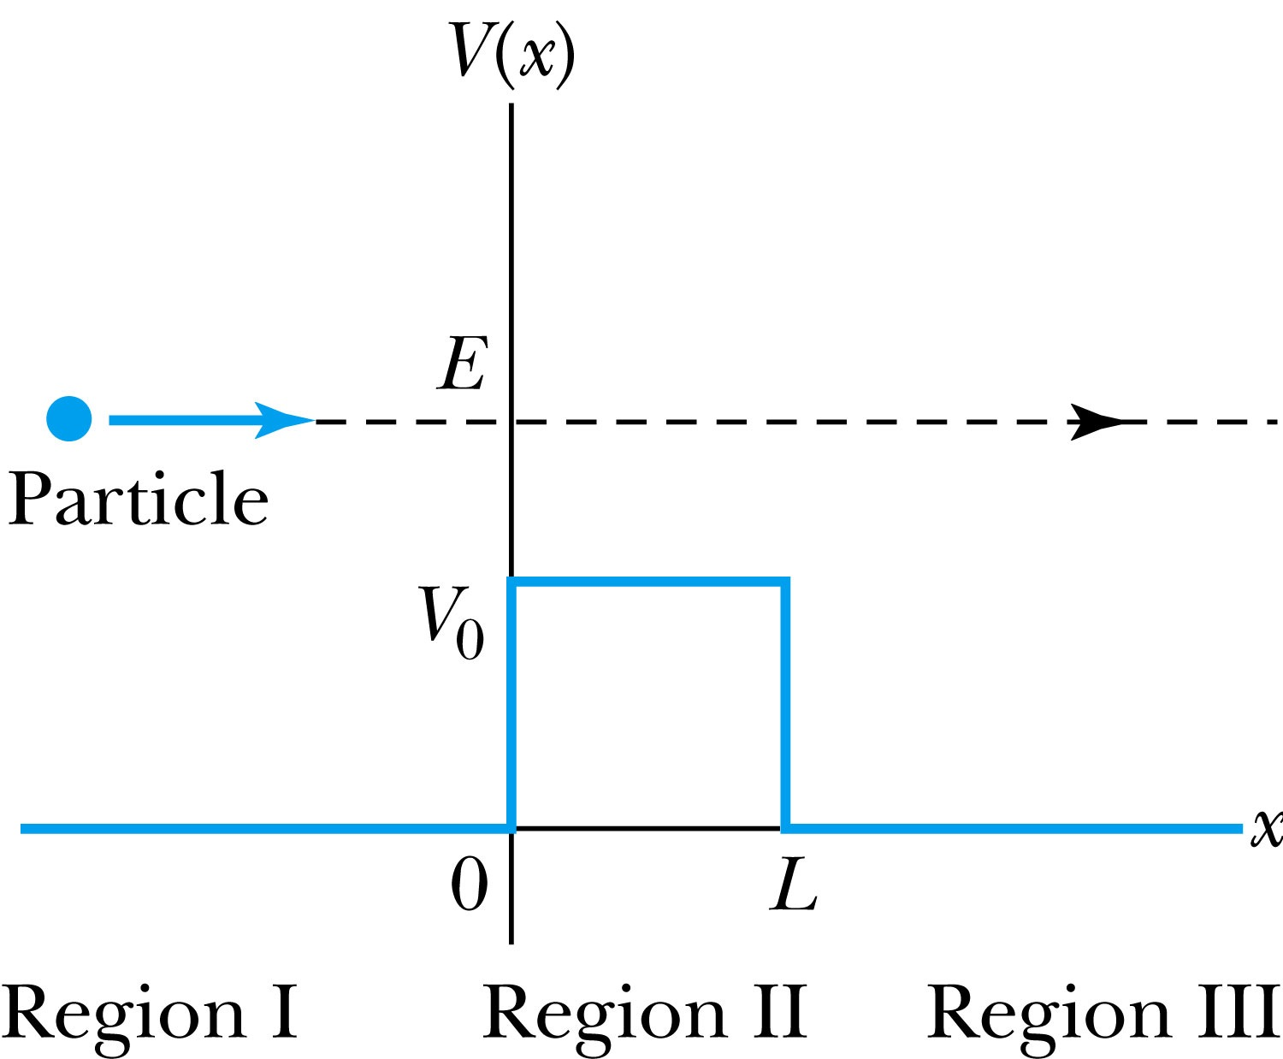
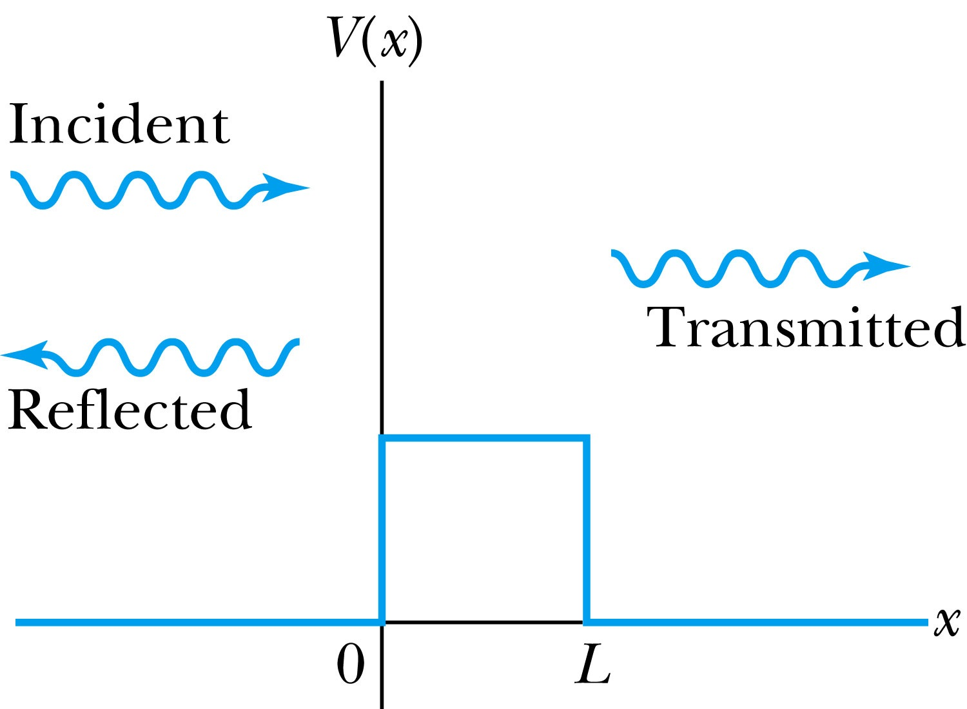
Barriers and Tunneling
Consider a particle of energy E approaching a potential barrier of height V₀ and the potential everywhere else is zero.
We will first consider the case when the energy is greater than the potential barrier.
In regions I and III the wave numbers are:
In the barrier region we have

Slide 8
Reflection and Transmission
The wave function will consist of an incident wave, a reflected wave, and a transmitted wave.
The potentials and the Schrödinger wave equation for the three regions are as follows:
The corresponding solutions are:
As the wave moves from left to right, we can simplify the wave functions to:

Slide 9
Probability of Reflection and Transmission
The probability of the particles being reflected R or transmitted T is:
The maximum kinetic energy of the photoelectrons depends on the value of the light frequency f and not on the intensity.
Because the particles must be either reflected or transmitted we have: R + T = 1
By applying the boundary conditions x → ±∞, x = 0, and x = L, we arrive at the transmission probability:
When does the transmission probability become 1?

Slide 10
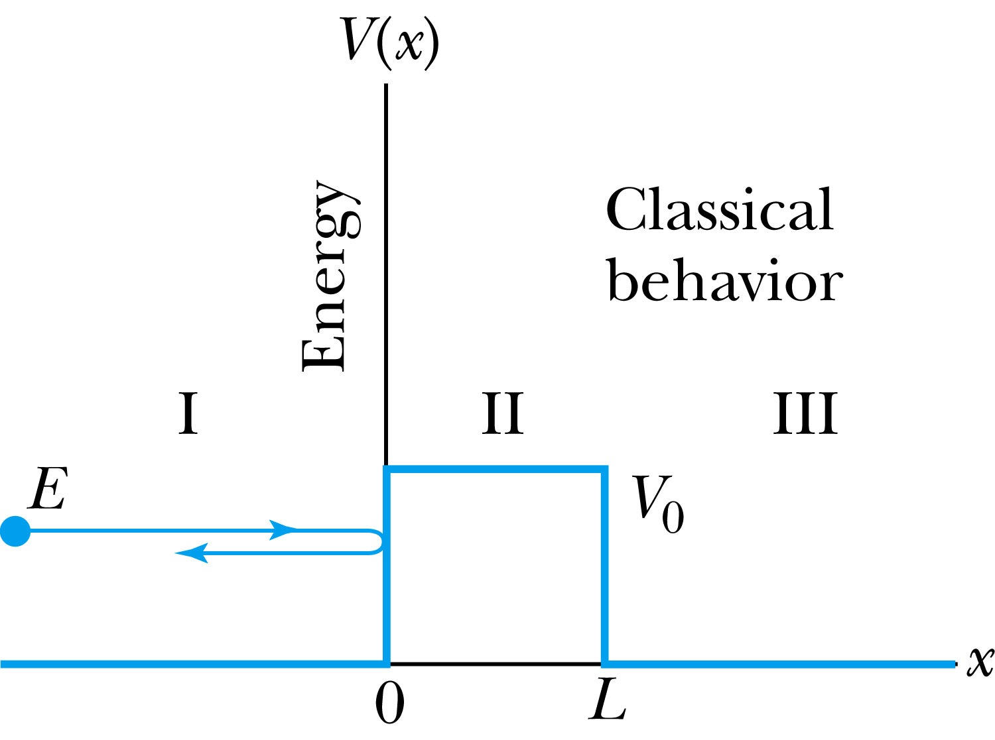
Tunneling
Now we consider the situation where classically the particle does not have enough energy to surmount the potential barrier, E < V₀.
The quantum mechanical result, however, is one of the most remarkable features of modern physics, and there is ample experimental proof of its existence. There is a small, but finite, probability that the particle can penetrate the barrier and even emerge on the other side.
The wave function in region II becomes
The transmission probability that describes the phenomenon of tunneling is

Slide 11
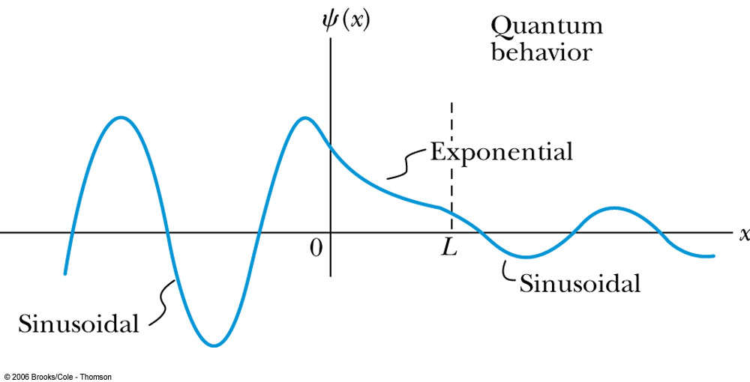
Uncertainty Explanation
Consider when κL >> 1 then the transmission probability becomes:
This violation allowed by the uncertainty principle is equal to the negative kinetic energy required! The particle is allowed by quantum mechanics and the uncertainty principle to penetrate into a classically forbidden region. The minimum such kinetic energy is:

Slide 12
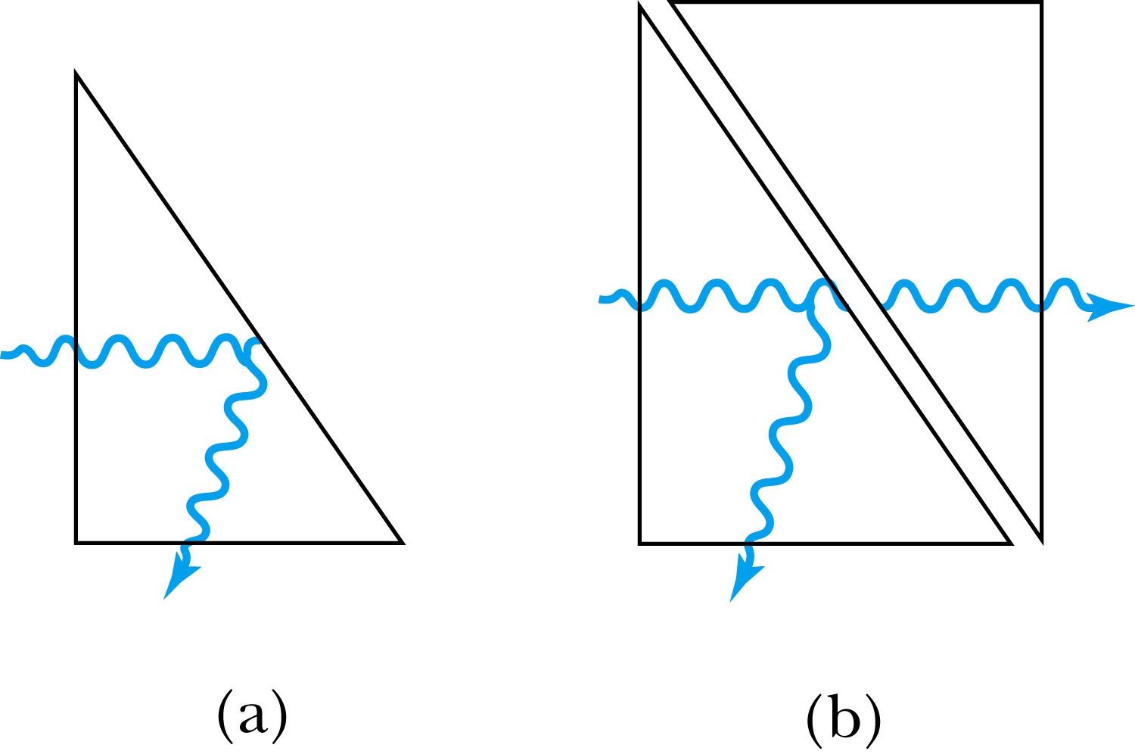
Analogy with Wave Optics
If light passing through a glass prism reflects from an internal surface with an angle greater than the critical angle, total internal reflection occurs. The electromagnetic field, however, is not exactly zero just outside the prism. Thus, if we bring another prism very close to the first one, experiments show that the electromagnetic wave (light) appears in the second prism.
The situation is analogous to the tunneling described here. This effect was observed by Newton and can be demonstrated with two prisms and a laser. The intensity of the second light beam decreases exponentially as the distance between the two prisms increases.

Slide 13
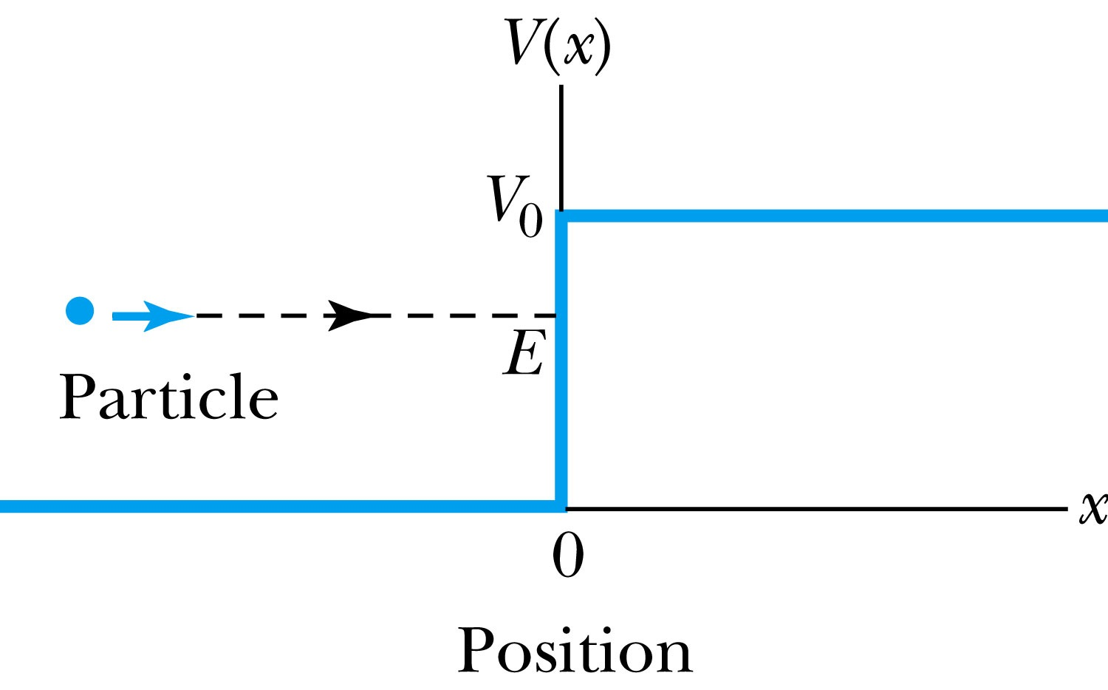
Potential Well
Consider a particle passing through a potential well region rather than through a potential barrier.
Classically, the particle would speed up passing the well region, because K = mv² / 2 = E - V₀.
According to quantum mechanics, reflection and transmission may occur, but the wavelength inside the potential well is shorter than outside. When the width of the potential well is precisely equal to half-integral or integral units of the wavelength, the reflected waves may be out of phase or in phase with the original wave, and cancellations or resonances may occur. The reflection/cancellation effects can lead to almost pure transmission or pure reflection for certain wavelengths. For example, at the second boundary (x = L) for a wave passing to the right, the wave may reflect and be out of phase with the incident wave. The effect would be a cancellation inside the well.

Slide 14
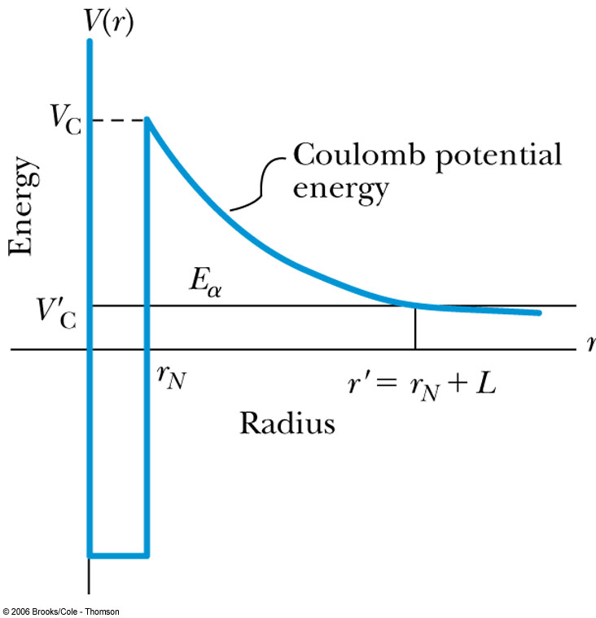
Alpha-Particle Decay
May nuclei heavier than Pb emits alpha particles (nucleus of He)! The phenomenon of tunneling explains the alpha-particle decay of heavy, radioactive nuclei.
Inside the nucleus, an alpha particle feels the strong, short-range attractive nuclear force as well as the repulsive Coulomb force.
The nuclear force dominates inside the nuclear radius where the potential is approximately a square well.
The Coulomb force dominates outside the nuclear radius.
The potential barrier at the nuclear radius is several times greater than the energy of an alpha particle (~5MeV).
According to quantum mechanics, however, the alpha particle can “tunnel” through the barrier. Hence this is observed as radioactive decay.

Slide 15
Application of the Schrödinger Equation to the Hydrogen Atom
The approximation of the potential energy of the electron-proton system is the Coulomb potential:
To solve this problem, we use the three-dimensional time-independent Schrödinger Equation.
For Hydrogen-like atoms with one electron (He⁺ or Li⁺⁺)
Replace e² with Ze² (Z is the atomic number)
Use appropriate reduced mass μ

Slide 16
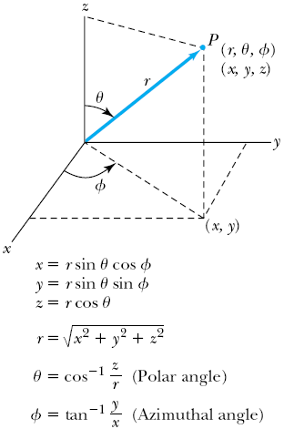
Application of the Schrödinger Equation
The potential (central force) V(r) depends on the distance r between the proton and electron.
Transform to spherical polar coordinates to exploit the radial symmetry.
Insert the Coulomb potential into the transformed Schrödinger equation.

Slide 17
Application of the Schrödinger Equation
The wave function ψ is a function of r, θ and φ .
The equation is separable into three equations of independent variables
The solution may be a product of three functions.
We can separate the Schrodinger equation in polar coordinate into three separate differential equations, each depending only on one coordinate: r, θ, or φ .

Slide 18
Solution of the Schrödinger Equation
Only r and θ appear on the left-hand side and only φ appears on the right-hand side of the equation
The left-hand side of the equation cannot change as φ changes.
The right-hand side cannot change with either r or θ.
Each side needs to be equal to a constant for the equation to be true in all cases. Set the constant −m_{ℓ}² equal to the right-hand side of the reorganized equation
The sign in this equation must be negative for a valid solution
It is convenient to choose a solution to be .
-------- azimuthal equation

Slide 19
Solution of the Schrödinger Equation for Hydrogen
Substitute ψ into the polar Schrodinger equation and separate the resulting equation into three equations: R(r), f(θ), and g(φ).
Separation of Variables
The derivatives in Schrodinger eq. can be written as
Substituting them into the polar coord. Schrodinger Eq.
Multiply both sides by r² sin² θ / Rfg
Reorganize

Slide 20
Solution of the Schrödinger Equation
satisfies the previous equation for any value of m_{ℓ}.
The solution be single valued in order to have a valid solution for any φ, which requires
m_{ℓ} must be zero or an integer (positive or negative) for this to work
Now, set the remaining equation equal to −m_{ℓ}² and divide either side with sin²θ and rearrange them as
Everything depends on r on the left side and θ on the right side of the equation.

Slide 21
Solution of the Schrödinger Equation
Set each side of the equation equal to constant ℓ(ℓ + 1).
Radial Equation
Angular Equation
Schrödinger equation has been separated into three ordinary second-order differential equations, each containing only one variable.

Slide 22
Solution of the Radial Equation
The radial equation is called the associated Laguerre equation, and the solutions R that satisfies the appropriate boundary conditions are called associated Laguerre functions.
Assume the ground state has ℓ = 0, and this requires m_{ℓ} = 0.
We obtain
The derivative of yields two terms, and we obtain

Slide 23
Solution of the Radial Equation
Let’s try a solution where A is a normalization constant, and a₀ is a constant with the dimension of length.
Take derivatives of R, we obtain.
To satisfy this equation for any r, each of the two expressions in parentheses must be zero.
Set the second parentheses equal to zero and solve for a₀.
Set the first parentheses equal to zero and solve for E.
Both equal to the Bohr’s results
Bohr’s radius
Ground state energy of the hydrogen atom

Slide 24
Principal Quantum Number n
The principal quantum number, n, results from the solution of R(r) in the separate Schrodinger Eq. since R(r) includes the potential energy V(r).
The result for this quantized energy is
The negative sign of the energy E indicates that the electron and proton are bound together.

Slide 25
Quantum Numbers
The full solution of the radial equation requires an introduction of a quantum number, n, which is a non-zero positive integer.
The three quantum numbers:
n Principal quantum number
ℓ Orbital angular momentum quantum number
m_{ℓ} Magnetic quantum number
The boundary conditions put restrictions on these
n = 1, 2, 3, 4, . . . (n>0) Integer
ℓ = 0, 1, 2, 3, . . . , n − 1 (ℓ < n) Integer
m_{ℓ} = −ℓ, −ℓ + 1, . . . , 0, 1, . . . , ℓ − 1, ℓ (|m_{ℓ}| ≤ ℓ) Integer
The predicted energy level is

Slide 26
Ex 7.3: Quantum Numbers & Degeneracy
What are the possible quantum numbers for the state n=4 in atomic hydrogen? How many degenerate states are there?
n ℓ m_{ℓ}
4 0 0
4 1 -1, 0, +1
4 2 -2, -1, 0, +1, +2
4 3 -3, -2, -1, 0, +1, +2, +3
The energy of a atomic hydrogen state is determined only by the primary quantum number, thus, all these quantum states, 1+3+5+7 = 16, are in the same energy state.
Thus, there are 16 degenerate states for the state n=4.

