Slide 1
PHYS 3313 – Section 001 Lecture #1
Wednesday, Jan. 18, 2017
Dr. Jaehoon Yu
Who am I?
From Higgs to Dark Matter!!
How is this class organized?
What do we want from this class?
What is Physics?
Brief history of modern physics

Slide 2
Announcements
Plea to you: Please turn off your cell-phones, pagers and computers in the class
Reading assignment #1: Read and follow through appendices 3, 5, 6 and 7 by Monday, Jan. 23
There will be a quiz next Wednesday, Jan. 25, on these reading assignments
Physics colloquium
4:00pm Wednesdays
The 1st one is today by Dr. Frank Lu of Havard Med. School on optics

Slide 3
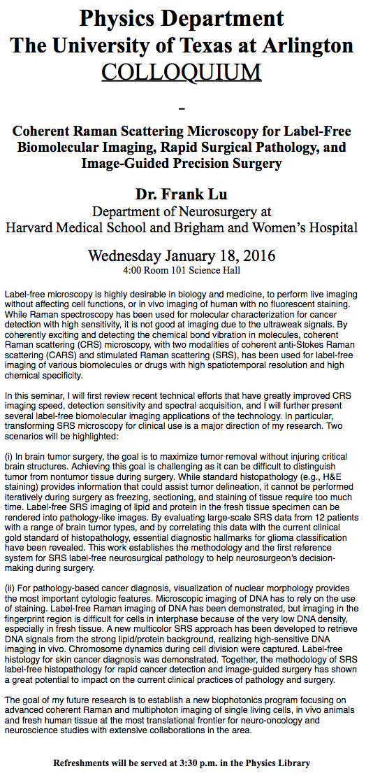

Slide 4
Who am I?
Name: Dr. Jaehoon Yu (You can call me Dr. Yu)
Office: Rm 342, Chemistry and Physics Building
Extension: x22814, E-mail: jaehoonyu@uta.edu
My profession: High Energy Particle Physics (HEP)
Collide particles (protons on anti-protons or electrons on anti-electrons, positrons) at the energies equivalent to 10,000 Trillion degrees
To understand
Fundamental constituents of matter
Forces between the constituents (gravitational, electro-magnetic, weak and strong forces)
Origin of Mass
Search for Dark Matter and Making of Dark Matter Beams
Creation of Universe (Big Bang Theory)
A pure scientific research activity
Direct use of the fundamental laws we find may take longer than we want but
Indirect product of research contribute to every day lives; eg. WWW
Why do we do with this?
Make our everyday lives better to help us live well as an integral part of the universe

Slide 5
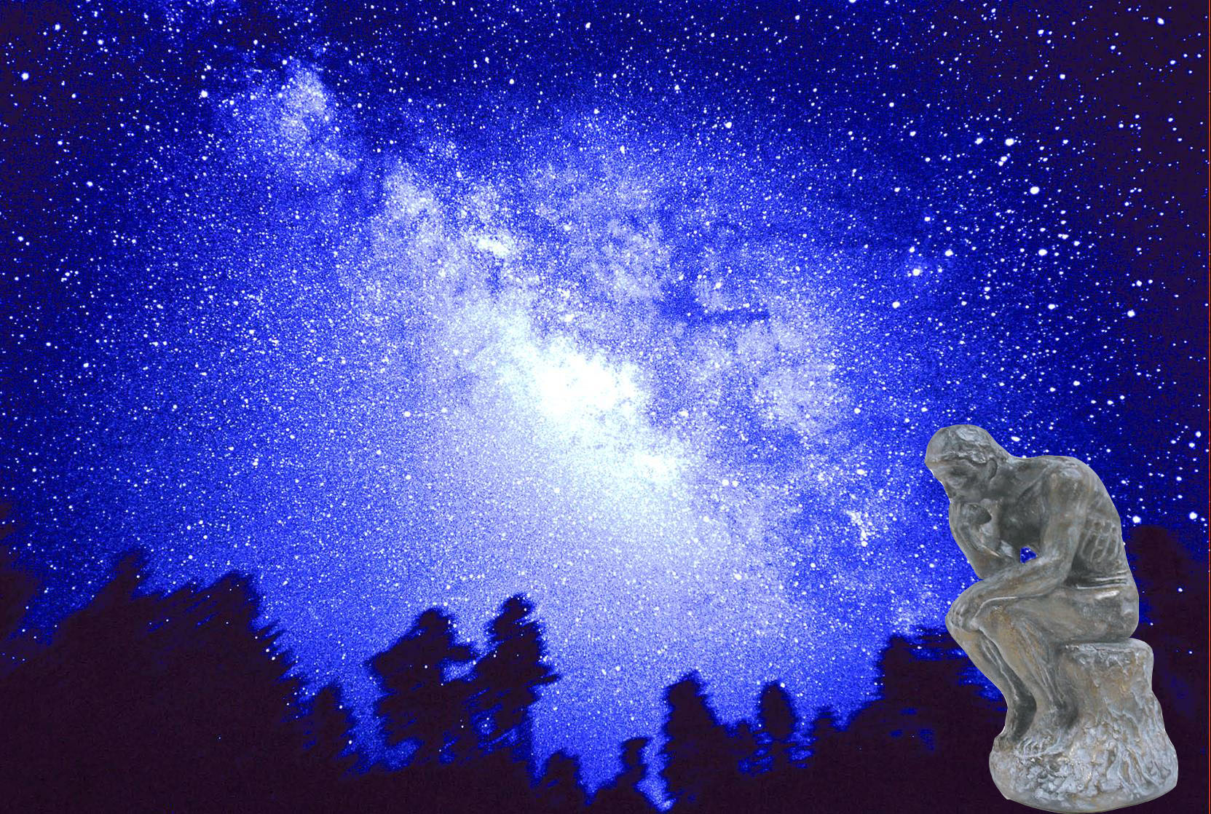
We always wonder…
What makes up the universe?
How does the universe work?
What holds the universe together?
How can we live in the universe well?
Where do we all come from?

Slide 6
High Energy Physics
Definition: A field of physics that pursues understanding the fundamental constituents of matter and basic principles of interactions between them.
Known interactions (forces):
Gravitational Force
Electromagnetic Force
Weak Nuclear Force
Strong Nuclear Force
Current theory: The Standard Model of Particle Physics

Slide 8
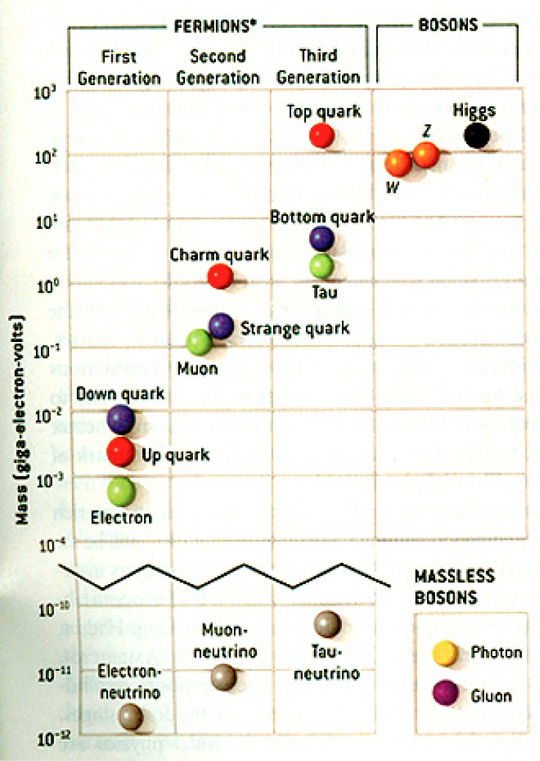
HEP and the Standard Model
Discovered in 1995, ~175m_{p}
Make up most ordinary matters ~0.1m_{p}
Total of 16 particles (12+4 force mediators) make up all the visible matter in the universe! ➔ Simple and elegant!!!
Tested to a precision of 1 part per million!

Slide 9
So what’s the problem?
Why is the mass range so large (0.1m_{p} – 175 m_{p})?
Is the new particle we’ve discovered really the Higgs particle?
Why is the matter in the universe made only of particles?
Neutrinos have mass!! What are the mixing parameters, particle-anti particle asymmetry and mass ordering?
Why are there only four apparent forces?
Were they all unified at the Big Bang?
Notes:
----- Meeting Notes (2/12/14 10:16) -----

Slide 10
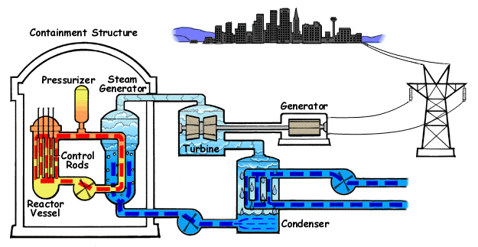
How does a nuclear power plant work?
Duke Energy
My 1000 year dream: Skip the whole thing!
Make electricity directly from nuclear force!

Slide 11
So what’s the problem?
Why is the mass range so large (0.1m_{p} – 175 m_{p})?
Is the particle we discovered really the Higgs particle?
Why is the matter in the universe made only of particles?
Neutrinos have mass!! What are the mixing parameters, particle-anti particle asymmetry and mass ordering?
Why are there only four apparent forces?
Were they all unified at the Big Bang?
Is the picture we present the real thing?
Notes:
----- Meeting Notes (2/12/14 10:16) -----

Slide 12
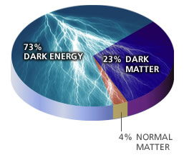
What makes up the universe?
~95% unknown!!
Notes:
----- Meeting Notes (2/12/14 10:16) -----

Slide 13
So what’s the problem?
Why is the mass range so large (0.1m_{p} – 175 m_{p})?
Is the particle we discovered really the Higgs particle?
Why is the matter in the universe made only of particles?
Neutrinos have mass!! What are the mixing parameters, particle-anti particle asymmetry and mass ordering?
Why are there only four apparent forces?
Were they all unified at the Big Bang?
Is the picture we present the real thing?
What makes up the remaining ~95% of the universe?
Are there any other particles we don’t know of?
Big deal for the new LHC Run!
Where do we all come from?
How can we live well in the universe as an integral partner?
Notes:
----- Meeting Notes (2/12/14 10:16) -----

Slide 14
Accelerators are Powerful Microscopes.
They make high energy particle beams
that allow us to see small things.
seen by
low energy beam
(poorer resolution)
seen by
high energy beam
(better resolution)

Slide 15
Accelerators are also Time Machines.
They make particles last seen
in the earliest moments of the universe.
Energy
particle beam
energy
anti-particle beam
energy
Particle and anti-particle annihilate.
E = mc²

Slide 16
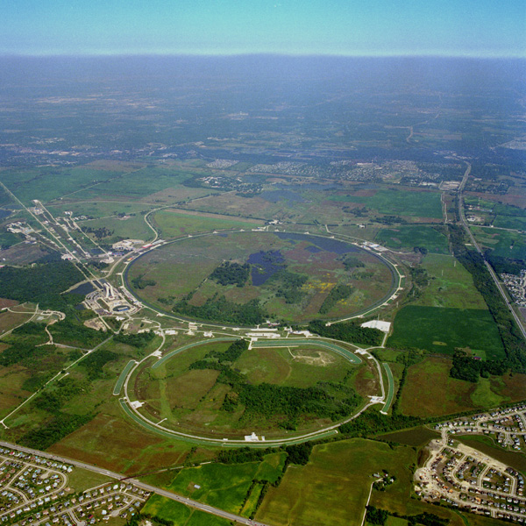
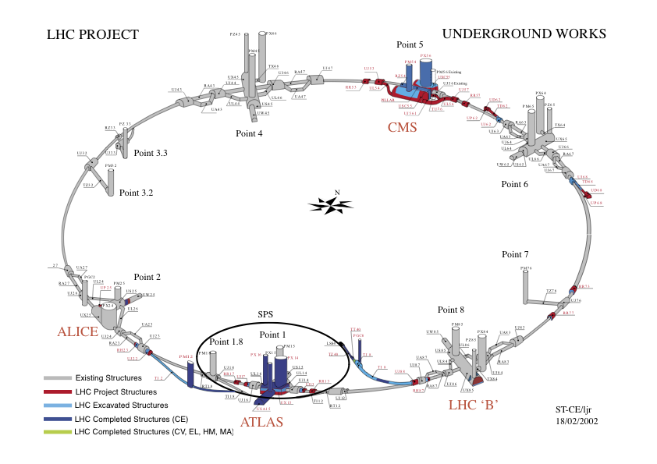
Fermilab Tevatron and LHC at CERN
World’s Highest Energy proton-anti-proton collider
4km (2.5mi) circumference
E_{cm}=1.96 TeV (=6.3x10⁻⁷J/p➔ 13M Joules on the area smaller than 10⁻⁴m²)
Equivalent to the kinetic energy of a 20t truck at the speed 130km/hr
~100,000 times the energy density at the ground 0 of the Hiroshima atom bomb
Tevatron was shut down in 2011
Vibrant other programs running, including the search for dark matter with beams!!
World’s Highest Energy p-p collider
27km (17mi) circumference, 100m (300ft) underground
Design E_{cm}=14 TeV (=44x10⁻⁷J/p➔ 362M Joules on the area smaller than 10⁻⁴m²)
Equivalent to the kinetic energy of a B727 (80tons) at the speed 310km/hr
~3M times the energy density at the ground 0 of the Hiroshima atom bomb
Large amount of data accumulated in 2010 – 2013
Beam returned 2015 after a 2 yr shutdown
Preparing for a new run in 2017
Chicago
CDF
p
DØ
Tevatron
p

Slide 17
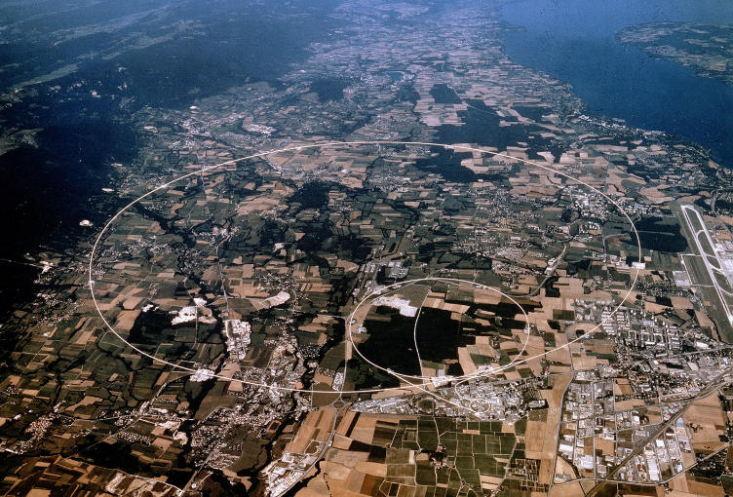
LHC @ CERN Aerial View
CMS
France
Geneva Airport
ATLAS
Swizerland

Slide 18
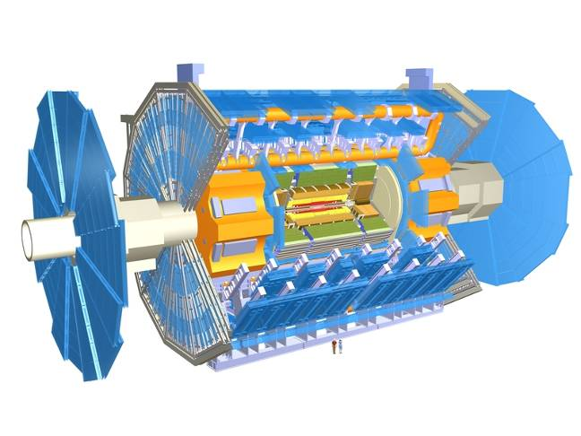
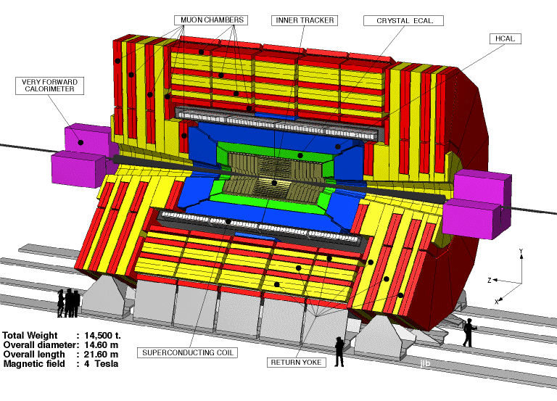
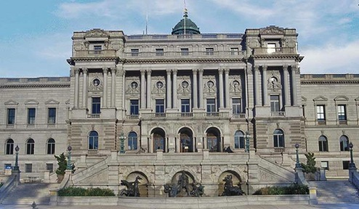
The ATLAS and CMS Detectors
Weighs 7000 tons and ~10 story tall
Records 200 – 400 collisions/second (out of 50million)
Records approximately 350 MB/second
Records ~2 PB per year ➔ 200*Printed material of the US Lib. of Congress
200x

Slide 19
Information & Communication Source
Course web page: http://www-hep.uta.edu/%7Eyu/teaching/spring17-3313-001/spring17-3313-001.html
Contact information & Class Schedule
Syllabus
Homework
Holidays and Exam days
Evaluation Policy
Class Style & Communication
Other information
Primary communication tool is e-mail: Make sure that your e-mail at the time of course registration is the one you most frequently read!!
Office Hours: 2:30 – 3:40pm, Mondays and Wednesdays or by appointments

Slide 20
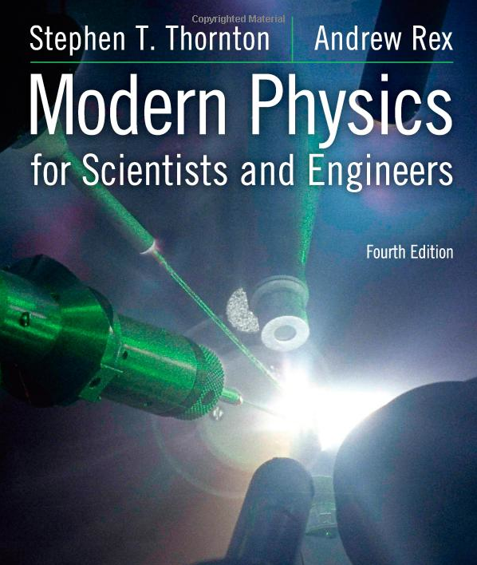
Textbook
Title: Modern Physics for Scientists and Engineers
4th edition
Authors: S.T. Thornton and A. Rex
ISBN: 978-1-133-10372-1

Slide 21
Evaluation Policy
Homework: 30%
Exams
Mid-term Exam (Wed., Mar. 8): 20%
Final Comprehensive Exam (11 – 1:30pm, Wed, May. 3): 25%
Missing an exam is not permissible unless pre-approved
No makeup test
You will get an F if you miss any of the exams without a prior approval
Group Research Project: 15%
Pop-quizzes: 10%
Extra credits: 10% of the total
Grading will be done on a sliding scale
55% of the grade is in your hand!!
100%

Slide 22
Homework
Solving homework problems is the only way to comprehend class material
Consists of a lot of reading, deriving and writing
Each homework carries the same weight
ALL homework grades will be used for the final grade
Home work will constitute 30% of the total
A good way of keeping your grades high
Strongly encouraged to collaborate
Just make sure to submit your own answers written in your OWN way!!

Slide 23
Group Research Projects
Detailed studies on important discoveries and theories that set the foundation of modern physics
Final project consists of
A 5 - 7 page paper each : 10% of the total
A 10+2 minute power point presentation for each group: 5% of total
Report Due and Presentation Dates
Presentation: Monday, Apr. 24 and Wednesday, Apr. 26
Report Due: At the beginning of the class on Wed. Apr. 26

Slide 24
Research Topics
Blackbody radiation
Michelson–Morley Experiment
The Photoelectric Effect
The Brownian Motion
Compton Effect
Discovery of Electron
Rutherford Scattering
Super-conductivity
The Discovery of Radioactivity

Slide 25
Attendances and Class Style
Attendances:
Will be taken randomly
Will be used for extra credits
Class style:
Lectures will be on electronic media
The lecture notes will be posted on the web AFTER each class
Will be mixed with traditional methods
Active participation through questions and discussions are STRONGLY encouraged ➔ Extra credit….
Communication between you and me is extremely important
If you have problems, please do not hesitate talking to me

Slide 26
Extra credit
Up to 10% addition to the total
Could boost a B to A, C to B or D to C
What constitute for extra credit?
Random attendances
Physics Colloquium Participations
Strong participation in the class discussions
Special projects
Watch the valid planetarium shows
Many other opportunities

Slide 27
Valid Planetarium Shows
Regular running shows
Phantom of the Universe – Fridays at 6:00, Saturdays at 6:00pm
Astronaut – Sundays at 1:30pm
Shows that need special arrangements
Black Holes (up to 2 times)
Bad Astronomy, Cosmic Origin, Experience the Aurora
From Earth to the Universe, IBEX, Ice Worlds, Magnificent Sun
Mayan Prophecies, Nanocam, Stars of Pharaoes
Two Small Pieces of Glass, Unseen Universe: The Vision of SOFIA
Violent Universe, We are Astronomers
How to submit for extra credit?
Obtain the ticket stub that is signed and dated by the planetarium star lecturer of the day
Collect the ticket stubs
Tape all of them on a sheet of paper with your name and ID written on it
Submit the sheet at the end of the semester when asked

Slide 28
What can you expect from this class?
All A’s would be perfect for you, wouldn’t it?
But easy come easy go
Must put in efforts to make it last and meaningful….
This class is going to be challenging!!
You will earn your grade in this class.
You will need to put in sufficient time and sincere efforts
Exams and quizzes will be tough!!
Sometimes problems might not look exactly like what you learned in the class
Just putting the right answer in free response problems does not work!

Slide 29
What can you expect from this class?
But you have a great control of your grade in your hands, up to 45%!!!
Homework is 30% of the total grade!!
Means you will have many homework problems
Sometimes much more than any other classes
Sometimes homework problems will be something that you have yet to learn in class
Exam’s problems will be easier that homework problems but the same principles!!
Group research project: 15%
Extra credit 10%
I will work with you so that your efforts are properly rewarded

