Slide 1
PHYS 3313 – Section 001
Lecture #2
Monday, Jan. 23, 2017
Dr. Jaehoon Yu
Higgs and Dark Matter
What do you expect to learn in this course?
Classical Physics
Concept of Waves and Particles
Conservation Laws and Fundamental Forces
Atomic Theory of Matter
Unsolved Questions of 1895 and the New Horizon

Slide 2
Announcements
Quiz #1 on appendices 3, 5, 6 and 7
  Beginning of the class
  This Wednesday, Jan. 25

Slide 3
Special Project #1
Compute the electric force between the two protons separate the farthest in an intact U²³⁸ nucleus. Use the actual size of the U²³⁸ nucleus. (10 points)
Compute the gravitational force between the two protons separate the farthest in an intact U²³⁸ nucleus. (10 points)
Express the electric force in #1 above in terms of the gravitational force in #2. (5 points)
You must look up the mass of the proton, actual size of the U²³⁸ nucleus, etc, and clearly write them on your project report
You MUST have your own, independent answers to the above three questions even if you worked together with others. All those who share the answers will get 0 credit if copied. Must be handwritten!
Due for the submission is Monday, Jan. 30!

Slide 4
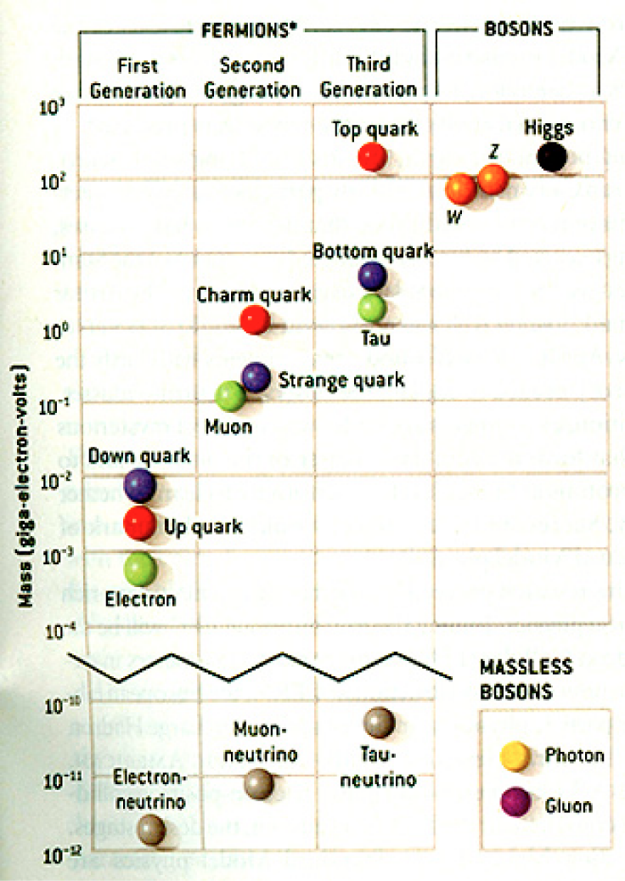
HEP and the Standard Model
Discovered in 1995, ~175m_{p}
Make up most ordinary matters ~0.1m_{p}
Total of 16 particles (12+4 force mediators) make up all the visible matter in the universe! ➔ Simple and elegant!!!
Tested to a precision of 1 part per million!

Slide 5
What is the Higgs and What does it do?
When there is perfect symmetry, one cannot tell directions!

Slide 6

What’s the symmetry?
Where is the head of the table?
Without a broken symmetry, one cannot tell directional information!!

Slide 7

A broken symmetry

Slide 8
What is the Higgs and What does it do?
When there is perfect symmetry, one cannot tell directions!
Only when symmetry is broken, can one tell directions
Higgs field works to break the perfect symmetry and gives mass to all fundamental particles
Sometimes, this field spontaneously generates a particle, the Higgs particle
So the Higgs particle is the evidence of the existence of the Higgs field!

Slide 9



So how does Higgs Field work again?
Person in space ➔ no symmetry breaking
Person in air ➔ symmetry can be broken
Sometimes, you get
Just like the tornado is a piece of evidence of the existence of air, Higgs particle is a piece of evidence of Higgs mechanism

Slide 10
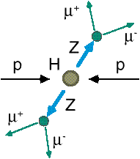
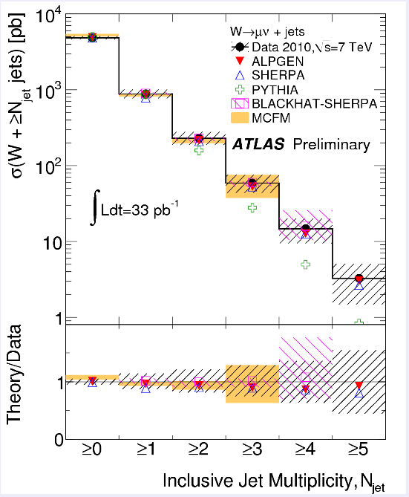
How do we look for the Higgs?
Identify Higgs candidate events
Understand fakes (backgrounds)
Look for a bump!!
  Large amount of data absolutely critical
e⁺ (μ⁺)
e⁻ (μ⁻)
e⁺
e⁻

Slide 11

What did statistics do for Higgs?

Slide 12

How about this?

Slide 13
So have we seen the Higgs particle?
The statistical significance of the finding is way over 7 standard deviations

Slide 14
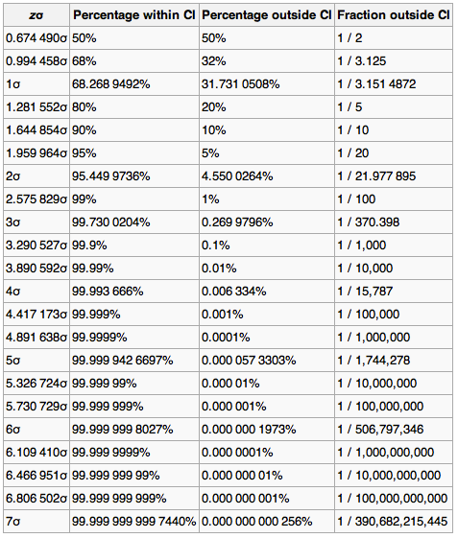
Statistical Significance Table

Slide 15
So have we seen the Higgs particle?
The statistical significance of the finding is much bigger than seven standard deviations
  Level of significance: much better than 99.999 999 999 7% (eleven 9s!!)
  We could be wrong once if we do the same experiment 391,000,000,000 times (will take ~13,000 years even if each experiment takes 1s!!)
So did we find the Higgs particle?
  We have discovered the heaviest new boson we’ve seen thus far
  It has many properties consistent with the Standard Model Higgs particle
    It quacks like a duck and walks like a duck but…
  We do not have enough data to precisely measure all the properties – mass, lifetime, the rate at which this particle decays to certain other particles, etc – to definitively determine its nature
Precision measurements and searches in new channels ongoing

Slide 16
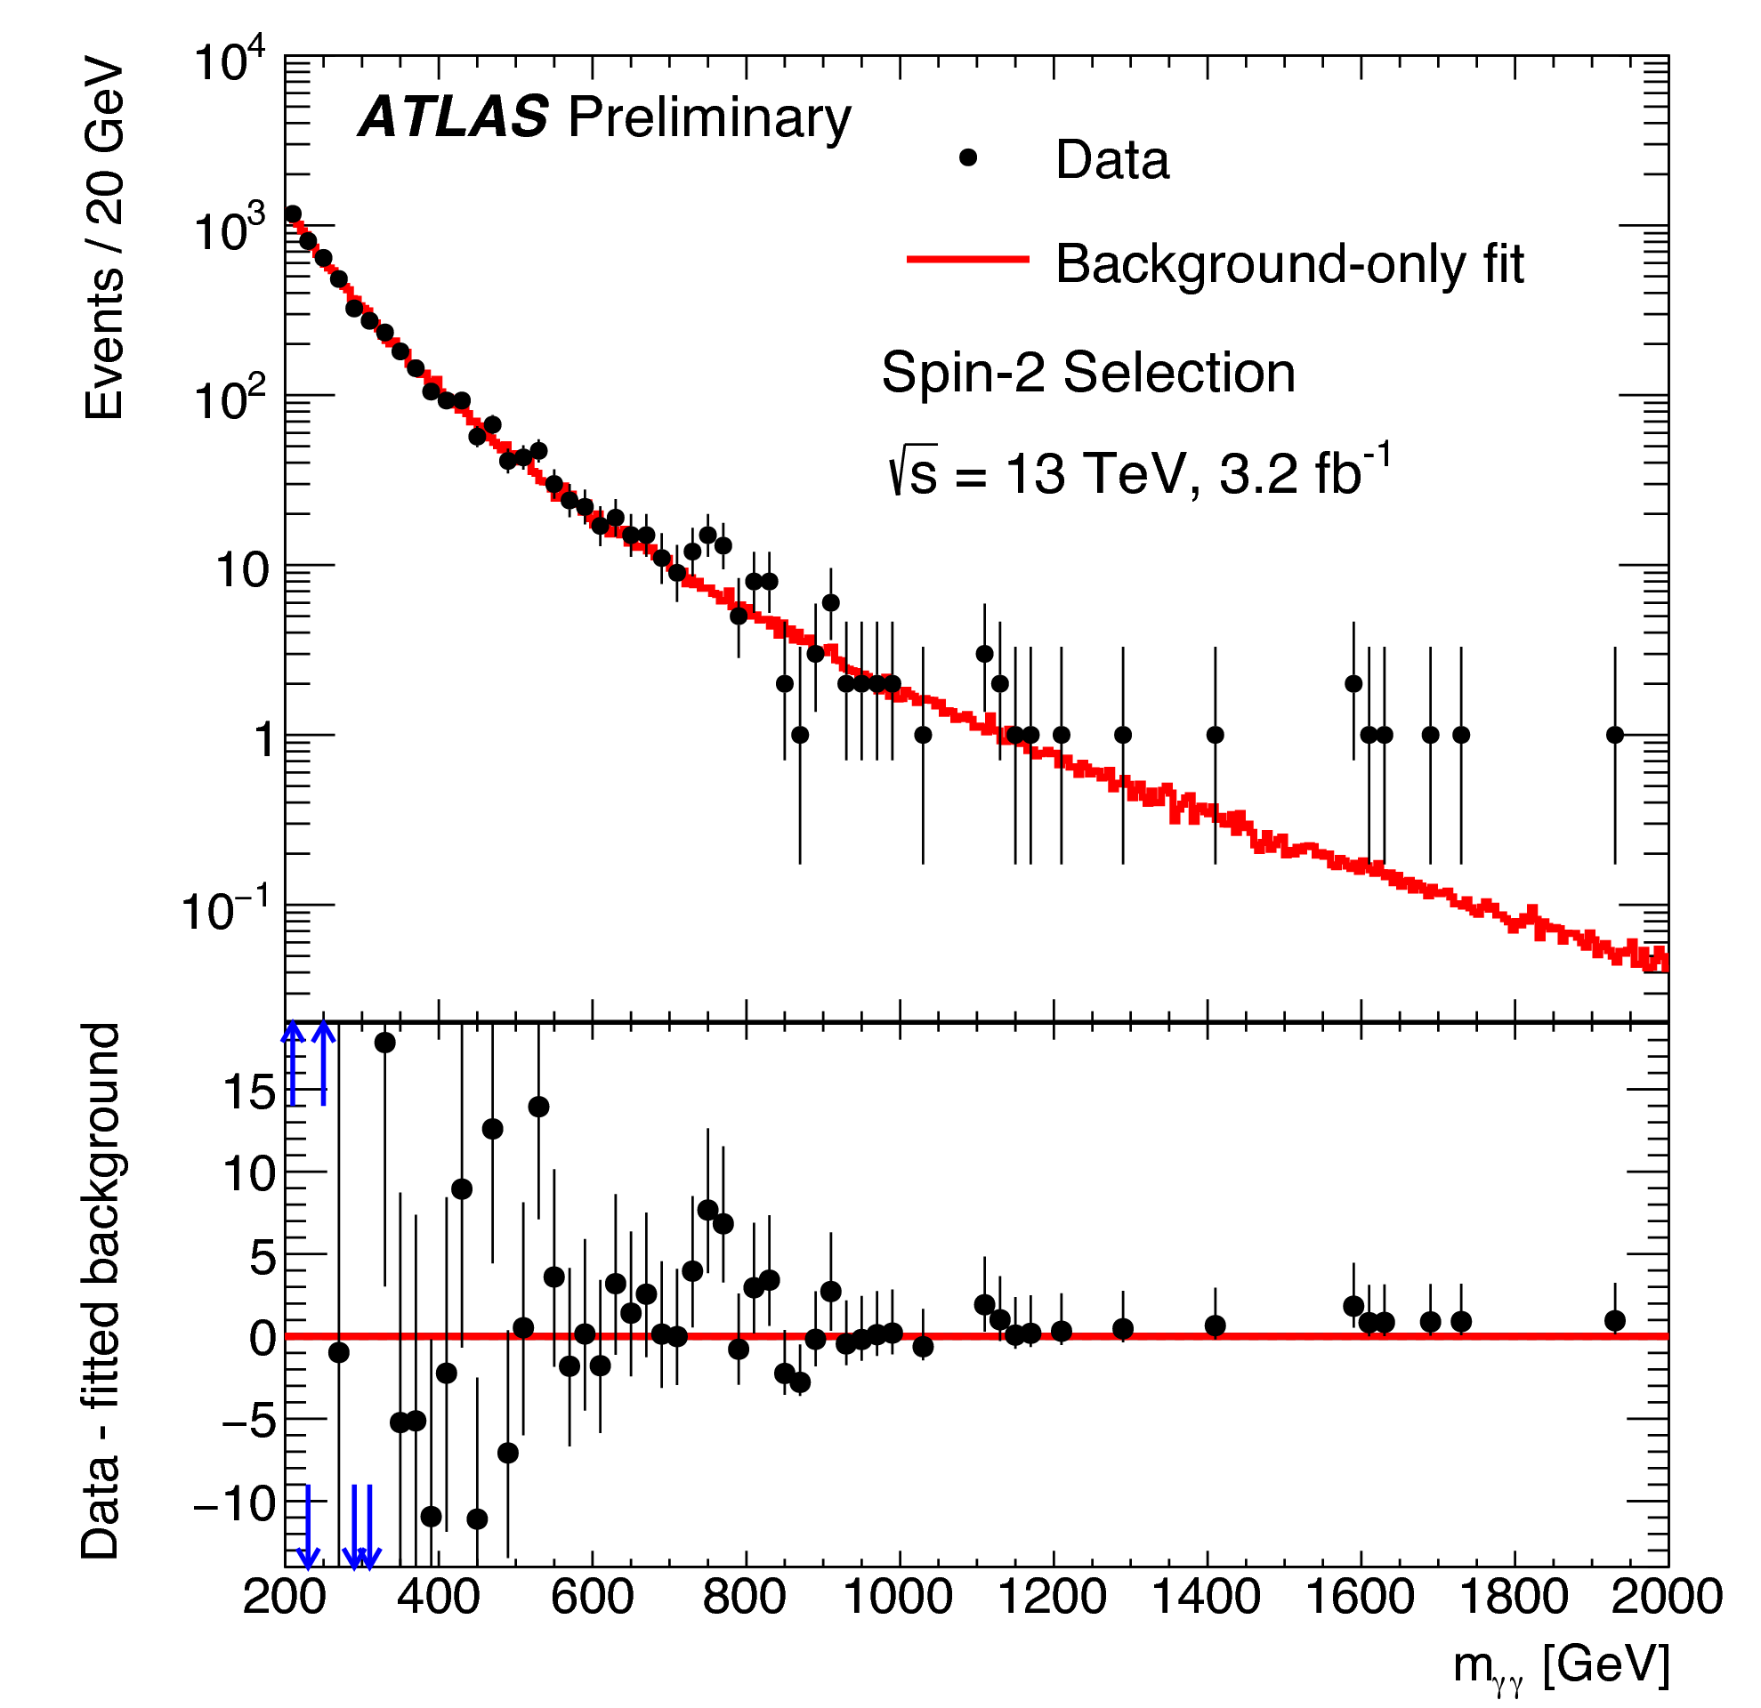
A hint of something new?
~760GeV
(2015 data)
Hmm!
~4.6σ Excess!!

Slide 17
Statistical Significance Table
Not good enough yet!!

Slide 18
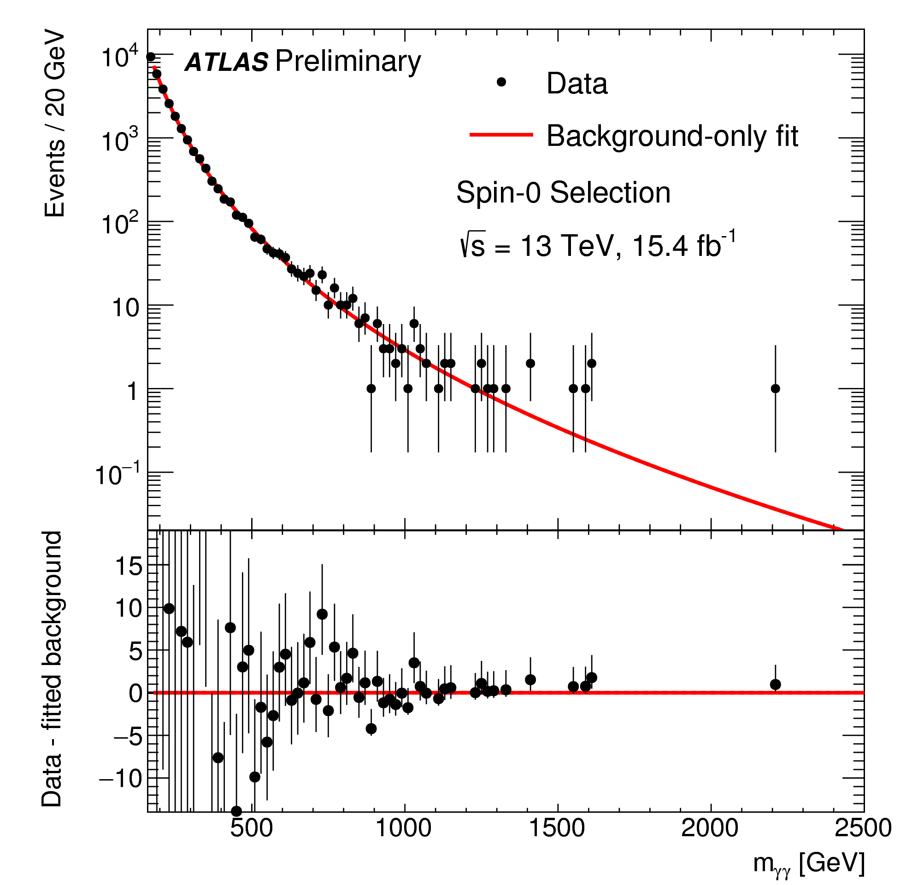
Disappeared after x4 data!!
~760GeV
(2015+2016 data)
Not there anymore!
<2σ!!

Slide 19
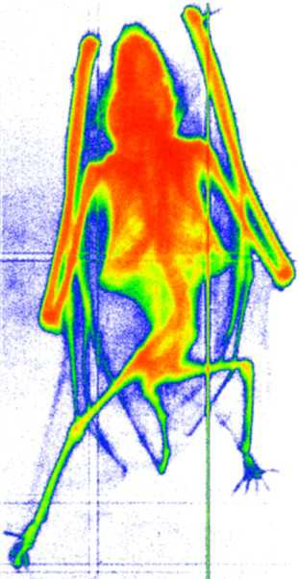
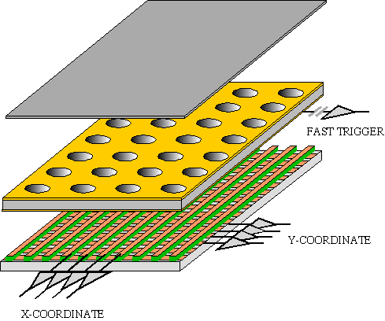
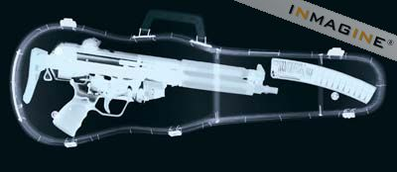
GEM Application Potential
FAST X-RAY IMAGING
Using the lower GEM signal, the readout can be self-triggered with energy discrimination:
9 keV absorption radiography of a small mammal (image size ~ 60 x 30 mm²)
A. Bressan et al,
Nucl. Instr. and Meth. A 425(1999)254
F. Sauli, Nucl. Instr. and Meth.A 461(2001)47

Slide 20
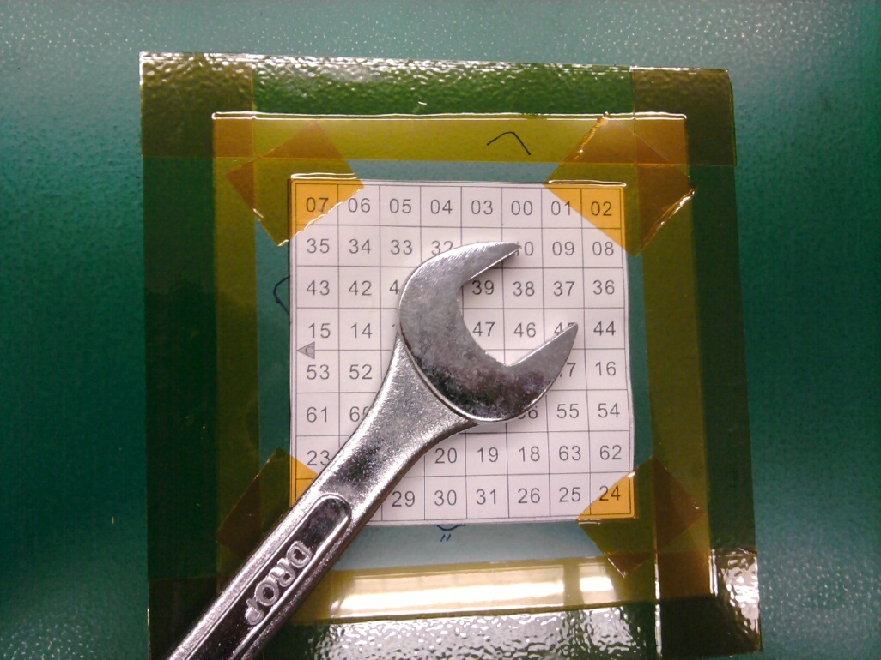
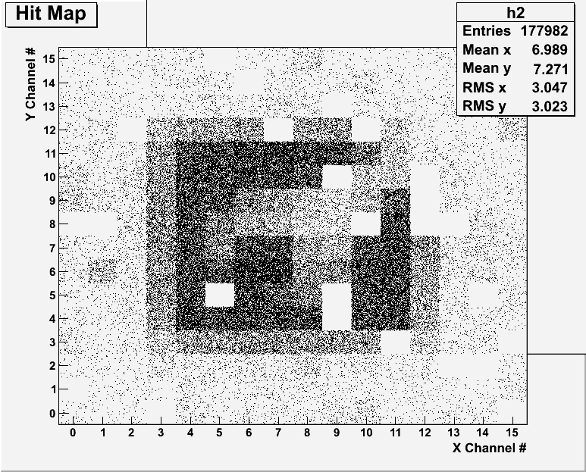
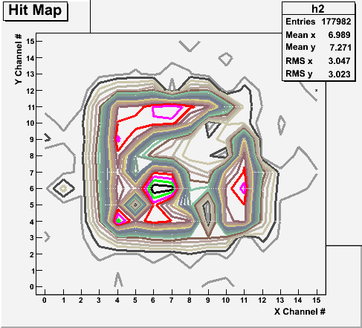
Bi-product of High Energy Physics Research
Can you see what the object is?
(GEM Detector X-ray Image)

Slide 21
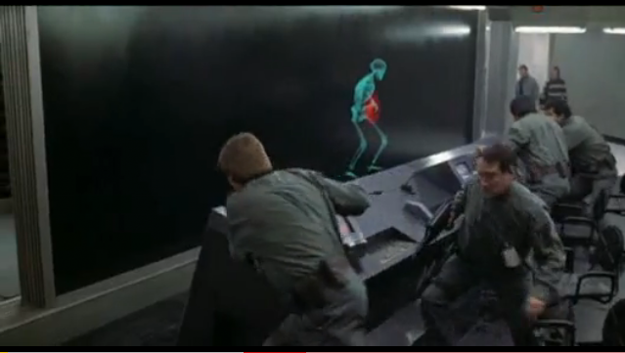
And in not too distant future, we could do …

Slide 22

Discovery of the God Particle in 2012
2012 God particle discovery

Slide 23


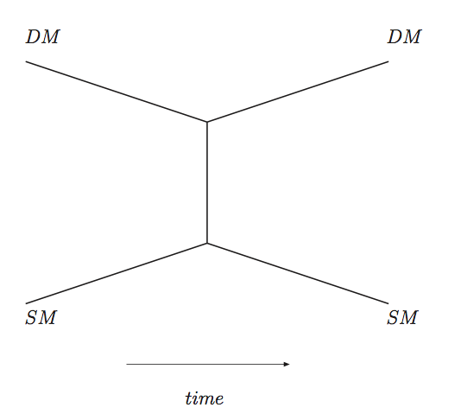
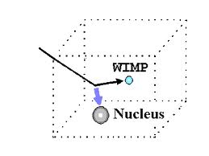
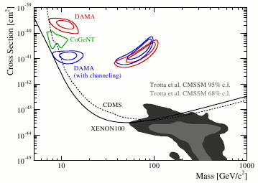
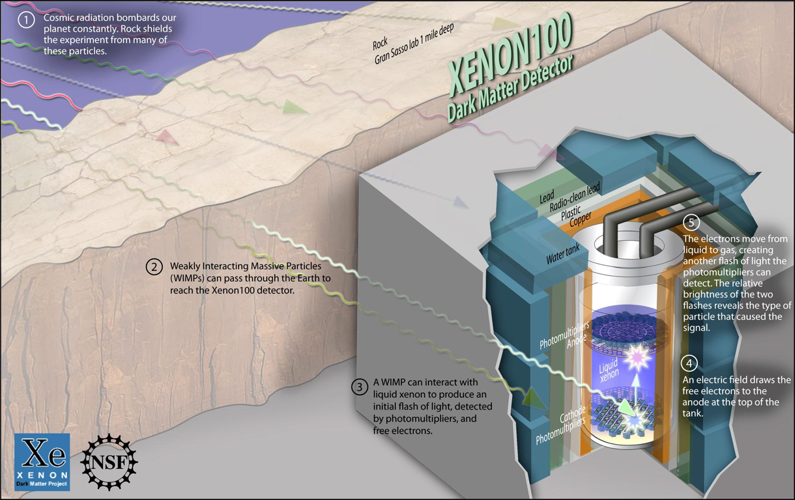

Dark Metter Search Motivation
Now that the Higgs particle, a part of only 5% of the universe, is seen
It is time for us to look into the 95% of the universe!!

Slide 24
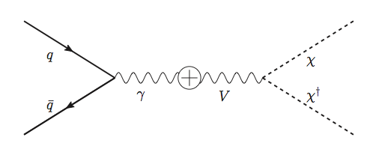
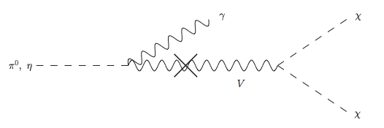
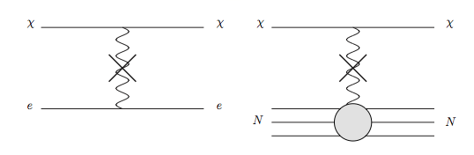
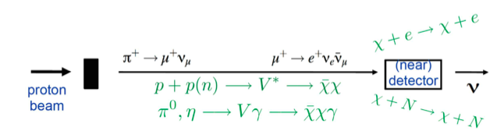
Light DM Production at High Intensity Accelerator
Production of DM:
Detection of DM:
How does a DM event look in an experiment?:
High Intensity Proton Beam

Slide 25
Search for Dark Matter at an Accelerator
Fermi National Accelerator Laboratory is turning into a lab with very high intensity accelerator program

Slide 26
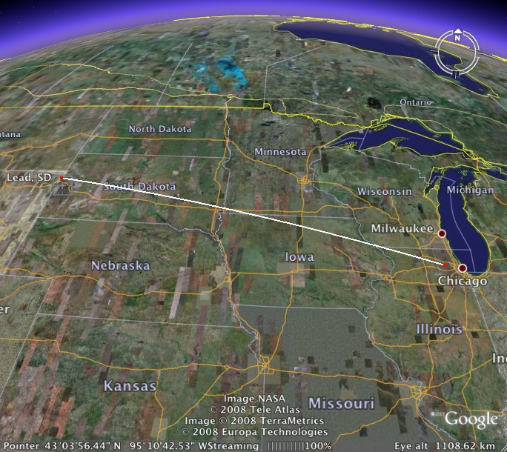
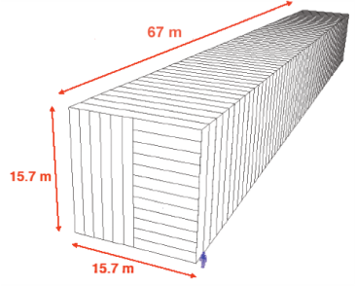
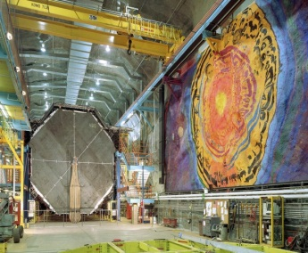
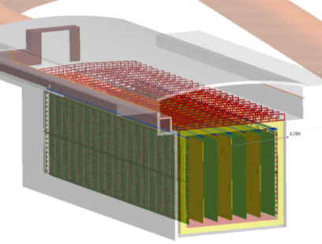
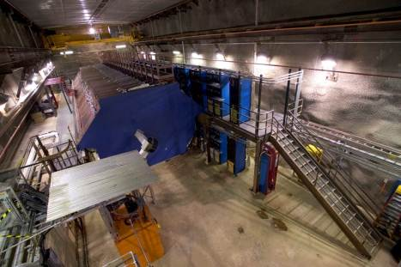
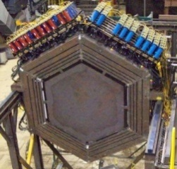

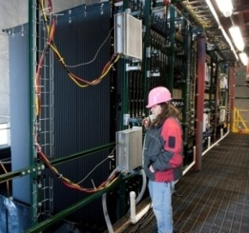
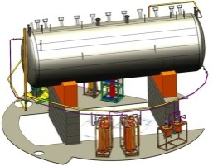
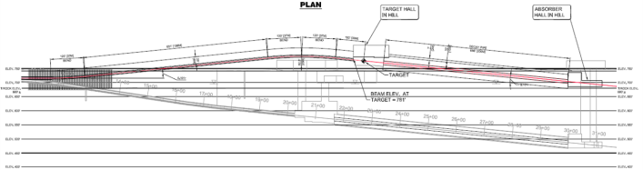
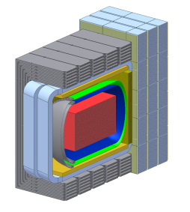
Intensity Frontier at Fermilab: Neutrinos
NOvA (far)
MINOS (far)
Operating
since 2005
(350 kW)
under construction
Online 2014
(700 kW)
Far detector
MINOS (near)
735 km
810 km
MINERvA
DUNE under development
1300 km
Proton decay
Supernovae neutrinos
MiniBooNE
NOvA
(near)
Goal: operating in early 2020s
MicroBooNE
Beamline
Near detector

Slide 27

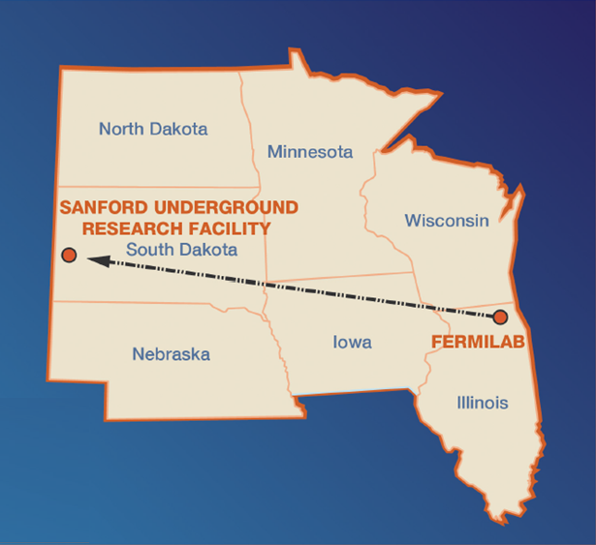
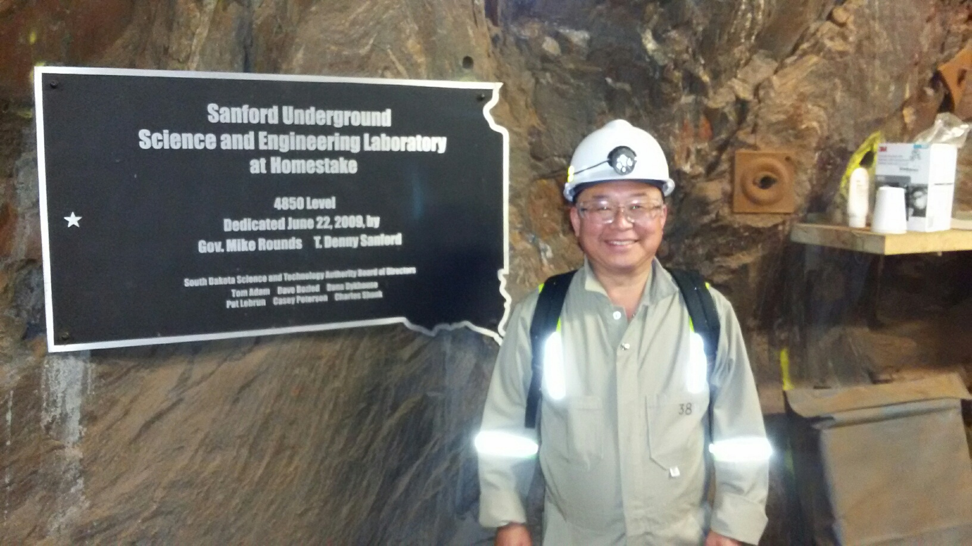
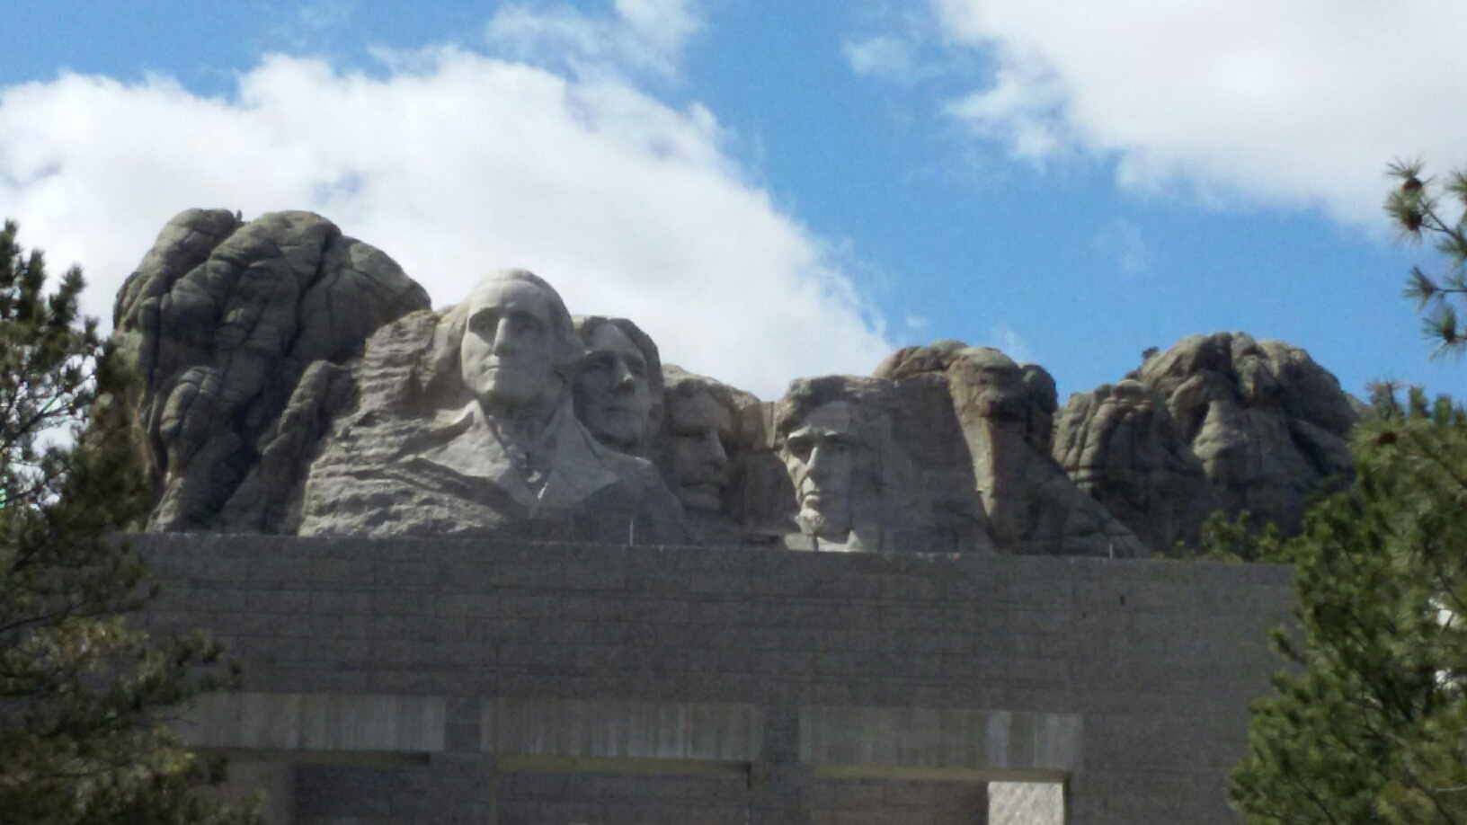
The Next Big Thing - DUNE Experiment
Stands for Deep Under Ground Neutrino Experiment
The flagship long baseline (1300km) ν experiment
  1500m underground in South Dakota mine
Yes, you are right! Mount Rushmore!!
Nobel Winning Neutrino Discovery by Ray Davis in 1960’s
Many Dark Matter experiments in progress
New DUNE area to be excavated shortly

Slide 28
Dark Matter Searches at Fermilab
Fermi National Accelerator Laboratory is turning into a lab with very high intensity accelerator program
UTA group is part of three experiments
  Deep Underground Neutrino Experiment (DUNE), a $1.3B US flagship experiment, with data expected in 2025
    High flux secondary beam and a near detector enables searches for DM
    In addition to precision measurements of key neutrino param..
    UTA playing very significant role in this experiment
A rich physics program for the next 20 – 30 years!!
If we see DM, we could use this to make DM Beam??

Slide 29
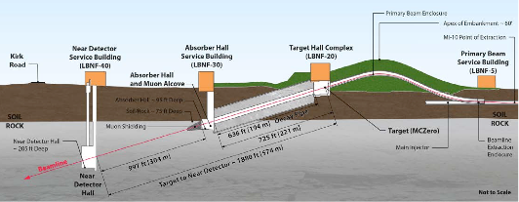
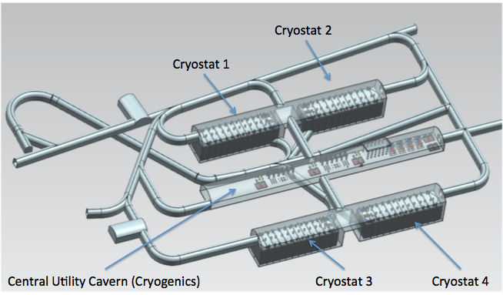
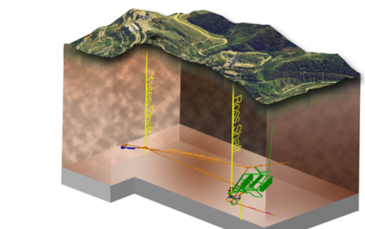
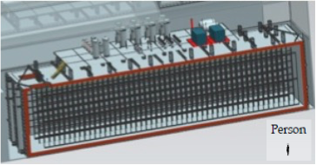
The Components of the DUNE Experiment
1300km
4 caverns with ~20kt total each
1500m underground
15m
62m
14m

Slide 30
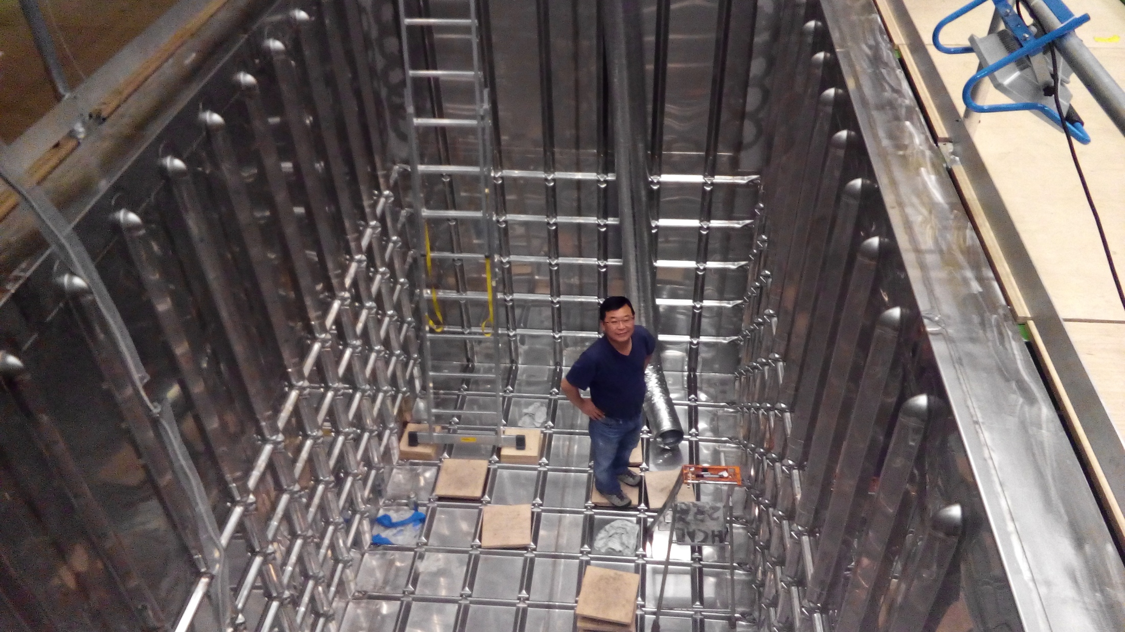
How BIG?
This is just for a 3mx1mx1m (42t) active volume baby prototype!!

Slide 31
So what?
Accelerators and advanced detectors are being developed for future precision measurements of Higgs and other newly discovered particles
The new frontier will give us a chance to look for dark matter at an accelerator and other paradigm changing phenomena
Outcome and the bi-product of HEP research improves our daily lives directly and indirectly
  WWW came from HEP
  GEM will make a large screen low dosage X-ray imaging possible
Many technological advances happened throughout the last 100 years & will happen even faster through the coming 100 yrs
Continued and sufficient investments to forefront scientific endeavor is essential for the future!

Slide 32
What do we want to learn in this class?
The physics that provided fundamentals to the technical progress for us, especially in the last 150 years or so
Learn concepts of quantum theory for microscopic phenomena and relativity for phenomena at high speed
Learn physical principles that we still exploit
Learn skills to express observations and measurements in mathematical language
Learn skills to research literatures and express your research in systematic manner in writing
Build up confidence in your physics abilities and to take on any challenges laid in front of you!!
Most importantly, let us have a lot of FUN!!

Slide 33
In this course, you will learn…
Concepts and derivation of many of the modern physics
  History at the beginning of the new era
  Special relativity
  Quantum theory
  Atomic physics
  Condensed Matter physics
  Nuclear physics
  Particle Physics
Focus on learning about the concepts with less complicated math
  You will learn some Quantum calculations and understand the concept of probabilities
Expectation at the end of the semester: You will be able to understand what bases fundamental physics provides to the current technology

Slide 34
Why do Physics?
Exp.{
To understand nature through experimental observations and measurements (Research)
Establish limited number of fundamental laws, usually with mathematical expressions
Predict the nature’s course
Theory and Experiment work hand-in-hand
Theory works generally under restricted conditions
Discrepancies between experimental measurements and theory are good for improvements
Improves our everyday lives, even though some laws can take a while till we see them amongst us
Theory {
34

Slide 35
Brief History of Physics
AD 18th century:
  Newton’s Classical Mechanics: A theory of mechanics based on observations and measurements, concepts of many kinematic parameters, including forces
    First unification of forces – planetary forces and forces on the Earth
AD 19th Century:
  Electricity, Magnetism, and Thermodynamics
Late AD 19th and early 20th century (Modern Physics Era, after 1895)
  Physicists thought everything was done and nothing new could be discovered
35

Slide 36
State of Minds in late 19th Century
Albert A. Michelson, 1894
  The more important fundamental laws and facts of physical science have all been discovered, and these are now so firmly established that the possibility of their ever being supplanted in consequence of new discoveries is exceedingly remote. Our future discoveries must be looked for in the sixth place of decimals!
William Thompson (Lord Kelvin), 1900
  There is nothing new to be discovered in physics now. All that remains is more and more precise measurement.

Slide 37
Brief History of Physics
AD 18th century:
  Newton’s Classical Mechanics: A theory of mechanics based on observations and measurements, concepts of many kinematic parameters, including forces
    First unification of forces – planetary forces and forces on the Earth
AD 19th Century:
  Electricity, Magnetism, and Thermodynamics
Late AD 19th and early 20th century (Modern Physics Era, after 1895)
  Physicists thought everything was done and nothing new could be discovered
  Concept of atoms did not quite exist
  There were only handful of problems not well understood late 19th century became the basis for new discoveries in 20th century
  That culminates in understanding of phenomena in microscopic scale and extremely high speed approaching the speed of light (3x10⁸m/s)
  Einstein’s theory of relativity: Generalized theory of space, time, and energy (mechanics)
  Quantum Mechanics: Theory of atomic phenomena
37

