Slide 1
PHYS 3313 – Section 001
Lecture #3
Wednesday, Jan. 25, 2017
Dr. Jaehoon Yu
Classical Physics
Concept of Waves and Particles
Conservation Laws and Fundamental Forces
Atomic Theory of Matter
Unsolved Questions of 1895 and the New Horizon

Slide 2
Reminder: Special Project #1
Compute the electric force between the two protons separate the farthest in an intact U²³⁸ nucleus. Use the actual size of the U²³⁸ nucleus. (10 points)
Compute the gravitational force between the two protons separate the farthest in an intact U²³⁸ nucleus. (10 points)
Express the electric force in #1 above in terms of the gravitational force in #2. (5 points)
You must look up the mass of the proton, actual size of the U²³⁸ nucleus, etc, and clearly write them on your project report
You MUST have your own, independent answers to the above three questions even if you worked together with others. All those who share the answers will get 0 credit if copied. Must be handwritten!
Due for the submission is Monday, Jan. 30!

Slide 3
Special Project #2
Compute the value of the speed of light using the formula (5 points):
Derive the unit of speed from the units specified in the back-side of the front cover of the text book. (5 points)
Be sure to write down the values and units taken from the back-side of the front cover of the text book.
You MUST have your own, independent answers to the above three questions even if you worked together with others. All those who share the answers will get 0 credit if copied. Must be handwritten!
Due for the submission is Monday, Jan. 30!

Slide 4
Brief History of Physics
AD 18th century:
  Newton’s Classical Mechanics: A theory of mechanics based on observations and measurements, concepts of many kinematic parameters, including forces
    First unification of forces – planetary forces and forces on the Earth
AD 19th Century:
  Electricity, Magnetism, and Thermodynamics
Late AD 19th and early 20th century (Modern Physics Era, after 1895)
  Physicists thought everything was done and nothing new could be discovered
  Concept of atoms did not quite exist
  There were only handful of problems not well understood late 19th century became the basis for new discoveries in 20th century
  That culminates in understanding of phenomena in microscopic scale and extremely high speed approaching the speed of light (3x10⁸m/s)
  Einstein’s theory of relativity: Generalized theory of space, time, and energy (mechanics)
  Quantum Mechanics: Theory of atomic phenomena
4

Slide 5
MECHANICS
CLASSICAL
PHYSICS
All these in just 300 years!!
ELECTRICITY
AND
MAGNETISM
THERMODYNAMICS
CONSERVATION LAWS

Slide 6
Triumph of Classical Physics:
The Conservation Laws
Conservation of energy: The total sum of energy (in all its forms) is conserved in all interactions.
Conservation of linear momentum: In the absence of external forces, linear momentum is conserved in all interactions.
Conservation of angular momentum: In the absence of external torque, angular momentum is conserved in all interactions.
Conservation of charge: Electric charge is conserved in all interactions.

Slide 7
Mechanics
Galileo (1564-1642)
  First great experimentalist
  Principle of inertia
  Established experimental foundations

Slide 8
Isaac Newton (1642-1727)
Three laws describing the relationship between mass and acceleration, concept of forces ➔ First unification of forces!!
Newton’s first law (law of inertia): An object in motion with a constant velocity will continue in motion unless acted upon by some net external force.
Newton’s second law: Introduces force (F) as responsible for the the change in linear momentum (p):
or
Newton’s third law (law of action and reaction): The force exerted by body 1 on body 2 is equal in magnitude and opposite in direction to the force that body 2 exerts on body 1.

Slide 9
Electromagnetism
Contributions made by:
  Coulomb (1736-1806)
  Oersted (1777-1851)
  Young (1773-1829)
  Ampère (1775-1836)
  Faraday (1791-1867)
  Henry (1797-1878)
  Maxwell (1831-1879)
  Hertz (1857-1894)

Slide 10
Culminates in Maxwell’s Equations
In the absence of dielectric or magnetic materials, the four equations developed by Maxwell are:
Gauss’ Law for electricity
A generalized form of Coulomb’s law relating electric field to its sources, the electric charge
Gauss’ Law for magnetism
A magnetic equivalent of Coulomb’s law relating magnetic field to its sources. This says there are no magnetic monopoles.
Faraday’s Law
An electric field is produced by a changing magnetic field
Generalized Ampére’s Law
A magnetic field is produced by an electric current or by a changing electric field

Slide 11
Thermodynamics
Deals with temperature (T), heat (Q), work (W), and the internal energy (U) of systems
Contributions made by:
  Benjamin Thompson (1753-1814)
  Sadi Carnot (1796-1832)
  James Joule (1818-1889)
  Rudolf Clausius (1822-1888)
  William Thompson (1824-1907)

Slide 12
The Kinetic Theory of Gases
Contributions made by:
Robert Boyle (1627-1691) ➔ PV = constant (fixed T)
Jacques Charles (1746-1823) & Joseph Louis Gay-Lussac (1778-1823) ➔ V/T=constant (fixed P)
Culminates in the ideal gas equation for n moles of a “simple” gas:
(where R is the ideal gas constant, 8.31 J/mol · K)
We now know that gas consists of rapidly moving molecules bouncing off each other and the wall!!

Slide 13
Additional Contributions
Amedeo Avogadro (1776-1856) ➔ Hypothesized in 1811 that the equal V of gases at the same T and P contain equal number of molecules (N_{A}=6.023x10²³ molecules/mol)
  1 mole of Hydrogen molecule is 2g & 1 mole of carbon is 12g.
John Dalton (1766-1844) opposed due to confusion between his own atomic model and the molecules
Daniel Bernoulli (1700-1782) ➔ Kinetic theory of gas in 1738
By 1895, the kinetic theory of gases are widely accepted
Ludwig Boltzmann (1844-1906), James Clerk Maxwell (1831-1879) & J. Willard Gibbs (1939-1903) made statistical interpretation of thermodynamics bottom half of 19th century

Slide 14
Primary Results of Statistical Interpretation
Average molecular kinetic energy is directly related to the absolute temperature
Internal energy U is directly proportional to the average molecular kinetic energy
Internal energy is equally distributed among the number of degrees of freedom (f ) of the system
(N_{A} = Avogadro’s Number)
And many others

Slide 15
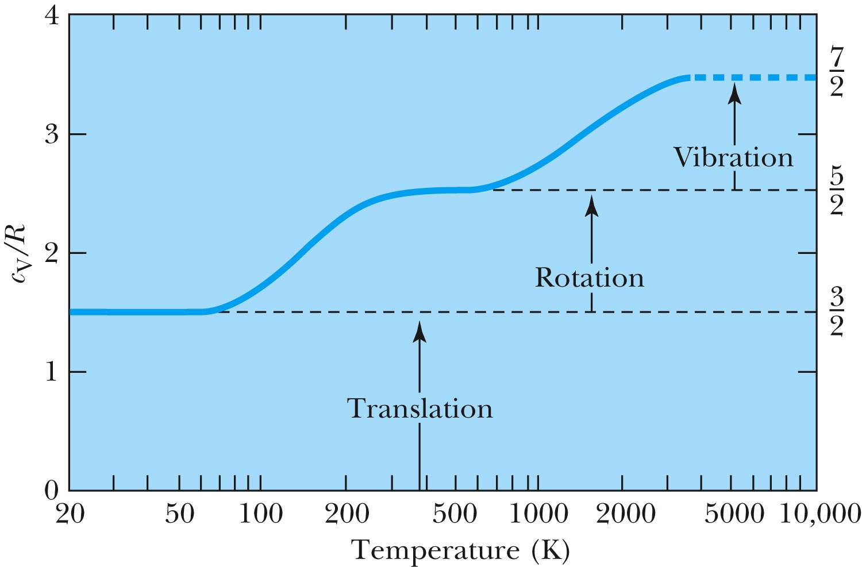
Experimental Demonstration of Equi-partition Principle
=f/2

Slide 16
Primary Results of Thermodynamics
Introduced thermal equilibrium
The first law establishes heat as energy
Introduces the concept of internal energy
Interprets temperature as a measure of the internal energy
Generates limitations of the energy processes that cannot take place

Slide 17
Concept of Waves and Particles
Two ways in which energy is transported:
Point mass interaction: transfers of momentum and kinetic energy: particles
Extended regions wherein energy transfers by way of vibrations and rotations are observed: waves

Slide 18
Particles vs. Waves
Two distinct phenomena describing physical interactions
  Both required Newtonian mass
  Particles in the form of point masses and waves in the form of perturbation in a mass distribution, i.e., a material medium
  The distinctions are observationally quite clear
    However, not so obvious for the case of visible light
  Thus as the 17th century begins the major disagreement arose concerning the nature of light

Slide 19
The Nature of Light
Isaac Newton promoted the corpuscular (particle) theory
  Published a book “Optiks” in 1704
  Particles of light travel in straight lines or rays
  Explained sharp shadows
  Explained reflection and refraction
Christian Huygens (1629 -1695) promoted the wave theory
  Presented the theory in 1678
  Light propagates as a wave of concentric circles from the point of origin
  Explained reflection and refraction
  Could not explain “sharp” edges of the shadow
Thomas Young (1773 -1829) & Augustin Fresnel (1788 – 1829) ➔ Showed in 1802 and afterward that light clearly behaves as wave through two slit interference and other experiments
In 1850 Foucault showed that light travel slowly in water than air, the final blow to the corpuscular theory in explaining refraction

Slide 20
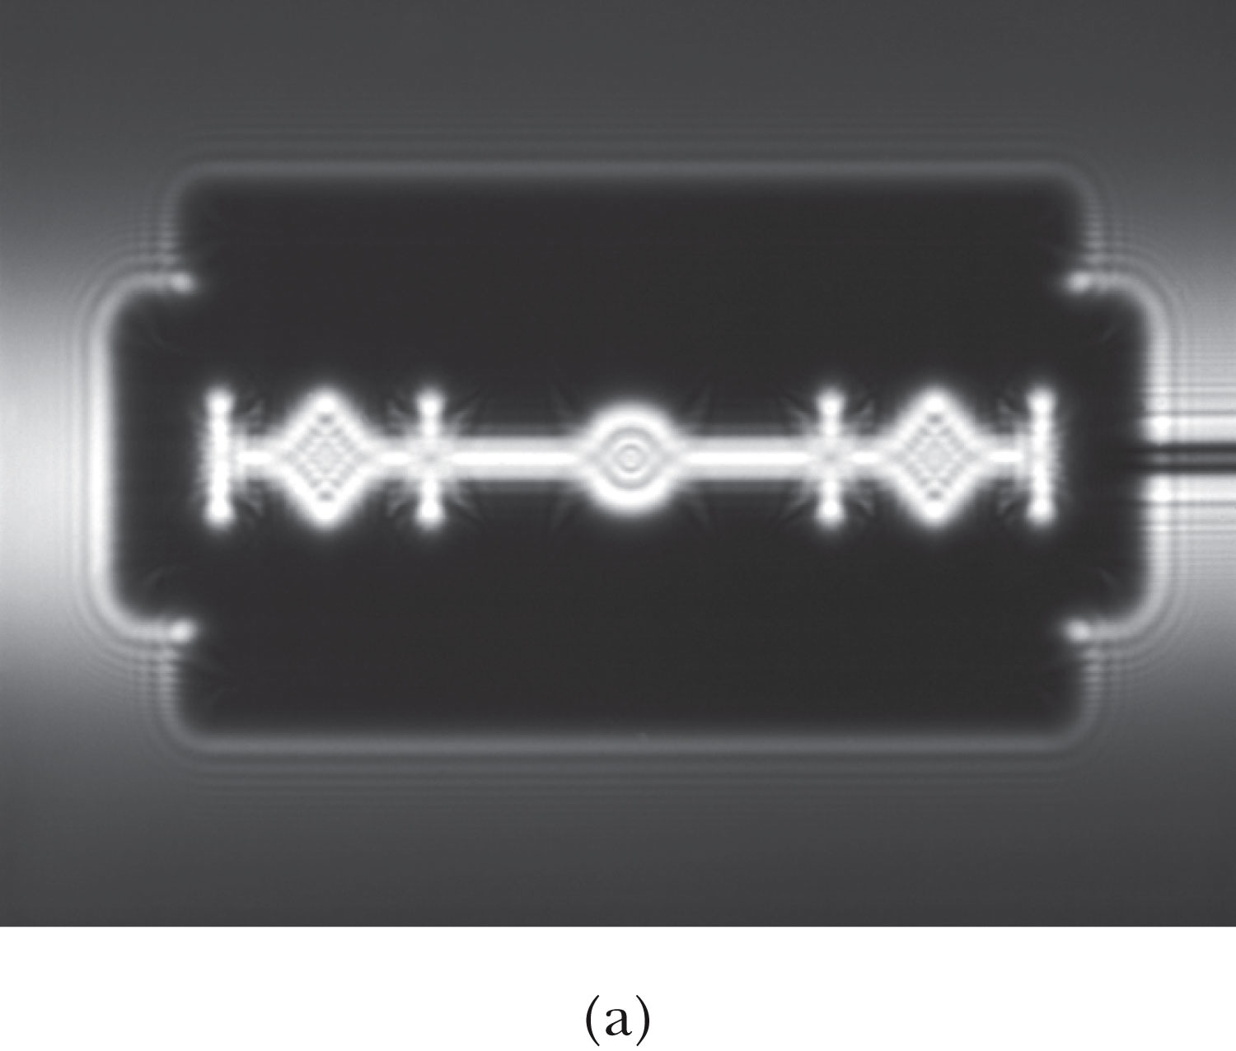
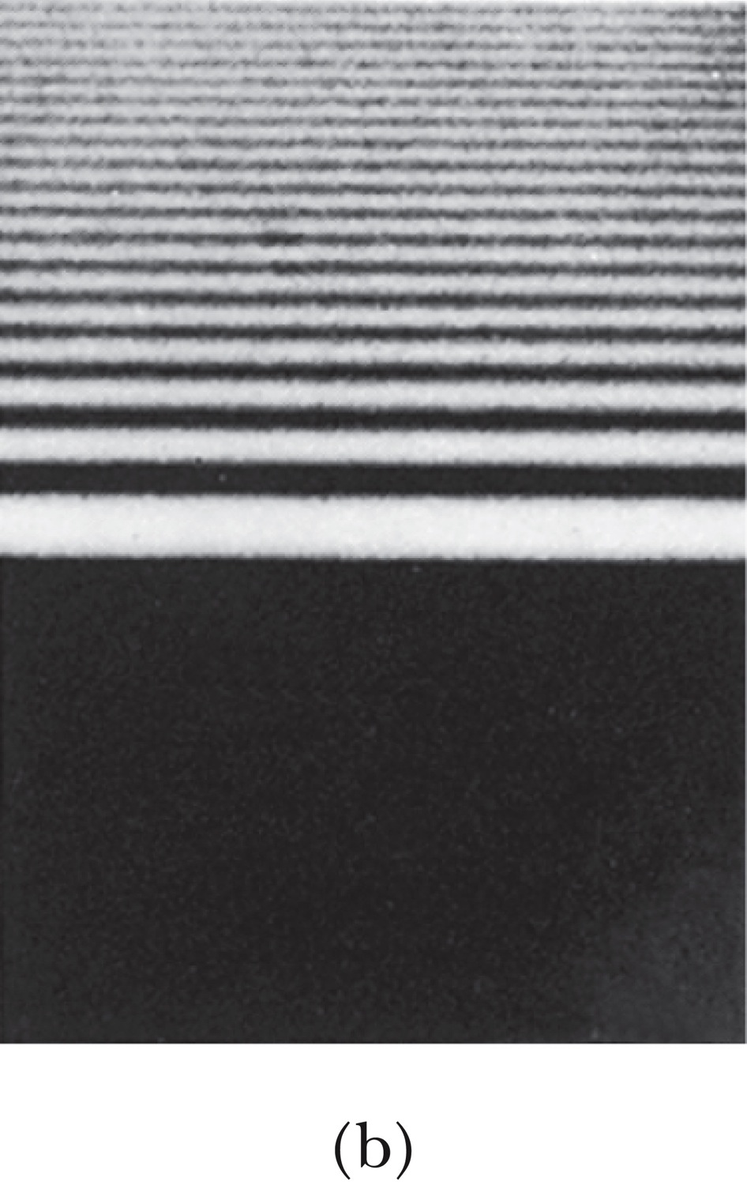
The Wave Theory Advances…
Contributions by Huygens, Young, Fresnel and Maxwell
Double-slit interference patterns
Refraction of light from the vacuum to a medium
Light was an electromagnetic phenomenon
Shadows are not as sharp as once thought with the advancement of experimental precision
Establishes the idea that light propagates as a wave

Slide 21
The Electromagnetic Spectrum
Visible light covers only a small range of the total electromagnetic spectrum
All electromagnetic waves travel in vacuum with the speed c given by:
(where μ₀ and ε₀ are the respective permeability and permittivity of “free” space)

