Slide 1
PHYS 3313 – Section 001
Lecture #4
Monday, Jan. 30, 2017
Dr. Jaehoon Yu
Conservation Laws and Fundamental Forces
Atomic Theory of Matter
Unsolved Questions of 1895 and the New Horizon
Unsolved Questions Today!
Galilean Transformation
Do we need Ether?

Slide 2
Announcements
Reading assignments: CH 2.10 (special topic), 2.13 and 2.14
  Please go through eq. 2.45 through eq. 2.49 and example 2.9
Homework #1
  chapter 2 end of the chapter problems
  17, 21, 23, 24, 32, 59, 61, 66, 68, 81 and 96
  Due is by the beginning of the class, Wednesday, Feb. 8
  Work in study groups together with other students but PLEASE do write your answer in your own way!
Quiz #1 results
  Class average: 22/100
  Top score: 73/100

Slide 3
Research Projects
Each of the 9 research groups has an assigned research topic

Slide 4
Research Topics
Blackbody radiation
Michelson–Morley Experiment
The Photoelectric Effect
The Brownian Motion
Compton Effect
Discovery of Electron
Rutherford Scattering
Super-conductivity
The Discovery of Radioactivity

Slide 5
Research Projects
Each of the 9 research groups has an assigned research topic
Study the topic as a group, looking up references
  Original theory or Original observation
  Experimental proofs or Theoretical prediction + subsequent experimental proofs
  Importance and the impact of the theory/experiment
Each member of the group writes a 5 – 7 page report, including figures (must not copy!!)
  10% of the total grade
  Can share the theme and facts but you must write your own!
  Due beginning of the class Wed. Apr. 26, 2017
Each group presents a 10+2min power point talk
  5% of the total grade
  Date and time will be announced close to the end of the semester

Slide 6
Reminder: Research Project Report
Must contain the following at the minimum
  Original theory or Original observation
  Experimental proofs or Theoretical prediction + subsequent experimental proofs
  Importance and the impact of the theory/experiment
  Conclusions and future prospects
  The reference to the original paper must be included!
  Bibliography referring to web site must be minimized (<20%)

Slide 7
Project Report Template

Slide 8
Research Presentations
Each of the 9 research groups makes a 10+2min presentation
  10min presentation + 2min Q&A
  All presentations must be in power point
  I must receive all final presentation files by 8pm, Sunday, Apr. 23, 2017
    No changes are allowed afterward
  The representative of the group makes the presentation followed by all group members’ participation in the Q&A session
Date and time:
  In class Monday and Wednesday, Apr. 24 and 26, 2017
Important metrics
  Contents of the presentation: 60%
    Inclusion of all important points as mentioned in the report
    The quality of the research and making the right points
  Quality of the presentation itself: 15%
  Presentation manner: 10%
  Q&A handling: 10%
  Staying in the allotted presentation time: 5%
  Judging participation and sincerity: 5%

Slide 9
Conservation Laws and Fundamental Forces
Conservations laws are the guiding principles of physics
Recall the fundamental conservation laws:
  Conservation of energy
  Conservation of linear momentum
  Conservation of angular momentum
  Conservation of electric charge
In addition to the classical conservation laws, two modern results include:
  The conservation of the number of baryons and leptons
  The fundamental invariance principles for time reversal, distance, and parity

Slide 10
Also in the Modern Context…
The three fundamental forces are introduced
  Gravitational:
    Responsible for planetary motions, holding things on the ground, etc
  Electroweak (unified at high energies)
    Weak: Responsible for the nuclear beta decay and effective only over distances of ~10⁻¹⁵ m
    Electromagnetic: Responsible for all non-gravitational interactions, such as all chemical reactions, friction, tension….
    (Coulomb force)
  Strong: Responsible for “holding” the nucleus together and effective in the distance less than ~10⁻¹⁵ m

Slide 11
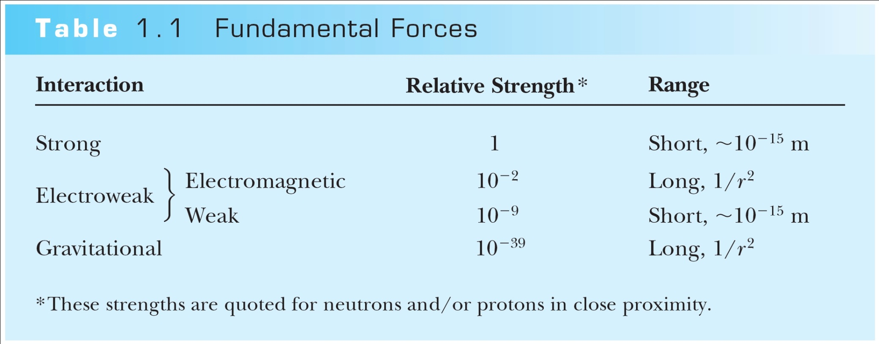
Relative Strength of Fundamental Forces

Slide 12
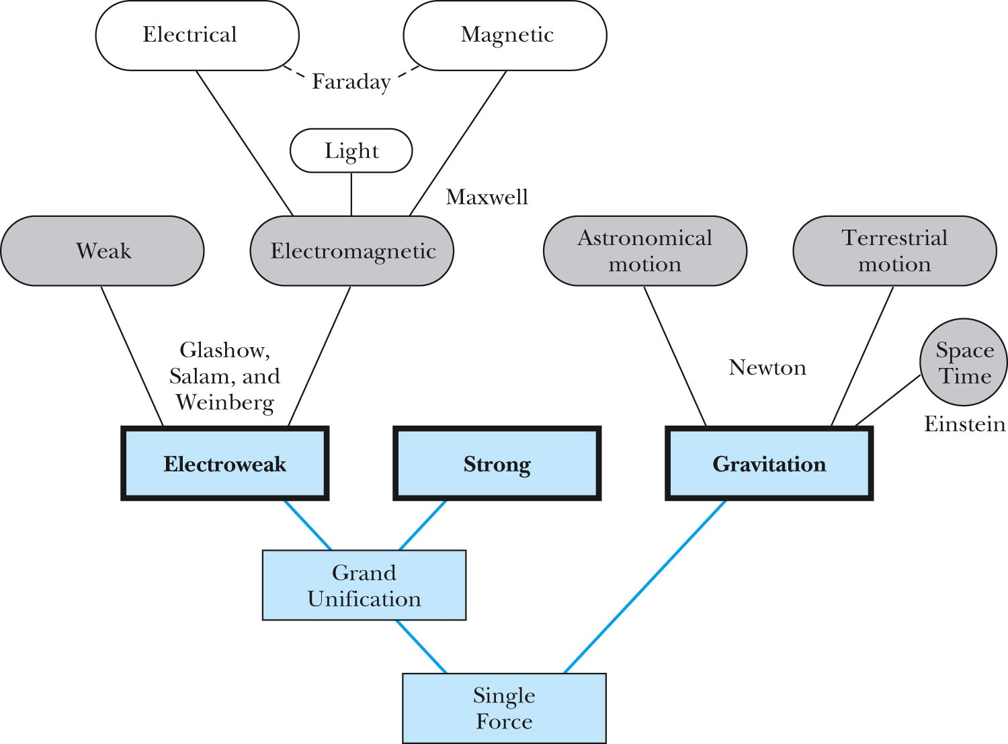
Unification of Forces
GUT, String theory
Not yet experimentally verified: p decays, magnetic monopole

Slide 13
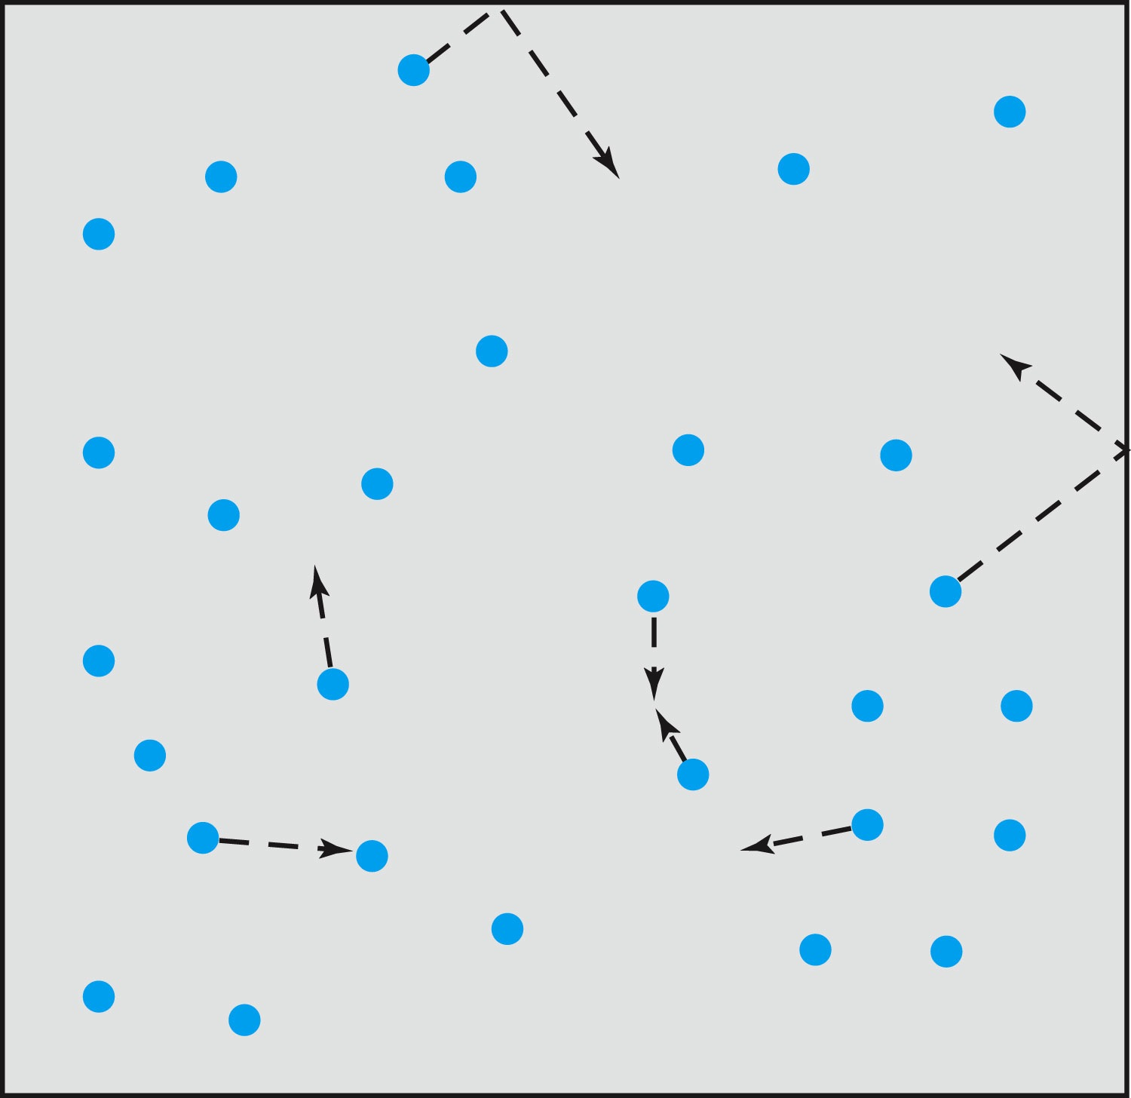
Relevance of Gas Concept to Atoms
The idea of gas (17th century) as a collection of small particles bouncing around with kinetic energy enabled the concept of small, unseen objects
This concept formed the bases of existence of something small that makes up matter

Slide 14
The Atomic Theory of Matter
Concept initiated by Democritus and Leucippus (~450 B.C.) (first to use the Greek atomos, meaning “indivisible”)
In addition to fundamental contributions by Boyle, Charles, and Gay-Lussac, Proust (1754 – 1826) proposes the law of definite proportions➔ For a compound of 2 or more elements, the weight proportion of the elements is always the same
Dalton advances the atomic theory of matter to explain the law of definite proportions
Avogadro proposed that all gases at the same temperature, pressure, and volume contain the same number of molecules (atoms); viz. 6.02 × 10²³ atoms
Cannizzaro (1826 – 1910) makes a distinction between atoms and molecules advancing the ideas of Avogadro.

Slide 15
Further Advances in Atomic Theory
Maxwell derives the speed distribution of atoms in a gas
Robert Brown (1753 – 1858), a botanist, observes microscopic “random” motion of suspended grains of pollen in water in 1811 (Brownian motion)
Einstein in the 20th century explains this random motion using atomic theory (~100 year later!)

Slide 16
Opposition to the Atomic Theory
Ernst Mach (1838 – 1916) opposes the theory on the basis of logical positivism, i.e., atoms being “unseen” questions their reality
Wilhelm Ostwald (1853 – 1932) supports Mach’s premise and called atoms hypothetical structures for bookkeeping based on experimental results of radioactivity, discrete spectral lines, and the formation of molecular structures

Slide 17
Overwhelming Evidence for Existence of Atoms
Max Planck (1858 – 1947) advances the concept to explain blackbody radiation, using submicroscopic “quanta”
Boltzmann requires existence of atoms for advances in statistical mechanics
Albert Einstein (1879 – 1955) uses molecules to explain Brownian motion and determines the approximate value of their sizes and masses
Jean Perrin (1870 – 1942) experimentally verifies Einstein’s predictions

Slide 18
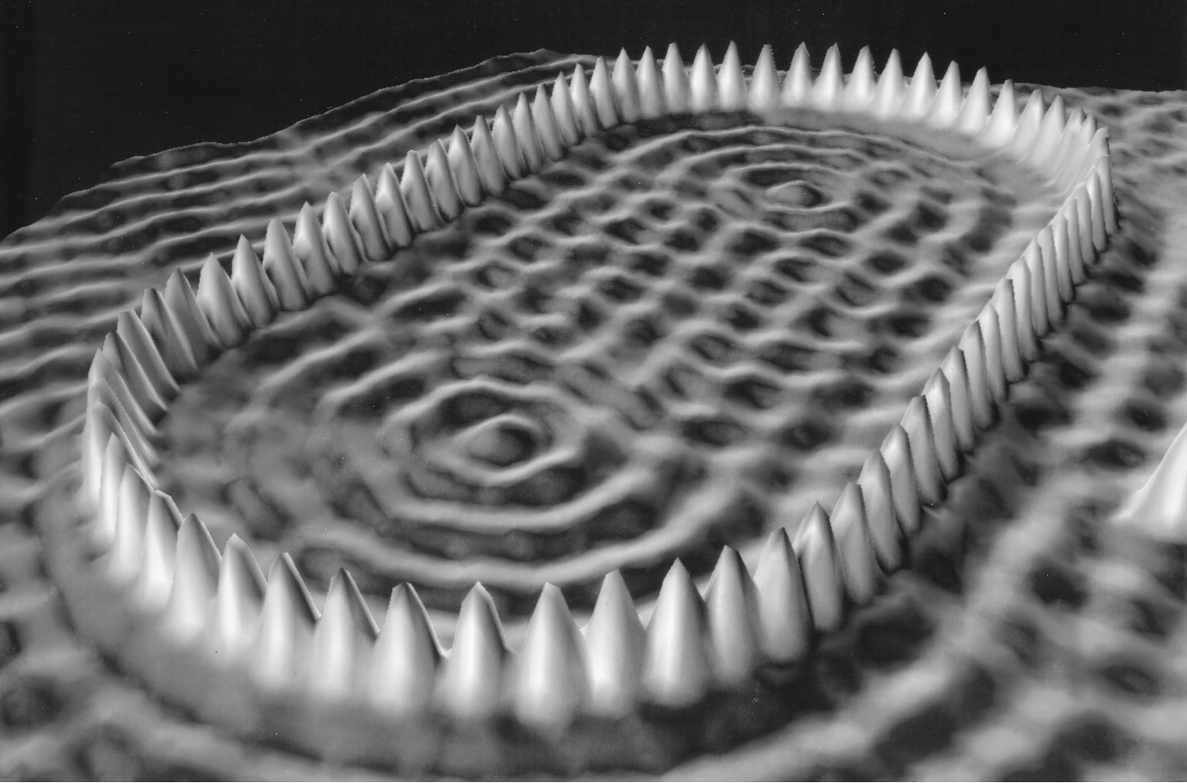
Unresolved Questions and New Horizons
The atomic theory controversy raises fundamental questions
  It was not universally accepted
  The constituents (if any) of atoms became a significant question
  The structure of matter remained unknown with certainty
  Experimental precisions were insufficient to discern this level of small scale

Slide 19
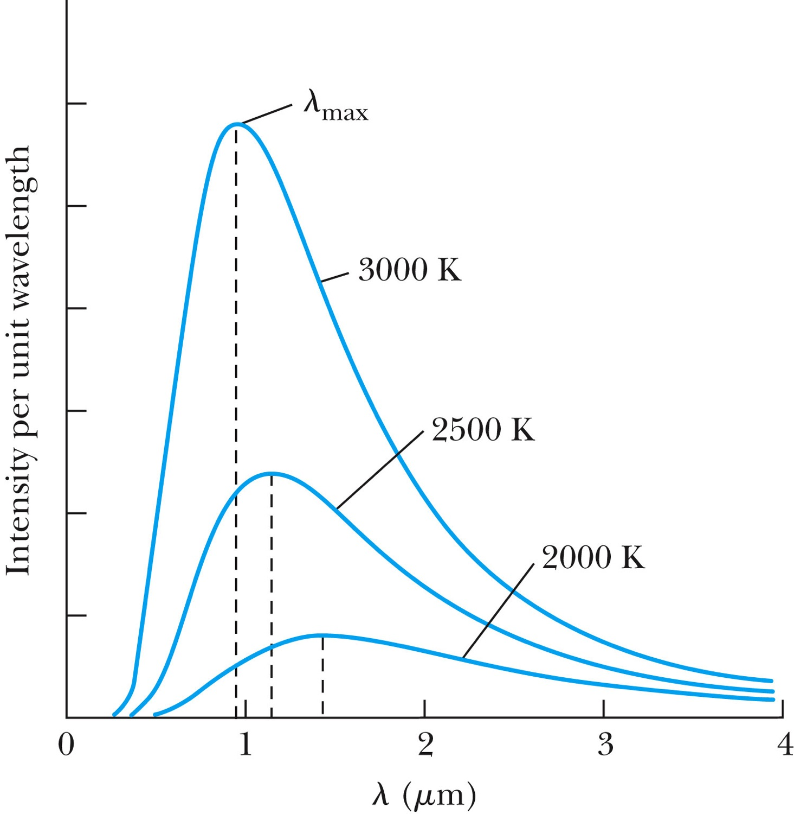
Further Complications
Three fundamental problems:
The (non) existence of a medium that transmits light waves from the sun – the electromagnetic medium
The observed differences in the electric and magnetic fields between stationary and moving reference systems
The failure of classical physics to explain blackbody radiation in which characteristic spectra of radiation that cover the entire EM wavelengths were observed depending on temperature not on the body itself!!
  Max Planck energy quantization

Slide 20
Additional Experimental Discoveries Contribute to the Complications
Discovery of x-rays (1895, Röntgen)
Discovery of radioactivity (1896, Becquerel)
Discovery of the electron (1897, Thompson)
Discovery of the Zeeman effect (1896, Zeeman), the dependence of spectral frequency on magnetic field

Slide 21
The Beginnings of Modern Physics
These new discoveries and the many resulting complications required a revision of the fundamental physical assumptions culminated on the successes of the classical foundations
To this end, the introduction of the modern theory of relativity and quantum mechanics becomes the starting point of this most fascinating revision
  1900 Max Planck’s Radiation Law
  1905 Einstein’s three papers: Brownian Motion, the Photo-electric effect, and the Special Relativity
  Broadened the horizon of physics!!

Slide 22
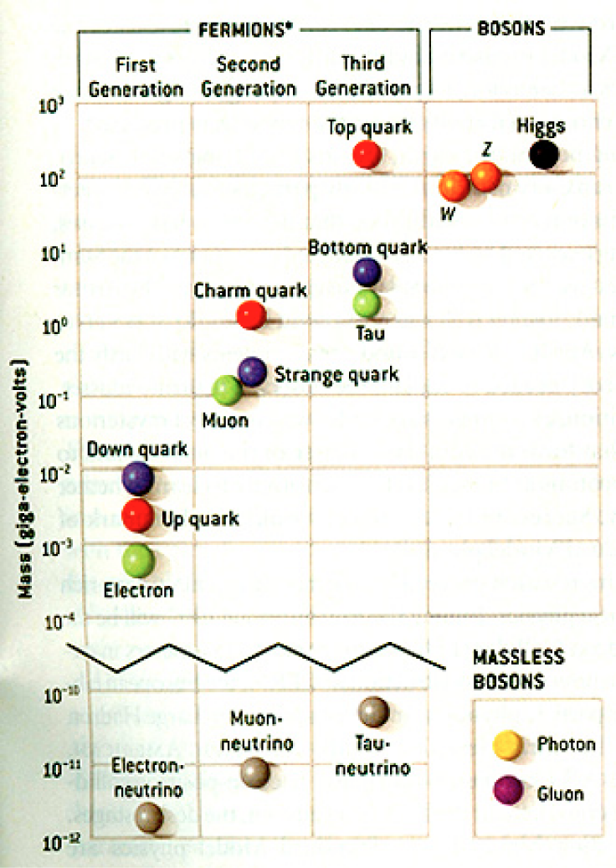
HEP and the Standard Model
Discovered in 1995, ~175m_{p}
Make up most ordinary matters ~0.1m_{p}
Total of 16 particles (12+4 force mediators) make up all the visible matter in the universe! ➔ Simple and elegant!!!
Tested to a precision of 1 part per million!

Slide 23
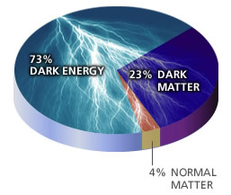
Unsolved Problems Today!
Why are there three families of quarks and leptons?
Why is the mass range so large (0.1m_{p} – 175 m_{p})?
How do matters acquire mass?
  Is the new particle we’ve discovered the Higgs particle?
Why is the matter in the universe made only of particles?
  What happened to anti-particles? Or anti-matters?
Do neutrinos have mass & what are the mixing parameters?
Why are there only three apparent forces?
Is the picture we present the real thing?
  What makes up the 95% of the universe?
  How about extra-dimensions?
How is the universe created?
Are there any other theories that describe the universe better?
Many more questions to be answered!!

