Slide 1
PHYS 3313 – Section 001
Lecture #5
Wednesday, Feb. 1, 2017
Dr. Jaehoon Yu
Galilean Transformation
Do we need Ether?
Michelson-Morley Experiment
Einstein’s postulates
Lorentz Transformations

Slide 2
Announcements
Reading assignments: CH 2.10 (special topic), 2.13 and 2.14
  Please go through eq. 2.45 through eq. 2.49 and example 2.9
Reminder: Homework #1
  chapter 2 end of the chapter problems
  17, 21, 23, 24, 32, 59, 61, 66, 68, 81 and 96
  Due is by the beginning of the class, Wednesday, Feb. 8
  Work in study groups together with other students but PLEASE do write your answer in your own way!
Colloquium today
  Dr. C.K.Shih of UT Austin

Slide 4
Special Project #3
Derive the three Lorentz velocity transformation equations, starting from Lorentz coordinate transformation equations. (10 points)
Derive the three reverse Lorentz velocity transformation equations, starting from Lorentz coordinate transformation equations. (10 points)
Prove that the space-time invariant quantity s²=x²-(ct)² is indeed invariant, i.e. s²=s’², in Lorentz Transformation. (5 points)
You must derive each one separately starting from the Lorentz spatial coordinate transformation equations to obtain any credit.
  Just simply switching the signs and primes will NOT be sufficient!
  Must take the simplest form of the equations, using β and γ.
You MUST have your own, independent handwritten answers to the above three questions even if you worked together with others. All those who share the answers will get 0 credit if copied.
Due for the submission is this Monday, Feb. 13!

Slide 5
Newtonian (Classical) Relativity
It is assumed that Newton’s laws of motion must be measured with respect to (relative to) some reference frame.
A reference frame is called an inertial frame if Newton’s laws are valid in that frame.
Such a frame is established when a body, not subjected to a net external force, is observed to move in rectilinear motion at constant velocity
➔ Newtonian Principle of Relativity (Galilean Invariance): If Newton’s laws are valid in one reference frame, then they are also valid in another reference frame moving at a uniform velocity relative to the first system.

Slide 6
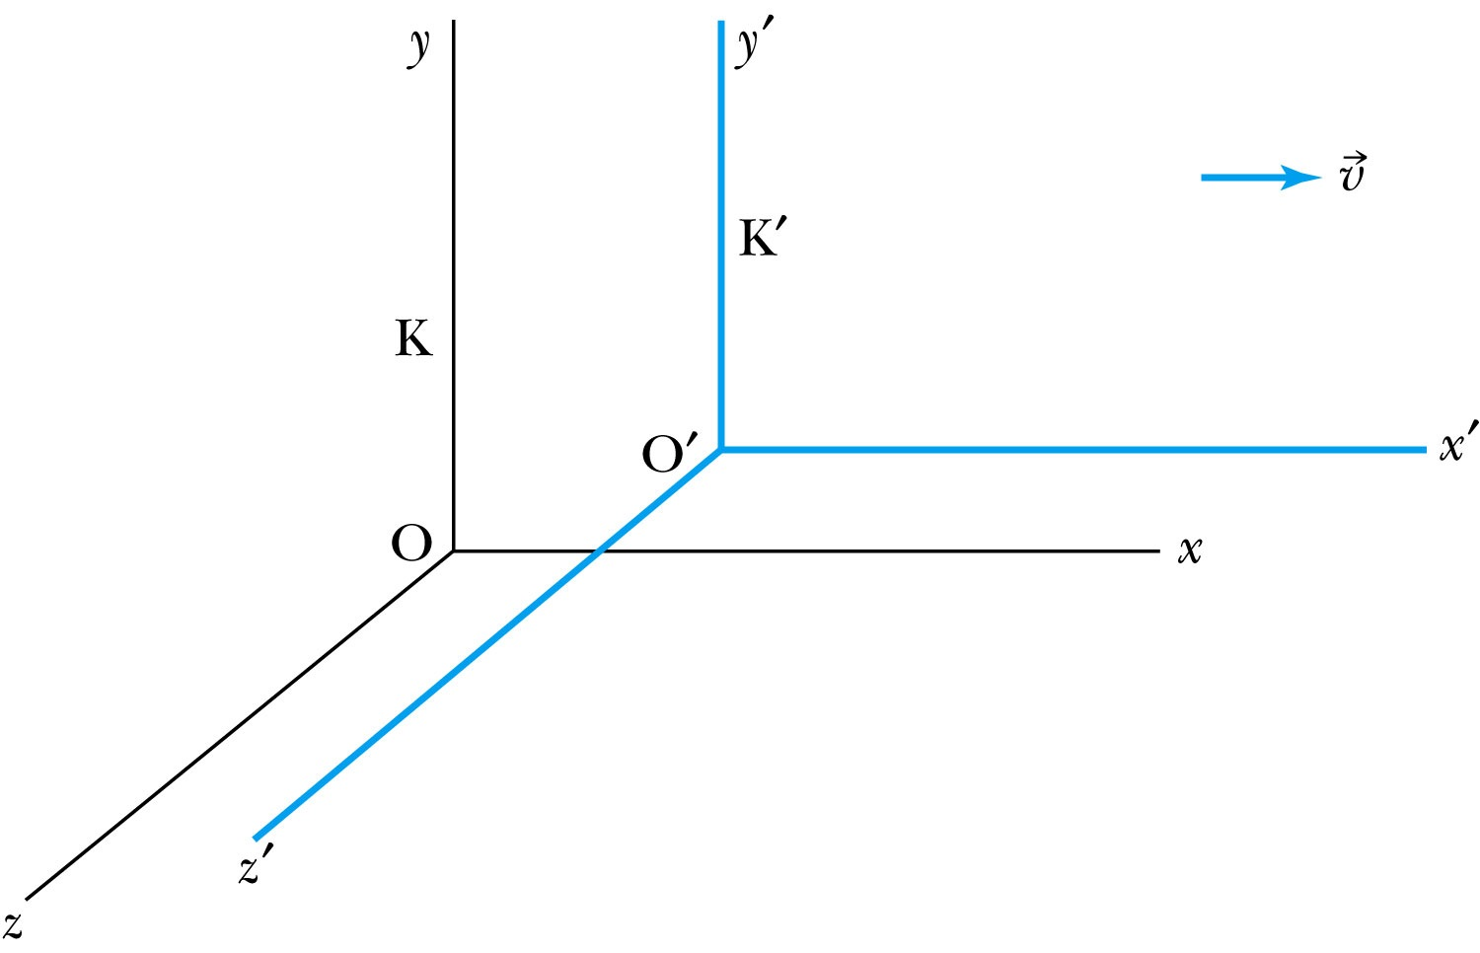
Inertial Frames K and K’
K is at rest and K’ is moving with a constant velocity
Axes are parallel
K and K’ are said to be INERTIAL COORDINATE SYSTEMS

Slide 7
The Galilean Transformation
For a point P
  In system K: P = (x, y, z, t)
  In system K’: P = (x’, y’, z’, t’)
P
x
K
K’
x’-axis
x-axis

Slide 8
Conditions of the Galilean Transformation
Parallel axes between the two inertial reference frames
K’ has a constant relative velocity in the x-direction with respect to K
Time (t) for all observers is a Fundamental invariant, i.e., the same for all inertial observers
  Space and time are separate!!

Slide 9
The Inverse Relations
Step 1. Replace with
Step 2. Replace “primed” quantities with
“unprimed” and “unprimed” with “primed”

Slide 10
The Transition to Modern Relativity
Although Newton’s laws of motion had the same form under the Galilean transformation, Maxwell’s equations did not.
In 1905, Albert Einstein proposed a fundamental connection between space and time and that Newton’s laws are only an approximation.

Slide 11
They Needed Ether!!
The wave nature of light suggested that there existed a propagation medium called the luminiferous ether or just ether.
  Provides an inertial reference frame
The properties of ether
  Very low density for planets to move through it without the loss of energy
  Sufficiently high elasticity to support the high velocity of light waves (c=?)

Slide 12
Ether as the Absolute Reference System
In Maxwell’s theory, the speed of light is given by
  The velocity of light between the moving systems must be a constant.
    Can you see why?
  Needed a system of medium that keeps this constant!
Ether proposed as the absolute reference system in which the speed of light is constant and from which other measurements could be made.
The Michelson-Morley experiment was an attempt to show the existence of ether.

Slide 13
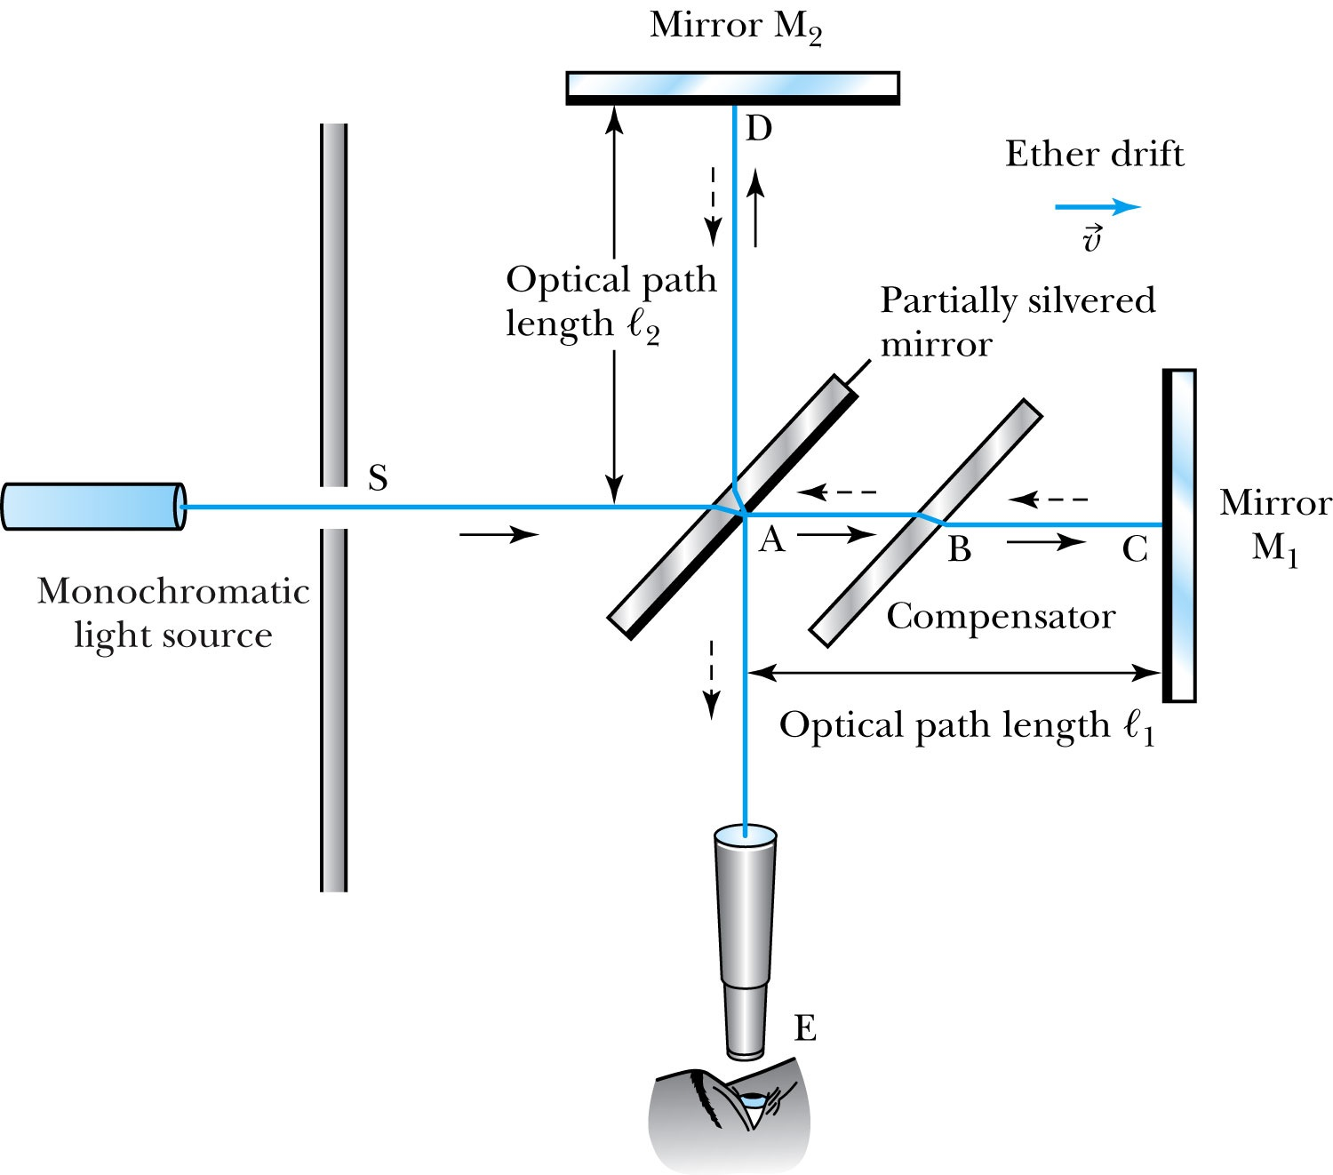
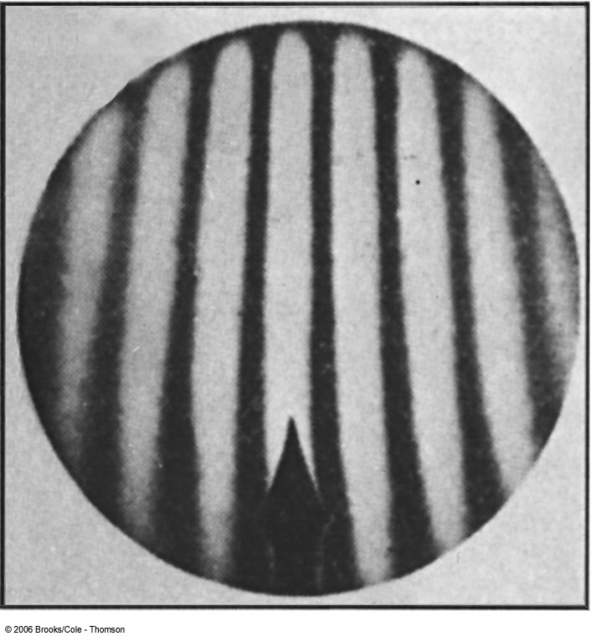
The Michelson-Morley Experiment
Albert Michelson (1852–1931) built an extremely precise device called the interferometer to measure the phase difference between two light waves traveling in orthogonal directions.

Slide 14
How does Michelson Interferometer work?
AC is parallel to the motion of the Earth inducing an “ether wind”
Light from source S is split by mirror A and travels to mirrors C and D in mutually perpendicular directions
After reflection the beams recombine at A slightly out of phase due to the “ether wind” as viewed by telescope E.
Ether

Slide 15
The analysis – Galilean X-formation
Travel time t₁ for a round trip over AC (the ether direction) is
Travel time t₂ for a round trip over AD (perpendicular direction to ether) is
The time difference is
c
v

Slide 16
The analysis
After rotating the machine by 90º, the time difference becomes
The difference of the time differences
Since v (the Earth’s speed) is 10⁻⁴ of c, we can do binomial expansion of the above

Slide 17
The Results
Using the Earth’s orbital speed as:
V = 3 × 10⁴ m/s
together with
ℓ₁ ≈ ℓ₂ = 1.2 m
So that the time difference becomes
Δt’ − Δt ≈ v²(ℓ₁ + ℓ₂)/c³ = 8 × 10⁻¹⁷ s
Although a very small number, it was within the experimental range of measurement for light waves.
Later with Morley, they increased the path lengths to 11m and improved precision better than a factor of 10
Yet, Michelson FAILED to “see” the expected interference pattern

Slide 18
Conclusions of Michelson Experiment
Michelson noted that he should be able to detect a phase shift of light due to the time difference between path lengths but found none.
He thus concluded that the hypothesis of the stationary ether must be incorrect.
After several repeats and refinements with assistance from Edward Morley (1893-1923), again a null result.
Thus, ether does not seem to exist!
Many explanations ensued afterward but none worked out!
This experiment shattered the popular belief of light being waves

Slide 19
The Lorentz-FitzGerald Contraction
Another hypothesis proposed independently by both H. A. Lorentz and G. F. FitzGerald suggested that the length ℓ₁, in the direction of the motion was contracted by a factor of
Thus making the path lengths equal to account for the zero phase shift.
  This, however, was an ad hoc assumption that could not be experimentally tested.

Slide 20
Einstein’s Postulates
Fundamental assumption: Maxwell’s equations must be valid in all inertial frames
The principle of relativity: The laws of physics are the same in all inertial systems. There is no way to detect absolute motion, and no preferred inertial system exists
  Published a paper in 1905 at the age 26
  Believed the principle of relativity to be fundamental
The constancy of the speed of light: Observers in all inertial systems measure the same value for the speed of light in a vacuum.

Slide 21
The Lorentz Transformations
General linear transformation relationship between P=(x, y, z, t) in frame S and P’=(x’,y’,z’,t’) in frame S’ ➔ these assume measurements are made in S frame and transferred to S’ frame
preserve the constancy of the speed of light between inertial observers
account for the problem of simultaneity between these observers
With the definitions and

Slide 22
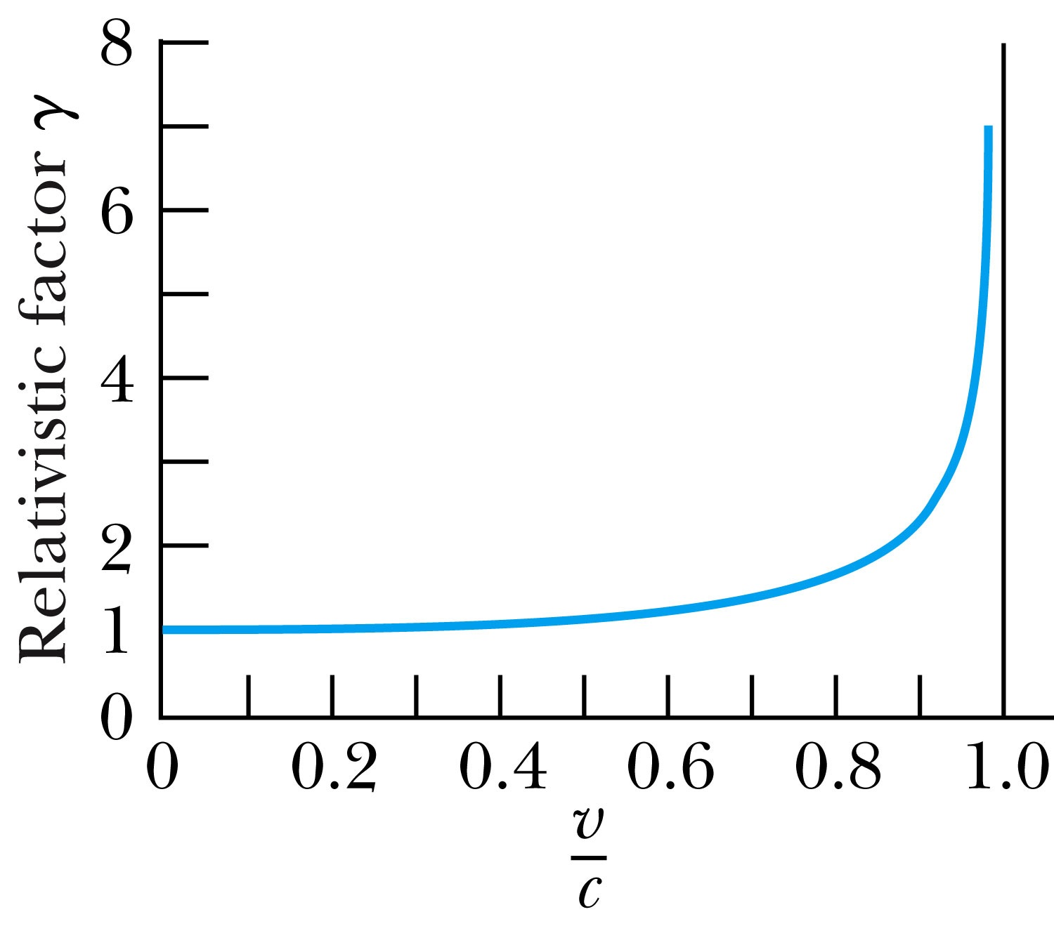
Properties of the Relativistic Factor γ
What is the property of the relativistic factor, γ?
Is it bigger or smaller than 1?
Recall Einstein’s postulate, β = v/c < 1 for all observers
γ = 1 only when v = 0

