Slide 1
PHYS 3313 – Section 001
Lecture #7
Wednesday, Feb. 8, 2017
Dr. Jaehoon Yu
Relativistic Velocity Addition
The Twin Paradox
Space-time Diagram
Invariant Quantities
The Relativistic Doppler Effect
Relativistic Momentum and Energy

Slide 2
Announcements
Submit homework #1 now!
Reading assignments: CH 3.3 (special topic – the discovery of Helium) and CH3.7
Colloquium today
  Dr. Cosmin Deaconu, Univ. of Chicago
  Radio-detection of Extreme High Energy Neutrinos in Polar Ice

Slide 3
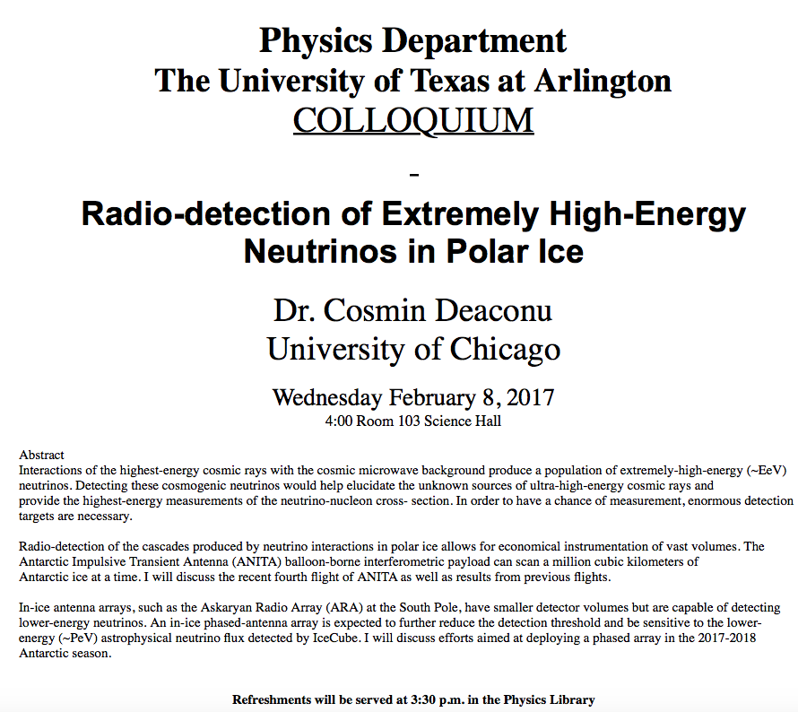

Slide 4
Reminder: Special Project #3
Derive the three Lorentz velocity transformation equations, starting from Lorentz coordinate transformation equations. (10 points)
Derive the three reverse Lorentz velocity transformation equations, starting from Lorentz coordinate transformation equations. (10 points)
Prove that the space-time invariant quantity s²=x²-(ct)² is indeed invariant, i.e. s²=s’², in Lorentz Transformation. (5 points)
You must derive each one separately starting from the Lorentz spatial coordinate transformation equations to obtain any credit.
  Just simply switching the signs and primes will NOT be sufficient!
  Must take the simplest form of the equations, using β and γ.
You MUST have your own, independent handwritten answers to the above three questions even if you worked together with others. All those who share the answers will get 0 credit if copied.
Due for the submission is this Monday, Feb. 13!

Slide 5
The Complete Lorentz Transformations

Slide 6
Addition of Velocities
How do we add velocities in a relativistic case?
Taking differentials of the Lorentz transformation, relative velocities may be calculated:

Slide 7
So that…
defining velocities as: v_{x} = dx/dt, v_{y} = dy/dt, v’_{x} = dx’/dt’, etc. it can be shown that:
With similar relations for v_{y} and v_{z:}

Slide 8
The Lorentz Velocity Transformations
In addition to the previous relations, the Lorentz velocity transformations for v’_{x}, v’_{y} , and v’_{z} can be obtained by switching primed and unprimed and changing v to –v.(the velocity of the moving frame!!)

Slide 9
Velocity Addition Summary
Galilean Velocity addition where and
From inverse Lorentz transform and
So
Thus
What would be the measured speed of light in S frame?
  Since we get
Observer in S frame measures c too! Strange but true!

Slide 10
Velocity Addition Example
Tom Brady is riding his bus at 0.8c relative to the observer. He throws a ball at 0.7c in the direction of his motion. What speed does the observer see?
What if he threw it just a bit harder?
Doesn’t help—asymptotically approach c, can’t exceed (it’s not just a postulate it’s the law)

Slide 11
A test of Lorentz velocity addition: π⁰ decay
How can one test experimentally the correctness of the Lorentz velocity transformation vs Galilean one?
In 1964, T. Alvager and company performed a measurements of the arrival time of two photons resulting from the decay of a π⁰ in two detectors separated by 30m.
Each photon has a speed of 0.99975c. What are the speed predicted by Galilean and Lorentz x-mation?
  v_{G}=c+0.99975c=1.99975c
How much time does the photon take to arrive at the detector?

