Slide 1
PHYS 3313 – Section 001
Lecture #8
Monday, Feb. 13, 2017
Dr. Jaehoon Yu
The Twin Paradox
Space-time Diagram
Invariant Quantities
The Relativistic Doppler Effect
Relativistic Momentum and Energy

Slide 2
Announcements
Quiz #2 Monday, Feb. 20
  Beginning of the class
  Covers CH1.1 – what we finish this this Wednesday, Feb. 15
  Bring your calculator!
    No phones or any type of computer allowed
  BYOF – Bring Your Own Formula
    Hand written formula and constants on front-n-back of a letter size sheet
      Lorentz Transformation Formulae are OK
    No solutions of any problems of any kind
    No derivations
      Lorentz velocity addition NOT allowed!!

Slide 3
Twin Paradox
The Set-up: Twins Mary and Frank at age 30 decide on two career paths: Mary (the Moving twin) decides to become an astronaut and to leave on a trip 8 light-years (ly) from the Earth at a great speed and to return; Frank (the Fixed twin) decides to stay on the Earth.
The Problem: Upon Mary’s return, Frank reasons, that her clocks measuring her age must run slow. As such, she will return younger. However, Mary claims that it is Frank who is moving and consequently his clocks must run slow.
The Paradox: Who is younger upon Mary’s return?

Slide 4
Twin Paradox cont’d
Let’s say, Mary is traveling at the speed of 0.8c
Frank will measure Mary’s total travel time as
  T=8ly/0.8c=10yrs
Mary’s clock will run slower due to relativity:
Thus, Frank claims that Mary will be 42 years old while he is 50 years old
Who is correct?

Slide 5
The Resolution
Frank’s clock is in an inertial system during the entire trip; however, Mary’s clock is not. As long as Mary is traveling at constant speed away from Frank, both of them can argue that the other twin is aging slower.
When Mary slows down to turn around, she leaves her original inertial system and eventually returns in a completely different inertial system.
Mary’s claim is no longer valid, because she does not remain in the same inertial system. There is also no doubt as to who is in the inertial system. Frank feels no acceleration during Mary’s entire trip, but Mary does.
So Frank is correct! Mary is younger!

Slide 6
Space-time
When describing events in relativity, it is convenient to represent events on a space-time diagram.
In this diagram one spatial coordinate x specifies the position, and instead of time t, ct is used as the other coordinate so that both coordinates have the same dimensions of length.
Space-time diagrams were first used by H. Minkowski in 1908 and are often called Minkowski diagrams. Paths on Minkowski space-time diagram are called worldlines.

Slide 7
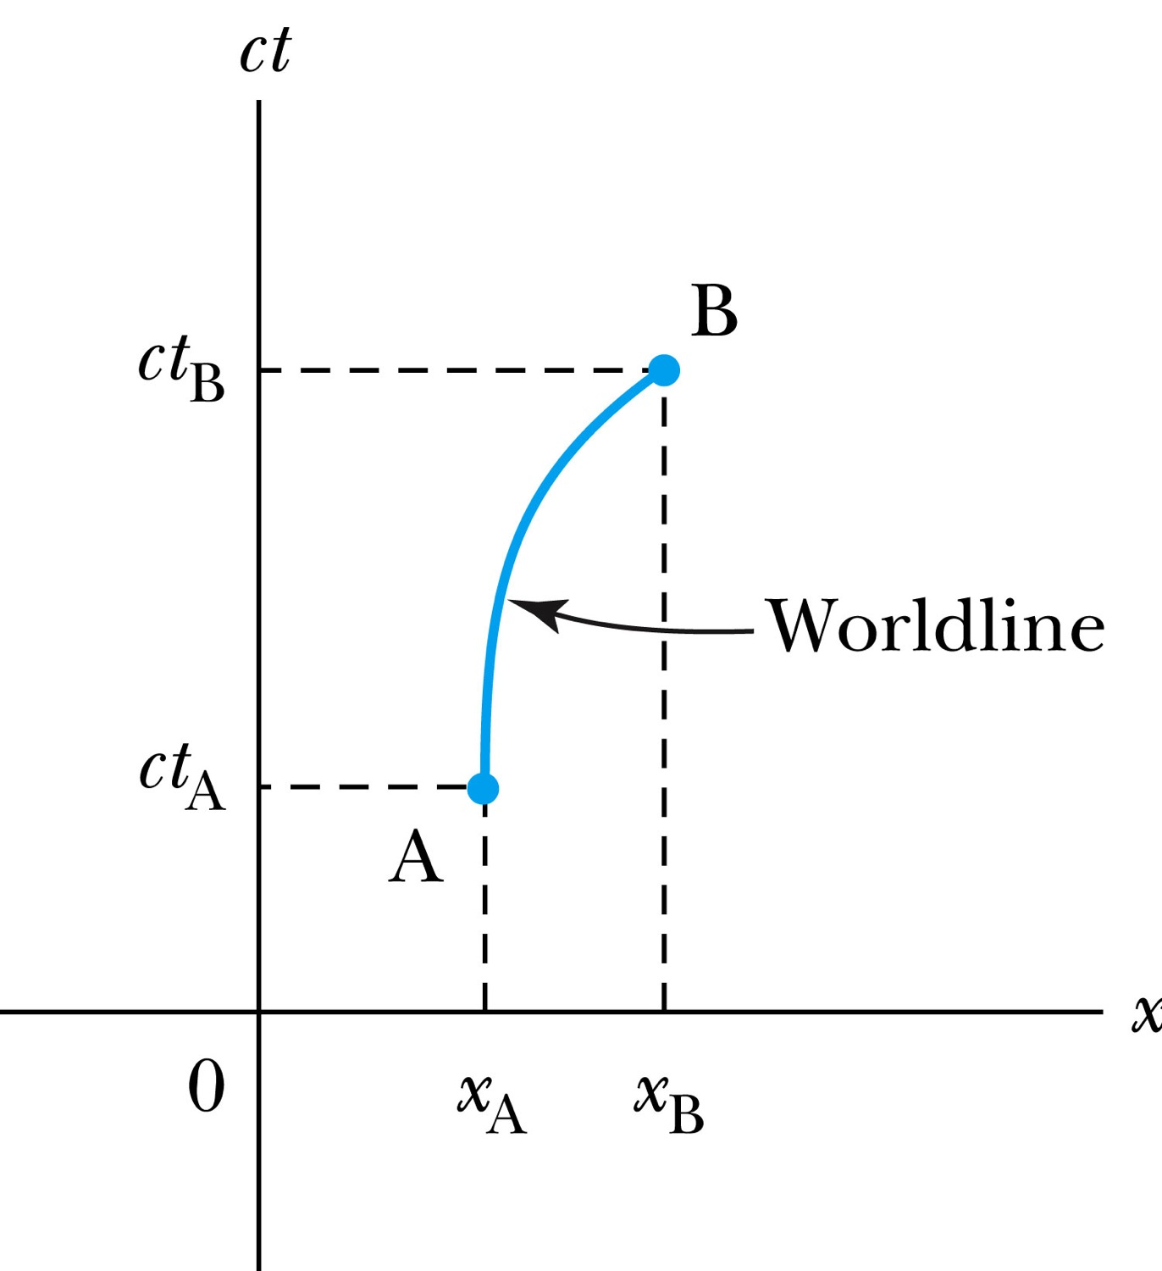
The Space-time Diagram
Notes:
Add the paragraph for Figure 2.21

Slide 8
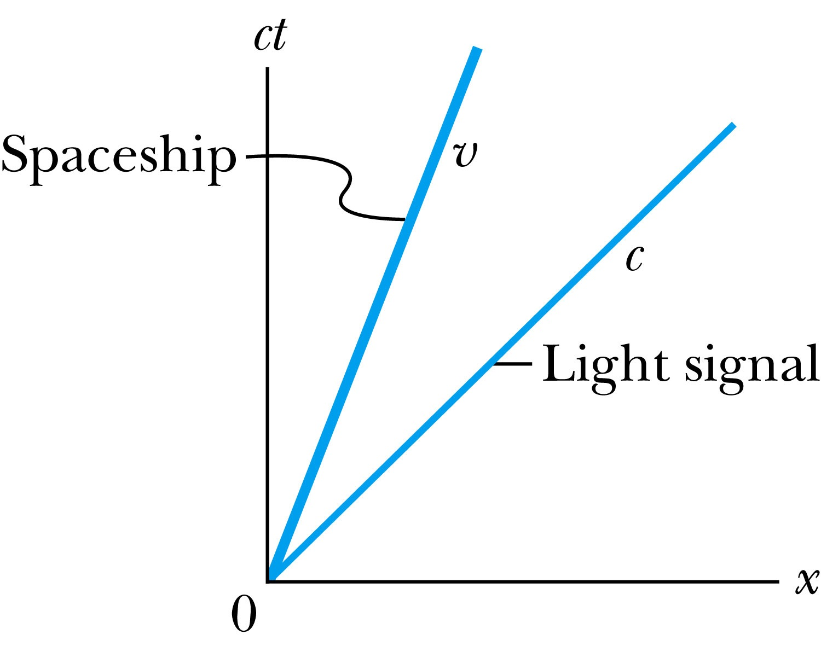
Particular Worldlines
How does the worldline for a spaceship running at the speed v(<c) look?
How does the worldline for a light signal look?
Notes:
Add the paragraph from Fig. 2.22

Slide 9
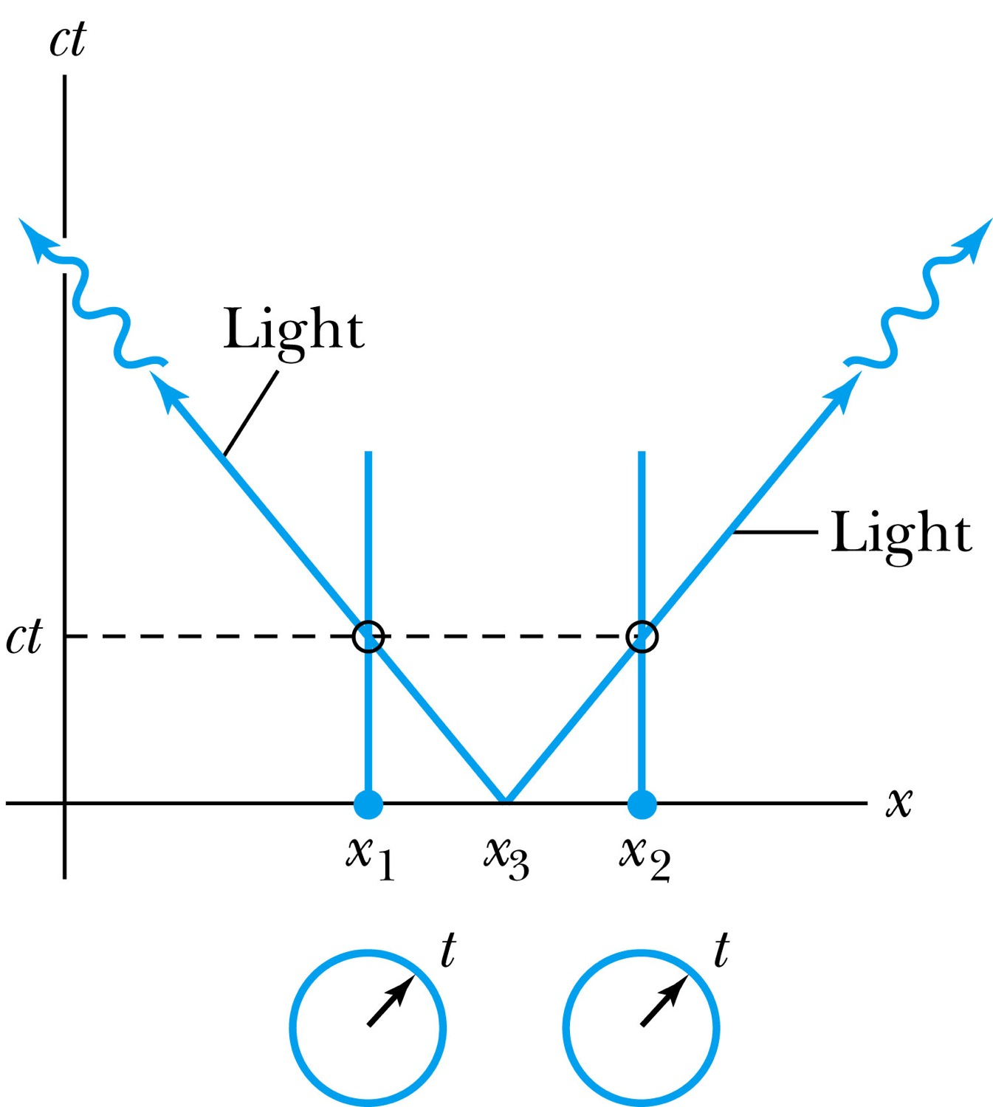
How about the time measured by two stationary clocks?
Notes:
Add paragraph from figure 2.23

Slide 10
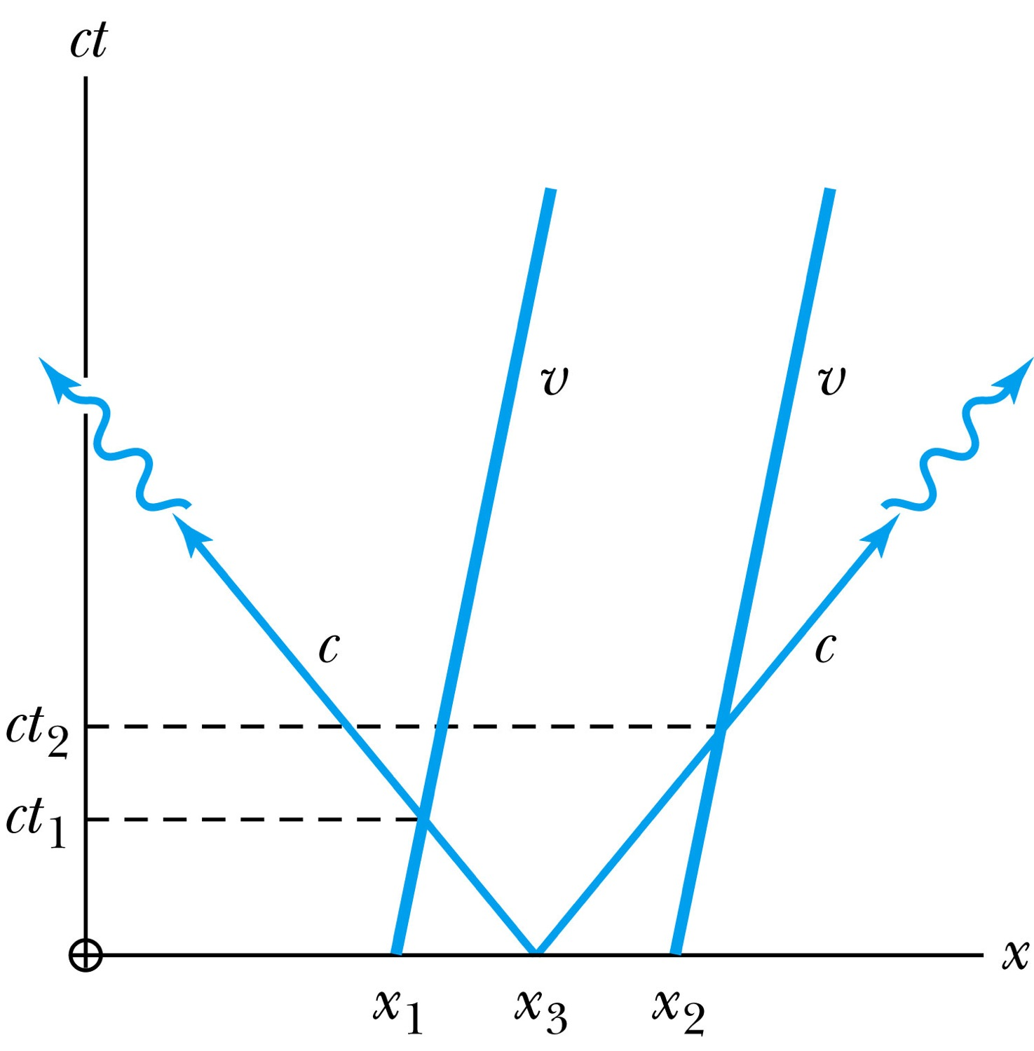
How about the time measured by two moving clocks?
Notes:
Add paragraph from figure 2.24

Slide 11
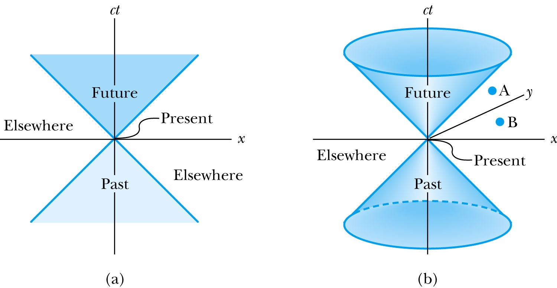
The Light Cone
Notes:
Add paragraph from Figure 2.25

Slide 12
Space-time Invariance
There are three possibilities for the invariant quantity Δs² (Space-Time Interval):

Slide 13
The Complete Lorentz Transformations

Slide 14
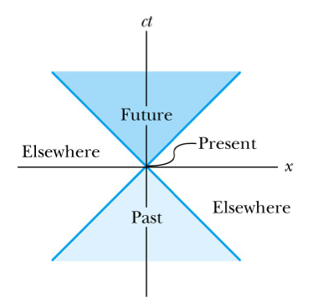
Space-time Invariance
There are three possibilities for the invariant quantity s² (Space-Time Interval):
s² = 0: x² = c² t²: light-like separation
  Two events can be connected only by a light signal.
s² > 0: x² > c² t²: space-like separation
  No signal can travel fast enough to connect the two events. The events are not causally connected!!
s² < 0: x² < c² t²: time-like separation
  Two events can be causally connected.
  These two events cannot occur simultaneously!
1
3
2

Slide 15
The Doppler Effect
The Doppler effect of sound
  Increased frequency of sound as the source approaches the receiver
  Decreased frequency as the source recedes.
The same change in sound frequency occurs when the source is fixed and the receiver is moving.
  The change in frequency of the sound wave depends on whether the source or the receiver is moving.
Does this violate the principle of relativity?
  No
  Why not?
  Sound wave is in a special frame of media such as air, water, or a steel plate in order to propagate;
Light does not need a medium to propagate!

Slide 16
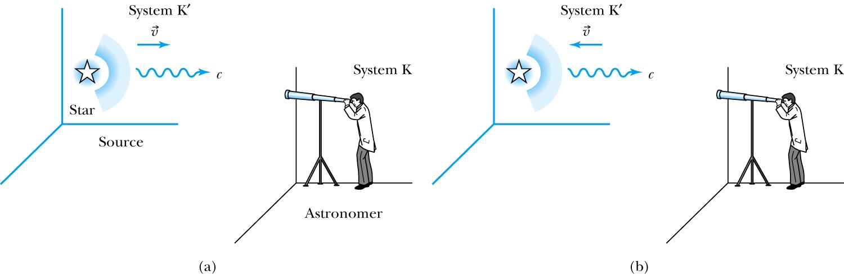
Recall the Doppler Effect
Notes:
Add paragraph from figure 2.27

Slide 17
The Relativistic Doppler Effect
Consider a source of light (a star) and a receiver (an astronomer) approaching one another with a relative velocity v.
Consider the receiver in system K and the light source in system K’ moving toward the receiver with velocity v.
The source emits n waves during the time interval T.
Because the speed of light is always c and the source is moving with velocity v, the total distance between the front and rear of the wave emitted during the time interval T is:
Length of the wave train = cT − vT

Slide 18
The Relativistic Doppler Effect (con’t)
Because there are n waves emitted by the source in time period T, the wavelength measured by the stationary receiver is
And the resulting frequency measured by the receiver is
The number of waves emitted in the moving frame of the source is n=f₀T ‘₀ with the proper time T’₀=T/γ we obtain the measured frequency by the receiver as

