Slide 1
PHYS 3313 – Section 001
Lecture #9
Wednesday, Feb. 15, 2017
Dr. Jaehoon Yu
The Relativistic Doppler Effect
Relativistic Momentum and Energy
Relationship Between Relativistic Quantities
Binding Energy
Quantization
Discovery of the X-ray and the Electron

Slide 2
Announcements
Homework #2
  CH3 end of the chapter problems: 2, 19, 27, 36, 41, 47 and 57
  Due Wednesday, Feb. 22
Reminder: Quiz #2 Monday, Feb. 20
  Beginning of the class
  Covers CH1.1 – what we finish today
  You can bring your calculator but it must not have any relevant formula pre-input
  BYOF: You may bring a one 8.5x11.5 sheet (front and back) of handwritten formulae and values of constants for the exam
  No derivations, word definitions, or solutions of any problems !
    Lorentz velocity addition NOT allowed!!
  No additional formulae or values of constants will be provided!
Colloquium today
  Dr. P. Onyisi of UT Austin

Slide 3
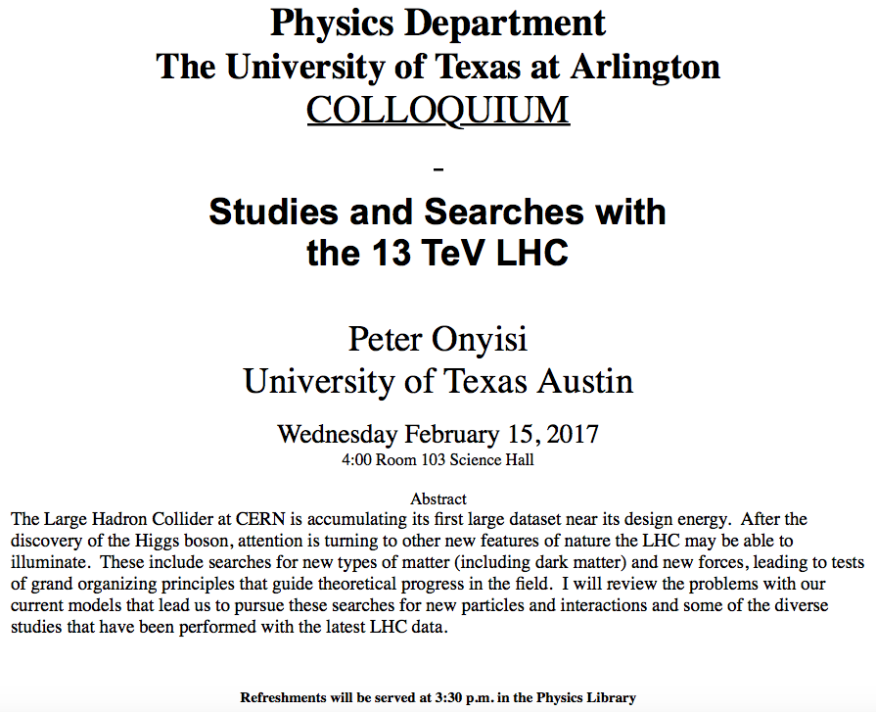

Slide 4
Results of Relativistic Doppler Effect
When source/receiver is approaching with β = v/c the resulting frequency is
Higher than the actual source’s frequency, blue shift!!
When source/receiver is receding with β = v/c the resulting frequency is
Lower than the actual source’s frequency, red shift!!
If we use +β for approaching source/receiver and -β for receding source/receiver, relativistic Doppler Effect can be expressed
For more generalized case

Slide 5
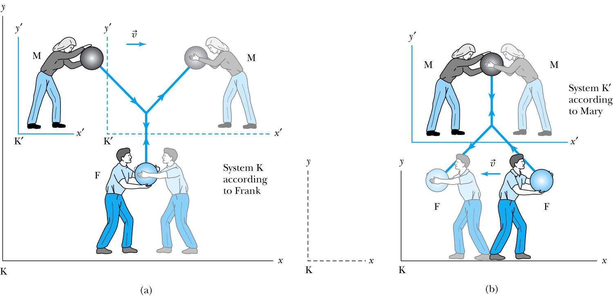
Relativistic Momentum
The most fundamental principle used here is the momentum conservation!
Frank is at rest in system K holding a ball of mass m.
Mary holds a similar ball in system K’ that is moving in the x direction with velocity v with respect to system K.
At one point they threw the ball at each other with exactly the same speed
Notes:
Add paragraph from figure 2.29

Slide 6
Relativistic Momentum
If we use the definition of momentum, the momentum of the ball thrown by Frank is entirely in the y direction
p_{Fy} = mu₀
The change of momentum as observed by Frank is
Δp_{F} = Δp_{Fy} = −2mu₀
Mary measures the initial velocity of her own ball to be
u’_{Mx} = 0 and u’_{My} = −u₀.
In order to determine the velocity of Mary’s ball as measured by Frank we use the velocity transformation equations:

Slide 7
Reminder: Lorentz Velocity Transformations
In addition to the previous relations, the Lorentz velocity transformations for v’_{x}, v’_{y} , and v’_{z} can be obtained by switching primed and unprimed and changing v to –v.(the velocity of the moving frame!!)

Slide 8
Relativistic Momentum
If we use the definition of momentum, the momentum of the ball thrown by Frank is entirely in the y direction
p_{Fy} = mu₀
The change of momentum as observed by Frank is
Δp_{F} = Δp_{Fy} = −2mu₀
Mary measures the initial velocity of her own ball to be
u’_{Mx} = 0 and u’_{My} = −u₀.
In order to determine the velocity of Mary’s ball as measured by Frank we use the velocity transformation equations:

Slide 9
Relativistic Momentum
Before the collision, the momentum of Mary’s ball as measured by Frank (in the Fixed frame) with the Lorentz velocity transformation becomes
For a perfectly elastic collision, the momentum after the collision is
Thus the change in momentum of Mary’s ball according to Frank is
OMG! The linear momentum is not conserved even w/o an external force!!
What do we do?
Redefine the momentum in a fashion
Something has changed. Mass is now, mγ!! The relativistic mass!!
Mass as the fundamental property of matter is called the “rest mass”, m₀!
Notes:
Spaced a bit more evenly

Slide 10
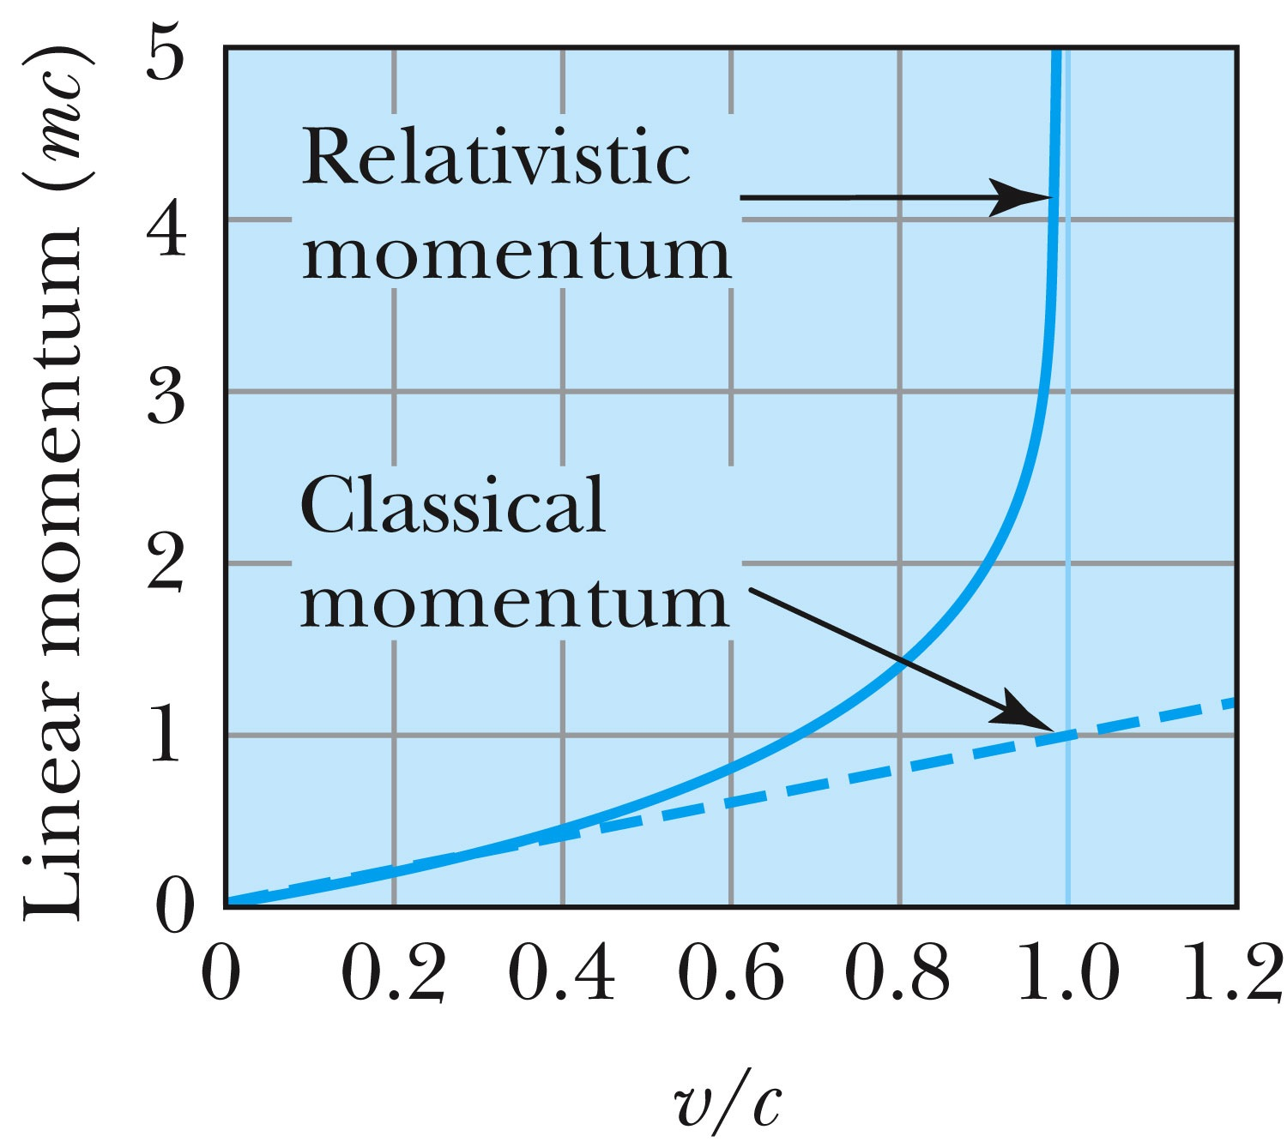
Relativistic and Classical Linear Momentum
Notes:
Add arrow head to the line from “Relativistic” to the graph
Possibly make the line from the “Classical” straight (as in figure 2.310
rather than curved, also add arrow head to this line pointing to the curve.

Slide 11
How do we keep momentum conserved in a relativistic case?
Redefine the classical momentum in the form:
This Γ(u) is different than the γ factor since it uses the particle’s speed u
➔ What? How does this make sense?
➔ Well the particle itself is moving at a relativistic speed, thus that must impact the measurements by the observer in the rest frame!!
Now, the agreed form of the momentum in all frames is (τ is the proper time):
Resulting in the new relativistic definition of the momentum:
When u→0, this formula becomes that of the classical.
What can the speed u be to maintain the relativistic momentum to 1% of classical momentum?
Notes:
Spaced a bit more evenly

Slide 12
Relativistic Energy
Due to the new idea of relativistic mass, we must now redefine the concepts of work and energy.
  Modify Newton’s second law to include our new definition of linear momentum, and the force becomes:
The work W done by a force F to move a particle from rest to a certain kinetic energy is
Resulting relativistic kinetic energy becomes
Why doesn’t this look anything like the classical KE?

Slide 13
Big note on Relativistic KE
Only is right!
and are wrong!

Slide 14
Total Energy and Rest Energy
Rewriting the relativistic kinetic energy:
The term mc² is called the rest energy and is denoted by E₀.
The sum of the kinetic energy and rest energy is interpreted as the total energy of the particle. (note that u is the speed of the particle)

Slide 15
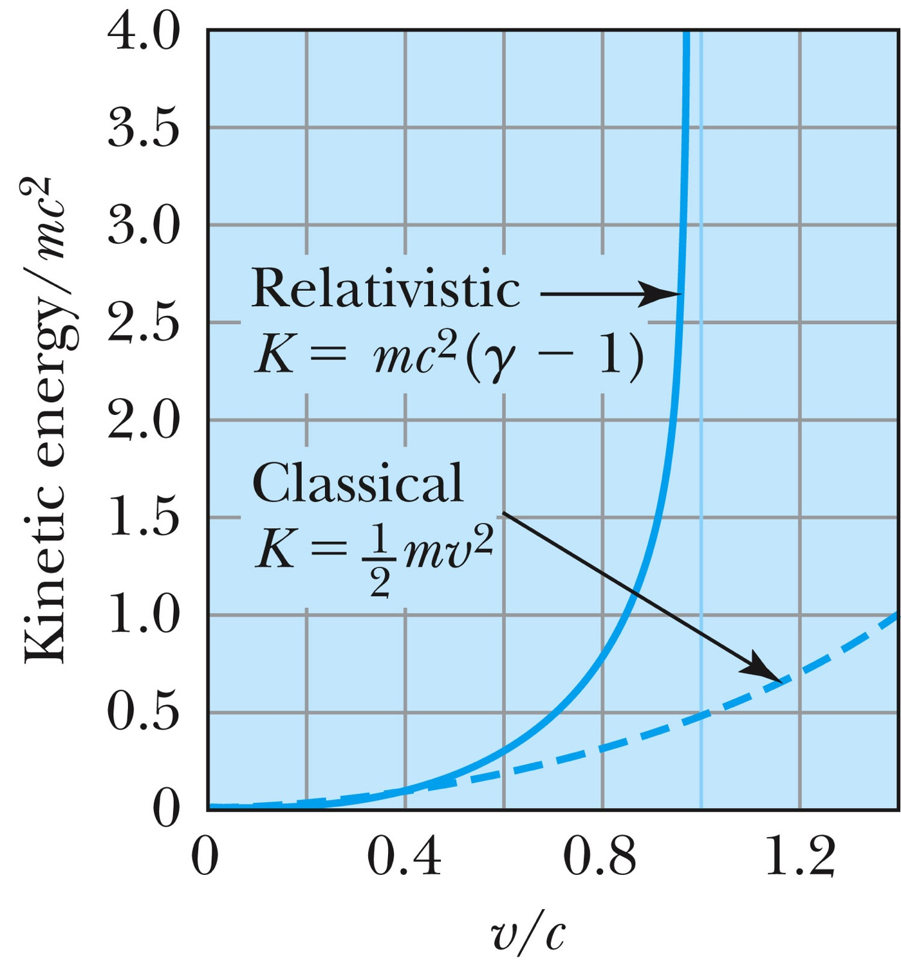
Relativistic and Classical Kinetic Energies
Notes:
Add arrow head to the line from “Relativistic” to the graph
Possibly make the line from the “Classical” straight (as in figure 2.310
rather than curved, also add arrow head to this line pointing to the curve.

Slide 16
Relationship of Energy and Momentum
We square this formula, multiply by c², and rearrange the terms.
Rewrite
Rewrite
Notes:
Title rewritten

Slide 17
Massless Particles have a speed equal to the speed of light c
Recall that a photon has “zero” rest mass and the equation from the last slide reduces to: E = pc and we may conclude that:
Thus the speed, u, of a massless particle must be c since, as 0, and it follows that: u = c.
Notes:
Add this slide

Slide 18
Units of Work, Energy and Mass
The work done in accelerating a charge through a potential difference V is W = qV.
  For a proton, with the charge e = 1.602 × 10⁻¹⁹ C being accelerated across a potential difference of 1 V, the work done is
  1 eV = 1.602 × 10⁻¹⁹ J
  W = (1.602 × 10⁻¹⁹)(1 V) = 1.602 × 10⁻¹⁹ J
eV is also used as a unit of energy.

Slide 19
Other Units
Rest energy of a particle:
Example: Rest energy, E₀, of proton
Atomic mass unit (amu): Example: carbon-12
What is 1u in eV?

Slide 20
Binding Energy
The potential energy associated with the force keeping a system together ➔ E_{B}.
The difference between the rest energy of the individual particles and the rest energy of the combined bound system.

Slide 21
Examples 2.13 and 2.15
Ex. 2.13: A proton with 2-GeV kinetic energy hits another proton with 2 GeV KE in a head on collision. (proton rest mass = 938MeV/c²)
  Compute v, β, p, K and E for each of the initial protons
  What happens to the kinetic energy?
Ex. 2.15: What is the minimum kinetic energy the protons must have in the head-on collision in the reaction p+p→π⁺+d, in order to produce the positively charged pion (139.6MeV/c² ) and a deuteron.(1875.6MeV/c²).

