Slide 1
PHYS 3313 – Section 001
Lecture #9
Wednesday, Feb. 15, 2017
Dr. Jaehoon Yu
The Relativistic Doppler Effect
Relativistic Momentum and Energy
Relationship Between Relativistic Quantities
Binding Energy
Quantization
Discovery of the X-ray and the Electron

Slide 2
Announcements
Homework #2
  CH3 end of the chapter problems: 2, 19, 27, 36, 41, 47 and 57
  Due Wednesday, Feb. 22
Reminder: Quiz #2 Monday, Feb. 20
  Beginning of the class
  Covers CH1.1 – what we finish today
  You can bring your calculator but it must not have any relevant formula pre-input
  BYOF: You may bring a one 8.5x11.5 sheet (front and back) of handwritten formulae and values of constants for the exam
  No derivations, word definitions, or solutions of any problems !
    Lorentz velocity addition NOT allowed!!
  No additional formulae or values of constants will be provided!
Colloquium today
  Dr. P. Onyisi of UT Austin

Slide 3
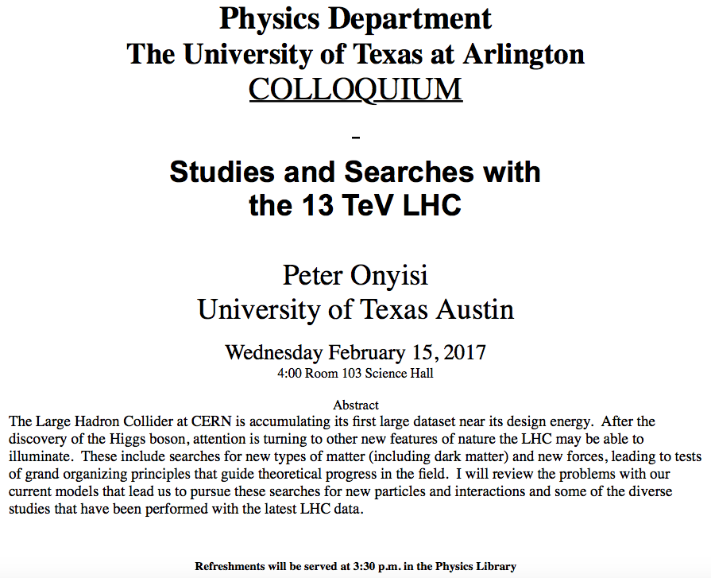

Slide 4
Results of Relativistic Doppler Effect
When source/receiver is approaching with β = v/c the resulting frequency is
Higher than the actual source’s frequency, blue shift!!
When source/receiver is receding with β = v/c the resulting frequency is
Lower than the actual source’s frequency, red shift!!
If we use +β for approaching source/receiver and -β for receding source/receiver, relativistic Doppler Effect can be expressed
For more generalized case

Slide 5
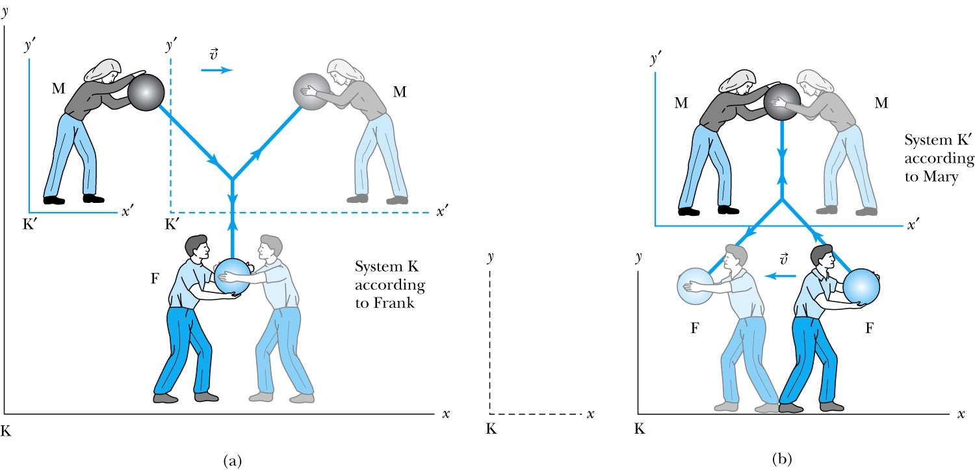
Relativistic Momentum
The most fundamental principle used here is the momentum conservation!
Frank is at rest in system K holding a ball of mass m.
Mary holds a similar ball in system K’ that is moving in the x direction with velocity v with respect to system K.
At one point they threw the ball at each other with exactly the same speed
Notes:
Add paragraph from figure 2.29

Slide 6
Relativistic Momentum
If we use the definition of momentum, the momentum of the ball thrown by Frank is entirely in the y direction
p_{Fy} = mu₀
The change of momentum as observed by Frank is
Δp_{F} = Δp_{Fy} = −2mu₀
Mary measures the initial velocity of her own ball to be
u’_{Mx} = 0 and u’_{My} = −u₀.
In order to determine the velocity of Mary’s ball as measured by Frank we use the velocity transformation equations:

Slide 7
Reminder: Lorentz Velocity Transformations
In addition to the previous relations, the Lorentz velocity transformations for v’_{x}, v’_{y} , and v’_{z} can be obtained by switching primed and unprimed and changing v to –v.(the velocity of the moving frame!!)

Slide 8
Relativistic Momentum
If we use the definition of momentum, the momentum of the ball thrown by Frank is entirely in the y direction
p_{Fy} = mu₀
The change of momentum as observed by Frank is
Δp_{F} = Δp_{Fy} = −2mu₀
Mary measures the initial velocity of her own ball to be
u’_{Mx} = 0 and u’_{My} = −u₀.
In order to determine the velocity of Mary’s ball as measured by Frank we use the velocity transformation equations:

Slide 9
Relativistic Momentum
Before the collision, the momentum of Mary’s ball as measured by Frank (in the Fixed frame) with the Lorentz velocity transformation becomes
For a perfectly elastic collision, the momentum after the collision is
Thus the change in momentum of Mary’s ball according to Frank is
OMG! The linear momentum is not conserved even w/o an external force!!
What do we do?
Redefine the momentum in a fashion
Something has changed. Mass is now, mγ!! The relativistic mass!!
Mass as the fundamental property of matter is called the “rest mass”, m₀!
Notes:
Spaced a bit more evenly

Slide 10
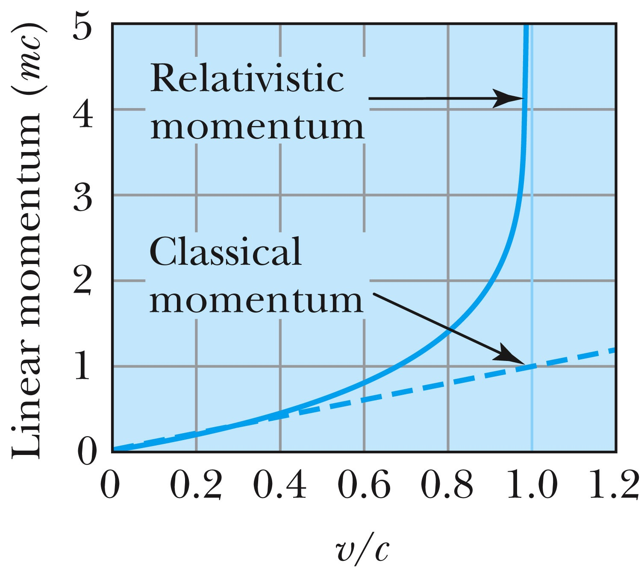
Relativistic and Classical Linear Momentum
Notes:
Add arrow head to the line from “Relativistic” to the graph
Possibly make the line from the “Classical” straight (as in figure 2.310
rather than curved, also add arrow head to this line pointing to the curve.

Slide 11
How do we keep momentum conserved in a relativistic case?
Redefine the classical momentum in the form:
This Γ(u) is different than the γ factor since it uses the particle’s speed u
➔ What? How does this make sense?
➔ Well the particle itself is moving at a relativistic speed, thus that must impact the measurements by the observer in the rest frame!!
Now, the agreed form of the momentum in all frames is (τ is the proper time):
Resulting in the new relativistic definition of the momentum:
When u→0, this formula becomes that of the classical.
What can the speed u be to maintain the relativistic momentum to 1% of classical momentum?
Notes:
Spaced a bit more evenly

Slide 12
Relativistic Energy
Due to the new idea of relativistic mass, we must now redefine the concepts of work and energy.
  Modify Newton’s second law to include our new definition of linear momentum, and the force becomes:
The work W done by a force F to move a particle from rest to a certain kinetic energy is
Resulting relativistic kinetic energy becomes
Why doesn’t this look anything like the classical KE?

Slide 13
Big note on Relativistic KE
Only is right!
and are wrong!

Slide 14
Total Energy and Rest Energy
Rewriting the relativistic kinetic energy:
The term mc² is called the rest energy and is denoted by E₀.
The sum of the kinetic energy and rest energy is interpreted as the total energy of the particle. (note that u is the speed of the particle)

Slide 15
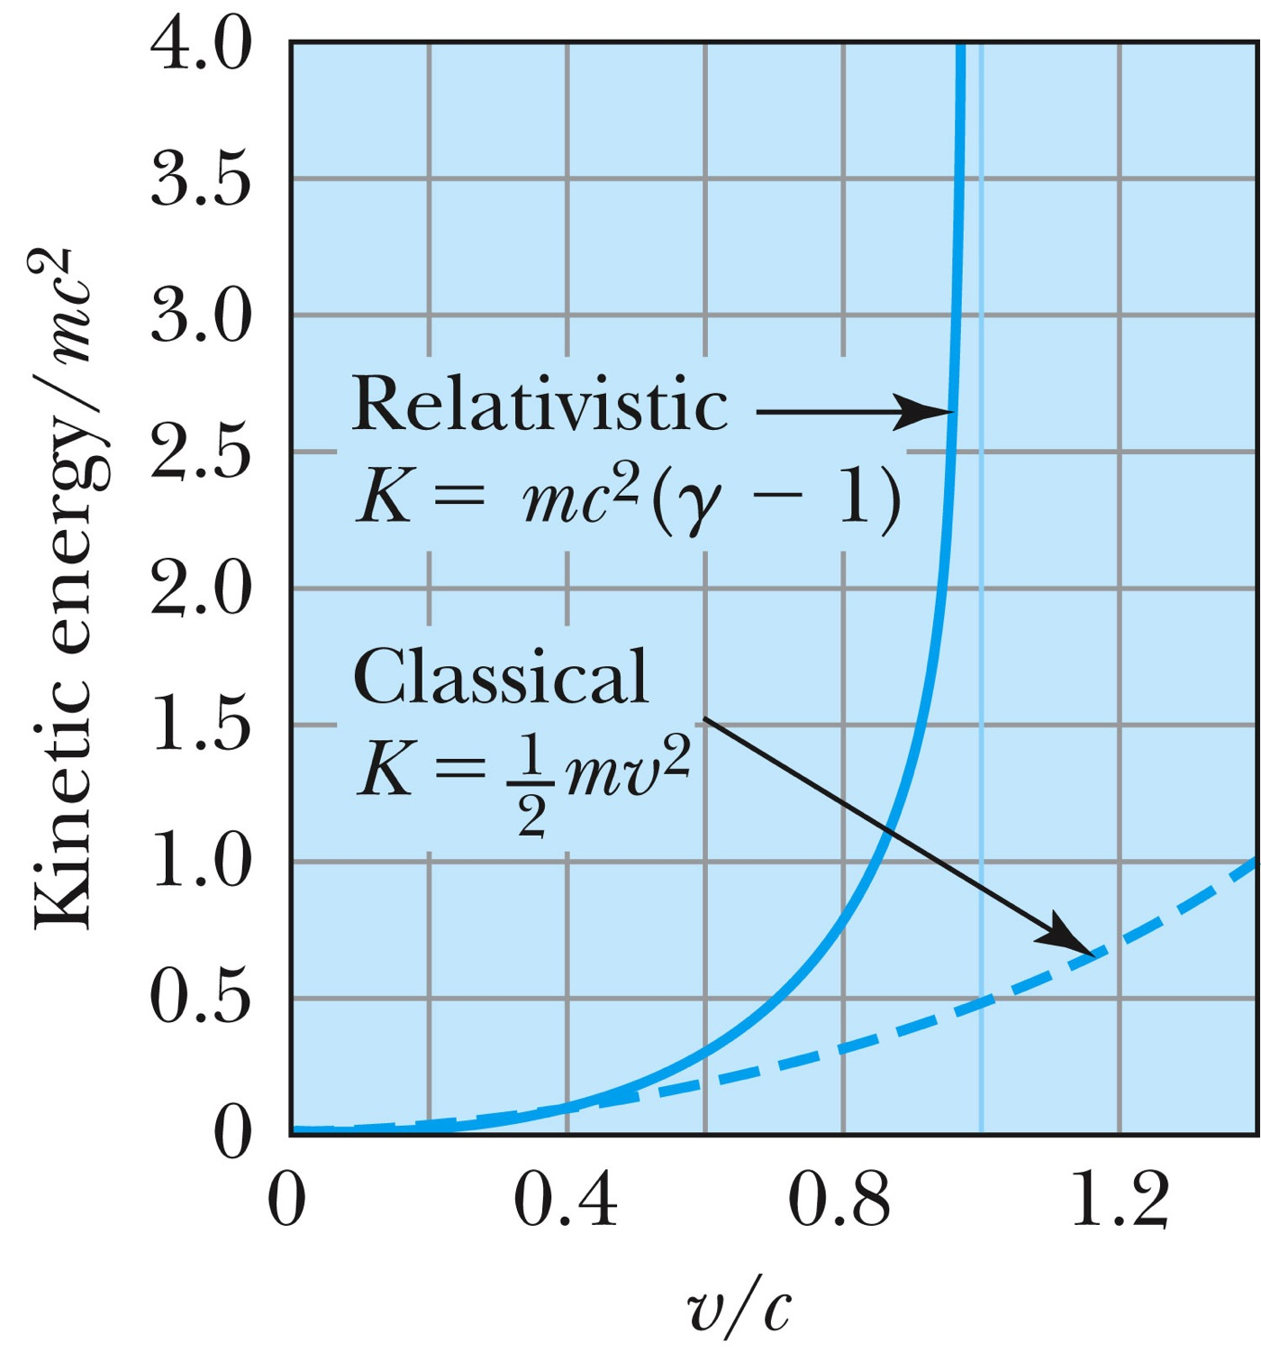
Relativistic and Classical Kinetic Energies
Notes:
Add arrow head to the line from “Relativistic” to the graph
Possibly make the line from the “Classical” straight (as in figure 2.310
rather than curved, also add arrow head to this line pointing to the curve.

Slide 16
Relationship of Energy and Momentum
We square this formula, multiply by c², and rearrange the terms.
Rewrite
Rewrite
Notes:
Title rewritten

Slide 17
Massless Particles have a speed equal to the speed of light c
Recall that a photon has “zero” rest mass and the equation from the last slide reduces to: E = pc and we may conclude that:
Thus the speed, u, of a massless particle must be c since, as 0, and it follows that: u = c.
Notes:
Add this slide

Slide 18
Units of Work, Energy and Mass
The work done in accelerating a charge through a potential difference V is W = qV.
  For a proton, with the charge e = 1.602 × 10⁻¹⁹ C being accelerated across a potential difference of 1 V, the work done is
  1 eV = 1.602 × 10⁻¹⁹ J
  W = (1.602 × 10⁻¹⁹)(1 V) = 1.602 × 10⁻¹⁹ J
eV is also used as a unit of energy.

Slide 19
Other Units
Rest energy of a particle:
Example: Rest energy, E₀, of proton
Atomic mass unit (amu): Example: carbon-12
What is 1u in eV?

Slide 20
Binding Energy
The potential energy associated with the force keeping a system together ➔ E_{B}.
The difference between the rest energy of the individual particles and the rest energy of the combined bound system.

Slide 21
Examples 2.13 and 2.15
Ex. 2.13: A proton with 2-GeV kinetic energy hits another proton with 2 GeV KE in a head on collision. (proton rest mass = 938MeV/c²)
  Compute v, β, p, K and E for each of the initial protons
  What happens to the kinetic energy?
Ex. 2.15: What is the minimum kinetic energy the protons must have in the head-on collision in the reaction p+p→π⁺+d, in order to produce the positively charged pion (139.6MeV/c² ) and a deuteron.(1875.6MeV/c²).

Slide 22
What does the word “Quantize” mean?
Dictionary: To restrict to discrete values
To consist of indivisible discrete quantities instead of continuous quantities
  Integer is a quantized set with respect to real numbers
Some examples of quantization?
  Digital photos
  Lego blocks
  Electric charge
  Photon (a quanta of light) energy
  Angular momentum
  Etc…

Slide 23
Discovery of the X Ray and the Electron
X rays were discovered by Wilhelm Röntgen in 1895.
  Observed X rays emitted by cathode rays bombarding glass
Electrons were discovered by J. J. Thomson.
  Observed that cathode rays were charged particles

Slide 24
Cathode Ray Experiments
In the 1890’s scientists and engineers were familiar with cathode rays, generated from one of the metal plates in an evacuated tube across a large electric potential
People thought cathode rays had something to do with atoms.
It was known that cathode rays could penetrate matter and their properties were under intense investigation during the 1890’s.

Slide 25
Observation of x Rays
Wilhelm Röntgen studied the effect of cathode rays passing through various materials.
He noticed that a nearby phosphorescent screen glowed during some of these experiments.
These rays were unaffected by magnetic fields and penetrated materials more than cathode rays.
He called them x rays and deduced that they were produced by the cathode rays bombarding the glass walls of his vacuum tube

Slide 26
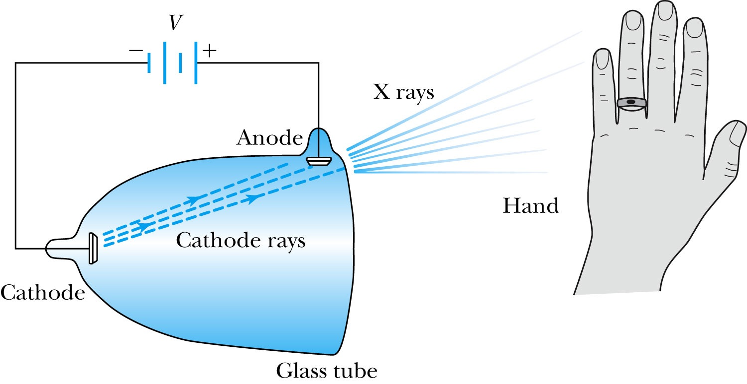
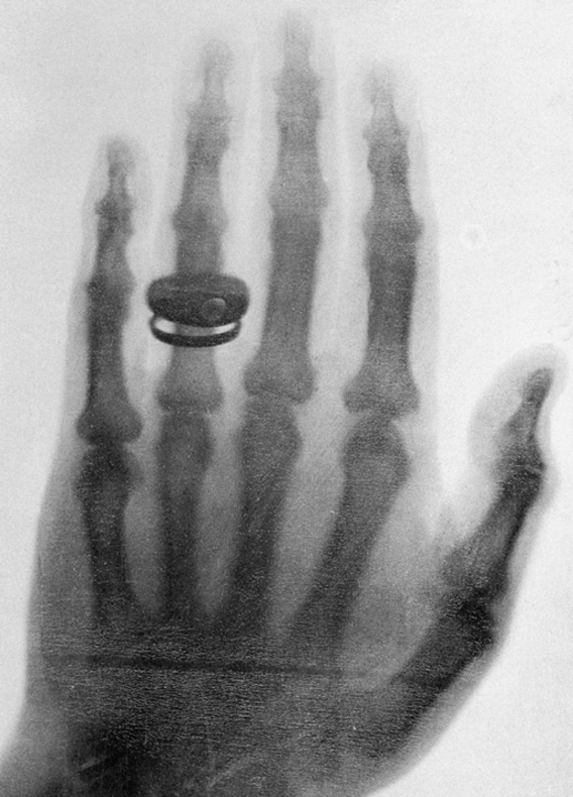
Röntgen’s X Ray Tube
Röntgen produced the X-ray by allowing cathode rays to impact the glass wall of the tube.
Took image the bones of a hand on a phosphorescent screen.
Tremendous contribution to medical imaging, and Röntgen received the 1st Nobel Prize for this!

Slide 27
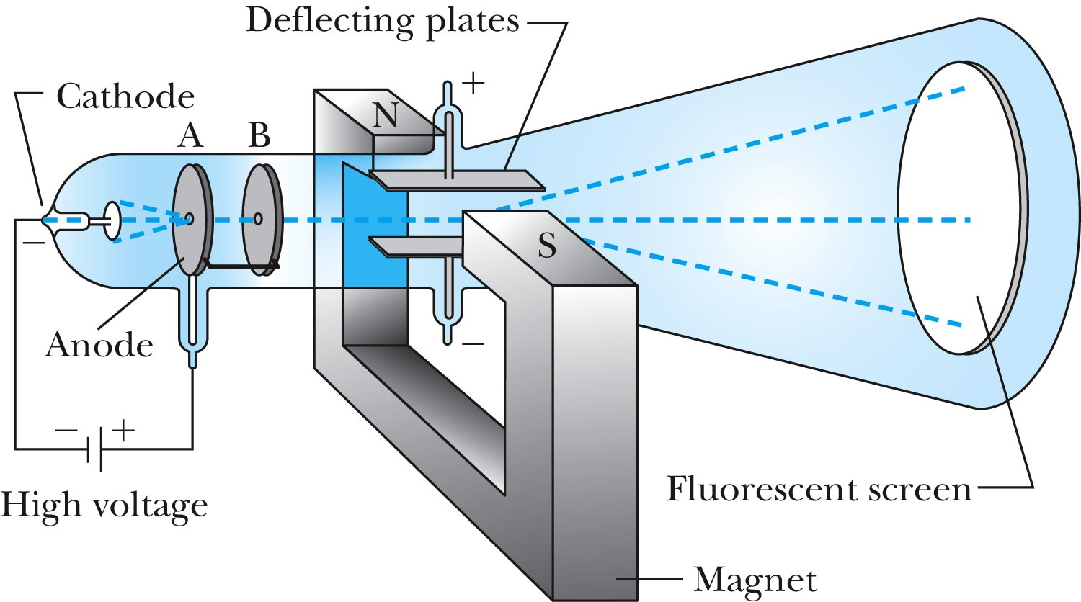
J.J. Thomson’s Cathode-Ray Experiment
Thomson showed that the cathode rays were negatively charged particles (electrons)! How?
  By deflecting them in electric and magnetic fields.

Slide 28
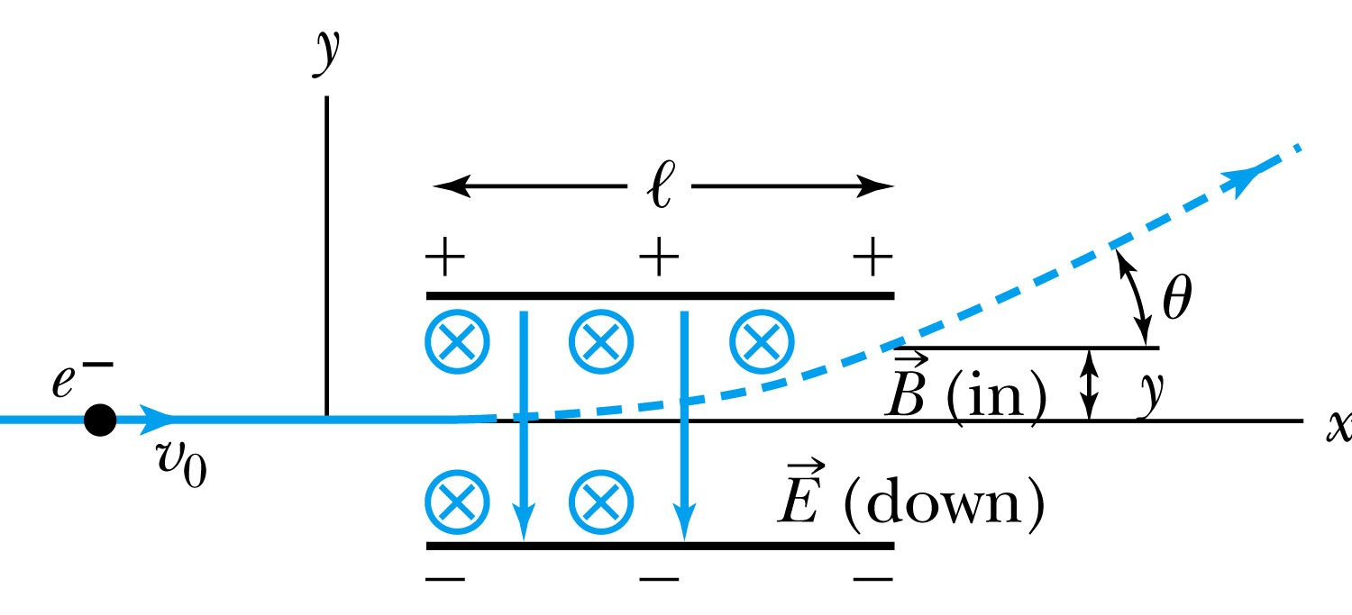
Thomson’s Experiment
Thomson measured the ratio of the electron’s charge to mass by sending electrons through a region containing a magnetic field perpendicular to an electric field.
Measure the deflection angle with only E!
Turn on and adjust B field till no deflection!
What do we know?
  l, B, E and θ
What do we not know?
  v₀, q and m

Slide 29
Calculation of q/m
An electron moving through the electric field w/o magnetic field is accelerated by the force:
Electron angle of deflection:
Adjust the perpendicular magnetic field until it balances E and keeps electrons from deflecting in y-direction
Charge to mass ratio:

Slide 30
Ex 3.1: Thomson’s experiment
In an experiment similar to Thomson’s, we use deflecting plates 5.0cm in length with an electric field of 1.2x10⁴V/m. Without the magnetic field, we find an angular deflection of 30º, and with a magnetic field of 8.8x10⁻⁴T we find no deflection. What is the initial velocity of the electron and its q/m?
First v₀ using E and B, we obtain:
q/m is then
What is the actual value of q/m using the known quantities?

Slide 31
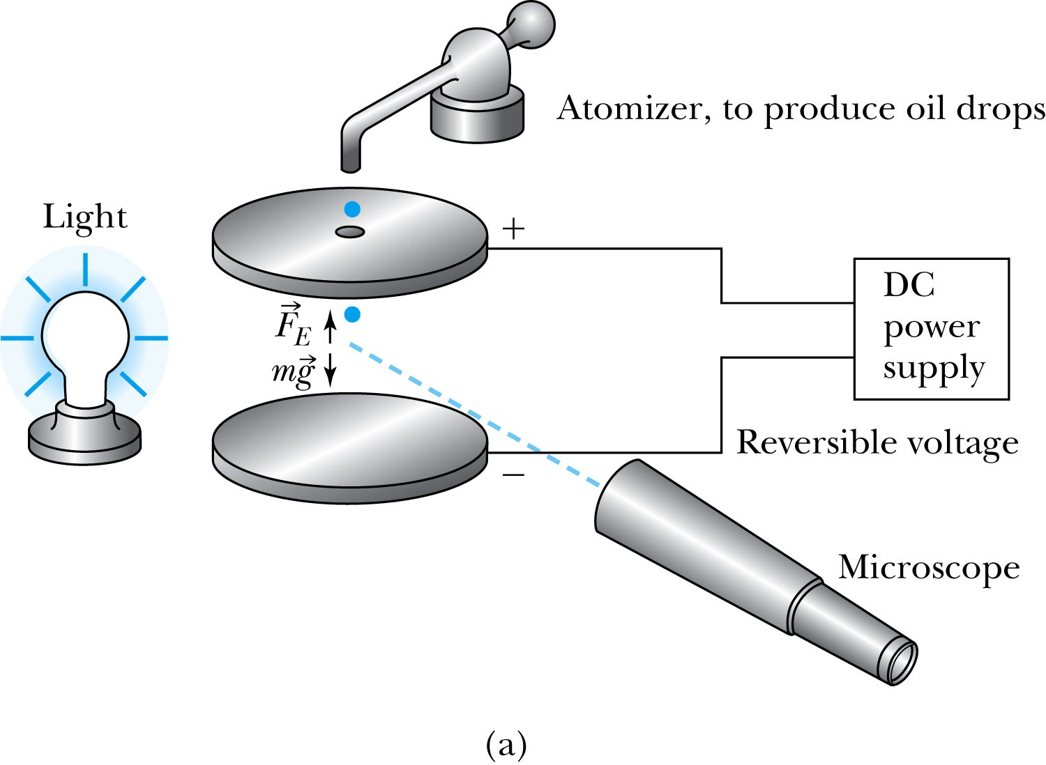
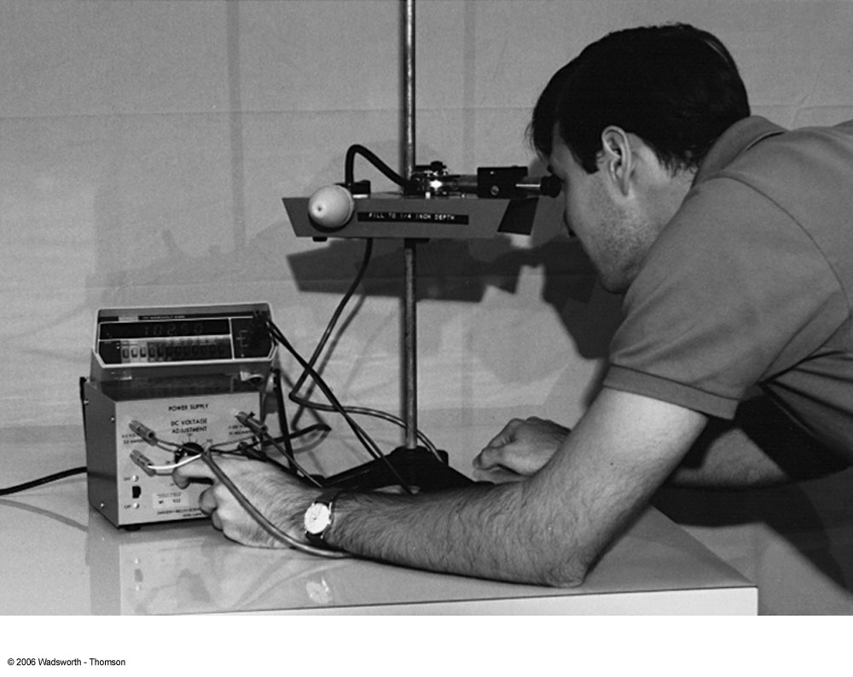
Determination of Electron Charge
Millikan (and Fletcher) in 1909 measured the charge of electron and showed that the free electric charge is in multiples of the basic charge of an electron

Slide 32
Calculation of the oil drop charge
Used an electric field and gravity to suspend a charged oil drop
So the magnitude of the charge on the oil drop
Mass is determined from Stokes’ relationship of the terminal velocity to the radius, medium viscosity and density
Thousands of experiments showed that there is a basic quantized electron charge

Slide 33
Line Spectra
Chemical elements produce unique wavelengths of light when burned or excited in an electrical discharge.
Collimated light is passed through a diffraction grating with thousands of ruling lines per centimeter.
  The diffracted light is separated at an angle θ according to its wavelength λ by the equation:
where d is the distance between rulings and n is an integer called the order number (n=1 strongest)
Diffraction maxima

Slide 34
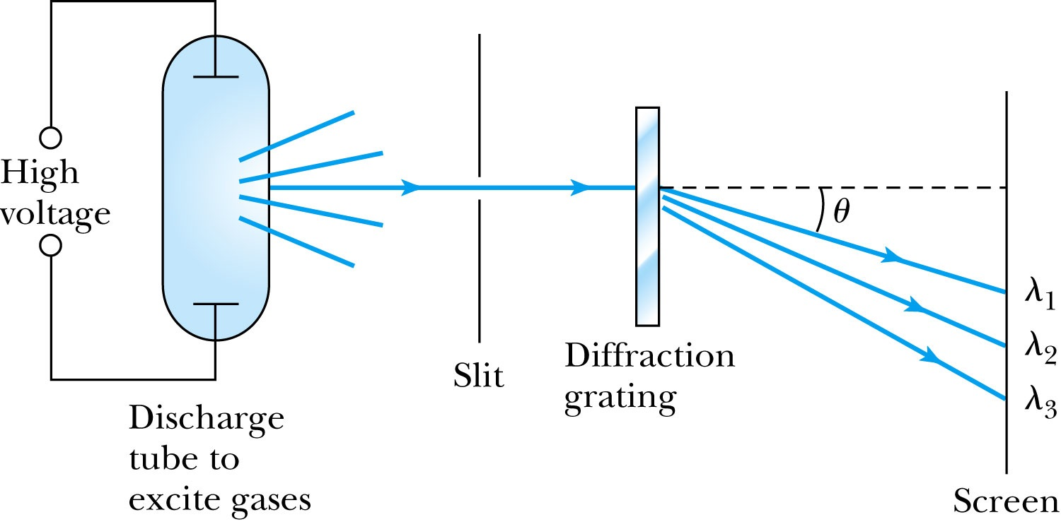
Optical Spectrometer
Diffraction creates a line spectrum pattern of light bands and dark areas on the screen.
Chemical elements and the composition of materials can be identified through the wavelengths of these line spectra

Slide 35
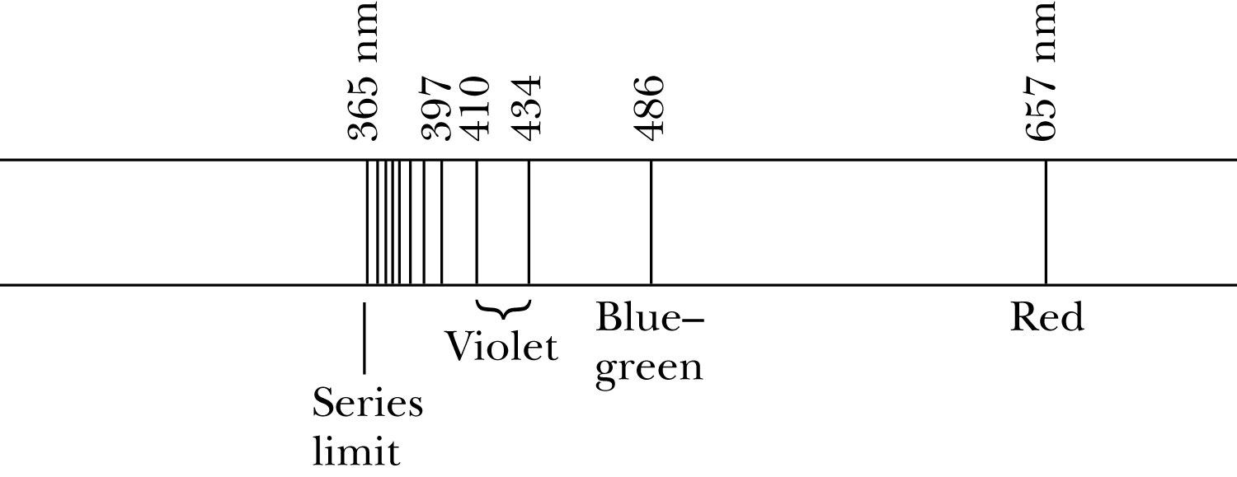
Balmer Series
In 1885, Johann Balmer found an empirical formula for wavelength of the visible hydrogen line spectra in nm:
(where k = 3,4,5… and k > 2)

Slide 36
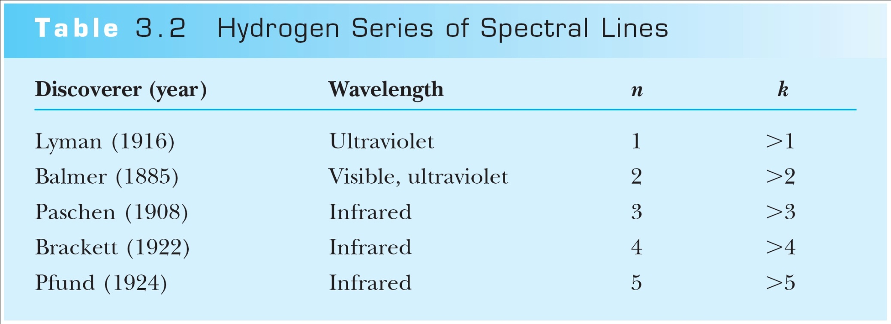
Rydberg Equation
Several more series of hydrogen emission lines at infrared and ultraviolet wavelengths were discovered, the Balmer series equation was extended to the Rydberg equation:
(n = 2, n>K)

Slide 37
Quantization
Current theories predict that charges are quantized in units (quarks) of ±e/3 and ±2e/3, but quarks are not directly observed experimentally.
The charges of particles that have been directly observed are always quantized in units of ±e.
The measured atomic weights are not continuous—they have only discrete values, which are close to integral multiples of a unit mass.

