Slide 1
PHYS 3313 – Section 001
Lecture #11
Wednesday, Feb. 22, 2017
Dr. Jaehoon Yu
Determination of Electron Charge
Line Spectra
Blackbody Radiation
Photoelectric Effect

Slide 2
Announcements
Midterm Exam
  In class Wednesday, March. 8
  Covers from CH1.1 through what we learn March 1 plus the math refresher in the appendices
  Mid-term exam constitutes 20% of the total
  Please do NOT miss the exam! You will get an F if you miss it.
  BYOF: You may bring a one 8.5x11.5 sheet (front and back) of handwritten formulae and values of constants for the exam
  No derivations, word definitions or solutions of any problems!
    Eg., Lorentz velocity transformation NOT allowed!
  No additional formulae or values of constants will be provided!
Colloquium at 4pm today in SH103
  Drs. Park, Jones and Asaadi of UTA Physics department

Slide 3
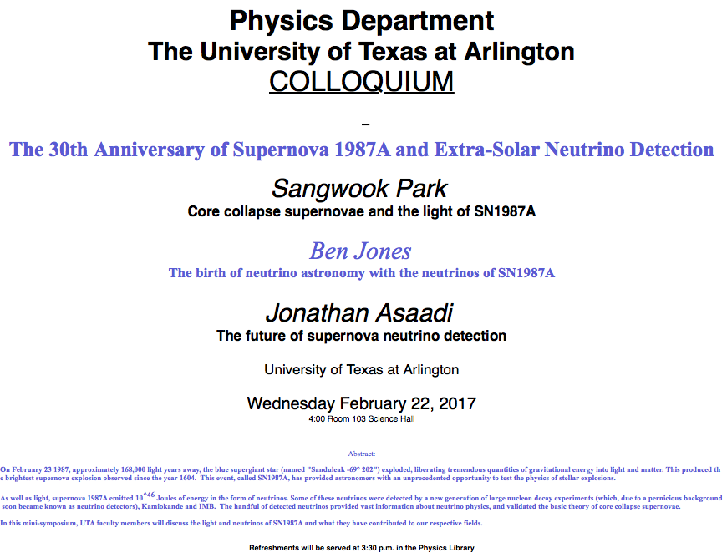

Slide 4
Special Project #4
A total of N_{i} incident projectile particle of atomic number Z₁ kinetic energy KE scatter on a target of thickness t and atomic number Z₂ and has n atoms per volume. What is the total number of scattered projectile particles at an angle θ? (20 points)
Please be sure to clearly define all the variables used in your derivation! Points will be deducted for missing variable definitions.
This derivation must be done on your own. Please do not copy the book, internet or your friends’.
Due is next Wednesday, March 1

Slide 5
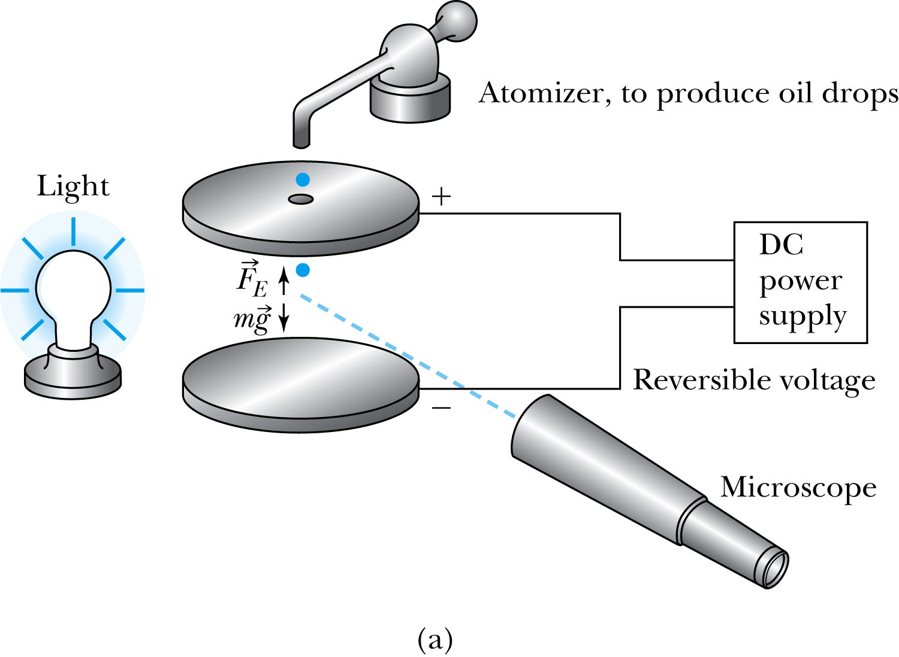
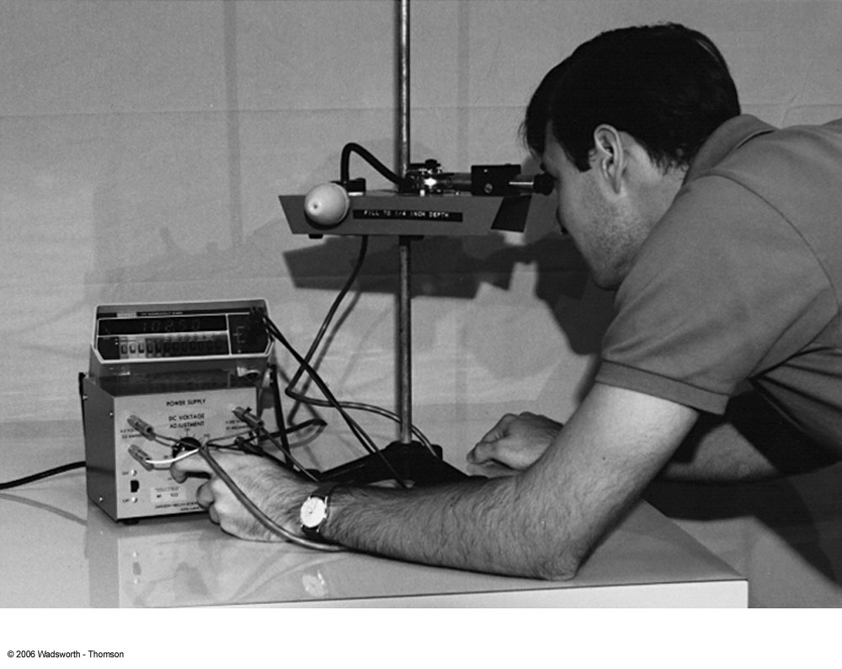
Determination of Electron Charge
Millikan (and Fletcher) in 1909 measured the charge of electron and showed that the free electric charge is in multiples of the basic charge of an electron

Slide 6
Calculation of the oil drop charge
Used an electric field and gravity to suspend a charged oil drop
So the magnitude of the charge on the oil drop
Mass is determined from Stokes’ relationship of the terminal velocity to the radius, the medium viscosity and density
Thousands of experiments showed that there is a basic quantized electron charge

Slide 7
Line Spectra
Chemical elements produce unique wavelengths of light when burned or excited in an electrical discharge.
Collimated light is passed through a diffraction grating with thousands of gratings per centimeter.
  The diffracted light is separated at an angle θ according to its wavelength λ by the equation:
where d is the distance between gratings and n is an integer called the order number (n=1 strongest)
Diffraction maxima

Slide 8
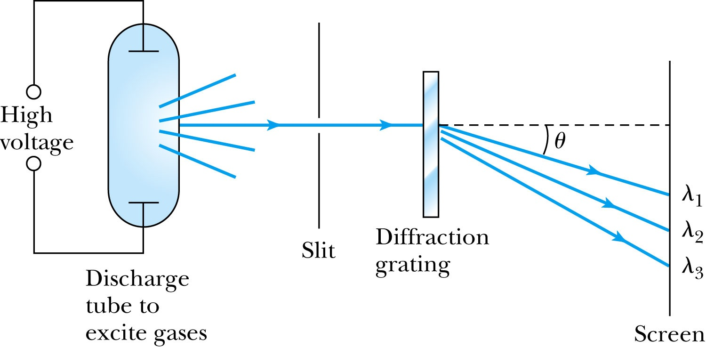
Optical Spectrometer
Diffraction creates a line spectrum pattern of light bands and dark areas on the screen.
Chemical elements and the composition of materials can be identified through the wavelengths of these line spectra

Slide 9
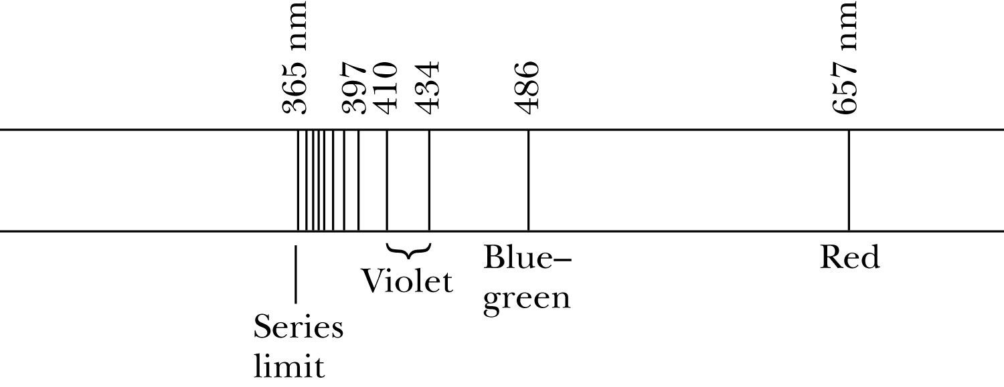
Balmer Series
In 1885, Johann Balmer found an empirical formula for wavelength of the visible hydrogen line spectra in nm:
(where k = 3,4,5… and k > 2)

Slide 10
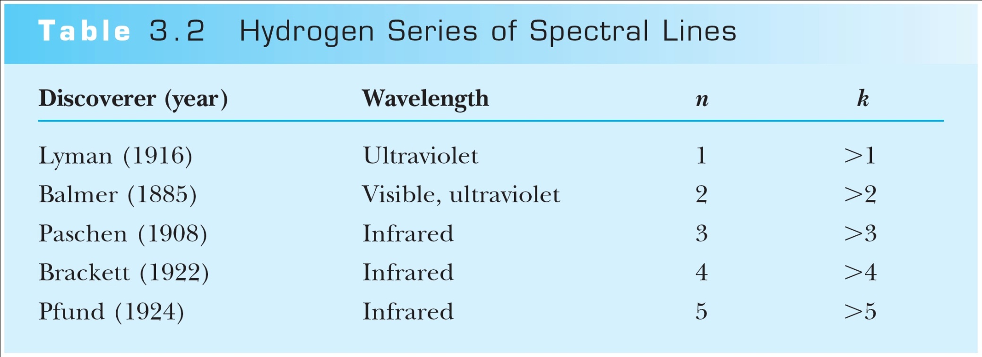
Rydberg Equation
Several more series of hydrogen emission lines at infrared and ultraviolet wavelengths were discovered, the Balmer series equation was extended to the Rydberg equation:
(Balmer series: n = 2, k>n)

Slide 11
More Quantization
Current theories predict that charges are quantized in units (quarks) of ±e/3 and ±2e/3, but quarks are not directly observed experimentally.
The charges of particles that have been directly observed are always quantized in units of ±e.
The measured atomic weights are not continuous—they have only discrete values, which are close to integral multiples of a unit mass.

Slide 12
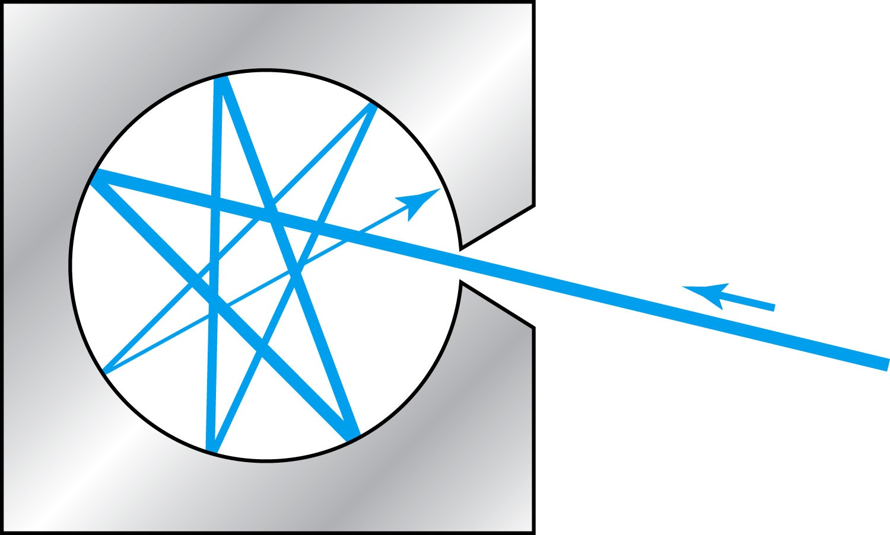
Blackbody Radiation
When a matter is heated, it emits radiation.
A blackbody is an ideal object that has 100% absorption and 100% emission without a loss of energy
A cavity in a material that only emits thermal radiation can be considered as a black-body. Incoming radiation is fully absorbed in the cavity.
Blackbody radiation is theoretically interesting because
  Radiation properties are independent of the particular material.
  Properties of intensity versus wavelength at fixed temperatures can be studied

Slide 13
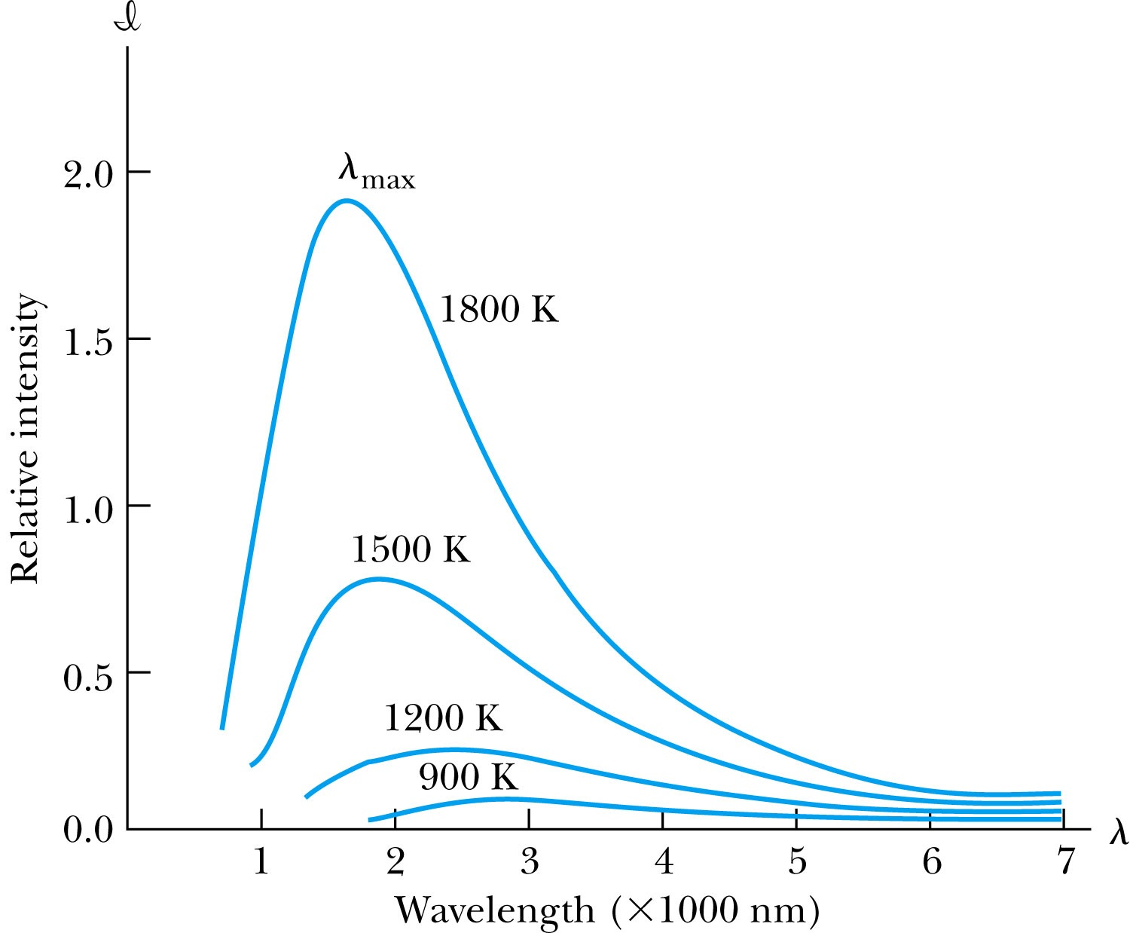
Wien’s Displacement Law
The intensity I(λ, T) is the total power radiated per unit area per unit wavelength at the given temperature. (Nobel 1911)
Wien’s displacement law: The peak of I(λ, T) distribution shifts to smaller wavelengths as the temperature increases.
(where λ_{max} = wavelength of the peak)

Slide 14
Ex 3.4: Using Wien’s Law
A furnace has a wall of temperature 1600 ºC. What is the wave length of maximum intensity emitted when a small door is opened?
Since it has a small door open, we treat the furnace as if it is a blackbody.
Using Wien’s displacement law, we obtain

Slide 15
Stefan-Boltzmann Law
The total power per unit area radiated from a blackbody increases with the temperature:
This is known as the Stefan-Boltzmann law, with the constant value of σ experimentally measured to be
  σ =5.6705×10⁻⁸ W / (m² · K⁴).
The emissivity ε (ε = 1 for an idealized blackbody) is the ratio of the emissive power of an object to that of an ideal blackbody and is always less than 1.

Slide 16
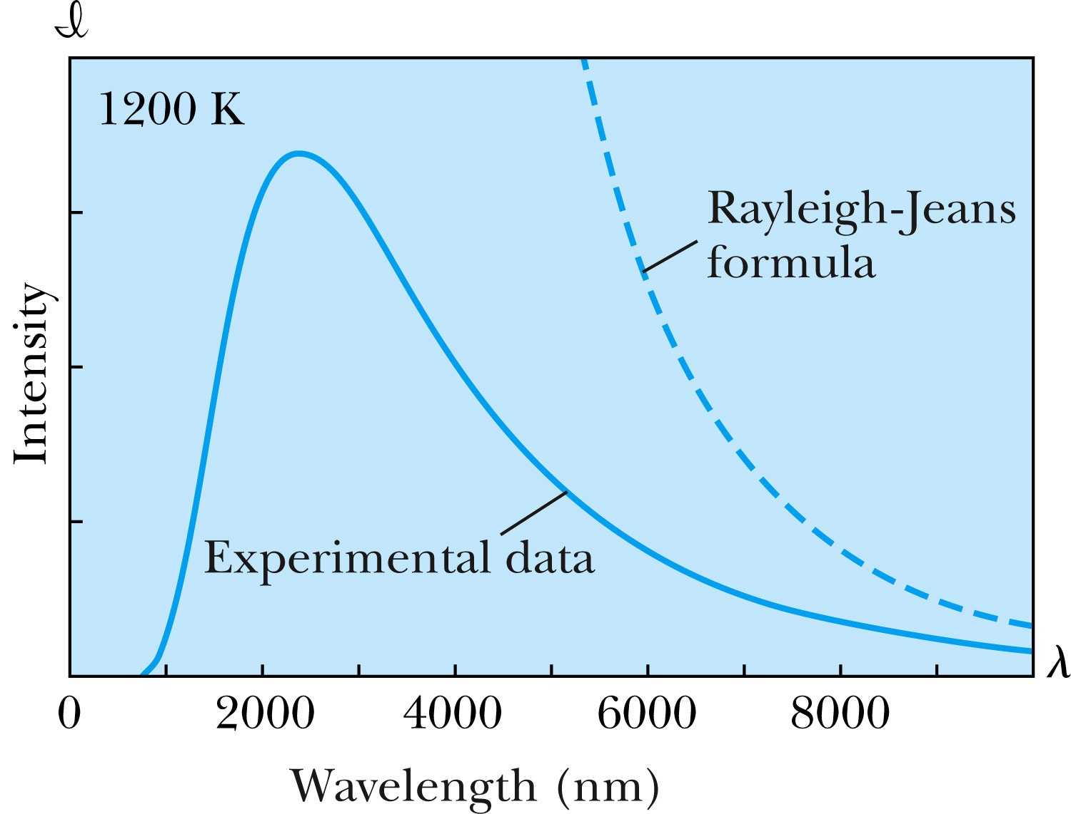
Rayleigh-Jeans Formula
Lord Rayleigh used the classical theories of electromagnetism and thermodynamics to show that the blackbody spectral distribution should be
Worked reasonably well at longer wavelengths but..
it deviates badly at short wavelengths.
➔ “the ultraviolet catastrophe” a serious issue that couldn’t be explained

Slide 17
Planck’s Radiation Law
Planck assumed that the radiation in the cavity was emitted (and absorbed) by some sort of “oscillators” that were contained in the walls. He used Boltzman’s statistical methods to arrive at the following formula that fit the blackbody radiation data.
Planck made two important modifications to classical theory:
    The oscillators (of electromagnetic origin) can only have certain discrete energies determined by E_{n} = nhf, where n is an integer, f is the frequency, and h is called Planck’s constant. h = 6.6261 × 10⁻³⁴ J·s.
    The oscillators can absorb or emit energy ONLY in discrete multiples of the fundamental quantum of energy given by
Planck’s radiation law

Slide 18
Photoelectric Effect
Definition: Incident electromagnetic radiation shining on a metal transfers energy to the electrons in the metal, allowing them to escape the surface of the metal. Ejected electrons are called photoelectrons.
Hertz noticed during his experiment in 1887 that when ultraviolet light falls on metal surface charge gets ejected ➔ Left it to Philip Lenard to study further
Other methods of electron emission:
Thermionic emission: Application of heat allows electrons to gain enough energy to escape.
Secondary emission: The electron gains enough energy by transfer from another high-speed particle that strikes the material from outside.
Field emission: A strong external electric field pulls the electron out of the material. (an example?)

Slide 19
Classical Interpretation of Photoelectric Effect
Classical theory allows EM radiation to eject photoelectrons from matter
Classical theory predicts the energy of the photoelectrons increase in proportion to the radiation intensity
Thus, the KE of the photoelectrons must be proportional to the intensity of light not the current
Time for an experiment!

Slide 20
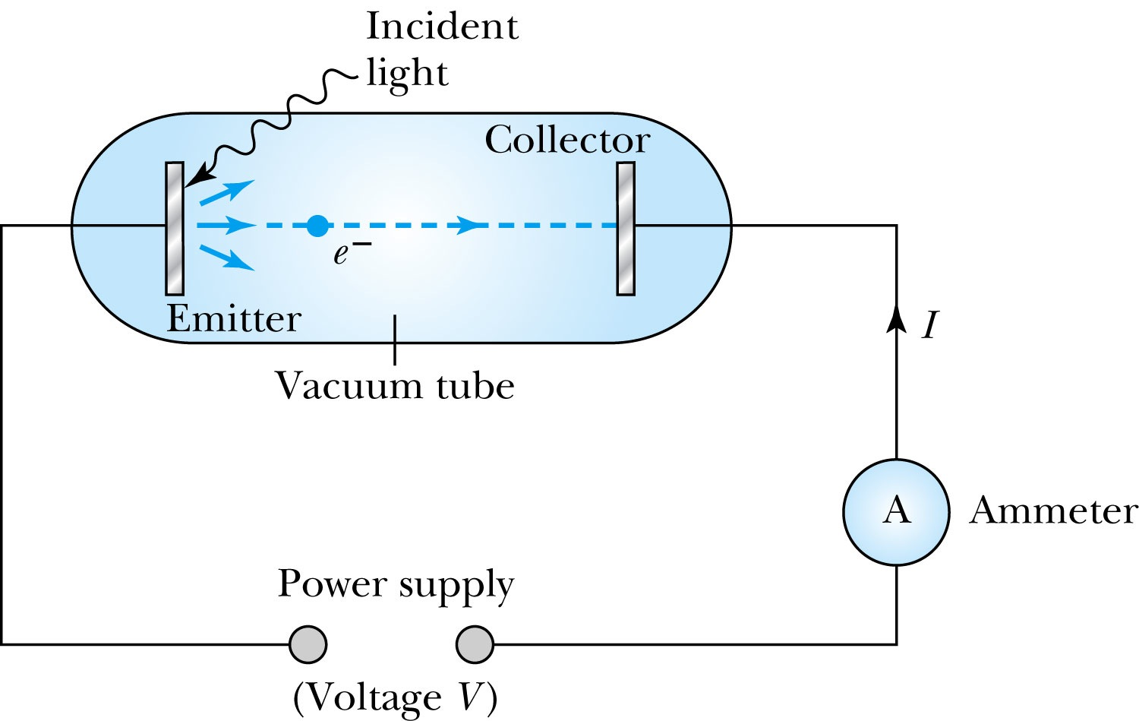
Photoelectric Effect Experimental Setup
Hmm.. Something does not make sense!!
Anode
Photocathode
V increased in reverse direction stops current independent of light intensity

Slide 21
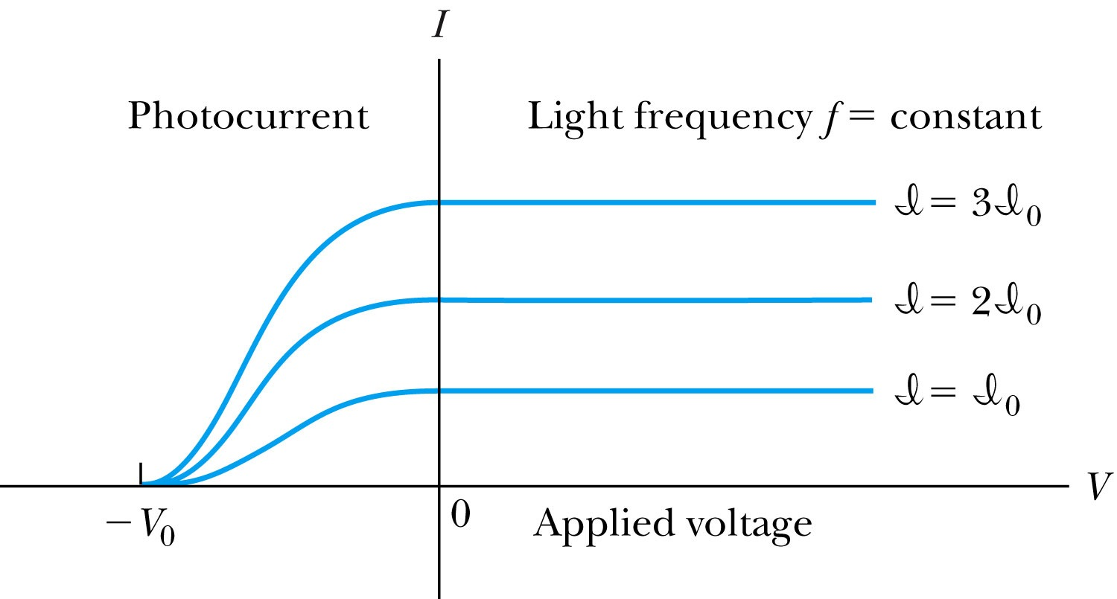
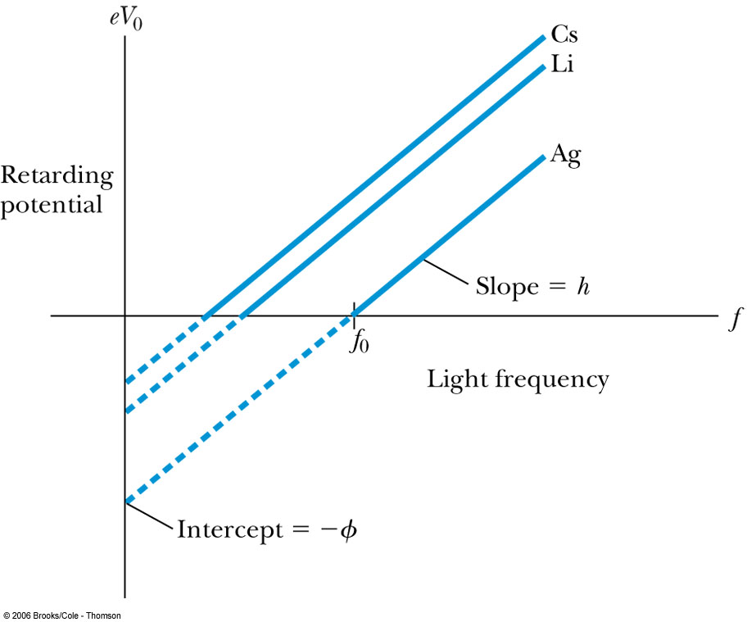
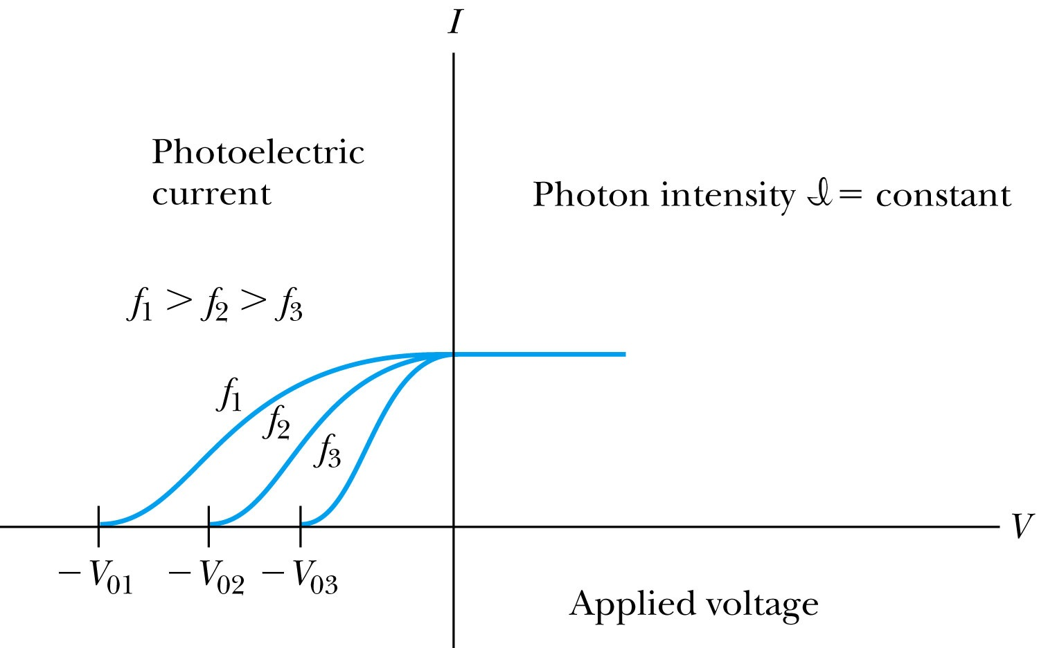
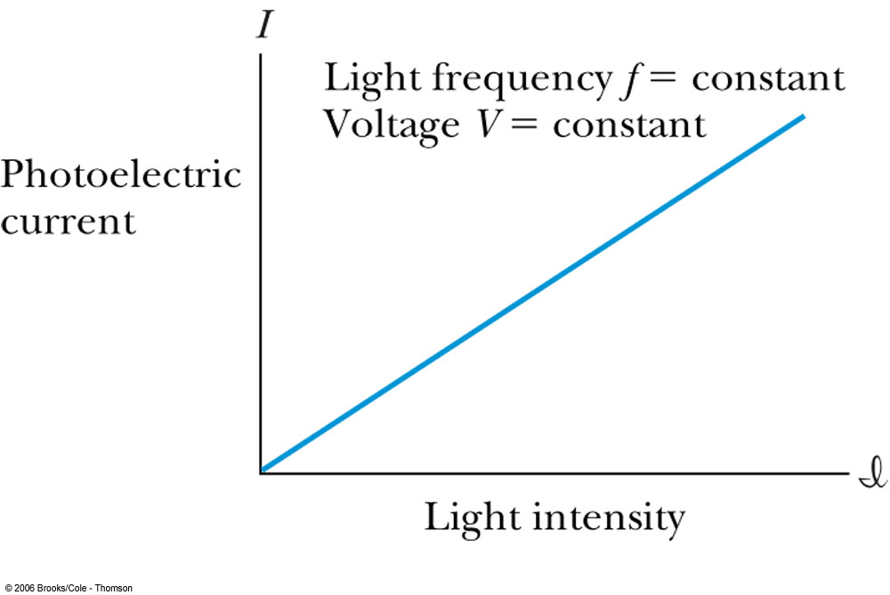
Experimental Observations
KE proportional to frequency!!
The same V₀ but higher current
The same current!!
Number of photoelectrons proportional to light intensity!!

Slide 22
Summary of Experimental Observations
Light intensity does not affect the KE of the photoelectrons
The max KE of the photoelectrons for a given emitter material depends only on the frequency of the light
The smaller the work function φ of the emitter material, the smaller is the threshold frequency of the light that can eject photoelectrons.
When the photoelectrons are produced, their number is proportional to the intensity of light.
The photoelectrons are emitted almost instantly following the illumination of the photocathode, independent of the intensity of the light. ➔ Totally unexplained by classical physics

