Slide 1
PHYS 3313 – Section 001 Lecture #12
Monday, Feb. 27, 2017
Dr. Jaehoon Yu
Photoelectric Effect
Compton Effect
Pair production/Pair annihilation
Rutherford Scattering Experiment and Rutherford Atomic Model

Slide 2
Announcements
Midterm Exam
In class Wednesday, March. 8
Covers from CH1.1 through what we learn March 6 plus the math refresher in the appendices
Mid-term exam constitutes 20% of the total
Please do NOT miss the exam! You will get an F if you miss it.
BYOF: You may bring a one 8.5x11.5 sheet (front and back) of handwritten formulae and values of constants for the exam
No derivations, word definitions or solutions of any problems!
Eg., Lorentz velocity transformation NOT allowed!
No additional formulae or values of constants will be provided!
Quiz 2 results
Class Average: 34.5/60
Equivalent to : 57.5/100
Previous result: 20.8/100
Class top score: 60/60

Slide 3
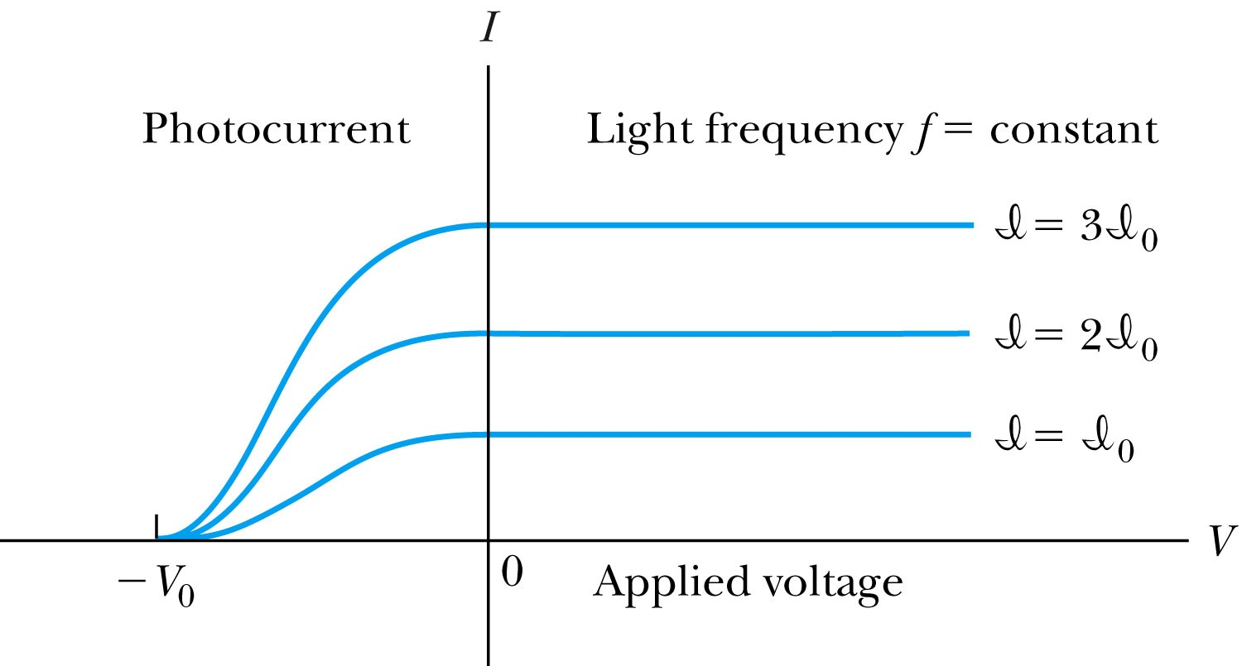
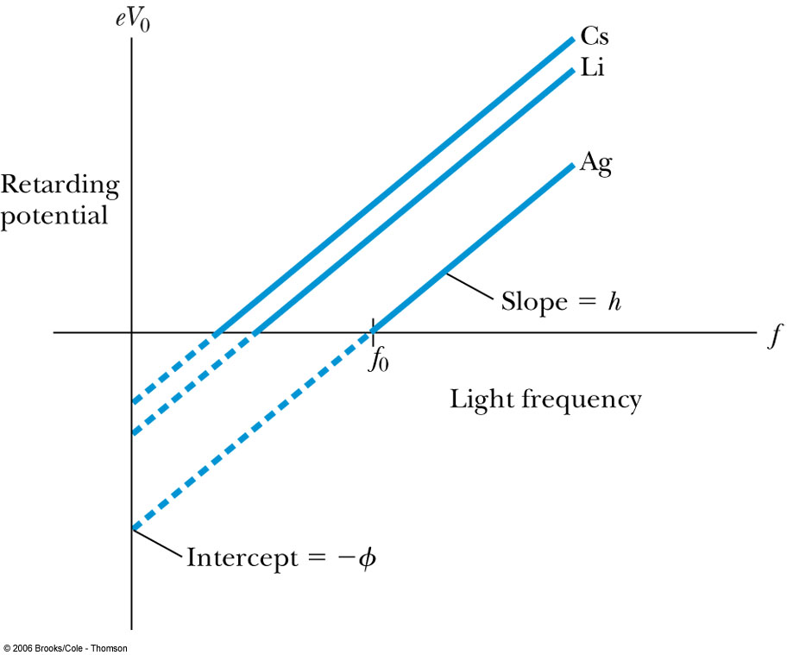
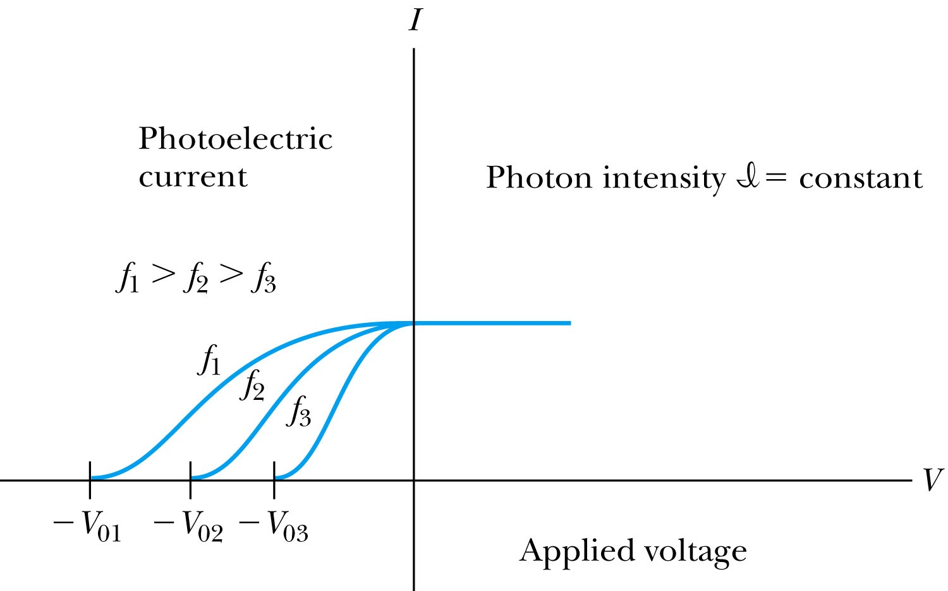
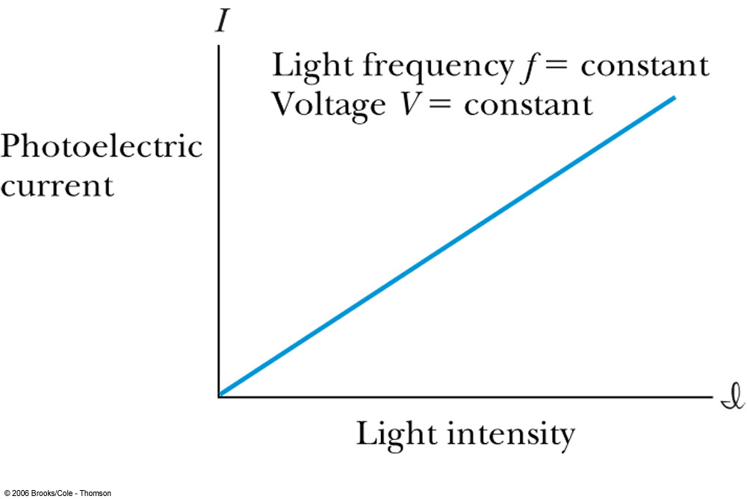
Experimental Observations
KE proportional to frequency!!
The same V₀ but higher current
The same current!!
Number of photoelectrons proportional to light intensity!!

Slide 4
Summary of Experimental Observations
Light intensity does not affect the KE of the photoelectrons
The max KE of the photoelectrons for a given emitter material depends only on the frequency of the light
The smaller the work function φ of the emitter material, the smaller is the threshold frequency of the light that can eject photoelectrons.
When the photoelectrons are produced, their number is proportional to the intensity of light.
The photoelectrons are emitted almost instantly following the illumination of the photocathode, independent of the intensity of the light. ➔ Totally unexplained by classical physics

Slide 5
Einstein’s Theory of Photoelectric Effect
Einstein suggested that the electromagnetic radiation of the light is quantized into particles called photons. Each photon has the energy quantum:
where f is the frequency of the light and h is Planck’s constant.
The photon travels at the speed of light in vacuum, and its wavelength is given by

Slide 6
Experimental Observations
The same current!!
Number of photoelectrons proportional to light intensity!!

Slide 7
Einstein’s Theory
Conservation of energy yields:
where φ is the work function of the metal
The photon energy can then be written
The retarding potentials measure the KE of the most energetic photoelectrons.

Slide 8
Quantum Interpretation
KE of the electron depends only on the light frequency and the work function φ of the material not the light intensity at all
Einstein in 1905 predicted that the stopping potential was linearly proportional to the light frequency, with the slope h, the same constant found by Planck.
From this, Einstein concluded that light is a particle with energy:
Was he already thinking about particle/wave duality?

Slide 9
Ex 3.11: Photoelectric Effect
Light of wavelength 400nm is incident upon lithium (φ=2.93eV). Calculate (a) the photon energy (eV) and (b) the stopping potential V₀.
Since the wavelength is known, we use plank’s formula:
The stopping potential can be obtained using Einstein’s formula for photoelectron energy

Slide 10
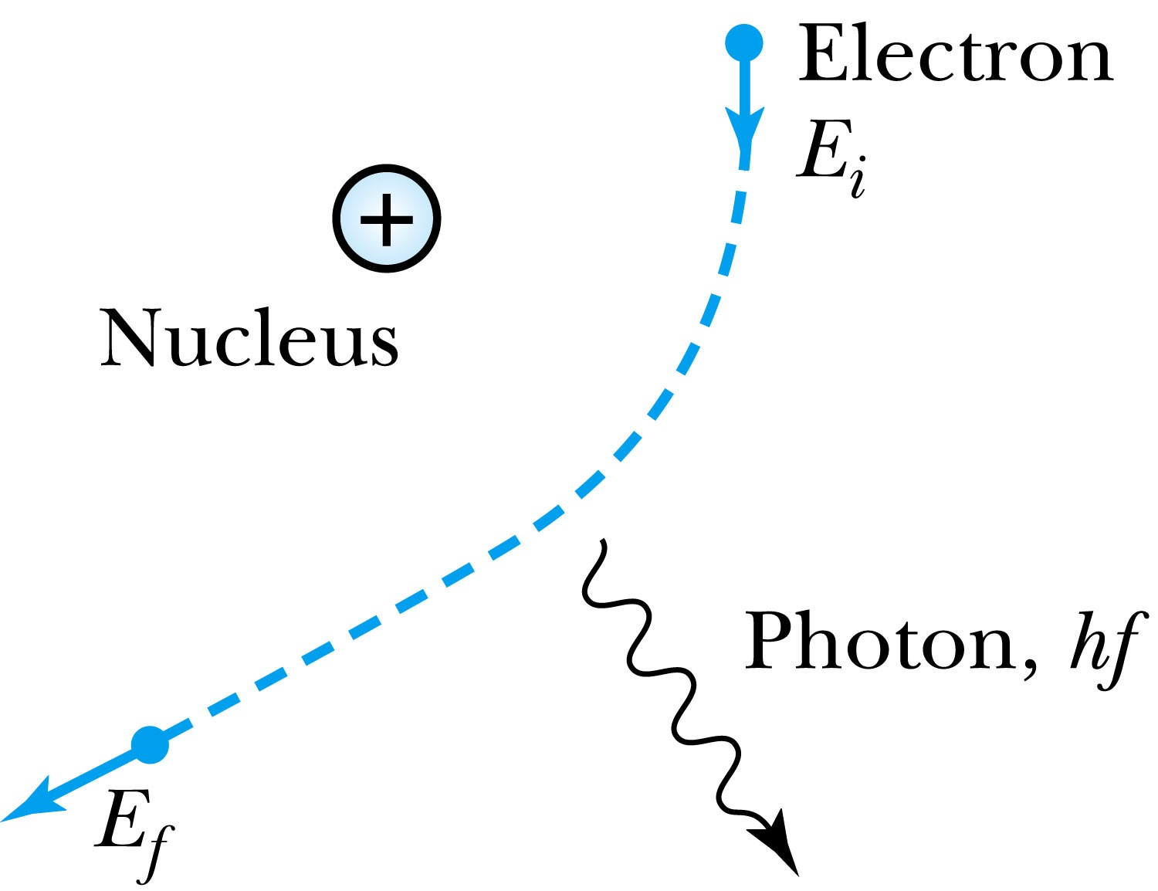
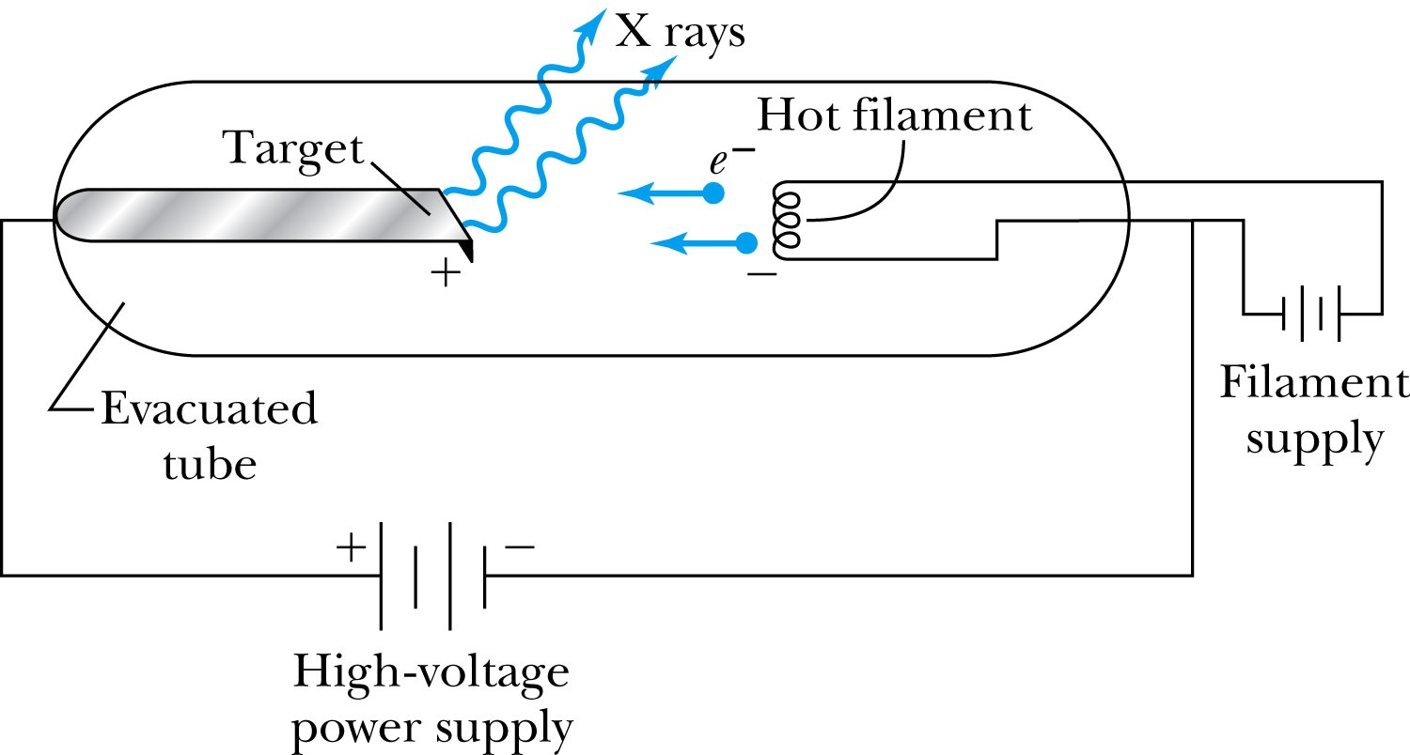
X-Ray Production
Bremsstrahlung (German word for braking radiation): Radiation of a photon from an energetic electron passing through matter due to an acceleration
Since linear momentum must be conserved, the nucleus absorbs very little energy, and it is ignored. The final energy of the electron is determined from the conservation of energy
An electron that loses a large amount of energy will produce an X-ray photon.
Current passing through a filament produces copious numbers of electrons by thermionic emission.
These electrons are focused by the cathode structure into a beam and are accelerated by potential differences of thousands of volts until they impinge on a metal anode surface, producing x rays by bremsstrahlung as they stop in the anode material
X-ray wavelengths range 0.01 – 10nm. What is the minimum energy of an electron to produce X-ray?

Slide 11
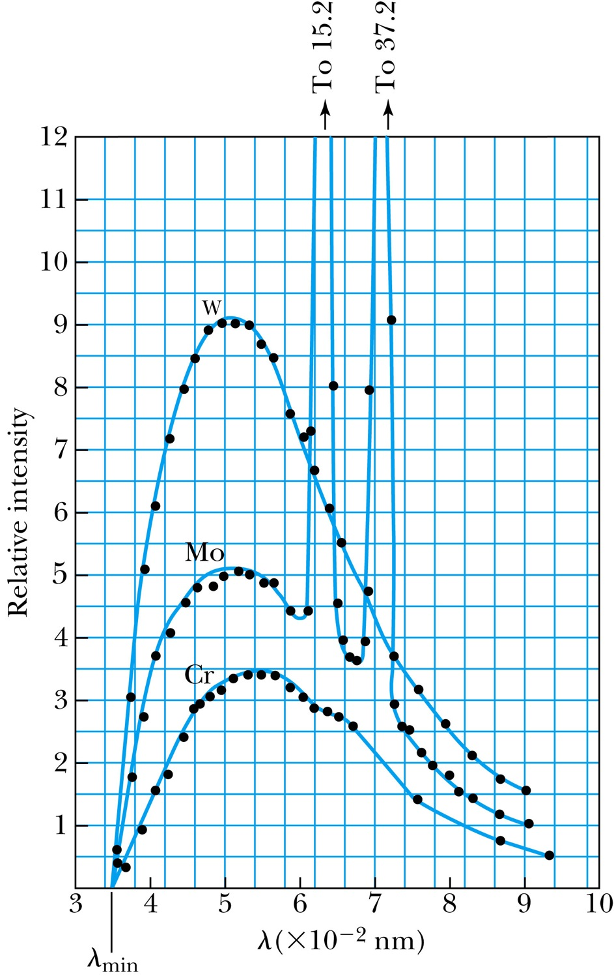
Inverse Photoelectric Effect.
Conservation of energy requires that the electron KE equals the maximum photon energy
Work function neglected since it’s small compared to the potential energy of the electron.
This is the Duane-Hunt limit
The photon wavelength depends only on the accelerating voltage
The same for all targets.

Slide 12
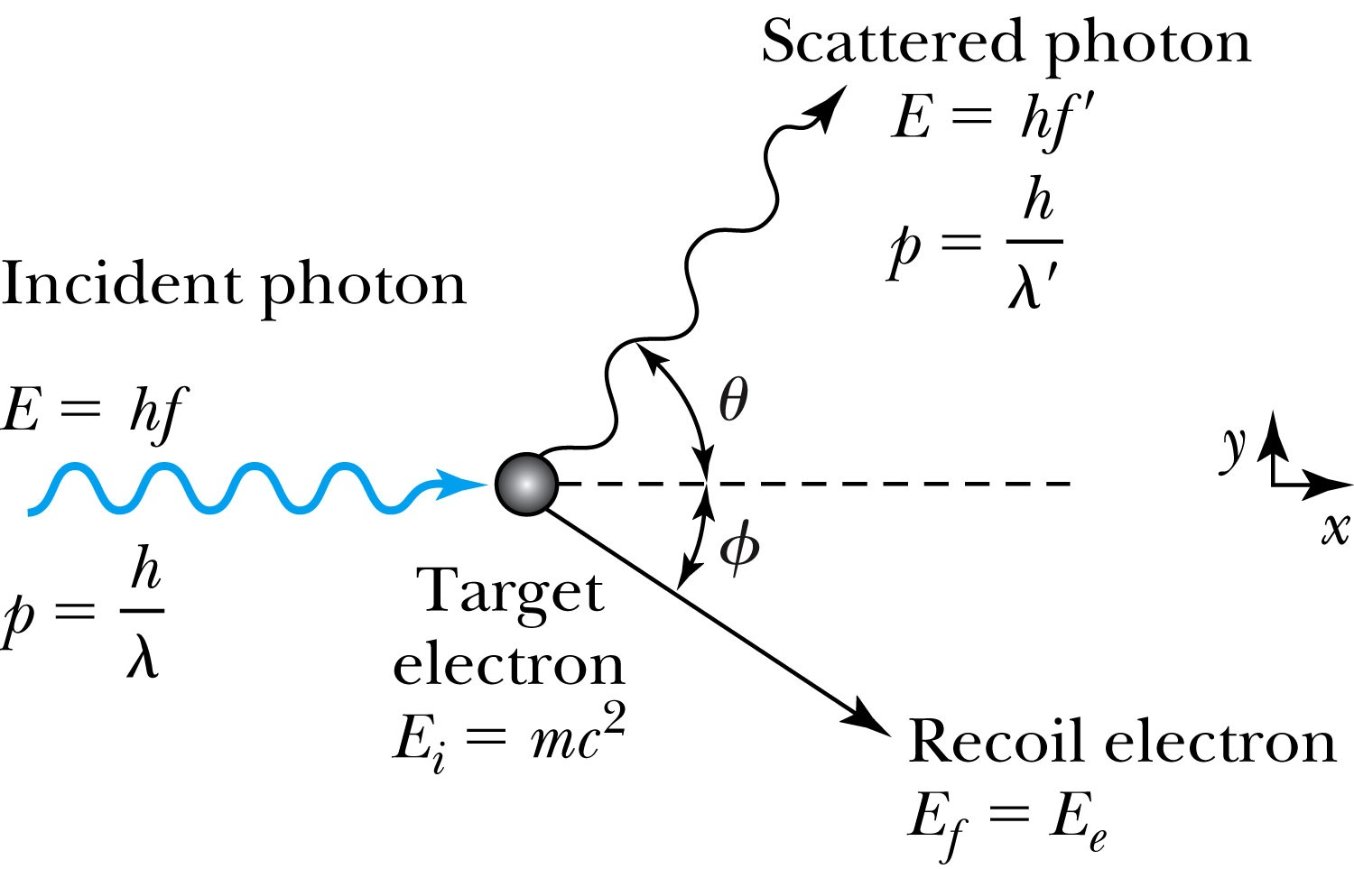
Compton Effect
When a photon enters matter, it is likely to interact with one of the atomic electrons.
The photon is scattered from only one electron
The laws of conservation of energy and momentum apply as in any elastic collision between two particles. The momentum of a particle moving at the speed of light is
The electron energy can be written as
Change of the scattered photon wavelength is known as the Compton effect:

Slide 13
Pair Production and Annihilation
If a photon can create an electron, it must also create a positive charge to balance charge conservation.
In 1932, C. D. Anderson observed a positively charged electron (e⁺) in cosmic radiation. This particle, called a positron, had been predicted to exist several years earlier by P. A. M. Dirac.
A photon’s energy can be converted entirely into an electron and a positron in a process called pair production.
Can only happen inside a material
How much energy do you think is needed?

Slide 14
Pair Production in Empty Space?
Energy conservation for pair production in empty space
Momentum conservation yields
Thus max momentum exchange
Recall that the total energy for a particle can be written as
However this yields a contradiction:
and hence the conversion of energy in empty space is impossible and thus pair production cannot happen in empty space

Slide 15
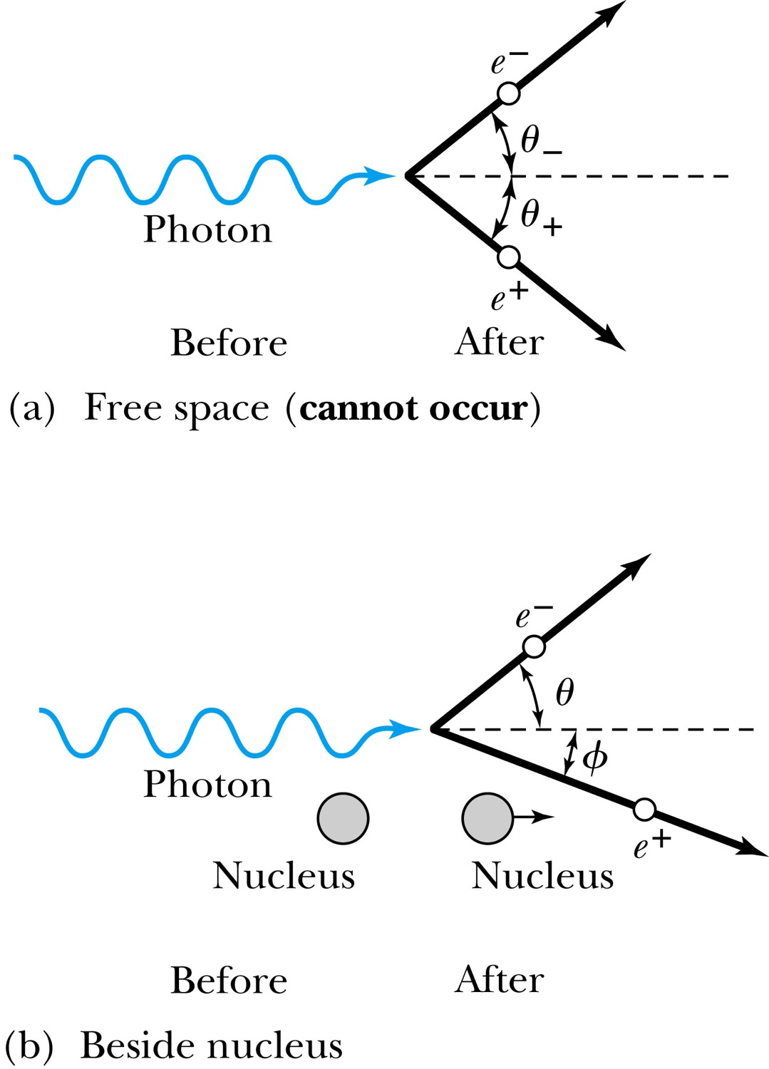
Pair Production in Matter
Since the relations and contradict each other, a photon can not produce an electron and a positron in empty space.
In the presence of matter, however, the nucleus absorbs some energy and momentum.
The photon energy required for pair production in the presence of matter is

Slide 16
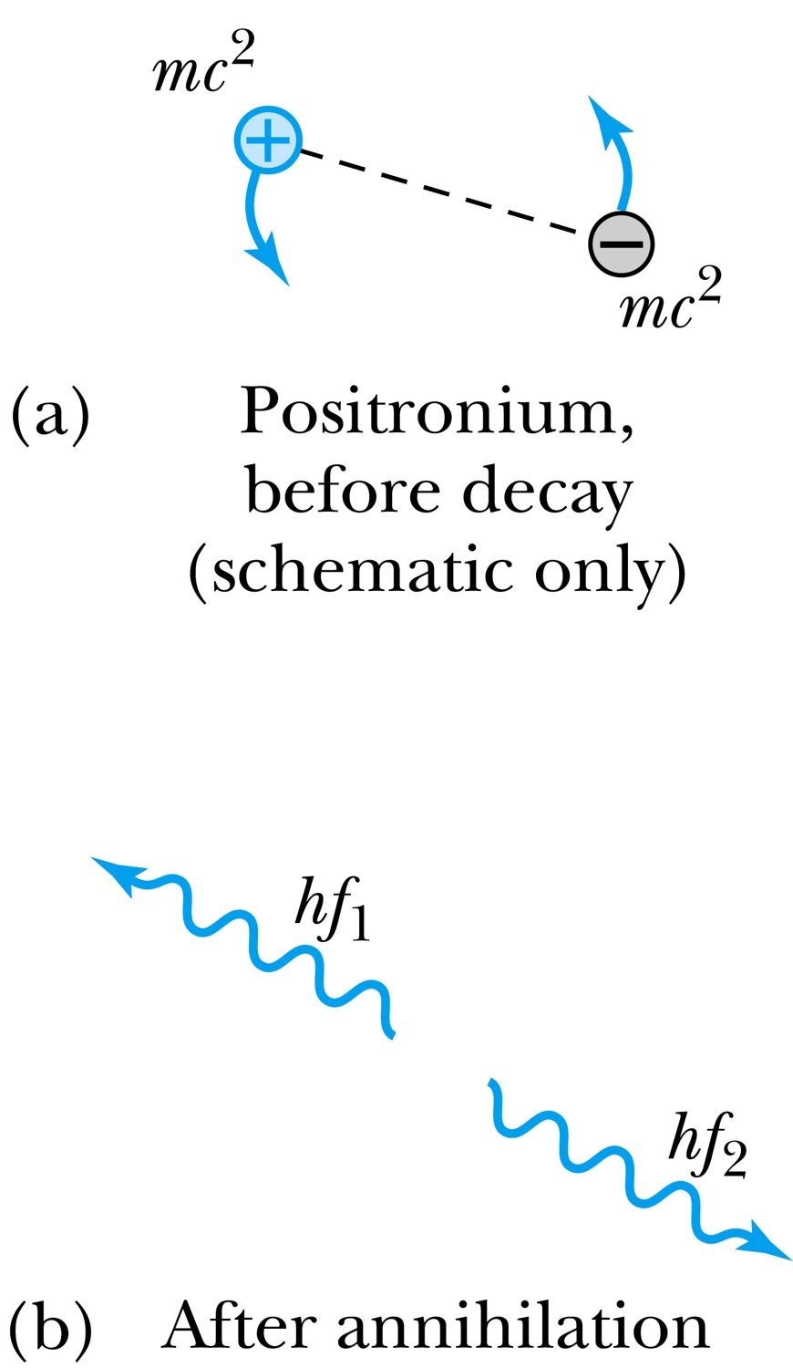
Pair Annihilation
A positron going through matter will likely annihilate with an electron.
A positron is drawn to an electron and form an atom-like configuration called positronium.
Pair annihilation in empty space will produce two photons to conserve momentum. Annihilation near a nucleus can result in a single photon.
Conservation of energy:
Conservation of momentum:
The two photons will be almost identical, so that
The two photons from a positronium annihilation will move in the opposite directions with an energy of:

