Slide 1
PHYS 3313 – Section 001 Lecture #13
Wednesday, March 1, 2017
Dr. Jaehoon Yu
Rutherford Scattering Experiment and Rutherford Atomic Model
The Classic Atomic Model
Bohr Radius
Bohr’s Hydrogen Model and Its Limitations
Characteristic X-ray Spectra

Slide 2
Announcements
Midterm Exam
In class Wednesday, March. 8
Covers from CH1.1 through what we learn March 6 plus the math refresher in the appendices
Please do NOT miss the exam! You will get an F if you miss it.
BYOF: You may bring a one 8.5x11.5 sheet (front and back) of handwritten formulae and values of constants for the exam
No derivations, word definitions or solutions of any problems!
No additional formulae or values of constants will be provided!
Homework #3
End of chapter problems on CH4: 5, 14, 17, 21, 23 and 45
Due: Monday, March 6
Colloquium today
Dr. Peter Brown from TAM
Quadruple extra credit colloquium: Wed. April 19, Dr. Nigel Lockyer, the Fermilab Director!

Slide 3
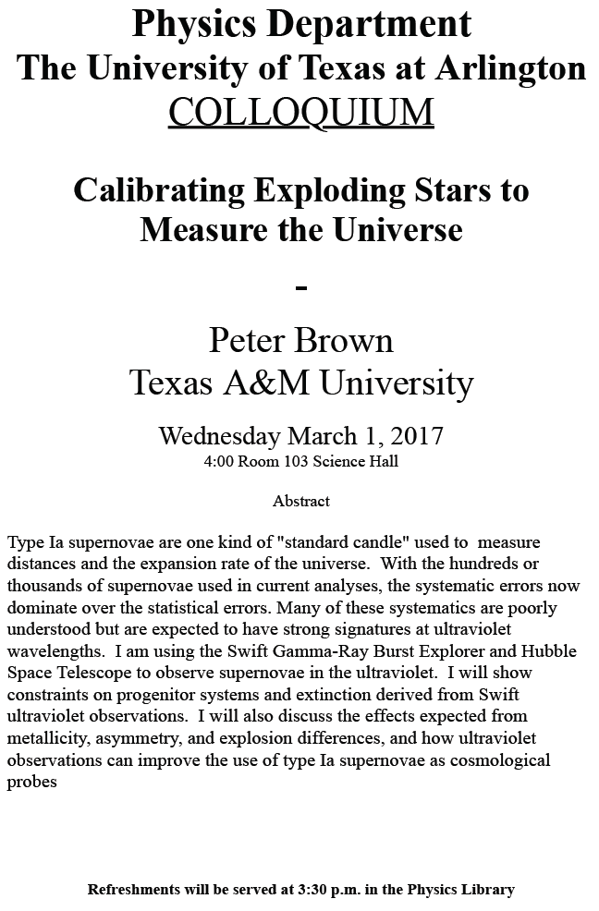

Slide 4
The Atomic Models of Thomson and Rutherford
Without seeing it, 19th century scientists believed atoms have structure.
Pieces of evidence that scientists had in 1900 to indicate that the atom was not a fundamental unit
There are simply too many kinds of atoms (~70 known at that time), belonging to a distinct chemical element
Too many to be fundamental!!
Atoms and electromagnetic phenomena seem to be intimately related
The issue of valence ➔ Why certain elements combine with some elements but not with others?
Is there a characteristic internal atomic structure?
The discoveries of radioactivity, X rays, and the electron

Slide 5
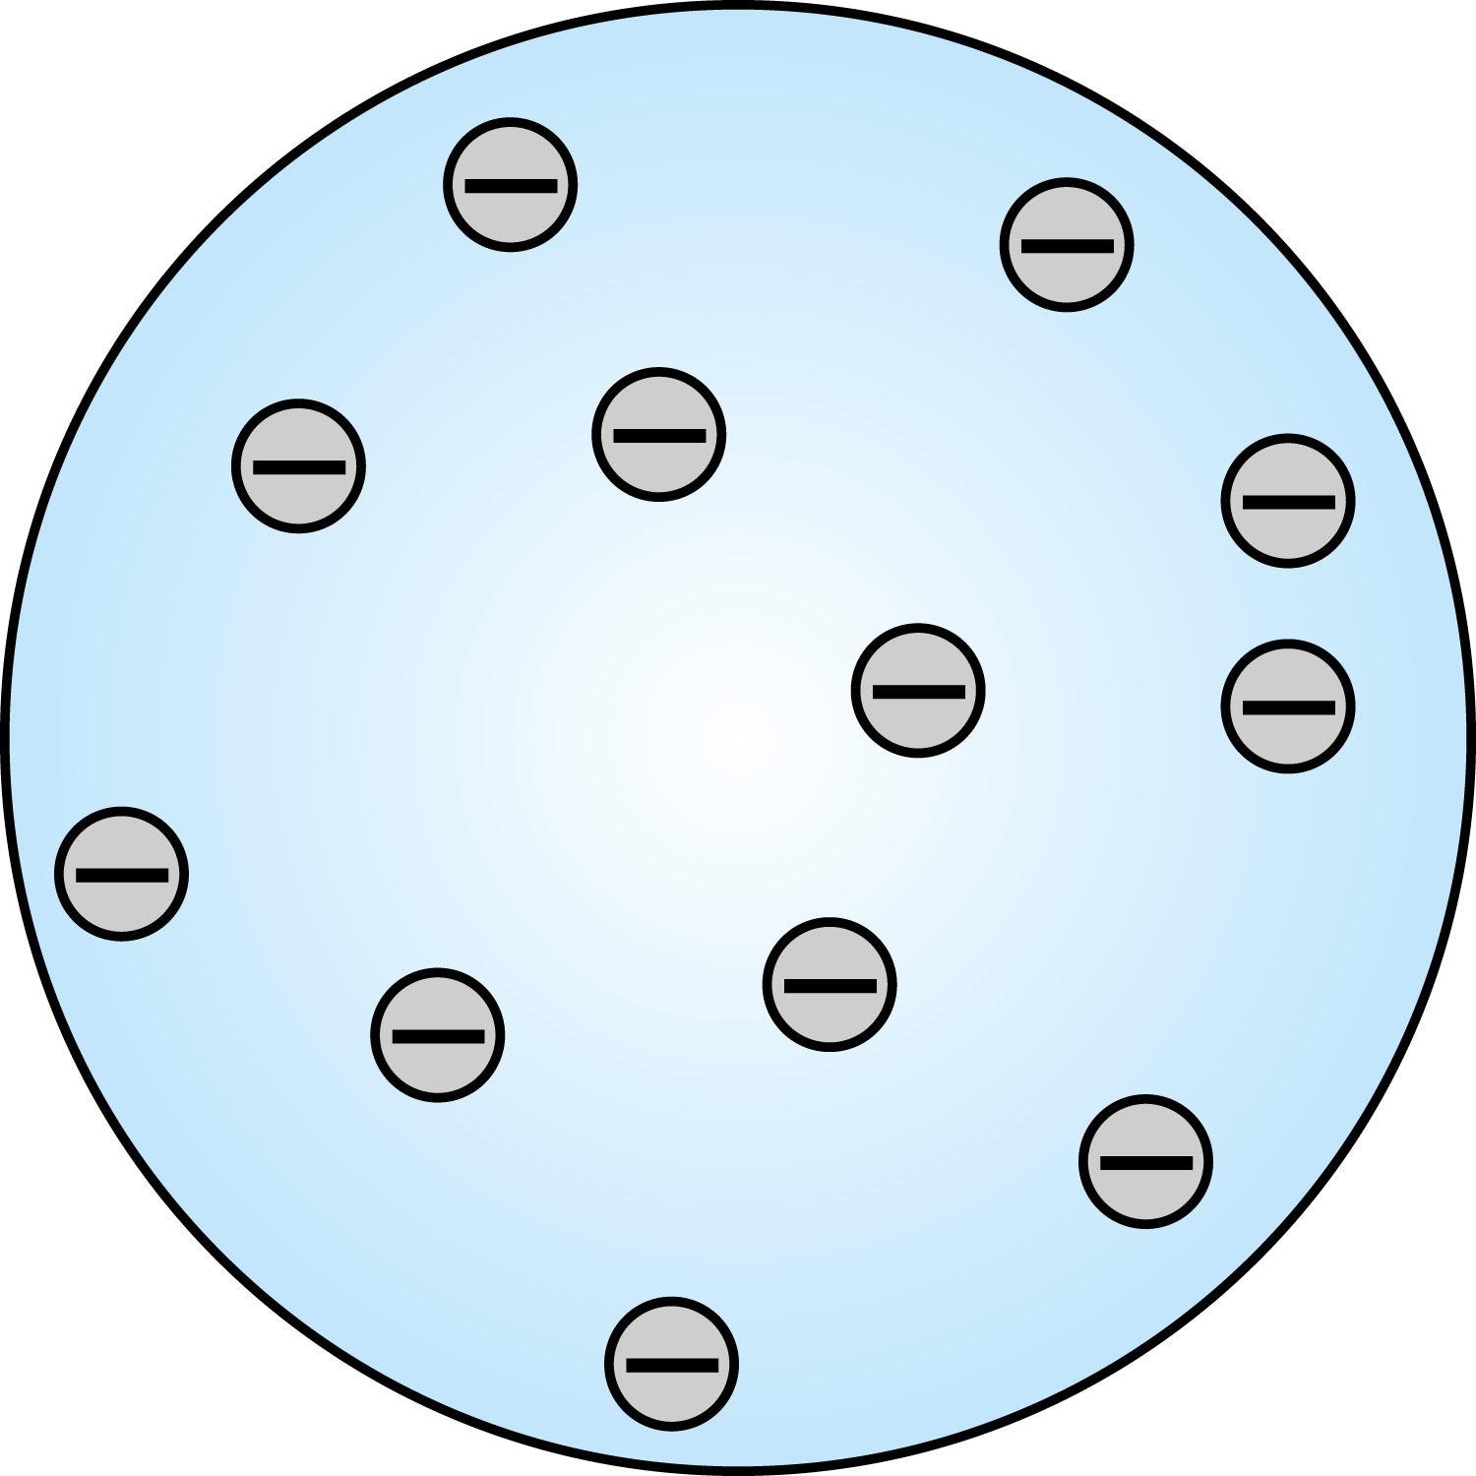
Thomson’s Atomic Model
Thomson’s “plum-pudding” model
Atoms are electrically neutral and have electrons in them
Atoms must have an equal amount of positive charges in it to balance electron negative charges
So how about positive charges spread uniformly throughout a sphere the size of the atom with the newly discovered “negative” electrons embedded in a uniform background.
Thomson thought when the atom was heated the electrons could vibrate about their equilibrium positions and thus produce electromagnetic radiation.

Slide 6
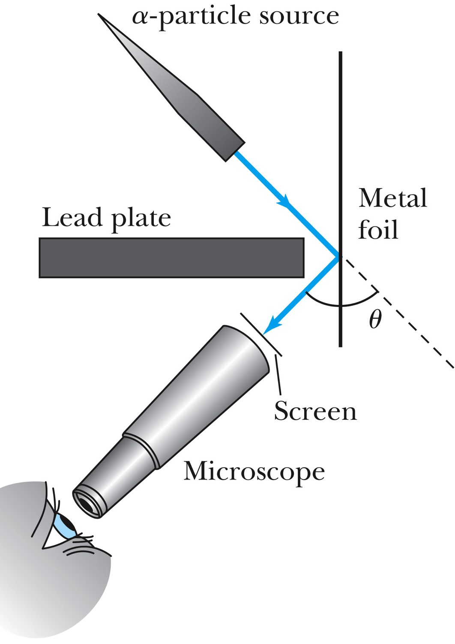
Experiments of Geiger and Marsden
Rutherford, Geiger, and Marsden conceived a new technique for investigating the structure of matter by scattering a particle off atoms.
Geiger showed that many particles were scattered from thin gold-leaf targets at backward angles greater than 90°.
Time to do some calculations!

Slide 7
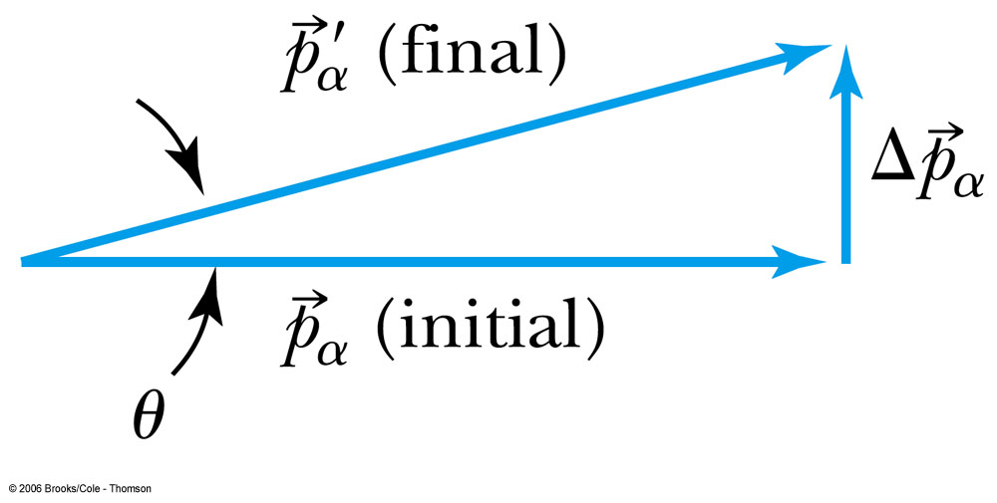
Ex 4.1: Maximum Scattering Angle
Geiger and Marsden (1909) observed backward-scattered (θ>=90º) α particles when a beam of energetic α particles was directed at a piece of gold foil as thin as 6.0x10⁻⁷m. Assuming an α particle scatters from an electron in the foil, what is the maximum scattering angle?
The maximum scattering angle corresponds to the maximum momentum change
Using the momentum conservation and the KE conservation for an elastic collision, the maximum momentum change of the α particle is in a head-on collision
Determine θ by letting Δp_{max} be perpendicular to the direction of motion.

Slide 8
Multiple Scattering from Electrons
If an α particle were scattered by many electrons, then N electrons results in <θ>_{total} ~ √N*θ
The number of atoms across a thin gold layer of 6 × 10⁻⁷ m:
Assume the distance between atoms is
and there are
This gives

Slide 9
Rutherford’s Atomic Model
<θ>_{total}~0.8*79=6.8º even if the α particle scattered from all 79 electrons in each atom of gold
The experimental results were inconsistent with Thomson’s atomic model.
Rutherford proposed that an atom has a positively charged core (nucleus) surrounded by negatively charged electrons.

Slide 10
Assumptions of Rutherford Scattering
The scatterer is so massive that it does not recoil significantly; therefore the initial and final KE of the α particle are practically equal.
The target is so thin that only a single scattering occurs.
The bombarding particle and target scatterer are so small that they may be treated as point masses with electrical charges.
Only the Coulomb force is effective.

Slide 11
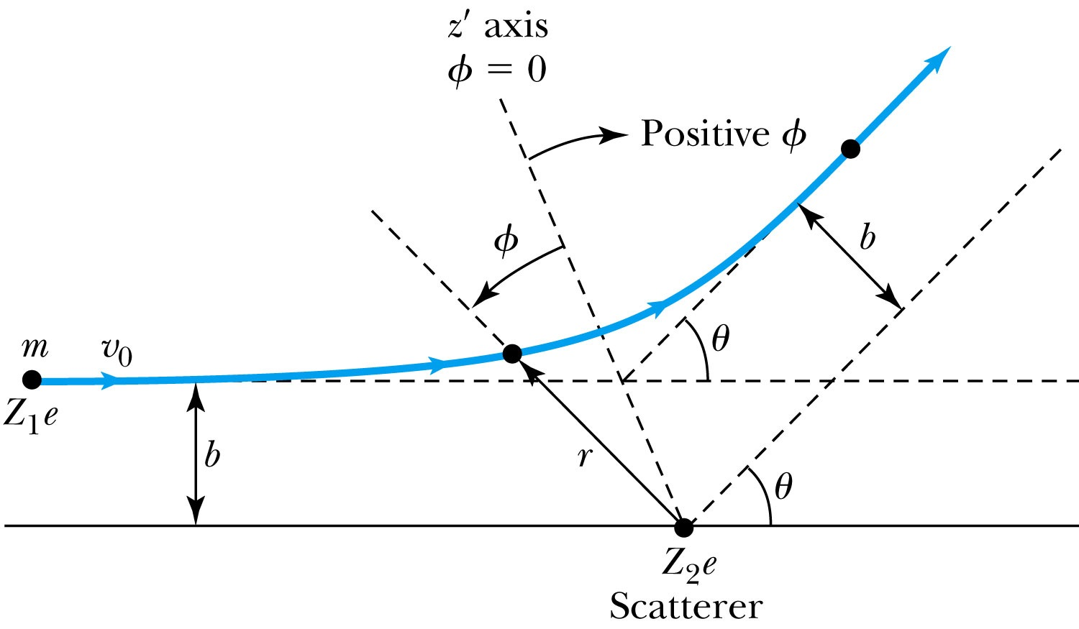
Rutherford Scattering
Scattering experiments help us study matter too small to be observed directly by measuring the angular distributions of the scattered particles
What is the force acting in this scattering?
There is a relationship between the impact parameter b and the scattering angle θ.
When b is small,
r gets small.
Coulomb force gets large.
θ can be large and the particle can be repelled backward.

Slide 12
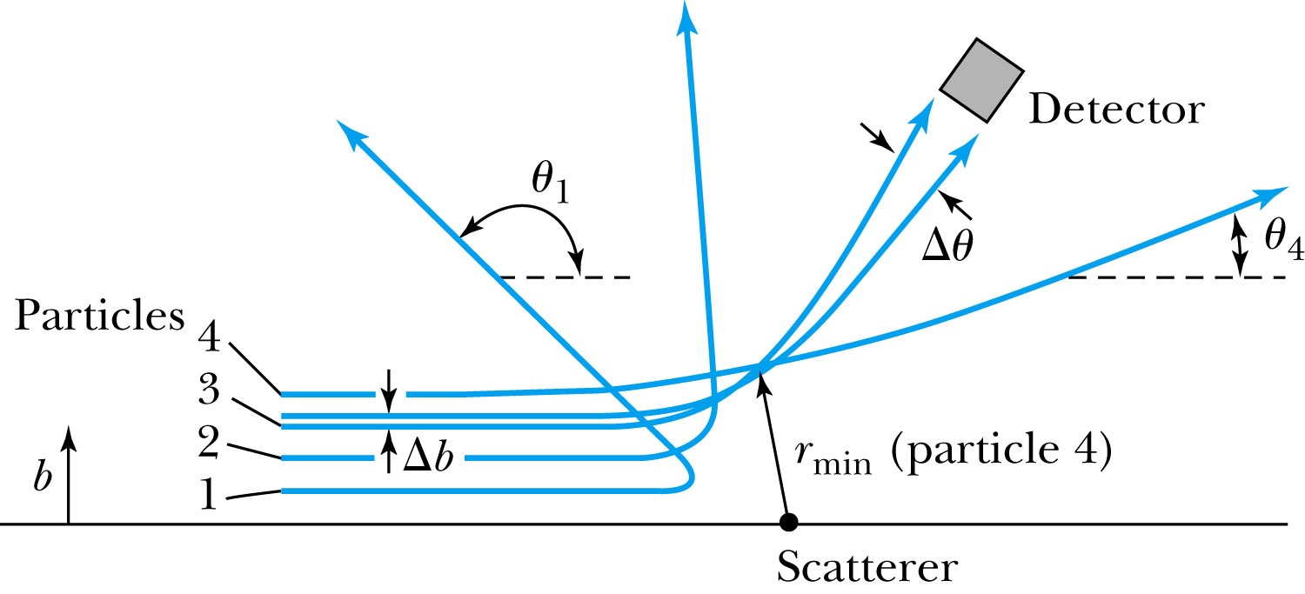
The Relationship Between the Impact Parameter b and the Scattering Angle
The relationship between the impact parameter b and scattering angle θ: Particles with small impact parameters approach the nucleus most closely (r_{min}) and scatter to the largest angles. Particles within a certain range of impact parameters b will be scattered within the window Δθ.

Slide 13
Rutherford Scattering
What are the quantities that can affect the scattering?
What was the force again?
The Coulomb force
The charge of the incoming particle (Z₁e)
The charge of the target particle (Z₂e)
The minimum distance the projectile approaches the target (r)
Using the fact that this is a totally elastic scattering under a central force, we know that
Linear momentum is conserved
KE is conserved
Angular momentum is conserved
From this, impact parameter

Slide 14
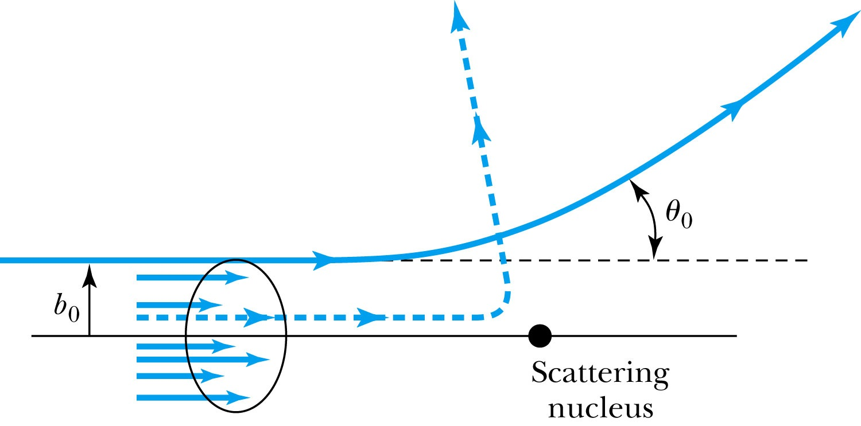
Rutherford Scattering - probability
Any particle inside the circle of area πb₀² will be similarly scattered.
The cross section σ = πb² is related to the probability for a particle being scattered by a nucleus.
The fraction of the incident particles scattered is
The number of scattering nuclei per unit area .
t: target thickness
n: atomic number density

Slide 15
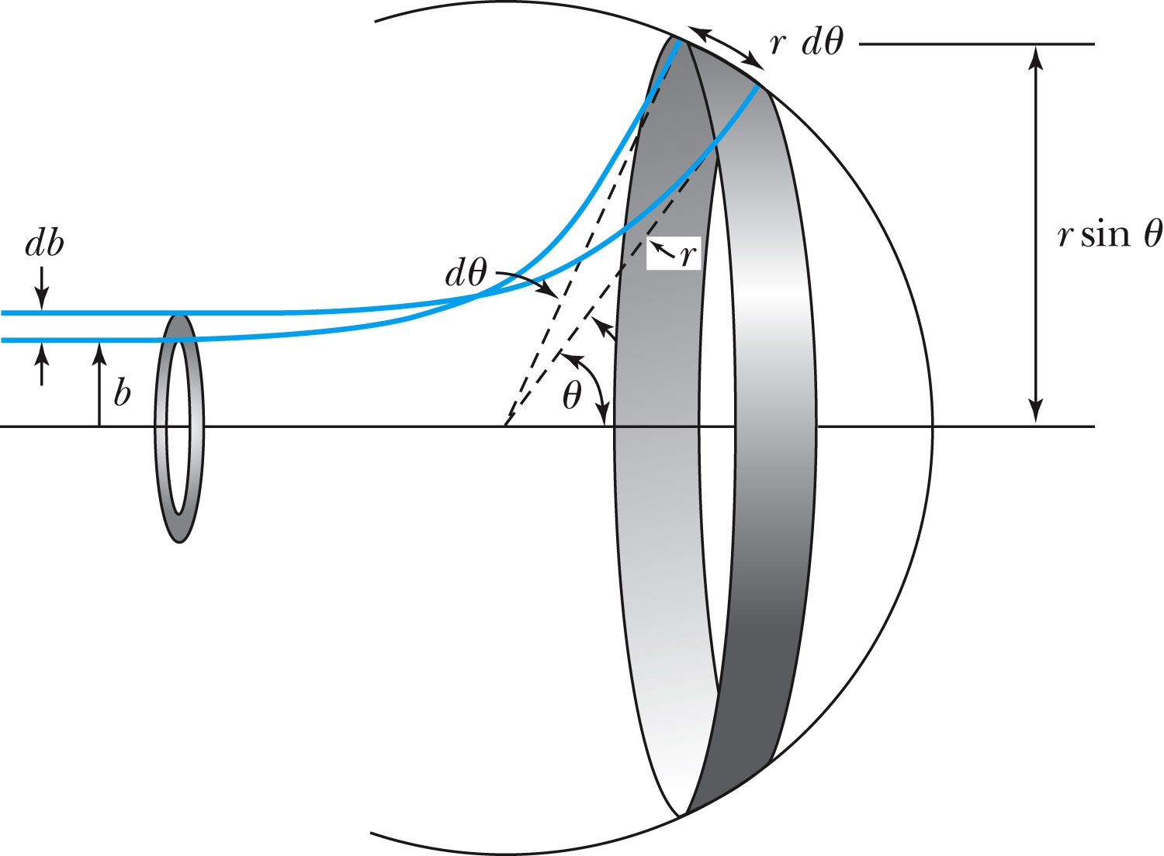
Rutherford Scattering Equation
In an actual experiment, a detector is positioned from θ to θ + dθ that corresponds to incident particles between b and b + db.
The number of particles scattered into the the angular coverage per unit area is

Slide 16
The Important Points
The scattering is proportional to the square of the atomic numbers of both the incident particle (Z₁) and the target scatterer (Z₂).
The number of scattered particles is inversely proportional to the square of the kinetic energy of the incident particle.
For a scattering angle θ, the scattering is proportional to 4th power of sin(θ/2).
The Scattering is proportional to the target thickness for thin targets.

