Slide 1
PHYS 3313 – Section 001
Lecture #14
Monday, March 6, 2017
Dr. Jaehoon Yu
The Classic Atomic Model
Bohr Radius
Bohr’s Hydrogen Model and Its Limitations
Characteristic X-ray Spectra

Slide 2
Announcements
Midterm Exam
  In class this Wednesday, March. 8
  Covers from CH1.1 through what we learn today, CH4.7 plus the math refresher in the appendices
  Please do NOT miss the exam! You will get an F if you miss it.
  BYOF: You may bring a one 8.5x11.5 sheet (front and back) of handwritten formulae and values of constants for the exam
    No derivations, word definitions or solutions of any problems!
    No additional formulae or values of constants will be provided!
Mid-term grade discussions
  Monday March 20 and Wednesday, March 22
  Monday we will have class for the first 45min..
  Wednesday we will replace the class with your grade discussion

Slide 3
The Classical Atomic Model
As suggested by the Rutherford Model, an atom consisted of a small, massive, positively charged nucleus surrounded by moving electrons. This then suggested consideration of a planetary model of the atom.
Let’s consider atoms in a planetary model.
The force of attraction on the electron by the nucleus and Newton’s 2nd law give
where v is the tangential speed of an electron.
The total energy is

Slide 4
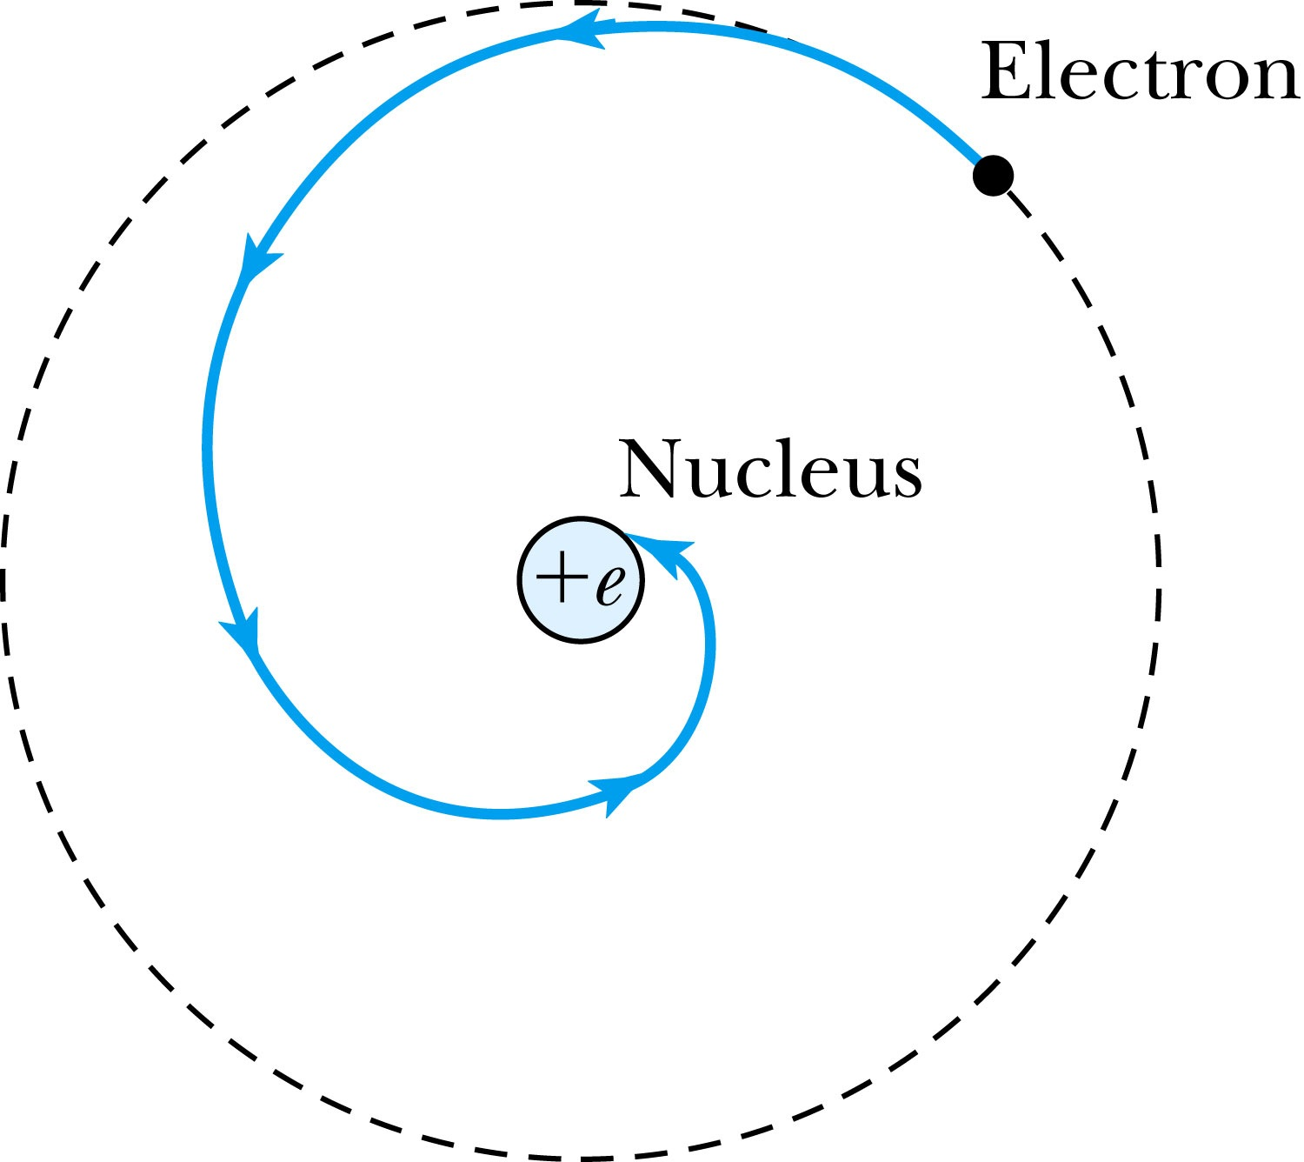
The Planetary Model is Doomed
From the classical E&M theory, an accelerated electric charge radiates energy (electromagnetic radiation) which means total energy must decrease. ➔Radius r must decrease!!
Electron crashes into the nucleus!?
Physics had reached a turning point in 1900 with Planck’s hypothesis of the quantum behavior of radiation.

Slide 5
The Bohr Model of the Hydrogen Atom – The assumptions
“Stationary” states or orbits must exist in atoms, i.e., orbiting electrons do not radiate energy in these orbits. These orbits or stationary states are of a fixed definite energy E.
The emission or absorption of electromagnetic radiation can occur only in conjunction with a transition between two stationary states. The frequency, f, of this radiation is proportional to the difference in energy of the two stationary states:
E = E₁ − E₂ = hf
where h is Planck’s Constant
  Bohr thought this has to do with the fundamental length of order ~10⁻¹⁰m
Classical laws of physics do not apply to transitions between stationary states.
The mean kinetic energy of the electron-nucleus system is quantized as
K = nhf_{orb}/2, where f_{orb} is the frequency of rotation. This is equivalent to the angular momentum of a stationary state to be an integral multiple of h/2π

Slide 6
How did Bohr Arrived at the angular momentum quantization?
The mean kinetic energy of the electron-nucleus system is quantized as
K = nhf_{orb}/2, where f_{orb} is the frequency of rotation. This is equivalent to the angular momentum of a stationary state to be an integral multiple of h/2π.
Kinetic energy can be written
Angular momentum is defined as
The relationship between linear and angular quantifies
Thus, we can rewrite

Slide 7
Bohr’s Quantized Radius of Hydrogen
The angular momentum is
So the speed of an orbiting e can be written
From the Newton’s law for a circular motion
So from the above two equations, we can get

Slide 8
Bohr Radius
The radius of the hydrogen atom for the n^{th} stationary state is
Where the Bohr radius for a given stationary state is:
The smallest diameter of the hydrogen atom is
  OMG!! The fundamental length!!
n = 1 gives its lowest energy state (called the “ground” state)

Slide 9
Ex. 4.6 Justification for non-relativistic treatment of orbital e
Are we justified for the non-relativistic treatment of the orbital electrons?
  When do we apply relativistic treatment?
    When v/c>0.1
Orbital speed:
Thus

Slide 10
Uncertainties
Statistical Uncertainty: A naturally occurring uncertainty due to the number of measurements
  Usually estimated by taking the square root of the number of measurements or samples, √N
Systematic Uncertainty: Uncertainty due to unintended biases or unknown sources
  Biases made by personal measurement habits
  Some sources that could impact the measurements
In any measurement, the uncertainties provide the significance to the measurement

Slide 11
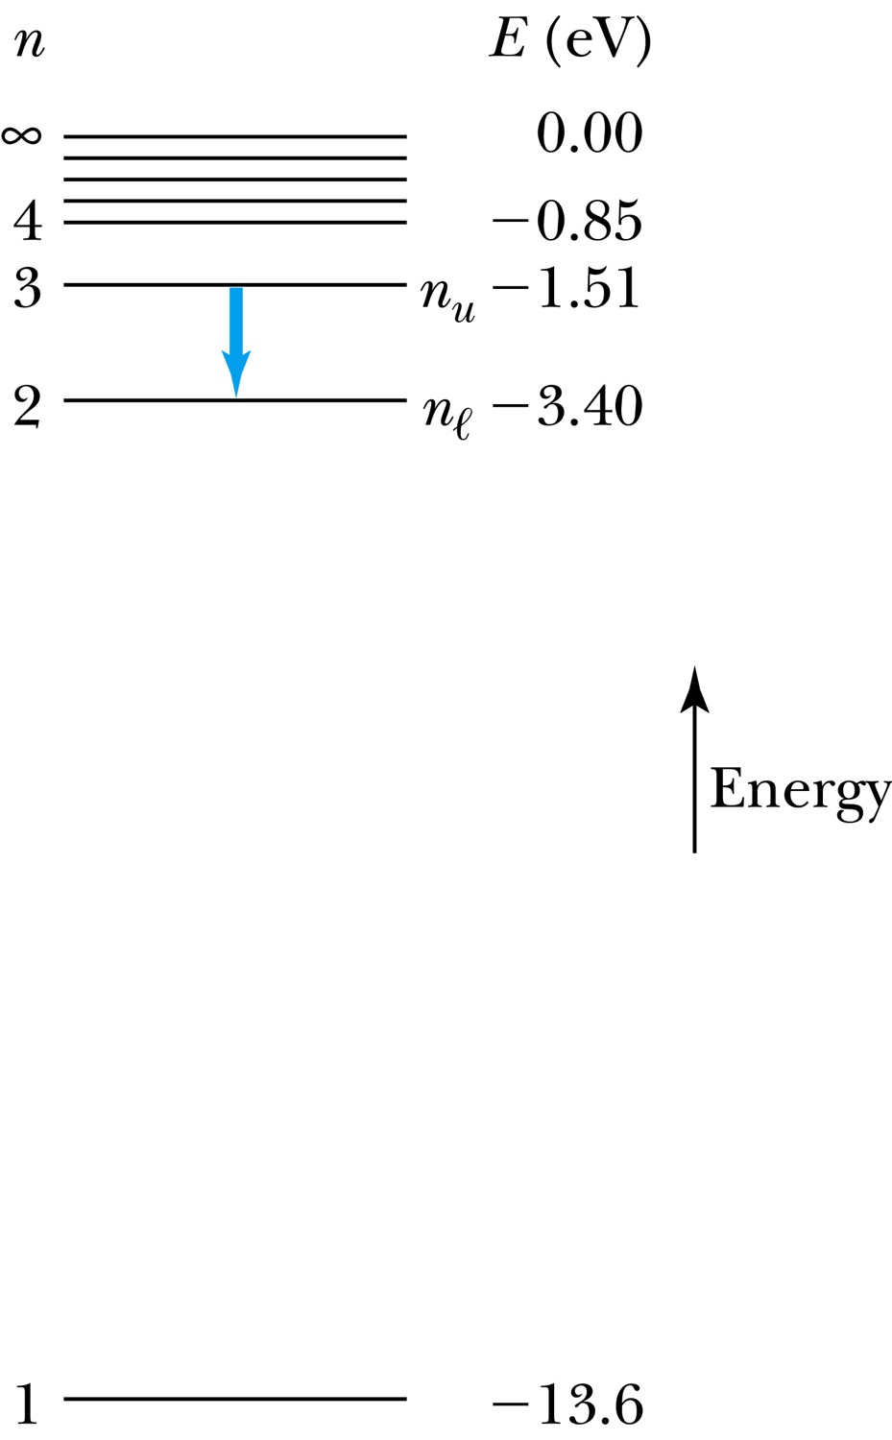
The Hydrogen Atom
Recalling the total E of an e in an atom, the n^{th} stationary states En
where E₀ is the ground state energy
Emission of light occurs when the atom is in an excited state and decays to a lower energy state (n_{u} → n_{ℓ}).
where f is the frequency of a photon.
R∞ is the Rydberg constant.

Slide 12
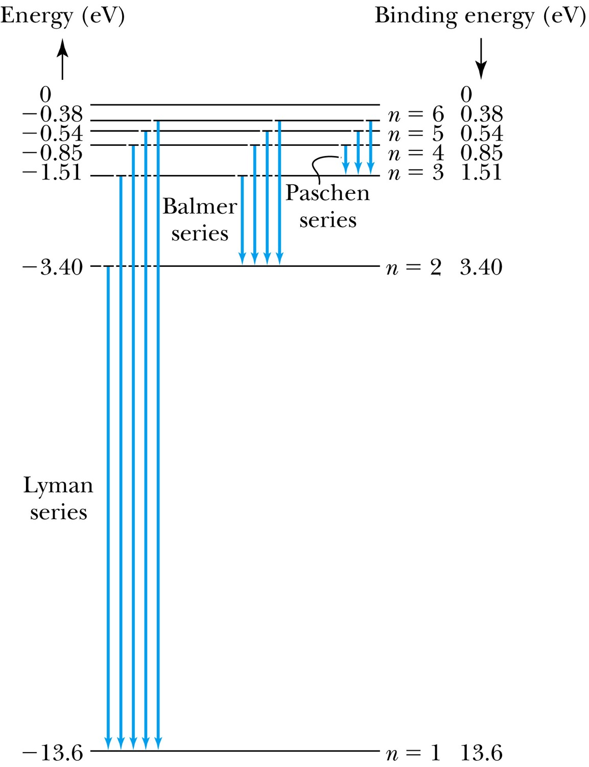
Transitions in the Hydrogen Atom
Lyman series: The atom will remain in the excited state for a short time before emitting a photon and returning to a lower stationary state. All hydrogen atoms exist in n = 1 (invisible).
Balmer series: When sunlight passes through the atmosphere, hydrogen atoms in water vapor absorb the wavelengths (visible).

Slide 13
Fine Structure Constant
The electron’s speed on an orbit in the Bohr model:
On the ground state, v₁ = 2.2 × 10⁶ m/s ~ less than 1% of the speed of light
The ratio of v₁ to c is the fine structure constant, α.

Slide 14
The Correspondence Principle
Classical electrodynamics
Bohr’s atomic model
+
Determine the properties
of radiation
Need a principle to relate the new modern results with the classical ones.
Bohr’s correspondence
principle
In the limits where classical and quantum theories should agree, the quantum theory must produce the classical results.

Slide 15
The Correspondence Principle
The frequency of the radiation emitted f_{classical} is equal to the orbital frequency f_{orb} of the electron around the nucleus.
The frequency of the photon in the transition from n + 1 to n is
For a large n the classical limit,
Substitute E₀:
So the frequency of the radiated E between classical theory and Bohr model agrees in large n case!!

Slide 16
The Importance of Bohr’s Model
Demonstrated the need for Plank’s constant in understanding the atomic structure
Assumption of quantized angular momentum which led to quantization of other quantities, r, v and E as follows
Orbital Radius:
Orbital Speed:
Energy levels:

Slide 17
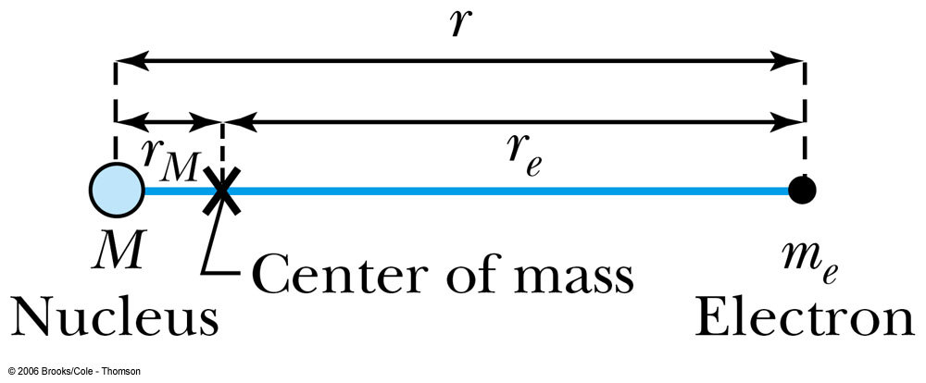
Successes and Failures of the Bohr Model
The electron and hydrogen nucleus actually revolve about their mutual center of mass ➔ reduced mass correction!!
All we need is to replace m_{e} with atom’s reduced mass.
The Rydberg constant for infinite nuclear mass, R∞ is replaced by R.

Slide 18
Limitations of the Bohr Model
The Bohr model was a great step of the new quantum theory, but it had its limitations.
Works only to single-electron atoms
  Works even for ions ➔ What would change?
  The charge of the nucleus
Could not account for the intensities or the fine structure of the spectral lines
  Fine structure is caused by the electron spin
  Under a magnetic field, the spectrum splits by the spin
Could not explain the binding of atoms into molecules

Slide 19
Characteristic X-Ray Spectra and Atomic Number
Shells have letter names:
K shell for n = 1
L shell for n = 2
The atom is most stable in its ground state.
When a transition occurs in a heavy atom, the radiation emitted is an x ray.
It has the energy E (x ray) = E_{u} − E_{ℓ}.
An electron from higher shells will fill the inner-shell vacancy at lower energy.

Slide 20
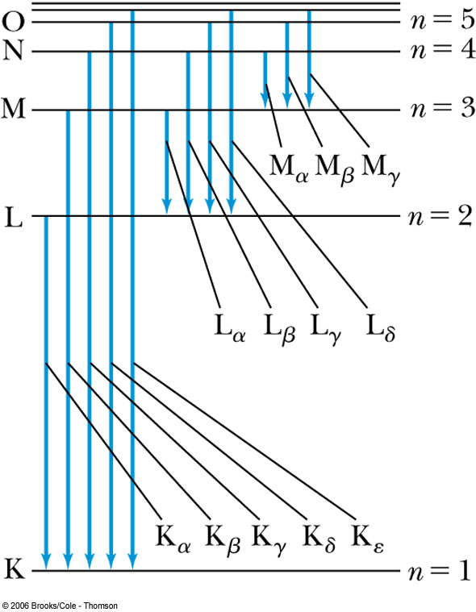
Atomic Number
L shell to K shell K_{α} x ray
M shell to K shell K_{β} x ray
Atomic number Z = number of protons in the nucleus
Moseley found a relationship between the frequencies of the characteristic x ray and Z.
This holds for the K_{α} x ray

Slide 21
Moseley’s Empirical Results
The x ray is produced from n = 2 to n = 1 transition.
In general, the K series of x ray wavelengths are
Moseley’s research clarified the importance of the electron shells for all the elements, not just for hydrogen
  Concluded correctly that atomic number Z, rather than the atomic weight, is the determining factor in ordering of the periodic table

Slide 22
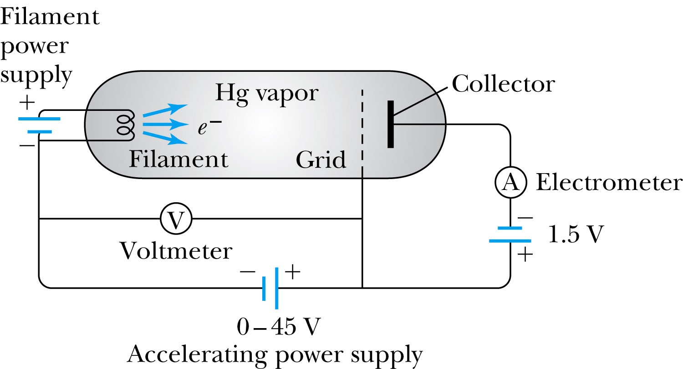
Atomic Excitation by Electrons
Franck and Hertz studied the phenomenon of ionization KE transfer from electrons to atoms.
When the accelerating voltage is below 5 V
electrons did not lose energy going through the mercury vapor
When the accelerating voltage is above 5 V, 10V, etc..
sudden drop in the current
Min. e KE

Slide 23
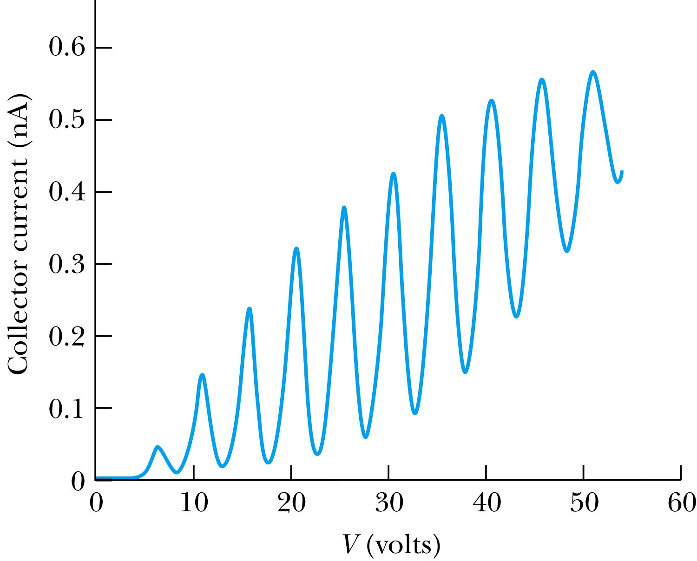
Atomic Excitation by Electrons
Ground state has E₀ which can be considered as 0.
First excited state has E₁.
The energy difference E₁ − 0 = E₁ is the excitation energy.
Hg (mercury) has an excitation energy of 4.88 eV in the first excited state
No energy can be transferred to Hg below 4.88 eV because not enough energy is available to excite an electron to the next energy level
Above 4.88 eV, the current drops because scattered electrons no longer reach the collector until the accelerating voltage reaches 9.76 eV and so on.

