Slide 1
PHYS 3313 – Section 001 Lecture #15
Monday, March 20, 2017
Dr. Jaehoon Yu
Bohr’s Hydrogen Model and Its Limitations
Characteristic X-ray Spectra
X-ray Scattering

Slide 2
Announcements
Mid-term grade discussions
Today at the bottom of the class in CPB342
Last names: A – D
Wednesday, March 22
12:45 – 1:20 pm: Last names start with D – J
1: 20 – 2:00 pm : Last names start with K – P
2:00 – 2:30 pm. : Last names start with P – Z
Mid-term exam results
Class average: 52.7/96
Equivalent to 54.9/100
Top score: 93/96

Slide 3
Evaluation Policy
Homework: 30%
Exams
Mid-term Exam (Wed., Mar. 8): 20%
Final Comprehensive Exam (11 – 1:30pm, Wed, May. 3): 25%
Missing an exam is not permissible unless pre-approved
No makeup test
You will get an F if you miss any of the exams without a prior approval
Group Research Project: 15%
Pop-quizzes: 10%
Extra credits: 10% of the total
Grading will be done on a sliding scale
55% of the grade is in your hand!!
100%

Slide 4
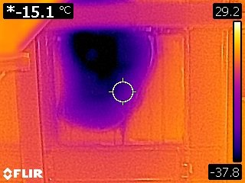
What did I do at CERN?
Figured out the size of the leak!

Slide 5
The Importance of Bohr’s Model
Demonstrated the need for Plank’s constant in understanding the atomic structure
Assumption of quantized angular momentum which led to quantization of other quantities, r, v and E as follows
Orbital Radius:
Orbital Speed:
Energy levels:

Slide 6
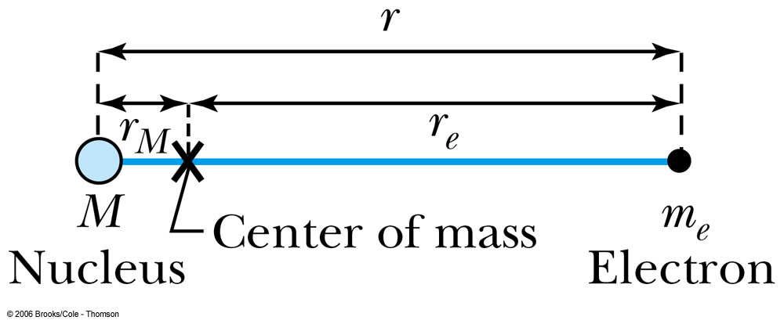
Successes and Failures of the Bohr Model
The electron and hydrogen nucleus actually revolve about their mutual center of mass ➔ reduced mass correction!!
All we need is to replace m_{e} with atom’s reduced mass.
The Rydberg constant for infinite nuclear mass, R∞ is replaced by R.

Slide 7
Limitations of the Bohr Model
The Bohr model was a great step of the new quantum theory, but it had its limitations.
Works only to single-electron atoms
Works even for ions ➔ What would change?
The charge of the nucleus
Could not account for the intensities or the fine structure of the spectral lines
Fine structure is caused by the electron spin
Under a magnetic field, the spectrum splits by the spin
Could not explain the binding of atoms into molecules

Slide 8
Characteristic X-Ray Spectra and Atomic Number
Shells have letter names:
K shell for n = 1
L shell for n = 2
An atom is most stable in its ground state.
When a transition occurs in a heavy atom, the radiation emitted is an X ray.
It has the energy E (x ray) = E_{u} − E_{ℓ}.
An electron from higher shells will fill the inner-shell vacancy at lower energy.

Slide 9
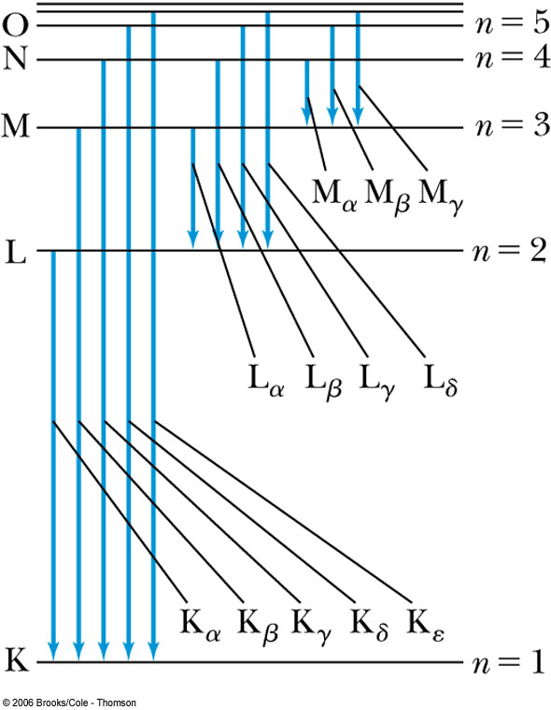
Atomic Number
L shell to K shell K_{α} X ray
M shell to K shell K_{β} X ray
Atomic number Z = number of protons in the nucleus
Moseley found a relationship between the frequencies of the characteristic X ray and Z.
This holds for the K_{α} X ray

Slide 10
Moseley’s Empirical Results
The X ray is produced from n = 2 to n = 1 transition.
In general, the K series of X ray wavelengths are
Moseley’s research clarified the importance of the electron shells for all the elements, not just for hydrogen
Concluded correctly that atomic number Z, rather than the atomic weight, is the determining factor in ordering of the periodic table

Slide 11
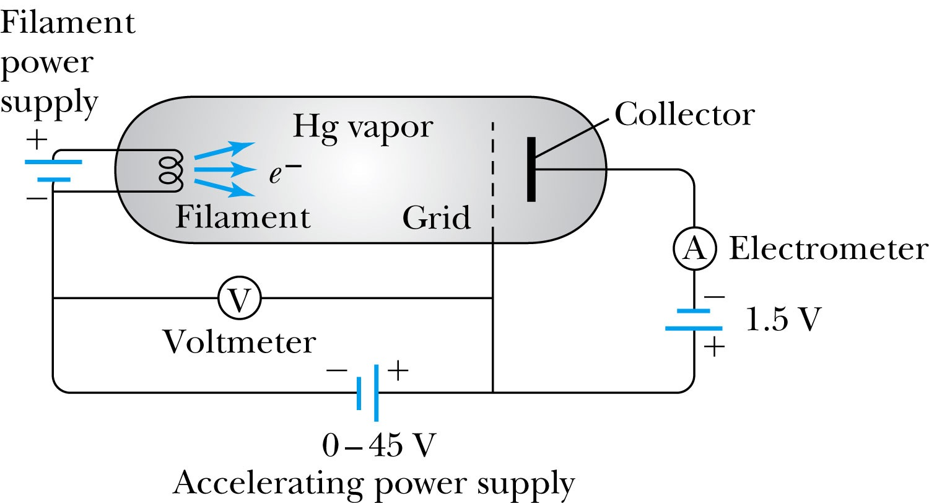
Atomic Excitation by Electrons
Franck and Hertz studied the phenomenon of ionization kinetic energy transfer from electrons to atoms.
When the accelerating voltage is below 5 V
electrons did not lose energy going through the mercury vapor
When the accelerating voltage is above 5 V, 10V, etc..
sudden drop in the current
Min. e KE

Slide 12
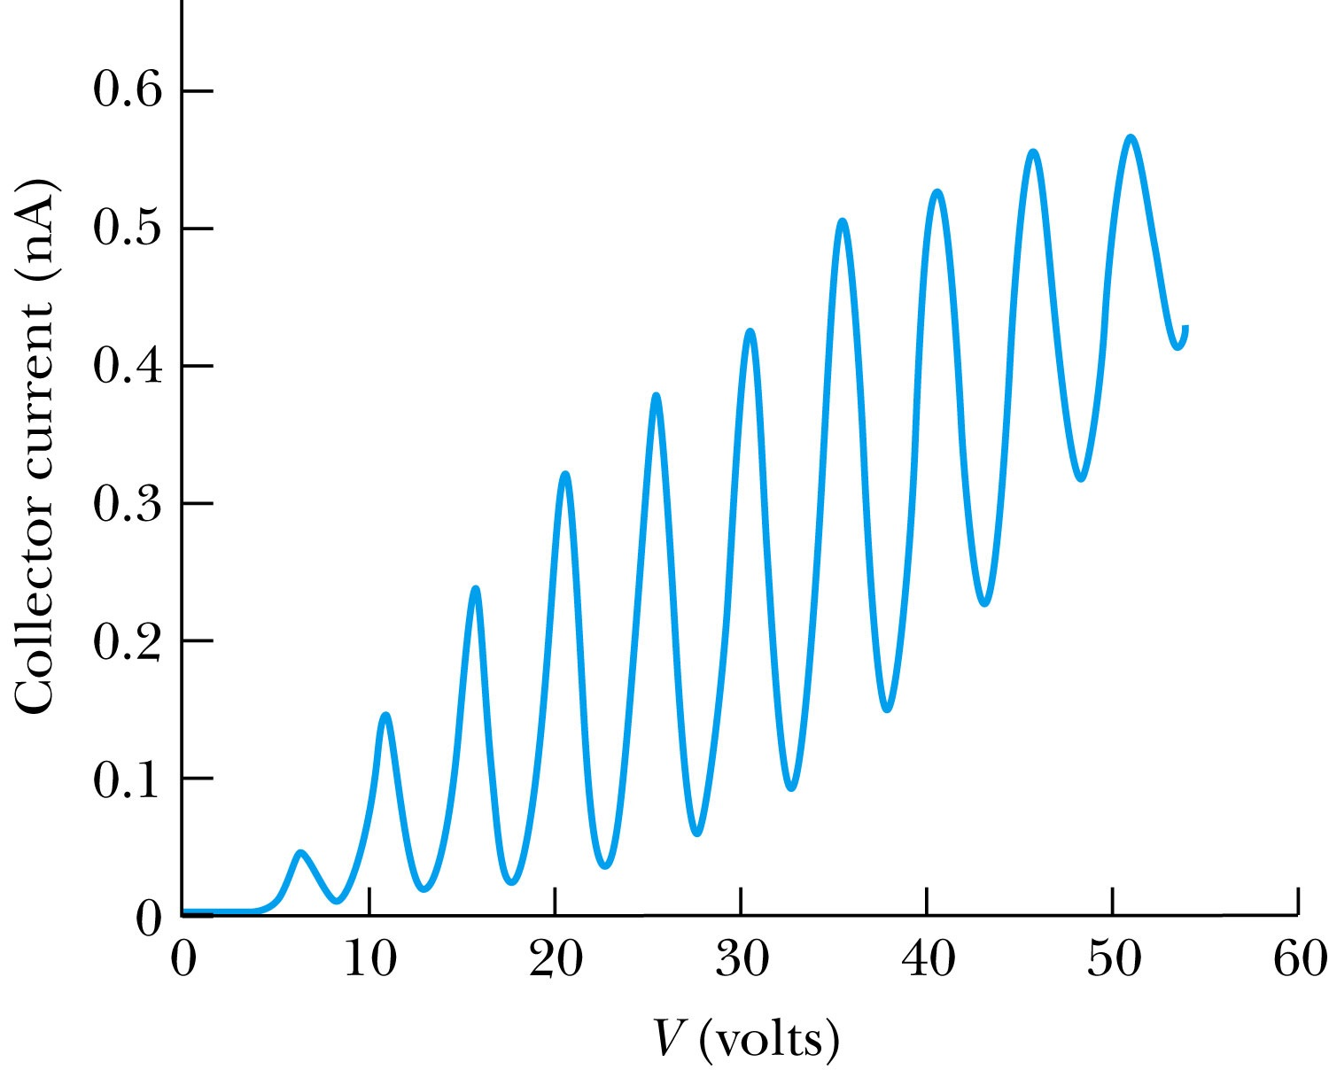
Atomic Excitation by Electrons
Ground state has E₀ which can be considered as 0.
First excited state has E₁.
The energy difference E₁ − 0 = E₁ is the excitation energy.
Hg (mercury) has an excitation energy of 4.88 eV in the first excited state
No energy can be transferred to Hg below 4.88 eV because not enough energy is available to excite an electron to the next energy level
Above 4.88 eV, the current drops because the scattered electrons no longer reach the collector until the accelerating voltage reaches 9.76 eV and so on.

