Slide 1
PHYS 3313 – Section 001
Lecture #16
Monday, March 27, 2017
Dr. Jaehoon Yu
X-ray Scattering
Bragg’s Law
de Broglie Waves
Bohr’s Quantization Conditions
Electron Scattering

Slide 2
Announcements
Reminder: Quadruple extra credit
  Colloquium on April 19, 2017
  Speaker: Dr. Nigel Lockyer, Director of Fermilab
  Title: Particle Physics: Science without Borders; Neutrinos Go Global
  Make your arrangements to take advantage of this opportunity
  Seats may be limited
I strongly encourage you to start the writing process ASAP
  Deadline for report submission: April 26, 2017

Slide 3
Research Projects
Each of the 9 research groups has an assigned research topic

Slide 4
Research Topics
Blackbody radiation
Michelson–Morley Experiment
The Photoelectric Effect
The Brownian Motion
Compton Effect
Discovery of Electron
Rutherford Scattering
Super-conductivity
The Discovery of Radioactivity

Slide 5
Research Projects
Each of the 9 research groups has an assigned research topic
Study the topic as a group, looking up references
  Original theory or Original observation
  Experimental proofs or Theoretical prediction + subsequent experimental proofs
  Importance and the impact of the theory/experiment
Each member of the group writes a 5 – 7 page report, including figures (must not copy!!)
  10% of the total grade
  Can share the theme and facts but you must write your own!
  Due beginning of the class Wed. Apr. 26, 2017
Each group presents a 10+2min power point talk
  5% of the total grade
  Date and time will be announced close to the end of the semester

Slide 6
Reminder: Research Project Report
Must contain the following at the minimum
  Original theory or Original observation
  Experimental proofs or Theoretical prediction + subsequent experimental proofs
  Importance and the impact of the theory/experiment
  Conclusions and future prospects
  The reference to the original paper must be included!
  Bibliography referring to web site must be minimized (<20%)

Slide 7
Project Report Template

Slide 8
Research Presentations
Each of the 9 research groups makes a 10+2min presentation
  10min presentation + 2min Q&A
  All presentations must be in power point
  I must receive all final presentation files by 8pm, Sunday, Apr. 23, 2017
    No changes are allowed afterward
  The representative of the group makes the presentation followed by all group members’ participation in the Q&A session
Date and time:
  In class Monday and Wednesday, Apr. 24 and 26, 2017
Important metrics
  Contents of the presentation: 60%
    Inclusion of all important points as mentioned in the report
    The quality of the research and making the right points
  Quality of the presentation itself: 15%
  Presentation manner: 10%
  Q&A handling: 10%
  Staying in the allotted presentation time: 5%
  Judging participation and sincerity: 5%

Slide 9
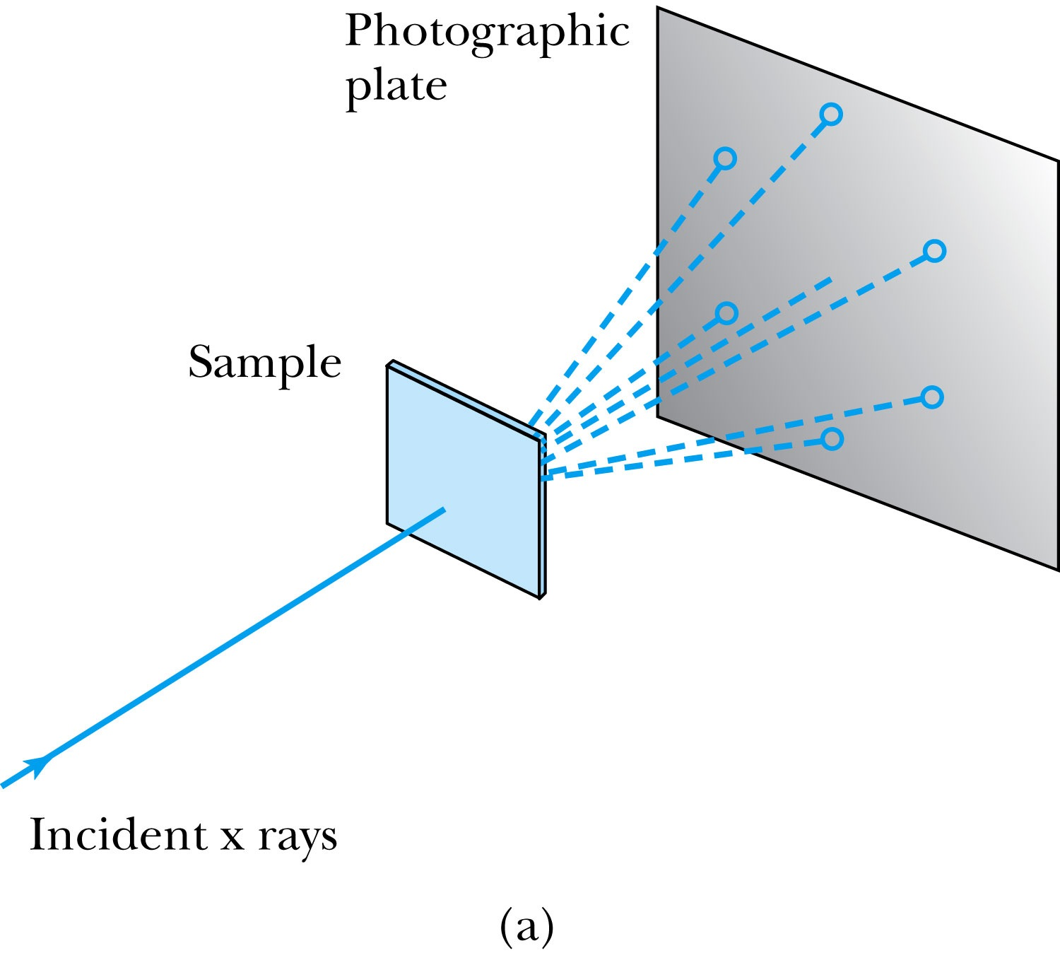
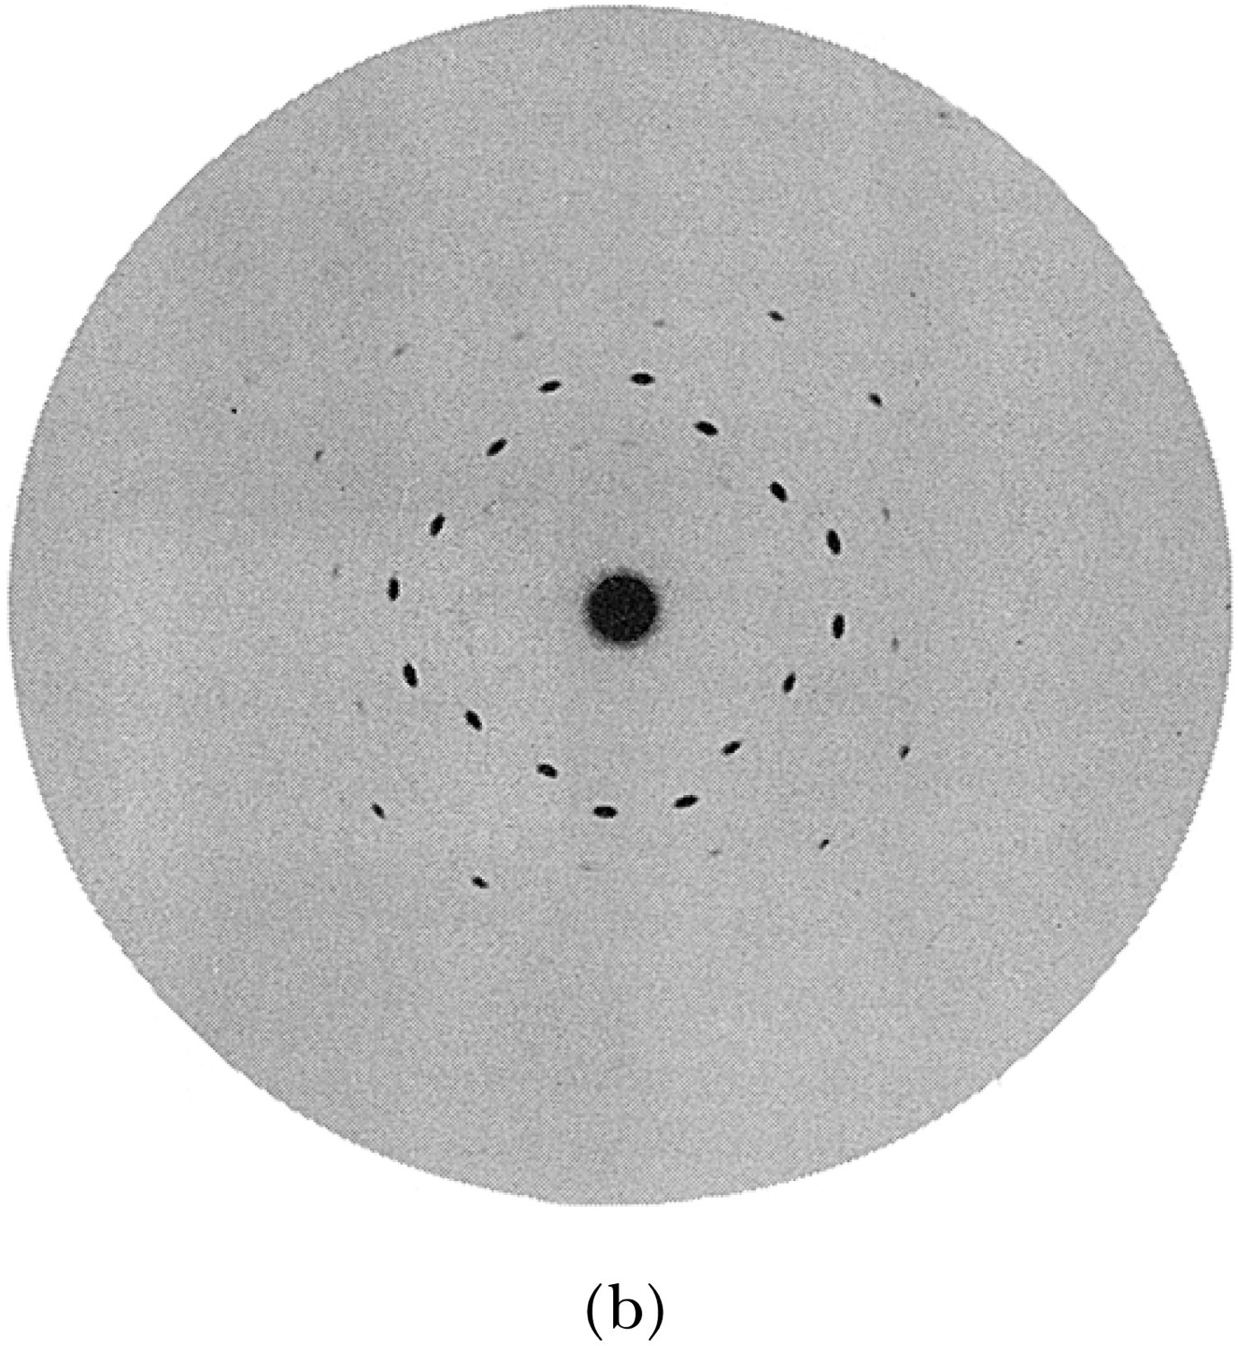
X-Ray Scattering
Max von Laue suggested that if X rays were a form of electromagnetic radiation, interference effects should be observed. (Wave property!!)
Crystals act as three-dimensional gratings, scattering the waves and producing observable interference effects.

Slide 10
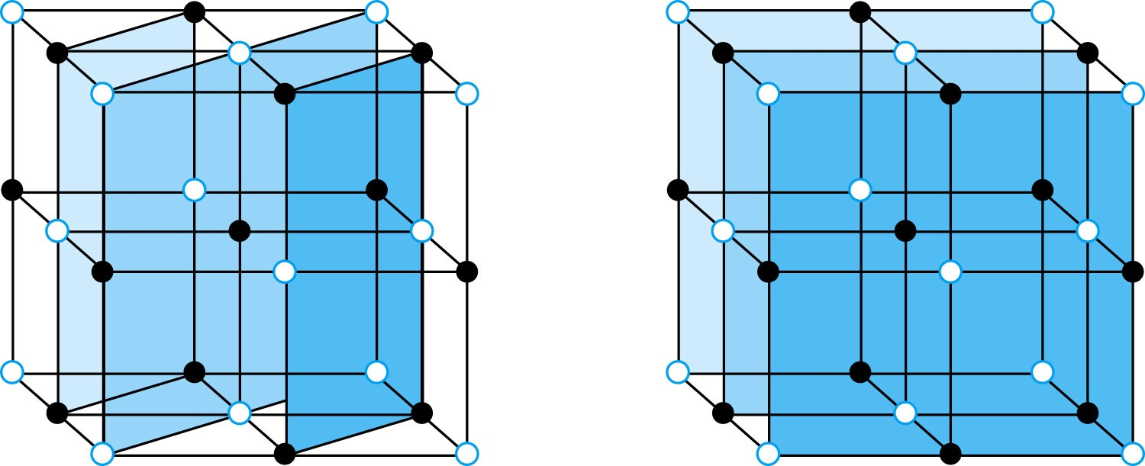
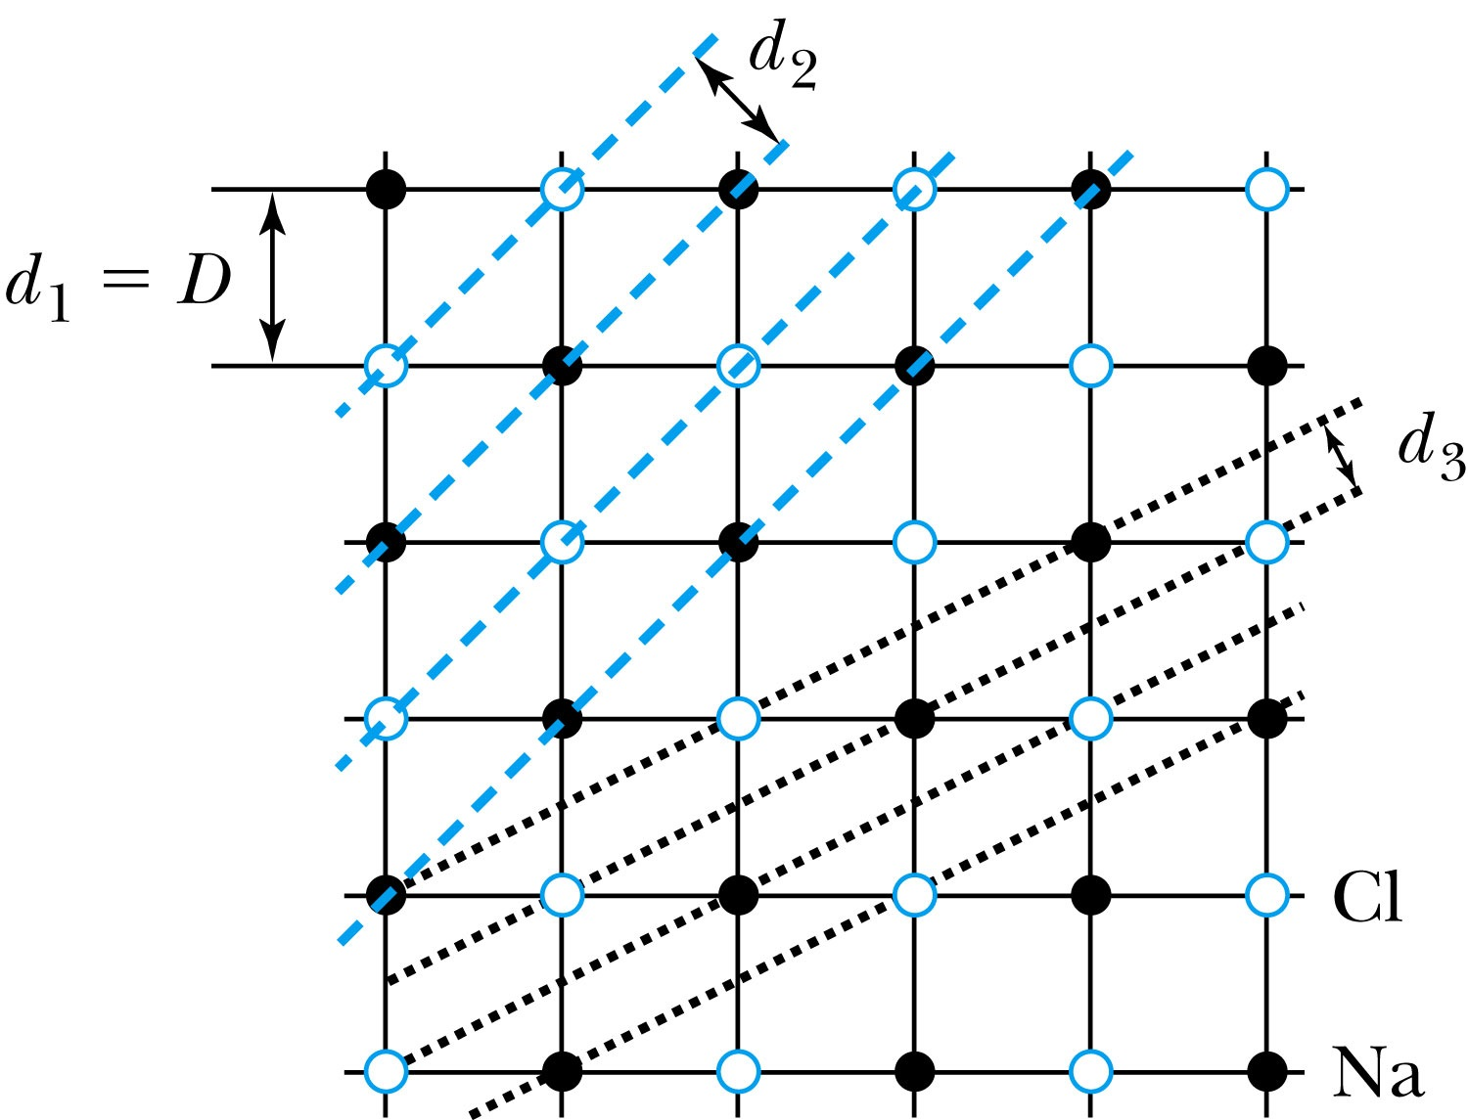
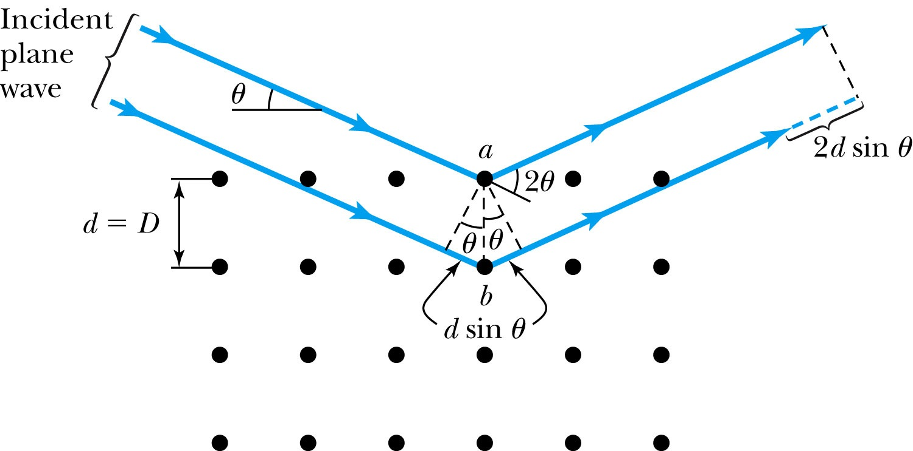
Bragg’s Law
William Lawrence Bragg interpreted the x-ray scattering as the reflection of the incident X-ray beam from a unique set of planes of atoms within the crystal.
There are two conditions for a constructive interference of the scattered X rays:
The angle of incidence must equal the angle of reflection of the outgoing wave. (total reflection)
The difference in path lengths between two rays must be an integral number of wavelengths.
Bragg’s Law:
nλ = 2d sin θ
(n = integer)

Slide 11
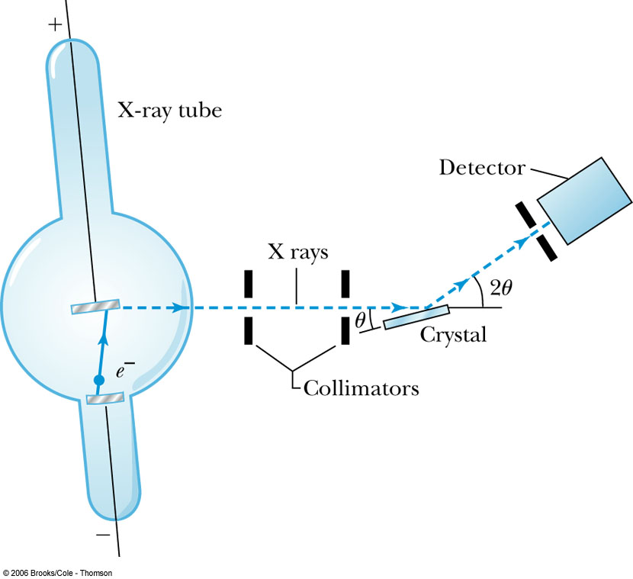
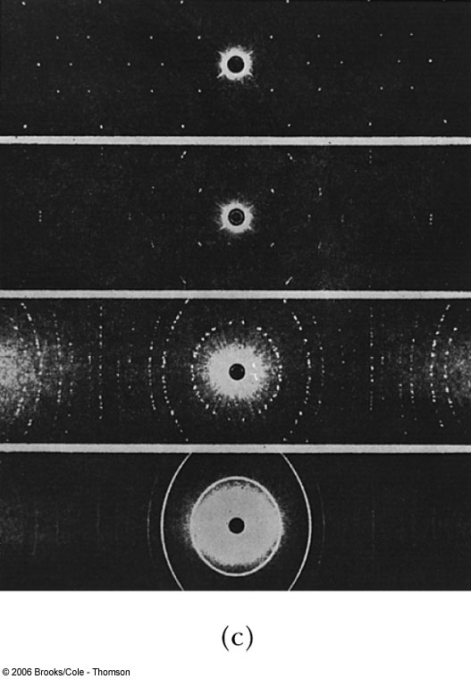
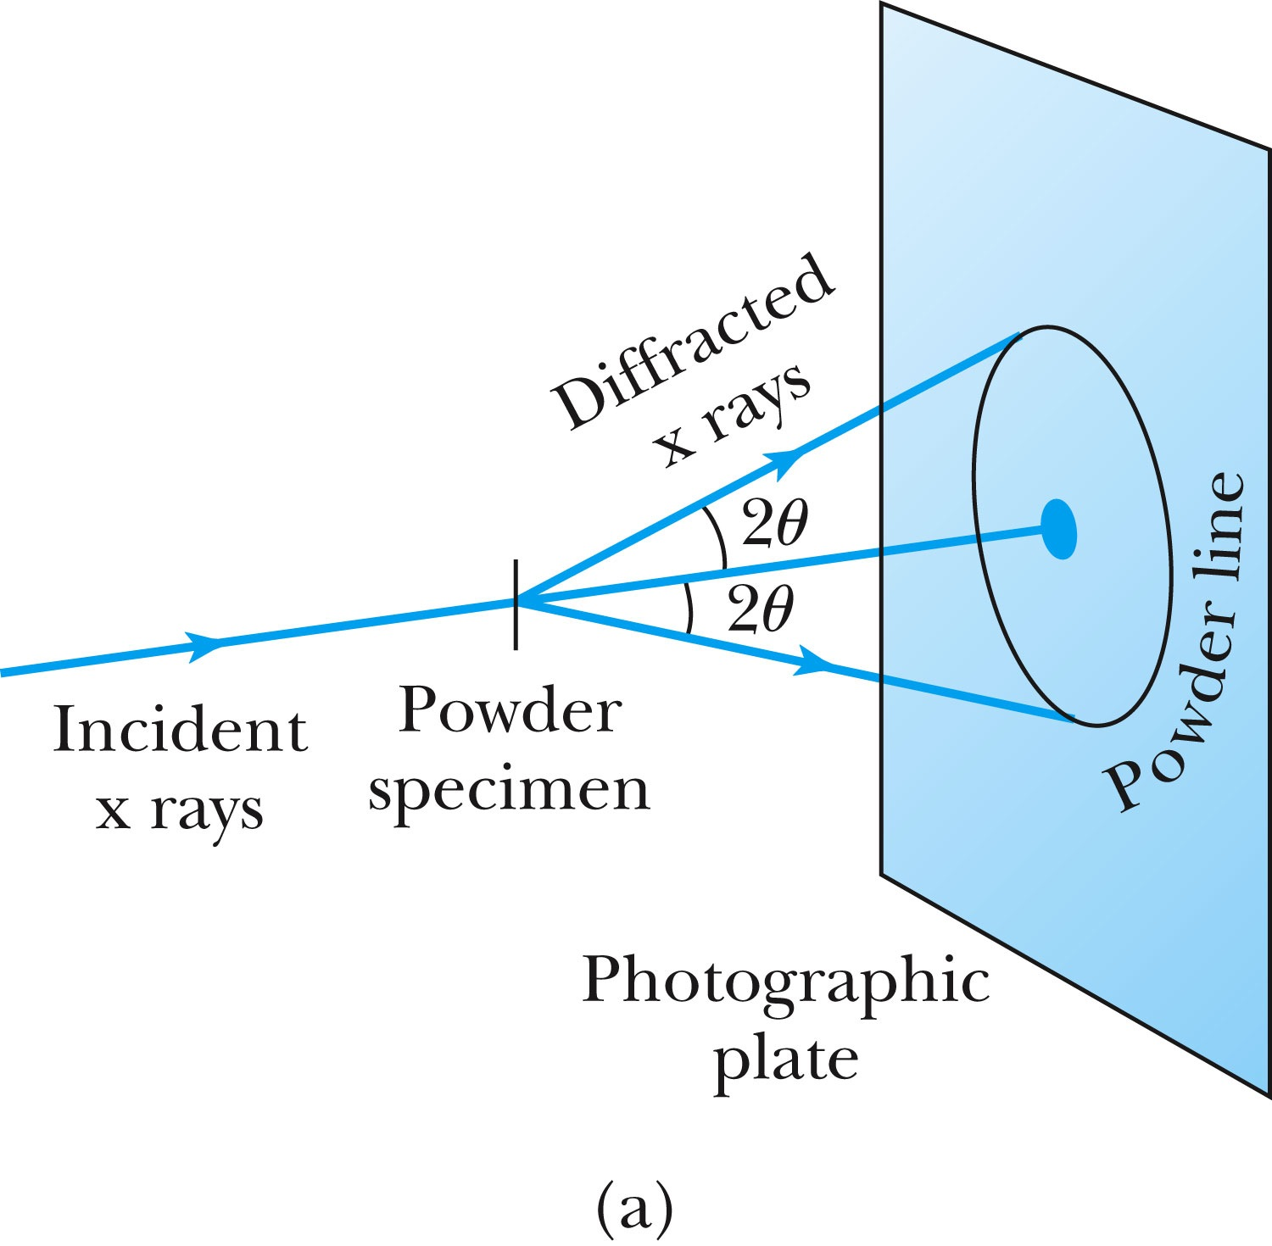
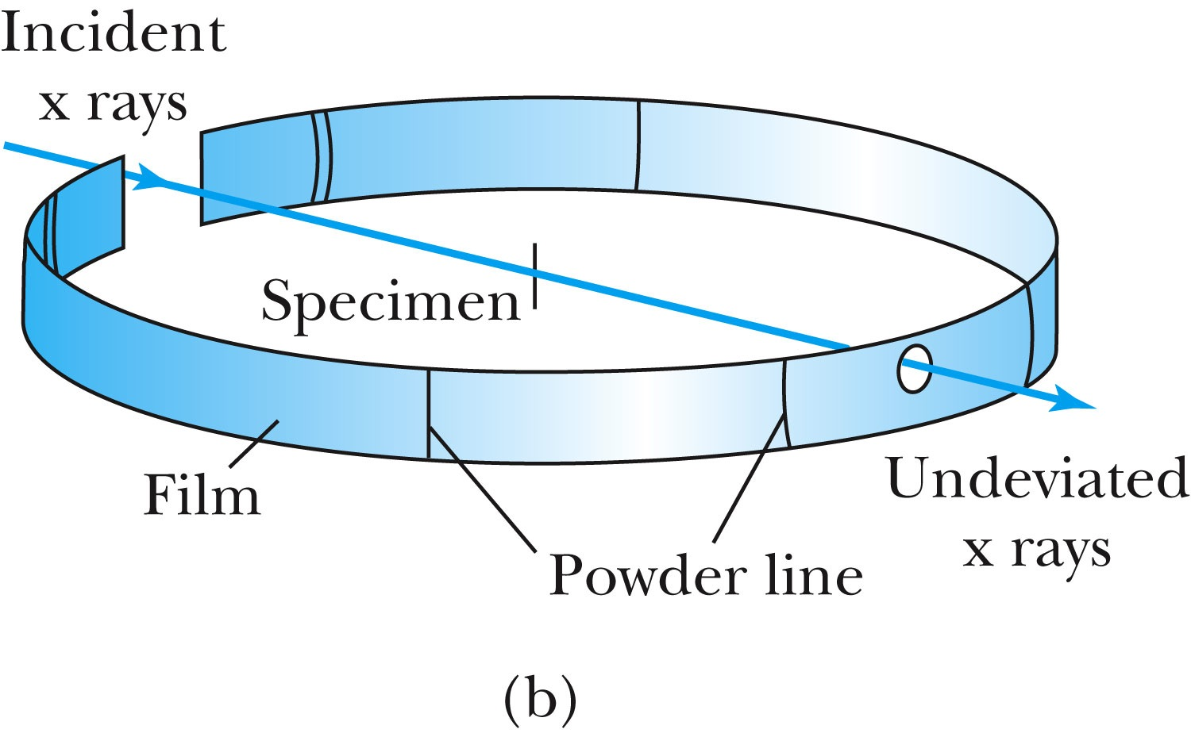
The Bragg Spectrometer
A Bragg spectrometer scatters X rays from several crystals. The intensity of the diffracted beam is determined as a function of scattering angle by rotating the crystal and the detector.
When a beam of X rays passes through the powdered crystal, the dots become a series of rings due to random arrangement.

Slide 12
Ex 5.1: Bragg’s Law
X rays scattered from rock salt (NaCl) are observed to have an intense maximum at an angle of 20º from the incident direction. Assuming n=1 (from the intensity), what must be the wavelength of the incident radiation?
Bragg’s law: nλ = 2d sin θ
What do we need to know to use this? The lattice spacing d!
We know n=1 and 2θ=20º.
We use the density of NaCl to find out what d is.

Slide 13
De Broglie Waves
Louis V. de Broglie suggested that matter particles should have wave properties similar to electromagnetic radiation ➔ many experiments supported this!
Thus the wavelength of a matter wave is called the de Broglie wavelength:
This can be considered as the probing beam length scale
Since for a photon, E = pc and E = hf, the energy can be written as

Slide 14
Ex 5.2: De Broglie Wavelength
Calculate the De Broglie wavelength of (a) a tennis ball of mass 57g traveling 25m/s (about 56mph) and (b) an electron with kinetic energy 50eV.
What is the formula for De Broglie Wavelength?
(a) for a tennis ball, m=0.057kg.
(b) for electron with 50eV KE, since KE is small, we can use non-relativistic expression of electron momentum!
What are the wavelengths of you running at the speed of 2m/s? What about your car of 2 metric tons at 100mph? How about the proton with 14TeV kinetic energy?
What is the momentum of the photon from a green laser (λ=532nm)?

Slide 15
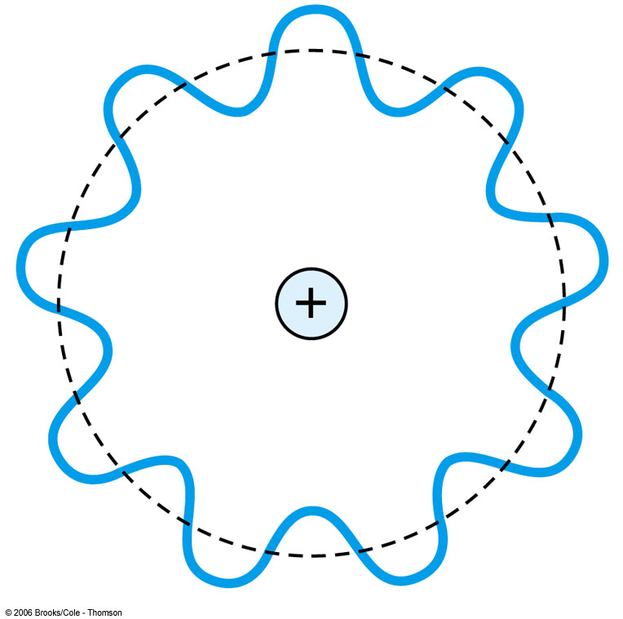
Bohr’s Quantization Condition
One of Bohr’s assumptions concerning his hydrogen atom model was that the angular momentum of the electron-nucleus system in a stationary state is an integral multiple of h/2π.
The electron is a standing wave in an orbit around the proton. This standing wave will have nodes and be in an integral number of wavelengths.
The angular momentum becomes:

Slide 16
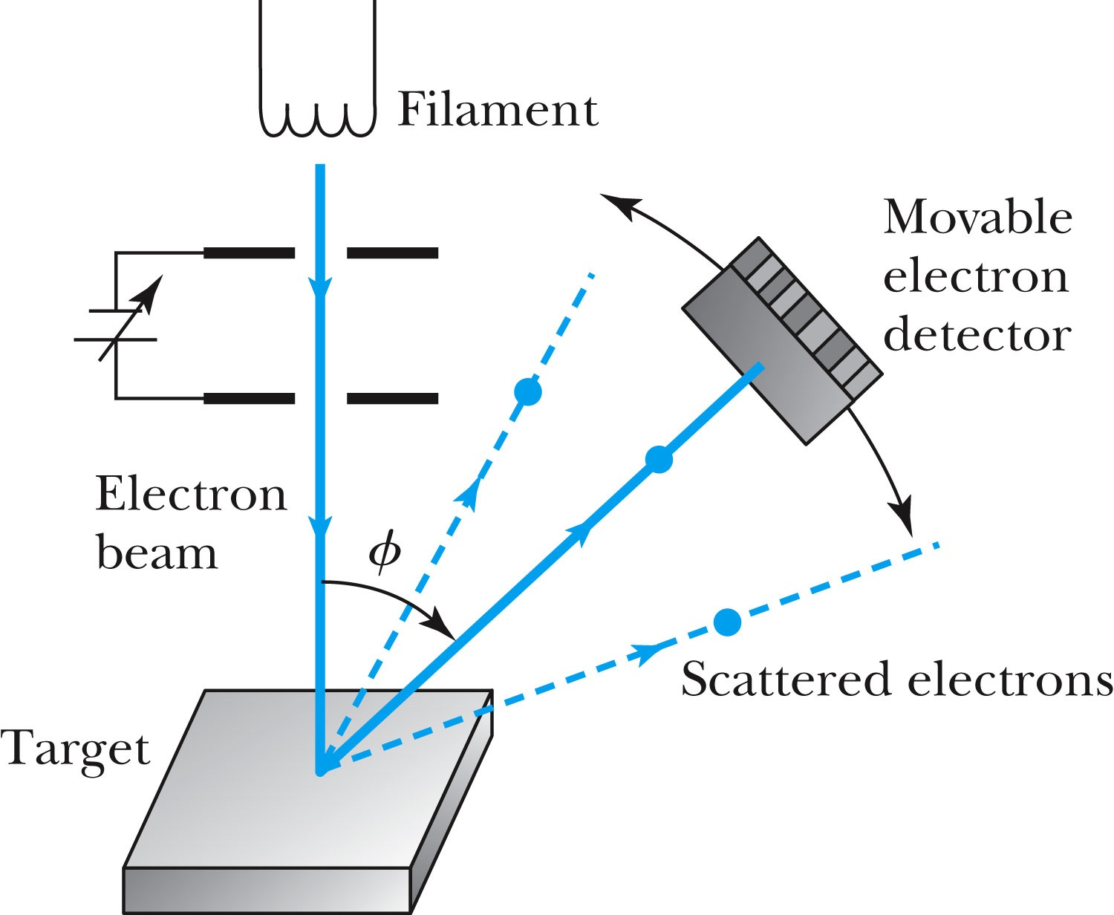
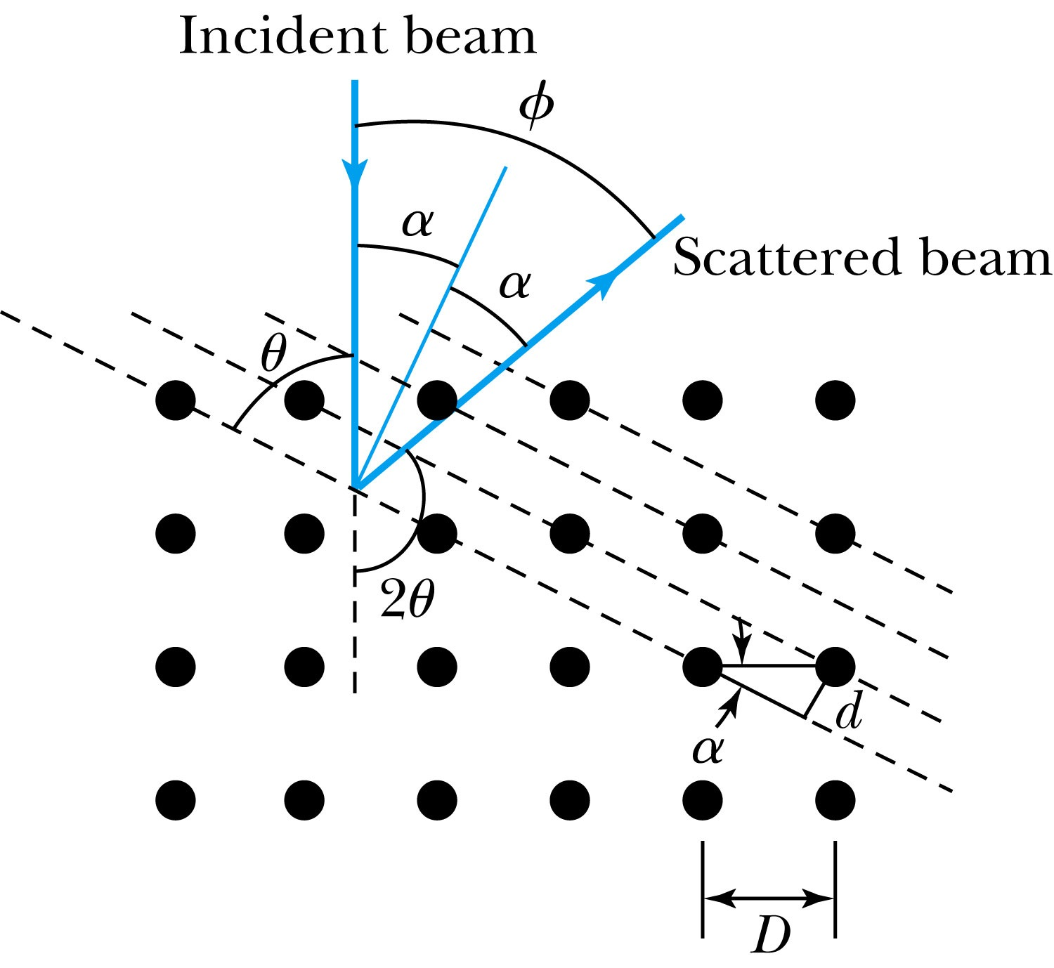
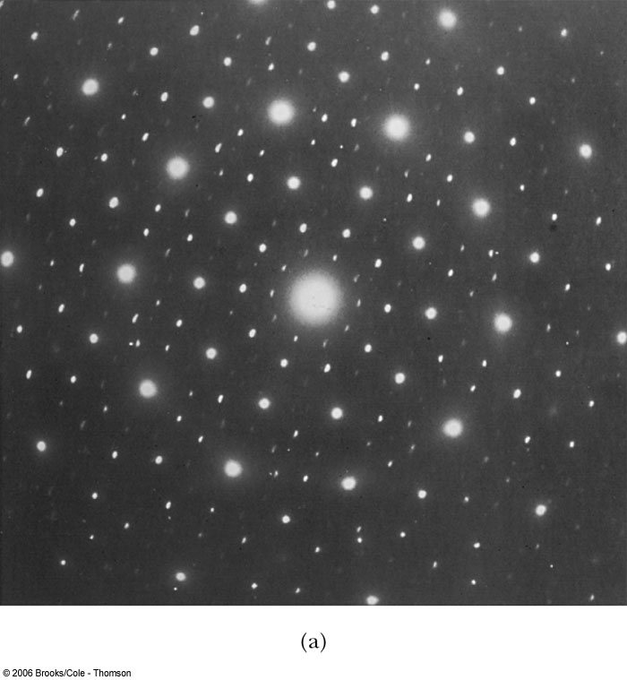
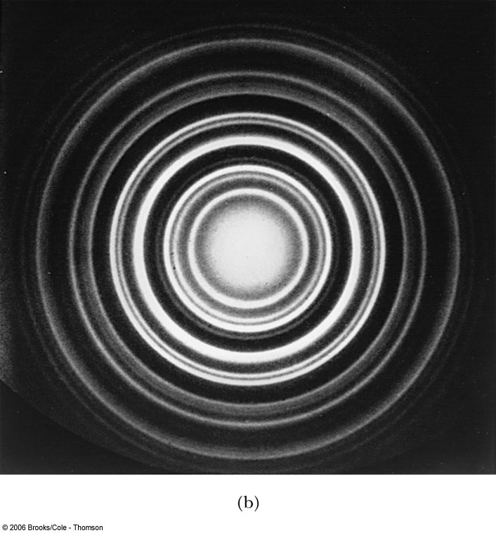
Electron Scattering
Davisson and Germer experimentally observed that electrons were diffracted much like X rays in nickel crystals. ➔ direct proof of de Broglie wave!
George P. Thomson (1892–1975), son of J. J. Thomson, reported seeing the effects of electron diffraction in transmission experiments. The first target was celluloid, and soon after that gold, aluminum, and platinum were used. The randomly oriented polycrystalline sample of SnO₂ produces rings as shown in the figure at right.

Slide 17
So particle/wave properties?
Photons, which we thought were waves, act particle like
Electrons, which we thought were particles, act wave particle like (eg electron scattering)
de Broglie: All matter has an intrinsic wavelength
  Wavelength is inversely proportional to momentum
  The more massive… the smaller the wavelength… the harder to observe the wavelike properties
  So while photons appear mostly wavelike, electrons (next lightest particle!) appear mostly particle like.
How can we reconcile the wave/particle views?
(eg Photoelectric effect or Compton Scattering)

