Slide 1
PHYS 3313 – Section 001 Lecture #17
Wednesday, March 29, 2017
Dr. Jaehoon Yu
Wave Motion and Properties
Wave Packets and Packet Envelops
Superposition of Waves
Electron Double Slit Experiment
Wave-Particle Duality
Uncertainty Principle
The Copenhagen Interpretation

Slide 2
Announcements
Reminder: Quadruple extra credit
Colloquium on April 19, 2017
Speaker: Dr. Nigel Lockyer, Director of Fermilab
Make your arrangements to take advantage of this opportunity
Seats may be limited
Colloquium today
Dr. Alphonse Sterling, NASA
Title: Jets in the Sun’s Corona

Slide 3
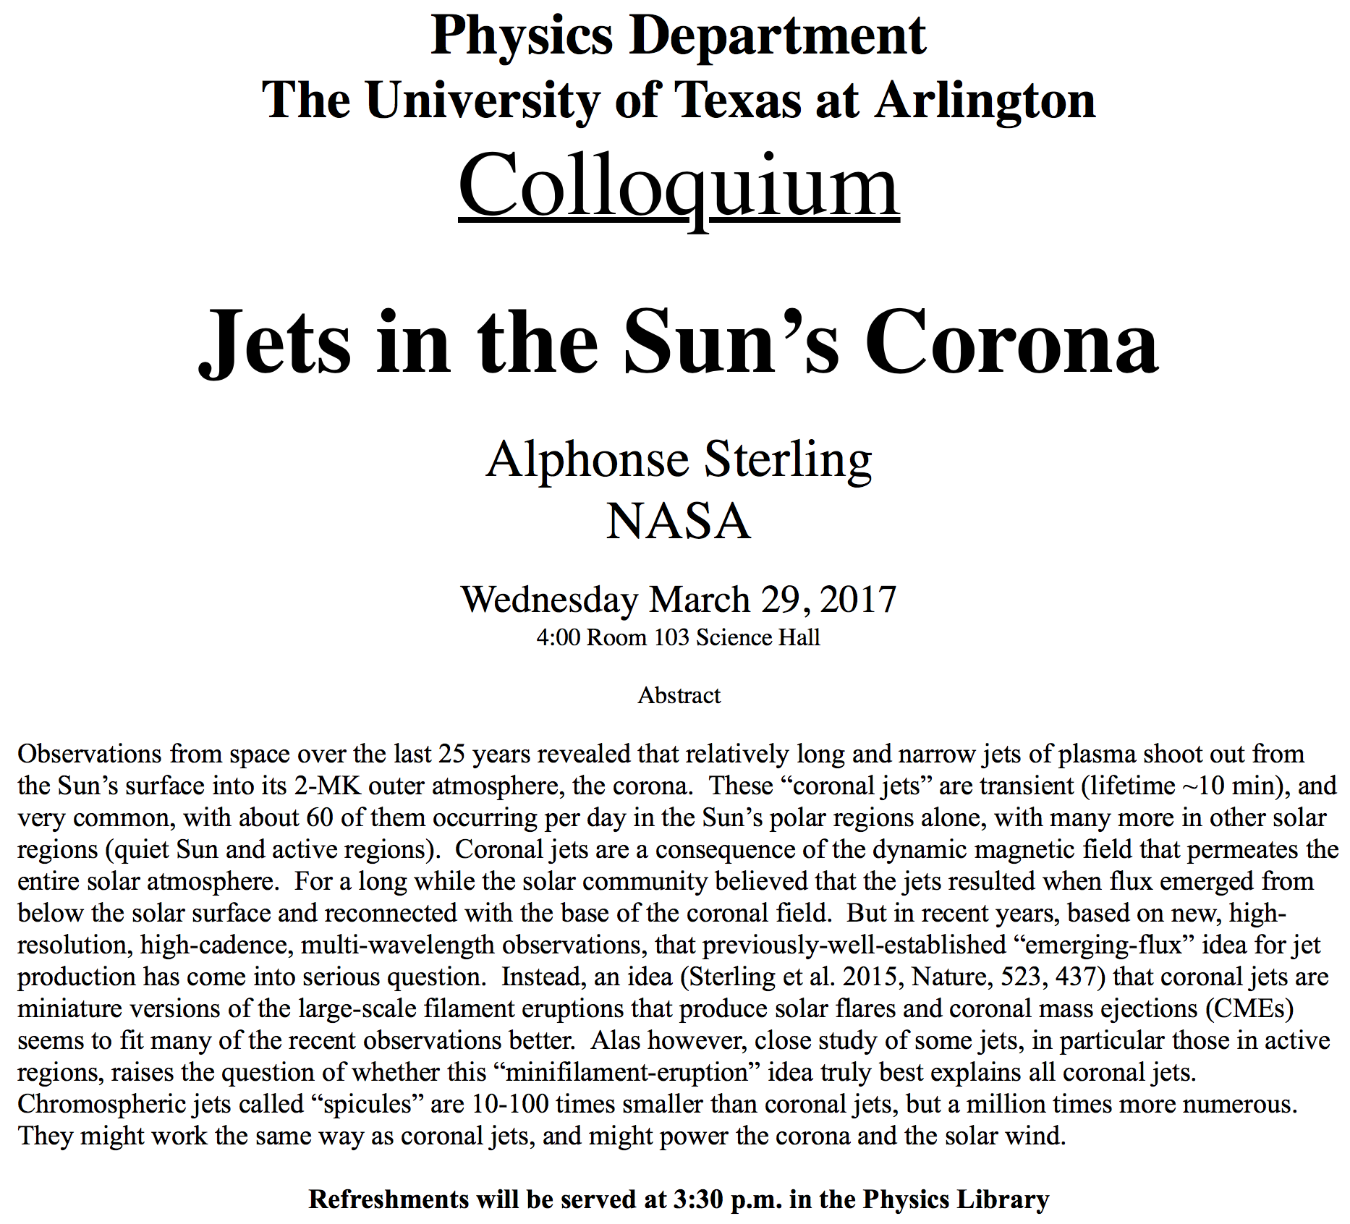

Slide 4
Special Project #4
Prove that the wave function Ψ=A[sin(kx-ωt)+icos(kx-ωt)] is a good solution for the time-dependent Schrödinger wave equation. Do NOT use the exponential expression of the wave function. (10 points)
Determine whether or not the wave function Ψ=Ae^{-α|x|} satisfy the time-dependent Schrödinger wave equation. (10 points)
Due for this special project is Wednesday, Apr. 5.
You MUST have your own answers!

Slide 5
Wave Motion
de Broglie matter waves suggest a further description. The displacement of a typical traveling wave is
This is a solution to the wave equation
Define the wave number k and the angular frequency ω as:
The wave function can be rewritten:

Slide 6
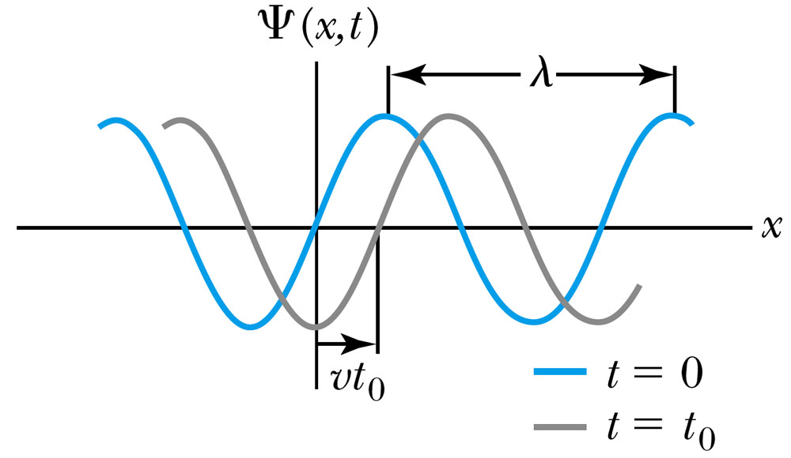
Wave Properties
The phase velocity is the velocity of a point on the wave that has a given phase (for example, the crest) and is given by
The phase constant φ shifts the wave:
.
(When φ=π/2)

Slide 7
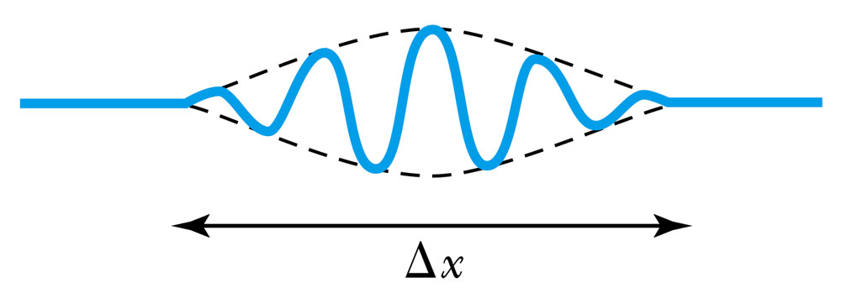
Principle of Superposition
When two or more waves traverse in the same region, they act independently of each other.
Combining two waves of the same amplitude yields:
The combined wave oscillates within an envelope that denotes the maximum displacement of the combined waves.
When combining many waves with different amplitudes and frequencies, a pulse, or wave packet, can be formed, which can move with a group velocity:

Slide 8
Fourier Series
The sum of many waves that form a wave packet is called a Fourier series:
Summing an infinite number of waves yields the Fourier integral:

Slide 9
Wave Packet Envelope
The superposition of two waves yields the wave number and angular frequency of the wave packet envelope.
The range of wave numbers and angular frequencies that produce the wave packet have the following relations:
A Gaussian wave packet has similar relations:
The localization of the wave packet over a small region to describe a particle requires a large range of wave numbers. Conversely, a small range of wave numbers cannot produce a wave packet localized within a small distance.

Slide 10
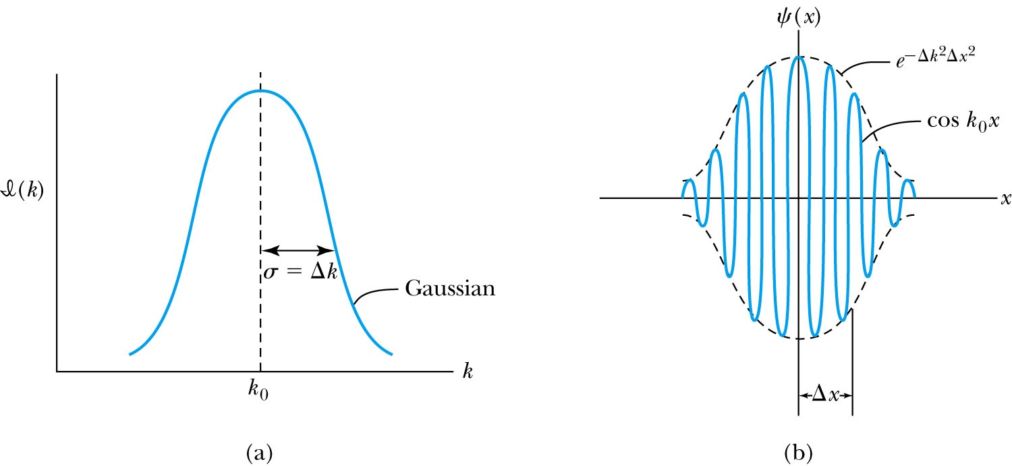
Gaussian Function
A Gaussian wave packet describes the envelope of a pulse wave.
The group velocity is

Slide 11
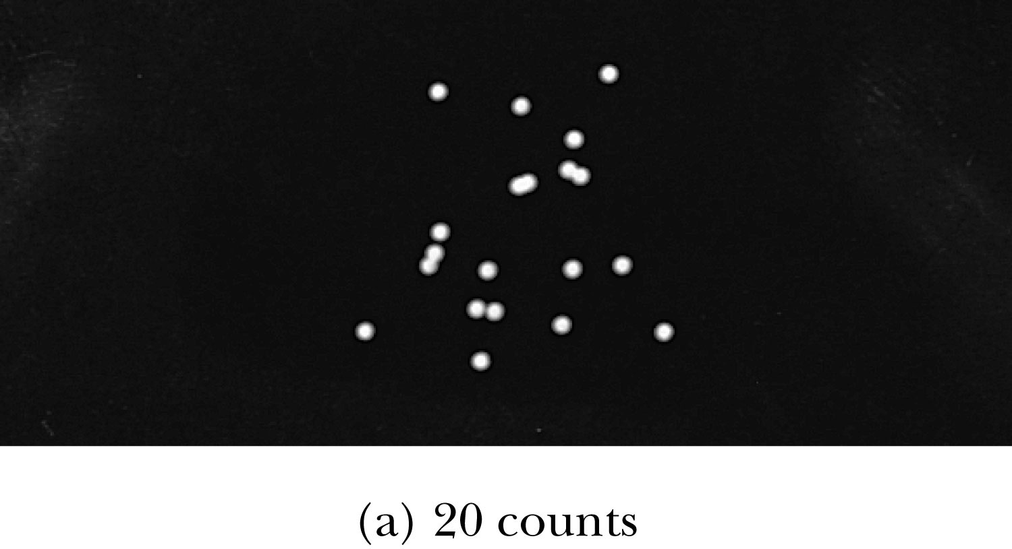
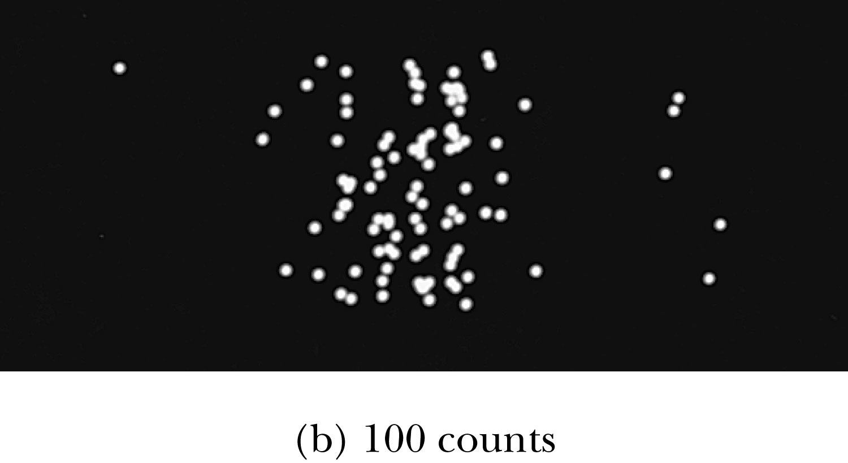
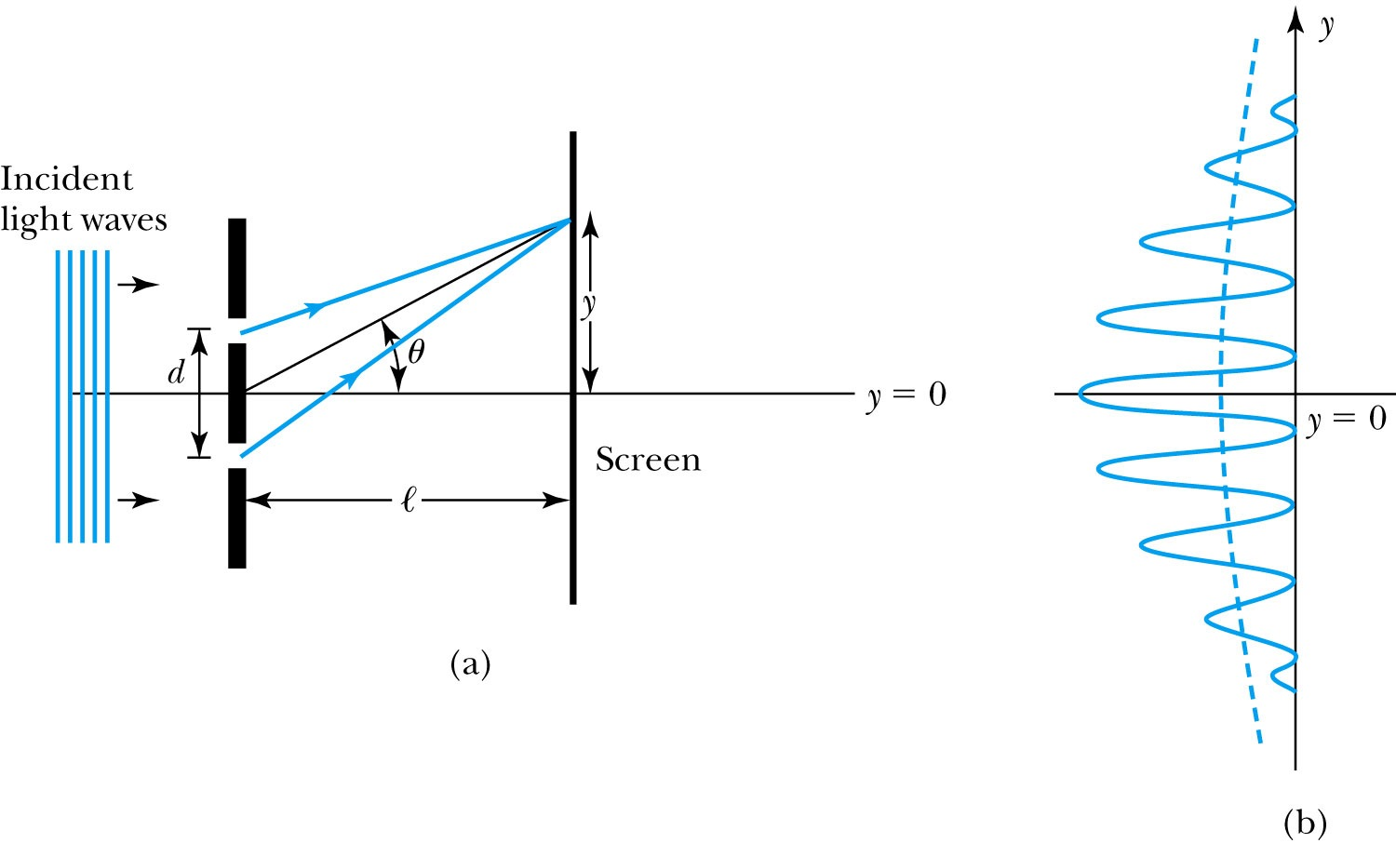
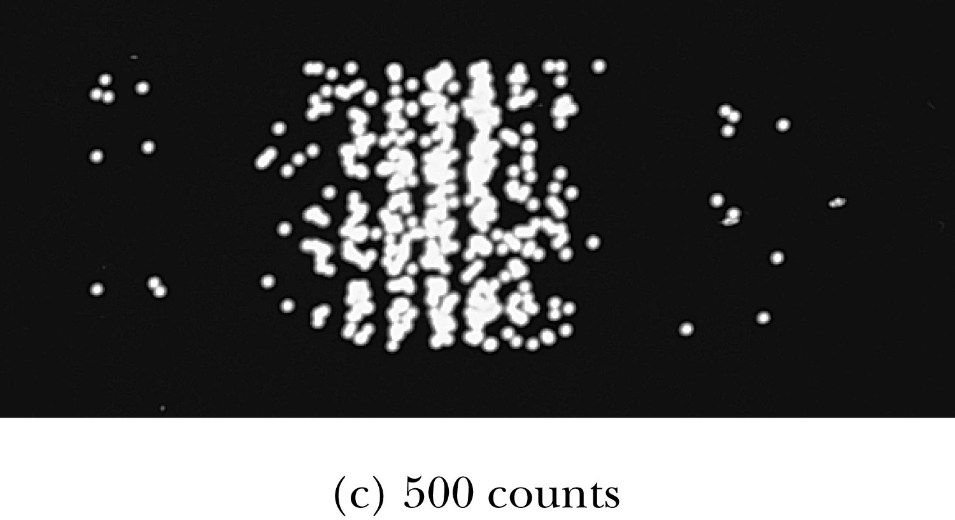
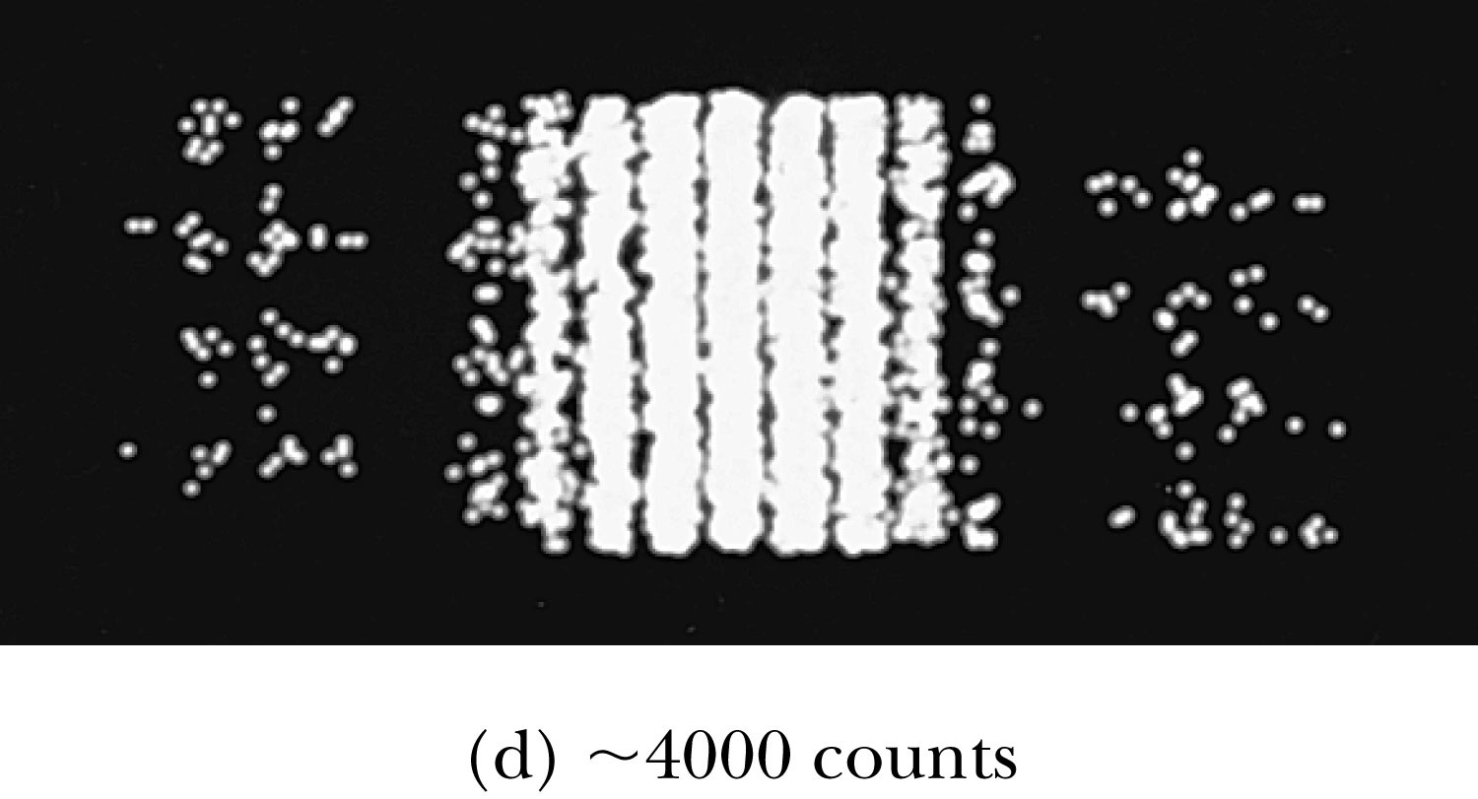
Waves or Particles?
Young’s double-slit diffraction experiment demonstrates the wave property of the light.
However, dimming the light results in single flashes on the screen representative of particles.

Slide 12
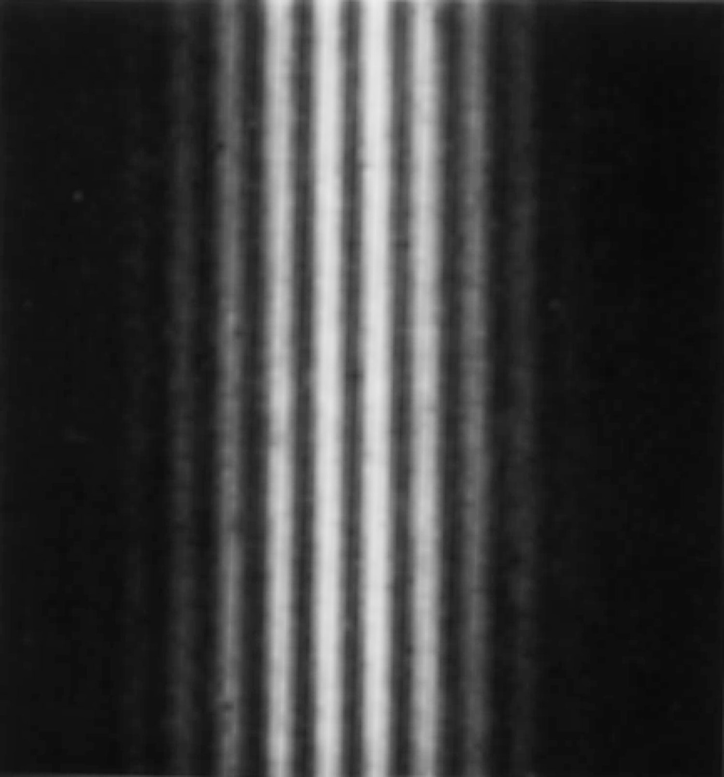
Electron Double-Slit Experiment
C. Jönsson of Tübingen, Germany, succeeded in 1961 in showing double-slit interference effects for electrons by constructing very narrow slits and using relatively large distances between the slits and the observation screen.
This experiment demonstrated that precisely the same behavior occurs for both light (waves) and electrons (particles).

Slide 13
Wave particle duality solution
The solution to the wave particle duality of an event is given by the following principle.
Bohr’s principle of complementarity: It is not possible to describe physical observables simultaneously in terms of both particles and waves.
Physical observables are the quantities such as position, velocity, momentum, and energy that can be experimentally measured. In any given instance we must use either the particle description or the wave description.

Slide 14
Uncertainty Principles
It is impossible to measure simultaneously, with no uncertainty, the precise values of k and x for the same particle. The wave number k may be rewritten as
For the case of a Gaussian wave packet we have
Thus for a single particle, we have Heisenberg’s uncertainty principle:
Momentum-position
Energy- time

Slide 15
Probability, Wave Functions, and the Copenhagen Interpretation
The wave function determines the likelihood (or probability) of finding a particle at a particular position in space at a given time.
The total probability of finding the particle is 1. Forcing this condition on the wave function is called the normalization.

Slide 16
The Copenhagen Interpretation
Bohr’s interpretation of the wave function consisted of 3 principles:
The uncertainty principle of Heisenberg
The complementarity principle of Bohr
The statistical interpretation of Born, based on probabilities determined by the wave function
Together, these three concepts form a logical interpretation of the physical meaning of quantum theory. According to the Copenhagen interpretation, physics depends on the outcomes of measurement.

Slide 17
Particle in a Box
A particle of mass m is trapped in a one-dimensional box of width l.
The particle is treated as a wave.
The box puts boundary conditions on the wave. The wave function must be zero at the walls of the box and on the outside.
In order for the probability to vanish at the walls, we must have an integral number of half wavelengths in the box.
or
The energy of the particle is .
The possible wavelengths are quantized which yields the energy:
The possible energies of the particle are quantized.
Find the quantized energy level of an electron constrained to move in a 1-D atom of size 0.1nm.

