Slide 1
PHYS 3313 – Section 001
Lecture #18
Monday, April 3, 2017
Dr. Jaehoon Yu
Probability of Particle
Time Independent Schrodinger Equation
Normalization and Probability
Expectation Values
Momentum, Position and Energy Operators

Slide 2
Announcements
Quiz this Wednesday, April 5
  At the beginning of the class
  Covers CH5.1 through what we finish today
  BYOF with the same rule as before
Reminder: Quadruple extra credit
  Colloquium on April 19, 2017
  Speaker: Dr. Nigel Lockyer, Director of Fermilab
  Make your arrangements to take advantage of this opportunity

Slide 3
Reminder: Special Project #4
Prove that the wave function is a good solution for the time-dependent Schrödinger wave equation. Do NOT use the exponential expression of the wave function. (10 points)
Determine whether or not the wave function Ψ=Ae^{-α|x|} satisfy the time-dependent Schrödinger wave equation. (10 points)
Due for this special project is this Wednesday, Apr. 5.
You MUST have your own answers!

Slide 4
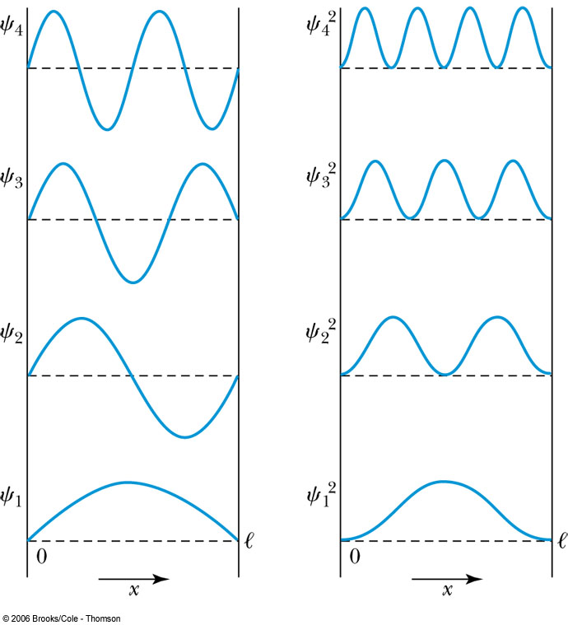
Probability of the Particle
The probability of observing a particle between x and x + dx in each state is
Note that E₀ = 0 is not a possible energy level.
The concept of energy levels, as first discussed in the Bohr model, has surfaced in a natural way by using waves.

Slide 5
The Schrödinger Wave Equation
Erwin Schrödinger and Werner Heisenberg proposed quantum theory in 1920
  The two proposed very different forms of equations
  Heisenberg: Matrix based framework
  Schrödinger: Wave mechanics, similar to the classical wave equation
Paul Dirac and Schrödinger later on proved that the two give identical results
The probabilistic nature of quantum theory is contradictory to the direct cause and effect seen in classical physics and makes it difficult to grasp!

Slide 6
The Time-dependent Schrödinger Wave Equation
The Schrödinger wave equation in its time-dependent form for a particle of energy E moving in a potential V in one dimension is
The extension into three dimensions is
where is an imaginary number

Slide 7
Ex 6.1: Wave equation and Superposition
The wave equation must be linear so that we can use the superposition principle to form a wave packet. Prove that the wave function in Schrödinger equation is linear by showing that it is satisfied for the wave equation Ψ (x,t)=aΨ₁ (x,t)+bΨ₂ (x,t) where a and b are constants and Ψ₁ (x,t) and Ψ₂ (x,t) describe two waves each satisfying the Schrödinger Eq.
Rearrange terms

Slide 8
General Solution of the Schrödinger Wave Equation
The general form of the solution of the Schrödinger wave equation is given by:
which also describes a wave propagating in the x direction. In general the amplitude may also be complex. This is called the wave function of the particle.
The wave function is also not restricted to being real. Only the physically measurable quantities (or observables) must be real. These include the probability, momentum and energy.

Slide 9
Ex 6.2: Solution for Wave Equation
Show that Ae^{i(kx-ωt)} satisfies the time-dependent Schrödinger wave Eq.
So Ae^{i(kx-ωt)} is a good solution and satisfies Schrödinger Eq.

Slide 10
Ex 6.3: Bad Solution for Wave Equation
Determine whether Ψ (x,t)=Asin(kx-ωt) is an acceptable solution for the time-dependent Schrödinger wave Eq.
This is not true in all x and t. So Ψ (x,t)=Asin(kx-ωt) is not an acceptable solution for the Schrödinger Eq. Is it for the classical wave eq:

Slide 11
Normalization and Probability
The probability P(x) dx of a particle being between x and X + dx was given by the equation
Here Ψ* denotes the complex conjugate of Ψ
The probability of the particle being between x₁ and x₂ is given by
The wave function must also be normalized so that the probability of the particle being somewhere on the x axis is 1.

Slide 12
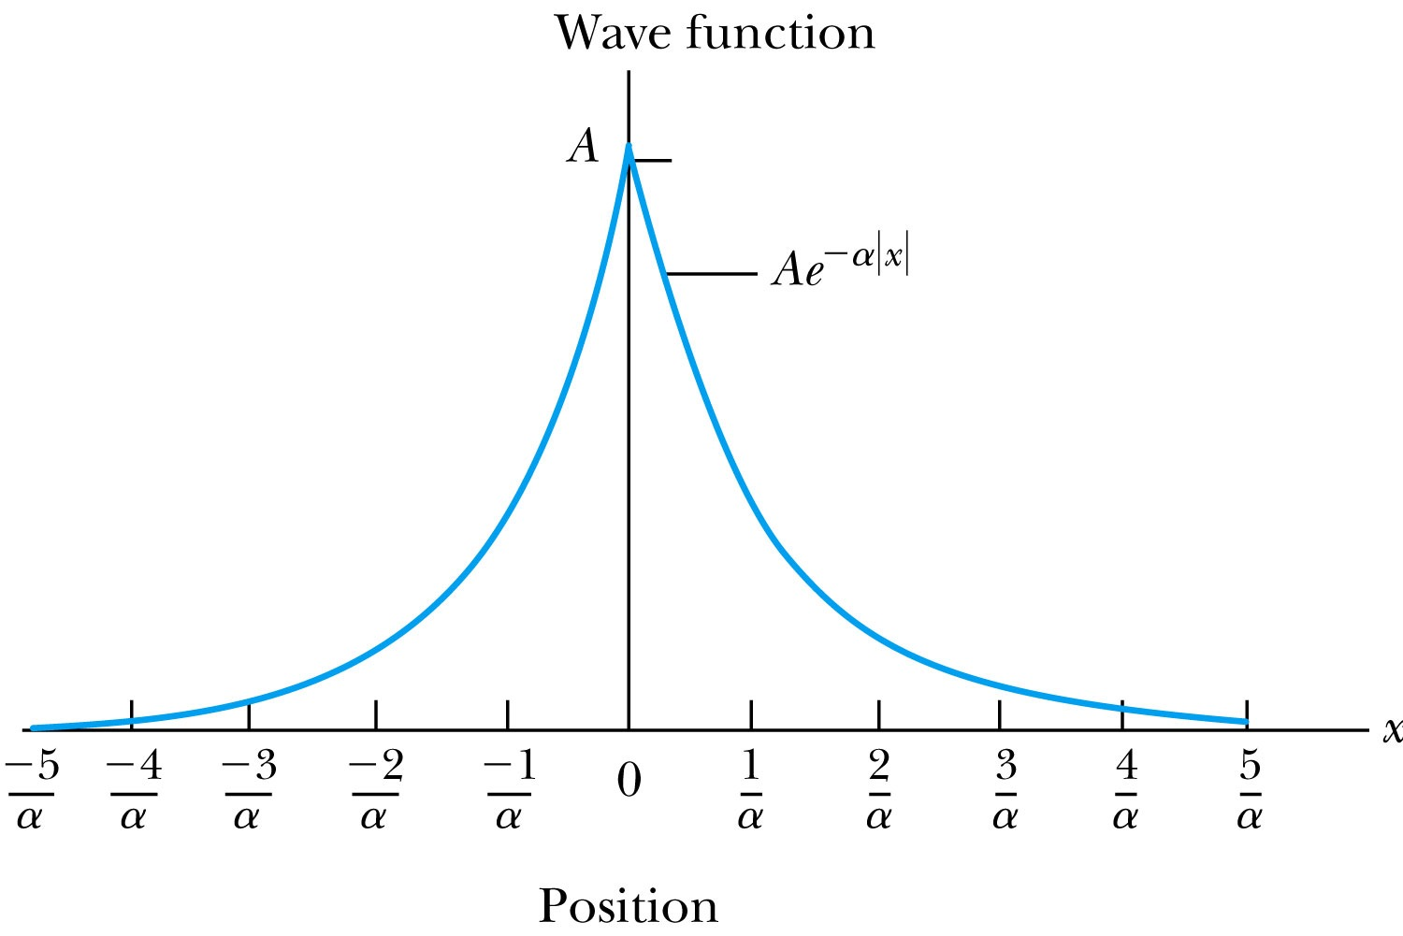
Ex 6.4: Normalization
Consider a wave packet formed by using the wave function that Ae^{-α|x|}, where A is a constant to be determined by normalization. Normalize this wave function and find the probabilities of the particle being between 0 and 1/α, and between 1/α and 2/α.
Probability density
Normalized Wave Function

Slide 13
Ex 6.4: Normalization, cont’d
Using the wave function, we can compute the probability for a particle to be in 0 to 1/α and 1/α to 2/α.
For 0 to 1/α:
For 1/α to 2/α:
How about 2/α:to ∞?

